Slide 1

FINESSE and HIBEAM at the European Spallation Source
John Womersley
University of Edinburgh

Slide 2
The European Spallation Source
ESS is the next generation European neutron scattering facility now under construction in Lund, Sweden
Consortium of 13 European countries
Construction started 2014
Now ~85% complete
User operations start 2027

Slide 3
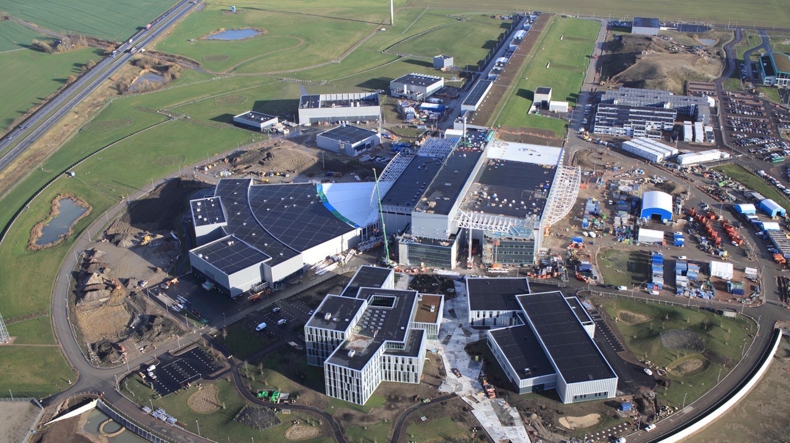
September 2014
Neutron Production Target
“Spallation” is the process that releases neutrons from the target nuclei
Superconducting Proton Accelerator
Utilities
Laboratories
Experiments
MaintenanceLaboratories
Offices
“

Slide 4
Particle physics at ESS
ESS business case based on delivering neutron fluxes for materials science and biology that are 10–20 x higher than existing facilities
2MW (eventually 5MW) proton beam, ~ 2 GeV, 3 ms pulse @14Hz
Potential for high impact physics with neutrons (and neutrinos)
In 2018, ESS Science Advisory Committee identified Particle Physics as one of the highest priority capability gaps for ESS
Call for proposals now underway (along with additional 4 or 5 neutron instruments)

Slide 5
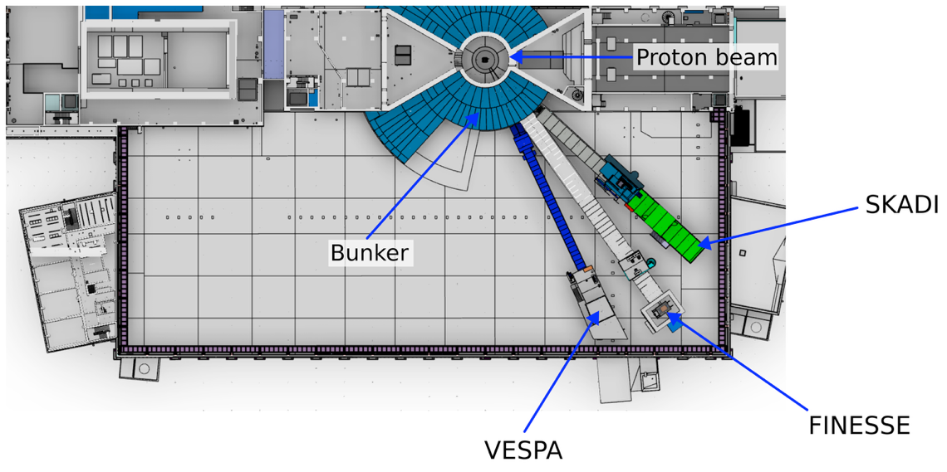
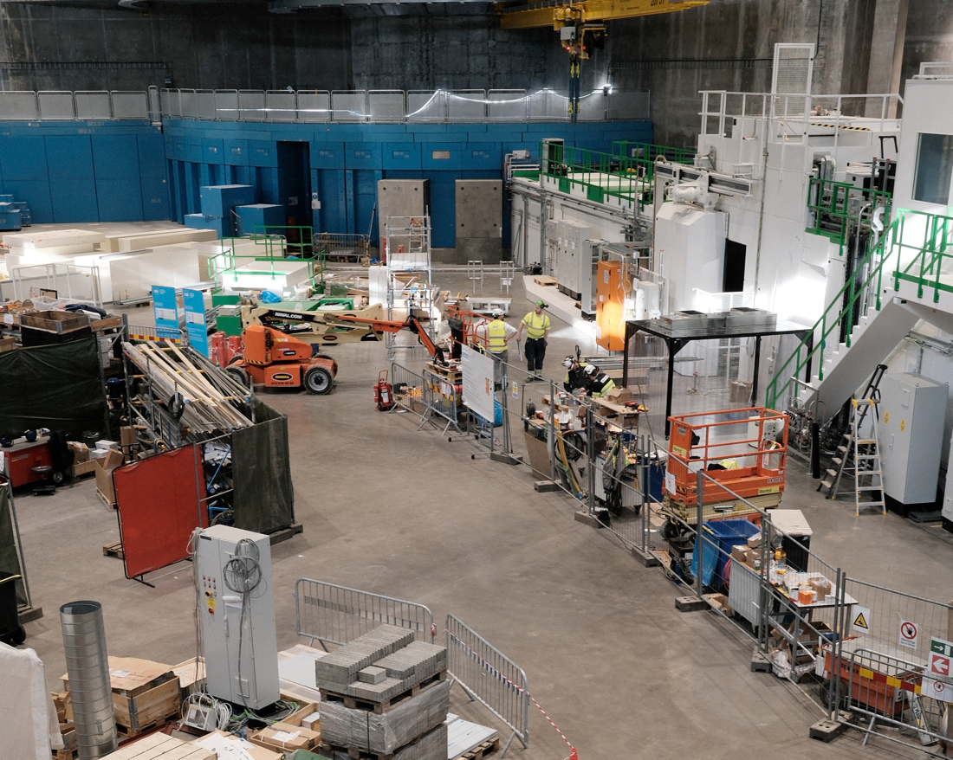
FINESSE
Proposal for a flexible beamline for PP and NP experiments
Dual-mode neutron optics
Low background configuration for precision measurements
High flux configuration for statistics-dominated searches
Locate at the E5 beam port which is already equipped for neutron extraction

Slide 6
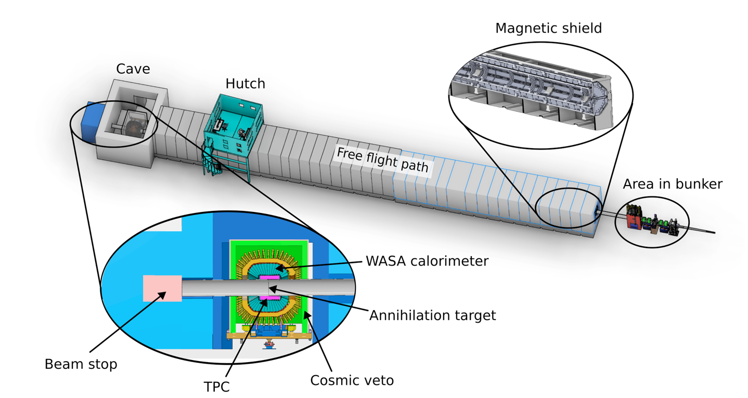
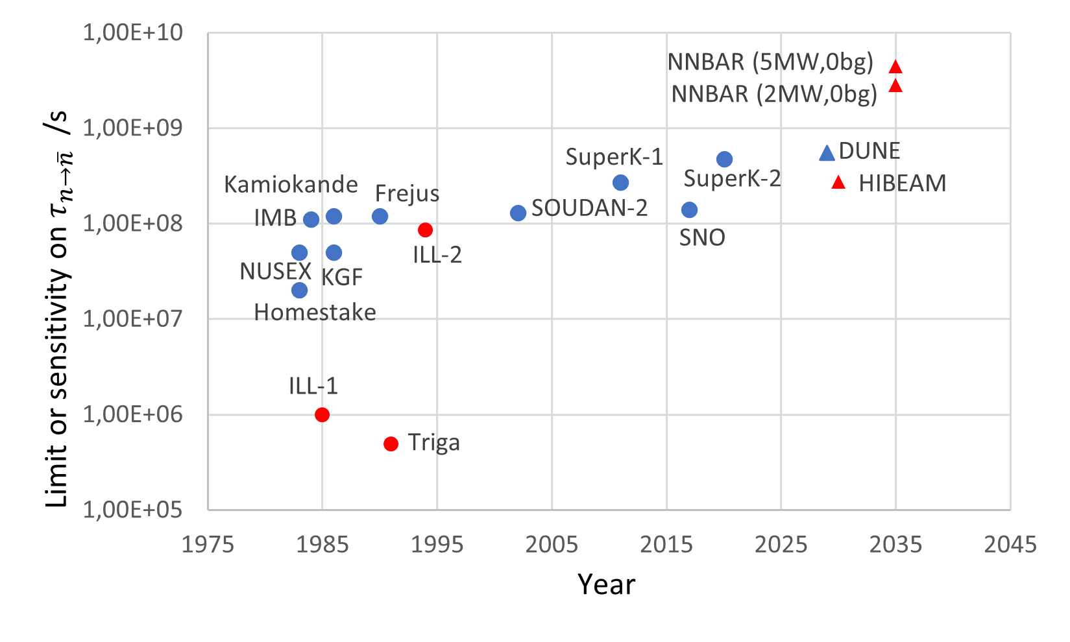
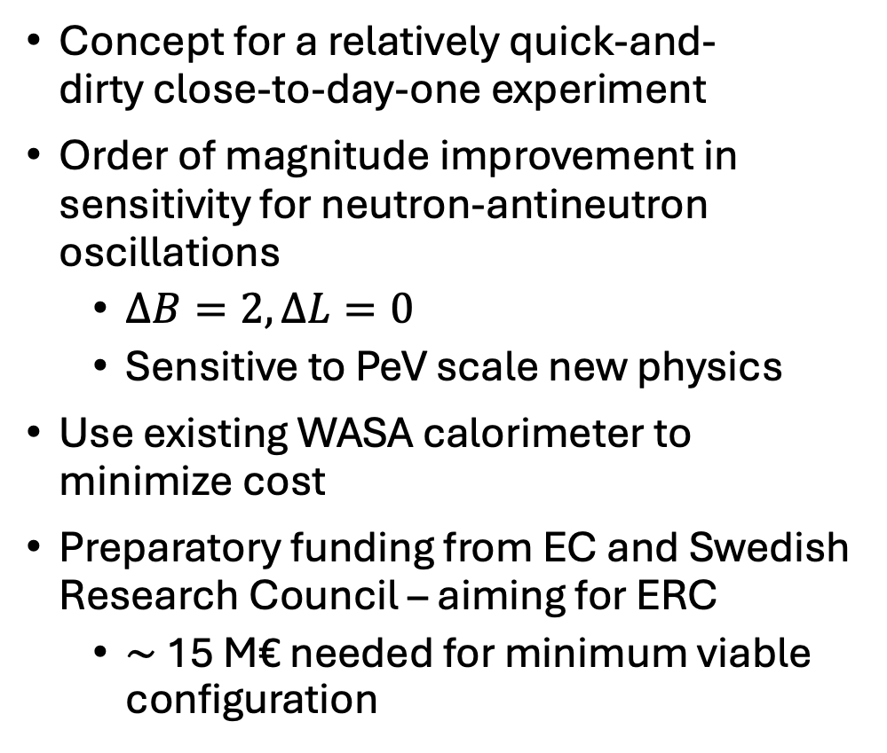
HIBEAM
Concept for a relatively quick-and- dirty close-to-day-one experiment
Order of magnitude improvement in sensitivity for neutron-antineutron oscillations
$∆B=2, ∆L=0$
Sensitive to PeV scale new physics
Use existing WASA calorimeter to minimize cost
Preparatory funding from EC and Swedish Research Council – aiming for ERC
$\sim$ 15 M€ needed for minimum viable configuration

