Slide 1


NUCLEAR Astrophysics Processes
Vishnu Varma

Slide 2

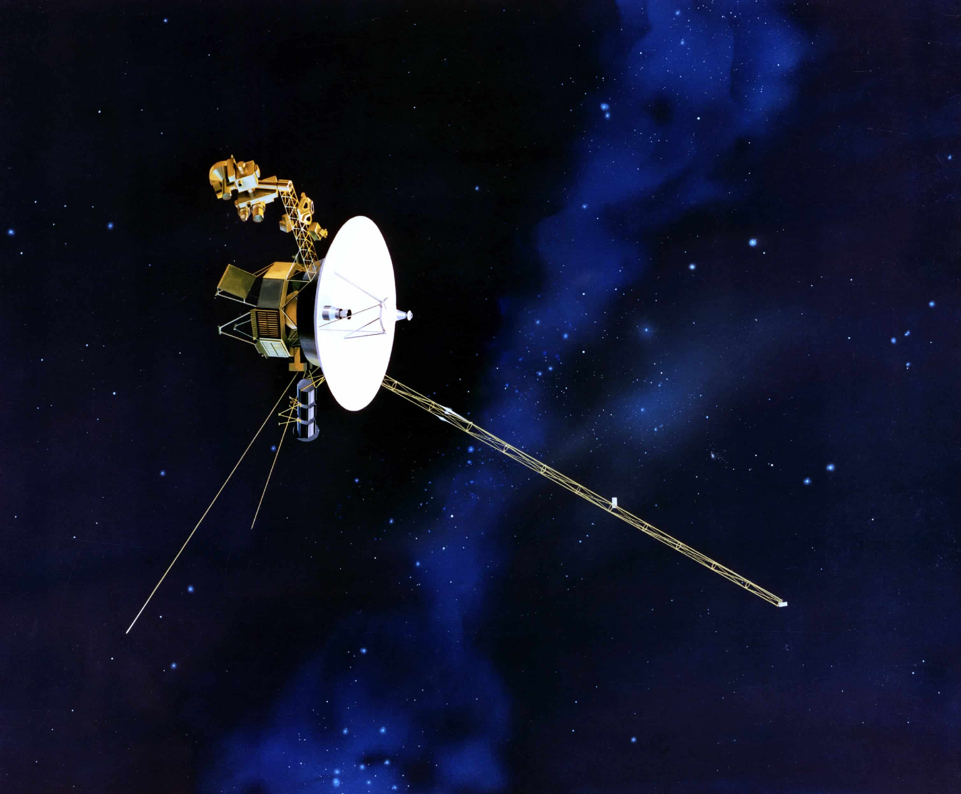





Slide 3
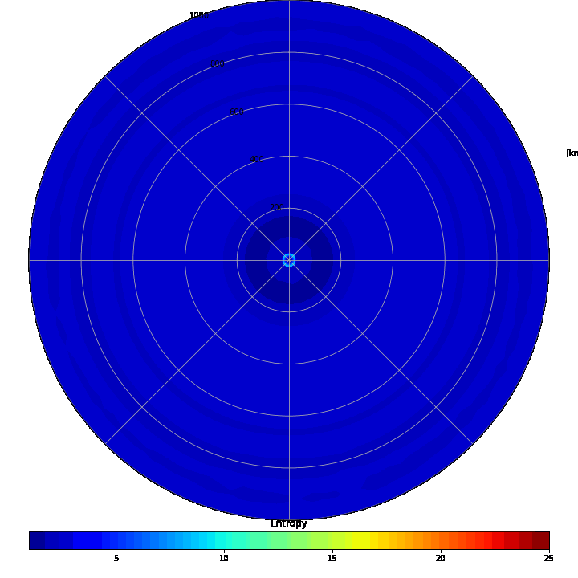
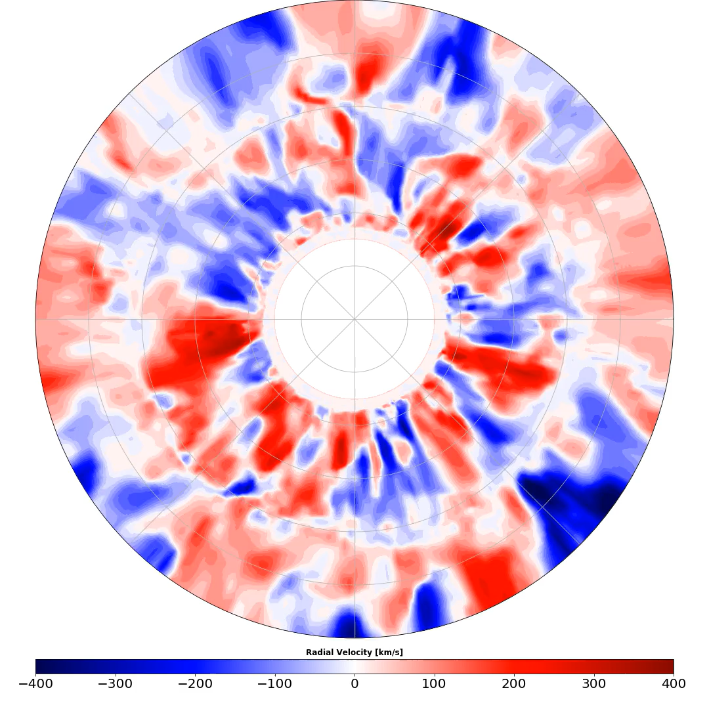
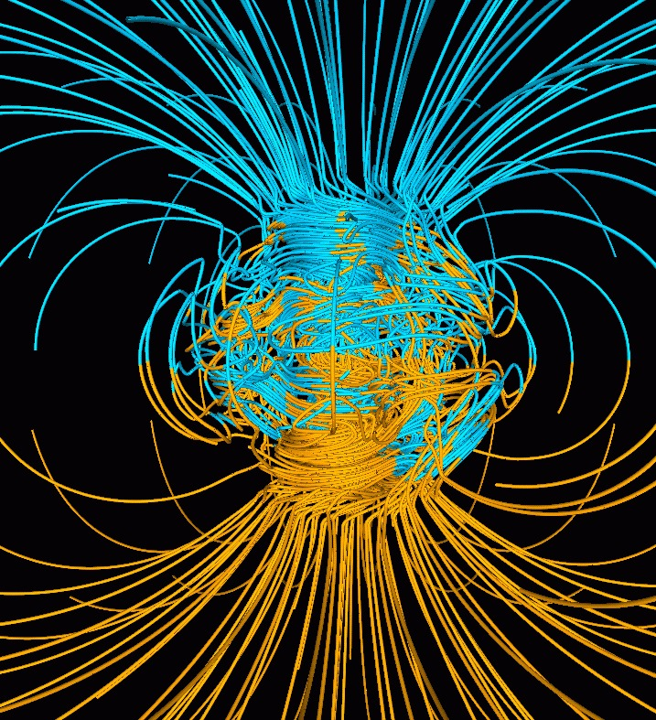
My Research

Slide 4
Day 1 : Nuclear Astrophysics Processes
Primordial Nucleosynthesis
Stellar Nucleosynthesis
Explosive Nucleosynthesis
Neutron Capture Processes
Day 2 : Observation of Nucleosynthesis
Day 3: Modelling in nuclear astrophysics

Slide 5
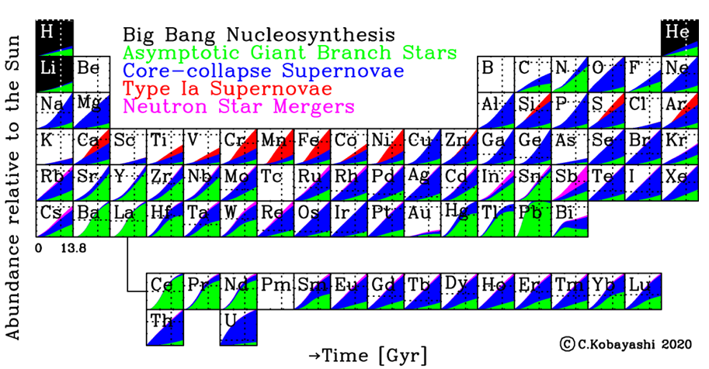
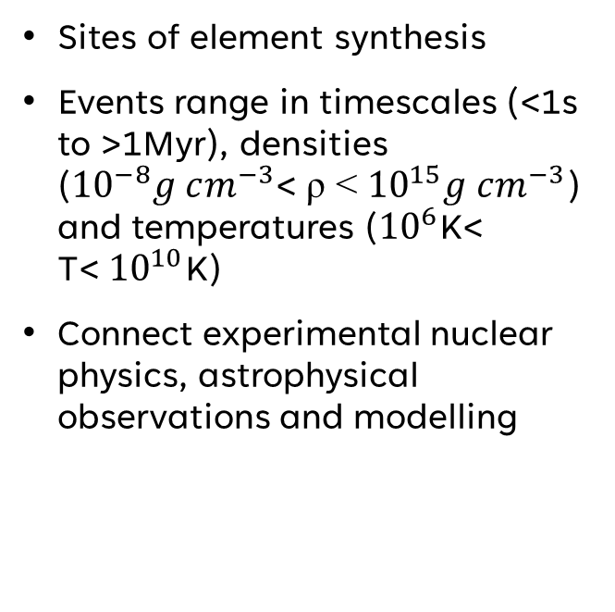
Why should you care about Nuclear Astrophysics?
Sites of element synthesis
Events range in timescales (<1s to >1Myr), densities (${10}^{−8}g cm^{−3}$< ρ < ${10}^{15}g cm^{−3}$) and temperatures (${10}^{6}$K< T<${ 10}^{10}$K)
Connect experimental nuclear physics, astrophysical observations and modelling

Slide 6
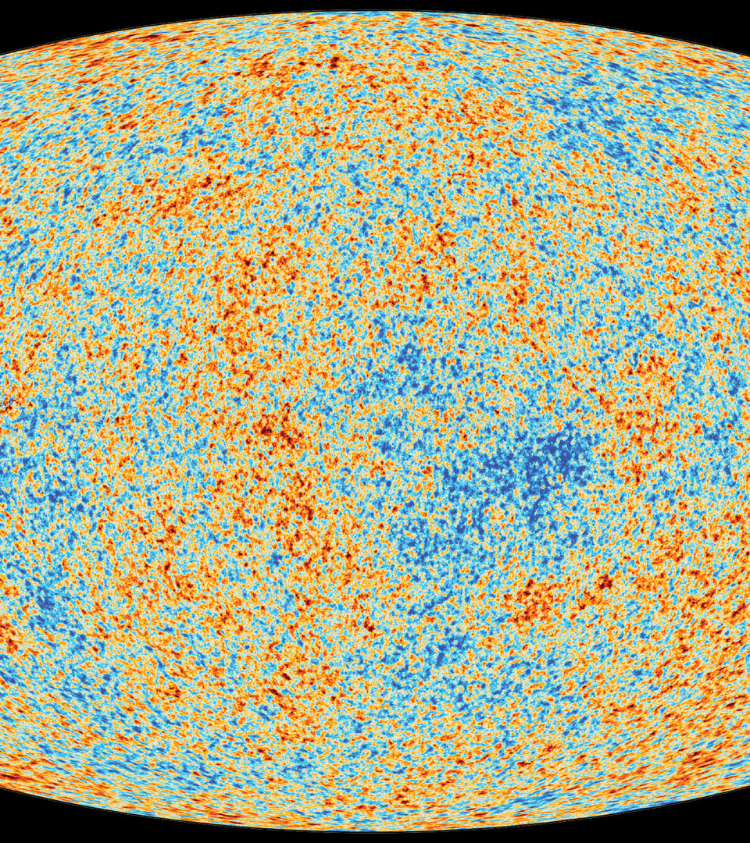
Primordial Nucleosynthesis

Slide 7
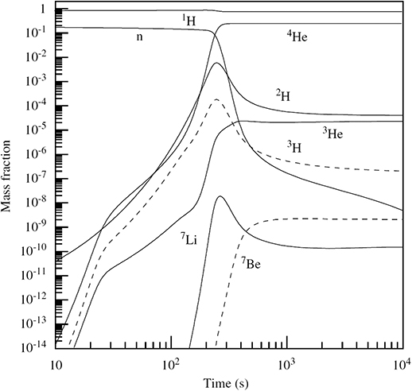
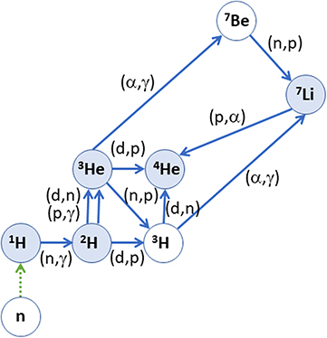
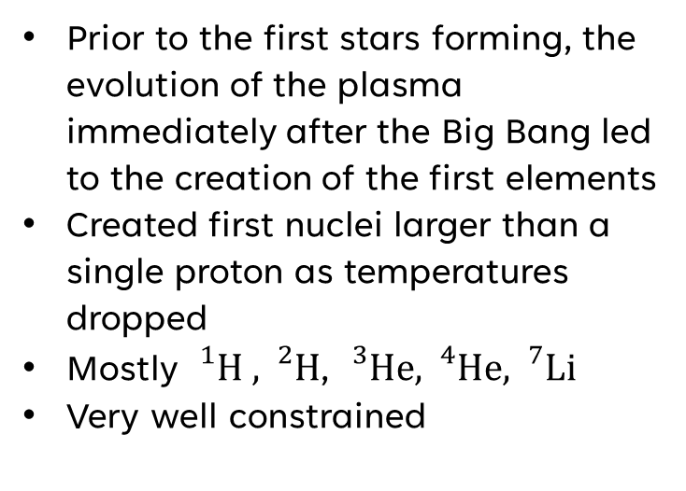
Standard Big bang Nucleosynthesis
Prior to the first stars forming, the evolution of the plasma immediately after the Big Bang led to the creation of the first elements
Created first nuclei larger than a single proton as temperatures dropped
Mostly ${}_{}^{1}H ,{}_{}^{2}H$, ${}_{}^{3}{He,{}_{}^{4}{He,{}_{}^{7}{Li}}}$
Very well constrained

Slide 8
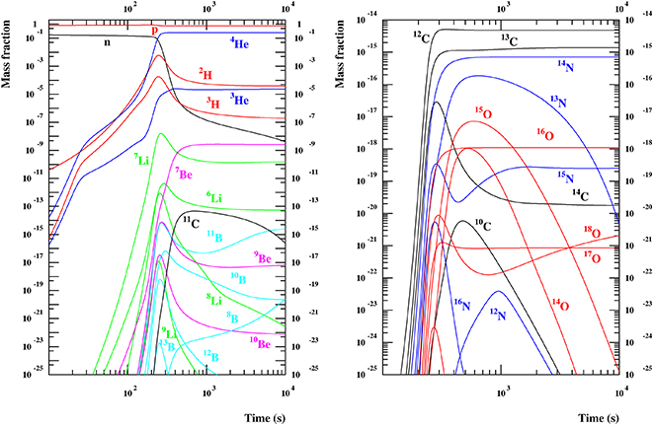
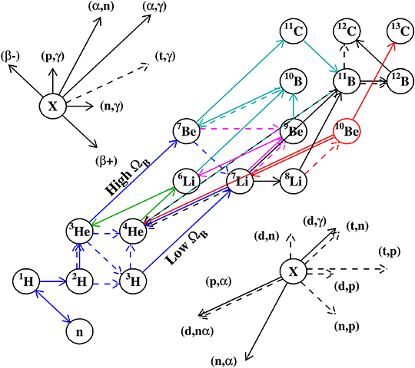
Standard Big bang Nucleosynthesis
Some uncertainties due to baryonic density (and the ratio of baryons to photons)
Affects precise abundance we expect from “heavier” elements
Figures from Coc et. al 2014

Slide 9
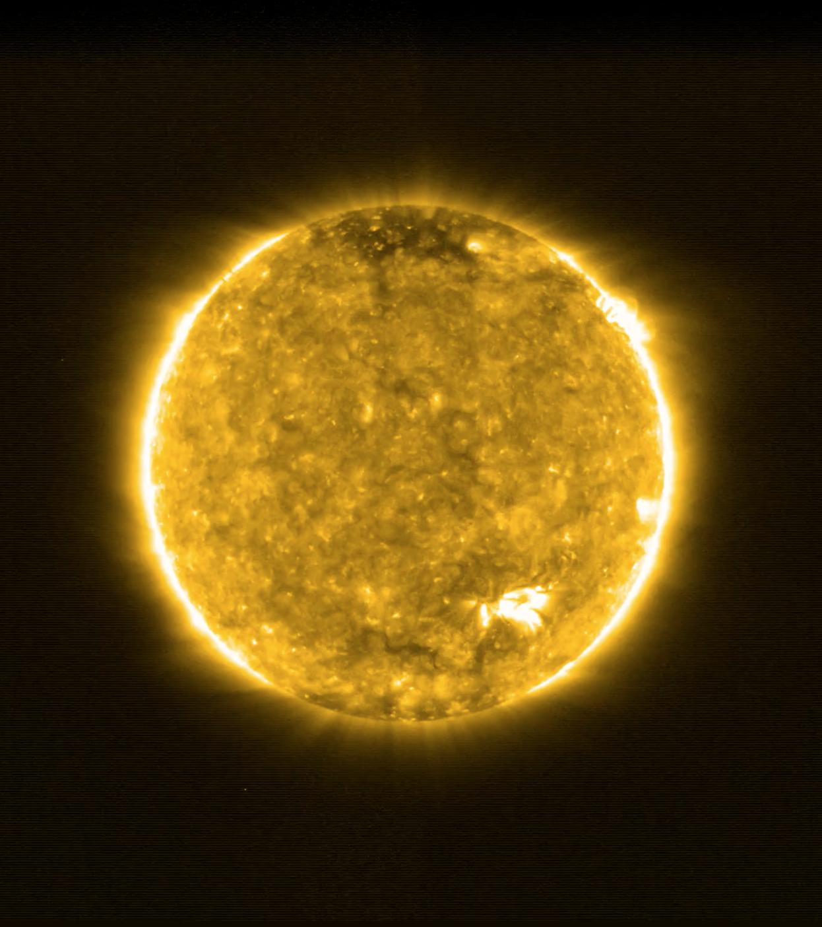
Stellar (Hydrostatic) Nucleosynthesis

Slide 10
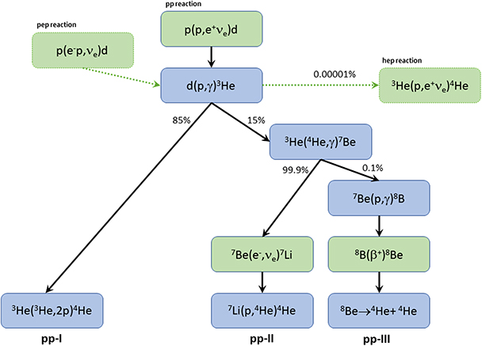
Hydrogen Burning
Beginning stage of all stars on the main sequence
Pp-chain is the burning process occurring in low mass stars (like the sun) and zero-metallicity stars
Hydrogen Burning

Slide 11
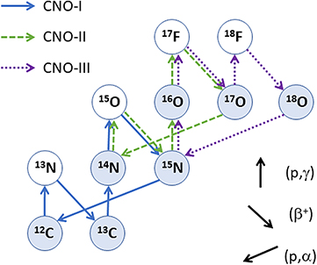
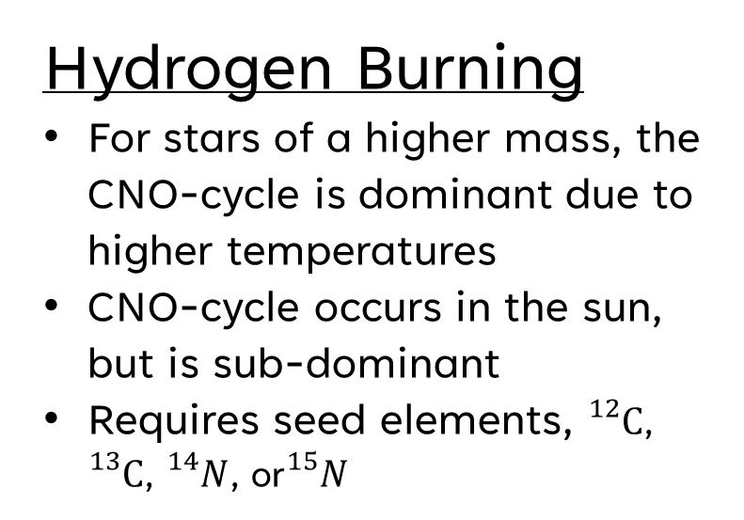
Hydrogen Burning
For stars of a higher mass, the CNO-cycle is dominant due to higher temperatures
CNO-cycle occurs in the sun, but is sub-dominant
Requires seed elements, ${}_{}^{12}C$, ${}_{}^{13}C$, ${}_{}^{14}N$, or${}_{}^{15}N$
Hydrogen Burning

Slide 12
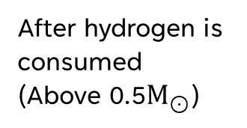
Post Main Sequence
Envelope expansion
After hydrogen is consumed (Above 0.5$M_{⊙}$)
Core-contraction

Slide 13
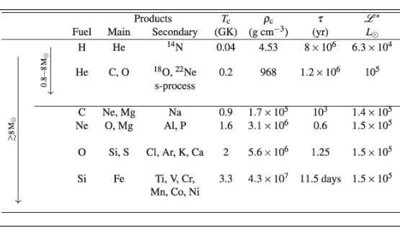
Burning TIMESCALES
Burning timescales for each core phase (From Rauscher 2020 “Essentials of Nucleosynthesis and Theoretical Nuclear Astrophysics”)

Slide 14

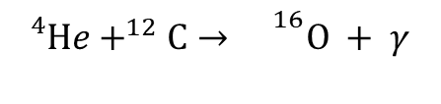
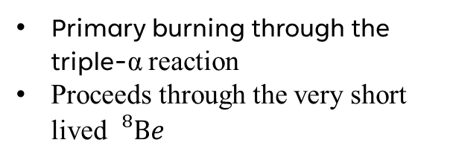
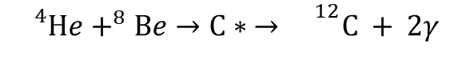
Helium Burning
Primary burning through the triple-α reaction
Proceeds through the very short lived ${}_{}^{8}{Be}$
$${}_{}^{4}{He}+^{4}He→Be$$
He Burning
$${}_{}^{4}{He}+^{8}Be→C∗ →{}^{12}C + 2γ$$
Once Carbon is formed, a secondary reaction can proceed:
$${}_{}^{4}{He}+^{12}C→{}^{16}O + γ$$

Slide 15
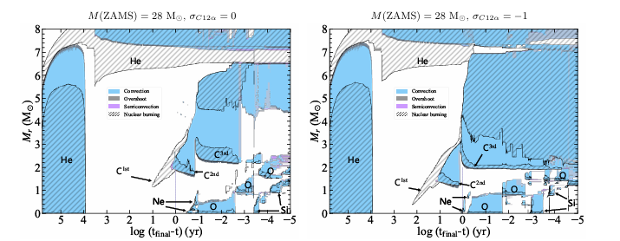
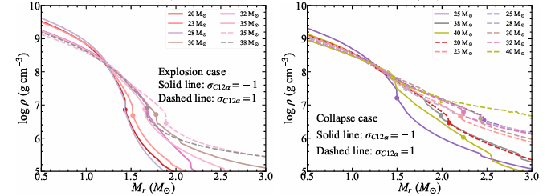
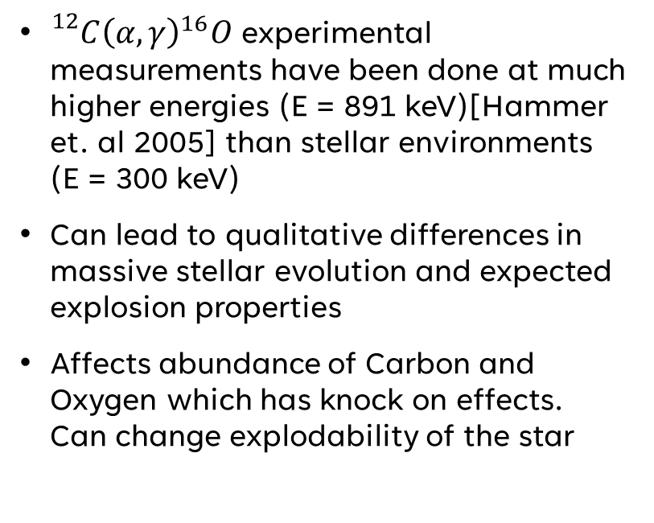

Sensitivity to ${}_{}^{12}C{\left(α,γ\right)}^{16}O$
${}_{}^{12}C{\left(α,γ\right)}^{16}O$experimental measurements have been done at much higher energies (E = 891 keV)[Hammer et. al 2005] than stellar environments (E = 300 keV)
Can lead to qualitative differences in massive stellar evolution and expected explosion properties
Affects abundance of Carbon and Oxygen which has knock on effects. Can change explodability of the star
Xin et. al 2026

Slide 16
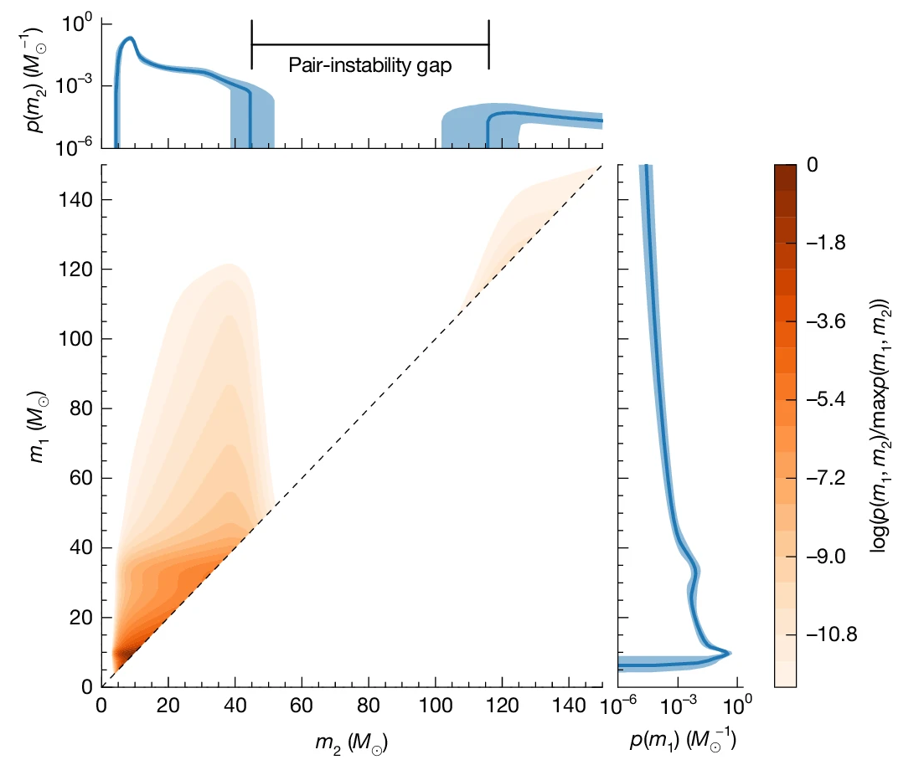
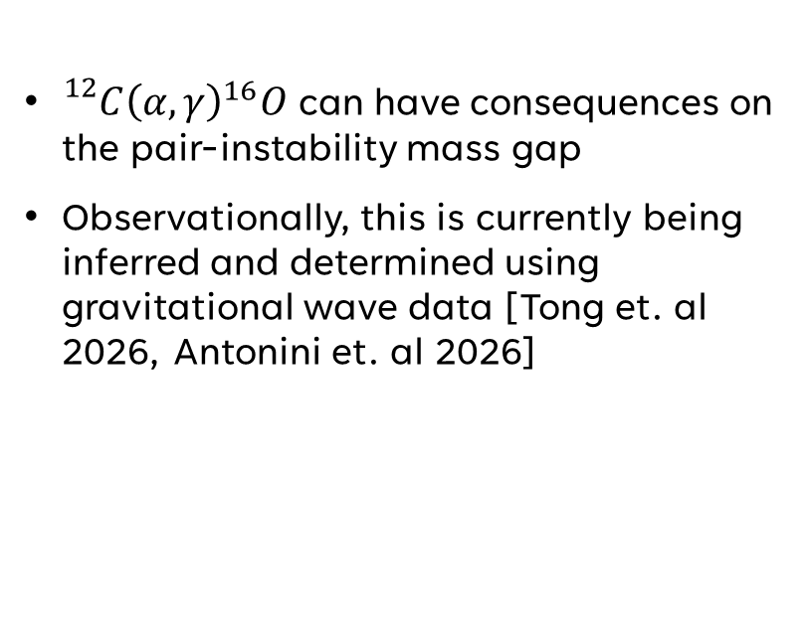
Sensitivity to ${}_{}^{12}C{\left(α,γ\right)}^{16}O$
${}_{}^{12}C{\left(α,γ\right)}^{16}O$can have consequences on the pair-instability mass gap
Observationally, this is currently being inferred and determined using gravitational wave data [Tong et. al 2026, Antonini et. al 2026]

Slide 17
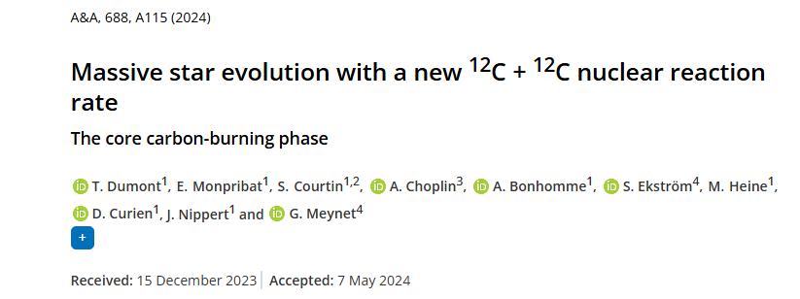
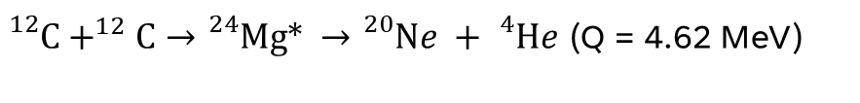
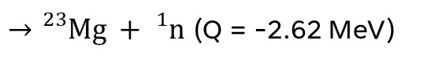
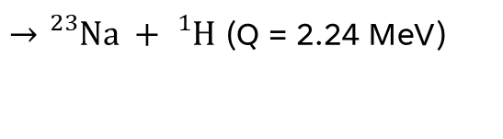
Carbon Burning
Still uncertainties in the precise cross sections for different exit channels
Study (Dumont et. al 2024) explores the impact of different theoretical expectations
${}_{}^{12}C+^{12}C→{}_{}^{24}{Mg∗ }$ $→{}_{}^{20}{Ne +{}_{}^{4}{He}}$ (Q = 4.62 MeV)
$→{}_{}^{23}{Na +{}_{}^{1}H}$ (Q = 2.24 MeV)
$→{}_{}^{23}{Mg +{}_{}^{1}n}$ (Q = -2.62 MeV)

Slide 18
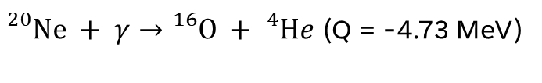
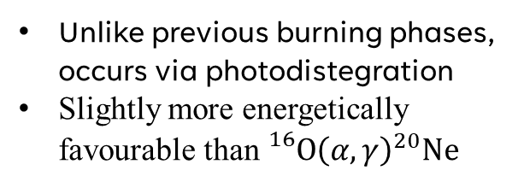
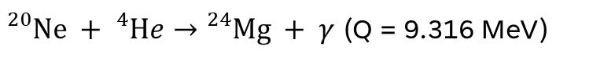
Neon Burning
Unlike previous burning phases, occurs via photodistegration
Slightly more energetically favourable than ${}_{}^{16}O{\left(α,γ\right)}^{20}Ne$
${}_{}^{20}{Ne} + γ→{}_{}^{16}{O +{}_{}^{4}{He}}$ (Q = -4.73 MeV)
${}_{}^{20}{Ne} +{}_{}^{4}{He}→{}_{}^{24}{Mg + γ}$ (Q = 9.316 MeV)

Slide 19
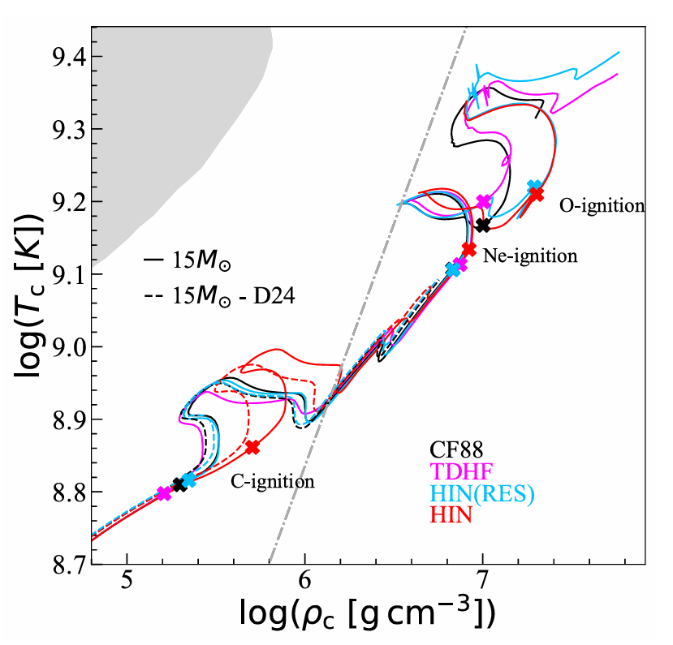
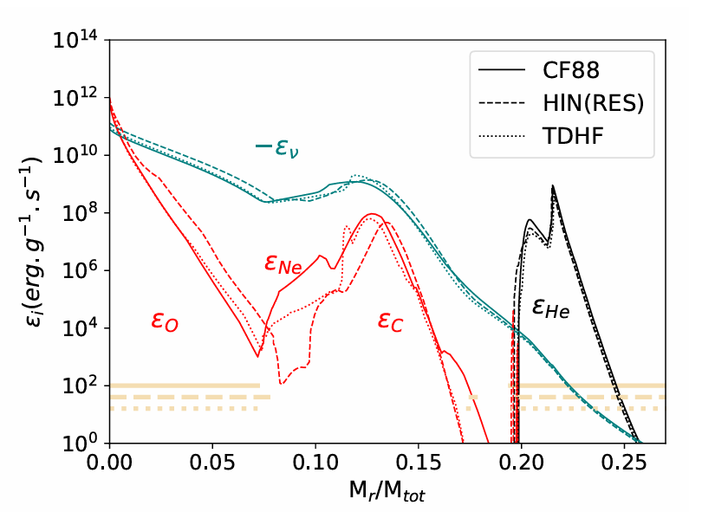
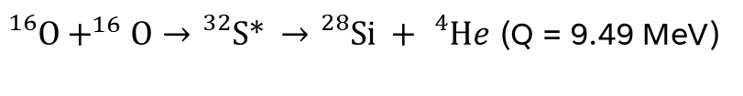
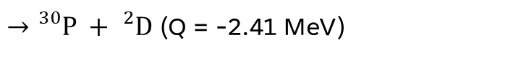
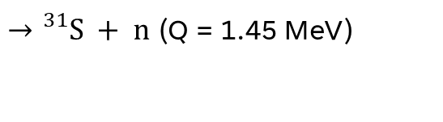
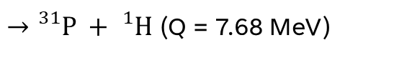
Oxygen Burning
Dumont et al(2025) have investigated the role of O-burning rates
Can affect energy generation, evolution of central temperatures and densities and conditions of ignition
${}_{}^{16}O+^{16}O→{}_{}^{32}{S∗} →{}_{}^{28}{Si +{}_{}^{4}{He}}$ (Q = 9.49 MeV)
$→{}_{}^{31}{P +{}_{}^{1}H}$ (Q = 7.68 MeV)
$→{}_{}^{31}{S + n}$ (Q = 1.45 MeV)
$→{}_{}^{30}{P +{}_{}^{2}D}$ (Q = -2.41 MeV)

Slide 20

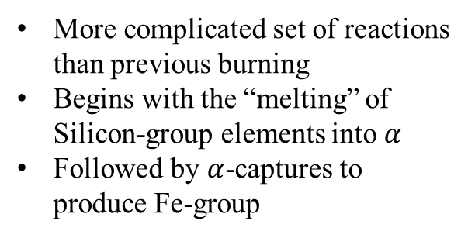
Silicon Burning
More complicated set of reactions than previous burning
Begins with the “melting” of Silicon-group elements into $α$
Followed by $α$-captures to produce Fe-group
$${}_{}^{28}{Si} +7{}_{}^{4}{He}→{}_{}^{56}{Ni }$$

Slide 21
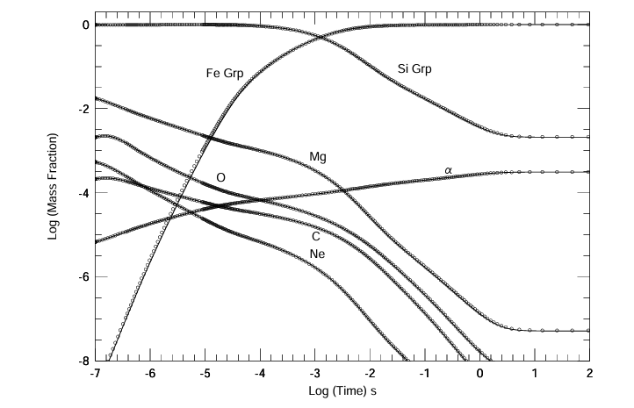
Quasi Equilibrium (QSE)
Begins with photodisintegration of Si-group into alpha-particles
3 GK < T < 5 GK
Multiple equilibrium groups form which are connected by bridging nuclei
Reactions within QSE clusters are much faster than connecting reactions
Final composition depends on T, ρ and Ye
Quasi-equilibrium evolution (Hix et. al 1998)

Slide 22
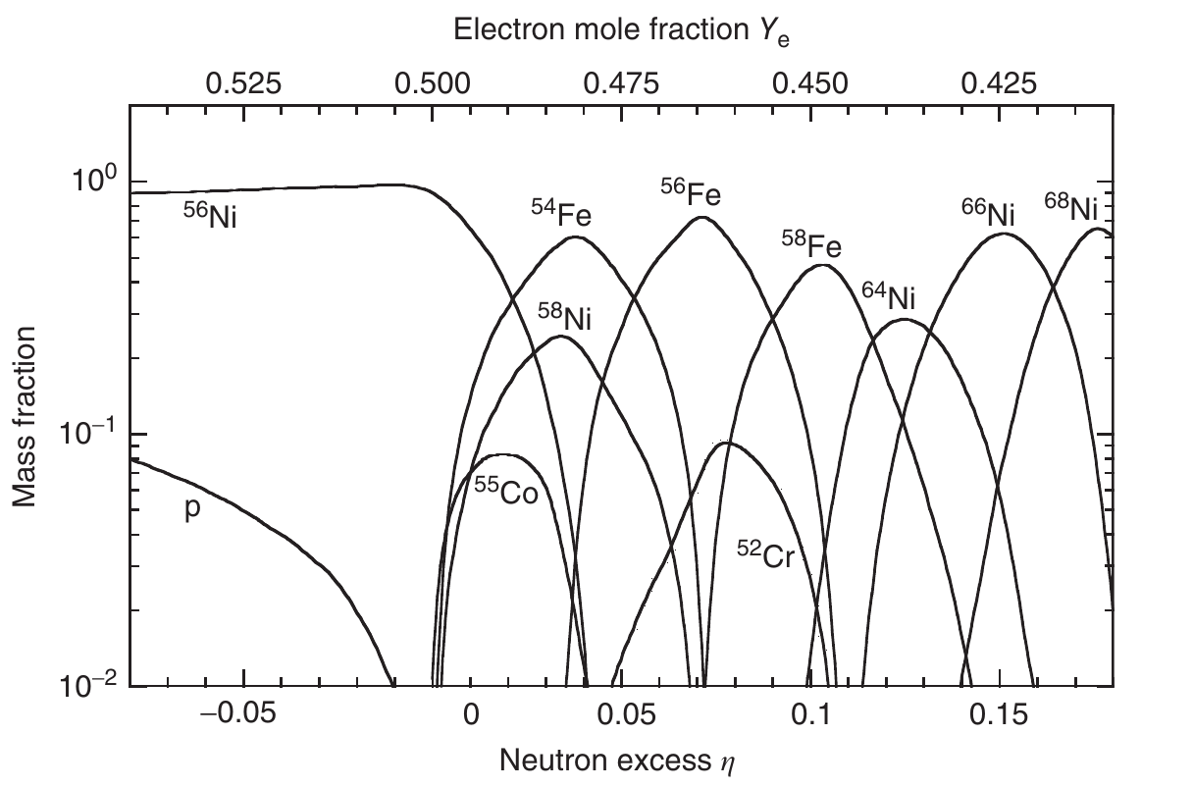
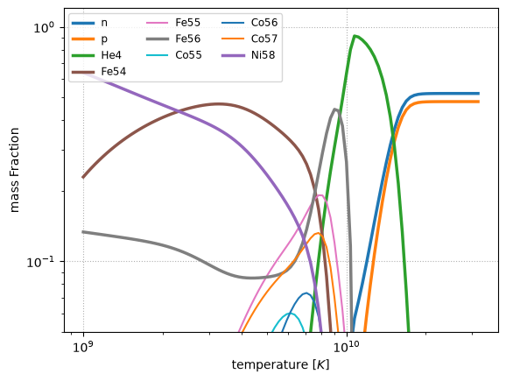
Nuclear Statistical Equilibrium
T > 5 GK
Forward/reverse reactions balance
Composition depends on T, ρ and Ye
Freeze-out determines final abundances
Abundance of dominant species vs electron fraction at T=3.5 GK (Iliadis 2017)
Pynucastro NSE examples: Nuclear statistical equilibrium — PHY 521 Fall 2025

Slide 23
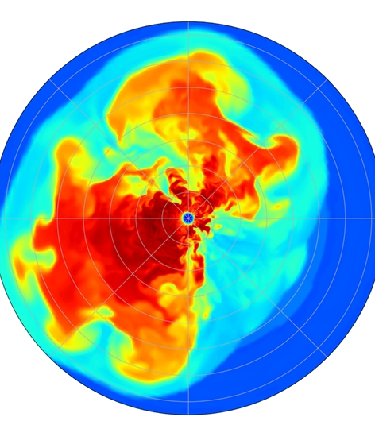
Explosive Nucleosynthesis

Slide 24
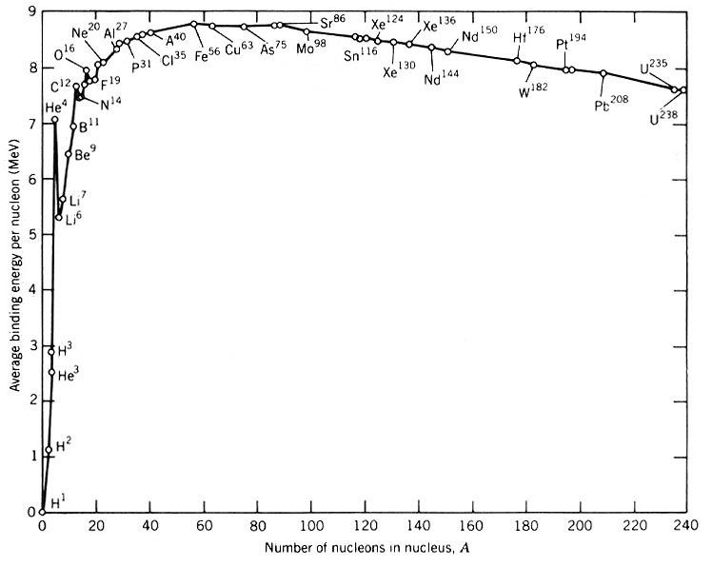
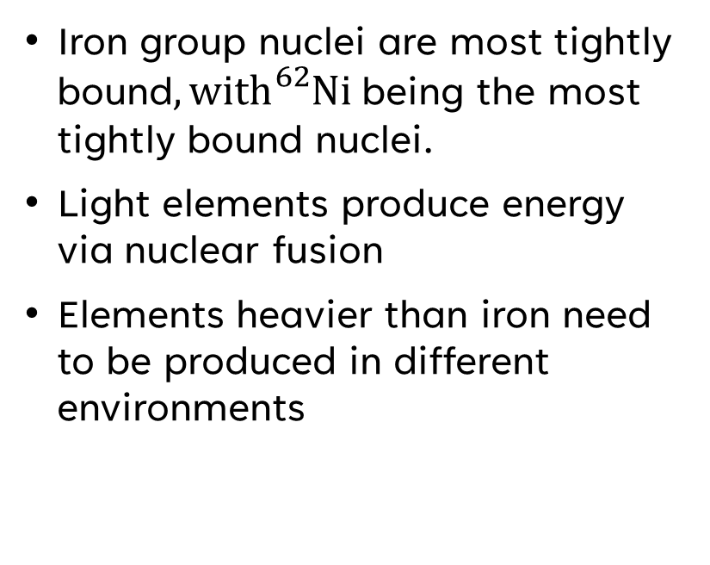
Binding Energy
Iron group nuclei are most tightly bound$, with{}_{}^{62}{Ni }$being the most tightly bound nuclei.
Light elements produce energy via nuclear fusion
Elements heavier than iron need to be produced in different environments
Wikimedia commons: Fichier:Binding energy.jpg — Wikipédia

Slide 25
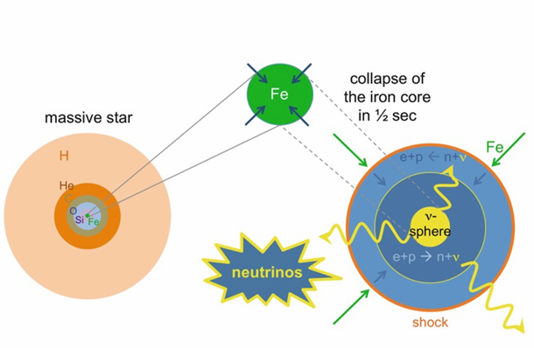
Core-collapse supernova
Nuclear burning stops, triggering the collapse of the iron core until nuclear densities are reached
Iron group nuclei photodisintegrate into their constituents and electron-capture processes occur
Energy losses happen primarily via neutrino losses

Slide 26
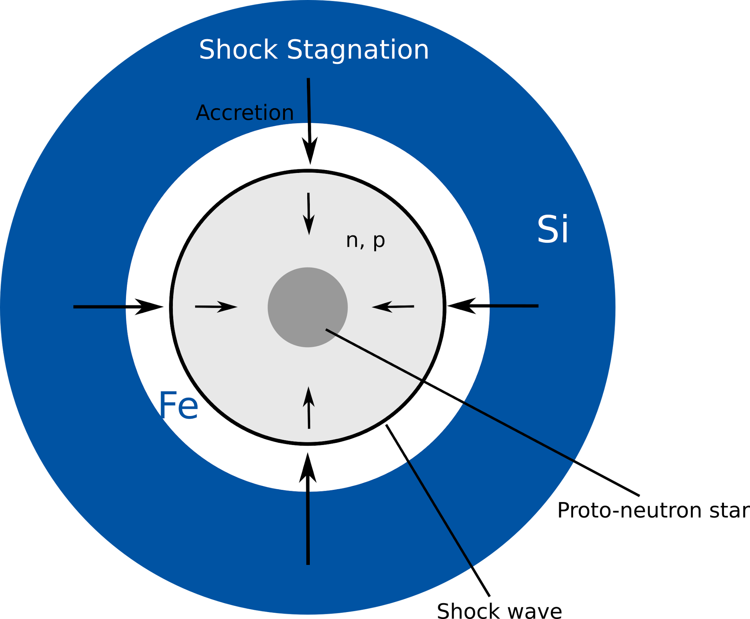
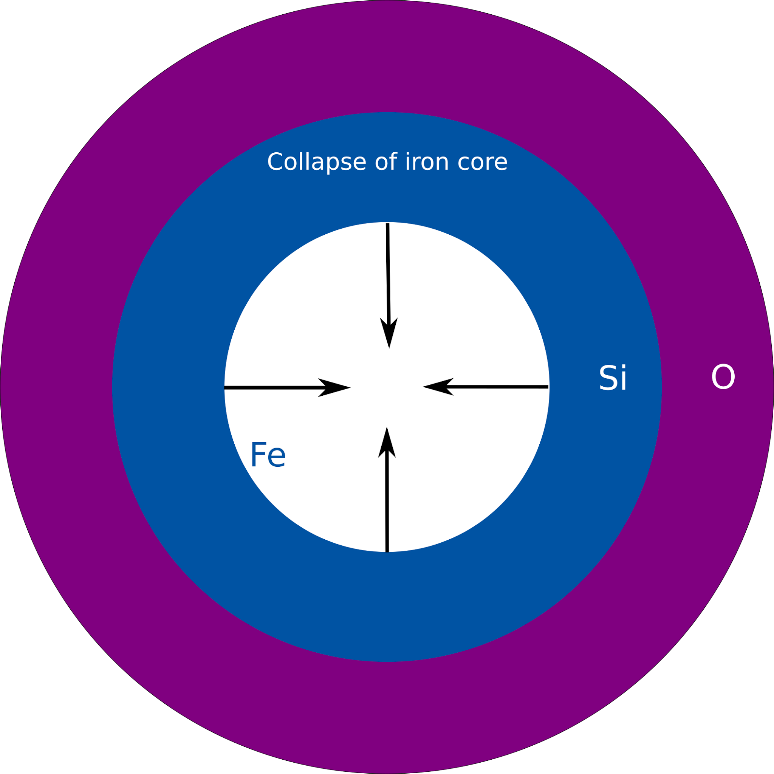
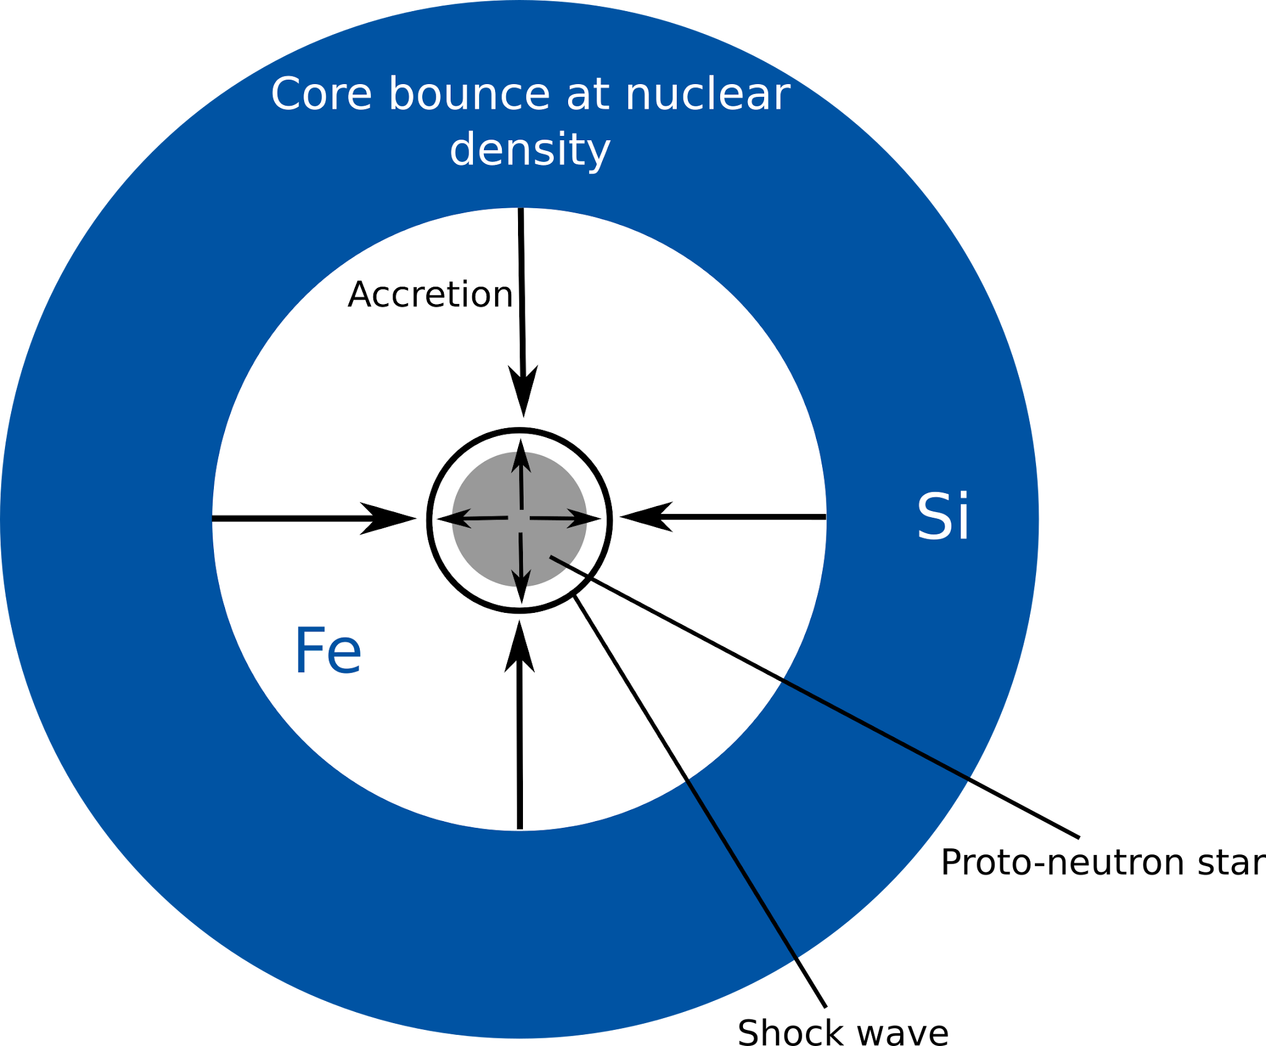
Collapse of iron core triggered by deleptonization and/or photodisintegration of heavy nuclei
Shock stalls due to energy losses
Collapse is halted once the core reaches nuclear densities

Slide 27

Core-collapse supernova
${10}^{53}$erg of neutrinos are released, some of which drive the explosion
Supernova shock passes through the previous hydrostatic shells, compressing material
Heats material instantaneously, then expands and cools
Peak temperature drops rapidly with radius $T∝{\left(\frac{E_{exp}}{r^{3}}\right)}^{1/4}$
Inner material can achieve NSE or QSE

Slide 28


Core-collapse supernova
Measurement uncertainties around the triple-α process (and previous reactions)can have an impact here
${}_{}^{40}{Ca}{\left(α,γ\right)}^{44}Ti and{}_{}^{44}{Ti}{\left(α,p\right)}^{47}V$ have known measurement uncertainties which impact Ti production (Vockenhuber et al 2008, Hoffman et al 2010)
Ti is reasonably well constrained in supernovae (we’ll see this tomorrow)
Peak shock temperature (($T_{9}$)) | Burning regime | Dominant products | Reaches NSE?
> 5 | Complete silicon burning | ${}_{}^{56}{Ni}$, Fe-group, ${}_{}^{44}{Ti}$ | ✓
4–5 | Incomplete silicon burning | Si, S, Ar, Ca + some Fe-group | Partial (QSE)
3–4 | Explosive oxygen burning | Si, S, Ar, Ca | ✗
2–3 | Explosive neon burning | O, Mg, Si | ✗
1.5–2 | Explosive carbon burning | O, Ne, Mg | ✗
< 1.5 | Little explosive processing | Composition largely unchanged | ✗

Slide 29

Other explosive environments
Largely binary stellar systems. Explosions are triggered either by accretion of material onto a hot surface, or a merger
  Type Ia supernovae
  X-ray bursts
  Novae
  Kilonovae

Slide 30

What about heavier elements?

Slide 31

Neutron-Capture processes

Slide 32

Chart of Nuclides
Nuclear burning stops, triggering the collapse of the iron core until nuclear densities are reached
Iron group nuclei photodisintegrate into their constituents and electron-capture processes occur
Energy losses happen primarily via neutrino losses

Slide 33


Solar Abundance
Anders and Grevesse 1989

Slide 34


R-Process
Rapid neutron capture process usually beginning from the iron group
Requires very high neutron densities, > ${10}^{20}$neutrons per $cm^{3}$, T > 1GK, and occurs very quickly (~ 1s)
Quickly captures free neutrons producing unstable heavy isotopes, before decaying down to stable nuclei
Historically expected to occur in core-collapse supernovae
Nuclear chart showing the nucleosynthesis processes occurring during stellar burning (yellow), the s-process (orange) and the r-process (violet) (credit: EMMI, GSI/Different Arts)

Slide 35



gw170817 / grb170817a / at2017GFO
Gillanders et al 2026
Pellouin & Daigne 2024
First neutron star merger observed using multi-messenger signals
Connected NS-NS merger to gamma-ray burst and r-process site
Lightcurve driven by radioactive decay
Detection of Lanthanides in spectra
NASAGoddard/CI Lab, Public domain, via Wikimedia Commons

Slide 36


S-Process
Slow neutron capture process usually beginning from the iron group
Requires low neutron densities, ${10}^{7}−{10}^{8}$ neutrons per $cm^{3}$, T = 0.1 – 0.4 GK
Process takes 100 – 100, 000 years
S-process branching occurs when neutron-capture rates and $β−decay$rates are comparable
Illustration of s-process branching points (Rauscher 2020)
Nuclear chart showing the nucleosynthesis processes occurring during stellar burning (yellow), the s-process (orange) and the r-process (violet) (credit: EMMI, GSI/Different Arts)

Slide 37



S-Process in agb stars
S-process has been theoretically described and observed in AGB stars
Asymptotic Giant Branch (AGB) stars are the late evolutionary stages of low to intermediate mass stars (1 – 8 $M_{⊙}$)
H-shell burning produces He, which is gradually compressed and heated until quasi-explosive He-burning is triggered. This process repeats itself
Between each thermal-pulse, in the intershell region, we have ${}_{}^{12}C{\left(p,γ\right)}^{13}N{\left(β^{+},ν\right)}^{13}C$ where neutrons are released primarily by ${}_{}^{13}C{\left(α,n\right)}^{16}O$allowing for s-process
Observations of heavy s-process elements in an AGB star compared to a theoretical model prediction (Kappeler et al 2011)

Slide 38

S and R-process Peaks
Although both processes form the very heavy elements, the different processes lead to different signatures
S-process peaks around: A = 87, 138, 208
R-process peaks around: A = 80, 130, 195
Plot of r and s-process peaks from Decoding the Mysteries of Heavy Element Formation in the Cosmos | Astronomy Passion. Credit: Maria Lugaro

Slide 39



P-Nuclei / $γ$-process
We find that 35 stable proton-rich nuclei are also abundant (e.g. in the solar composition), which are shielded against neutron captures
May be produced in core-collapse supernovae and X-ray bursts
In CCSNe, these nuclei can be produced via $\left(γ, n\right),\left(γ, p\right) and\left(γ,α\right)$ reactions on seed s-process nuclei
Expected to occur in O/Ne-rich layers as the shock passes through
This process still severely under-produces p-nuclides

Slide 40



Neutrino-processes / $ν$-process
In CCSNe, due to the high neutrino fluxes, even neutrinos that don’t participate in heating material can impact nucleosynthesis
Charged and neutral current neutrino interactions:
This process has been shown to aid production of some elements and the dominant site for ${}_{}^{7}{Li},^{11}B$, ${}_{}^{19}F$, ${}_{}^{138}{La}$and ${}_{}^{180}{Ta}$
Evolution of neutrino-driven wind Ye and elemental yields(Fischer et al 2020)

Slide 41

Summary
Elements up to iron can be created during hydrostatic stellar burning (seed nuclei from BBN)
Most of the heaviest elements, beyond iron, are produced in neutron-capture events
Very specific low $Y_{e}$, and high entropy conditions are required for the r-process
The s-process requires long timescales and a continuous neutron source
Different mechanisms are required for proton-rich nuclei
We need a range of processes and astrophysical environments to explain the observed solar abundance

