Slide 1


Observations of Nucleosynthesis
Vishnu Varma

Slide 2
Day 1 : Nuclear Astrophysics Processes
Day 2 : Observation of Nucleosynthesis
Day 3: Modelling in nuclear astrophysics
Philosophy of doing Astrophysics
Solar and Stellar Spectroscopy
Abundance measurements in transients
Pre-solar grains
Galactic abundance measurements

Slide 3

Philosophy of doing astrophysics

Slide 4
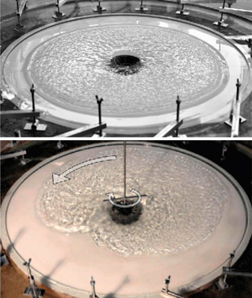
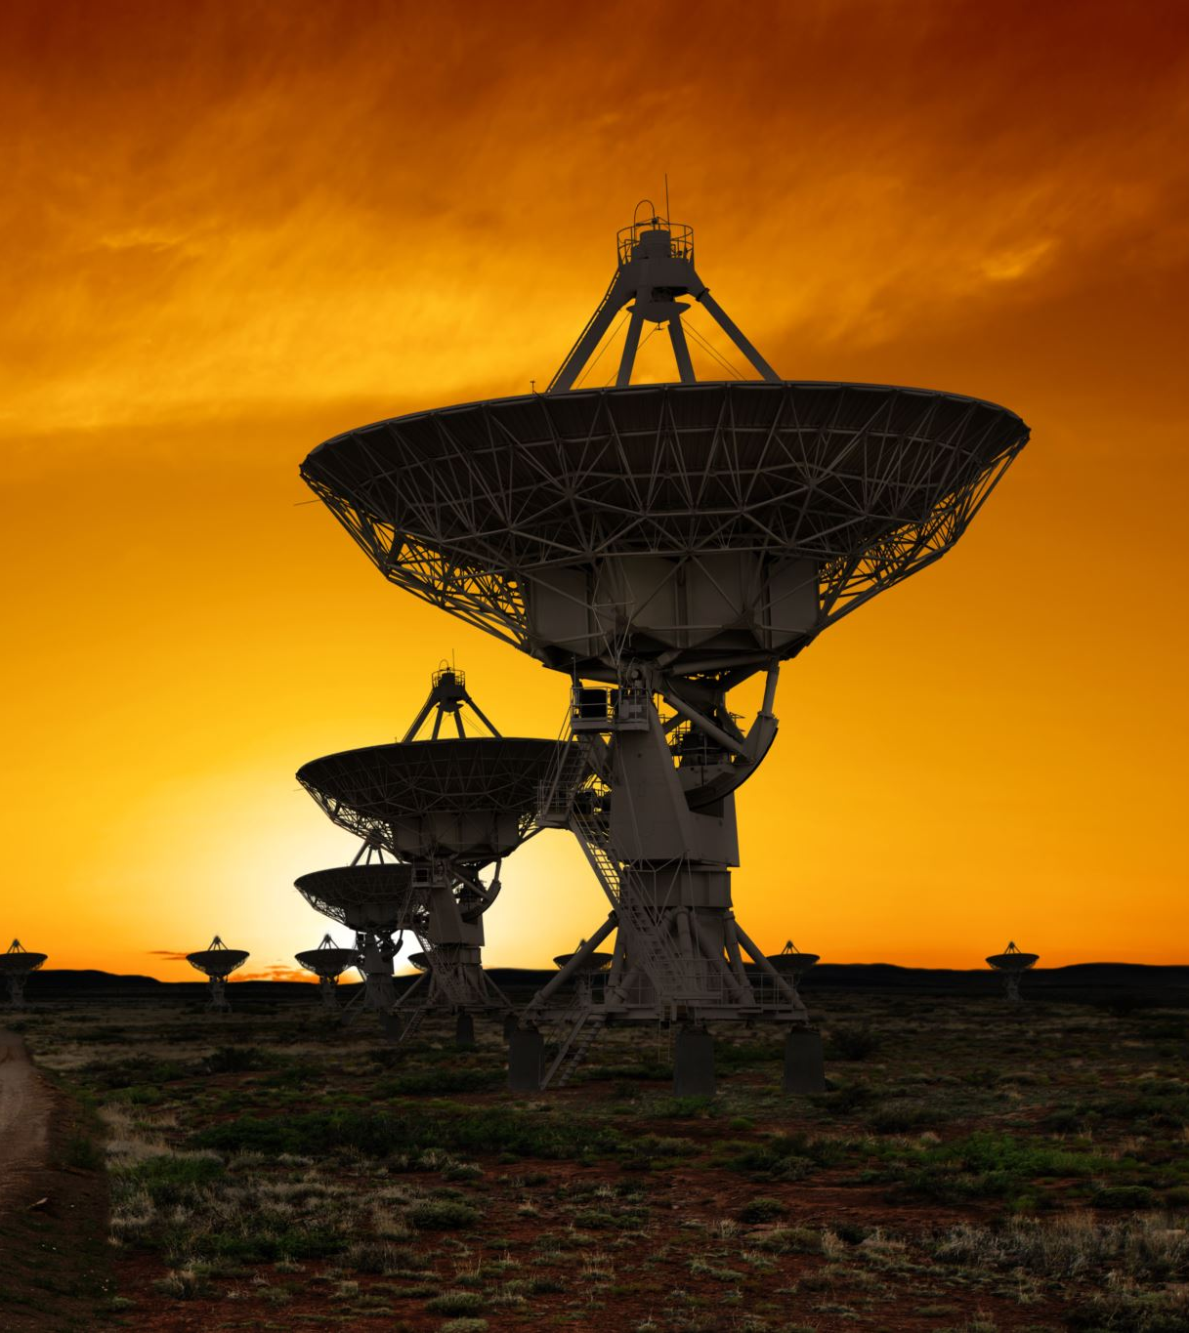
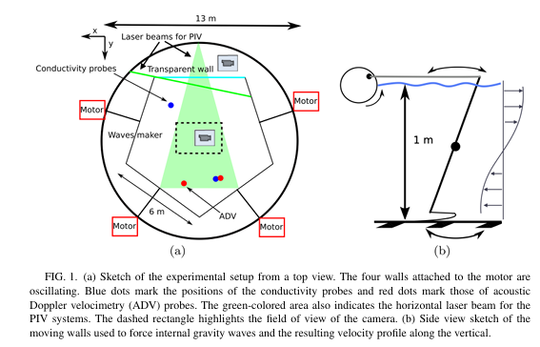
Astrophysics as a science
Astrophysics isn’t an experimental science, better categorized as a historical science (Cleland 2002)
No experiments – can’t perform controlled, repeatable tests
Computational simulations are our closest analog to experiments
Theory is usually multi-physical so we rely on terrestrial experiments for simpler verifications
Ocean IGW experiment in Grenoble: Rodda et al 2022
Foglizzo et al 2012

Slide 5

Inferences rather than measurements
Even fundamental properties in astrophysics (e.g. temperature, density) are inferred
Most observations require some form of modelling for interpretation
Models are physically motivated, but can have much larger uncertainties than experimental sciences
Modern interpretations are often statistical

Slide 6
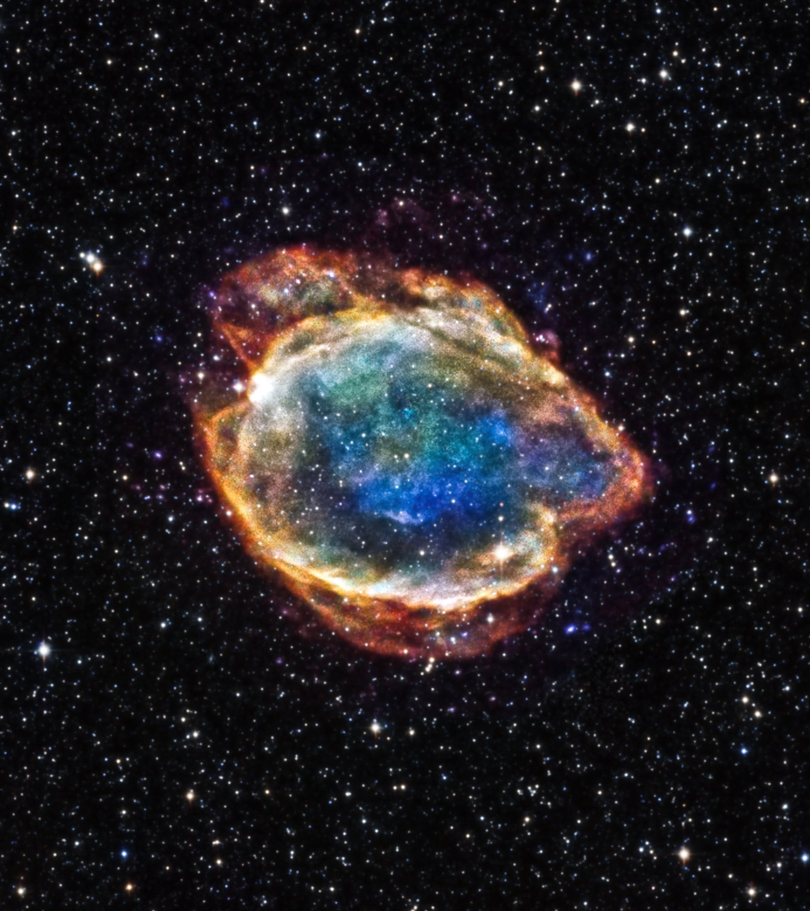
Unobservable processes
Most observations of astrophysical objects occur at a single snapshot in time
E.g. We may observe the presence of molybdenum in a star, but we don’t see the process that produced it
In transients, we may observe the signs of an explosion, but we can’t observe the mechanism itself.
Leads us to be very model dependent to make interpretations

Slide 7
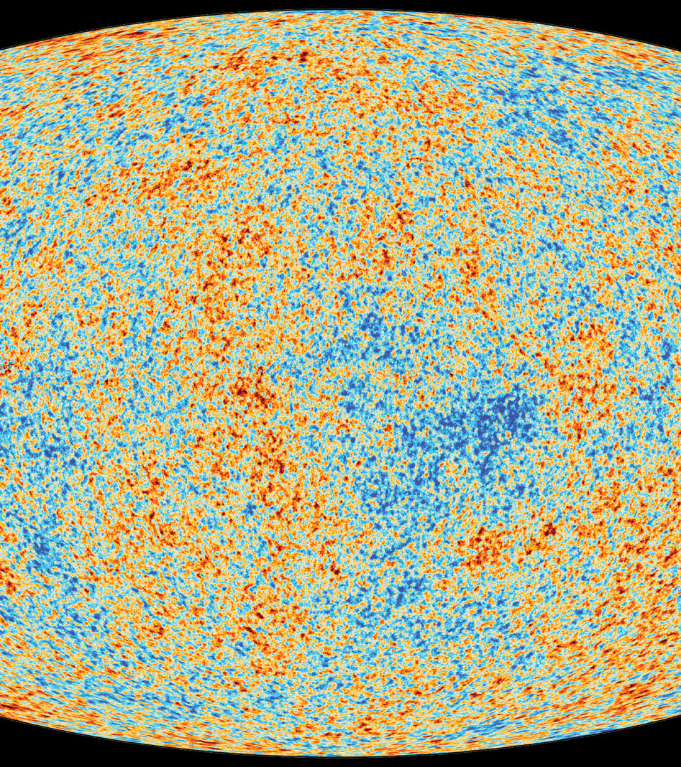
STELLAR Spectroscopy
(Many visual aids are from NASA Space Telescope Science Institute)

Slide 8
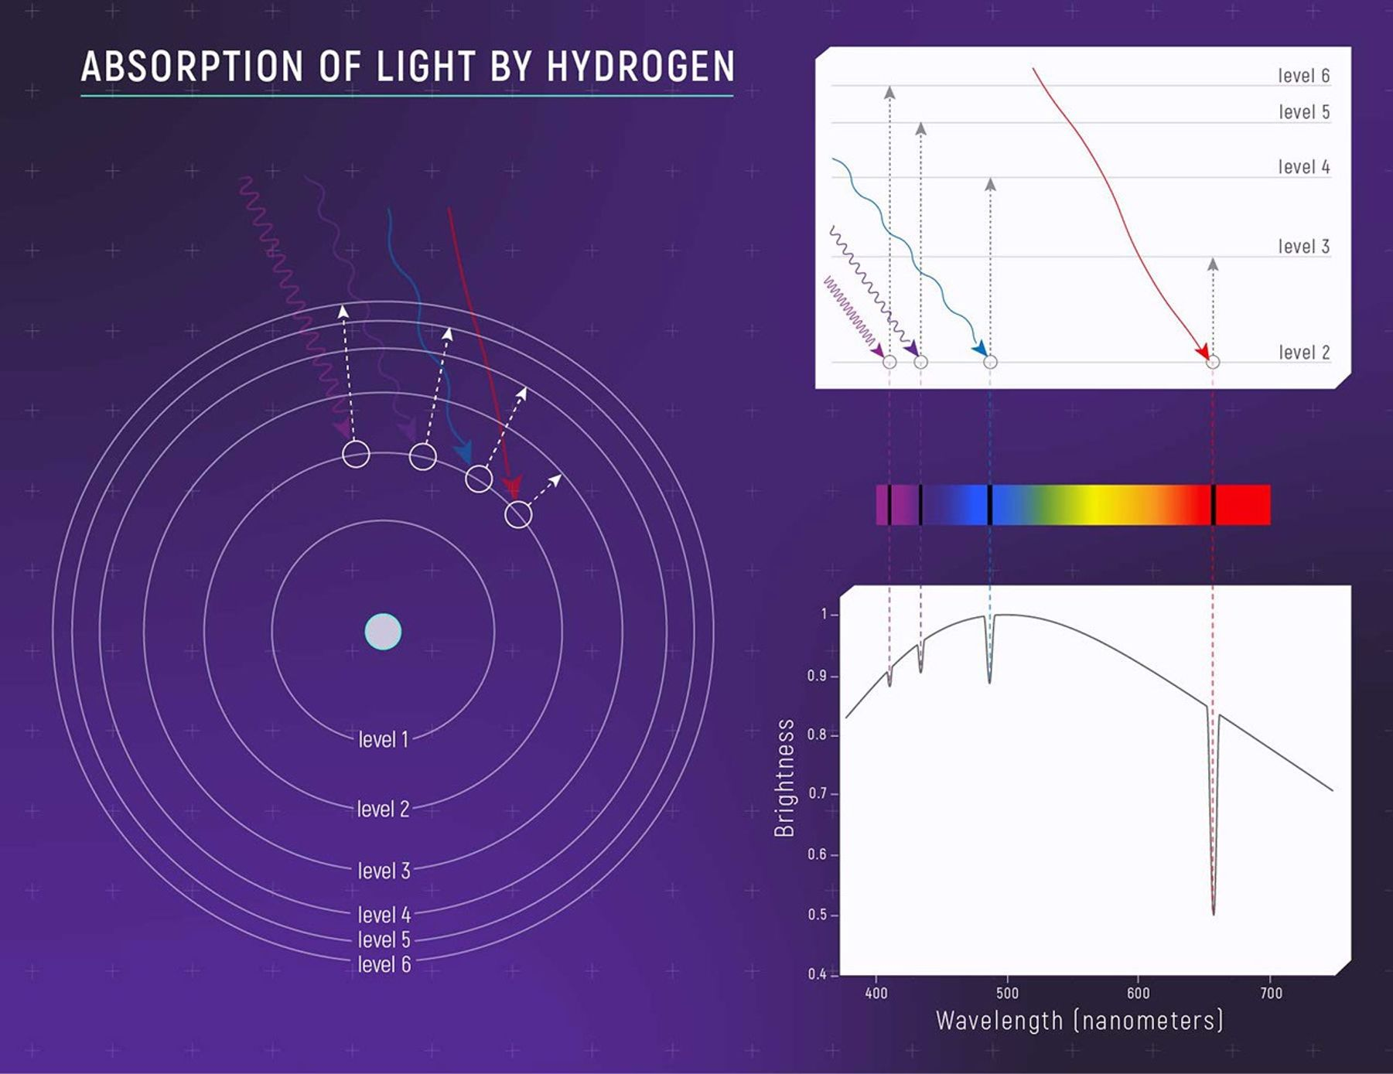
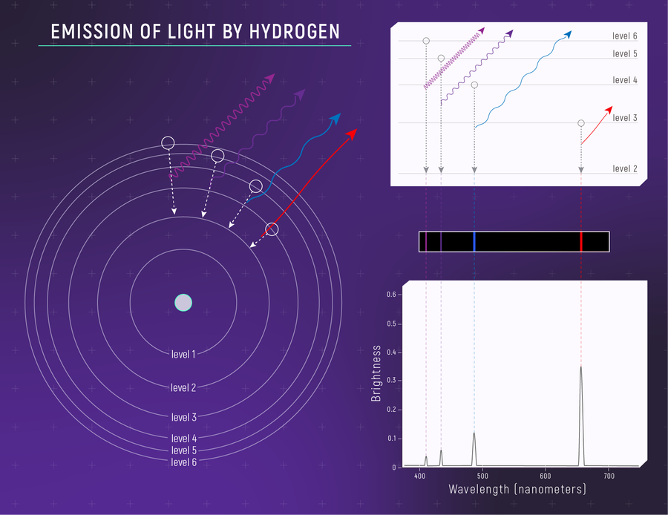
Spectroscopy 101
Discrete energy transitions unique to each element/isotope
Atomic lines mainly the result of electron transition (Molecules have additional vibrational and rotational levels)
Laboratory measurements provide rest wavelengths, transition probabilities, energy levels and line-broadening information (i.e. NIST Atomic Spectra Database)
Illustration showing a set of jumps that correspond to absorption of visible wavelengths (the Balmer Series). NASA, ESA, and L. Hustak (STScI)
This illustration shows a set of drops that correspond to emission of visible wavelengths (the Balmer Series). NASA, ESA, CSA, Leah Hustak (STScI)

Slide 9
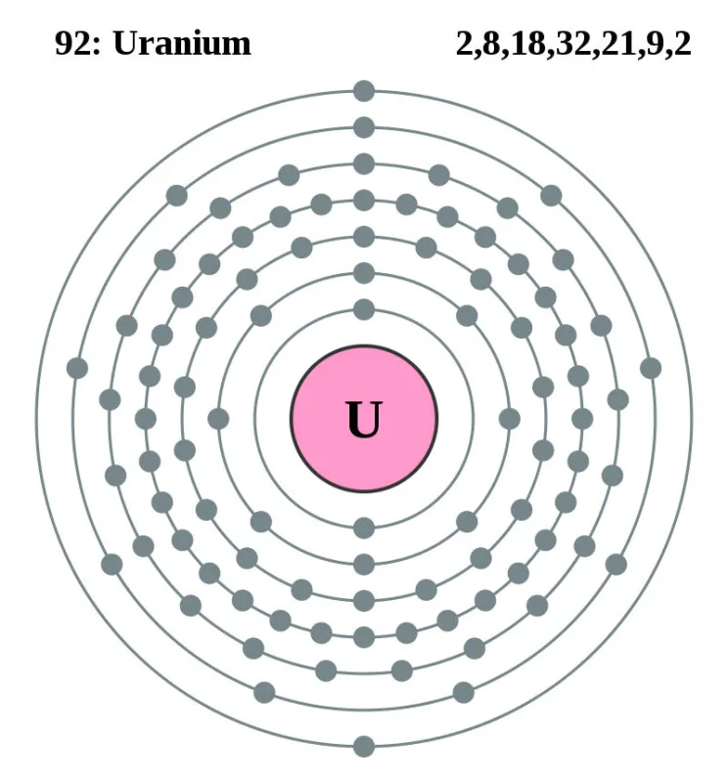
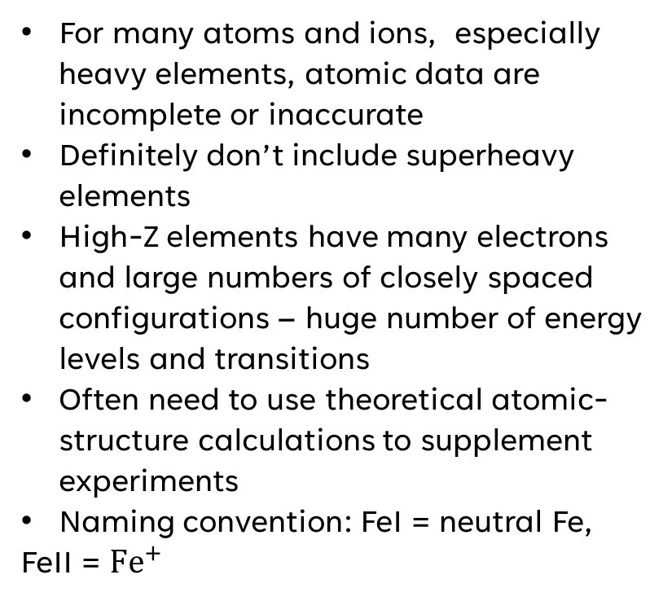
Spectroscopy 101
For many atoms and ions, especially heavy elements, atomic data are incomplete or inaccurate
Definitely don’t include superheavy elements
High-Z elements have many electrons and large numbers of closely spaced configurations – huge number of energy levels and transitions
Often need to use theoretical atomic-structure calculations to supplement experiments
Naming convention: FeI = neutral Fe,
FeII = ${Fe}^{+}$

Slide 10
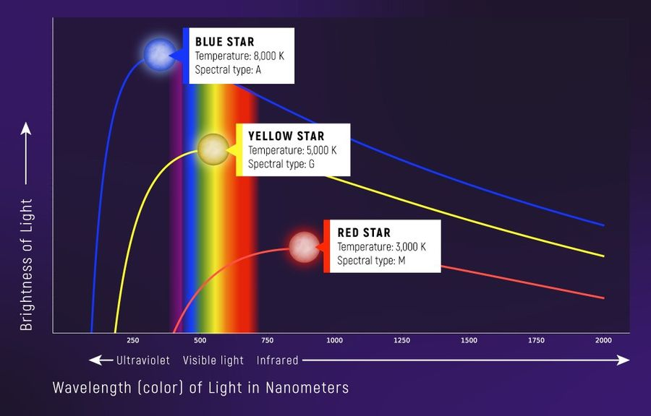
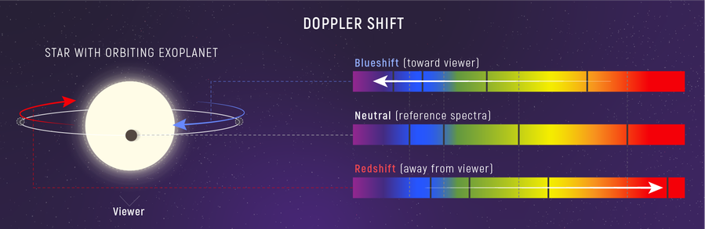
Stellar Spectroscopy
Information that can be attained from spectra:
  Temperature – from peak of continuum
  Density from line broadening from surface pressure
  Motion – relative motion from us shifts the position of lines (redshift and blueshift)
Doppler shifts need to be corrected to precisely identify lines
Doppler shift of a star’s spectrum. While the star is moving toward us, its spectrum is blueshifted. While the star is moving away from us, wavelengths appear longer and the light is redshifted. NASA, ESA, CSA, Leah Hustak (STScI)

Slide 11
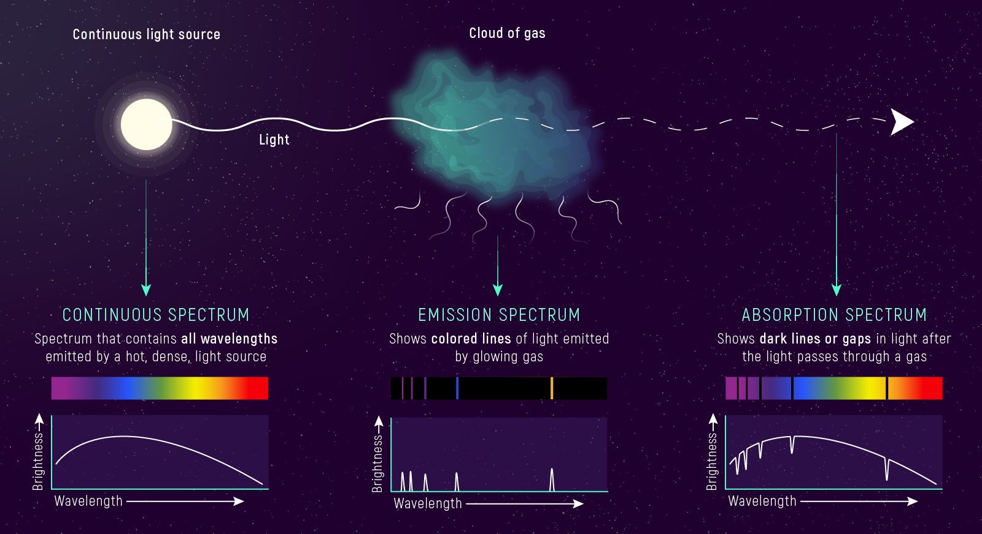
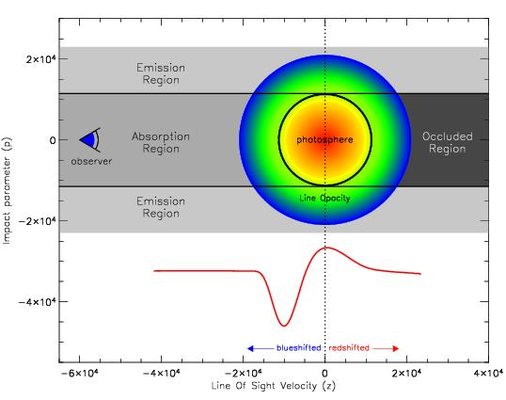
Stellar Spectroscopy
Continuum: Hot optically thick source, contains all wavelengths
Absorption: Cooler gas before a continuum
Emission: Excited low-density gas, shows gaps in continuum
The same transitions can appear in absorption or emission
Astrophysical objects can have both absorption and emission together: e.g. P-Cygni profile, expanding material in front has absorption, elsewhere the outflow emits over a broad range of velocities
A P Cygni profile showing blueshifted absorption trough and doppler broadened emission towards the red. Image from Daniel Kasen, http://supernova.lbl.gov/~dnkasen/
Continuum, absorption and emission spectra modified from Credit: NASA, ESA, and L. Hustak (STScI).

Slide 12
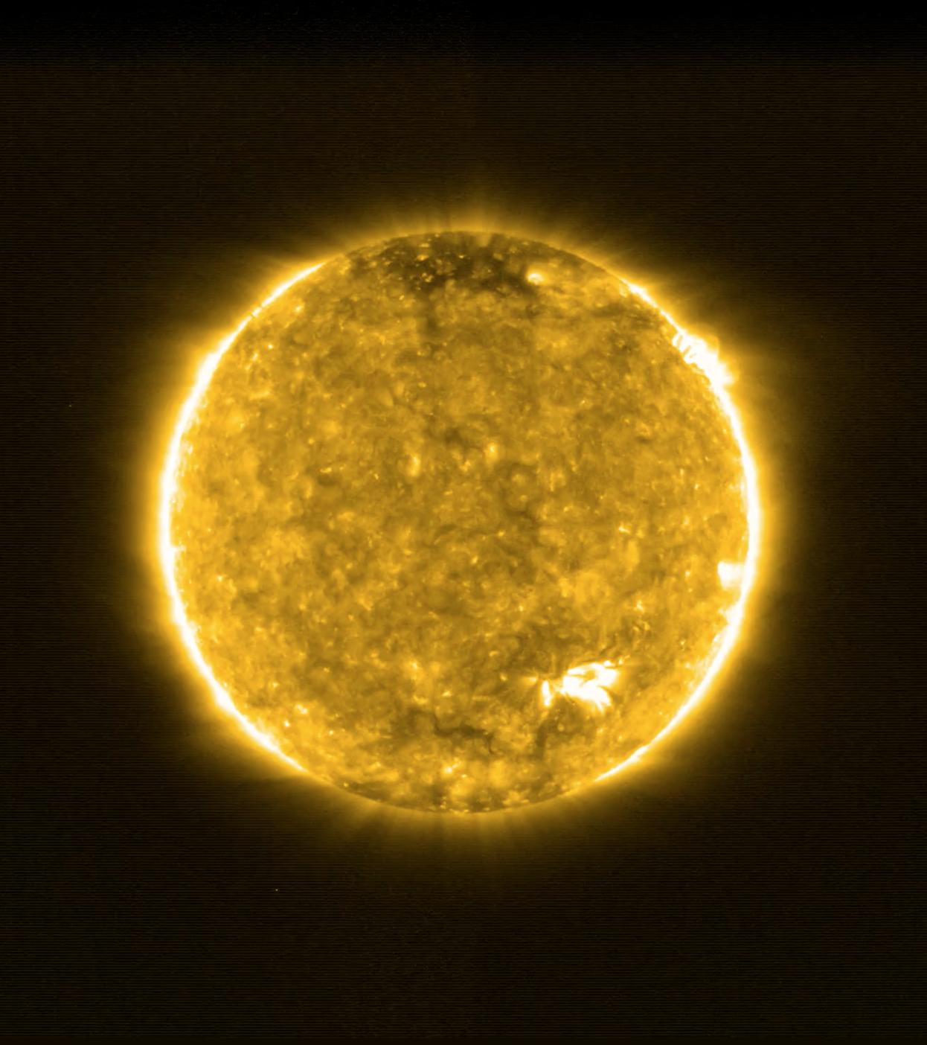
Solar abundance measurements

Slide 13
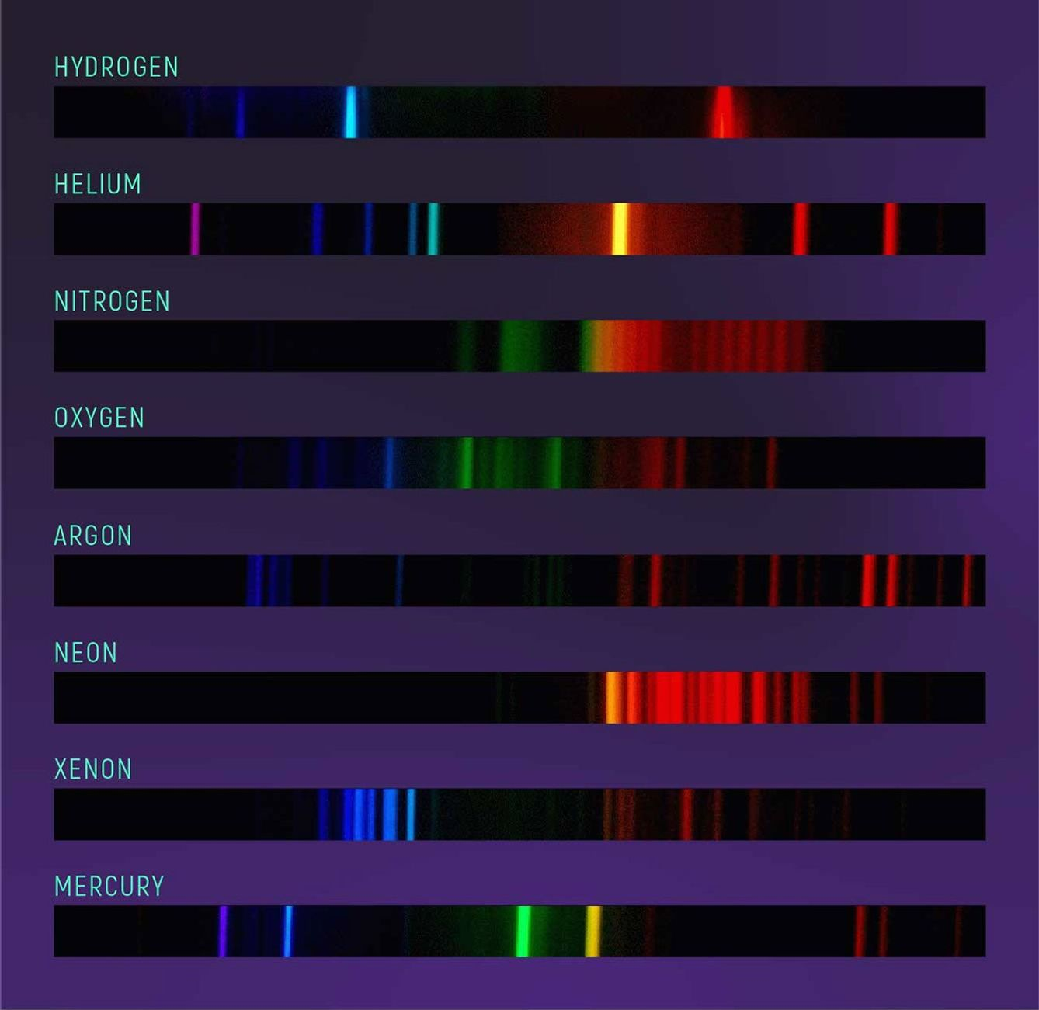
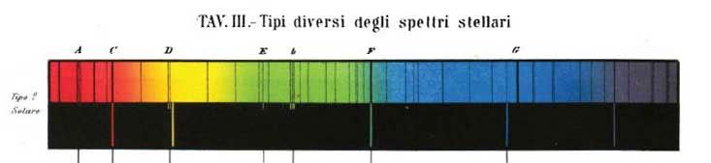
Solar Spectroscopy
Photograph of the emission spectra of gases measured in a laboratory. In the 1850s, scientists discovered that different elements emit different patterns of light when heated in a flame. They noticed that the patterns of known elements studied in the lab correspond to patterns seen in the absorption lines in the Sun.
Credit: M. Richmond, RIT.
Spectral lines are compared to laboratory measurements
First detection of Helium during the 1868 solar eclipse (Jules Janssen and Normal Lockyer). Lockyer proposed the lines were a new element
Spectrum of the Sun published by astronomer and Catholic priest Angelo Secchi in 1877. Secchi was one of the first astronomers to characterize stars based on their spectra.
Credit: P.A. Secchi, Le Stelle: Saggio di Astronomia Siderale, Milan, 1877.

Slide 14
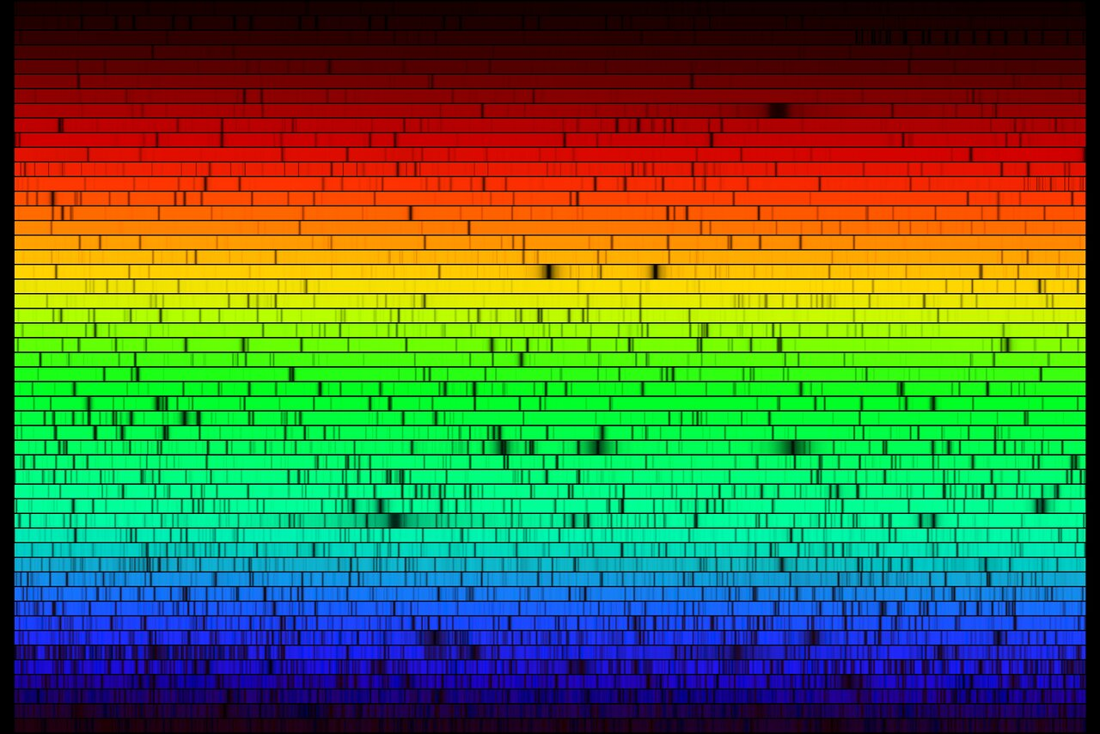
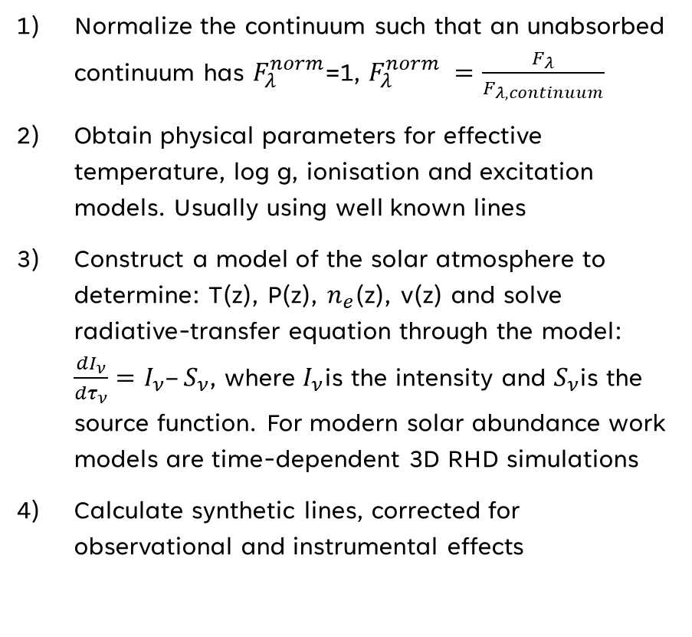
Determining the solar abundance
Normalize the continuum such that an unabsorbed continuum has $F_{λ}^{norm}$=1, $F_{λ}^{norm} =\frac{F_{λ}}{F_{λ,continuum}}$
Obtain physical parameters for effective temperature, log g, ionisation and excitation models. Usually using well known lines
Construct a model of the solar atmosphere to determine: T(z), P(z), $n_{e}$(z), v(z) and solve radiative-transfer equation through the model: $\frac{dI_{ν}}{dτ_{ν}}=I_{ν}–S_{ν}$, where $I_{ν}$is the intensity and $S_{ν}$is the source function. For modern solar abundance work models are time-dependent 3D RHD simulations
Calculate synthetic lines, corrected for observational and instrumental effects
A high-resolution spectrum of our Sun, created with the Fourier Transform Spectrometer at the McMath-Pierce Solar Facility at the National Solar Observatory on Kitt Peak. Wavelength increasing from left to right along each strip, and from bottom to top. Each of the 50 slices covers 60 angstroms, for a complete spectrum across the visual range from 4000 to 7000 angstroms.
Credit: N.A.Sharp/KPNO/NOIRLab/NSO/NSF/AURA

Slide 15
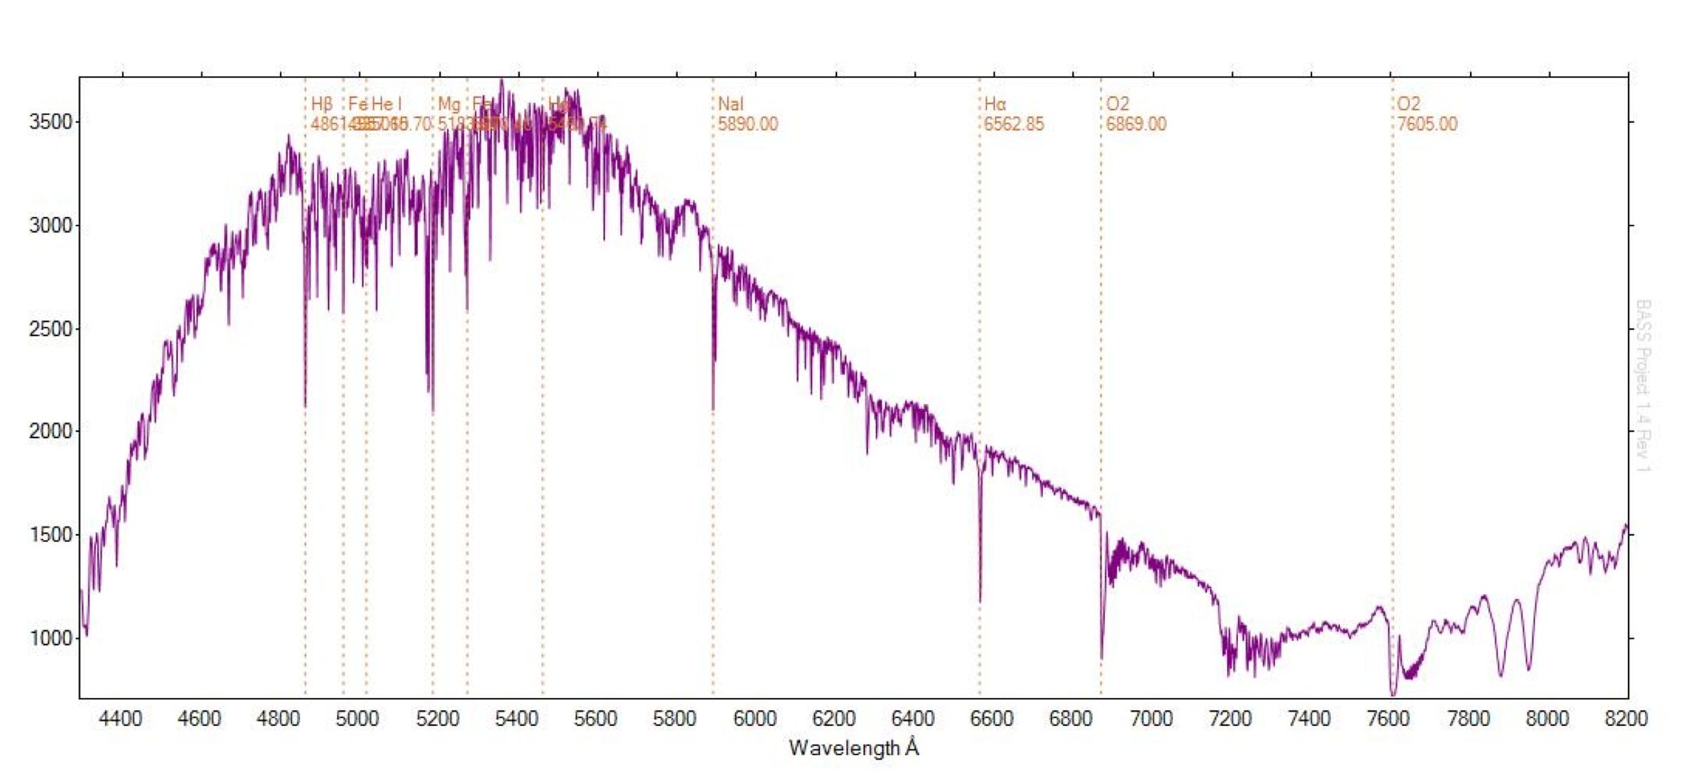
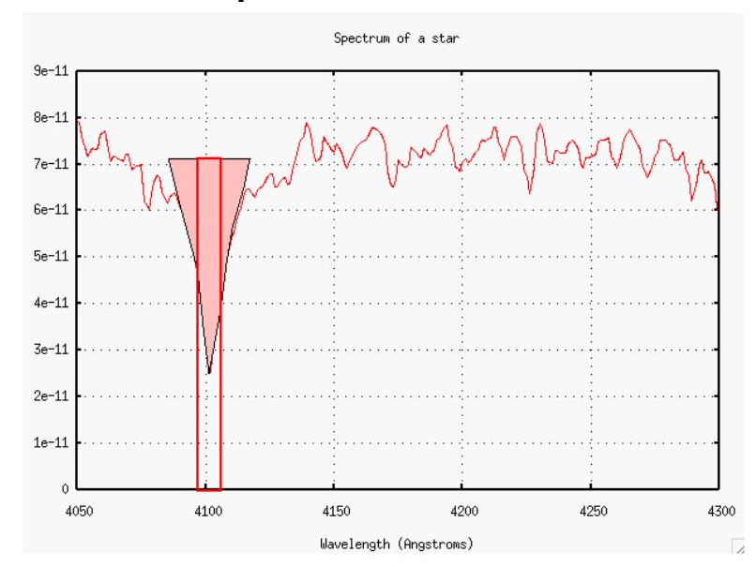
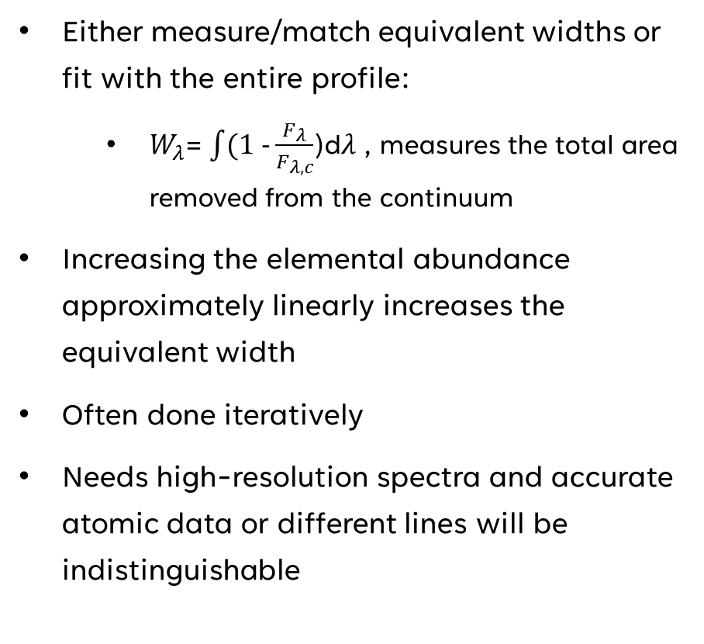
Determining the solar abundance
Either measure/match equivalent widths or fit with the entire profile:
  $W_{λ}$= $\int{(1 −\frac{F_{λ}}{F_{λ,c}}}$)d$λ$ , measures the total area removed from the continuum
Increasing the elemental abundance approximately linearly increases the equivalent width
Often done iteratively
Needs high-resolution spectra and accurate atomic data or different lines will be indistinguishable

Slide 16
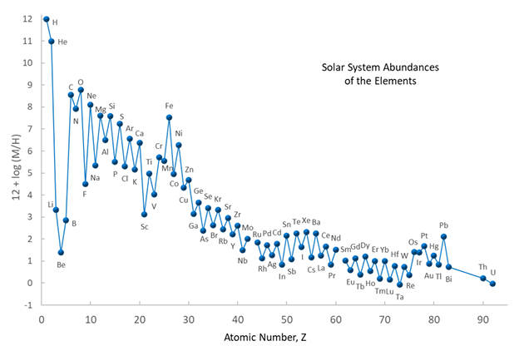
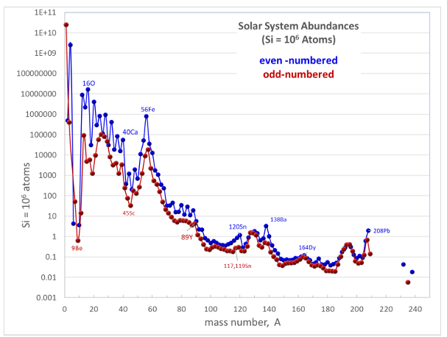
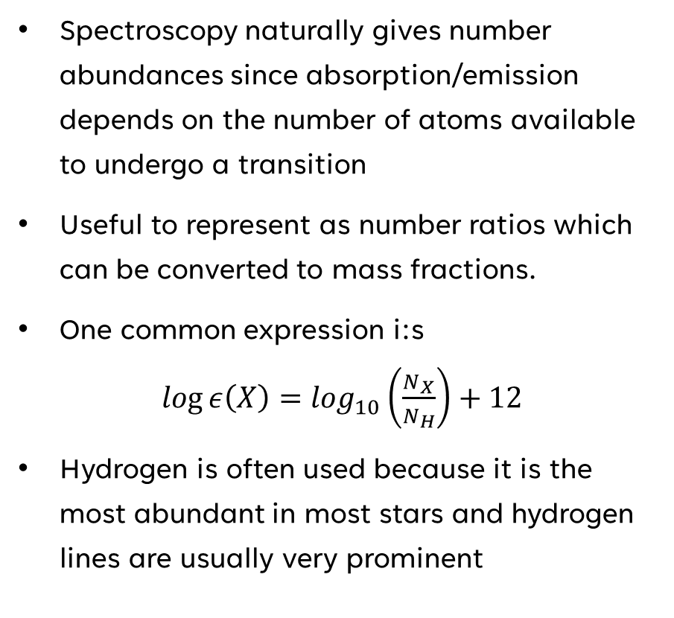
Determining the solar abundance
Spectroscopy naturally gives number abundances since absorption/emission depends on the number of atoms available to undergo a transition
Useful to represent as number ratios which can be converted to mass fractions.
One common expression i:s $log ε\left(X\right)=\log_{10}\left(\frac{N_{X}}{N_{H}}\right)+12$
Hydrogen is often used because it is the most abundant in most stars and hydrogen lines are usually very prominent
Solar abundances as a function of atomic and mass numbers from Lodders 2019. Both plots use different normalizations

Slide 17
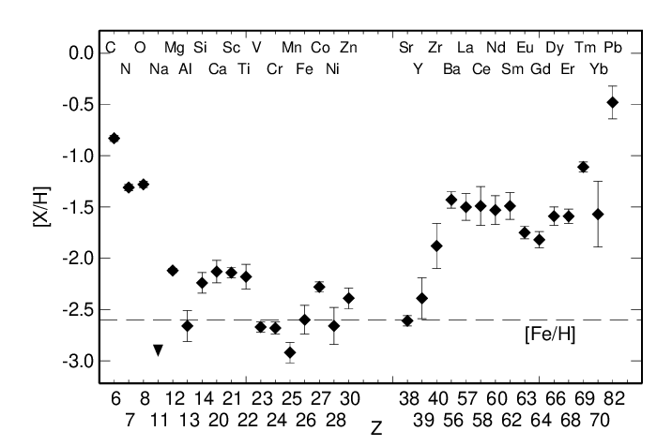
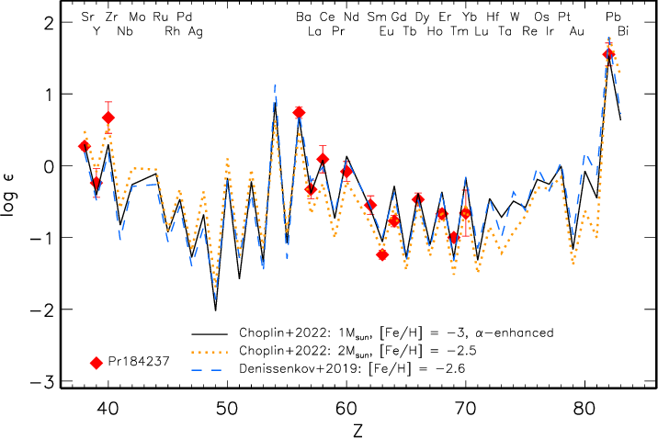
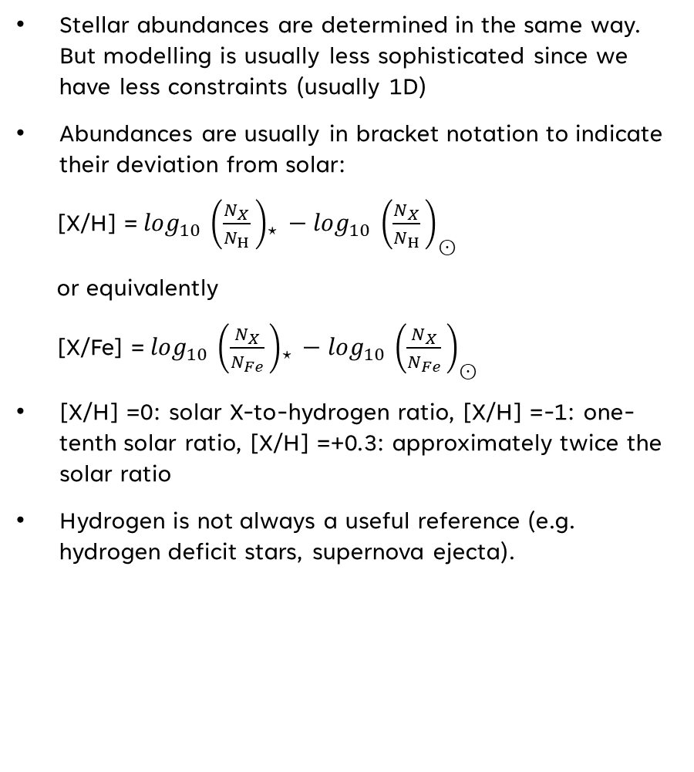
Stellar abundances
Stellar abundances are determined in the same way. But modelling is usually less sophisticated since we have less constraints (usually 1D)
Abundances are usually in bracket notation to indicate their deviation from solar:
[X/H] =${\log_{10}{​\left(\frac{N_{X}}{​N_{H}}​\right)}}_{⋆}​−\log_{10}{​{\left(\frac{N_{X}}{​N_{H}}​\right)}_{⊙}​}$
or equivalently
[X/Fe] =${\log_{10}{​\left(\frac{N_{X}}{​N_{Fe}}​\right)}}_{⋆}​−\log_{10}{​{\left(\frac{N_{X}}{​N_{Fe}}​\right)}_{⊙}​}$
[X/H] =0: solar X-to-hydrogen ratio, [X/H] =-1: one-tenth solar ratio, [X/H] =+0.3: approximately twice the solar ratio
Hydrogen is not always a useful reference (e.g. hydrogen deficit stars, supernova ejecta).
Abundances pattern of Pr184237 compared to solar and theoretical models (Mashonika et al 2023)

Slide 18
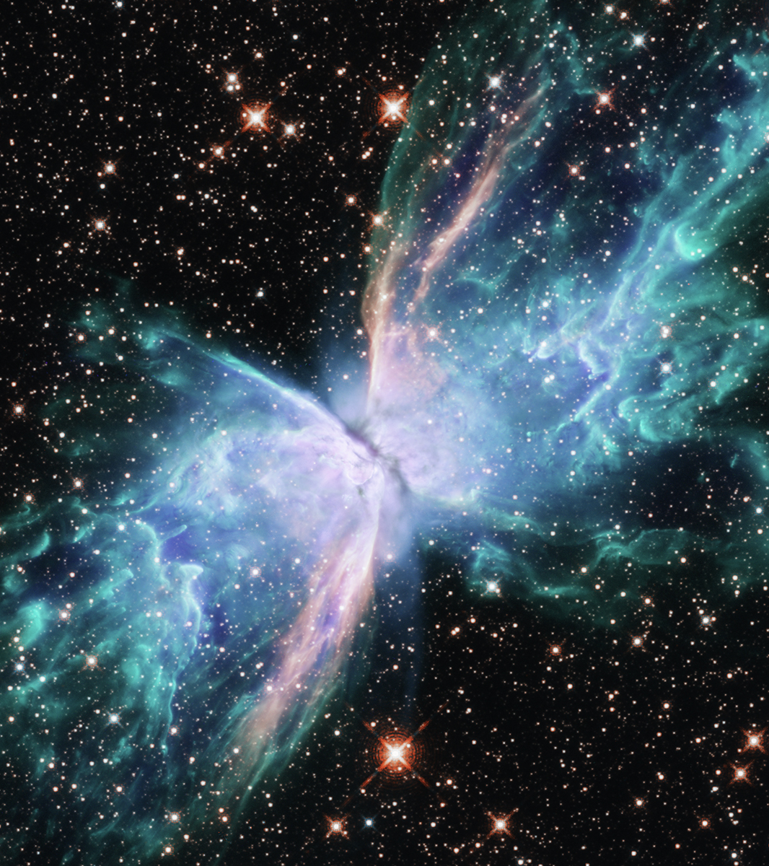
Transient observations

Slide 19
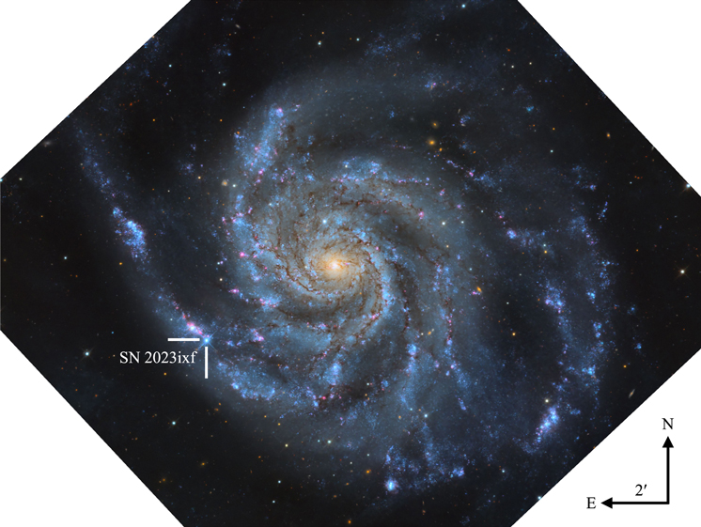
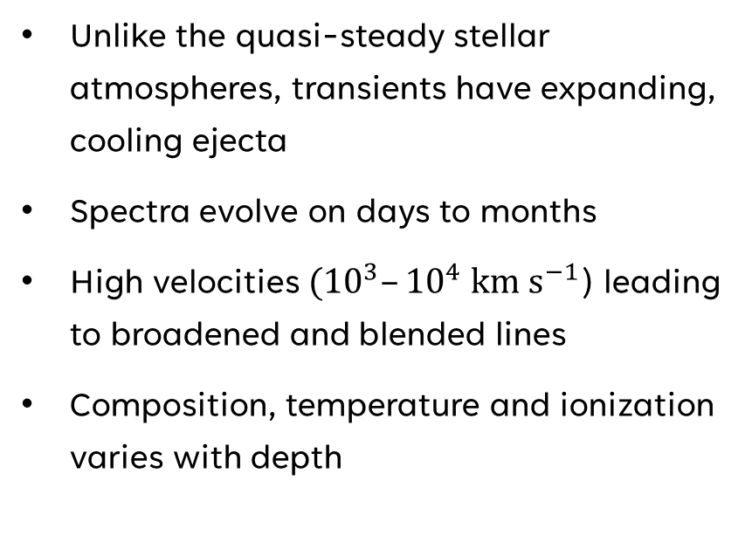
Transient Spectroscopy
Unlike the quasi-steady stellar atmospheres, transients have expanding, cooling ejecta
Spectra evolve on days to months
High velocities $({10}^{3}–{10}^{4} km s^{−1}$) leading to broadened and blended lines
Composition, temperature and ionization varies with depth
SN 2023ixf in its host galaxy Messier 101 (From Hosseinzadeh et al 2023). Image credit: Travis Deyoe, Mount Lemmon SkyCenter, University of Arizona

Slide 20
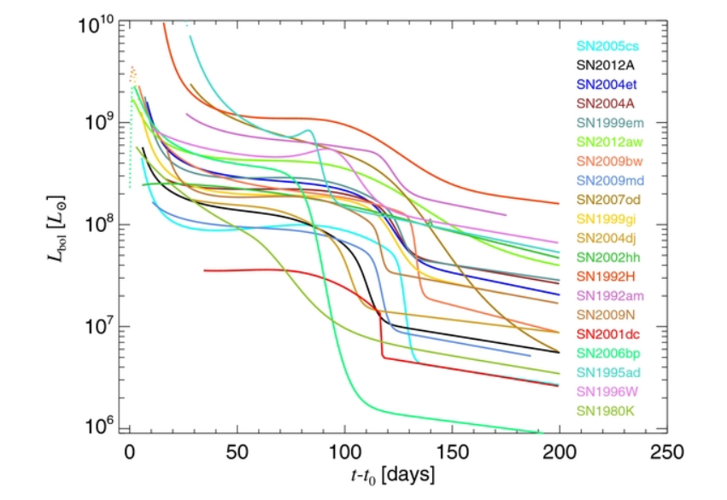
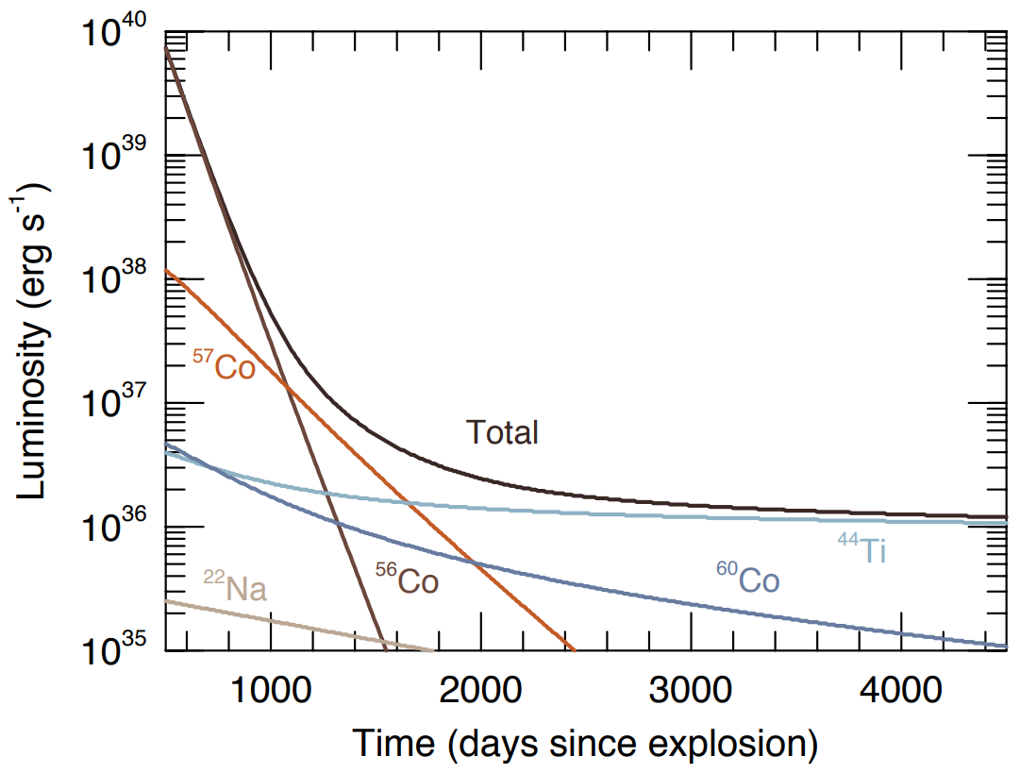
Supernova lightcurves
Supernovae lighcurves vary over time (decays)
Luminosity dominated by the decay of radioactive ⁵⁶Ni (Truran, Arnett & Cameron 1967, Colgate & McKee 1969)
⁵⁶Ni → ⁵⁶Co → ⁵⁶Fe
⁴⁴Ti → ⁴⁴Sc → ⁴⁴Ca
Masses can be estimated using relatively simple modelling
Comparison of type II supernovae bolometric luminosities from Pejcha & Prieto 2015
Luminosity decay of Cobolt and Titanium isotopes. Figure by Frank Timmes on cococubed.com

Slide 21
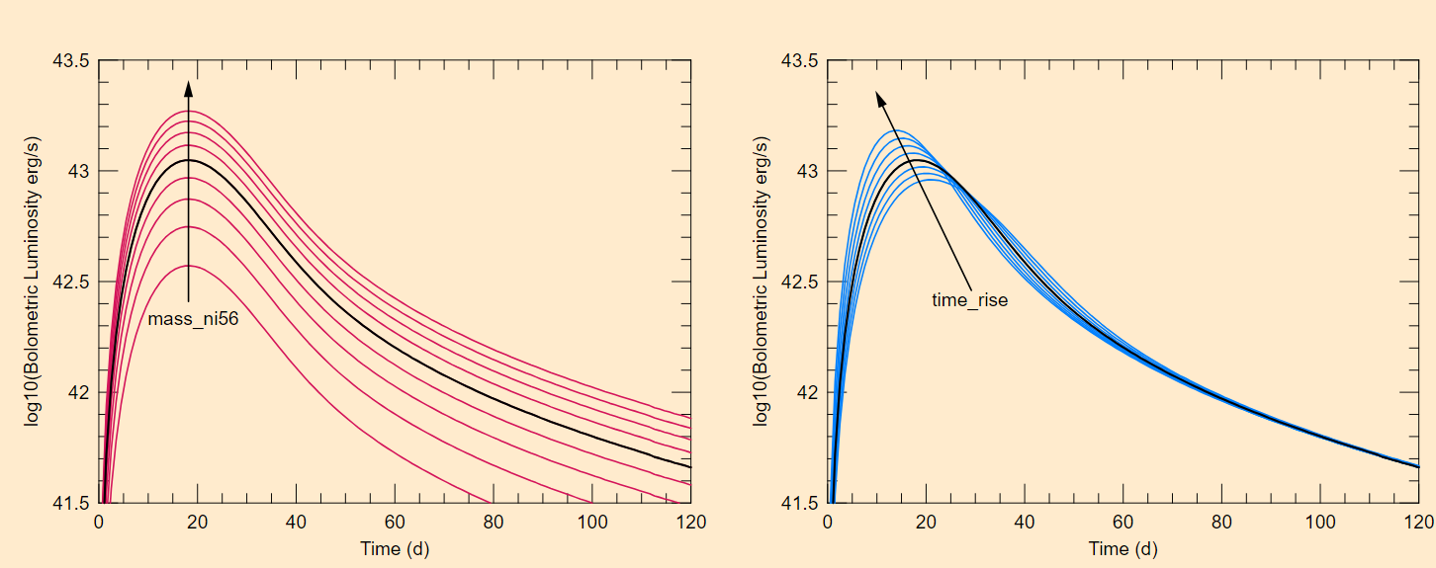
Supernova Lightcurves
Variation of lightcurves due to Nickel mass and rise time of explosion energy. Figure by Frank Timmes on cococubed.com

Slide 22
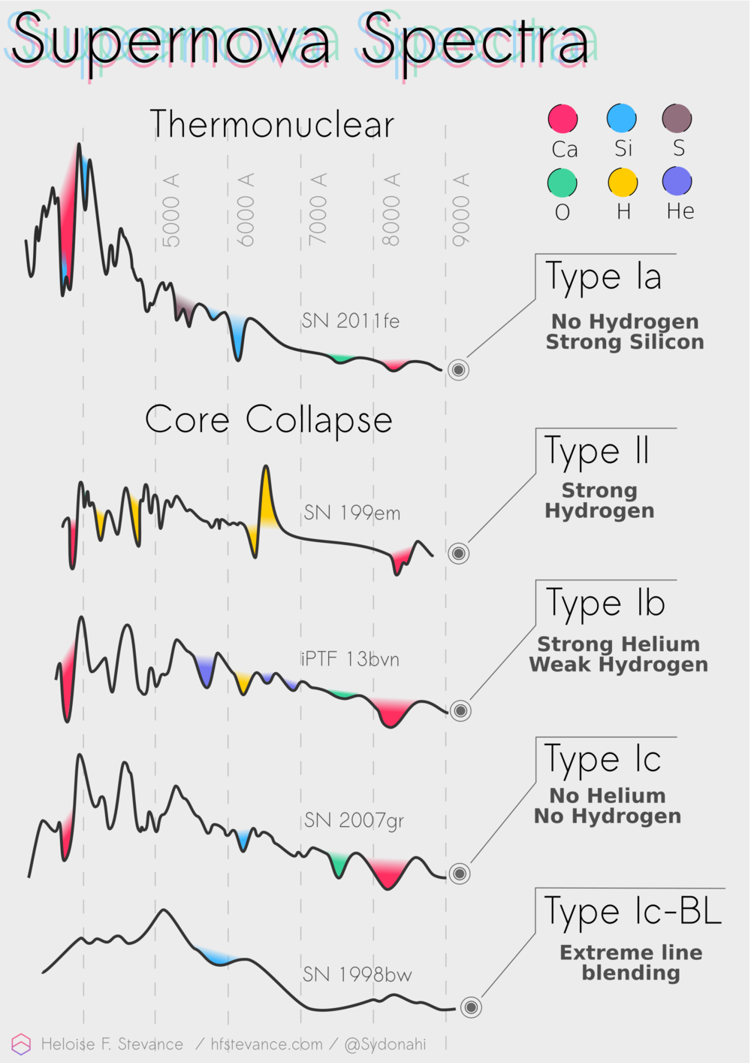
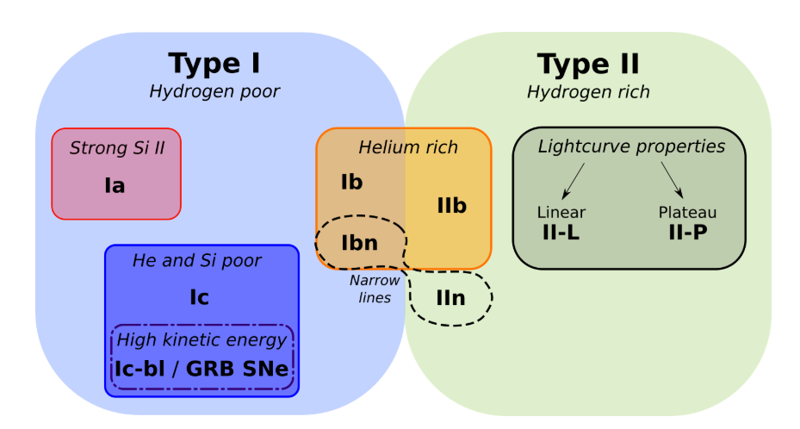
Supernova classification
Early SN spectra resembles a stellar photosphere, with an expanding line-forming ejecta (photospheric phase)
Blueshifted absorption gives expansion velocity
Presence or absence of lines generally determine the SN classification
Supernova classification diagram by Heloise Stevance (https://www.hfstevance.com/ccsne)

Slide 23
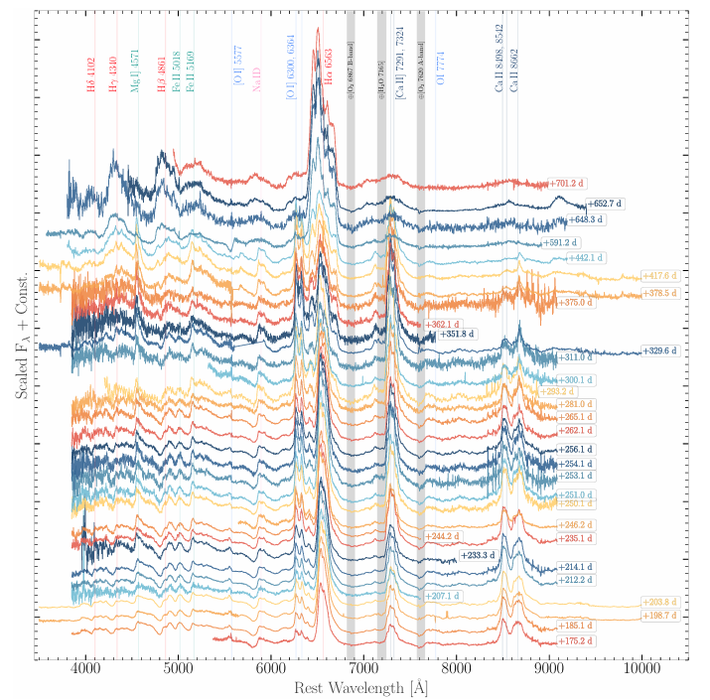
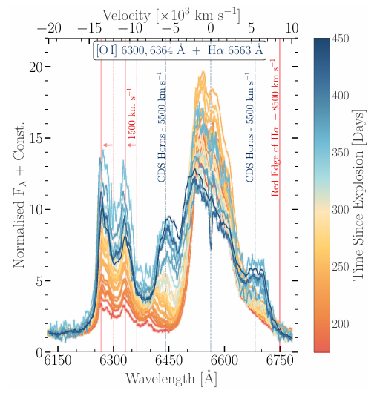
Nebular Phase spectroscopy
Singh et al 2026
Expansion, cooling and thus recombination removes free electrons, reducing opacity
After some months, the nebular becomes optically thin and the deep interior becomes visible (nebular phase)
The nebular phase lasts from a few months to a few years
Nebular spectra reveal the deep interior of supernova ejecta
Broad forbidden emission lines ([O I], [Ca II])
Line profiles can diagnose asymmetry
Temporal evolution of Hα and [O I] doublets of SN 2023ixf in the nebular phase from 175d until 450d.
Notes:
Forbidden lines are rarely observed in laboratory conditions because high particle densities lead to frequent collisions that de-excite the atom before photon emission occurs

Slide 24
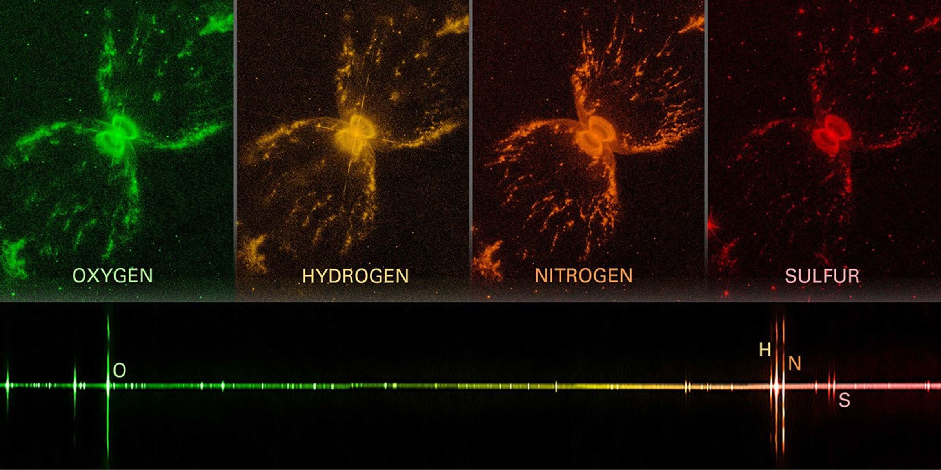
Supernova Remnant
Emission spectrum of the Southern Crab Nebula. Bright emission lines show that the hot gas in the center of the Southern Crab Nebula contains oxygen, hydrogen, nitrogen, and sulfur.
Credit: NASA, ESA, and J. DePasquale (STScI).

Slide 25
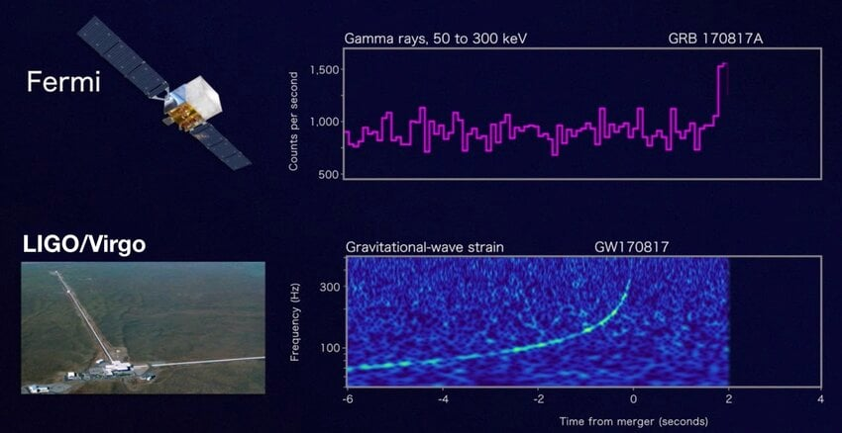
Kilonova Spectroscopy
Kilonova spectroscopy can be even more difficult
Ejecta velocities can be a significant fraction of c
Lanthanides/actanides have a huge line forrest, individual element determination is difficult
Many features remain model dependent
Gravitational wave and gamma ray signal from GW170817 (GRB170817A) from Singhal et al 2022

Slide 26
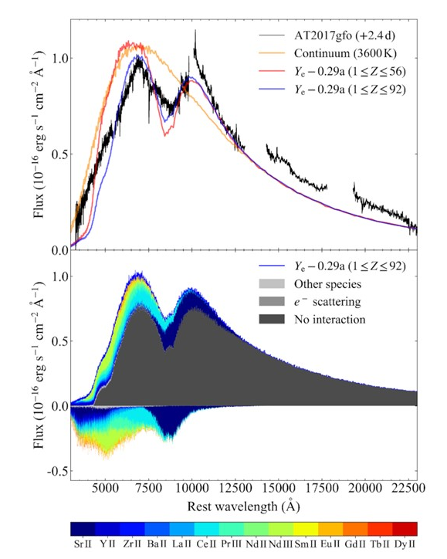
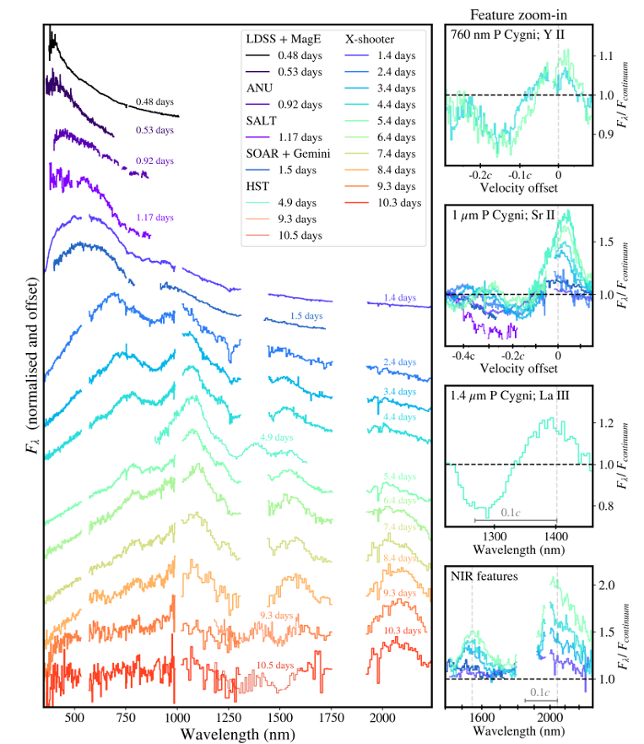
Kilonova Spectroscopy
Transition from photospheric to nebular phase is much faster than supernova
Several days vs months because kilonovae have less ejecta and generally higher velocities
Early photospheric phase dominated by light, first-peak r-process material
Later quasi-nebular phase shows presence of lanthanide-rich material
Spectral evolution of the kilonova AT2017gfo over the first 10 days (Sneppen et al 2024)
Modelling of AT2017gfo spectrum at +2.4d post-explosion (Gillanders et al 2022)

Slide 27
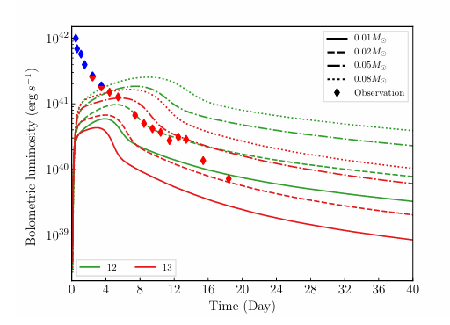
kILONOVA Lightcurves
Not one dominant isotope like in the CCSNe case
Kilonova lightcurves are driven by radioactive decay, many beta decays, alpha decays and fission channels contribute
Heating resembles a power-law rather than a single exponential
Colour evolution constrains opacity and lanthanide content
Can’t directly constrain individual elements/isotopes from lightcurve, but we can constrain total radioactive mass ejecta
Comparison of two modelled kilonova lightcurves compared to data from GW170817 (Zhu et al 2020)

Slide 28
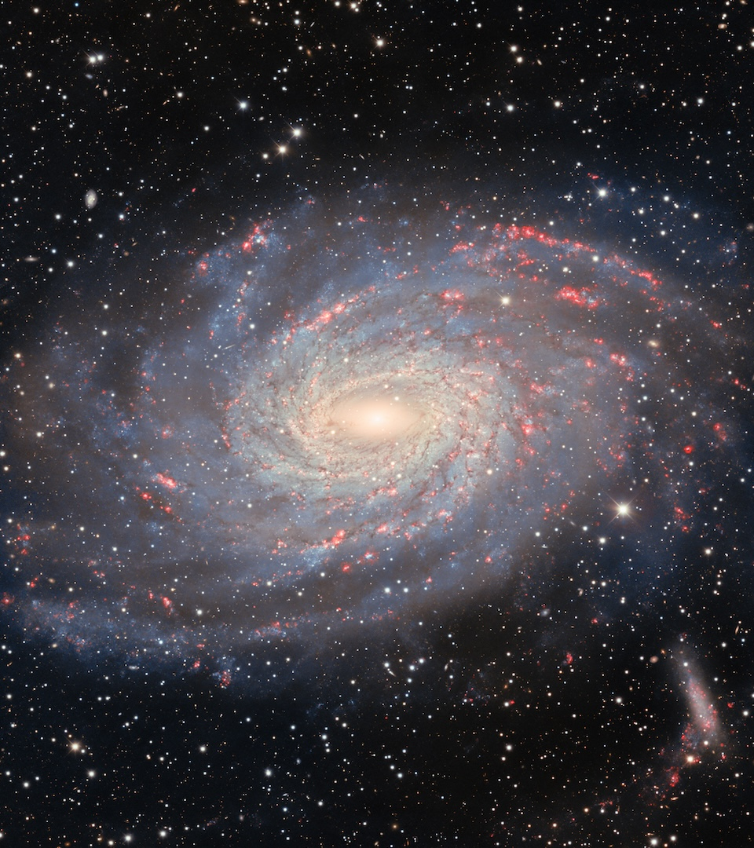
Galactic Measurements

Slide 29
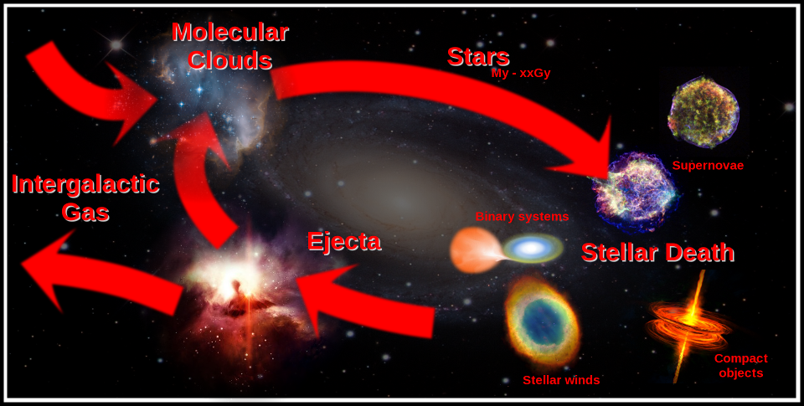
Chemical Enrichment
Galaxies consist of dark matter, stars and gas
As stars age and die, some of their enriched material is returned to the ISM
Inflows of gas from the intergalactic medium (IGM) and outflows into the IGM also affect abundances
Overall, the enrichment of the ISM by stellar processes leads to a steady increase in heavy elements
Generally, observations only give us a snapshot
The baryon cycle in galaxies (credit: Richard Longland)

Slide 30
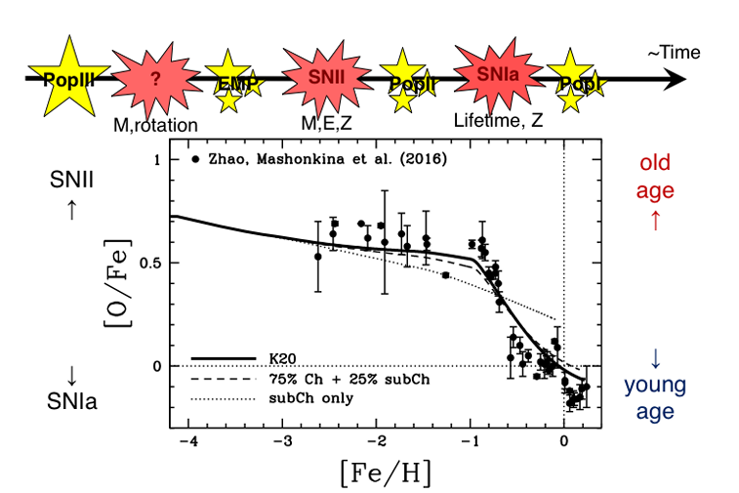
Chemical Evolution
Chemical composition of stars and gas across a galaxy
Usually expressed as [Fe/H], [α/Fe], [X/Fe] or gas-pase 12 + log(O/H)
Different ratios trace different stellar processes. Some are used as a proxy for time evolution
Aims to reconstruct chemical enrichment history of the galaxy
Interpretations are usually made based on stellar model outputs (we will discuss these in more detail tomorrow)
Galactic chemical evolution model compared to Milky Way observational data, comparing different SN Ia models (Kobayashi et al 2020)

Slide 31
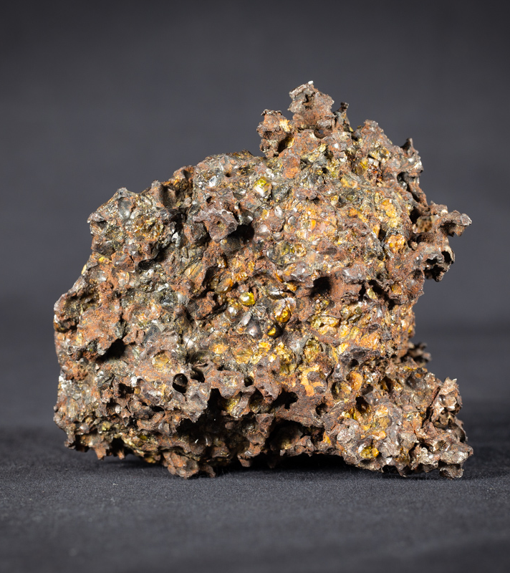
Pre-solar grains

Slide 32
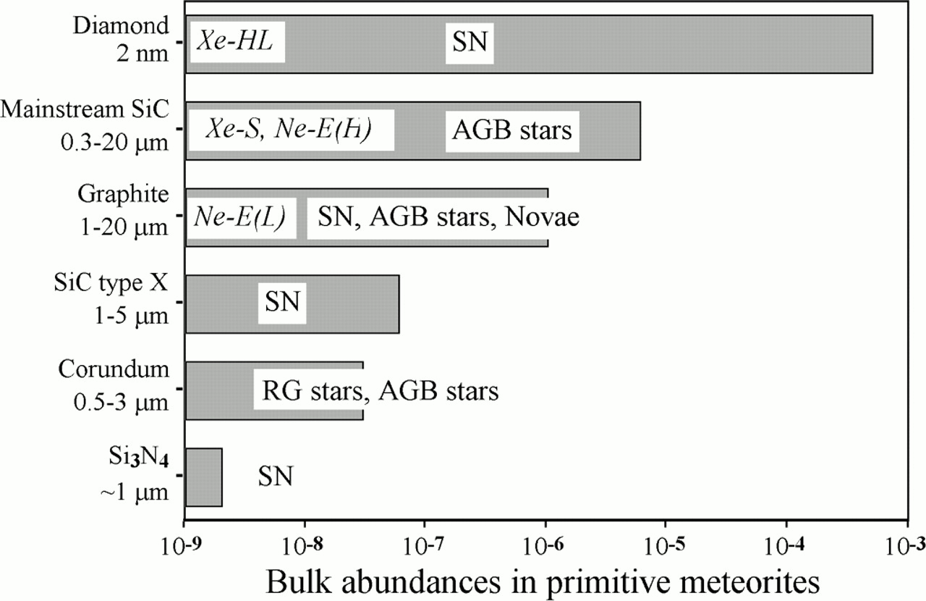
What are pre-solar grains?
Observations of isotopic anomalies (i.e. deviations from average solar system ratios) showed that not all pre-solar material had been vaporized and homogenized
Range of isotopic compositions found in meteoritic grains left little doubt that these grains condensed in stellar outflows and supernova ejecta
SiC and graphite grains contain small grains of TiC, ZrC and MoC (identified in transmission electron microscopes)
Zinner 1998

Slide 33
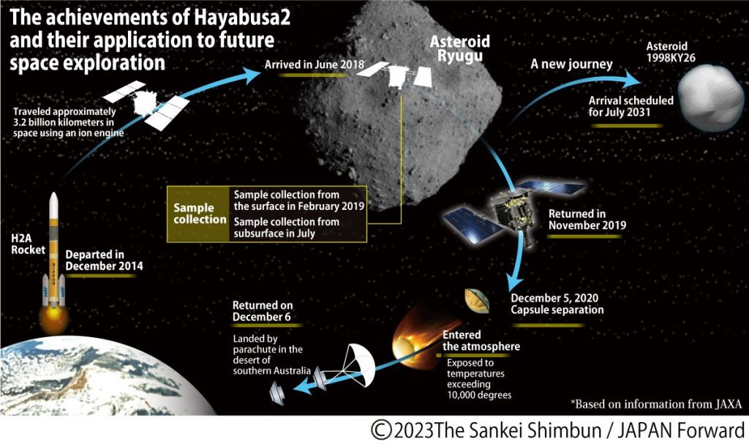
How are grains obtained?
Antarctic and Dessert missions
Meteorite samples
Space missions collected from asteroids or comets

Slide 34
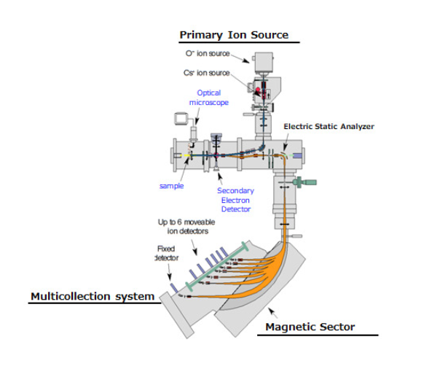
How are they measured?
Grains used to be isolated by acid dissolution (dissolving the meteorites in a sequence of acids and analysing residue. Leaves rhobust phases like SiC and graphites)
These days use in-situ analysis
Mass spectrometry – needs to be able to distinguish individual grains which are micro-scales

Slide 35
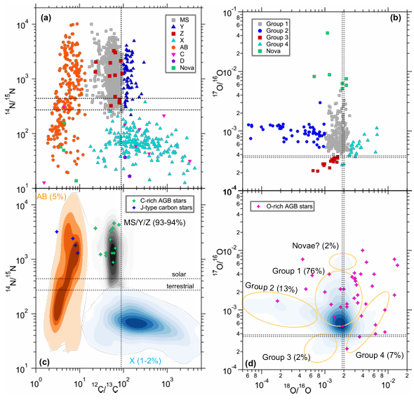

How are they measured?
Measured with mass spectrometry – needs to be able to distinguish individual grains which are micro-scales
Overabundance of select isotopes compared to solar/terrestrial values
Stardust grains have much wider range of values than terrestrial
Each grain from a singular event
Image from Liu 2024 review paper on Presolar Grains

Slide 36

Where do they come from?
Individual grains from astrophysical formation sites (Davis 2011)
Many sites are determined by modelling – inferred from effects of the decay of radio nuclides
Many from core-collapse supernovae and AGB
None unambiguously from type 1a supernova, although they produce 2/3 of all iron

Slide 37


AGB STARS AND THE S-PROCESS
90% of SiC grains have isotopic characteristics suggesting AGB formation channels
Produces ~1/3 of all graphite grains
AGBs produce a lot of carbon and undergoes s-process
Grains are often in agreement with models of AGB s-process and inferred presence of ${}_{}^{99}{Tc}$

Slide 38

Supernova grains
Produces 2/3 of graphite grains and ~2% of SiC, 10% of silicates and oxides
SiC grains expected to come from C-rich regions
Measurements of molybdenum (Mo) likely comes from explosive burning of O-rich layers
Detailed modelling requires multi-D nucleosynthesis including mixing processes. So many processes aren’t fully explained

Slide 39


Summary
Stellar spectroscopy measures atomic absorption or emission transitions
Our interpretation of which elements/isotopes cause features is determined by experimental and theoretical atomic data
Even with good atomic data, lines can be shifted/broadened by physical effects like expansion velocities and magnetic fields
Some radioactive elements can be inferred by their lightcurves and half-lives
Pre-solar grains can provide us with individual stardust grains from single events.

Slide 40
Questions?

Slide 41
Discussion Question
Should we trust model-dependent observations?
What information about nucleosynthesis is fundamentally inaccessible to observation?
What count as decisive evidence that a particular would event produces a particular element? (i.e. what would make you trust a result without experimentation?)

