Slide 1
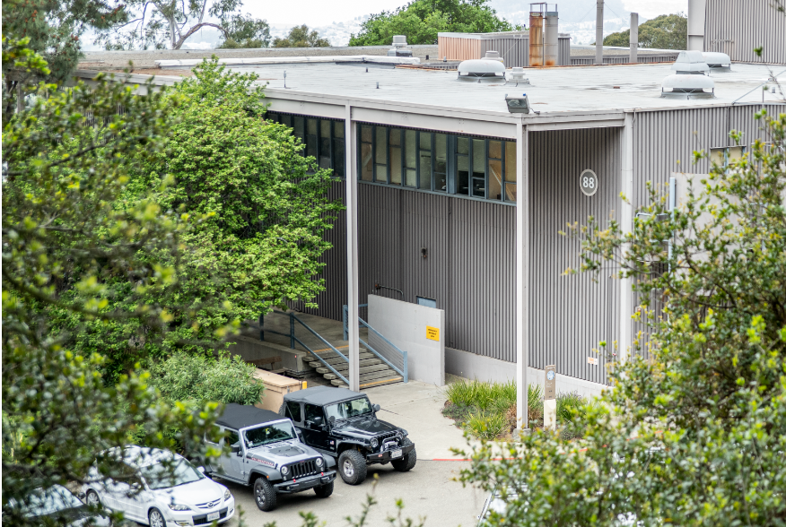
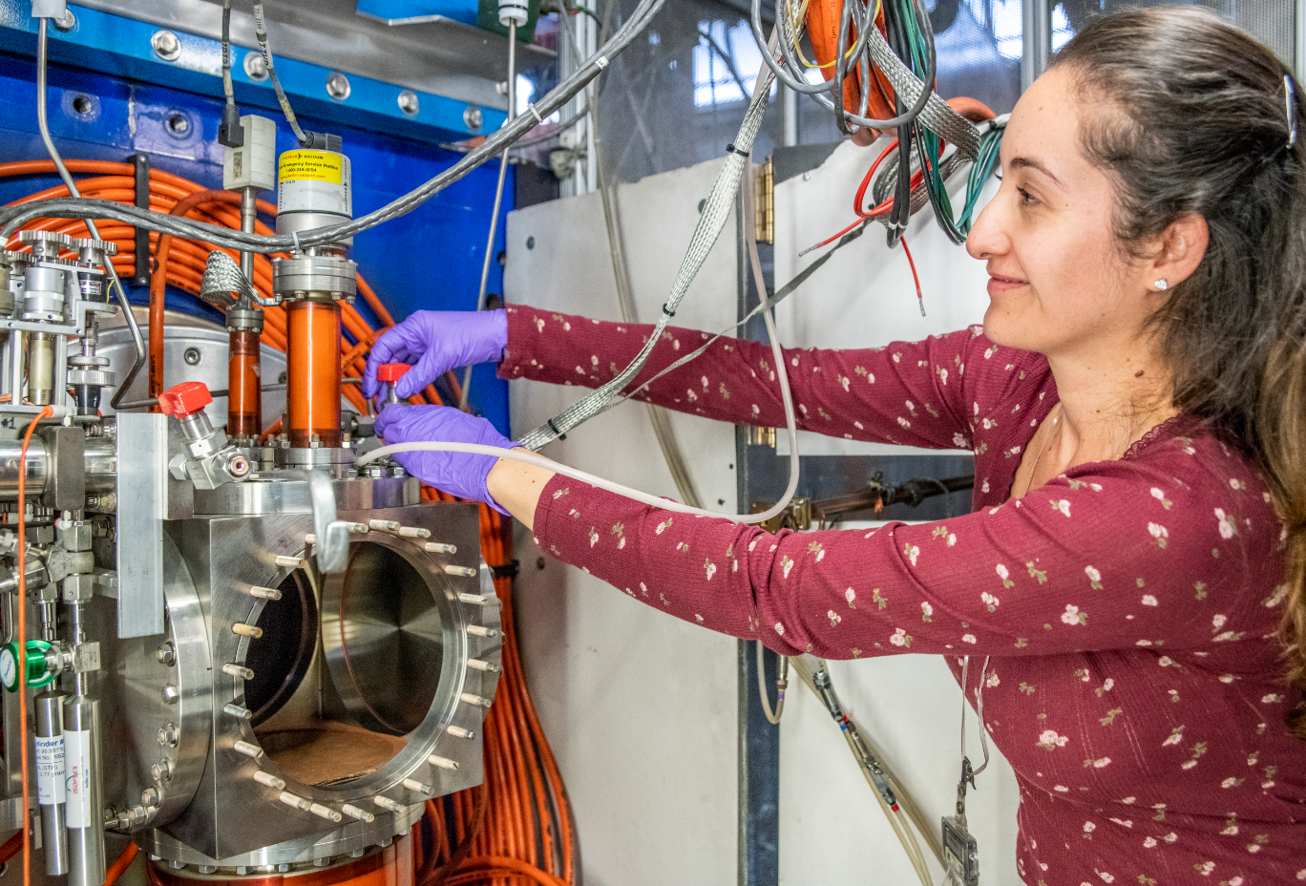
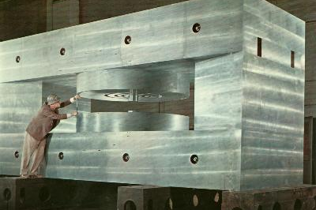
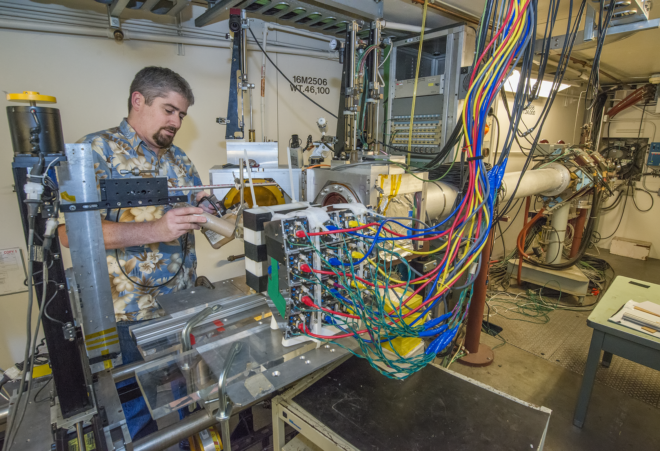


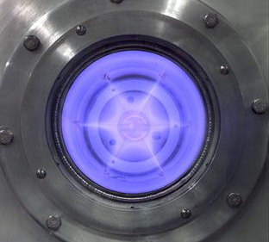
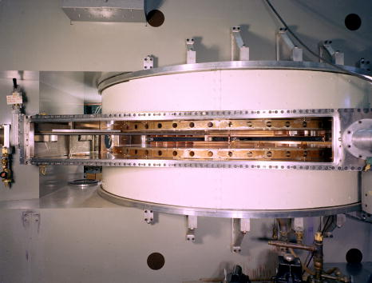
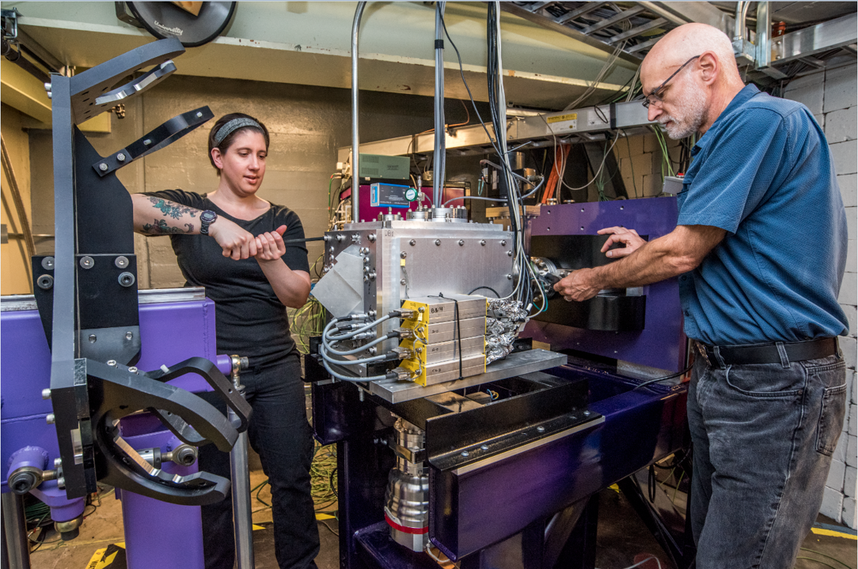
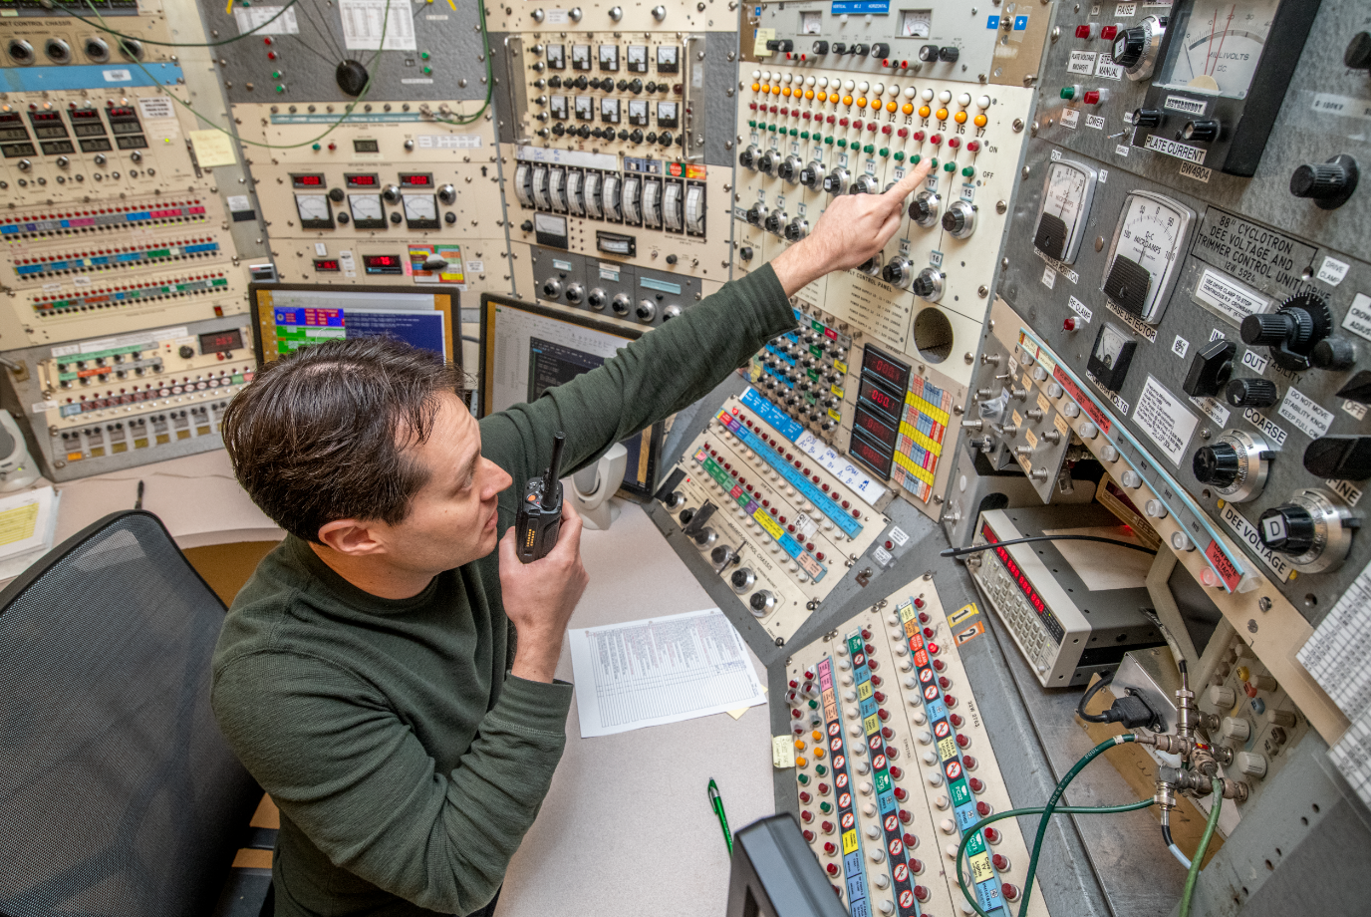
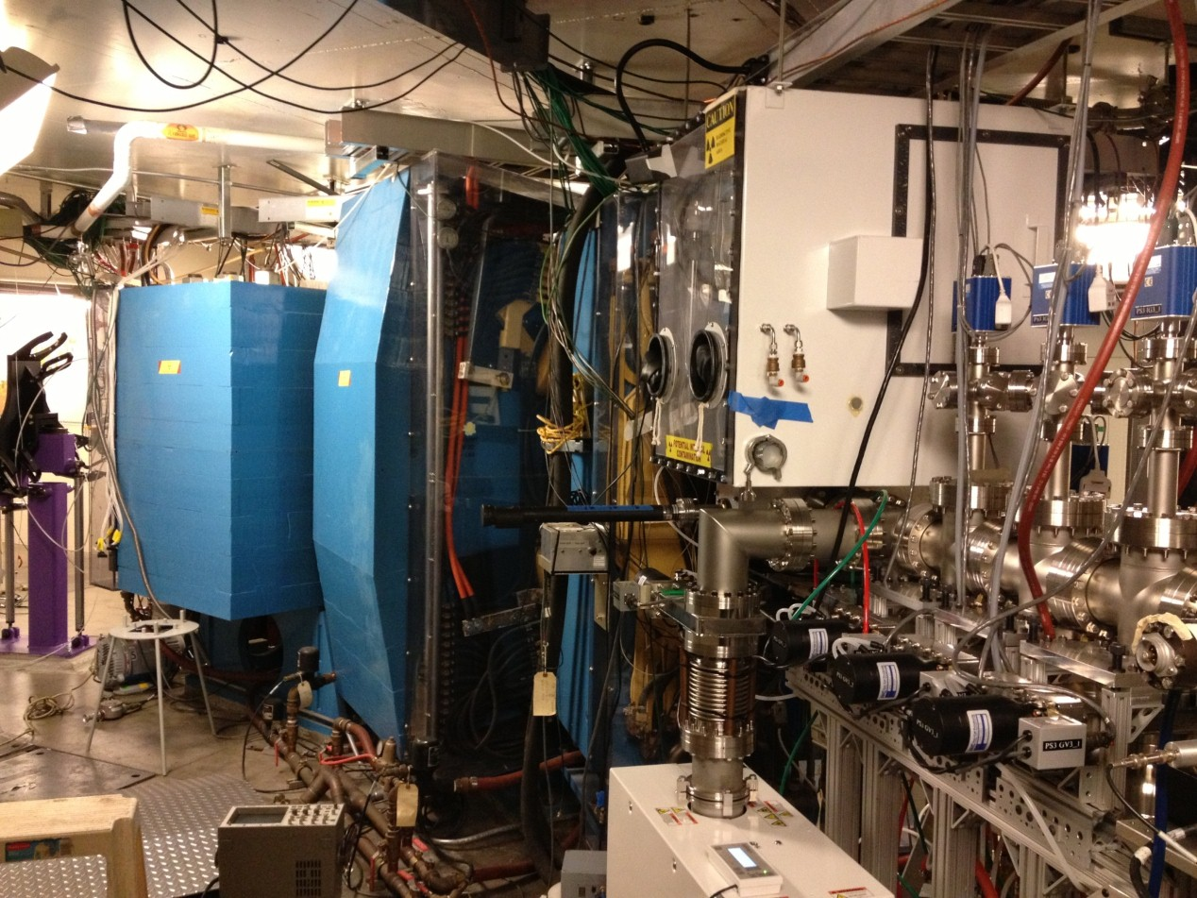
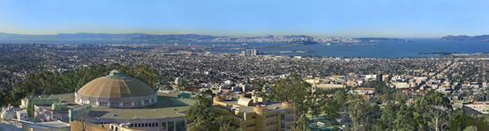
Superheavy Elements: Part 1
Jacklyn Gates
Research Coordinator, 88-Inch Cyclotron
Lawrence Berkeley National Laboratory

Slide 2




Where I am From

Slide 3



Westminster College, New Wilmington, PA
Began by majoring in pre-med/chemistry
Interest: instrumental, analytical and nuclear and solid-state chemistry

Slide 4
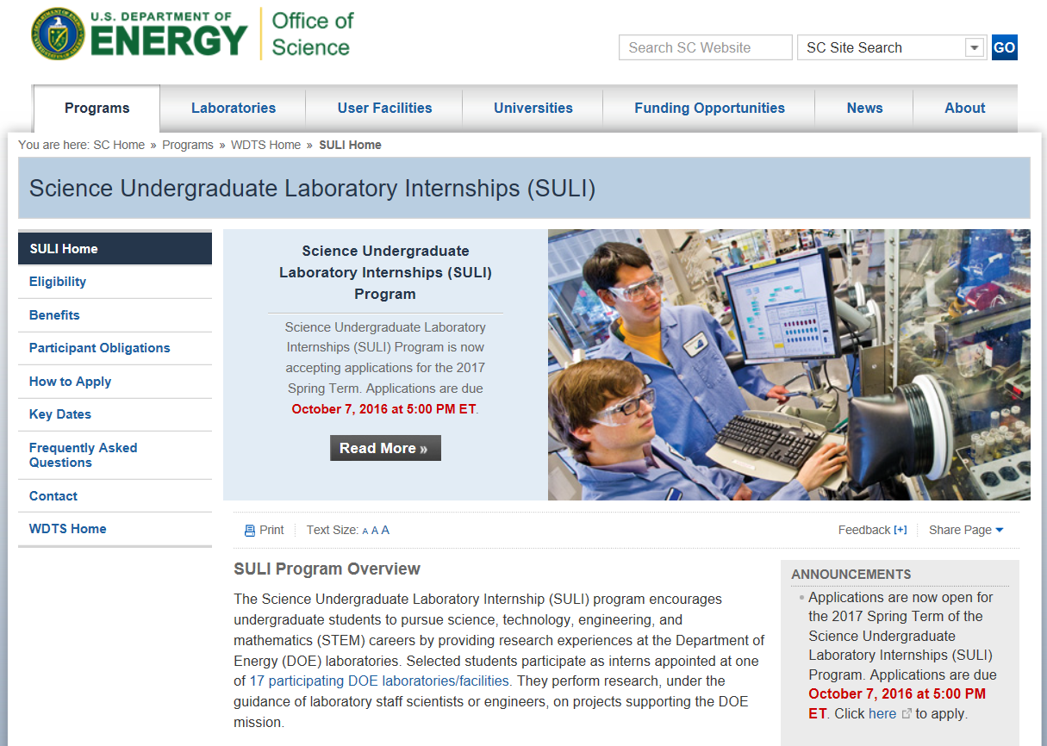
Science Undergraduate Laboratory Internship
10-16 week paid internships at DOE national labs for undergraduate students
Applied in junior year after college Advisor’s recommendation
Areas of interest:
  Materials
  Solid state
  Nuclear

Slide 5
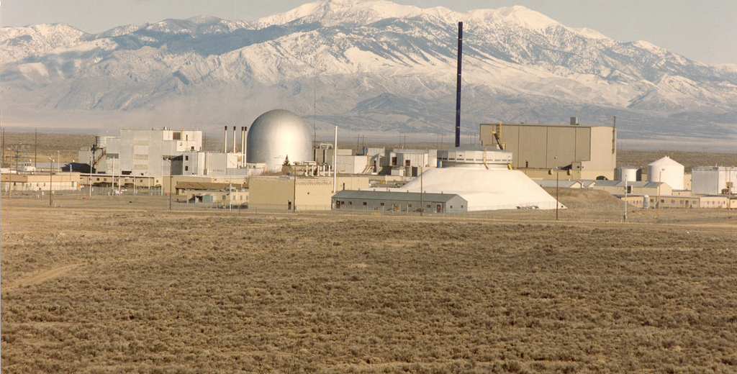

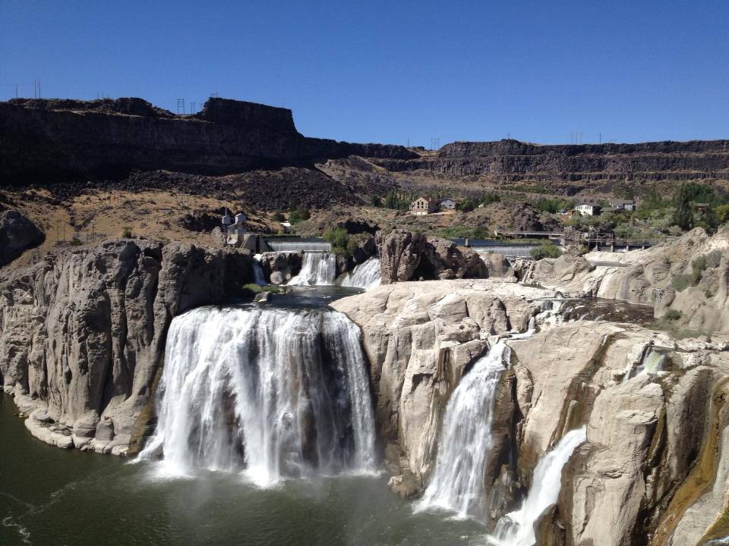
SULI Internship – Argonne National Laboratory West
Spent 12 weeks in Idaho in summers of 2003 and 2004
ANL, West
Idaho Falls, ID

Slide 6
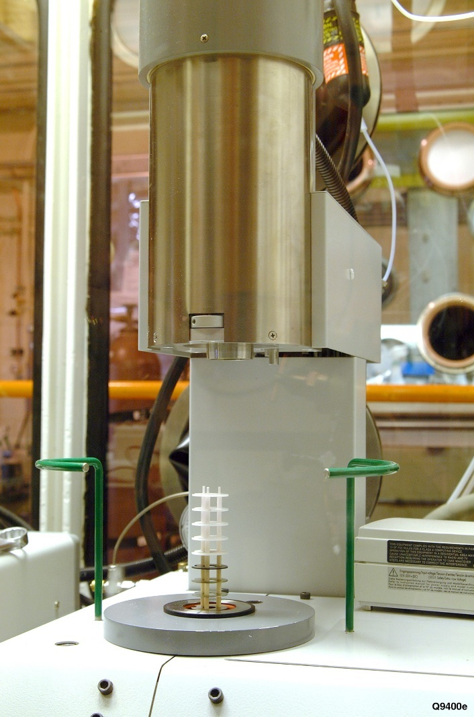
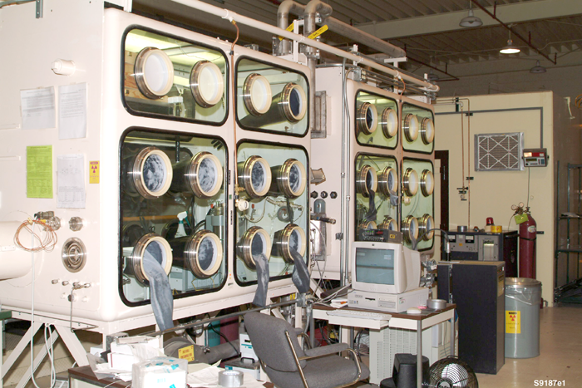
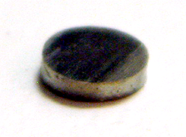
SULI Internship – Argonne National Laboratory West
Goal: study fuel cells for nuclear reactors

Slide 7

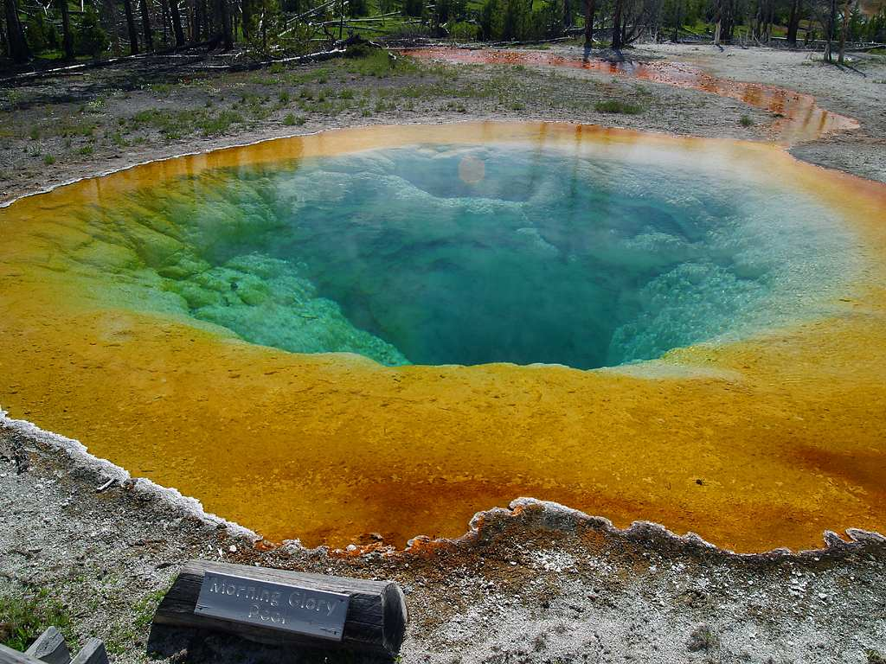

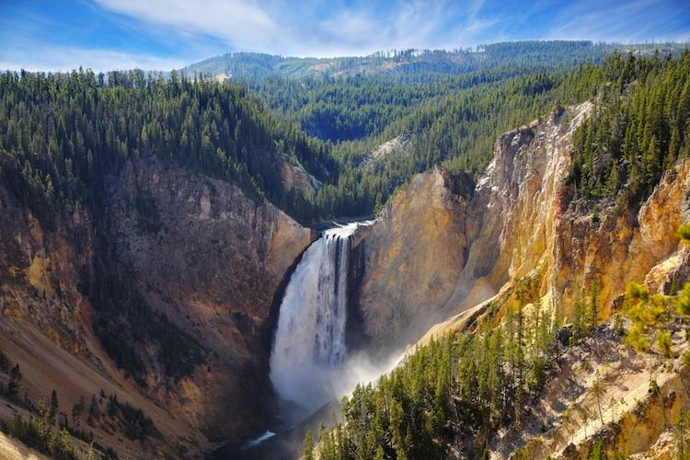
SULI Internship – Argonne National Laboratory West
Craters of the Moon National Park
Yellowstone National Park
Places within 2 hours drive of Idaho Falls, Idaho
Grand Teton National Park

Slide 8


Grad School: UC Berkeley
2004: Moved to Berkeley, CA
Grad school at College of Chemistry, UC Berkeley
University of California, Berkeley
Berkeley, CA

Slide 9

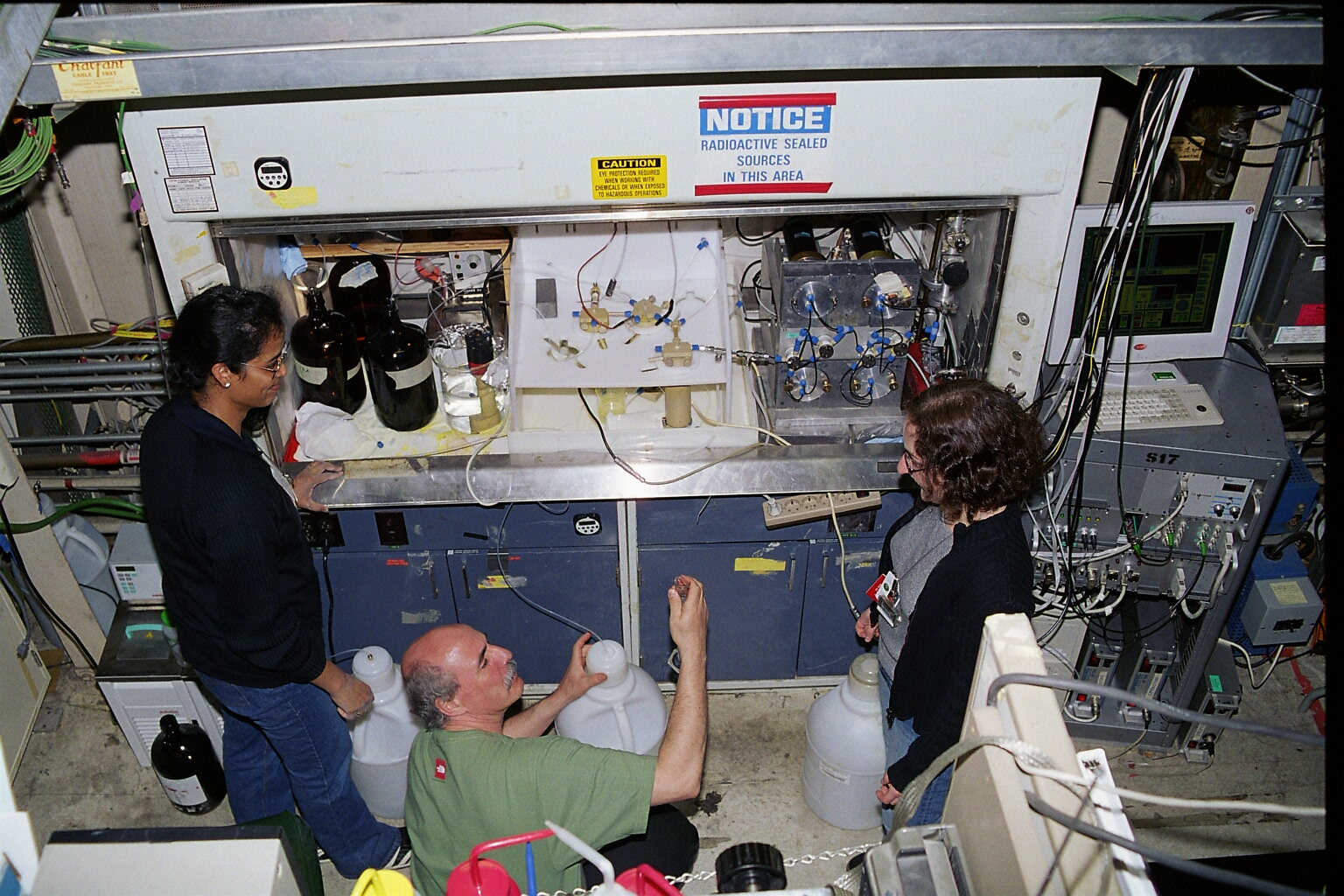
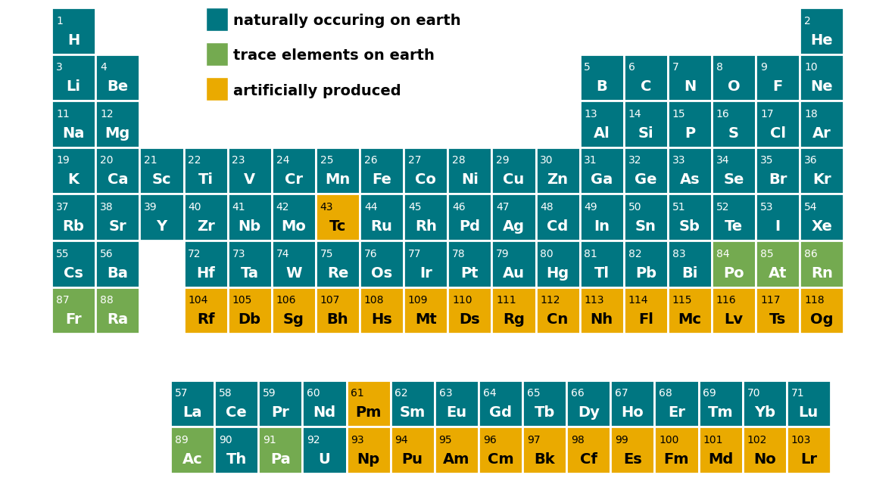

Grad School Doing … Alchemy?

Slide 10

Postdoctoral Research – GSI in Germany

Slide 11
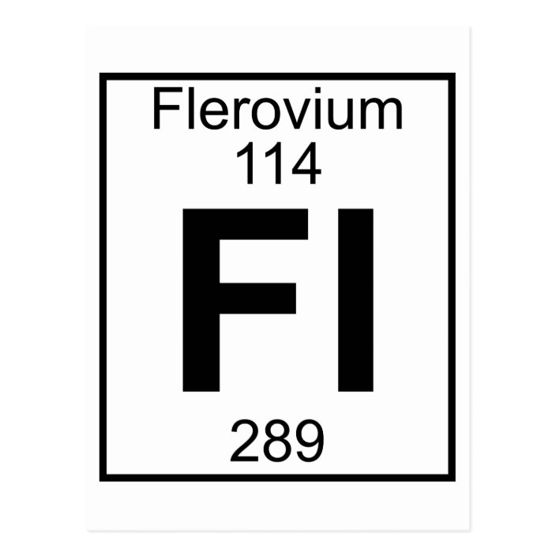
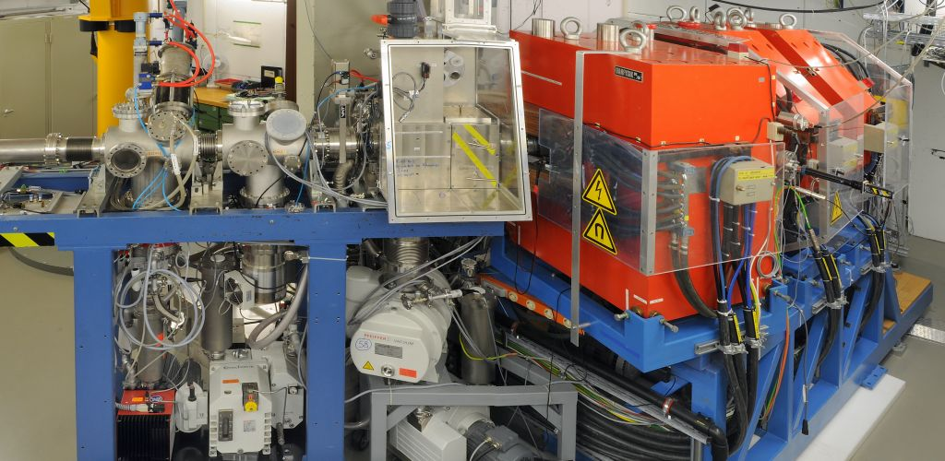
Postdoctoral Research – GSI in Germany

Slide 12
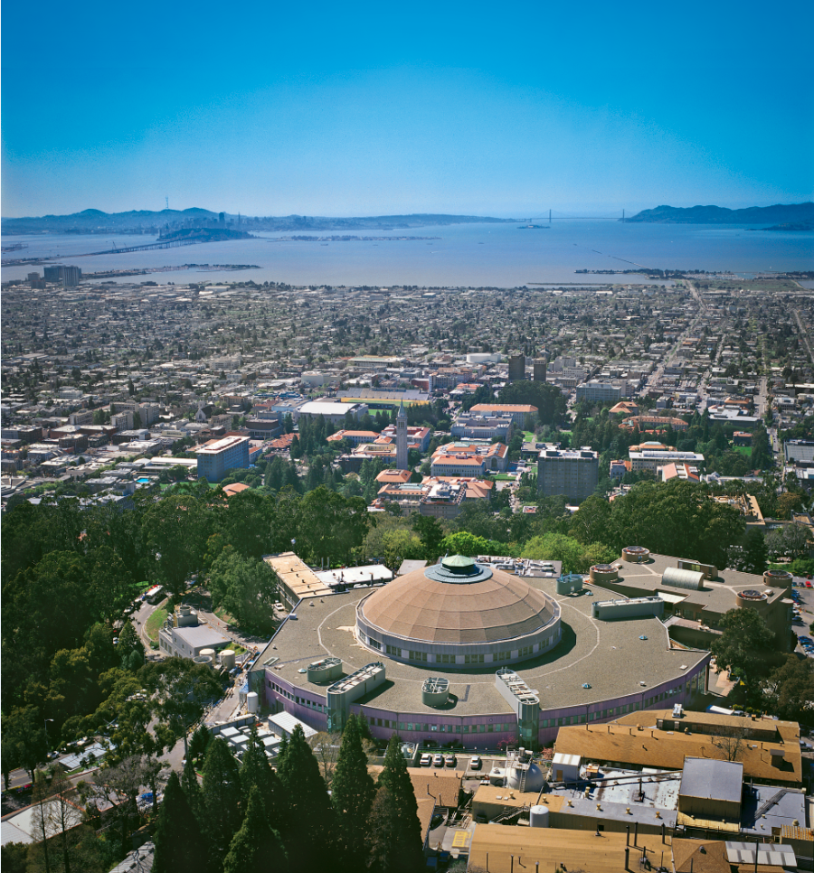
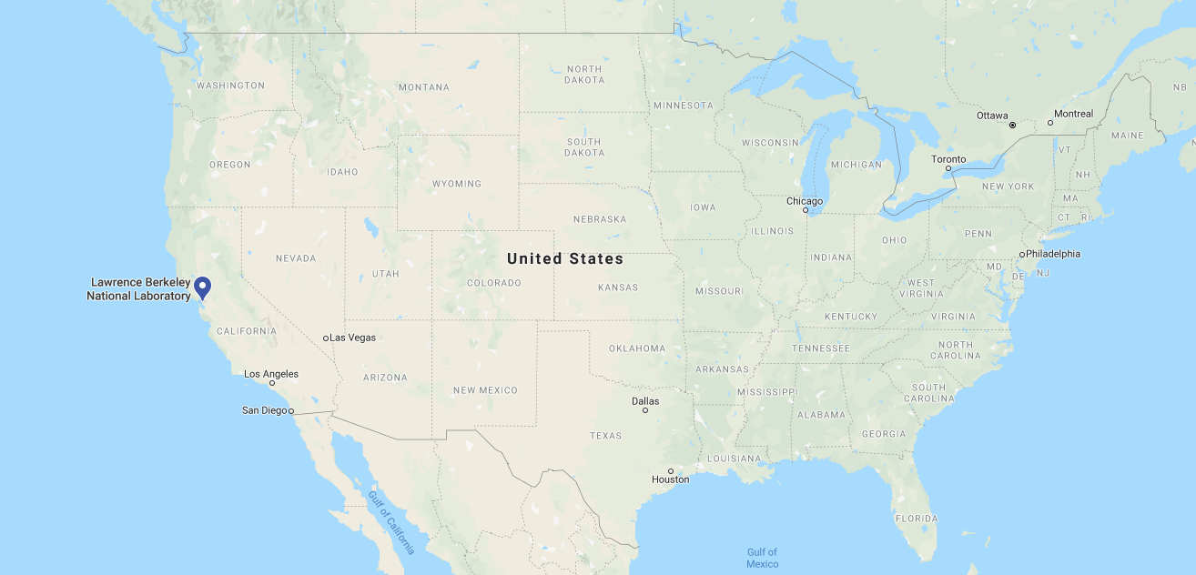

Where I Ended Up

Slide 13

Outline
Lecture 1: Historical Superheavy Elements (SHE)
Introduction to the periodic table
Experimental production of superheavy elements + challenges
Lecture 2: Modern-Day Superheavy Elements
What we can do with just a few atoms

Slide 14
Periodic Table
Question: How many elements are known?

Slide 15
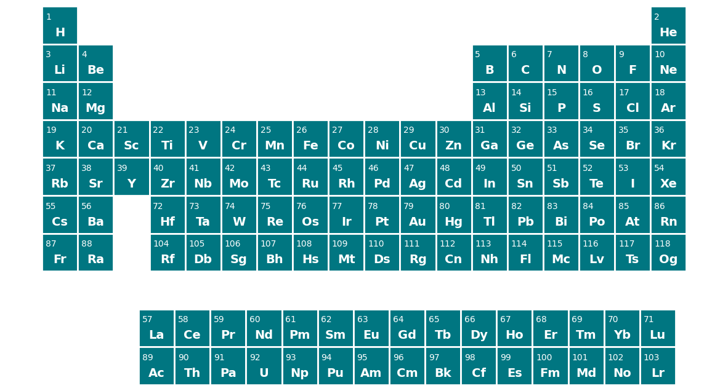
Periodic Table
Question: How many elements (and which ones) are naturally occurring
15

Slide 16
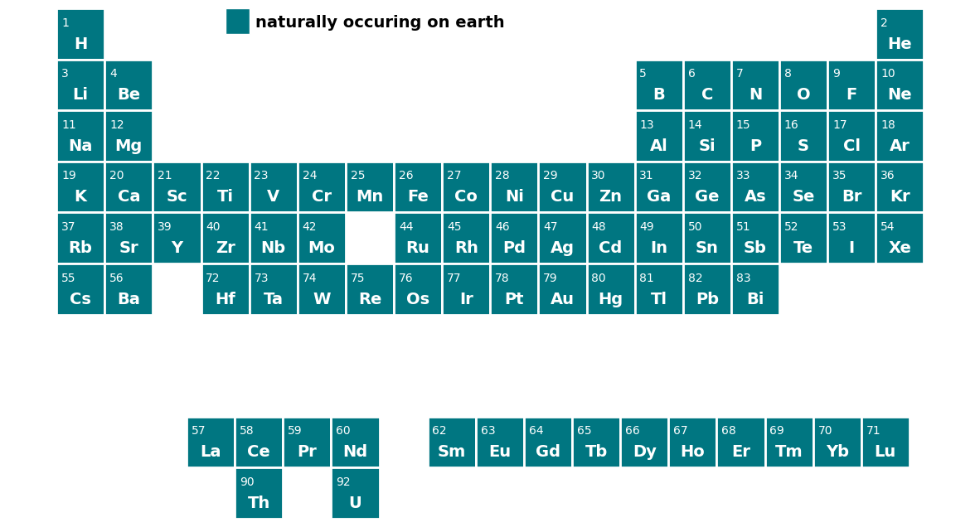
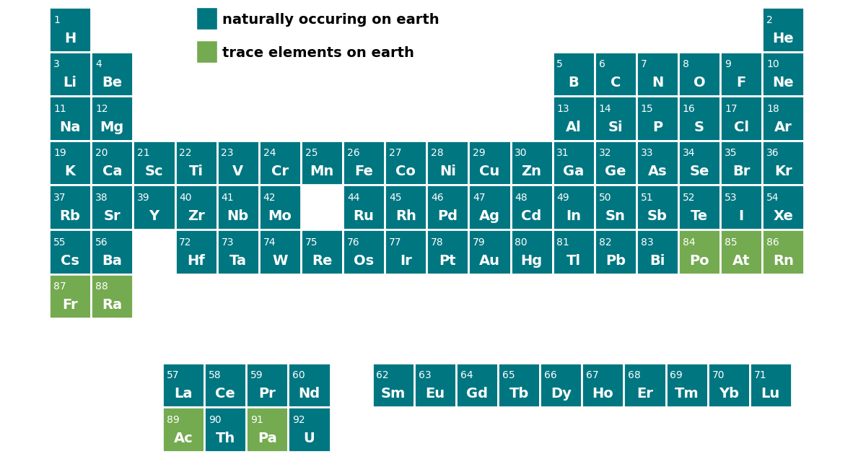
Periodic Table
16

Slide 17
Periodic Table
Question: Which Elements are Superheavy Elements?

Slide 18
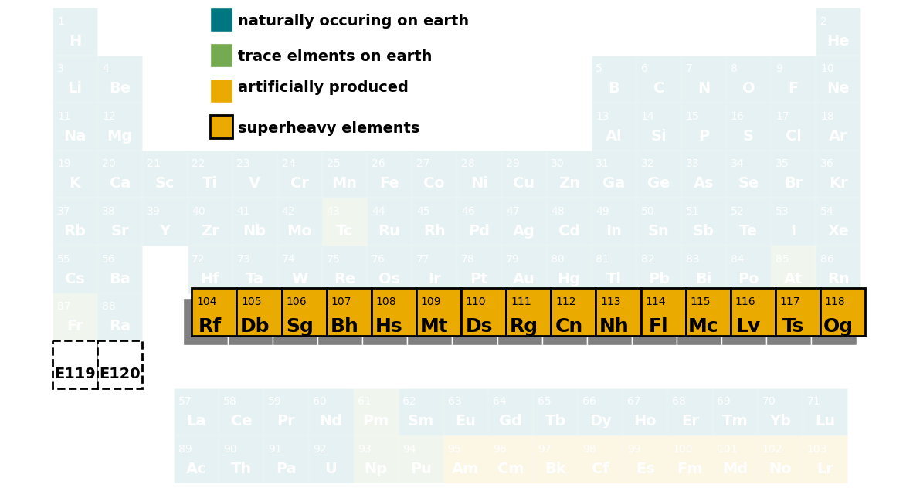
Periodic Table
Superheavy Elements (Z≥104)
Not naturally occurring
Cannot be made in nuclear reactors
Have to be made atom-at-a-time
Very short lived (seconds or less)

Slide 19
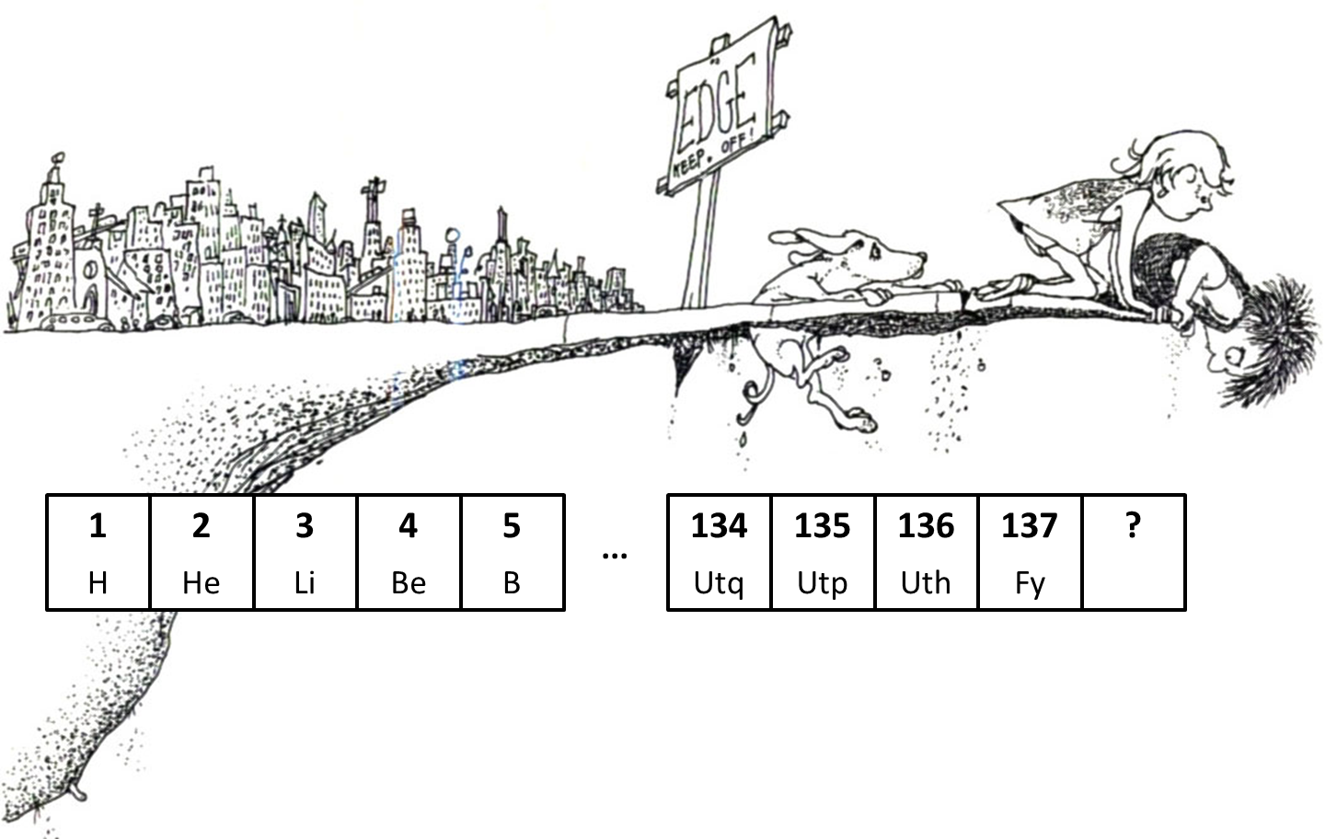
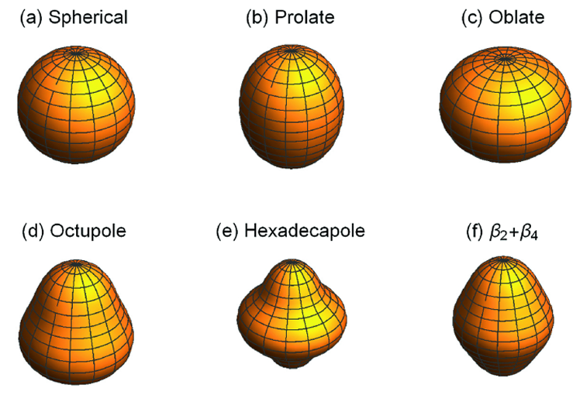
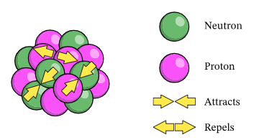
Why Try To Find New Superheavy Elements
Where does the periodic table end?
What shapes are the nuclei?
How do nuclear forces work at the extremes?
Are there stable superheavy elements?
19

Slide 20
Periodic Table
Question: Who Invented the Modern-Day Periodic Table?

Slide 21
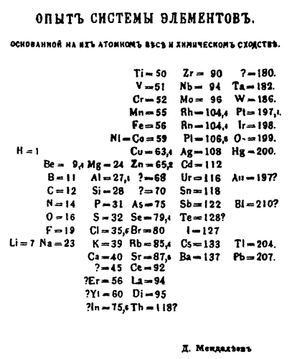
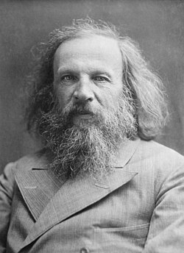
Mendeleev’s Periodic Table from 1869
Question: Why is this the most famous early periodic table?
Mendeleev organized all known elements by their chemical properties
Noticed repeating chemical property trend as masses increased
Orders of some elements are reversed
Left holes and predicted properties of elements to fill those holes
Dmitri Mendeleev

Slide 22

Confirmation of Mendeleev’s Periodic Table
Gallium (eka-Al) discovered in 1975 in zinc blende
Had the mass and density predicted by Mendeleev in 1971
Followed by the discovery of Scandium (eka-B) and Germanium (eka-Si) in 1879 and in 1886

Slide 23
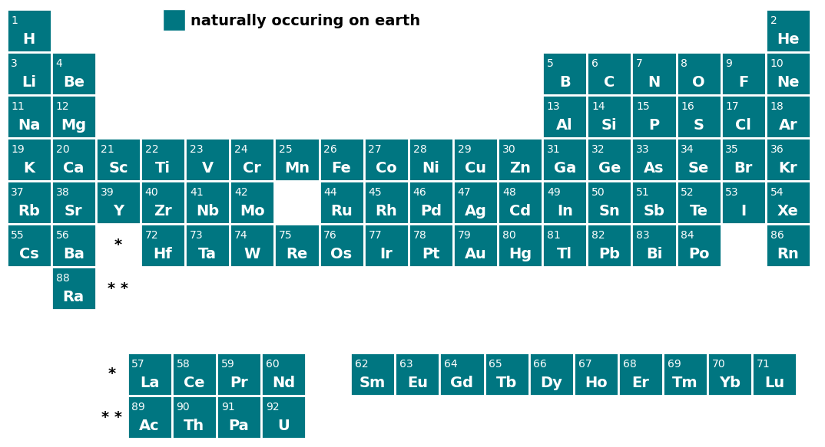
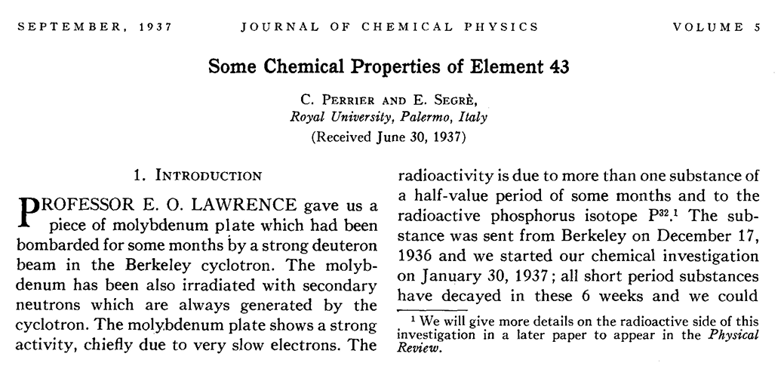

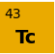
Race Is On: First Discovery of an Artificially Produced Element
23

Slide 24
Periodic Table
New elements being discovered every 3 years!
24

Slide 25
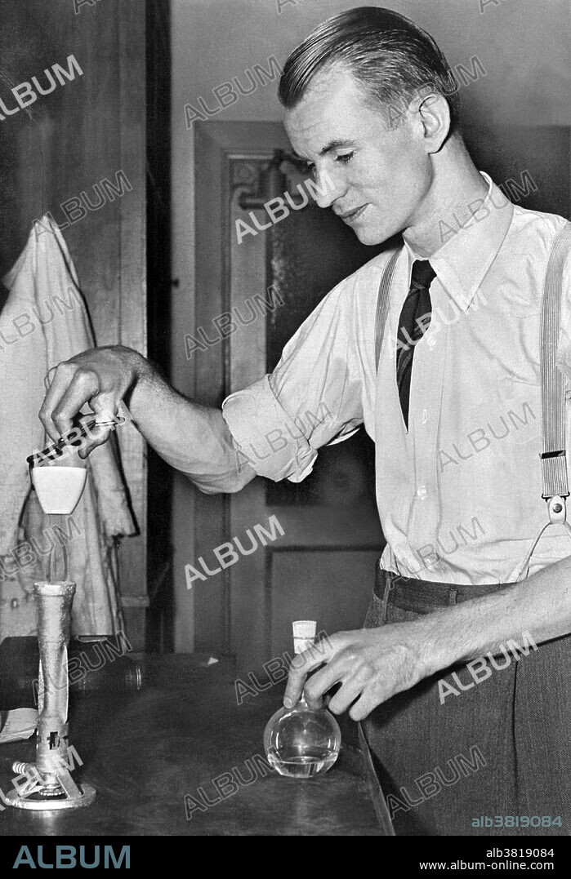
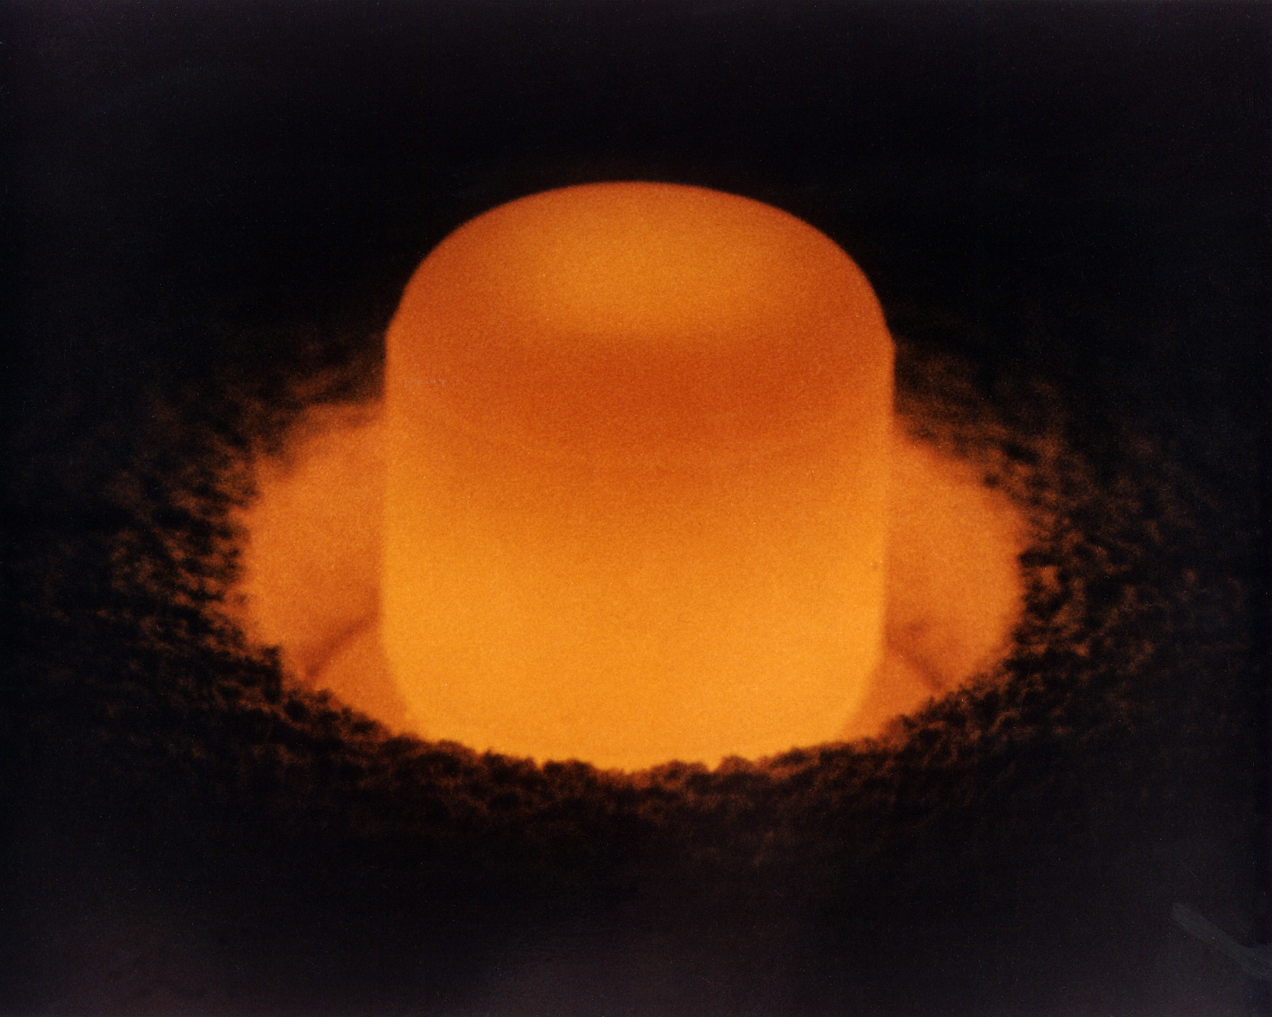
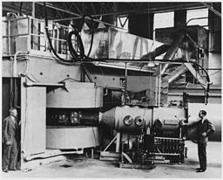
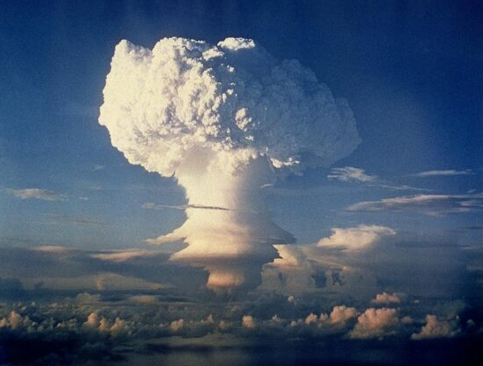
Race Is On: Discovery of Transuranic Elements at Berkeley
Neutrons on U
Neutrons on Pu
Alpha + Pu
Alpha + Am
Alpha + Cm
Fall-out Debris
1940
Discovery of Neptunium and Plutonium
1944
Discovery of Americium
1945
Discovery of Curium
1949
Discovery of Berkelium
1950
Discovery of Californium
1952
Discovery of Einsteinium and Fermium

Slide 26
New Elements Through Chemical Identification
• ‘High’ intensity neutron or alpha beam (100 nA)
• thick targets that cover broad excitation functions
• complicated chemical separation (hours) from high-activity target material
• single irradiation/separation/counting cycle
Detection
System
target
α or neutrons
Beaker
Ion Exchange
Column

Slide 27
Lifetimes of Early Element Discovery
Z= 93 94 95 96 97 98
²³⁹Np
2.4 d
²³⁸Pu
87.7 y
²⁴¹Am
432 y
²⁴²Cm
163 d
²⁴³Bk
4.5 h
²⁴⁵Cf
43.6 m
Z= 99 100
²⁵³Es
3 d
²⁵⁵Fm
20 h

Slide 28
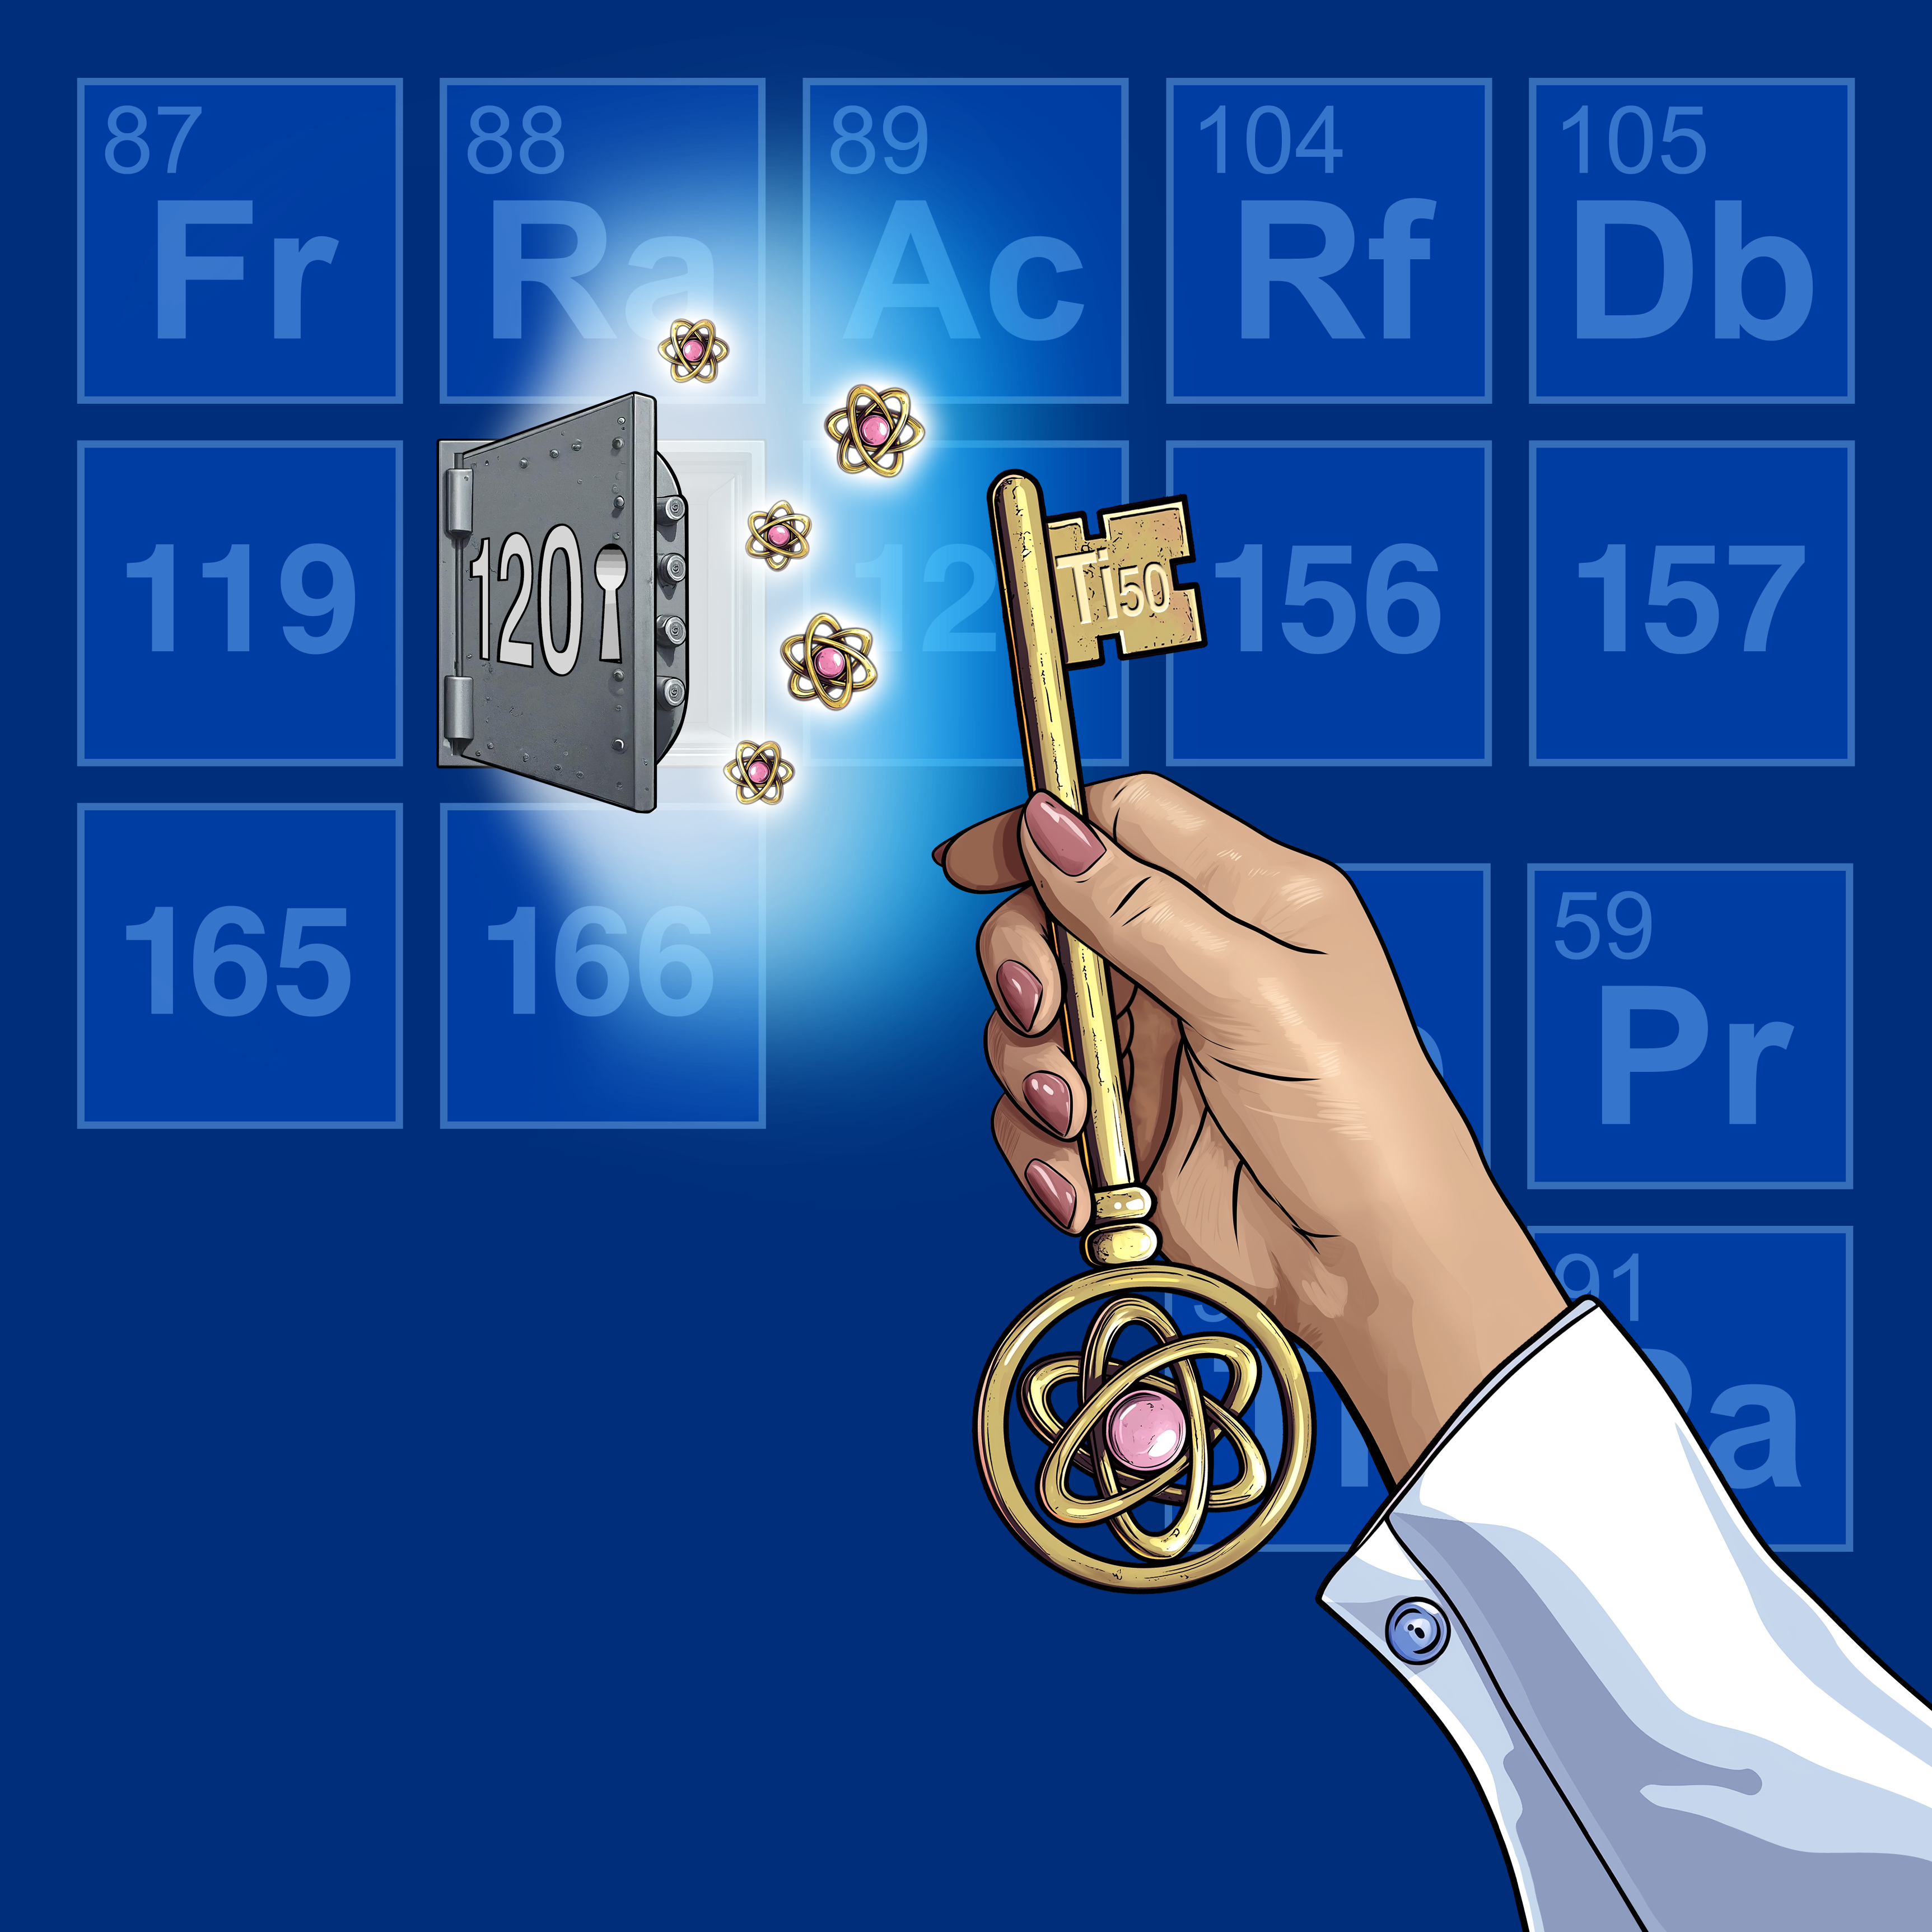
Discovering new elements — cosmic puzzle
Test limits of nuclear stability
Probe the nuclear force and shell effects
Explore the limits of the periodic table
Understand nucleosynthesis and element formation
Fundamental science driving innovation (e.g., detectors, accelerators)

Slide 29
Periodic Table
Question: Where does the periodic table end?
What is the definition of an element?
When can we no longer make something that fits that definition?

Slide 30

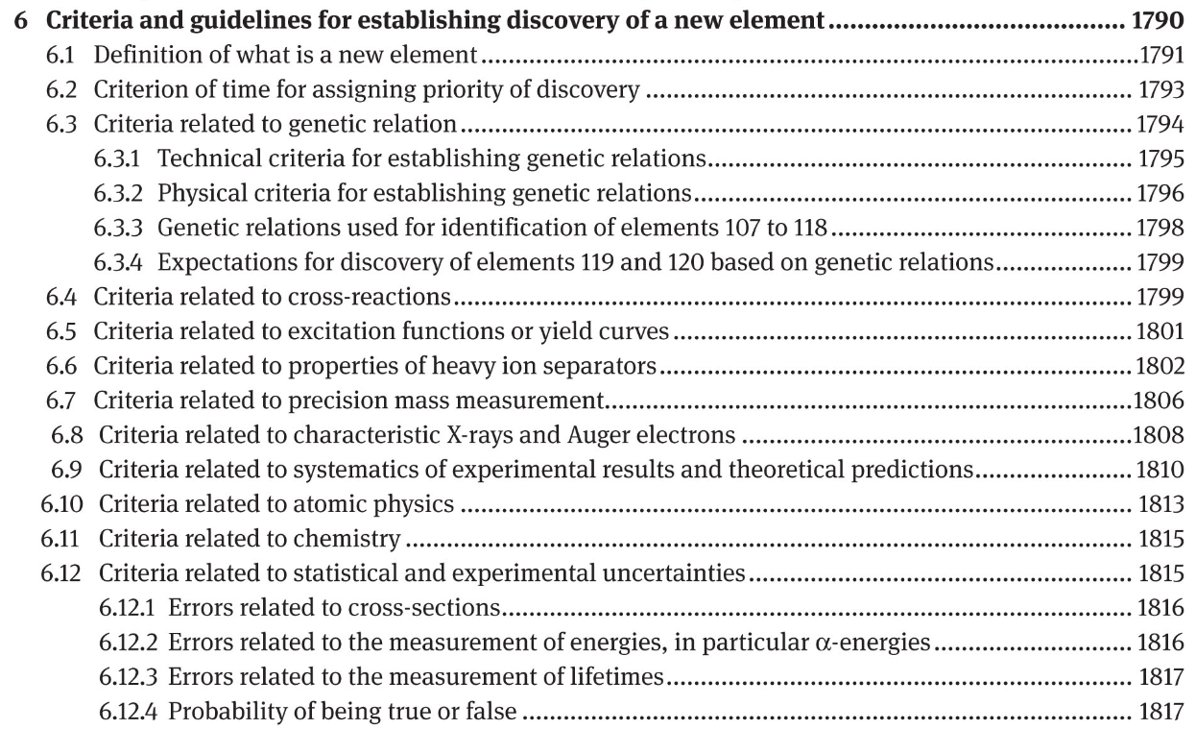
Criteria For Discovery
Joint IUPAC/IUPAP Report from 2018 detailing criteria used to verify claims for discovery of a new element

Slide 31

Criteria For Discovery
‘Discovery of a chemical element is the experimental demonstration, beyond reasonable doubt, of the existence of a nuclide with an atomic number Z not identified before, existing for at least 10⁻¹⁴ s.’
10⁻¹⁴ s ≈ time it takes for a nucleus to acquire its outer electrons + nucleus to de-excite to ground/isomeric state
Discovery can be based on chemical or physical methods or on both.
Do not need to know exact Z
Or the exact A
Notes:
10^-14s excludes shorter living transitional nuclear configurations, compound nuclei and/or nuclear resonances from being called an element, although X-rays or conversion electrons could be emitted from that system

Slide 32
Periodic Table
Question: What is the heaviest nuclide that meets the criteria?

Slide 33

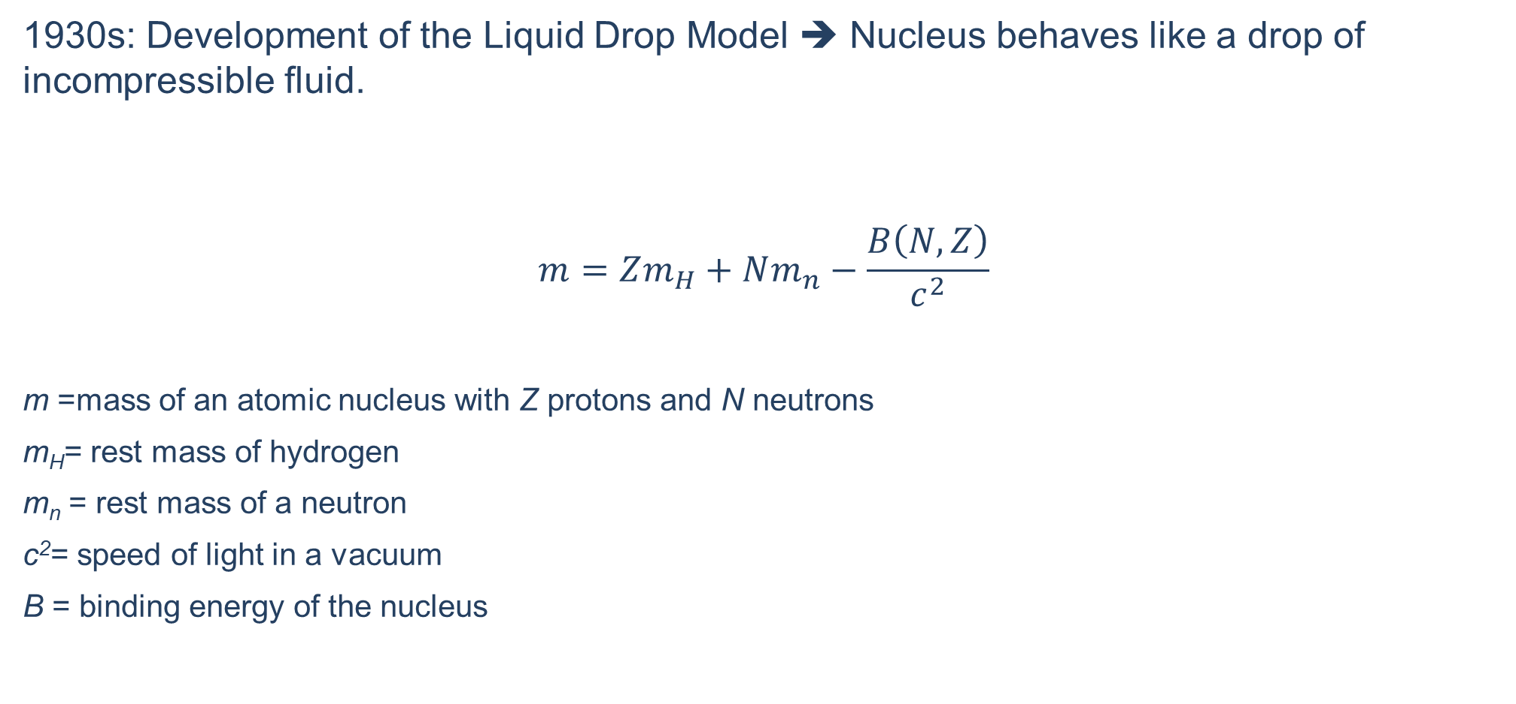
Overview of the Semi-Empirical Mass Model
1930s: Development of the Liquid Drop Model ➔ Nucleus behaves like a drop of incompressible fluid.
$$m=Zm_{H}+Nm_{n}−\frac{B\left(N,Z\right)}{c^{2}}$$
m =mass of an atomic nucleus with Z protons and N neutrons
m_{H}= rest mass of hydrogen
m_{n} = rest mass of a neutron
c²= speed of light in a vacuum
B = binding energy of the nucleus

Slide 34
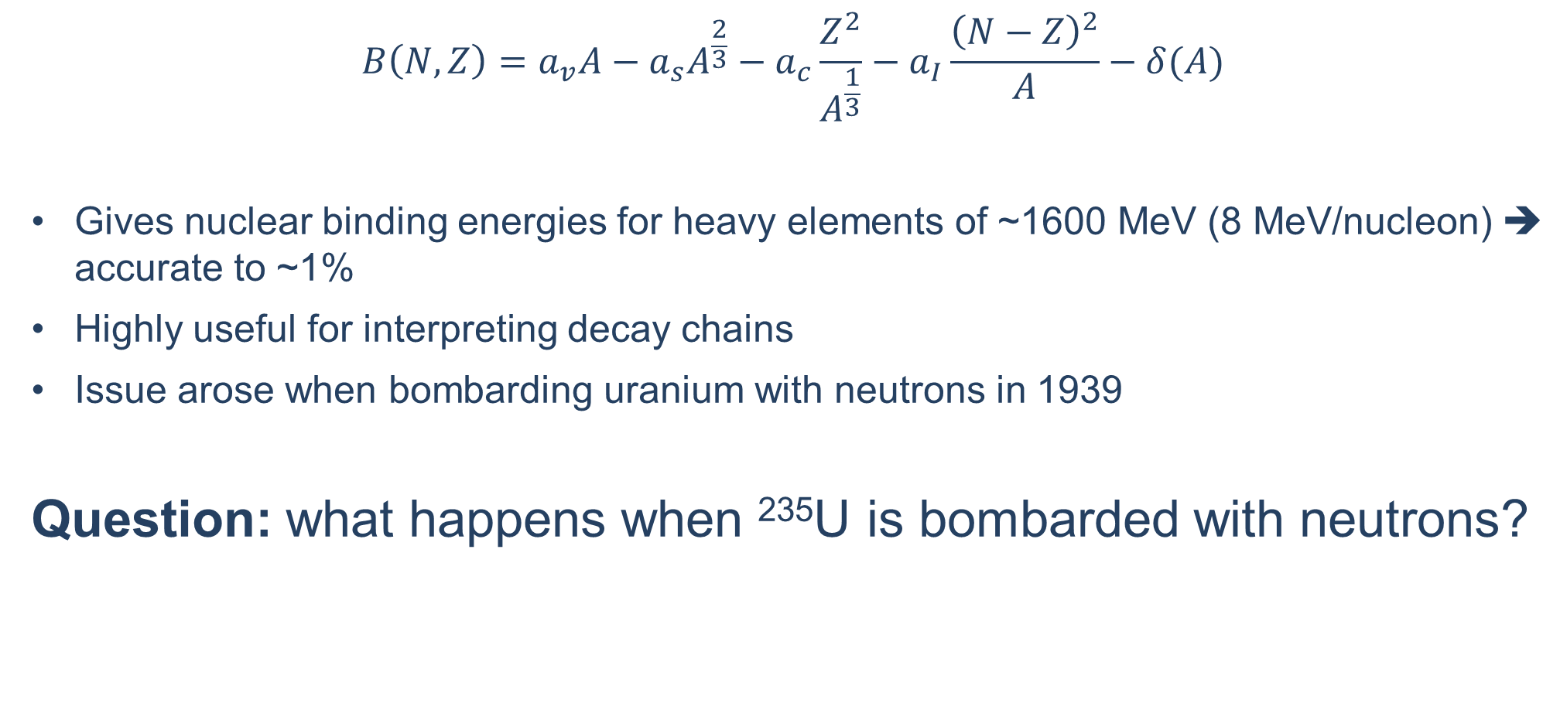
Overview of the Semi-Empirical Mass Model
$$B\left(N,Z\right)=a_{v}A−a_{s}A^{\frac{2}{3}}−a_{c}\frac{Z^{2}}{A^{\frac{1}{3}}}−a_{I}\frac{{\left(N−Z\right)}^{2}}{A}−δ(A)$$
Gives nuclear binding energies for heavy elements of ~1600 MeV (8 MeV/nucleon) ➔ accurate to ~1%
Highly useful for interpreting decay chains
Issue arose when bombarding uranium with neutrons in 1939
Question: what happens when ²³⁵U is bombarded with neutrons?
Weizsäcker, C.F.v., Zur Theorie der Kernmassen. Z. Physik 96, 431–458 (1935). https://doi.org/10.1007/BF01337700
H.A. Bethe and R.F. Bacher, Rev. Mod. Phys. 8, 82 (1936): https://doi.org/10.1103/RevModPhys.8.82.
Notes:
However, in some experiments in which uranium was bombarded with neutrons a confusing number of radioactive decay products, which were difficult to reconcile with properties given by the semi-empirical mass model, were observed. This all was explained when Hahn and Strassmann [4] identified barium in the products following neutron irradiation of uranium and Meitner and Frisch[5] suggested one could think of the nucleus as a deformable charged liquid drop that had split into two smaller nuclei of about equal size in fission.

Slide 35
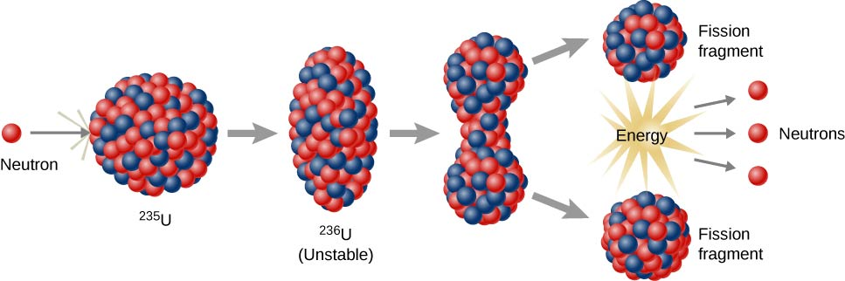
²³⁵U bombarded with Neutrons
Observed confusing decay properties not consistent with the semi-empirical mass model
1939: Hahn and Strassmann identify barium as one of the decay products
1939: Meitner and Frisch suggest fission ➔ think of nucleus as deformable charged liquid drop that can split into two smaller nuclei
O. Hahn and F. Strassmann, Naturwiss. 27, 11 (1939): https://doi.org/10.1007/BF01488241.
L. Meitner and O.R. Frisch, Nature 143, 239 (1939): https://doi.org/10.1038/143471a.

Slide 36
Periodic Table
Question: How heavy can nuclei be before they begin to spontaneously fission?

Slide 37
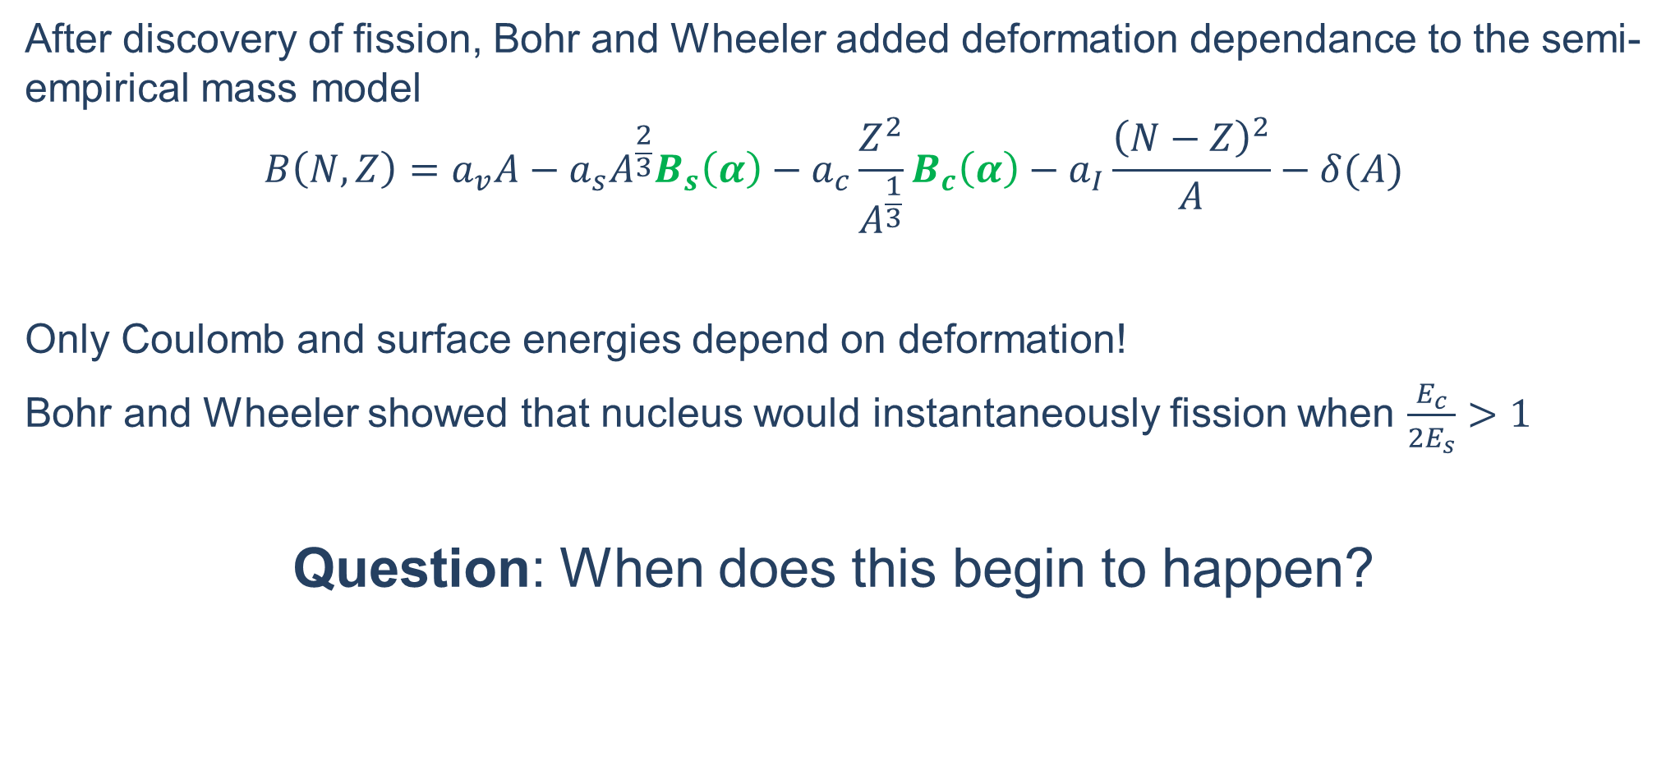
Liquid Drop Model: When nuclei begin to fission
After discovery of fission, Bohr and Wheeler added deformation dependance to the semi-empirical mass model
$$B\left(N,Z\right)=a_{v}A−a_{s}A^{\frac{2}{3}}B_{s}\left(α\right)−a_{c}\frac{Z^{2}}{A^{\frac{1}{3}}}B_{c}\left(α\right)−a_{I}\frac{{\left(N−Z\right)}^{2}}{A}−δ(A)$$
Only Coulomb and surface energies depend on deformation!
Bohr and Wheeler showed that nucleus would instantaneously fission when $\frac{E_{c}}{2E_{s}}>1$
Question: When does this begin to happen?
N. Bohr and J.A. Wheeler, Phys. Rev. 56, 426 (1939), https://doi.org/10.1103/PhysRev.56.426.

Slide 38
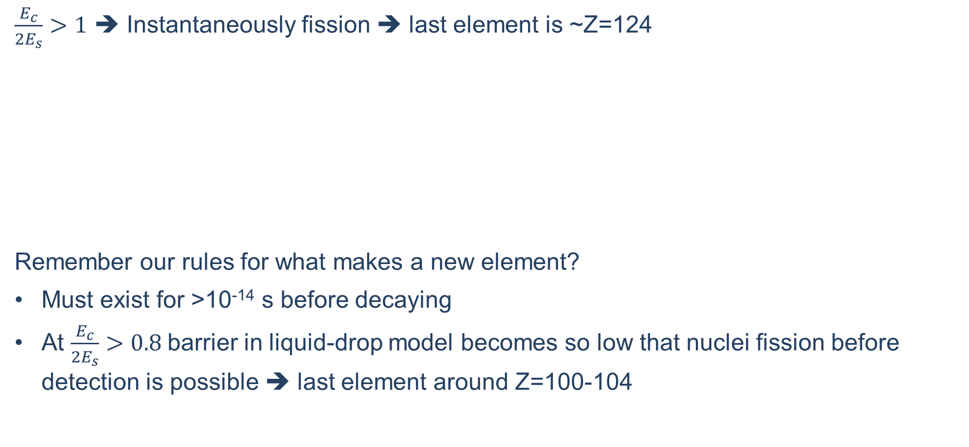
Liquid Drop Model: When nuclei begin to fission
$\frac{E_{c}}{2E_{s}}>1$ ➔ Instantaneously fission ➔ last element is ~Z=124
Remember our rules for what makes a new element?
Must exist for >10⁻¹⁴ s before decaying
At $\frac{E_{c}}{2E_{s}}>0.8$barrier in liquid-drop model becomes so low that nuclei fission before detection is possible ➔ last element around Z=100-104
Z | 50 | 82 | 100 | 102 | 114 | 124 | 130
A | 124 | 208 | 252 | 254 | 288 | 306 | 335
E_{c}/2E_{s} | 0.40 | 0.65 | 0.79 | 0.82 | 0.90 | 1.00 | 1.01

Slide 39
Periodic Table
Question: Why Do We Have Elements Beyond What is Predicted by the Liquid-Drop Model?

Slide 40
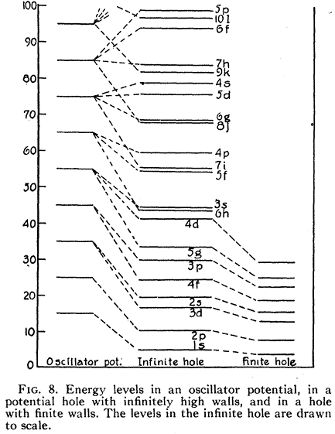
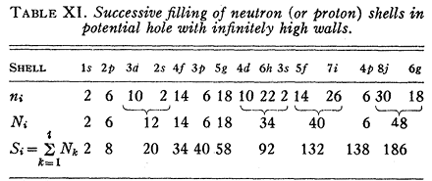
First Evidence for Nuclear Shells
1930’s: Eugene Wigner suggested certain numbers of nucleons (protons and neutrons) correspond to particularly stable configurations
1936: Bethe and Bacher noted that in an oscillator potential there are large gaps in the corresponding single-particle level spectrum
Investigated to see if there were unusually large deviations between their theory and measured masses at Z=20 and N=20 (⁴⁰Ca)
H.A. Bethe and R.F. Bacher, Rev. Mod. Phys. 8, 82 (1936): https://doi.org/10.1103/RevModPhys.8.82.

Slide 41
The Case for Closed Shells
1948: Maria Goeppert Mayer makes the case for magic numbers beyond 20
Isotopic abundance
Number of isotones
Number of stable odd-Z isotopes
    Most neutron numbers have one odd Z isotone
    Exception are N=20, N=50 and N=82
Similar arguments used to justify magic numbers of:
Z=20, Z=50, Z=82, and N=126
Number of stable isotopes, energy of radioactive decay, abundances, neutron absorption cross sections, location of delayed neutron emitters
Arguments for N=50, 82 being magic numbers
Mayer, Phys. Rev. 74 (1948) 235: https://doi.org/10.1103/PhysRev.74.235
Notes:
1a) For elements with even Z, the relative abundance of a single isotope is not greater than 60%, with Z>40, relative abundances greater than 35% are not encountered. Exceptions are
1b) isotopic abundance is not symmetrically distributed around the center, but the light, neutron-poor isotopes have low abundances. The concentration of the lightest isotope is, as a rule, less than 2%. Exceptions are in table 2

Slide 42
Are There Closed Shells Beyond Z=82 and N=126?

Slide 43

Island-of-Stability: Conceptualization
G. Sharff-Goldhaber: Nucleonics 15, 122 (1957)

Slide 44
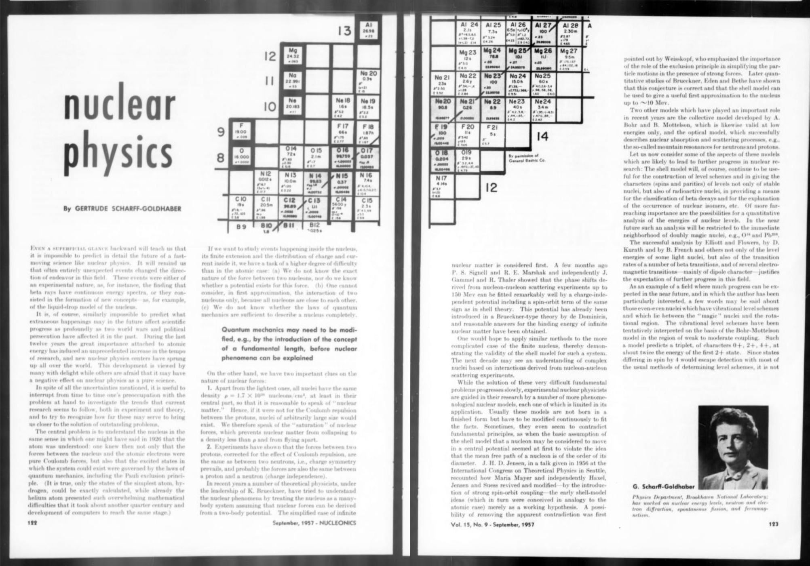
Island-of-Stability: Conceptualization
G. Sharff-Goldhaber:
Nucleonics 15, 122 (1957)

Slide 45
Radioactive nuclei will be found further away from the stability region, owing to the use of heavier bombarding particles and faster detection methods. The study of the binding energies of nuclei of this type may throw further light on the nature of nucleon-nucleon forces. Also, the number of known elements will certainly be increased.
Relatively long-lived isotopes may well be found among the far-transuranic nuclides because of magic-number stability.
There may be, for instance, another region of relative stability at the doubly magic nucleus ₁₂₆X³¹⁰ (the closing of the j neutron shell).
45

Slide 46



Chart of the Nuclides
$${}_{1}^{1}H$$
$${}_{1}^{2}H$$
$${}_{1}^{3}H$$
N
N 10
N 11
N 12
N 13
N 14
N 15
N 16
N 17
N 18
N 19
N 20
N 21
N 22
N 23
C
C 8
C 9
C 10
C 11
C 12
C 13
C 14
C 15
C 16
C 17
C 18
C 19
C 20
C 21
C 22
B
B 7
B 8
B 9
B 10
B 11
B 12
B 13
B 14
B 15
B 16
B 17
B 18
B 19
B 20
B 20
Be
Be 6
Be 7
Be 8
Be 9
Be 10
Be 11
Be 12
Be 13
Be 14
Be 15
Be 16
Li
Li 4
Li 5
Li 6
Li 7
Li 8
Li 9
Li 10
Li 11
Li 12
Li 13
Proton Number
He 5
He 7
He
He 3
He 4
He 5
He 6
He 7
He 8
He 9
He 10
H 3
H 4
H 5
H 6
H 7
H
H 1
H 2
H 4
H 5
H 6
H 7
0
1
2
3
4
5
6
7
Neutron Number

Slide 47


Chart of the Nuclides
Proton Number
Neutron Number
47

Slide 48


Chart of the Nuclides: 2025
Decay Mode
Spontaneous Fission
Electron Capture or b⁺
Alpha
b⁻
Milliseconds to days
Days to years
Z →
Years to centuries or longer
N →
48

Slide 49
How do We Make Superheavy Elements?

Slide 50

Three techniques for making elements
Sequential neutron capture and beta decay
Oldest (and natural) methods for production of new elements

Slide 51
Making Transactinides: Problems Arise
²⁵⁵No
²⁵⁶No
²⁵⁷No
²⁵⁸No
²⁵⁹No
²⁶⁰No
²⁶²No
Fermium gap
Fm isotopes SF or a decay
Impedes formation of nuclei with Z>100 in nuclear reactors
Nuclear and supernova explosions have higher neutron fluences ➔ gap may be bypassed in nature
²⁵⁴Md
28 m
²⁵⁵Md
27 m
²⁵⁶Md
77 m
²⁵⁷Md
5.5 h
²⁵⁸Md
51 d
²⁵⁹Md
95 m
²⁶⁰Md
32 d
²⁵³Fm
²⁵⁴Fm
²⁵⁵Fm
²⁵⁶Fm
²⁵⁷Fm
100 d
²⁵⁸Fm
0.4 ms
²⁵⁹Fm
1.5 s
n, g
n, g
²⁵²Es
²⁵³Es
²⁵⁴Es
²⁵⁵Es
²⁵⁶Es
²⁵⁷Es
Decay Mode
a
b⁻
b⁺
SF
n, g
n, g
n, g
²⁵¹Cf
²⁵²Cf
²⁵³Cf
²⁵⁵Cf
²⁵⁵Cf
²⁵⁶Cf
Z
n, g
N

Slide 52
Three techniques for making elements
Sequential neutron capture and beta decay
Oldest (and natural) methods for production of new elements
Compound Nucleus Reactions
Add two nuclei together!
Multi-nucleon Transfer Reactions

Slide 53
How to Make New Elements
Ca (Z=20)
Cm (Z=96)
Lv (E=116)
Combine Nuclei of Two Lighter Elements

Slide 54
What are some challenges with combining nuclei?

Slide 55




Challenge 1: Atoms are Tiny
Seconds since the big bang
4.3 x 10¹⁷
Stars in the Observable Universe
10²⁴
Atoms in my body
~7 x 10²⁷
~7 000 000 000 000 000 000 000 000 000
Grains of Sand on Earth
7.5 x 10¹⁸
55

Slide 56


Challenge 2: Nuclei are even smaller
Nucleus
56

Slide 57
Challenge 3: Nuclei Repel Each Other
Ca (Z=20)
Cm (Z=94)
Lv (E=116)
Force~3500 N or ~300 MeV
S
N
N
S
Repel
Human Lifting Heavy Object ~500 N

Slide 58


Slide 59

Challenge 4: Even Superheavy Atoms are Tiny
If you make it, how do you find and study it?
Mole = 6x10²³ atoms
Millimole = 6x10²⁰ atoms
Nanomole = 6x10¹⁴ = 600 000 000 000 000
Superheavy element chemistry = <10 atoms

Slide 60

Challenge 5: They Don’t Last Long
All elements heavier than Lead decay into lighter elements…eventually
10 atoms/hr
~4 s
1 atom/week
~0.5 s
1 atom/day
~1 s
1 atom/week
~0.001 s
1 atom/min
~5 s
10 atoms/s
~55 s

Slide 61

Challenge 5: They Don’t Last Long
All elements heavier than Lead decay into lighter elements…eventually
He
Spontaneous Fission
Alpha Decay

Slide 62

Challenge 6: Not All Beam Energies Work
How fast the beam is going matters!
Too slow ➔ don’t overcome positive charge repulsion
Too fast ➔ break everything apart
Just right ➔ chance to make elements
Beam just right
Beam too fast
Beam too slow

Slide 63
How do we overcome these challenges?

Slide 64

How to Make Elements
Ion Source
Accelerator
Target
0.1 c
Separate
Detect

Slide 65

Places capable of producing the heaviest elements
4
5
3
2
1
7
6
Berkeley, CA, USA
Lemont, IL, USA
Darmstadt, Germany
Jyväskylä, Finland
Dubna, Russia
Tokyo, Japan
Lanzhou, China
65

Slide 66
Step 1: Accelerate
How do you accelerate atoms to 10% the speed of light?

Slide 67




Step 1: Accelerate – Turn Atoms into Ions
VENUS Ion source
Can output 8-12 trillion ions/second

Slide 68







Step 1: Accelerate
Charged particle acceleration in gap
-
+
-
+
$$+E_{kin}$$
$$+E_{kin}$$
$$+E_{kin}$$
$$E_{kin}=qV$$
88-Inch Cyclotron
$$r=mv/qB$$

Slide 69

Step 2: Bombard Targets
Example target: ²⁴⁴Pu ≈ 0.22 um Pu or ~2000 atoms
Material electroplated or vapor deposited on Ti (1-2 um), Al (1-2 um) or carbon (50-100 mg/cm²) thick-foils
Beam
Ti
Pu
~12 cm

Slide 70
How to Make Superheavy Elements
Is this sufficient for making a superheavy element?

Slide 71
What’s ‘Really’ Going On in the Process?

Slide 72

Compound Nucleus Reactions: Theory
$$σ_{EVR}\left(E_{c.m.}\right)=\sum_{J}{σ_{cap}\left(E_{c.m},J\right)P_{CN}\left(E_{c.m},J\right)W_{sur}\left(E_{c.m},J\right)}$$
Fusion by Diffusion
Fusion = (sticking) x ( diffusion) x (survival)
Capture
Fusion
Survival
Production cross section

Slide 73

Compound Nucleus Reactions: Theory
$$σ_{EVR}\left(E_{c.m.}\right)=\sum_{J}{σ_{cap}\left(E_{c.m},J\right)P_{CN}\left(E_{c.m},J\right)W_{sur}\left(E_{c.m},J\right)}$$
Capture
Step 1: Capture ➔ Probability to overcome coulomb barrier
T
P
T
P
T
P
Bau, XJ: Front. Phys., 28 (2020): https://doi.org/10.3389/fphy.2020.00014
Zagrebaev, VI: Nucl. Phys. A, 944 (2015), 257: https://doi.org/10.1016/j.nuclphysa.2015.02.010
Cap, T: Euro. Phys. J. A, 58 (2022) 231: https://doi.org/10.1140/epja/s10050-022-00891-8

Slide 74

Compound Nucleus Reactions: Theory
$$σ_{EVR}\left(E_{c.m.}\right)=\sum_{J}{σ_{cap}\left(E_{c.m},J\right)P_{CN}\left(E_{c.m},J\right)W_{sur}\left(E_{c.m},J\right)}$$
Capture
Step 1: Capture ➔ Probability to overcome coulomb barrier
Probability of overcoming coulomb barrier increases with increasing energy
Bau, XJ: Front. Phys., 28 (2020): https://doi.org/10.3389/fphy.2020.00014
Zagrebaev, VI: Nucl. Phys. A, 944 (2015), 257: https://doi.org/10.1016/j.nuclphysa.2015.02.010
Cap, T: Euro. Phys. J. A, 58 (2022) 231: https://doi.org/10.1140/epja/s10050-022-00891-8

Slide 75

Compound Nucleus Reactions: Theory
$$σ_{EVR}\left(E_{c.m.}\right)=\sum_{J}{σ_{cap}\left(E_{c.m},J\right)P_{CN}\left(E_{c.m},J\right)W_{sur}\left(E_{c.m},J\right)}$$
Fusion
Step 2: Compound Nucleus Formation ➔ Probability of two (nearly) touching spheres to fuse
T
CN*
P
Bau, XJ: Front. Phys., 28 (2020): https://doi.org/10.3389/fphy.2020.00014
Zagrebaev, VI: Nucl. Phys. A, 944 (2015), 257: https://doi.org/10.1016/j.nuclphysa.2015.02.010
Cap, T: Euro. Phys. J. A, 58 (2022) 231: https://doi.org/10.1140/epja/s10050-022-00891-8

Slide 76
Compound Nucleus Reactions: Theory
$$σ_{EVR}\left(E_{c.m.}\right)=\sum_{J}{σ_{cap}\left(E_{c.m},J\right)P_{CN}\left(E_{c.m},J\right)W_{sur}\left(E_{c.m},J\right)}$$
Fusion
Step 2: Compound Nucleus Formation ➔ Probability of two (nearly) touching spheres to fuse
Competes with quasifission ➔ two nuclei transfer a few protons/neutrons between them, then break apart
qf₁
qf₂
T
P
CN*
Bau, XJ: Front. Phys., 28 (2020): https://doi.org/10.3389/fphy.2020.00014
Zagrebaev, VI: Nucl. Phys. A, 944 (2015), 257: https://doi.org/10.1016/j.nuclphysa.2015.02.010
Cap, T: Euro. Phys. J. A, 58 (2022) 231: https://doi.org/10.1140/epja/s10050-022-00891-8

Slide 77

Compound Nucleus Reactions: Theory
$$σ_{EVR}\left(E_{c.m.}\right)=\sum_{J}{σ_{cap}\left(E_{c.m},J\right)P_{CN}\left(E_{c.m},J\right)W_{sur}\left(E_{c.m},J\right)}$$
Fusion
Step 2: Compound Nucleus Formation ➔ Probability of two (nearly) touching spheres to fuse
Probability depends on angular momentum and energy
Bau, XJ: Front. Phys., 28 (2020): https://doi.org/10.3389/fphy.2020.00014
Zagrebaev, VI: Nucl. Phys. A, 944 (2015), 257: https://doi.org/10.1016/j.nuclphysa.2015.02.010
Cap, T: Euro. Phys. J. A, 58 (2022) 231: https://doi.org/10.1140/epja/s10050-022-00891-8

Slide 78

Compound Nucleus Reactions: Theory
$$σ_{EVR}\left(E_{c.m.}\right)=\sum_{J}{σ_{cap}\left(E_{c.m},J\right)P_{CN}\left(E_{c.m},J\right)W_{sur}\left(E_{c.m},J\right)}$$
Survival
Step 3: Survival ➔ Deexcitation via neutron and gamma emission
Competes with fission of the compound nucleus (much more common)
Nucleus may have to emit 1-6 neutrons ➔ competition with fission at each step
ff₁
ff₂
CN*
CN
Bau, XJ: Front. Phys., 28 (2020): https://doi.org/10.3389/fphy.2020.00014
Zagrebaev, VI: Nucl. Phys. A, 944 (2015), 257: https://doi.org/10.1016/j.nuclphysa.2015.02.010
Cap, T: Euro. Phys. J. A, 58 (2022) 231: https://doi.org/10.1140/epja/s10050-022-00891-8
Notes:
the survival probability is simply given by the ratio of the neutron decay width ΓnΓn and the total neutron plus fission width Γtot=Γn+ΓfΓtot=Γn+Γf, multiplied by the probability P<�< that the excitation energy (after the emission of the neutron) is less than the threshold for next chance fission or next neutron emission
Incorporates fission barrier and neutron separation energies
Roughly every 10 MeV requires emission of an additional neutron.

Slide 79


Compound Nucleus Reactions: Theory
$$σ_{EVR}\left(E_{c.m.}\right)=\sum_{J}{σ_{cap}\left(E_{c.m},J\right)P_{CN}\left(E_{c.m},J\right)W_{sur}\left(E_{c.m},J\right)}$$
Survival
Step 3: Survival ➔ Deexcitation via neutron and gamma emission
Competes with fission of the compound nucleus (much more common)
Nucleus may have to emit 1-6 neutrons ➔ competition with fission at each step
Bau, XJ: Front. Phys., 28 (2020): https://doi.org/10.3389/fphy.2020.00014
Zagrebaev, VI: Nucl. Phys. A, 944 (2015), 257: https://doi.org/10.1016/j.nuclphysa.2015.02.010
Cap, T: Euro. Phys. J. A, 58 (2022) 231: https://doi.org/10.1140/epja/s10050-022-00891-8
Notes:
the survival probability is simply given by the ratio of the neutron decay width ΓnΓn and the total neutron plus fission width Γtot=Γn+ΓfΓtot=Γn+Γf, multiplied by the probability P<�< that the excitation energy (after the emission of the neutron) is less than the threshold for next chance fission or next neutron emission
Incorporates fission barrier and neutron separation energies
Roughly every 10 MeV requires emission of an additional neutron.

Slide 80

Compound Nucleus Reactions: Theory
$$σ_{EVR}\left(E_{c.m.}\right)=\sum_{J}{σ_{cap}\left(E_{c.m},J\right)P_{CN}\left(E_{c.m},J\right)W_{sur}\left(E_{c.m},J\right)}$$
T
P
T
qf₁
qf₂
P
survival
T
P
ff₁
ff₂
CN*
CN
capture
fusion

Slide 81
Compound Nucleus Reactions: Theory
capture
fusion
survival

Slide 82


Compound Nucleus Reactions: Theory
$$σ_{EVR}\left(E_{c.m.}\right)=\sum_{J}{σ_{cap}\left(E_{c.m},J\right)P_{CN}\left(E_{c.m},J\right)W_{sur}\left(E_{c.m},J\right)}$$
Cap, T: Euro. Phys. J. A, 58 (2022) 231: https://doi.org/10.1140/epja/s10050-022-00891-8

Slide 83
Remember our First Challenge

Slide 84

Target Atom the Size of Oak Ridge
Nucleus
84

Slide 85





Step 2: Bombard Targets
Beam Intensity: 10¹³ s⁻¹
No Nuclear Interaction: 10¹³ in 10¹³
Rutherford or Elastic Scatters: 1 in 10⁴
Nuclear Reaction: 1 in 10⁹
Compound Nucleus: 1 in 10¹³
²⁸⁸115: 1 in 10¹⁷

Slide 86


Separation: Particle Separators
Velocity filters and gas-filled separators allowed for separation of superheavy elements from reaction products in ~1 us
SHIP (GSI, Germany) GARIS (RIKEN, Japan)

Slide 87

Step 3: Separate: Berkeley Gas-filled Separator (BGS)
Everything recoils into the BGS
Beam and unwanted reaction products bend more ➔ crash into walls
Superheavy elements directed to a detector
87

Slide 88

Separator: Berkeley Gas-filled Separator (BGS)
88

Slide 89



Step 4: Detect
SuperHeavy RECoil (SHREC) detector
Highly pixelated
Sensitive to low energies (>200 keV)
Large-area focal plane detector
89

Slide 90
How Can You Tell a Single Atom from Background?

Slide 91

How to Detect Single Atoms
Identify Lv through its decay
1 ms
α
α
SHE
100 ms
8 ms
91

Slide 92

How we detect a SHE
Implantation
²⁹⁰Lv
²⁹⁰Lv
8.2 ms
α 10.84
Signal 1: See Lv implant into detector
Record position
Record time
Record energy

Slide 93
How we detect a SHE
Implantation
α
²⁹⁰Lv
²⁸⁶Fl
8 ms
²⁹⁰Lv
8.2 ms
α 10.84
Signal 2: See Lv decay in detector
Record position
Record time
Record energy
α
²⁸⁶Fl
106 ms
α 10.18
SF 43%

Slide 94
How we detect a SHE
Implantation
α
α
²⁹⁰Lv
²⁸⁶Fl
²⁸²Cn
8 ms
100 ms
²⁹⁰Lv
8.2 ms
α 10.84
Signal 3: See Fl decay in detector
Record position
Record time
Record energy
α
²⁸⁶Fl
106 ms
α 10.18
SF 43%
α
²⁸²Cn
0.88 ms
SF

Slide 95
How we detect a SHE
Implantation
α
α
SF
²⁹⁰Lv
²⁸⁶Fl
²⁸²Cn
8 ms
100 ms
1 ms
²⁹⁰Lv
8.2 ms
α 10.84
Signal 4: See Cn decay in detector
Record position
Record time
Record energy
α
²⁸⁶Fl
106 ms
α 10.18
SF 43%
α
²⁸²Cn
0.88 ms
SF

