Slide 1

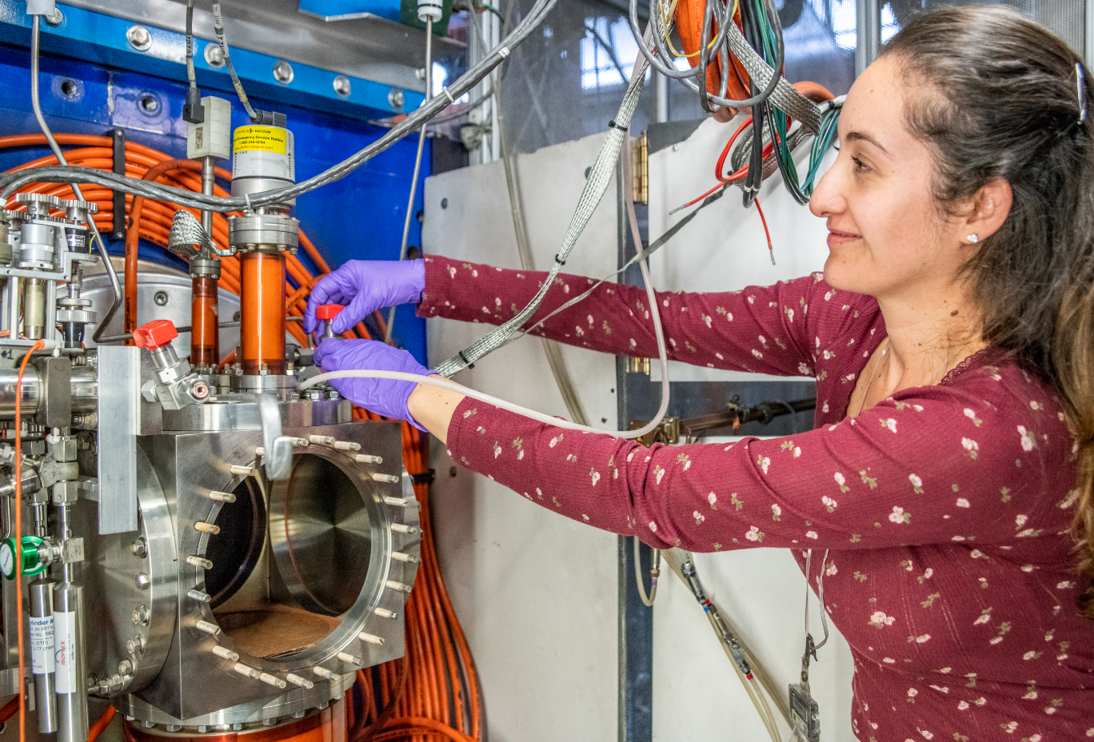
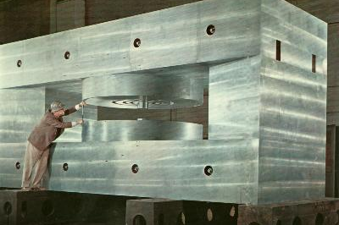
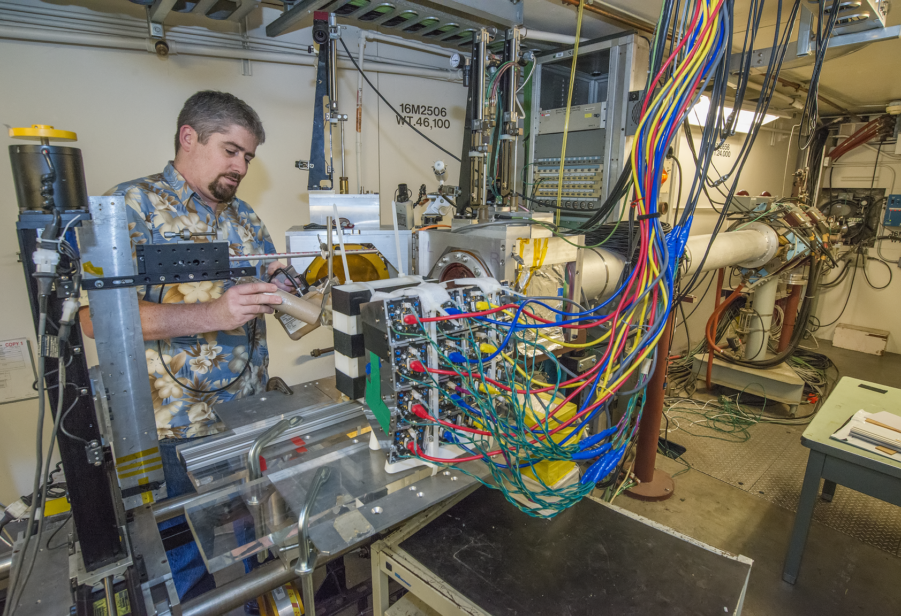


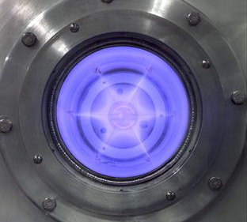
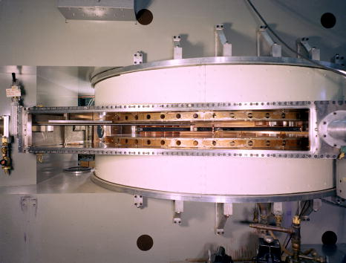
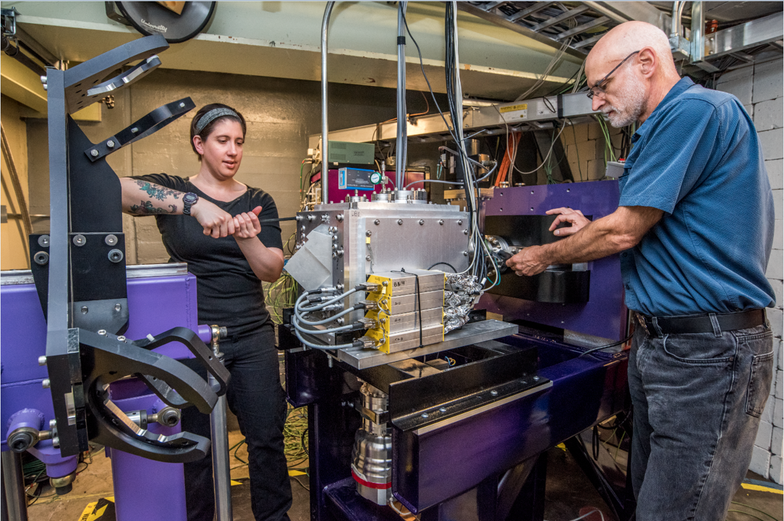
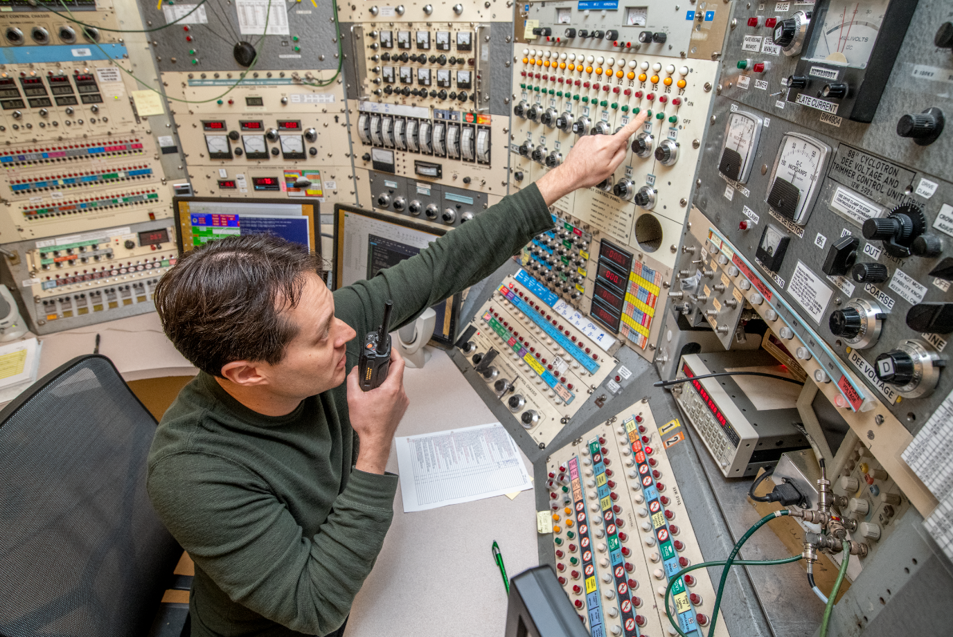
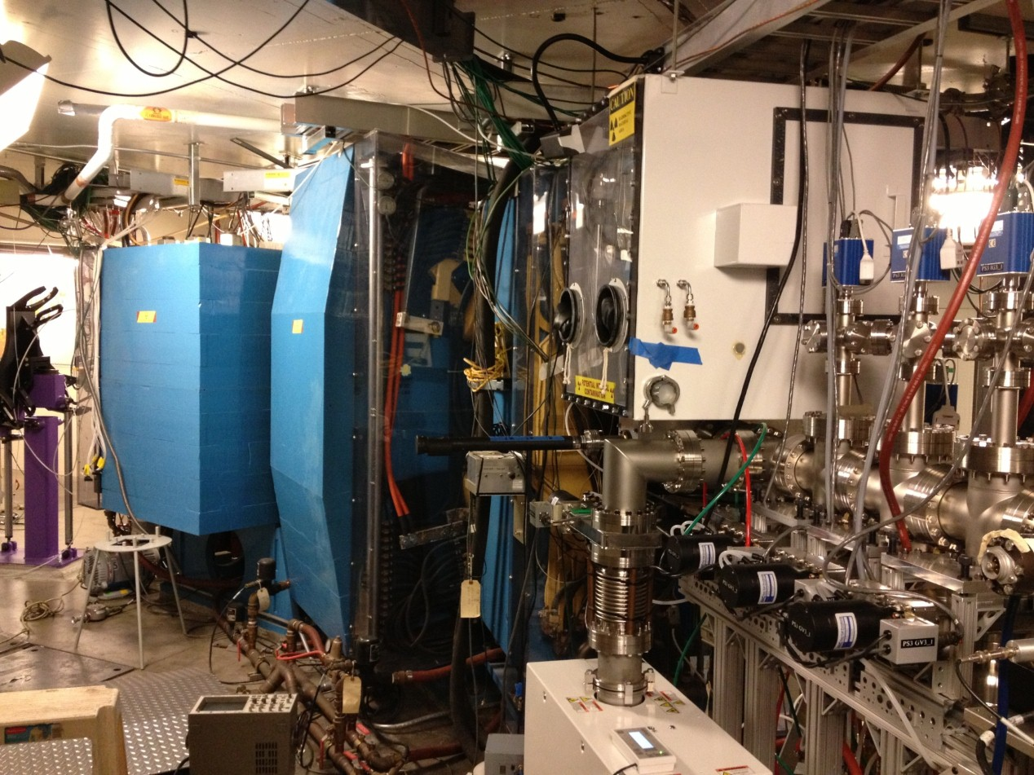
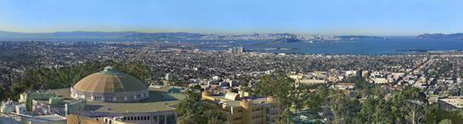
Superheavy Elements: Part 2
Jacklyn Gates
Research Coordinator, 88-Inch Cyclotron
Lawrence Berkeley National Laboratory

Slide 2
What can we do with these short-lived elements?

Slide 3
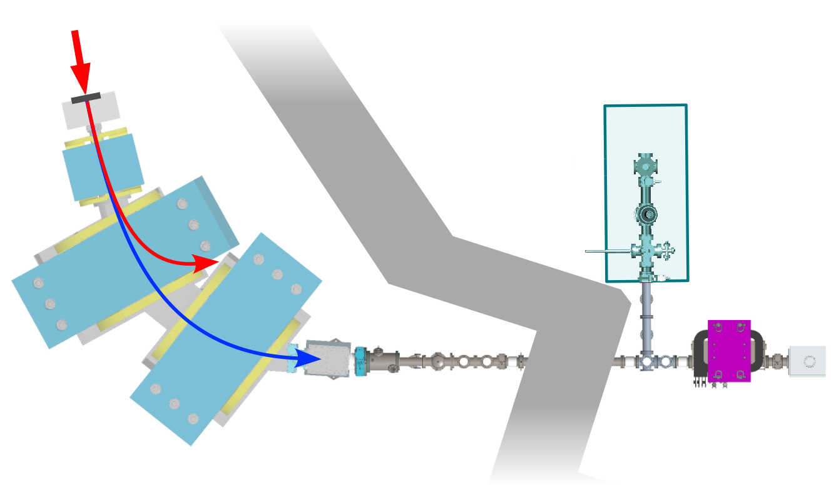
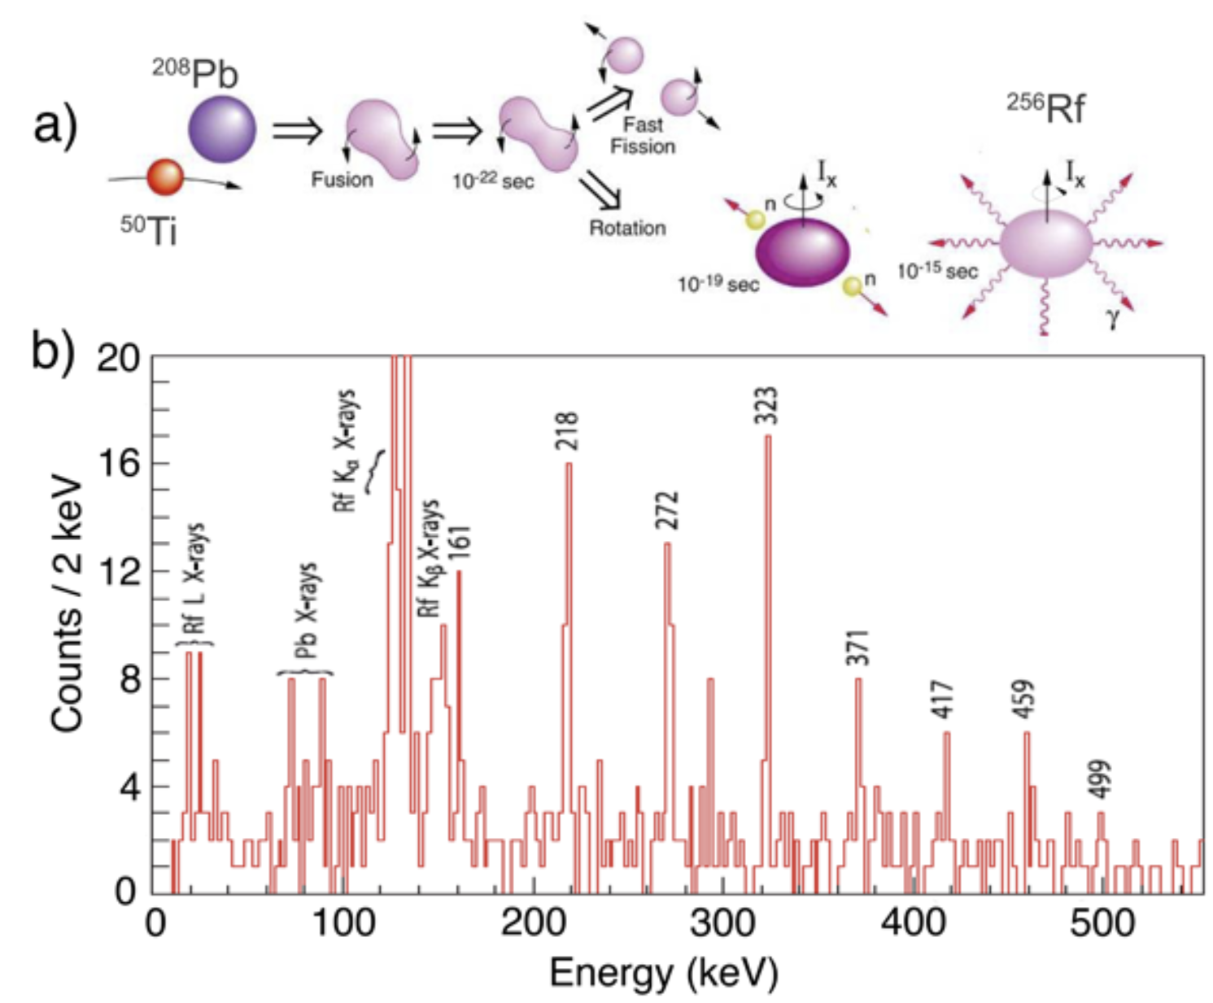

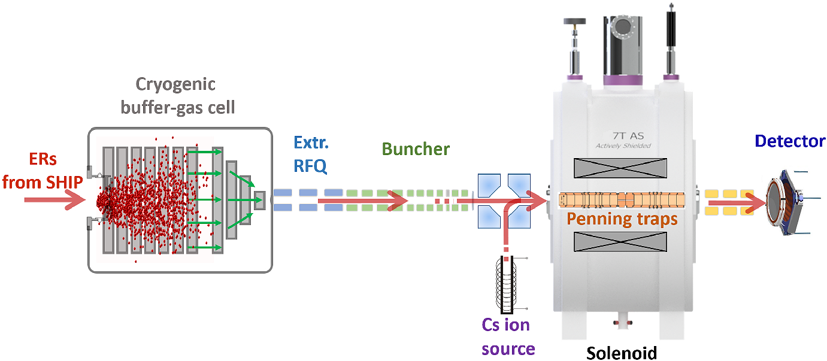
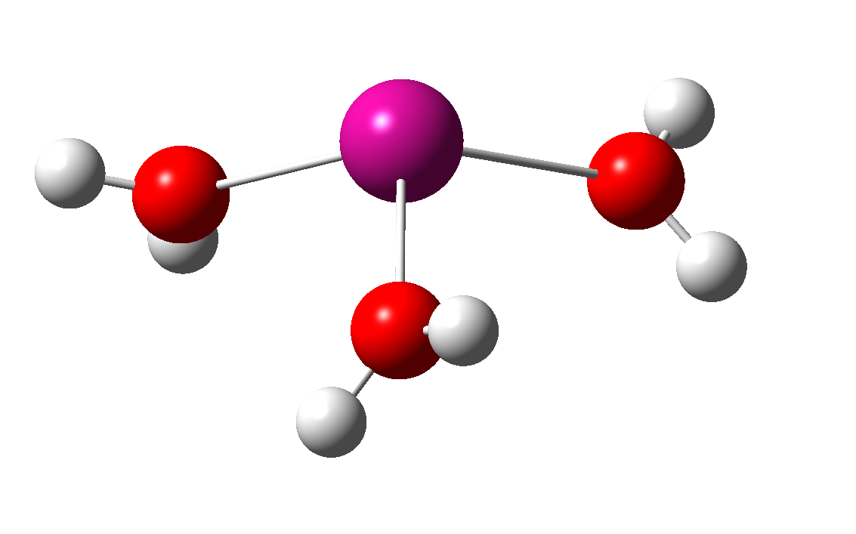
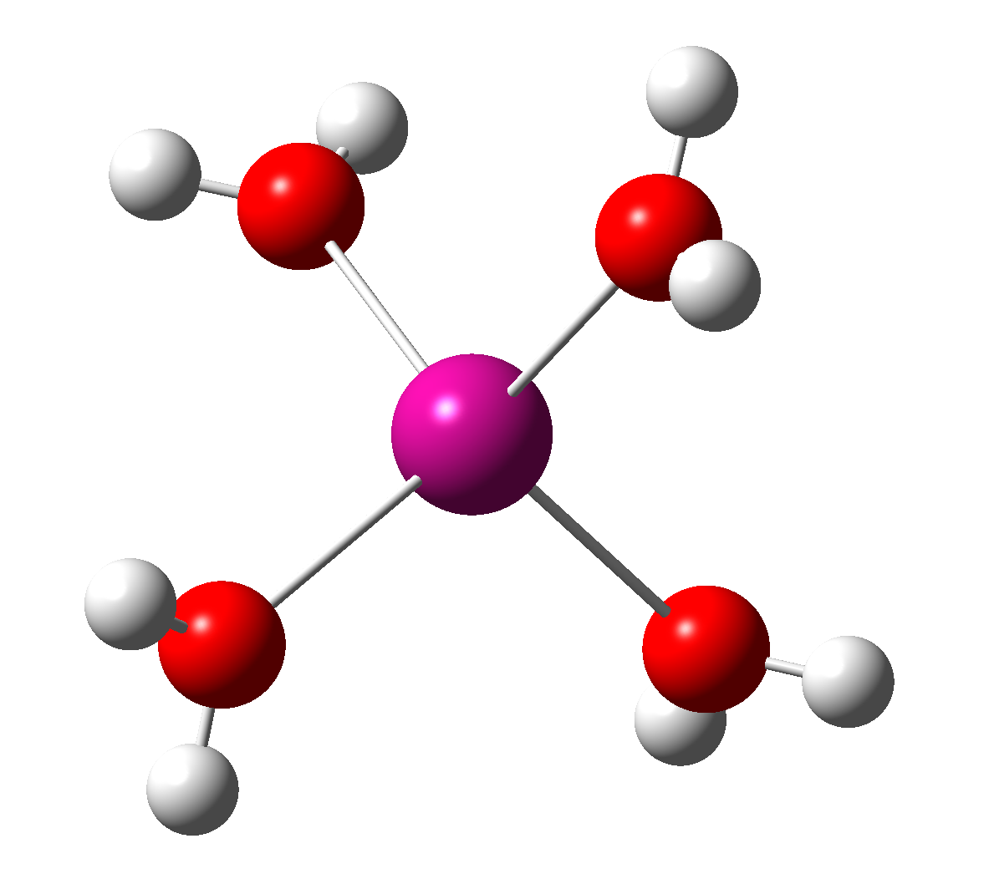
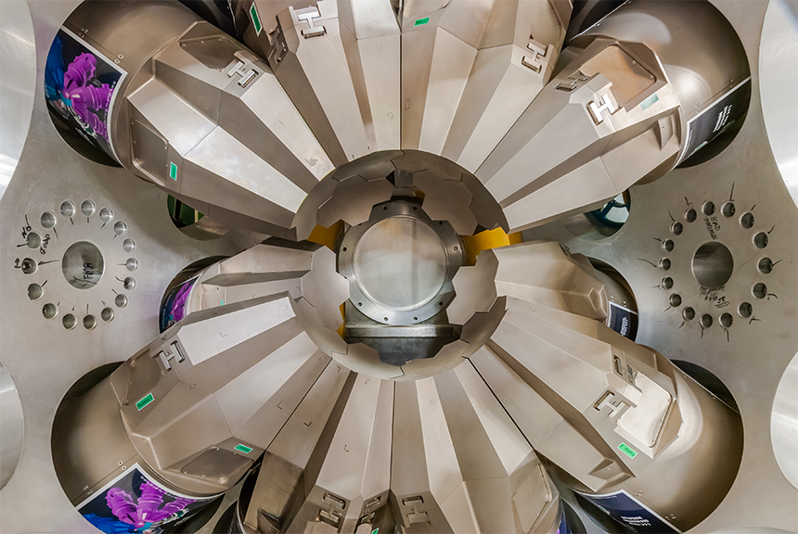
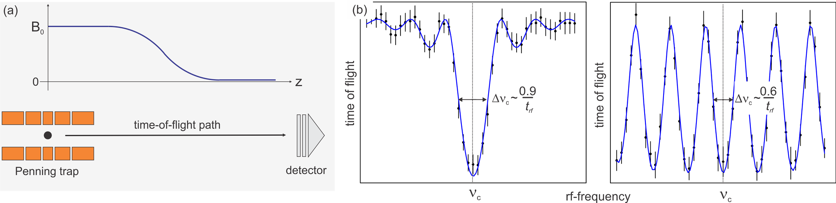
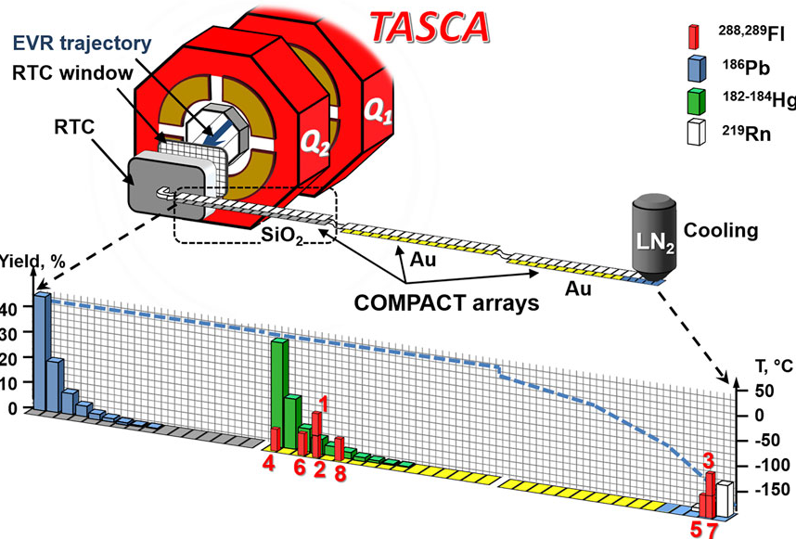
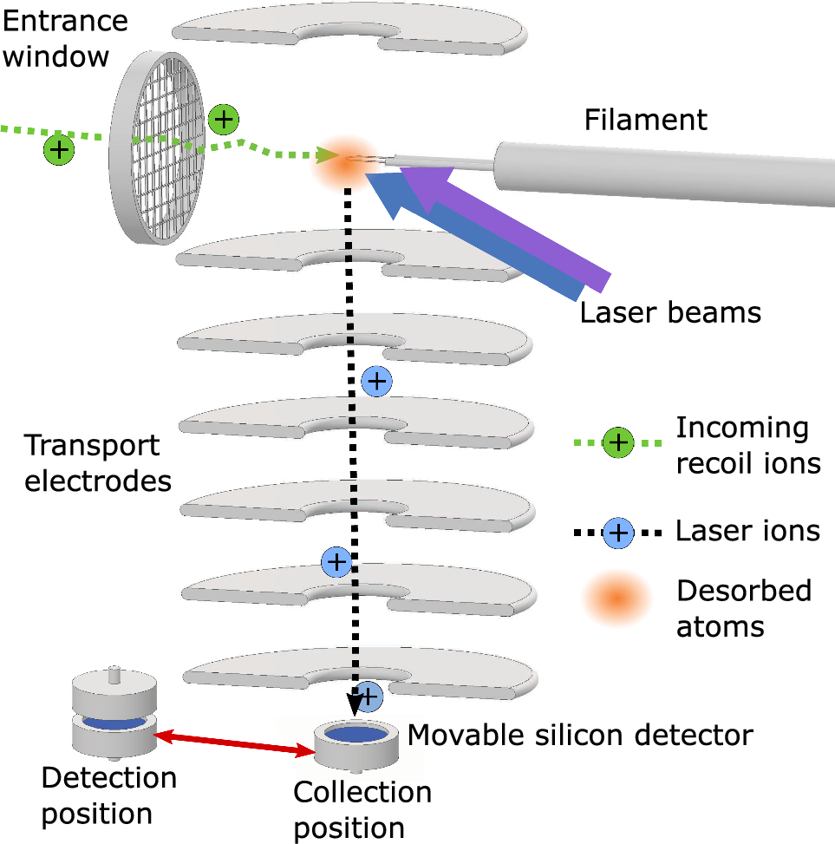
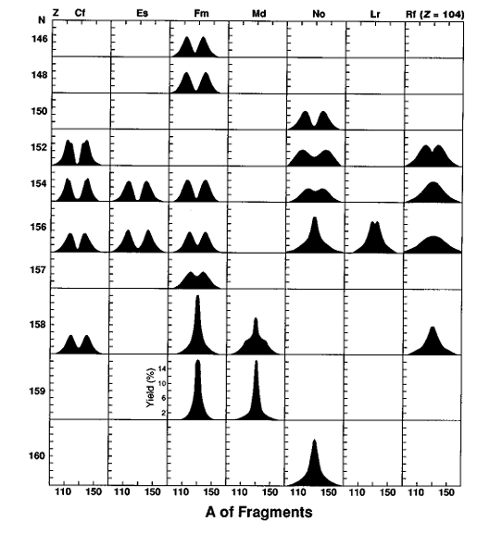
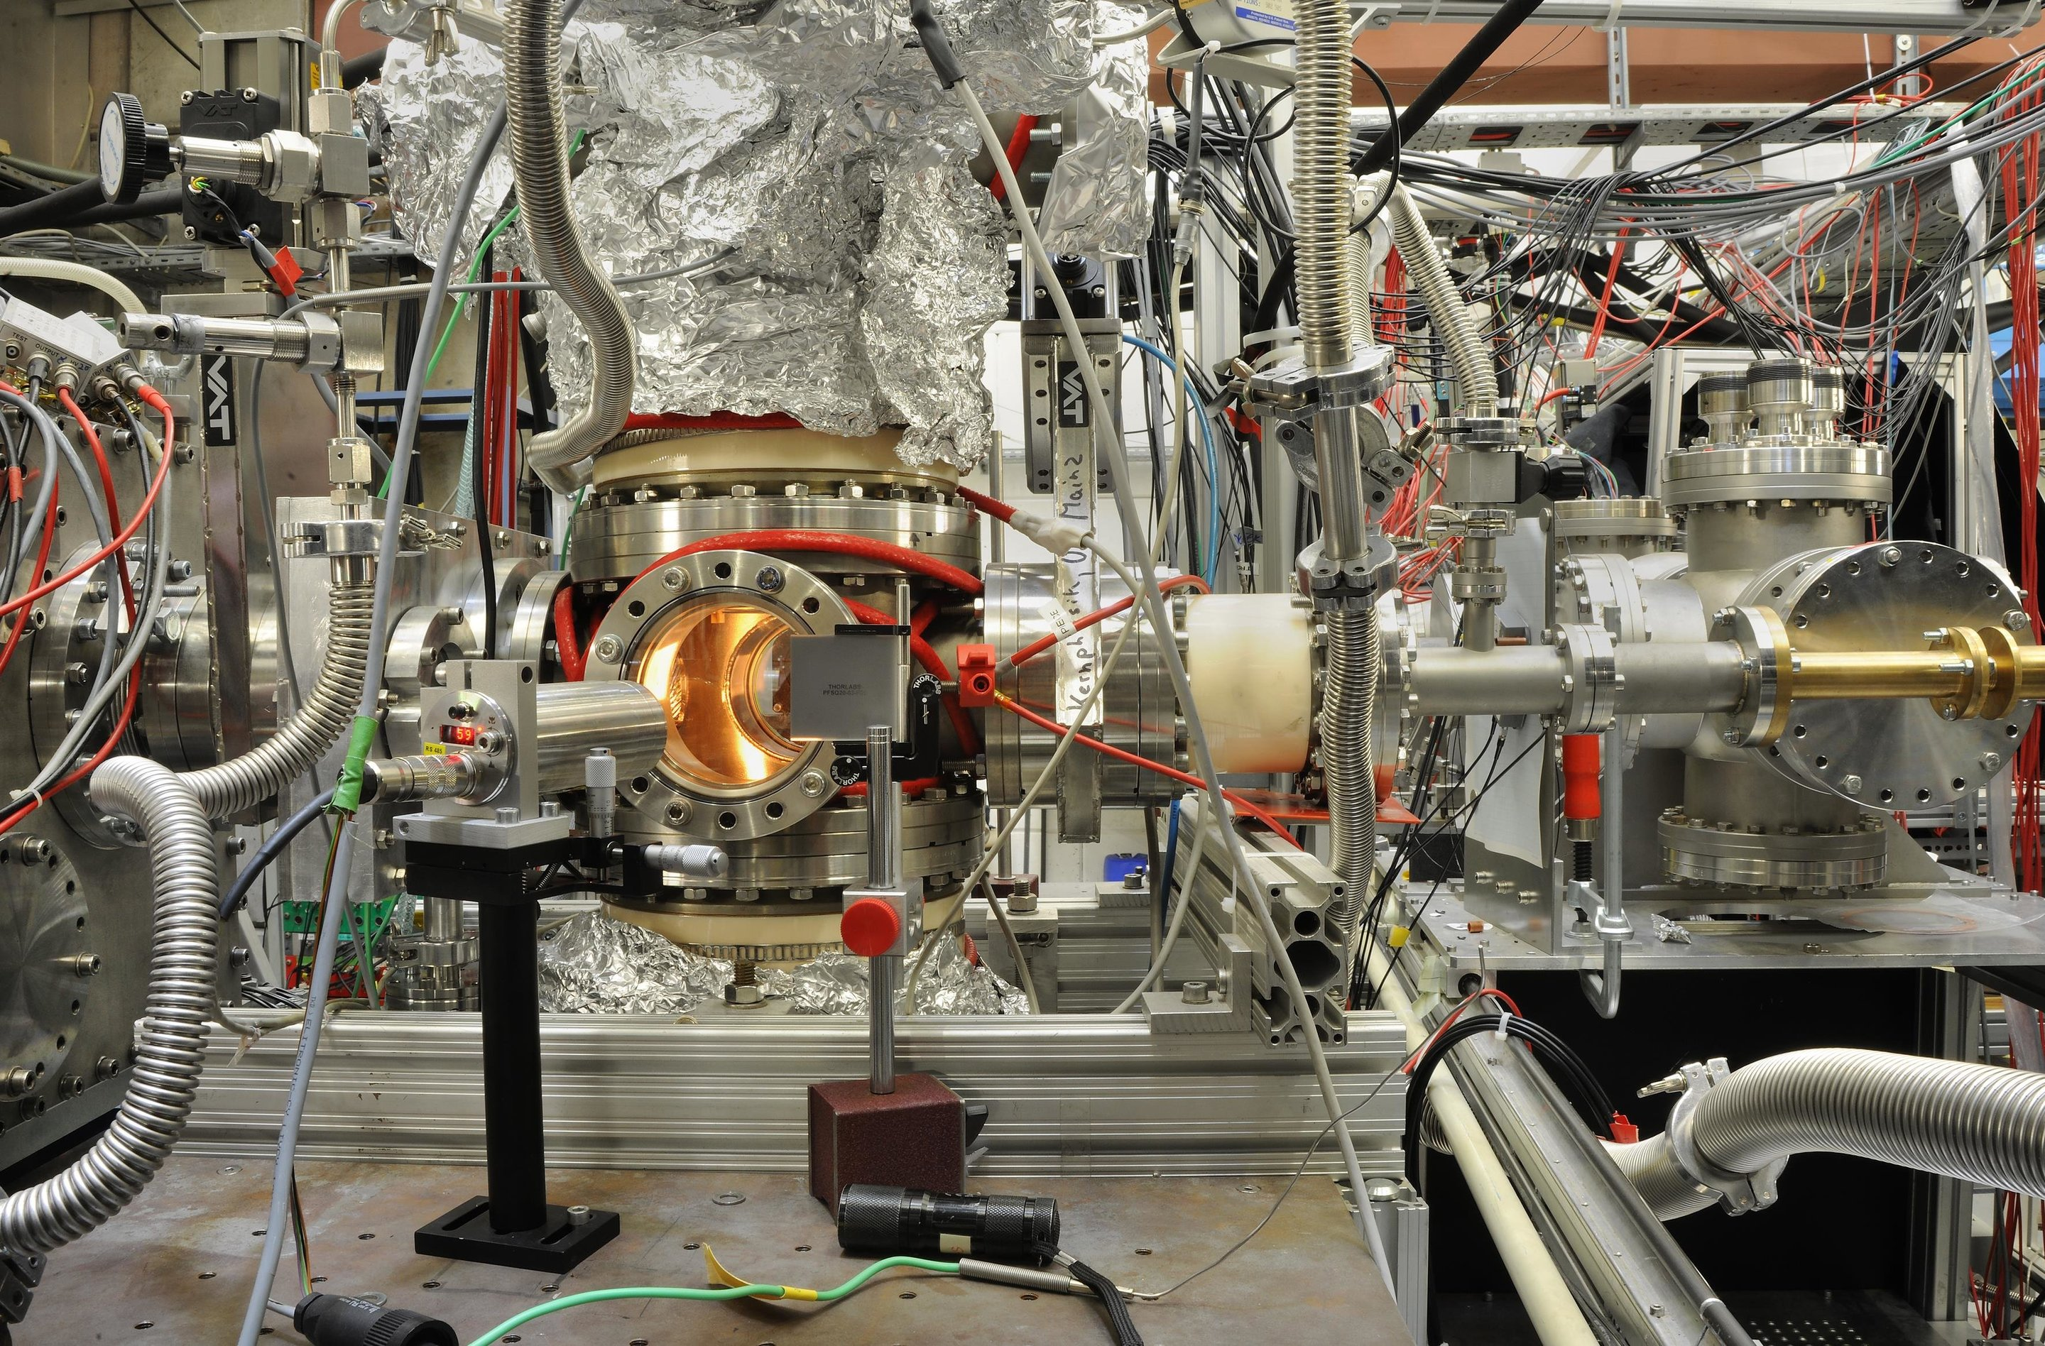
Science with Single Superheavy Element Atoms
Searching for New Elements
Chemistry
Alpha/Gamma Spectroscopy
Mass Measurements
Atomic Spectroscopy
Alpha/Fission Systematics

Slide 4
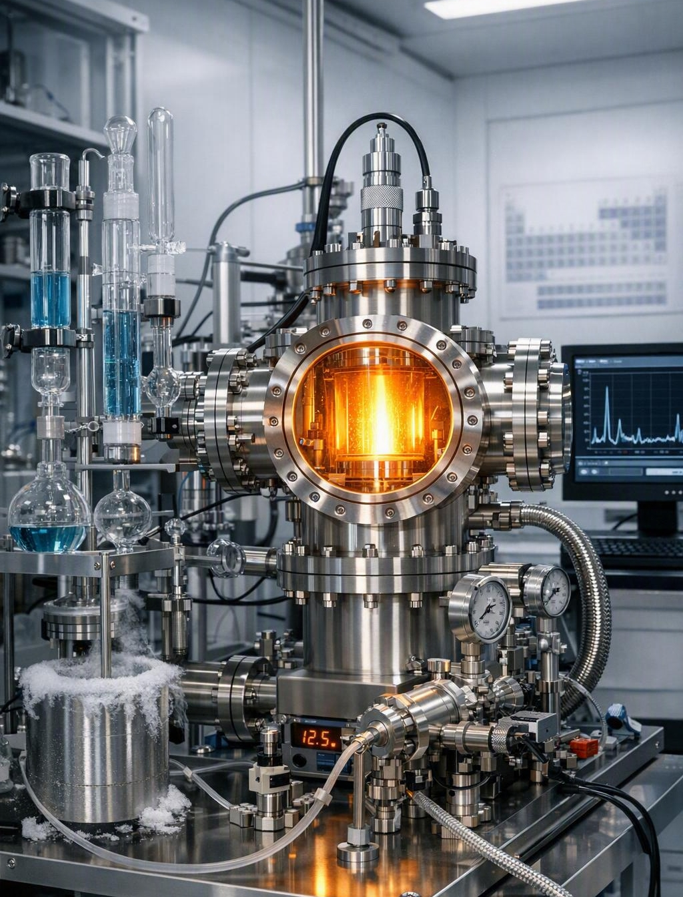
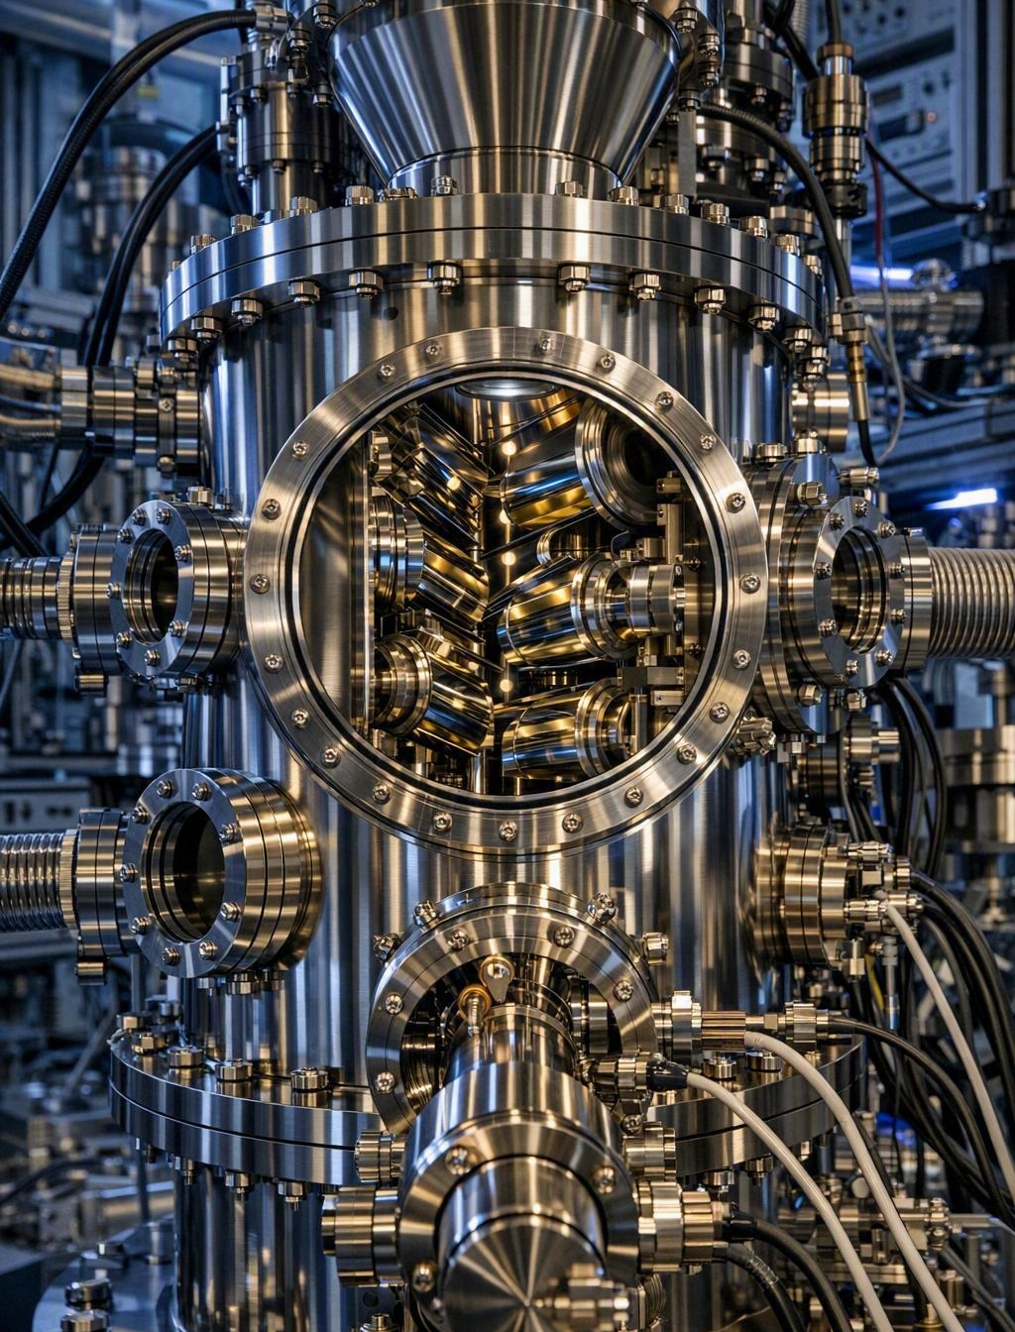
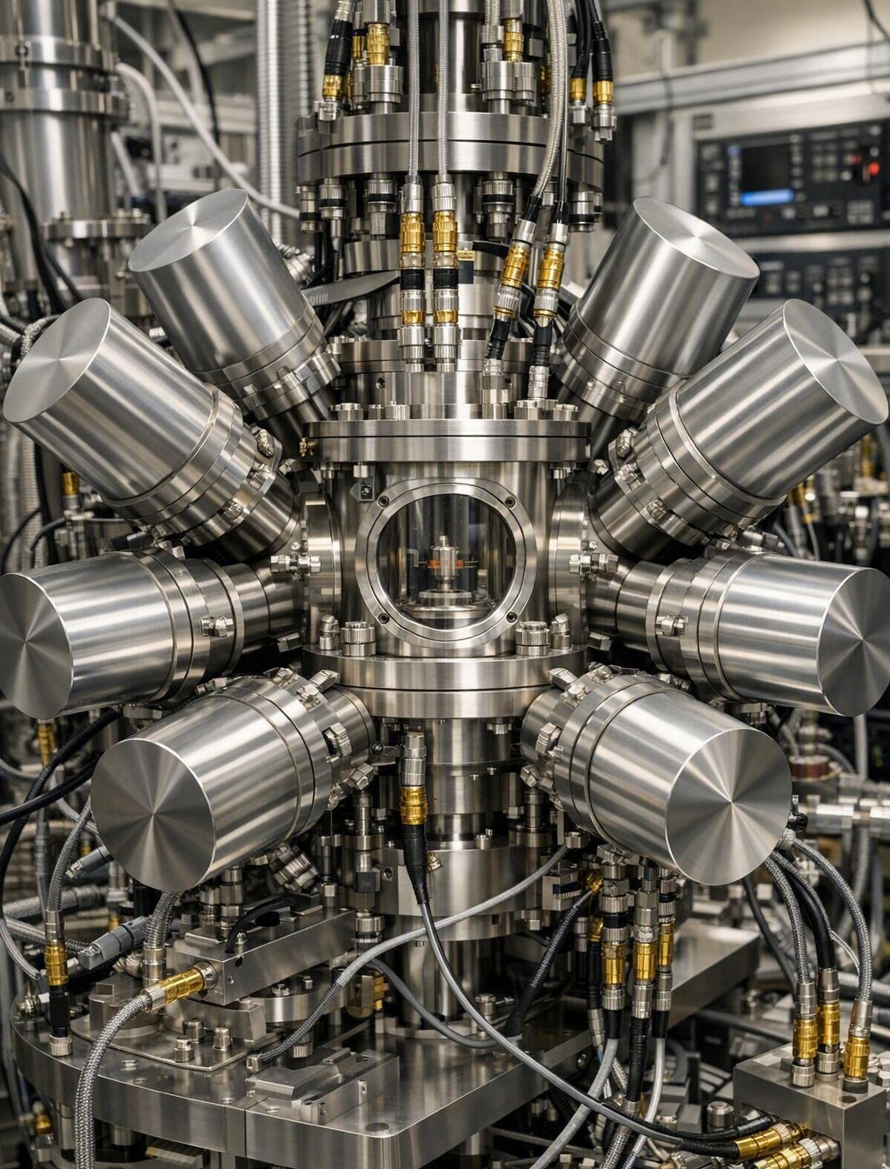
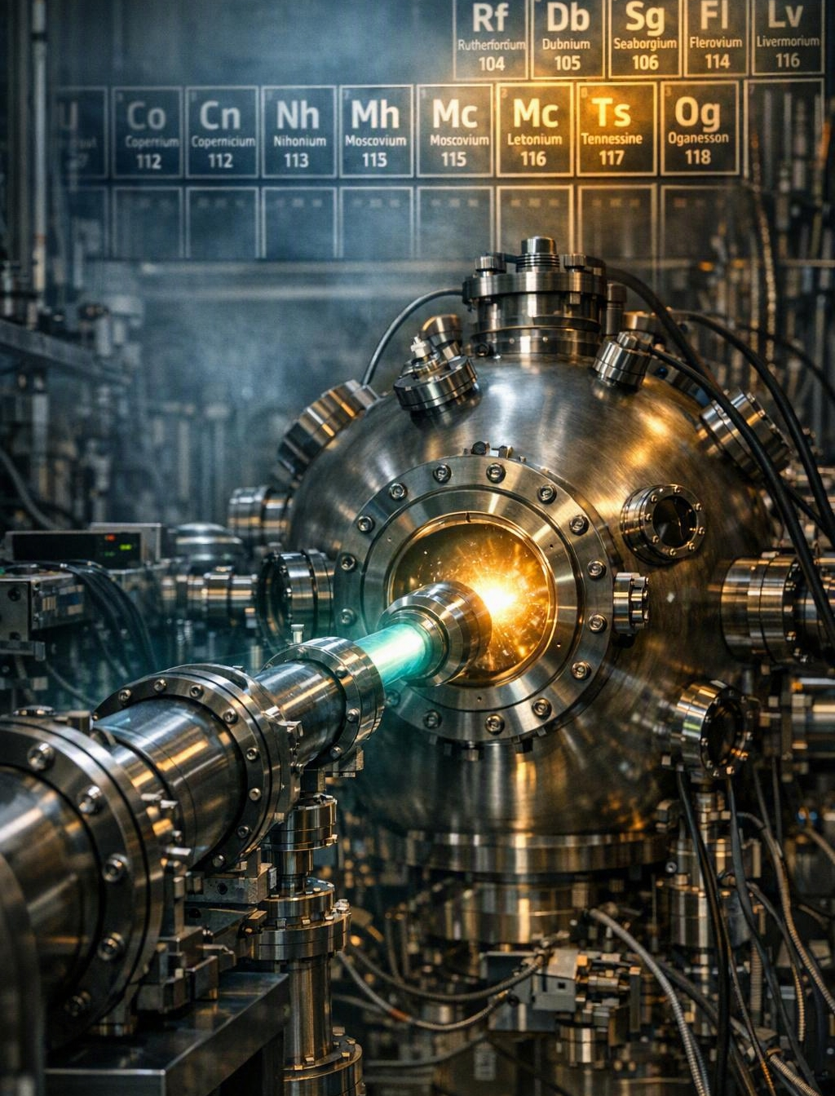
Science with Single Superheavy Element Atoms
Chemistry
Mass Measurements
Spectroscopy
Searching for New Elements

Slide 5
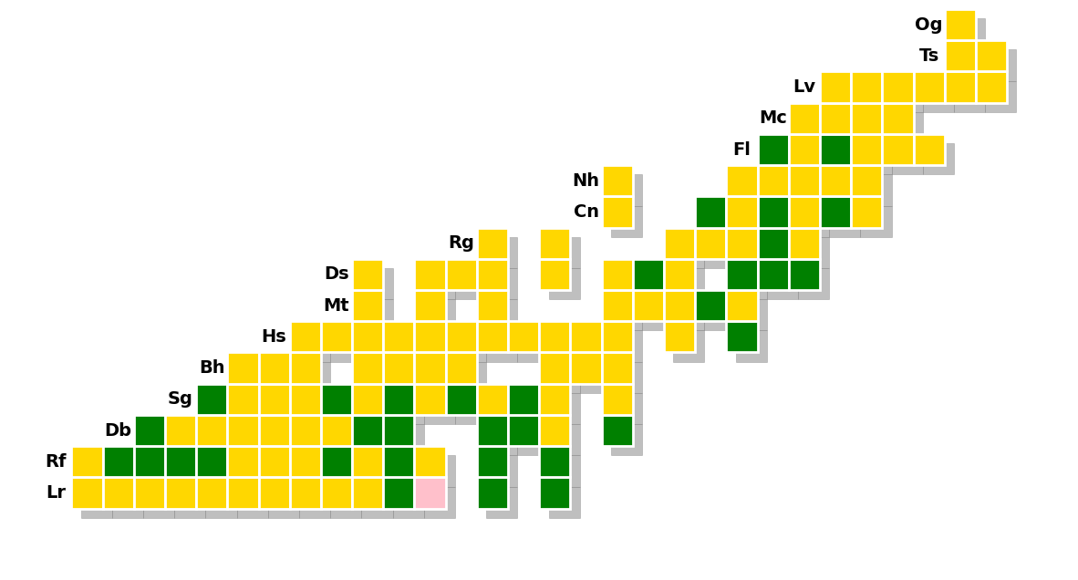
Chart of the Nuclides: 2025
Decay Mode
Spontaneous Fission
Electron Capture or b⁺
Alpha
b⁻
Milliseconds to days
Days to years
Z →
Years to centuries or longer
N →
5

Slide 6
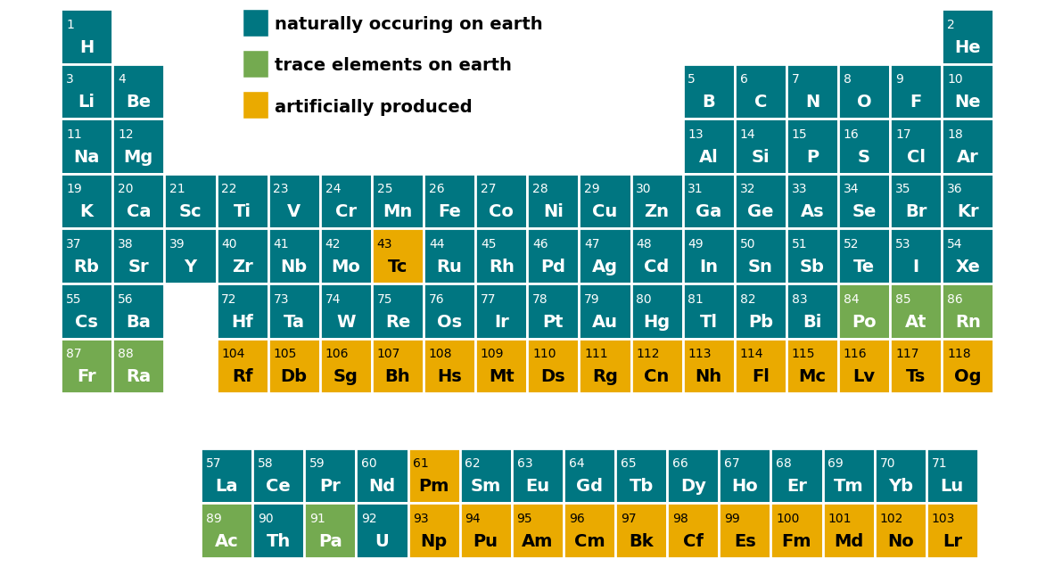
What reactions could you use to make element 119?

Slide 7
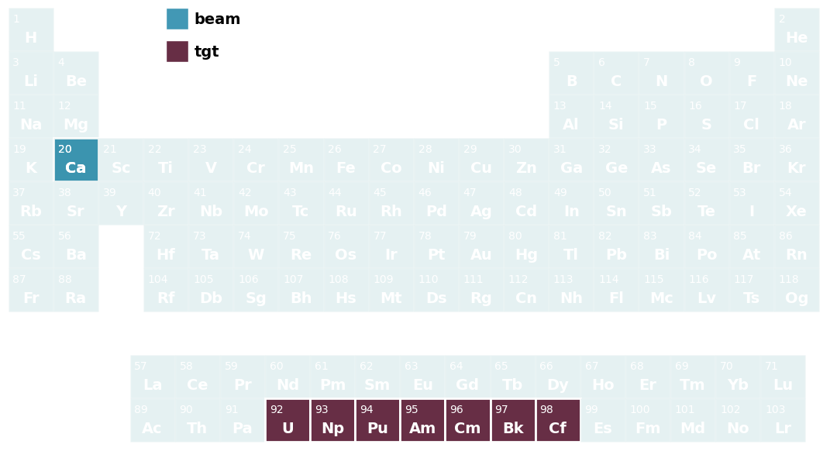
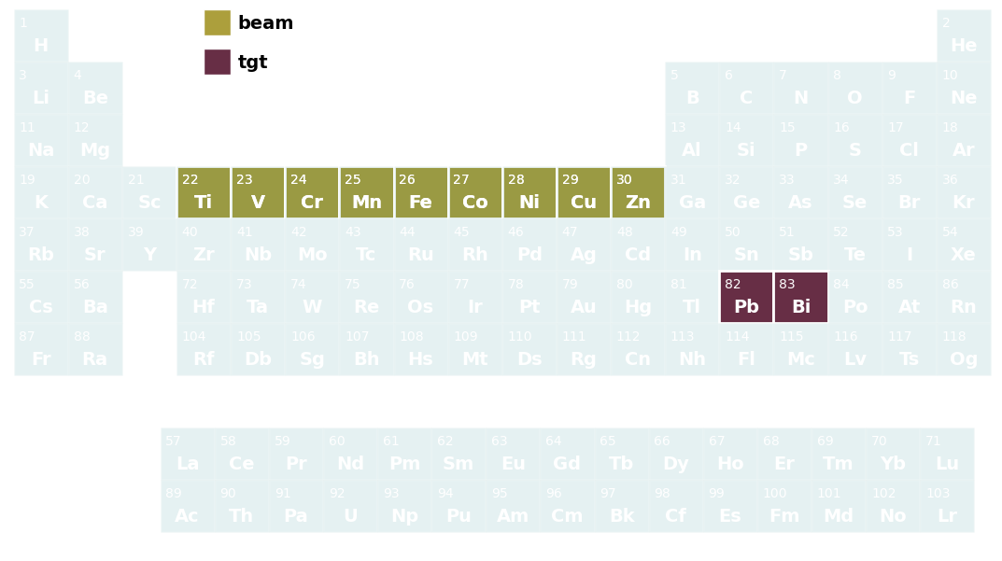
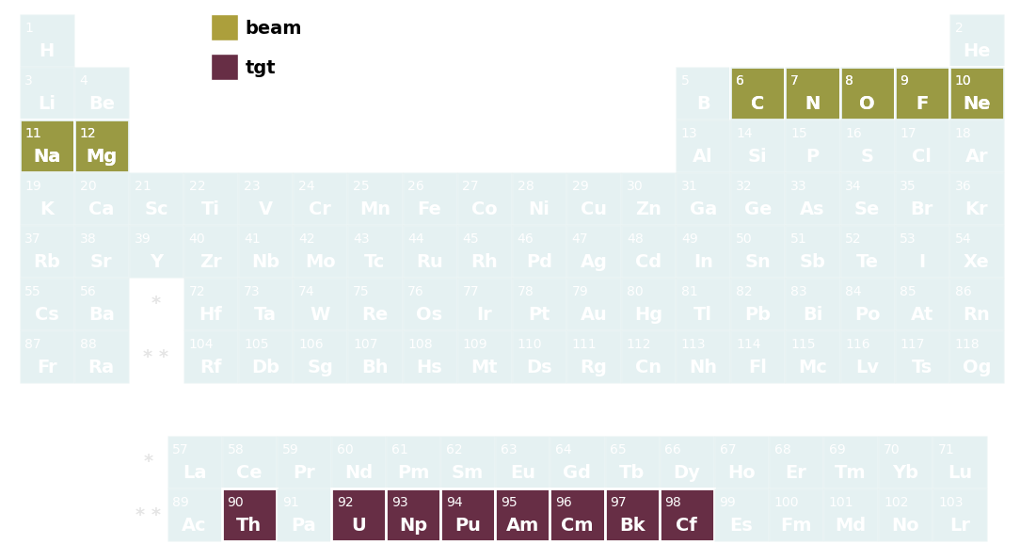
Challenge 6: Not All Combinations Work
Decay Mode
Spontaneous Fission
Electron Capture or β⁺
Ca+Actinides
Alpha
β⁻
Cold Fusion
Z →
Hot Fusion
N →

Slide 8
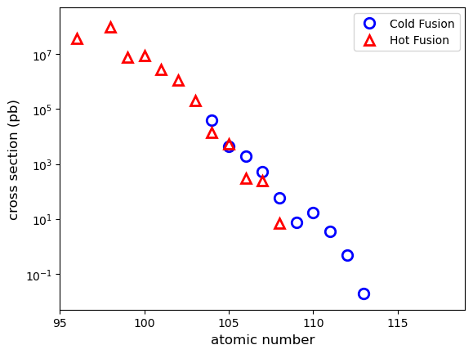
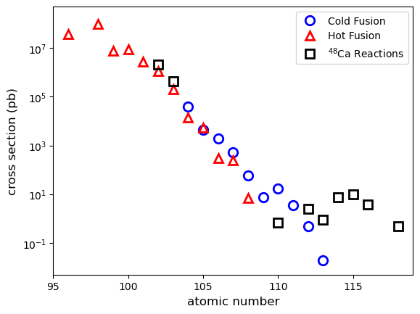
Rates of Superheavy Element Production
Production rates decrease as atomic number increases
1000 atoms/day
atoms/day
atoms/week
atoms/year

Slide 9
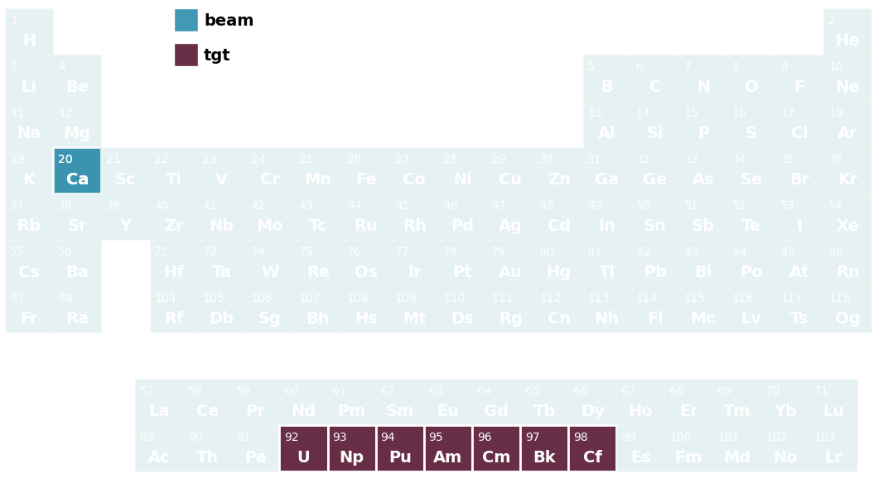
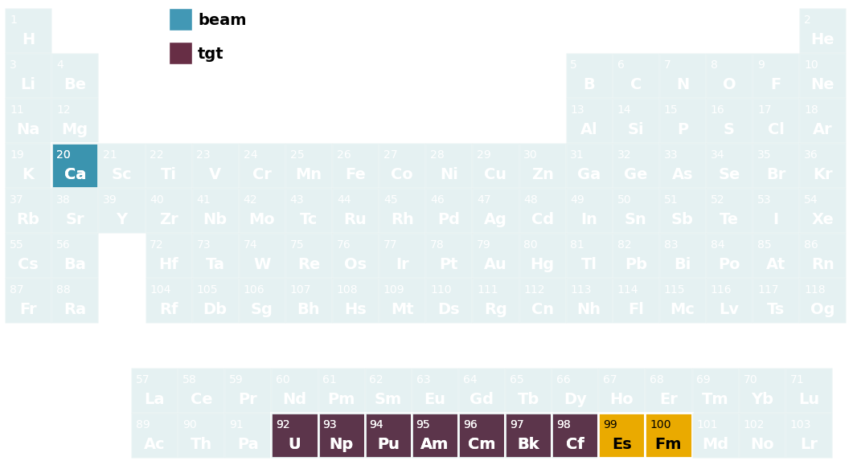
Chart of the Nuclides: 2025
E120: ⁴⁸Ca+²⁵⁷Fm
E119: ⁴⁸Ca+²⁵⁴Es
If we can’t get more protons from the target, we have to get them from the beam
Z →
N →

Slide 10

Ideal Reactions for Next New Elements
E120: ⁴⁸Ca+²⁵⁷Fm
E119: ⁴⁸Ca+²⁵⁴Es
Z →
N →
10

Slide 11
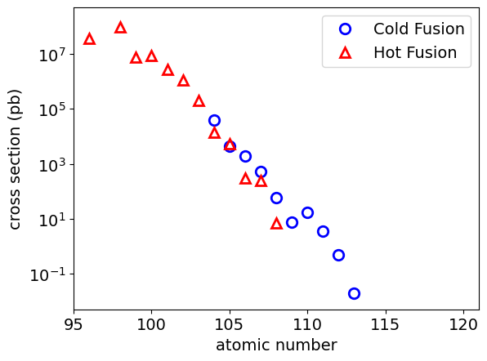
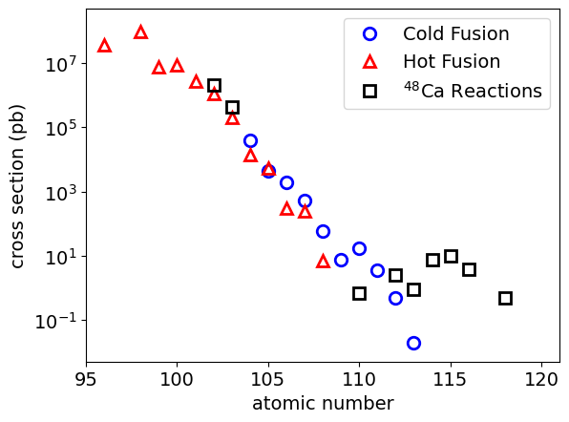
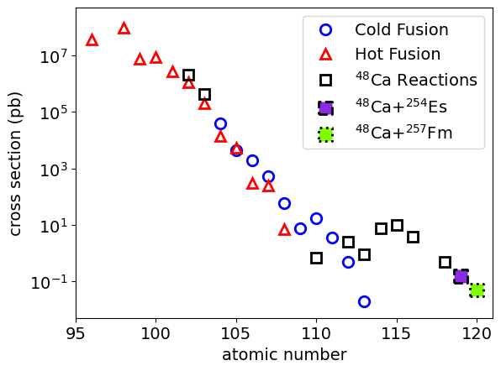
Rates of Superheavy Element Production
Production rates decrease as atomic number increases
1000 atoms/day
atoms/day
atoms/week
atoms/year
11

Slide 12

Ideal Reactions for Next New Elements
E120: ⁴⁸Ca+²⁵⁷Fm
E119: ⁴⁸Ca+²⁵⁴Es
Z →
HFIR Recently(?) isolated:
1.08 μg ²⁵⁴Es
0.5 pg ²⁵⁷Fm
Porter: Sep. Sci. Tech. 32 (1997) 83
Boll: Tech. Report ORNL/TM-2019/1283
N →
12

Slide 13
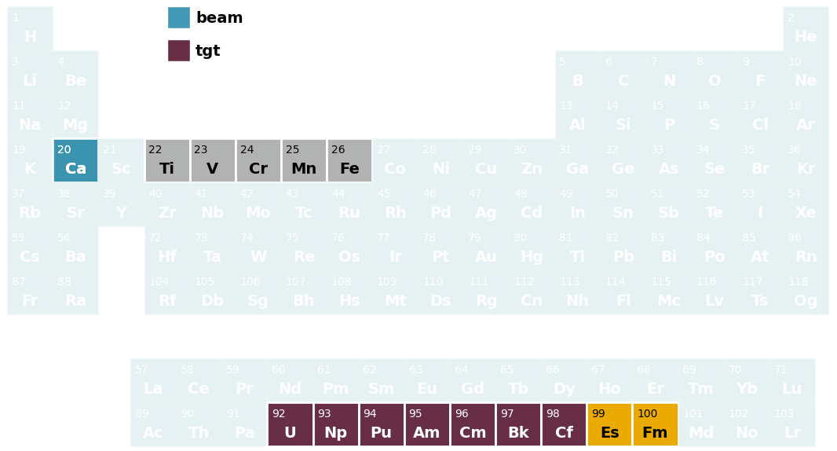
Ideal Reactions for Next New Elements
E120: ⁴⁸Ca+²⁵⁷Fm
E119: ⁴⁸Ca+²⁵⁴Es
If we can’t get more protons from the target, we have to get them from the beam
Z →
N →
13

Slide 14
Cross Section Predictions for Beyond Oganesson
⁵⁰Ti beams is best for new elements
10⁰
10⁻¹
10⁻²
10⁻³
10⁻⁴
10⁻⁵
10⁻⁶
10⁻⁷
10⁻⁸
10¹
10⁰
10⁻¹
10⁻²
10⁻³
10⁻⁴
10⁻⁵
10⁻¹
10⁻²
10⁻³
10⁻⁴
10⁻⁵
⁵⁰Ti
atom in ~1000 weeks
atom in ~50 weeks
atom in ~6000 weeks
⁵⁰Ti
⁵⁴Cr
⁶⁴Ni
⁵⁴Cr
⁵⁰Ti
⁵⁴Cr
⁵⁸Fe
⁵⁸Fe
⁵⁸Fe
⁶⁴Ni
⁶⁴Ni
114 116 118 120 122 124 126
Z
112 114 116 118 120 122 124 126
Z
116 118 120 122
Z
Adamian, EPJA 41, 235 (2009): https://doi.org/10.1140/epja/i2009-10795-4
Kuzima PRC 85, 014319 (2012): https://doi.org/10.1103/PhysRevC.85.014319
Adamian, PRC 101, 034301 (2020): https://doi.org/10.1103/PhysRevC.101.034301

Slide 15
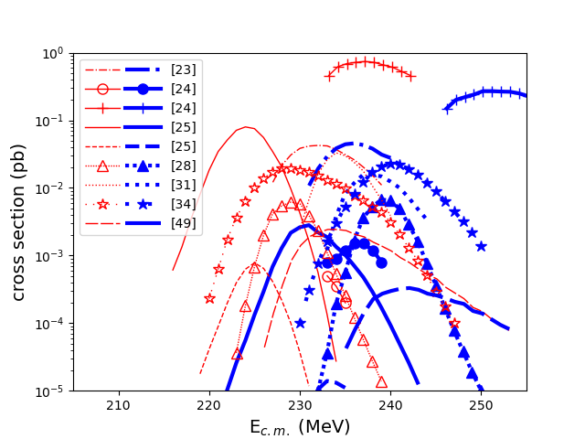
Cross Section Predictions for E120: ⁵⁰Ti+²⁴⁹Cf
Large disagreement among theoretical models for the same reaction
Just a subset of them
[23] Zagrebaev, PRC 78, 034610 (2008): https://doi.org/10.1103/PhysRevC.78.034610
[24] Adamian, EPJA 41, 235 (2009): https://doi.org/10.1140/epja/i2009-10795-4
[25] Nasirov, PRC 84, 044612 (2011): https://doi.org/10.1103/PhysRevC.84.044612
[28] K. Siwek-Wilczyńska, PRC 86, 014611 (2012): https://doi.org/10.1103/PhysRevC.86.014611
[31] Liu, PRC 87, 034616 (2013): https://doi.org/10.1103/PhysRevC.87.034616
[34] Zhu, PRC 89, 024615 (2014): https://doi.org/10.1103/PhysRevC.89.024615
[42] Zhang, PRC 109, 014622 (2024): https://doi.org/10.1103/PhysRevC.109.014622

Slide 16
Chart of the Nuclides: 2024
Decay Mode
Spontaneous Fission
2000
Electron Capture or β⁺
2011
2007
2008
2011
Alpha
2017
2011
β⁻
Z →
GSI: ²³⁸U(⁷⁰Zn,xn)^{308-x}122: S. Hofmann, EPJA 14 (2002) 147
Dubna: ²⁴⁴Pu(⁵⁸Fe,xn)^{302-x}120: Yu. Ts. Oganessian, PRC 79 (2009) 024603
GSI: ²³⁸U(⁶⁴Ni,xn)^{302-x}120: S. Hofmann, 2008 GSI Scientific Report
GSI: ²⁴⁹Cf(⁵⁰Ti,xn)^{299-x}120: J. Khuyagbaatar, PRC 102 (2020) 064602.
GSI: ²⁴⁹Bk(⁵⁰Ti,xn)^{299-x}119: J. Khuyagbaatar, PRC 102 (2020) 064602.
GSI: ²⁴⁸Cm(⁵⁴Cr,xn)^{302-x}120: Hofmann: EPJA 52 (2016) 180
RIKEN: ²⁴⁸Cm(⁵¹V,xn)^{299-x}119: Ongoing experiment
N →
16

Slide 17
Need for Proof-of-Principle Experiment
Decay Mode
Spontaneous Fission
Electron Capture or β⁺
Alpha
β⁻
⁵⁰Ti+²⁴²Pu (Dubna)
⁵⁴Cr+²³⁸U (Dubna)
⁵⁰Ti+²⁴⁴Pu (LBNL)
Z →
Make known SHE using ⁵⁰Ti and ⁵⁴Cr
How does production rate change?
What is the best beam energy?
Is it feasible to make new elements?
N →
17

Slide 18
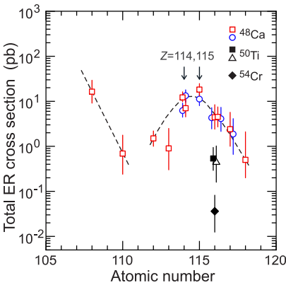
Proof-of-Principle Results
Berkeley has investigated the ⁵⁰Ti+²⁴²Pu reaction ➔ Lv
Groups in Dubna have investigated the ⁵⁰Ti+²⁴²Pu and ⁵⁴Cr+²³⁸U reactions ➔Lv
What they’ve learned:
⁴⁸Ca ➔ ⁵⁰Ti production drops x10
⁵⁰Ca ➔ ⁵⁴Cr production drops x10
Gates: PRL 133, 172502 (2024)
Oganessian: EPJA 60 (2024) 227
Oganessian: PRC 112, 014603 (2025)

Slide 19
Cross Section Predictions for Beyond Oganesson
Where do they land?
x5 - x50 HIGHER than predictions!
10⁰
10⁻¹
10⁻²
10⁻³
10⁻⁴
10⁻⁵
10⁻⁶
10⁻⁷
10⁻⁸
10¹
10⁰
10⁻¹
10⁻²
10⁻³
10⁻⁴
10⁻⁵
10⁻¹
10⁻²
10⁻³
10⁻⁴
10⁻⁵
⁵⁰Ti
⁵⁰Ti
⁵⁴Cr
⁶⁴Ni
⁵⁴Cr
⁵⁰Ti
⁵⁴Cr
⁵⁸Fe
⁵⁸Fe
⁵⁸Fe
⁶⁴Ni
⁶⁴Ni
114 116 118 120 122 124 126
Z
112 114 116 118 120 122 124 126
Z
116 118 120 122
Z
Adamian, EPJA 41, 235 (2009): https://doi.org/10.1140/epja/i2009-10795-4
Kuzima PRC 85, 014319 (2012): https://doi.org/10.1103/PhysRevC.85.014319
Adamian, PRC 101, 034301 (2020): https://doi.org/10.1103/PhysRevC.101.034301
19

Slide 20

Toward a Search for Element 120
New elements are in sight!
Estimate an atom of E119 or E120 could be produced every ≈100-200 days
Element discovery experiments ongoing:
China: ⁵⁴Cr+²⁴³Am➔119
Dubna: ⁵⁰Ti+²⁴⁹Bk/²⁴⁹Cf➔119 and 120
20

Slide 21
How about going more neutron rich without going higher in Z?

Slide 22
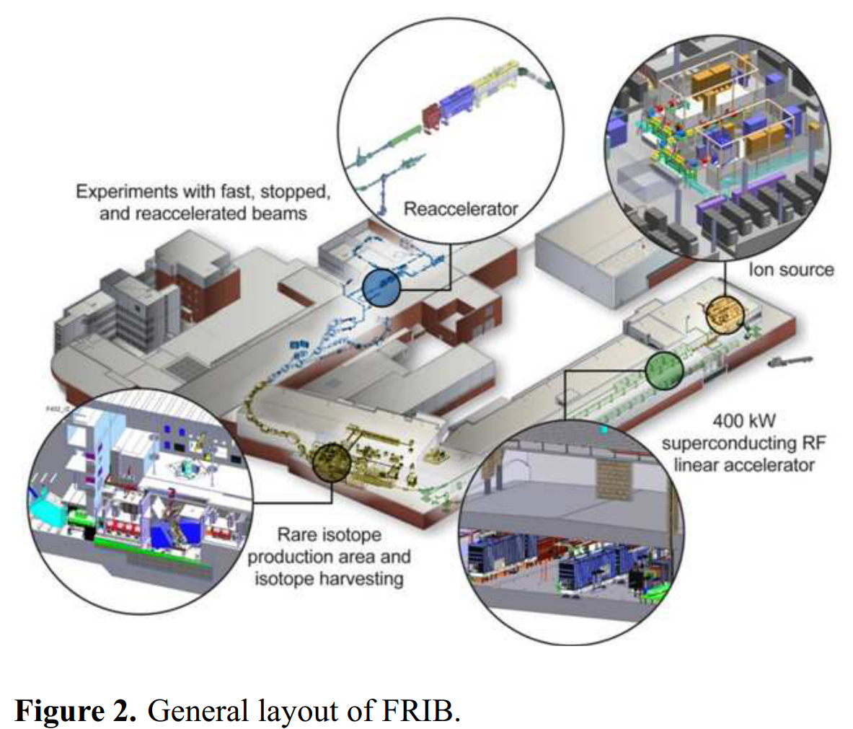
Radioactive Beams
FRIB: Premier facility for radioactive ion beams
Heaviest Lv isotope: ²⁹³Lv
Produced in the ²⁴⁸Cm(⁴⁸Ca,3n) reaction
What beam would you need to make ³⁰⁰Lv
with a ²⁴⁸Cm target?

Slide 23
Radioactive Beams
Isotopes | Intensity (pps) | Fast Beam (pps) | Stopped Beam (pps) | Reaccelerated Beam (pps)
⁴⁸Ca | 10¹³
⁵⁰Ca |  | 2x10⁶ | 2x10⁴ | 2000
⁵²Ca |  | 1.3x10⁴ | 3x10² | 29
⁵⁴Ca |  | 1.4x10³ | 4 | “contact manager for user relations”
⁵⁶Ca |  | 6x10⁰ | 0.03
⁵⁸Ca |  | 6x10⁻² | 0.0003
Rates from the FRIB rate calculator: https://frib.msu.edu/user-facilities/frib/calculator?

Slide 24
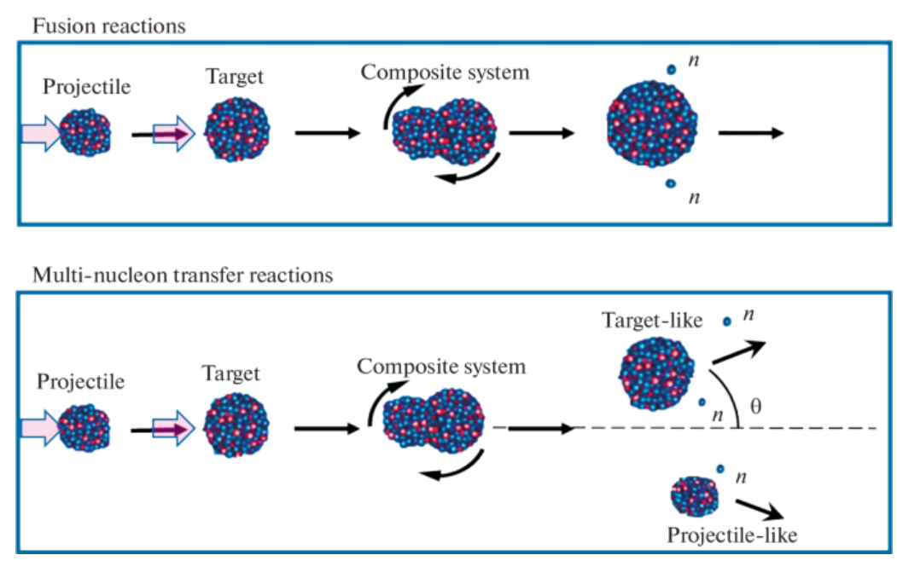
Multi-Nucleon Transfer Reactions
Devaraja: Nuclei. Phys. Part. Nuclei Lett. 19, 693–716 (2022). https://doi.org/10.1134/S1547477122060085

Slide 25
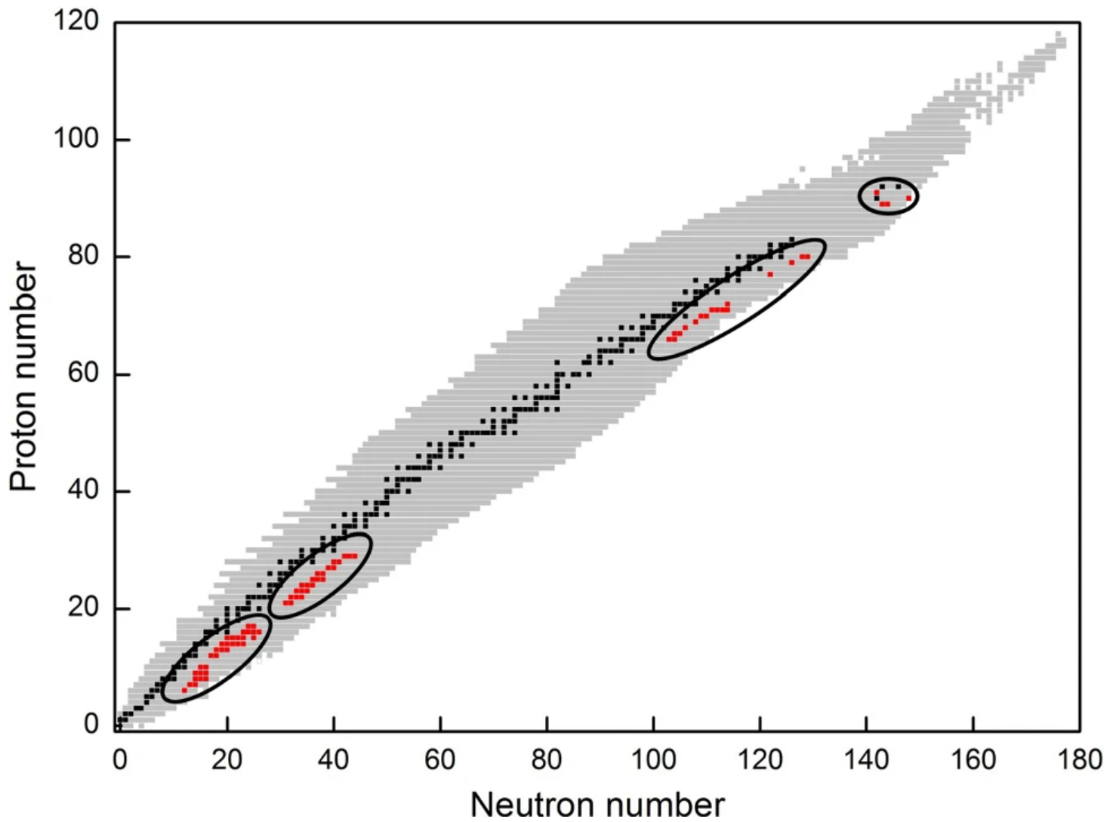
Isotopes Discovered by MNT
76 isotopes discovered by MNT between 1970 – 1995
No new isotopes discovered by MNT since
Heinz: Eur. Phys. J. A 58, 114 (2022). https://doi.org/10.1140/epja/s10050-022-00771-1

Slide 26
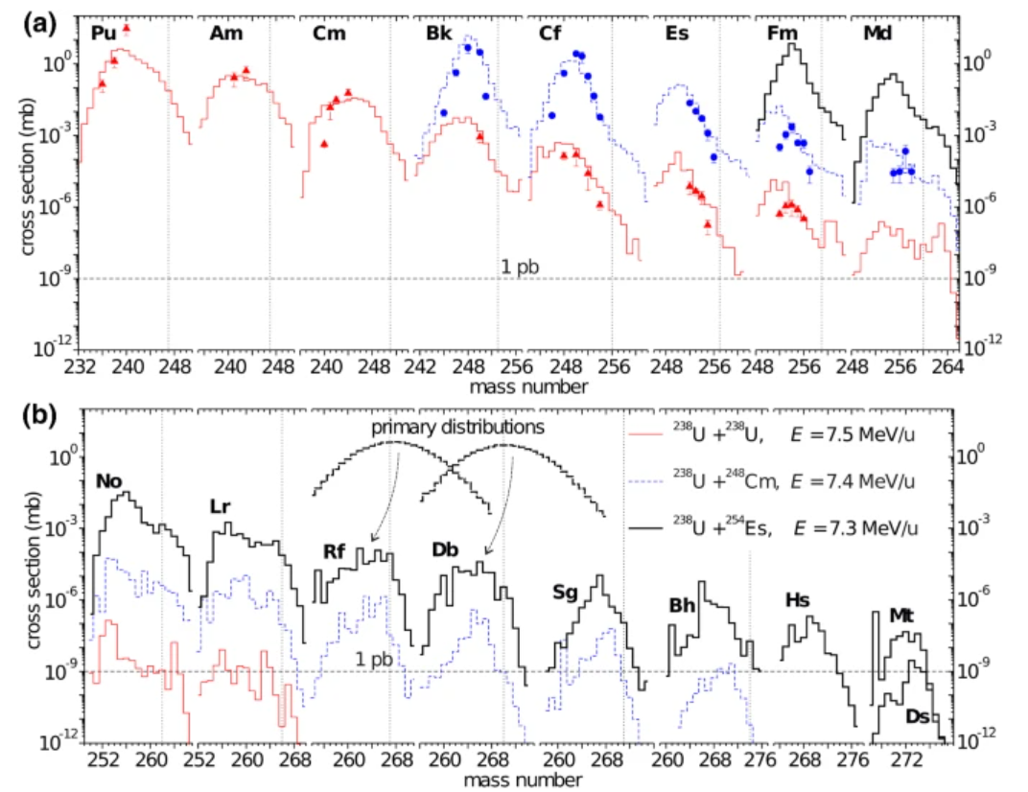
Will MNT Work To Make New SHE?
Theoretical Calculations for reaction products from:
²³⁸U+²³⁸U ______
²³⁸U+²⁴⁸Cm ----------
²³⁸U+²⁵⁴Es ______
Combined with experimental data from:
Triangles: ²³⁸U+²³⁸U
Circles: ²³⁸U+²⁴⁸Cm
Heinz: Eur. Phys. J. A 58, 114 (2022). https://doi.org/10.1140/epja/s10050-022-00771-1

Slide 27
Potential Issues with MNT
Longer lifetimes
Decay mode
How do you detect a single atom that beta decays in days or weeks?
Milliseconds to days
Days to years
Z →
Years to centuries or longer
N →
27

Slide 28
Science with Single Superheavy Element Atoms
Searching for New Elements
Chemistry
Alpha/Gamma Spectroscopy
Mass Measurements
Atomic Spectroscopy
Alpha/Fission Systematics

Slide 29
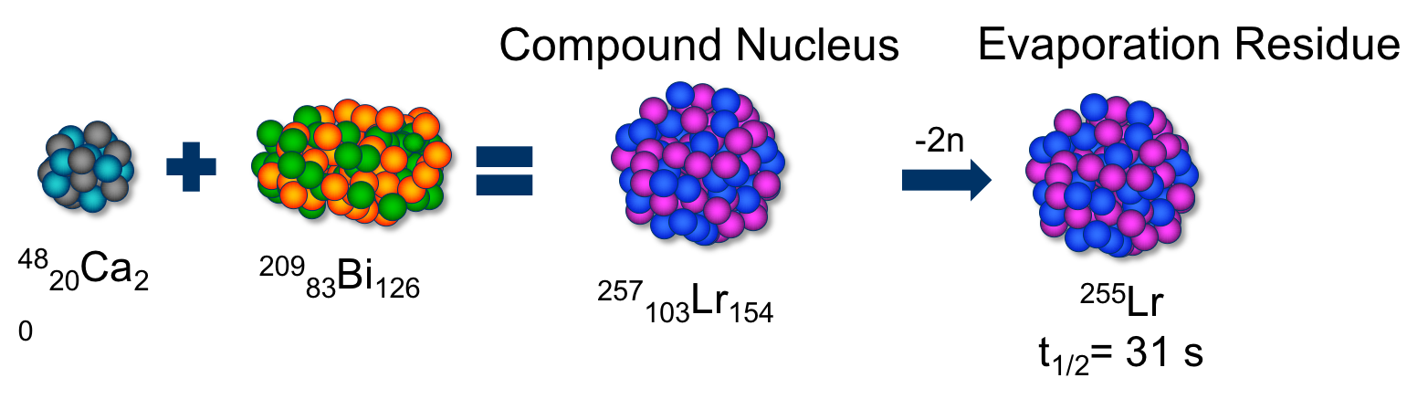

Is Chemistry Different in Superheavy Elements?
Einstein’s theory of relativity: E=mc² changes chemistry
Electrons start to orbit near the speed of light
Electrons get heavier
nuclei get large
E
m
c²
=

Slide 30
Is Chemistry Different in Superheavy Elements?
Relativistic Effects
1
Some electron
orbitals contract
2
Some electron
orbitals expand
3
Spin Orbit Splitting
p_{3/2}
p
p_{1/2}
s and p_{1/2} orbitals
d and f orbitals

Slide 31
Is Chemistry Different in Superheavy Elements?
Electron Orbital Energy (eV)
Change in orbital energy ➔ change in chemistry
Ru (Z=44)
Os (Z=76)
Hs (Z=108)
nr rel
nr rel
nr rel
5s
5s_{1/2}
7s
6s
6s_{1/2}
6d_{5/2}
4d_{5/2}
7s_{1/2}
4d
5d_{5/2}
4d_{3/2}
6d_{3/2}
6d
5d
5d_{3/2}
Desclaux: At. Data Nucl. Data Tables, 12 (1973) 311

Slide 32
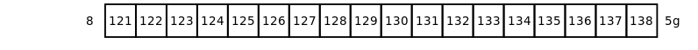
Periodic Table Predicts
5g¹
5g²
5g³
5g⁴
5g⁵
. . . . . . . . . . . . . . . . . . . . . . . . . . . . . . . .
5g¹⁸
Modern Theory Predicts
8p¹
8p²
or
7d¹8p
6f²7d¹8p¹
or
6f³8p²
5g¹6f³8p¹
or
6f³8p²
6f¹7d¹8p¹
or
6f²8p¹

Slide 33
What techniques can you use to study chemistry of single atoms?

Slide 34
How do you get your SHE to a chemistry setup?

Slide 35
Stuff to be aware of:
SHE produced in target with momentum of the beam ➔ 0.02 c (~40 MeV)
SHE partially stripped of electrons as they exit the target
All chemistry setups require thermalized, neutral atoms (preferably)
How we solve this problem:
Stop the SHE in gas ➔ use gas to transport it to a chemistry setup
Beam
Rotating
Target
Helium

Slide 36
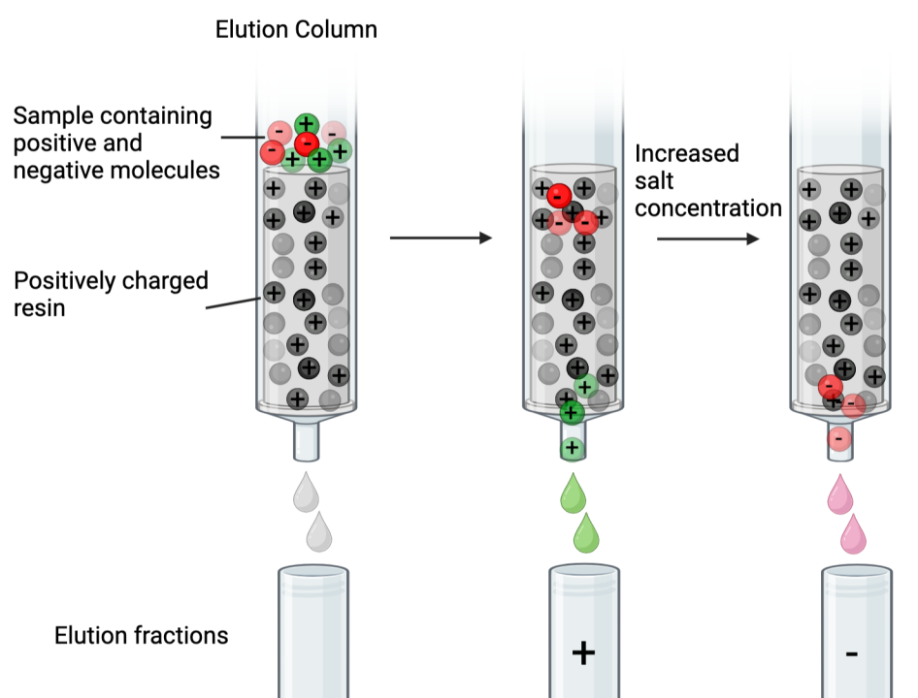
Traditional Method: Ion Exchange Columns
Step 1: Get a SHE into liquid solution
Capture SHE in a gas jet
Automated system to extract from gas jet
Step 2: Load solution with SHE onto column
Negative molecules stick to the column
Positive ions pass through column
Step 3: Flush column with solution of different pH
Differences in ion affinity determine retention

Slide 37
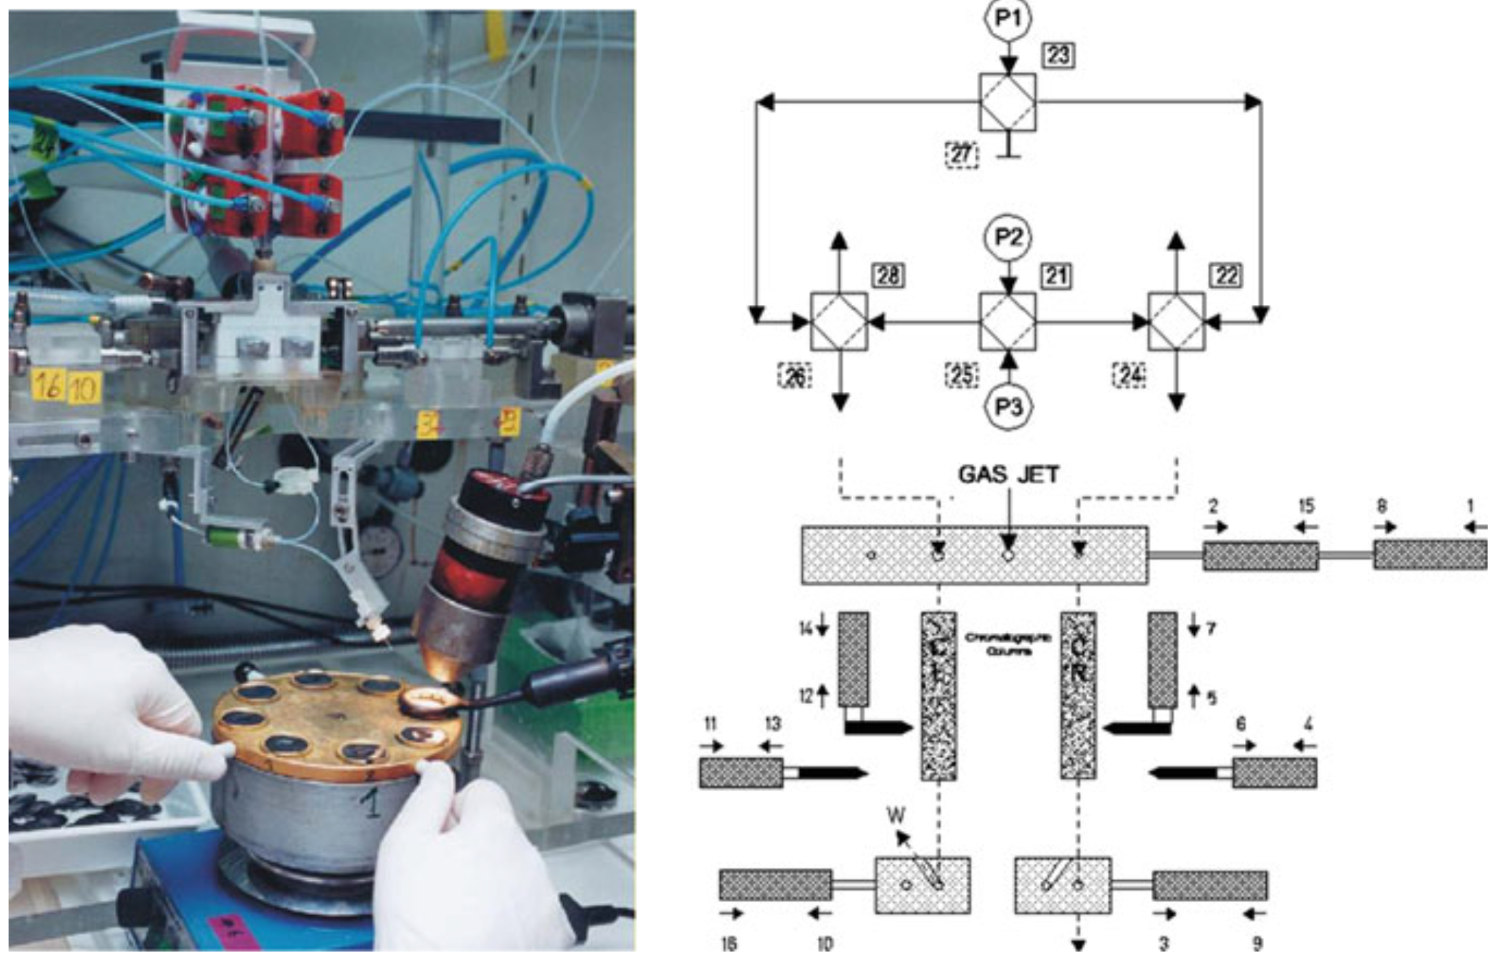
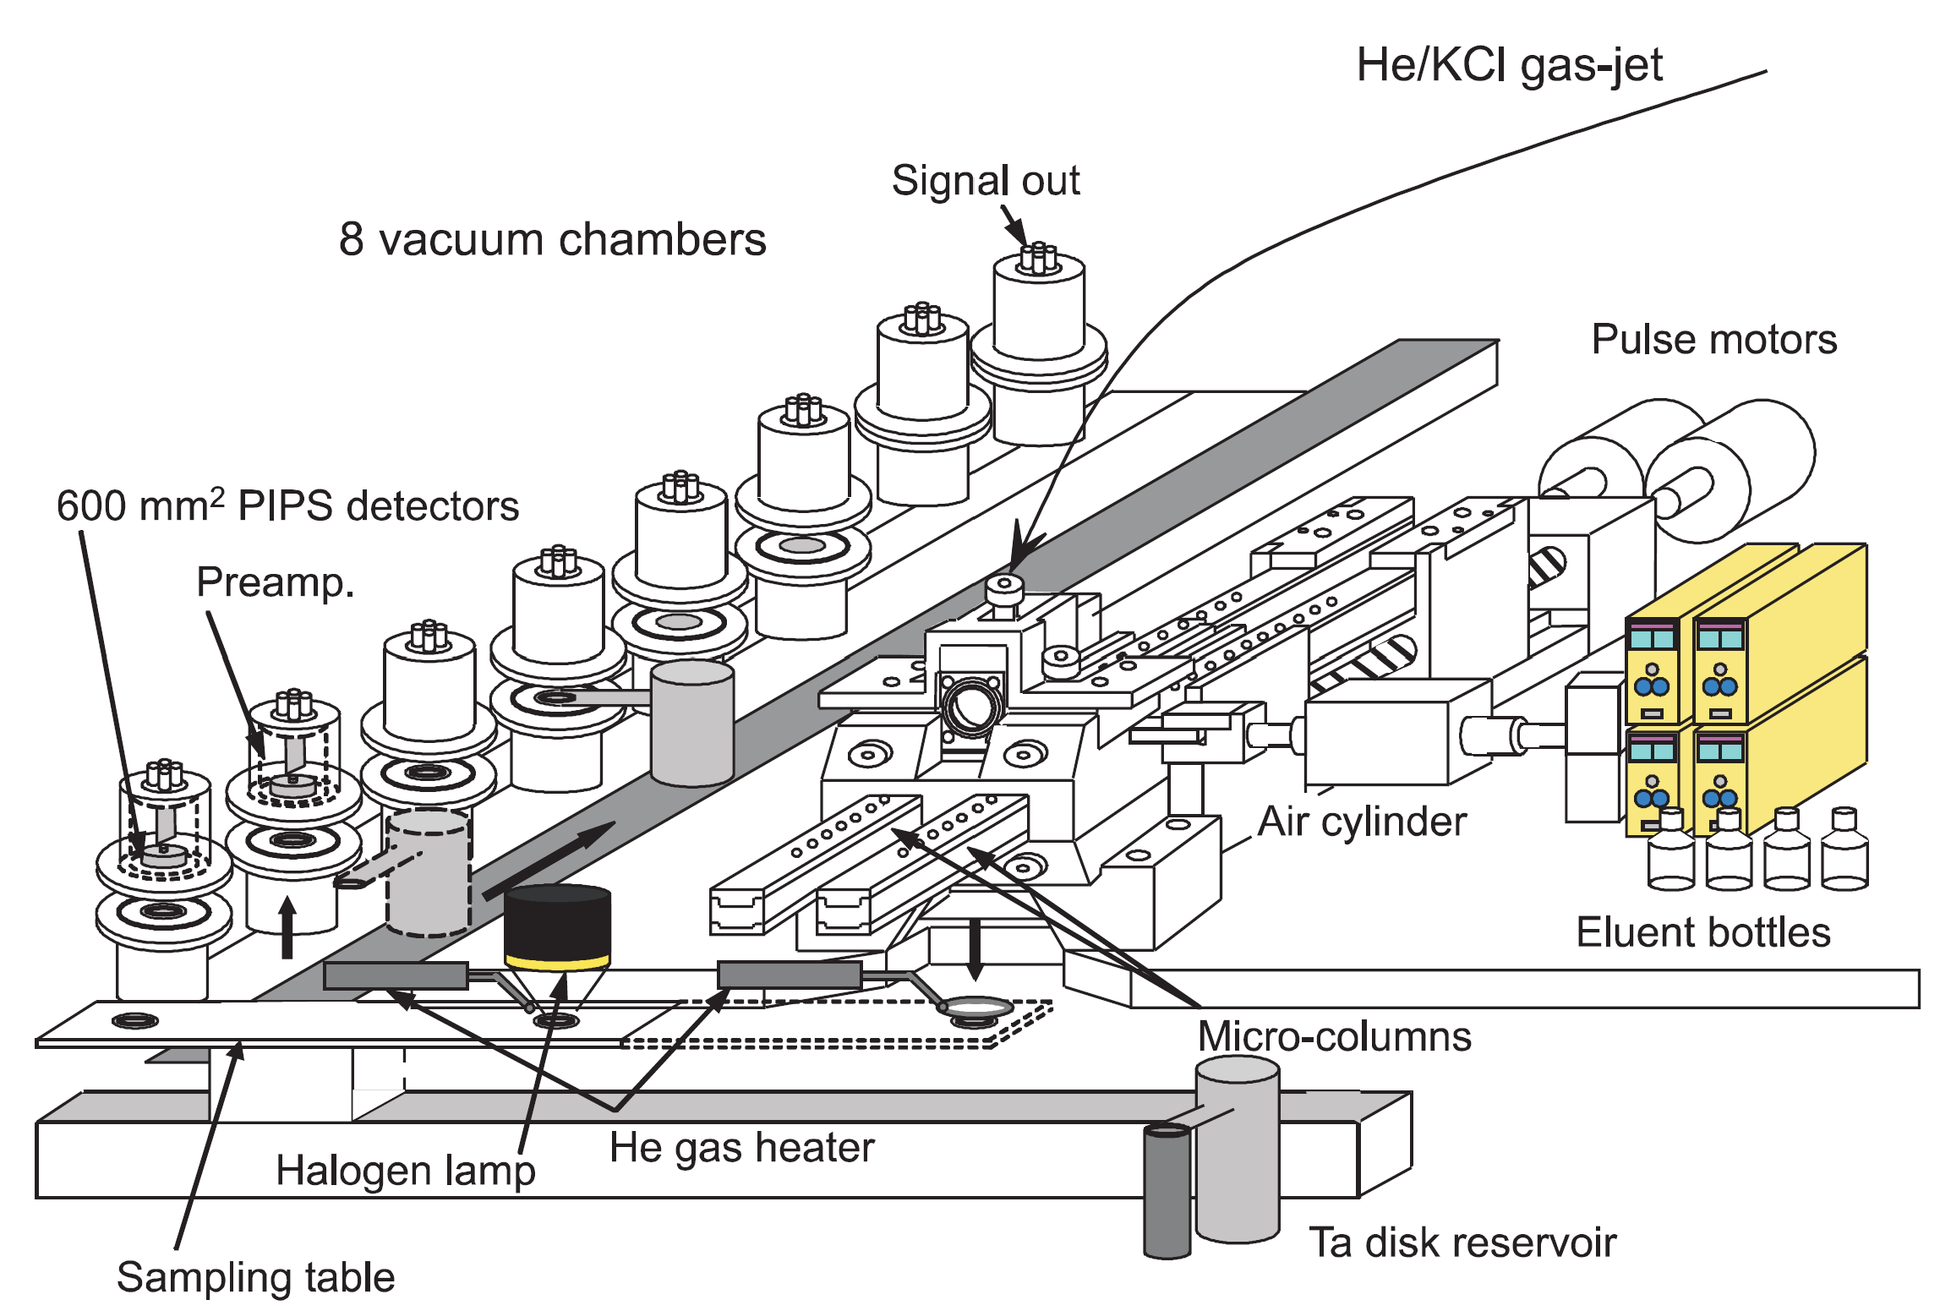
Traditional Method: Ion Exchange Columns
Pros
Can detect if anion (-) or cation (+) complexes are formed
High chemically selectively
Detection techniques sensitive to single atoms
Cons
Qualative measurement – how does SHE compare to other members in its group
Can be slow ➔ limited by SHE lifetime
Elements investigated
Rf (104) – Sg (106)

Slide 38
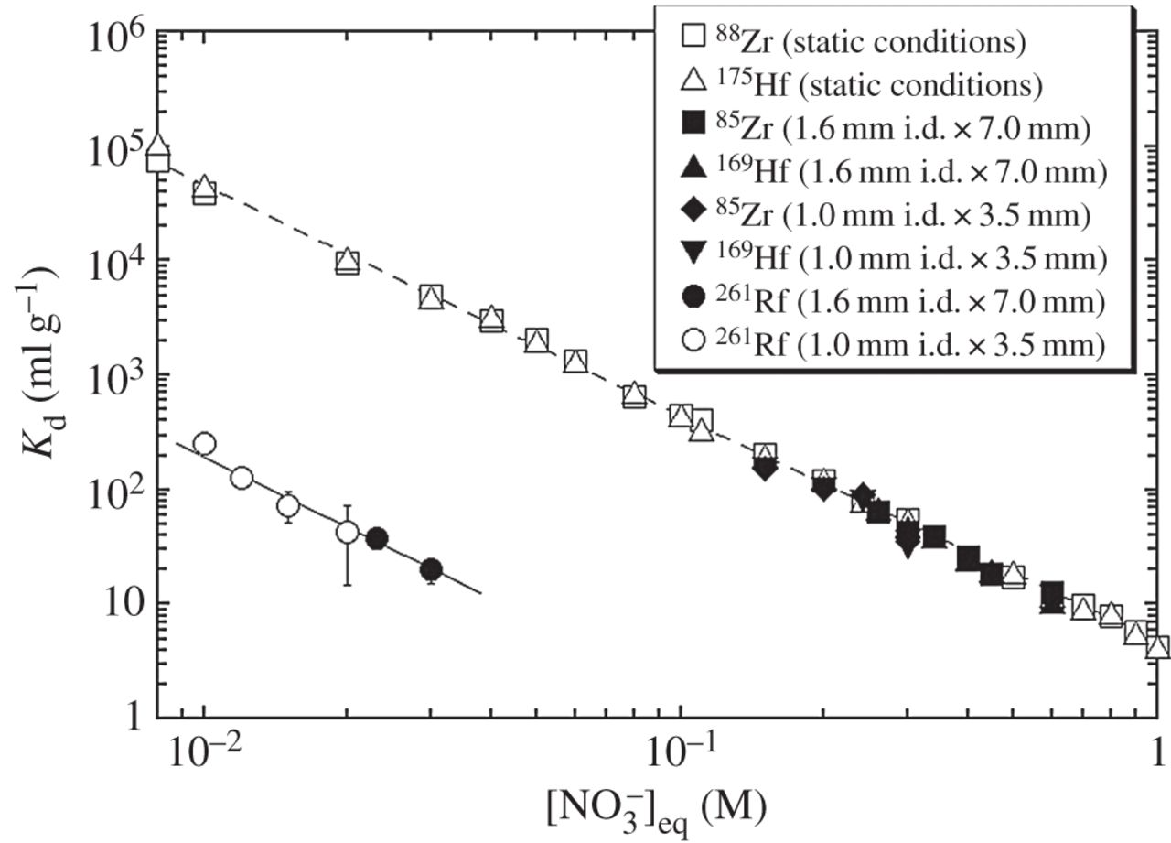
Traditional Method: Ion Exchange Example
Experiment compared extraction of Zr, Hf and Rf from solutions with constant F⁻ concentration and varied [NO₃]⁻
Goal: Compare ability of elements to bind with F⁻
K_{d} = distribution constant ↑ K_{d} = ↑ extraction
[NO₃]⁻ = concentration of anion in solution
Conclusion: Rf has a weaker tendency to form F⁻ complexes compared with Hf and Zr

Slide 39
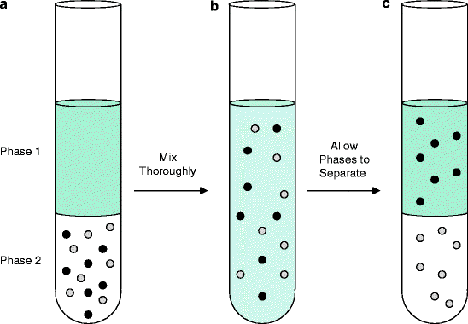
Traditional Method: Liquid/Liquid Extraction
Step 1: Get a SHE into liquid solution
Capture SHE in a gas jet
Automated system to extract from gas jet
Step 2: Add organic solution containing extractant
Step 3: Mix thoroughly
Step 4: Centrifuge solution to separate organic and aqueous
Step 5: Detect how many SHE are in each phase
Ratio of molecules in each phase depends on complexes that are formed and stability of those complexes

Slide 40



Traditional Method: Liquid/Liquid Extraction
Pros
High chemically selectively
Detection techniques sensitive to single atoms
Cons
Qualative measurement – how does SHE compare to other members in its group
Can be slow ➔ Limited by kinematics
Elements investigated
Rf (104) – Sg (105)

Slide 41

Traditional Method: Gas Chromatography
Hassium
Step 1: Stop SHE
Usually high purity Helium, sometimes He + reactive gas (O, CO)
Step 2: flow gas through heater (optional)
SHE ions/atoms carried in the gas
Step 3: Flow gas over array of pin-diode detectors
Temperature gradient from room temp to LN temperature
Elements stick to column based on product and its adsorption enthalpy
Step 4: Detect decay of SHE
Decay indicates position of adsorption
Osmium
Beam
Rotating
Target
Helium
20°C – Temperature – -176°C
Duellmann, Ch.E. Nature 418 (2002) 859: https://doi.org/10.1038/nature00980
PIN Diode Detectors

Slide 42

Isothermal chromatography with short-lived radionuclides
Heat source (e.g. resistance oven)
Escape detector
Read-out
electronics
100%
Relative yield, %
-ΔH_{ads} = 150 kJ / mol
-ΔH_{ads} = 160 kJ / mol
-ΔH_{ads} = 170 kJ / mol
Rf – Bh as halides and
oxyhalides
0%
300
350
400
450
500
550
600
650
700
750
800
850
Temp., ⁰C
Slide courtesy of P. Steinegger

Slide 43


Traditional Method: Gas Chromatography
Negative temperature gradient
Detector channel
100%
-DH_{ads} = 60 kJ / mol
-DH_{ads} = 70 kJ / mol
Relative yield, %
-DH_{ads} = 80 kJ / mol
Rf – Hs as halides, oxyhalides, and oxides + Cn, Fl, and Nh (elemental?)
0%
1
2
3
4
5
6
7
8
9
10
11
12
Slide courtesy of P. Steinegger
Channel length, cm
43

Slide 44

Traditional Method: Gas Chromatography
Pros
Detection techniques sensitive to single atoms
Faster ➔ can be used with lifetimes of ~150 ms
Cons
Qualative measurement – how does SHE compare to other members in its group
Results can be ambiguous
Elements investigated
Rf (104) – Mc (115)

Slide 45
Traditional Method: Gas Chromatography Examples
Experiment compared extraction where Pb, Hg, Rn, and Fl decay on a thermochromatography column ➔ temperate at decay correlated with adsorption enthalpy
Goal: Compare adsorption enthalpies of Fl homologues
Result: Fl adsorbs to gold column at 2 temperatures
Room temperature (Hg-like behavior)
-150 C (Rn-like behavior)
Has been repeated by multiple laboratories
Conclusion: Still being discussed
Yakushev: DOI: 10.3389/fchem.2022.976635

Slide 46

Traditional Method: Gas Chromatography Examples
Experiment compared extraction where Tl, Bi, Nh, and Mc decay on a thermochromatography column ➔ temperate at decay correlated with adsorption enthalpy
Goal: Compare adsorption enthalpies of Mc and Nh with their homologues
Result: Fl adsorbs to gold column at 2 temperatures
Room temperature (Hg-like behavior)
-150 C (Rn-like behavior)
Has been repeated by multiple laboratories
Conclusion: Still being discussed
Yakushev: DOI: 10.3389/fchem.2024.1474820

Slide 47


New(ish) Technique: Ionization Potentials
Ionization potential ➔ How much energy is required to remove electron from an element
Produced ²⁵⁶Lr and neutralized it in a He/CdI₂ gas mixture
Transported ²⁵⁶Lr atoms to ionization cavity
Ionized ²⁵⁶Lr on tantalum surface
Counted number of ²⁵⁶Lr ionized
Sato, T.K.: Nature 520, 209 (2015): https://doi.org/10.1038/nature14342
Sato, T.K.: JACS 140 (2018) 14609: https://doi.org/10.1021/jacs.8b09068

Slide 48


New(ish) Ionization Potentials
Well-known relationship between ionization efficiency and ionization potential
φ = material dependent work function
K = Boltzmann constant
T = temperature of ionizing surface
N = effective number of atom-surface interactions
Sato, T.K.: Nature 520, 209 (2015): https://doi.org/10.1038/nature14342
Sato, T.K.: JACS 140 (2018) 14609: https://doi.org/10.1021/jacs.8b09068

Slide 49

New(ish) Technique: Ionization Potentials
Pros
Quantitative measurement
Cons
Low efficiency
Ionization potential not precisely known ➔ scan over temperatures
Elements investigated
No (103) and below
Sato, T.K.: Nature 520, 209 (2015): https://doi.org/10.1038/nature14342
Sato, T.K.: JACS 140 (2018) 14609: https://doi.org/10.1021/jacs.8b09068

Slide 50

New(ish) Technique: Ionization Potential Results
Measured No and Lr ionization potentials
Lr has the most weakly-bound valence electron among all actinides
Confirmed that No closes out the actinide series
Sato, T.K.: Nature 520, 209 (2015): https://doi.org/10.1038/nature14342
Sato, T.K.: JACS 140 (2018) 14609: https://doi.org/10.1021/jacs.8b09068

Slide 51

New Technique: Mass Number Measurements in FIONA
Produce SHE
Stop SHE in Gas Catcher
Detect
Reaccelerate
Separate SHE with the BGS
Perform Chemistry in an RFQ Trap
Separate Reaction Products by Mass Number in FIONA

Slide 52




First Direct Molecule Identifications
Observe Similar Chemical Behavior for Ac and No
Supporting calculations performed by D. Dixon (University of Alabama)
J.L. Pore et al., Nature 644, 376 (2025)

Slide 53
Chemistry Techniques
Gas Chromatography
Ion Exchange, Liquid/Liquid Extraction, FIONA
Ionization Potentials

Slide 54
Science with Single Superheavy Element Atoms
Searching for New Elements
Chemistry
Alpha/Gamma Spectroscopy
Mass Measurements
Atomic Spectroscopy
Alpha/Fission Systematics

Slide 55

Comprehensive Overview of Decay Spectroscopy of SHE
Ackermann: arXiv: https://doi.org/10.48550/arXiv.2501.04053

Slide 56

Ways to do Decay Spectroscopy
Target
Separator

Slide 57
Spectroscopy at the Focal Plane

Slide 58

Spectroscopy at the Focal Plane Detector
Ackermann: arXiv: https://doi.org/10.48550/arXiv.2501.04053

Slide 59

Alpha-gamma spectroscopy
Look for gamma or conversion electron decay in coincidence with alpha decay
Can be used to determine energies/spins/parities of excited states in nuclei

Slide 60
What can we learn from decay spectroscopy?
Proton and neutron arrangements: Observing alpha and gamma rays shows how nucleons organize themselves in extreme conditions.
Magic numbers: Pinpointing excited states and energy levels tests theoretical models where quantum shell effects prevent immediate self-destruction.
Deformed shapes: Data shows how heavy nuclei depart from simple spherical shapes, acting more like viscous drops under high coulomb repulsion.
Element identification
Decay Modes and Stability Limits
Lifetimes and half-lives
Decay chains

Slide 61

Example of Decay Spectroscopy: Evolution of States
Ackermann: arXiv: https://doi.org/10.48550/arXiv.2501.04053

Slide 62
Drive for Spectroscopy of Single Atoms
Historic method for determining mass and proton number:
Watch for alpha decay into ‘long’-lived nuclei that has had a precision measurement performed ➔ X-rays for Z, chemistry or mass measurements for A
None of the new elements/isotopes produced in ⁴⁸Ca+Actinide reactions decay to previously known isotopes ➔ no link can be used to determine A,Z
Assumed physics in ⁴⁸Ca+Actinide same as lighter regions ➔ need A and/or Z measurement
Production rates == 1-10 atoms/week

Slide 63
Decay Spectroscopy of E115
Photon spectra
3n
Alpha spectra
115→113
²⁸⁸115
10.48
171 ms
115→113
113→111
113→111
²⁸⁴113
9.97/9.81
0.97 s
C3 at LBL
111→109
111→109
²⁸⁰111
9.77
3.6 s
109→107
109→107
²⁷⁶109
9.17-9.95
0.54 s
107→105
107→105
²⁷²107
8.73-9.15
12 s
TASISpec
²⁶⁸105
SF
27 h

Slide 64

Decay Spectroscopy of E115
Observed photons in coincidence with alpha-decay
Develop level scheme for low-lying states in ²⁷⁶109 and ²⁷²107
Determine multipolarities for several transitions
Close to identifying single-particle states
Photon spectra
115→113
113→111
111→109
109→107
107→105

Slide 65
K-Isomer Spectroscopy

Slide 66

K – Isomers
K quantum number: total projection of the sum j_{i} of the spin of the nucleon S_{i} and the orbital angular momentum ℓ_{i} of all excited 2-quasi-particle states onto the symmetry axis of the nucleus.
K-Isomers: long-lived states whose decay to ground state is hindered with high K-quantum numbers
Occur in axially-symmetric nuclei near deformed nuclear shells
Ackermann and Theisen: Phys. Scr. 92 083002 (2017)
DOI 10.1088/1402-4896/aa7921

Slide 67

Determining Location of the Next Shells
Single-particle states responsible for the stability of SHE can be probed via:
1) States which are near the ground state in deformed nuclei near Z=102 are also near the ground state for spherical SHE. We can study these states in Z=102-104 with production rates of up to atoms per second.
2) We can produce SHE at rates of nearly 1 atom per day. New capabilities allow us to perform spectroscopy directly with SHE.
114
100
100
82
-0.3 -0.2 -0.1 0.0 0.1 0.2 0.3 0.4 0.5 0.6
Deformation e₂
Nilsson diagram for protons with Z≥82

Slide 68

K-isomers in 257Db
Implant SHE into silicon detector surrounded by (optional) germanium array
Looking to observe low-energy (10-1000s of keV) signals just before the alpha/fission decay of a heavy element ➔ decay of isomeric state
Measure energy of electron transitions and photons emitted during decay ➔ build level scheme to identify nuclear levels
Chakma: Eur. Phys. J. A, 56, 245 (2020) https://doi.org/10.1140/epja/s10050-020-00242-5

Slide 69



K-isomers in ²⁵⁷Db
Electron and gamma rays coincident with ²⁵⁷Db alpha decays
Decay energies of ²⁵⁷Db alphas
Brionnet: Phys. Rev. C 112 (2025) 014320 https://doi.org/10.1103/9xc8-z41p

Slide 70
In-Beam Spectroscopy

Slide 71
Ways to do Decay Spectroscopy
Target
Separator

Slide 72
In-beam Spectroscopy
Probe highly excited nuclear levels populated during de-excitation of a nucleus
Step 1: Surround target with lots of germanium
Step 2: Make SHE in nuclear reaction
Step 3: Observe gamma rays emitted during deexcitation of SHE
GRETINA

Slide 73
In-beam Spectroscopy
Observed gamma ray spectrum from the de-excitation of ²⁵⁶Rf
Picket-fence pattern ➔ emission of photons from rotational states ➔ ²⁵⁶Rf is quadrupole-deformed
Spacing on picket-fence pattern ➔ rotational moment of inertia ➔ orbital level density (bigger energy gap ➔ higher moment of inertia)
Greenlees, P.T. Phys. Rev. Lett., 109 (2012) 012501: http://link.aps.org/doi/10.1103/PhysRevLett.109.012501

Slide 74
Spectroscopy
Alpha-Gamma
K-isomer
In-Beam

Slide 75
Science with Single Superheavy Element Atoms
Searching for New Elements
Chemistry
Alpha/Gamma Spectroscopy
Mass Measurements
Atomic Spectroscopy
Alpha/Fission Systematics

Slide 76

Atomic Masses – Penning Traps
Precise masses can be used to access evolution of neutron shell gaps at N=152 and N=162
Newer techniques such as PI-ICR can identify energies of isomeric states
Downside: Lots of ions required to make measurements ➔ limit to how high in Z measurements can go
Block, M., Nucl. Phys. A, 944 (2015) 471: https://doi.org/10.1016/j.nuclphysa.2015.09.009
Block, M. La Rivista del Nuovo Cimento 45 (2022) 279: https://doi.org/10.1007/s40766-022-00030-5
Notes:
Two-neutron shell gap parameter at N=152 for Z=97–105 (top figure) and two-neutron shell gap parameters for Z=106,108,110 as a function of the neutron number (bottom figure) after the incorporation of our results into the AME. Data points are divided into filled (33% contribution from our work) and empty (no contribution).
N=152 shell gap strongest at Z=101, the drops at Z=102, error on Z>102 is too high to determine

Slide 77


Atomic Masses – Penning Trap
B-field
=
E-field
Force
Ion in B field
Strong magnetic field (~6T) + set of hyperboloid-shaped electrodes (Penning Trap) provides 3-D confinement
This causes trapped ions undergo 3 modes of motion inside the trap (two radial, one axial)
Cyclotron motion with frequency ν_{c}, is described by the two radial modes
m is the mass of the trapped ion, q is the ion’s charge, B is the magnetic field at the trap center.
ν- is called magnetron motion (~ kHz)
ν+ is the modified cyclotron motion (~MHz)
$$ν_{c}=\frac{qB}{2πm}=ν_{−}+ν_{+}$$
Slide courtesy of R. Orford
Notes:
The fields are oriented in such a way that an electrostatic potential well is created along the magnetic field lines. In such a configuration, the magnetic field confines the ion motion to the plane perpendicular to the magnetic field lines (radial motions), whereas the electrostatic potential well traps ions along the magnetic field lines (axial motion)

Slide 78
Atomic Masses – Penning Trap
Block, M., Nucl. Phys. A, 944 (2015) 471: https://doi.org/10.1016/j.nuclphysa.2015.09.009
Block, M. La Rivista del Nuovo Cimento 45 (2022) 279: https://doi.org/10.1007/s40766-022-00030-5

Slide 79




Measure the cyclotron frequency to determine the ion’s mass
Two main ways to do that:
$$ν_{c}=\frac{qB}{2πm}=ν_{−}+ν_{+}$$
2) Phase-imaging ion cyclotron resonance (PI-ICR)
v_{c} determined from the angular advance of a trapped ions motion inside the trap over some period of time
Use a position-sensitive MCP to measure the projected location of the ions inside the trap at two different times.
1) Time-of-flight ion cyclotron resonance (TOF-ICR)
v_{c} determined applied rf frequency which gives results in the minimum TOF of the ejected ions (measured from trap ejection to MCP detector)
Standard mass measurement technique since 2013

Slide 80

Atomic Masses – Penning Trap
Shaded = Mass measurement performed
Open = Mass measurement planned
Block, M., Nucl. Phys. A, 944 (2015) 471: https://doi.org/10.1016/j.nuclphysa.2015.09.009
Block, M. La Rivista del Nuovo Cimento 45 (2022) 279: https://doi.org/10.1007/s40766-022-00030-5
Notes:
Direct mass measurements in the region of the heaviest nuclides. Direct measurements with TRIGA-TRAP [69] (magenta), SHIPTRAP [66, 67] (red) and the RIKEN MR-ToF [70] (orange) are marked in color. Measurements that are planned or have been performed but are yet unpublished are indicated by the open squares

Slide 81
Question: can we obtain high-resolution mass measurements with fewer atoms?

Slide 82

Atomic Masses – MR-TOF
Multi-Reflection Time-of-Flight (MR-TOF)
Accelerate ions across a known voltage gap ➔ ion velocity depends on mass
Inject ions into field-free drift region as a bunch
Trap ion between two electrostatic mirrors
Ions separate during flight path according differing A/q
$$E_{kin}=mv^{2}$$
ions
Mirror 1
Free-drift Region
Mirror 2
Deflector
To detector

Slide 83


Atomic Masses – MR-TOF
Observed time-of-flight and alpha decay energy for 11 events attributed to ²⁵⁷Db and its daughters
Schury, P. Phys. Rev. C 104 (2021) L021304: https://doi.org/10.1103/PhysRevC.104.L021304

Slide 84
Question: how about even fewer atoms?

Slide 85
Drive for Mass Measurements of Single Atoms
Historic method for determining mass and proton number
Watch for alpha decay into ‘long’-lived nuclei that has had a precision measurement performed ➔ X-rays for Z, chemistry or mass measurements for A
None of the new elements/isotopes produced in ⁴⁸Ca+Actinide reactions decay to previously known isotopes ➔ no link can be used to determine A,Z
Assumed physics in ⁴⁸Ca+Actinide same as lighter regions ➔ need A and/or Z measurement
Production rates == 1-10 atoms/week

Slide 86
New Technique: Mass Number Measurements in FIONA
Produce SHE
Stop SHE in Gas Catcher
Detect
Reaccelerate
Separate SHE with the BGS
Capture in RFQ Trap
Separate Reaction Products by Mass Number in FIONA

Slide 87




FIONA
Position on silicon detector at exit of mass separator denotes mass number ➔ not a high precision device
One decay each of Mc and Nh from ⁴⁸Ca+²⁴³Am fell at masses 280 and 284 ➔ production of 3n exit channel and ²⁸⁸Mc/²⁸⁴Nh
First mass measurement in ⁴⁸Ca+Actinides
Gates, J.M.: PRL 121 (2018) 222501: https://doi.org/10.1103/PhysRevLett.121.222501

Slide 88
Mass Measurements
FIONA
MR-ToF
Penning Traps

Slide 89
Science with Single Superheavy Element Atoms
Searching for New Elements
Chemistry
Alpha/Gamma Spectroscopy
Mass Measurements
Atomic Spectroscopy
Alpha/Fission Systematics

Slide 90

New(ish) Technique: Laser Spectroscopy
Probe the excited states of electrons
What we can learn from laser spectroscopy
Energies of excited states
Ionization potential
How these change with isotope number
nuclear spin
magnetic moments
charge distribution radius.

Slide 91
New(ish) Technique: Laser Spectroscopy
Step a: Stop SHE
High purity He gas
Step b: Neutralize SHE
Attract to neutralizing filament
Pulse filament to remove SHE
Step c: Excite SHE electrons
1 or 2 laser excitations
Step d: Ionize SHE
Step e: Detect

Slide 92
New(ish) Technique: Laser Spectroscopy
Step a: Stop SHE
High purity He gas
Step b: Neutralize SHE
Attract to neutralizing filament
Pulse filament to remove SHE
Step c: Excite SHE electrons
1 or 2 laser excitations
Step d: Ionize SHE
Step e: Detect

Slide 93
New(ish) Technique: Laser Spectroscopy
Pros
Quantitative measurement
Obtain nuclear information
Cons
Low efficiency ➔ only used for ‘high’-rate SHE
Excited states are not precisely known ➔ scan over multiple frequencies
Slow ➔ required lifetimes ~s
Elements investigated
No (102) and below
Block, M., Nucl. Phys. A, 944 (2015) 471: https://doi.org/10.1016/j.nuclphysa.2015.09.009
Block, M. La Rivista del Nuovo Cimento 45 (2022) 279: https://doi.org/10.1007/s40766-022-00030-5

Slide 94

New(ish) Technique: Laser Spectroscopy
Experiment investigated excited states in ²⁵⁴No using laser spectroscopy
Goal: Measured atomic levels of ²⁵⁴No – Identified 30 Rydberg states – highly excited electronic states of an atom
Result: Able to detect Series 1, 2 & 3
Later performed similar measurements on ^{252,253}No
Chhetri, P. Phys. Rev. Lett. 120 (2018) 263003: https://doi.org/10.1103/PhysRevLett.120.263003

Slide 95

New(ish) Technique: Laser Spectroscopy Results
Deformation parameter B2 for even-even isotopes
Relative depth of central depression:
^{252,253,254}No = strong quadrupole deformation with central depression
Raeder, S. Phys. Rev. Lett. 120 (2018) 232503: https://doi.org/10.1103/PhysRevLett.120.232503
Notes:
Upper panel: Deformation parameter β2 for different even-even isotopes of Th, U, Pu, Cm, and No obtained from the DFT calculations with the UNEDF1 functional. The inset figure shows the calculated proton distribution of 254No from highest density (red) to low density (blue). Lower panel: Relative depth of the central depression.

Slide 96
Mass Measurements
Atomic Spectroscopy

Slide 97
Science with Single Superheavy Element Atoms
Searching for New Elements
Chemistry
Alpha/Gamma Spectroscopy
Mass Measurements
Atomic Spectroscopy
Alpha/Fission Systematics

Slide 98

Spontaneous Fission Lifetimes
Plot of spontaneous fission partial half-lives for known fission emitters
Strong N=152 shell in lighter isotopes
year
second
Khuyagbaatar, J.: Nucl. Phys. A 1002 (2020) 121958: https://doi.org/10.1016/j.nuclphysa.2020.121958

Slide 99
Fission Fragment Masses
Can observe the evolution of fragment mass yields for actinide and transactinide isotopes
Lane, M.R. Phys. Rev. C 53 (1996) 2893: https://doi.org/10.1103/PhysRevC.53.2893
Notes:
Left: Average or most probable TKE vs Z2/A1/3. The solid line is the linear fit of Viola and the dashed line is the linear fit of Unik. The superscripts ``h’’ and ``l‘’ represent the high-and low-energy components of the bimodal nuclei. For Z104 the element sybmols are denoted by Rf(Z104) and Ha(Z105). FromRef.25.
Right: mass-yield distributions

Slide 100


Total Kinetic Energy
TKE Distributions for actinide and transactinide nuclides
Symmetric fission
Lane, M.R. Phys. Rev. C 53 (1996) 2893: https://doi.org/10.1103/PhysRevC.53.2893
Notes:
Left: Average or most probable TKE vs Z2/A1/3. The solid line is the linear fit of Viola and the dashed line is the linear fit of Unik. The superscripts ``h’’ and ``l‘’ represent the high-and low-energy components of the bimodal nuclei. For Z104 the element sybmols are denoted by Rf(Z104) and Ha(Z105). FromRef.25.
Right: TKE distributions
Stuff to see: multicomponent TKE for several isotopes like 262No, 260Md, 258No, 259Md, 258Fm. Bimodal fission results from 2 fission paths, 1 leading to symmetric, compact spherical shapes ➔ high TKE and the other leading to symmetric, elongated shapes which have a lower TKE.

Slide 101
Alpha Decay

Slide 102
Alpha Spectroscopy
Any SHE that alpha decays can be used to investigate alpha spectroscopy
Setups with lower FWHM for alpha energies ➔ more beneficial

Slide 103

Alpha Decay Half-life
Can measure alpha decay energies and half-lives for all isotopes observed to decay via alpha
Trends in alpha-decay energies show influence of a shell at N=162
Evidence of potential neutron closed shell near N=184?
Oganessian, Yu.Ts., Phys. Today 68 (2015) 32: https://doi.org/10.1063/PT.3.2880
Notes:
he dependence of alpha decay half-lives on neutron number. Solid and open symbols correspond to nuclei with odd and even numbers of neutrons, respectively. The symbols indicate atomic numbers—pentagons for 107, triangles for 109, upside-down triangles for 111, diamonds for 113, circles for 115, and squares for 117. The dashed lines are guides to the eye and labeled with corresponding atomic numbers. Nuclei synthesized in hot-fusion reactions with calcium-48 projectiles are shown in orange; in cold-fusion reactions, blue; and in other reactions, black. For nuclei with neutron number N > 165, half-lives grow by orders of magnitude with increasing N. The stability of those nuclei against alpha decay is enhanced for larger neutron numbers. The positions of neutron magic numbers, the established N = 152 and N = 162 and the predicted N = 184, are indicated by gray dot-dashed vertical lines.

Slide 104

Alpha energy systematics
Can use known alpha decay energies to hone theories of nuclear structure
Olsen, E., Phys. Rev. C 99 (2019) 014317: https://doi.org/10.1103/PhysRevC.99.014317

Slide 105

Alpha decay
Honing theories allows us to look and identify new isotopes through observations of isotopic chains and comparisons to theory
Olsen, E., Phys. Rev. C 99 (2019) 014317: https://doi.org/10.1103/PhysRevC.99.014317

