Slide 1


Astrophysical Modelling
Vishnu Varma

Slide 2
Day 1 : Nuclear Astrophysics Processes
Day 2 : Observation of Nucleosynthesis
Day 3: Modelling in nuclear astrophysics
Nucleosynthesis modelling
Transient modelling
Galactic chemical evolution
Stellar modelling

Slide 3
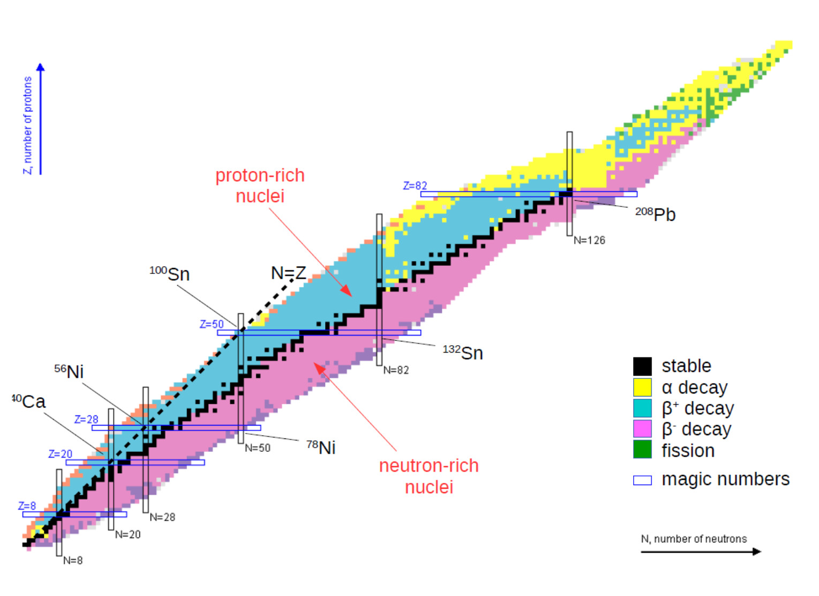
Nucleosynthesis modelling
I will be using pynucastro for many of my examples: https://pynucastro.github.io/

Slide 4
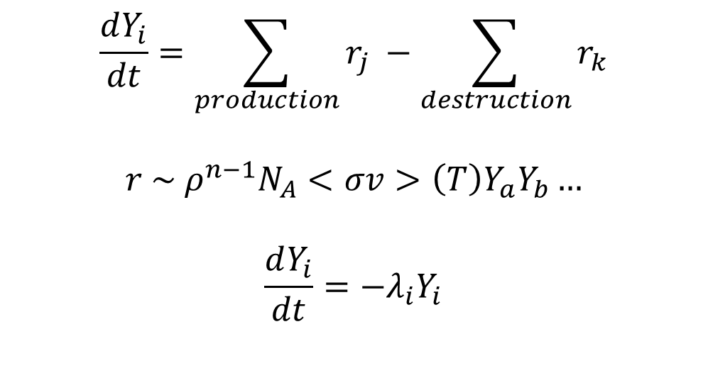
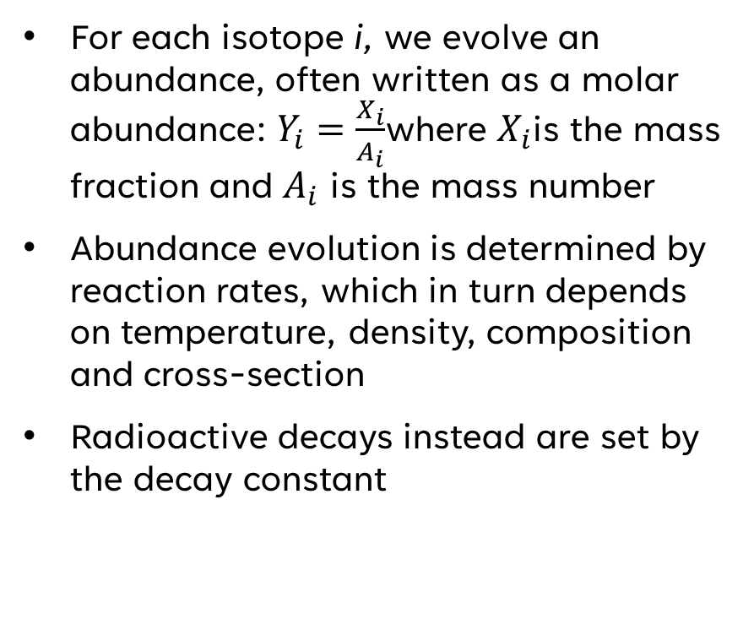
Modelling basics
For each isotope i, we evolve an abundance, often written as a molar abundance: $Y_{i}=\frac{X_{i}}{A_{i}}$where $X_{i}$is the mass fraction and $A_{i}$ is the mass number
Abundance evolution is determined by reaction rates, which in turn depends on temperature, density, composition and cross-section
Radioactive decays instead are set by the decay constant
$$\frac{dY_{i}}{dt}=\sum_{production}{r_{j}} −\sum_{destruction}{r_{k}}$$
$$r \sim ρ^{n−1}N_{A}<σv>\left(T\right)Y_{a}Y_{b}…$$
$$\frac{dY_{i}}{dt}=−λ_{i}Y_{i}$$

Slide 5
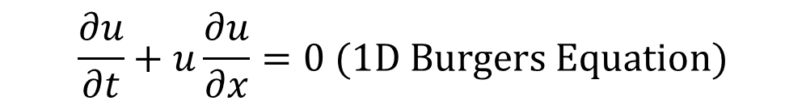
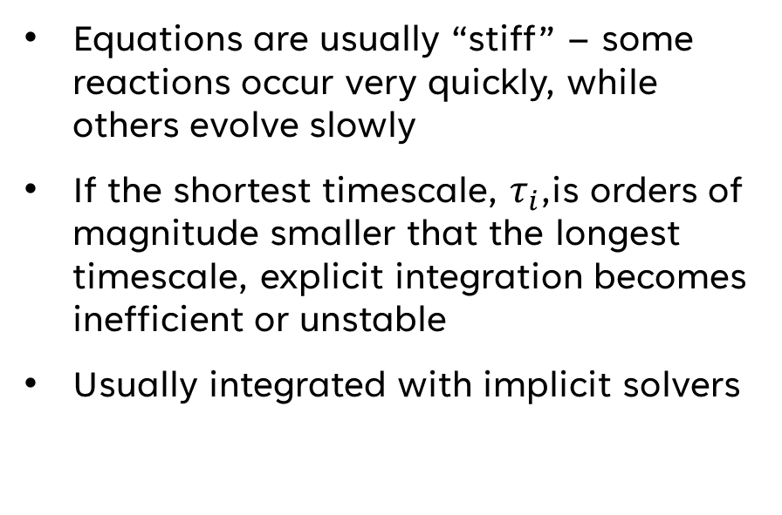
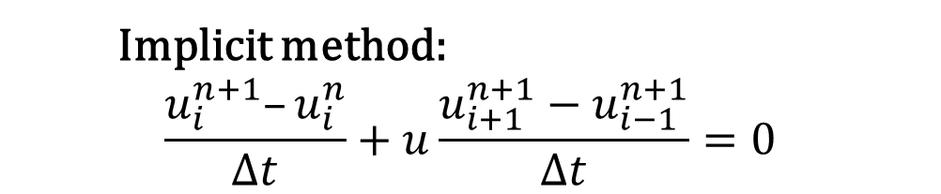
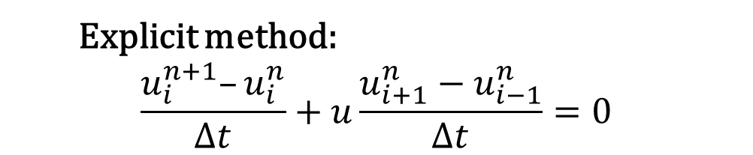
Modelling basics (Numerical integration)
$$\frac{∂u}{∂t}+u\frac{∂u}{∂x}=0 (1D Burgers Equation)$$
Equations are usually “stiff” – some reactions occur very quickly, while others evolve slowly
If the shortest timescale, $τ_{i}$,is orders of magnitude smaller that the longest timescale, explicit integration becomes inefficient or unstable
Usually integrated with implicit solvers
Explicit method:
$$\frac{u_{i}^{n+1}–u_{i}^{n}}{Δt}+u\frac{u_{i+1}^{n}−u_{i−1}^{n}}{Δt}=0$$
Implicit method:
$$\frac{u_{i}^{n+1}–u_{i}^{n}}{Δt}+u\frac{u_{i+1}^{n+1}−u_{i−1}^{n+1}}{Δt}=0$$

Slide 6

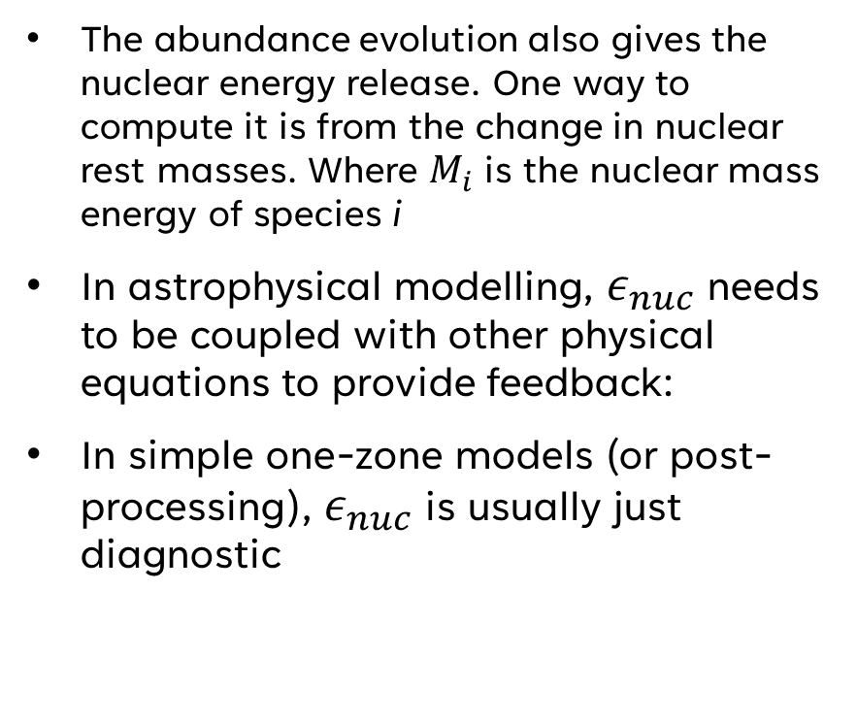

Modelling basics (Energy generation)
The abundance evolution also gives the nuclear energy release. One way to compute it is from the change in nuclear rest masses. Where $M_{i}$ is the nuclear mass energy of species i
In astrophysical modelling, $ε_{nuc}$ needs to be coupled with other physical equations to provide feedback:
In simple one-zone models (or post-processing), $ε_{nuc}$ is usually just diagnostic
$$ΔE=−N_{A}\sum_{i}{ΔY_{i}M_{i} → } ε_{nuc}=\frac{dE}{dt}$$
$$c_{V}\frac{dT}{dt} =ε_{nuc} − ε_{nuc} − P\frac{d}{dt}\left(\frac{1}{ρ}\right)$$

Slide 7
WHAT GOES INTO A NUCLEAR NETWORK?
Isotope list and nuclear masses
Thermonuclear reaction rates and reverse rates
Weak rates, electron captures and β-decays
Screening corrections and partition functions
For r-process networks: neutron captures, photodisintegration, fission and decay chains
Small in-situ networks may have 10–100 species; post-processing networks may have hundreds to thousands
A reaction network Jacobian for a 13 species α-chain network (Credit: Frank Timmes – cococubed.com)

Slide 8
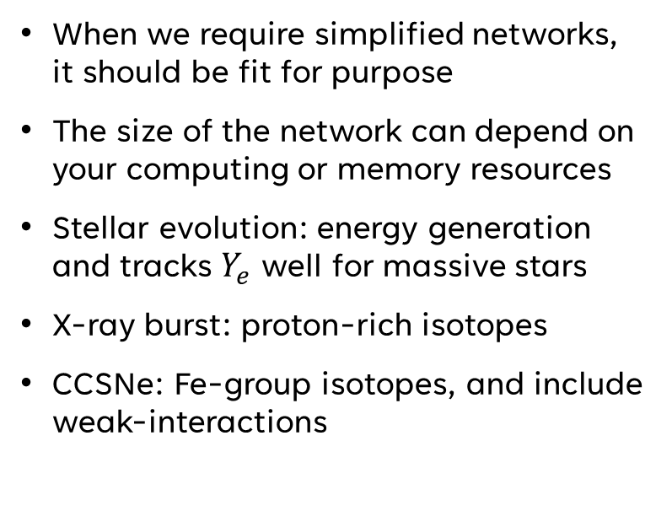
How to craft a nuclear Network
When we require simplified networks, it should be fit for purpose
The size of the network can depend on your computing or memory resources
Stellar evolution: energy generation and tracks $Y_{e}$ well for massive stars
X-ray burst: proton-rich isotopes
CCSNe: Fe-group isotopes, and include weak-interactions
A few α-chain network variations (Credit: Frank Timmes – cococubed.com)

Slide 9
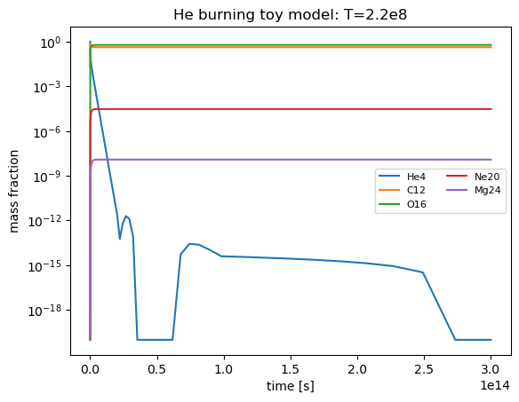
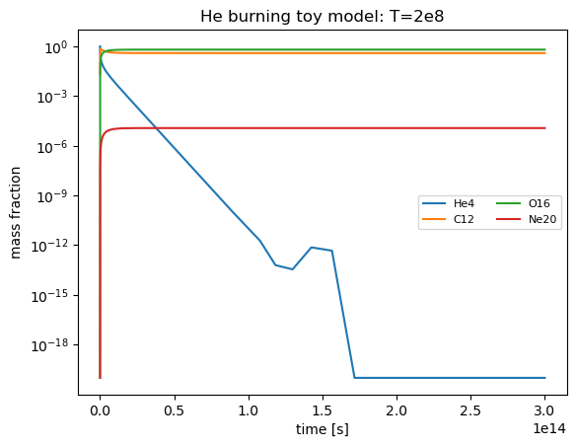
ONE-ZONE MODELLING
choose T(t), ρ(t)
network
abundances
interpret
Simplest controlled experiment: choose one thermodynamic history
Can be fixed T, ρ; an analytic expansion; or a trajectory from a simulation
Useful for identifying reaction flows and sensitivity to uncertain rates
Caveat: no self-consistent dynamics, mixing, shocks or radiation feedback
6

Slide 10
IN-SITU NUCLEOSYNTHESIS
burning
heating
motion / expansion
new T, ρ
Solves dYᵢ/dt = Rᵢ(T,ρ,{Yⱼ}) during the model run
Nuclear energy generation is included in the energy equation
Needed when burning drives convection, expansion, shocks or bursts
More accurately deals with the coupling between mixing and nuclear reactions
Examples: stellar burning, Type Ia flames, X-ray bursts, convective-reactive flows
Small networks are faster, but less complete isotopically
Models can become too memory intensive or numerically unstable with large numbers of isotopes
8
Notes:
Add image? Maybe gif or something showing energy generation?

Slide 11
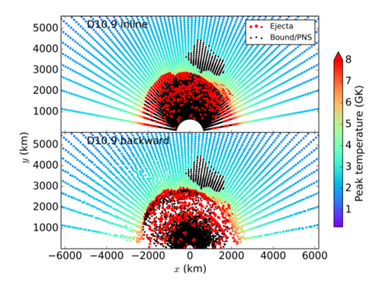
POST-PROCESSING NUCLEOSYNTHESIS
simulation
trajectories
large network
yields
Done after modelling as a secondary step, using thermodynamic trajectories
Extract thermodynamic histories from zones, shells or tracer particles
Evolve a large network afterwards for detailed isotopic yields
Relies on well sampled data output from models
Caveat: post-processing cannot fix wrong trajectories, mixing, fallback or Yₑ
Comparison of tracer particles calculated during simulation and those run through backwards integration (Sieverding et al 2023)
9

Slide 12
Nucleosynthesis modelling
In-situ
Solves the nuclear reactions during the modelling process
More accurately deals with the coupling between mixing and nuclear reactions
Models can become too memory intensive or numerically unstable with large numbers of isotopes
Post-processing
Done after modelling as a secondary step, using thermodynamic trajectories
Relies on well sampled data output from models
Possible to utilise a full range of isotopes and reactions, however, relies on accuracy of interpolation

Slide 13
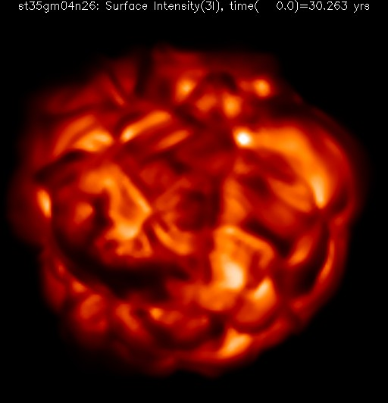
Stellar Modelling

Slide 14
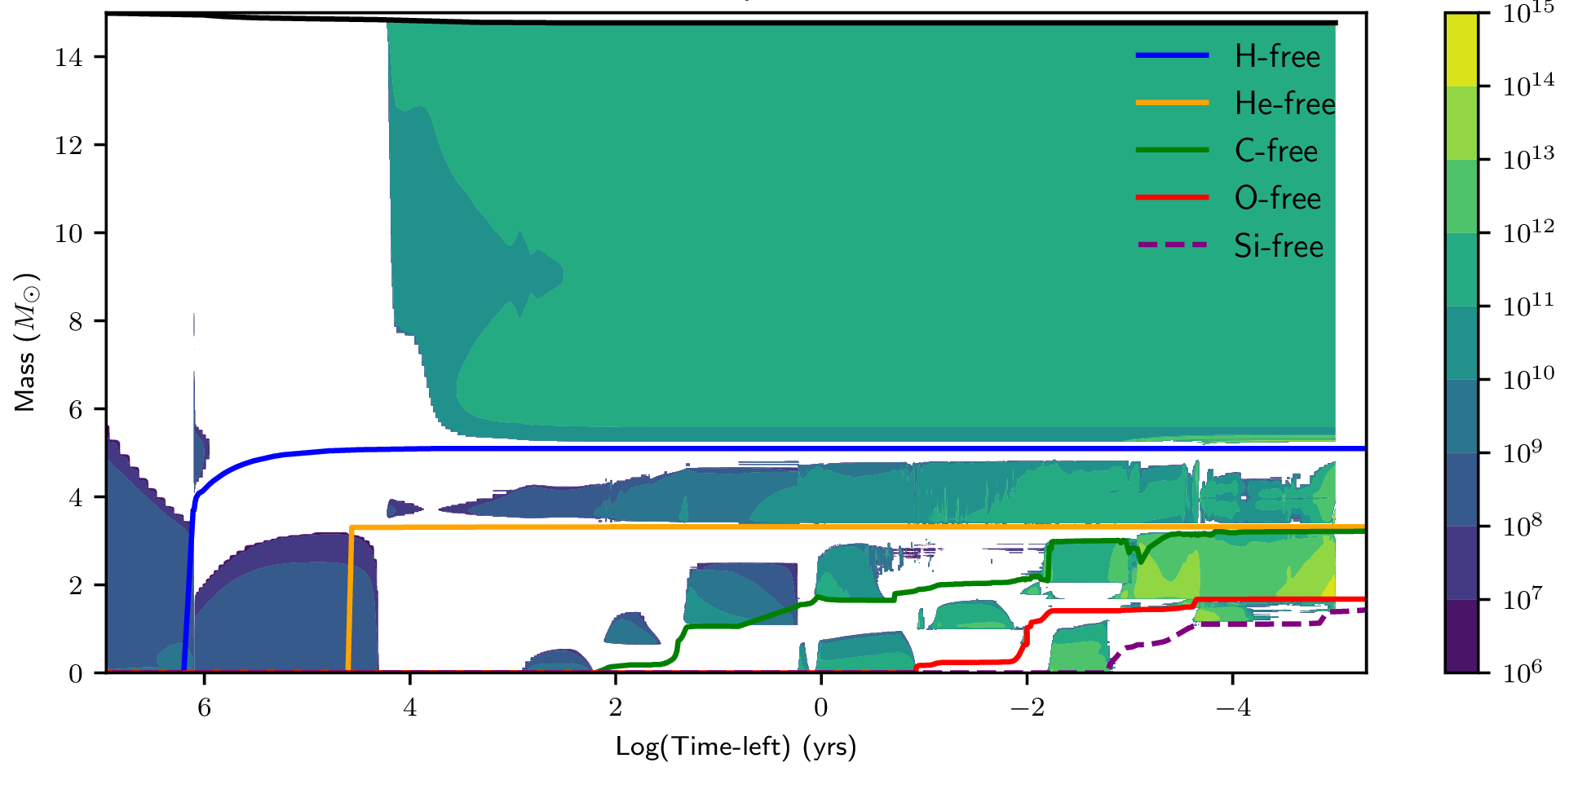
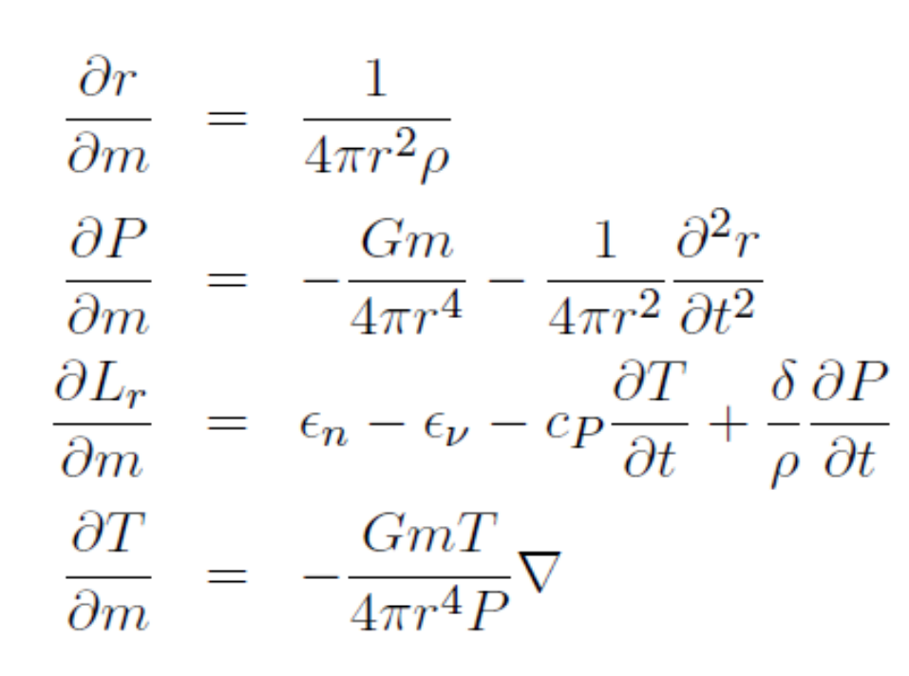
1D STELLAR EVOLUTION
A star is divided into radial mass zones and evolved through its lifetime
Codes solve hydrostatic structure (stellar structure equations), burning, mixing, mass loss and composition changes
Multidimensional and mixing processes are represented by prescriptions (e.g. convection, magnetic fields)
In-situ networks capture H, He, C, Ne, O and Si burning energetics

Slide 15
1D STELLAR EVOLUTION
In-situ network must reproduce the energy generation of each burning phase
Composition evolves with mixing: ∂Xᵢ/∂t = nuclear + mixing
The network can affect lifetimes, core masses, entropy and pre-collapse structure
Late massive-star evolution requires careful treatment of Si burning and Yₑ
Multidimensional and mixing processes are represented by prescriptions (e.g. convection, magnetic fields)
In-situ networks capture H, He, C, Ne, O and Si burning energetics

Slide 16
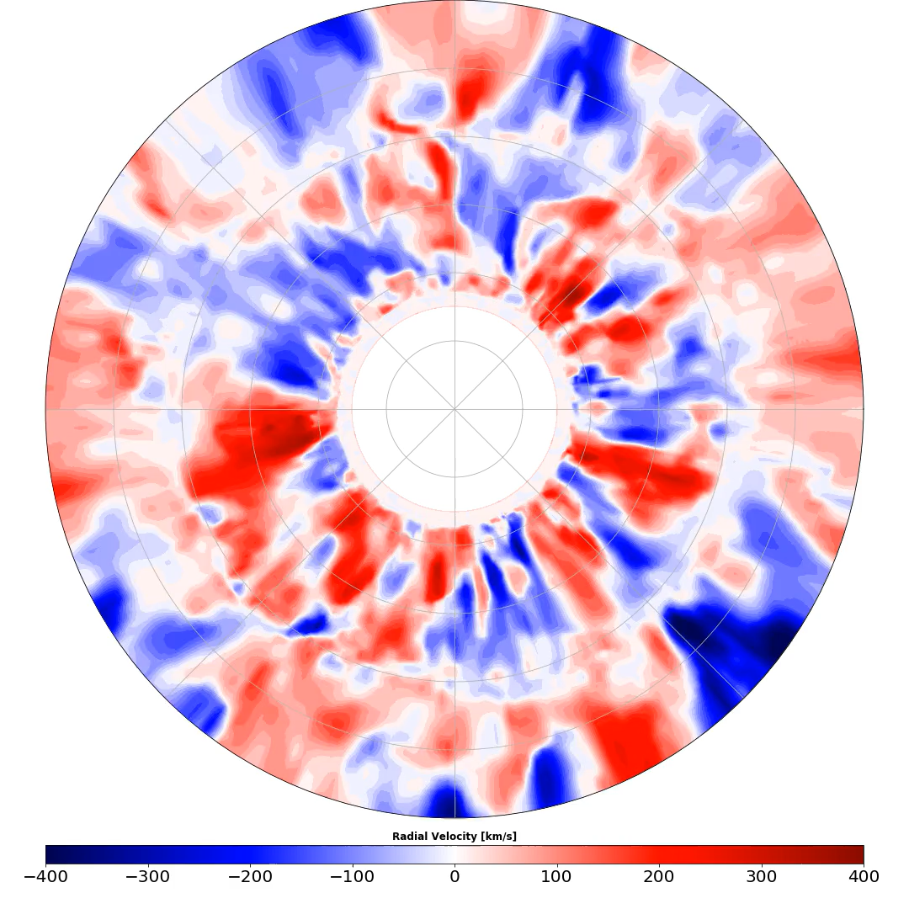
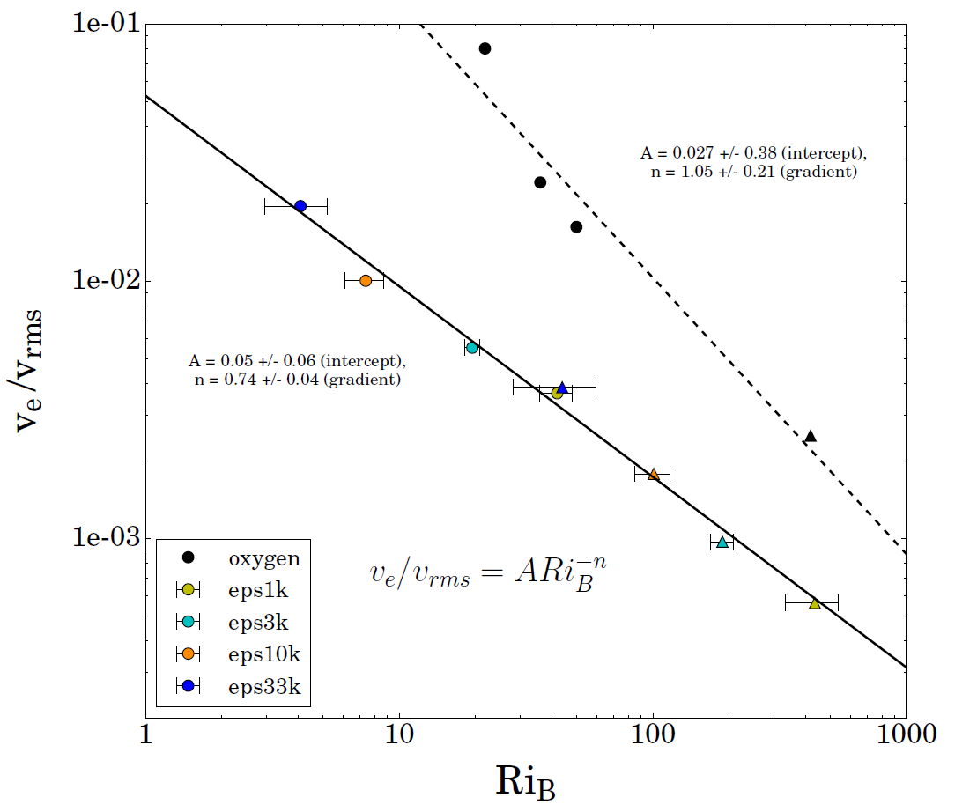
3D STELLAR CONVECTION
Resolve turbulent flows, entrainment and shell interactions more directly
Follows a limited burning region. Impossible to follow full stellar lifetime
Reduced in-situ networks capture local energy generation
Useful to understand realistic physical processes (convection, magnetic fields)
Can be used to develop and refine prescriptions in 1D models

Slide 17
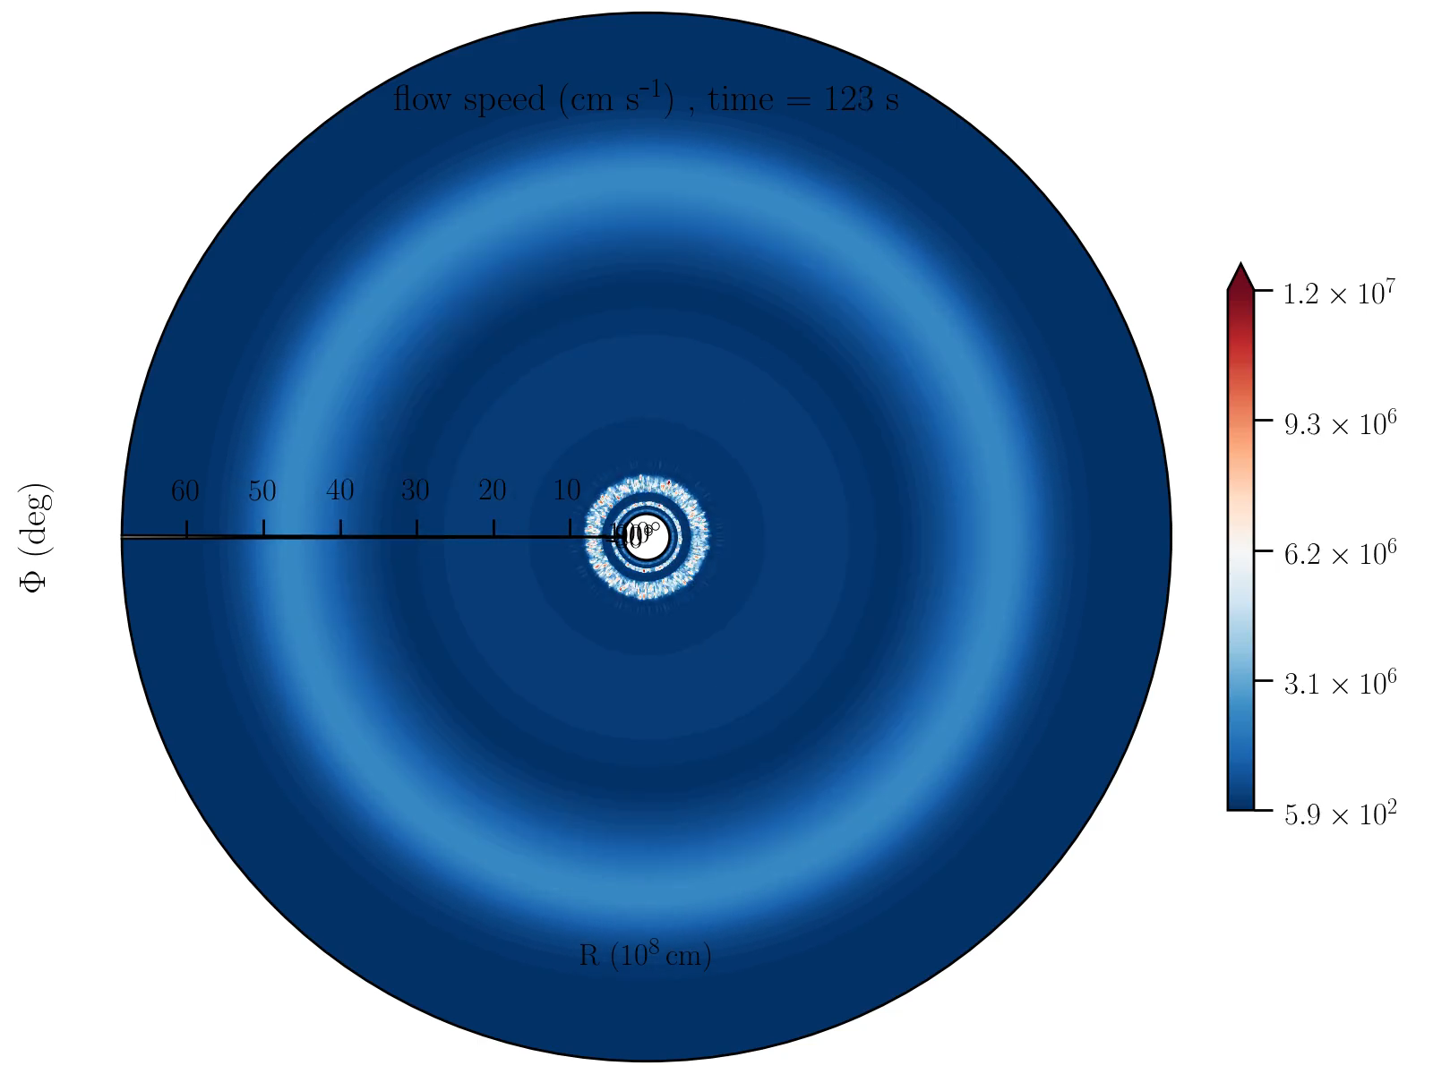
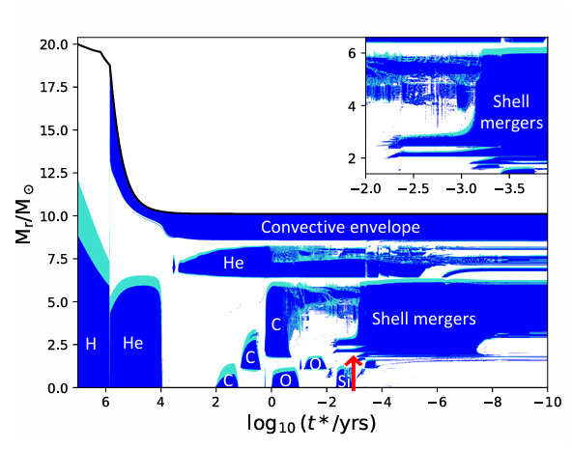
3D Stellar convection

Slide 18
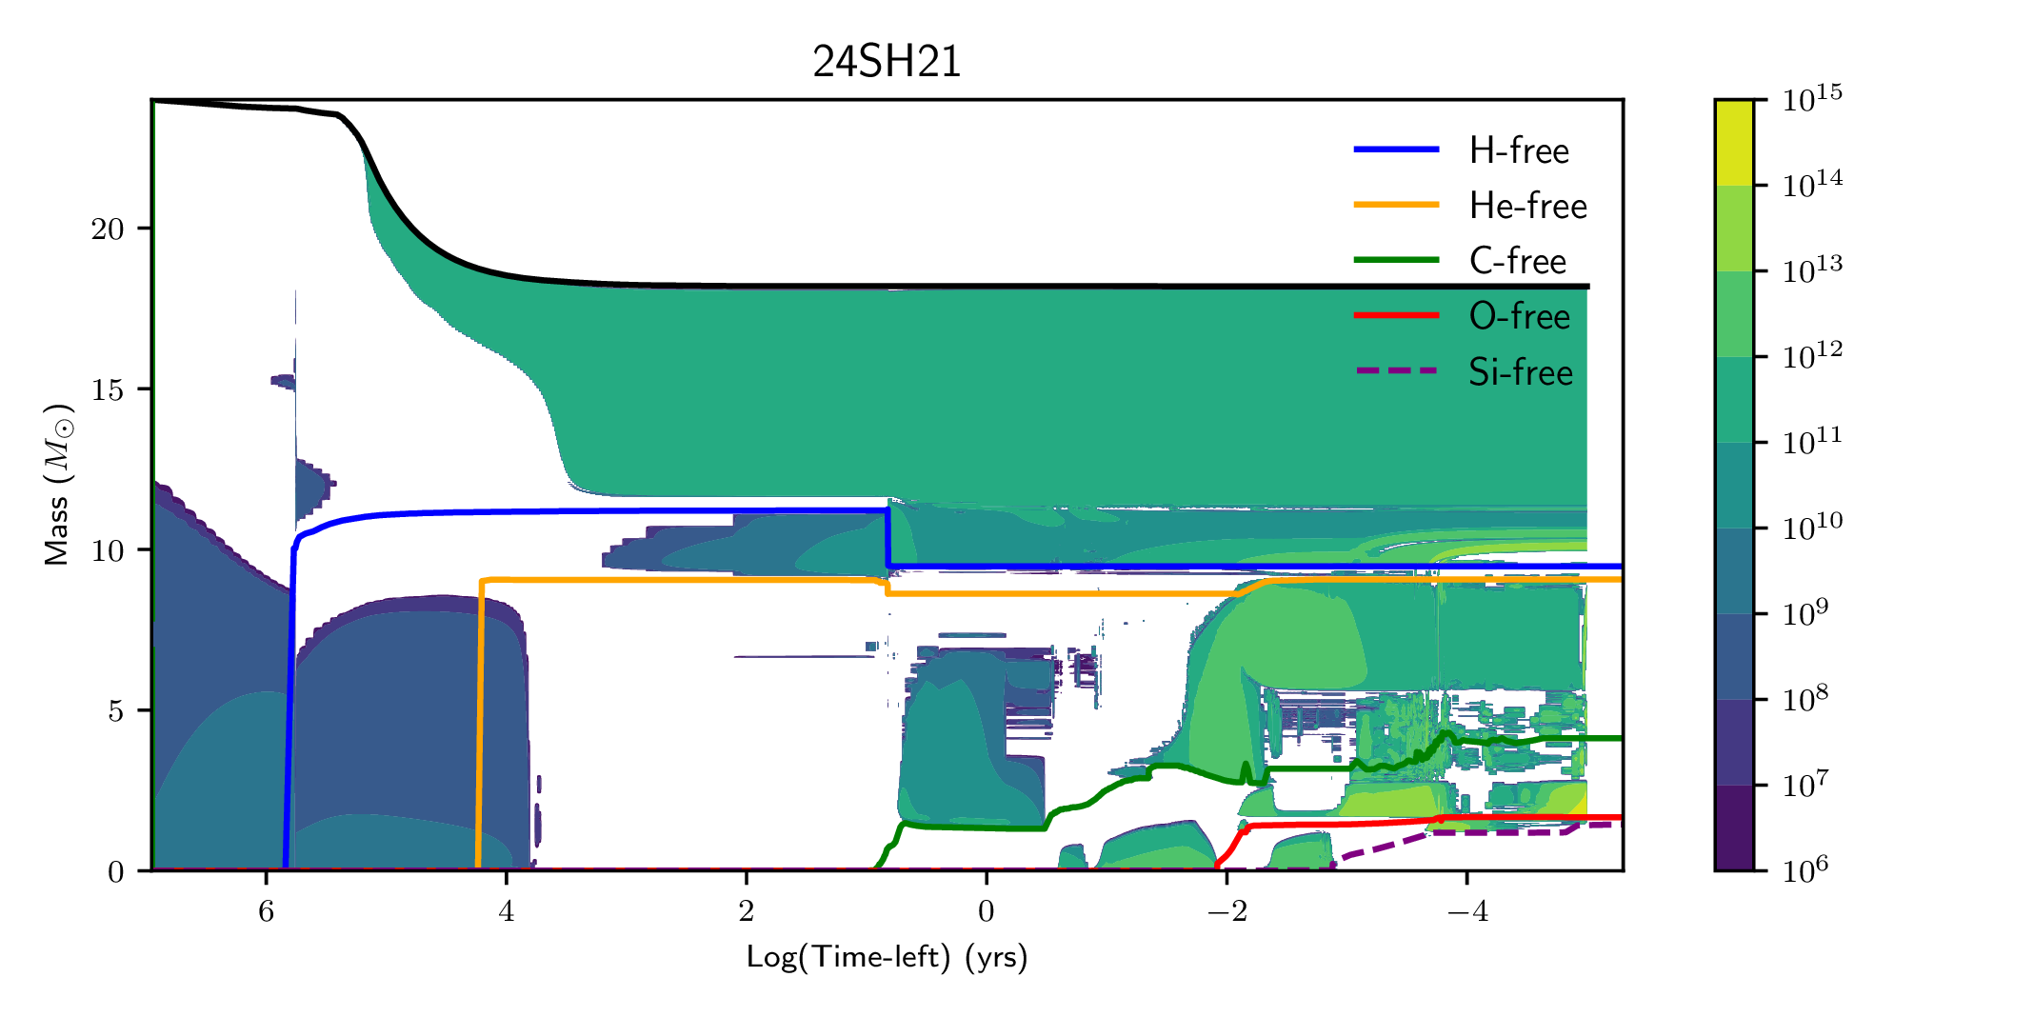
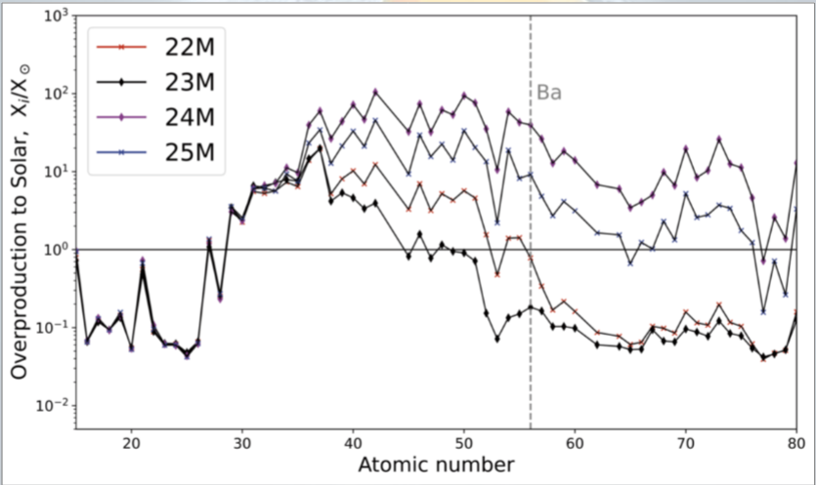
Post-processing in Stellar evolution
Some neutron capture processes can occur during stellar evolution (weak s-process in massive stars, AGB s-process), which can’t be captured by reduced networks
Use each mass shell as a trajectory: T(m,t), ρ(m,t), Xᵢ(m,t)
Integrate over the ejected mass to obtain yields: Mᵢ = ∫ Xᵢ(m) dm
Uncommon processes (stellar mergers) can lead to interesting nucleosynthesis signatures
1D model
mass-shell histories
yields
large network

Slide 19
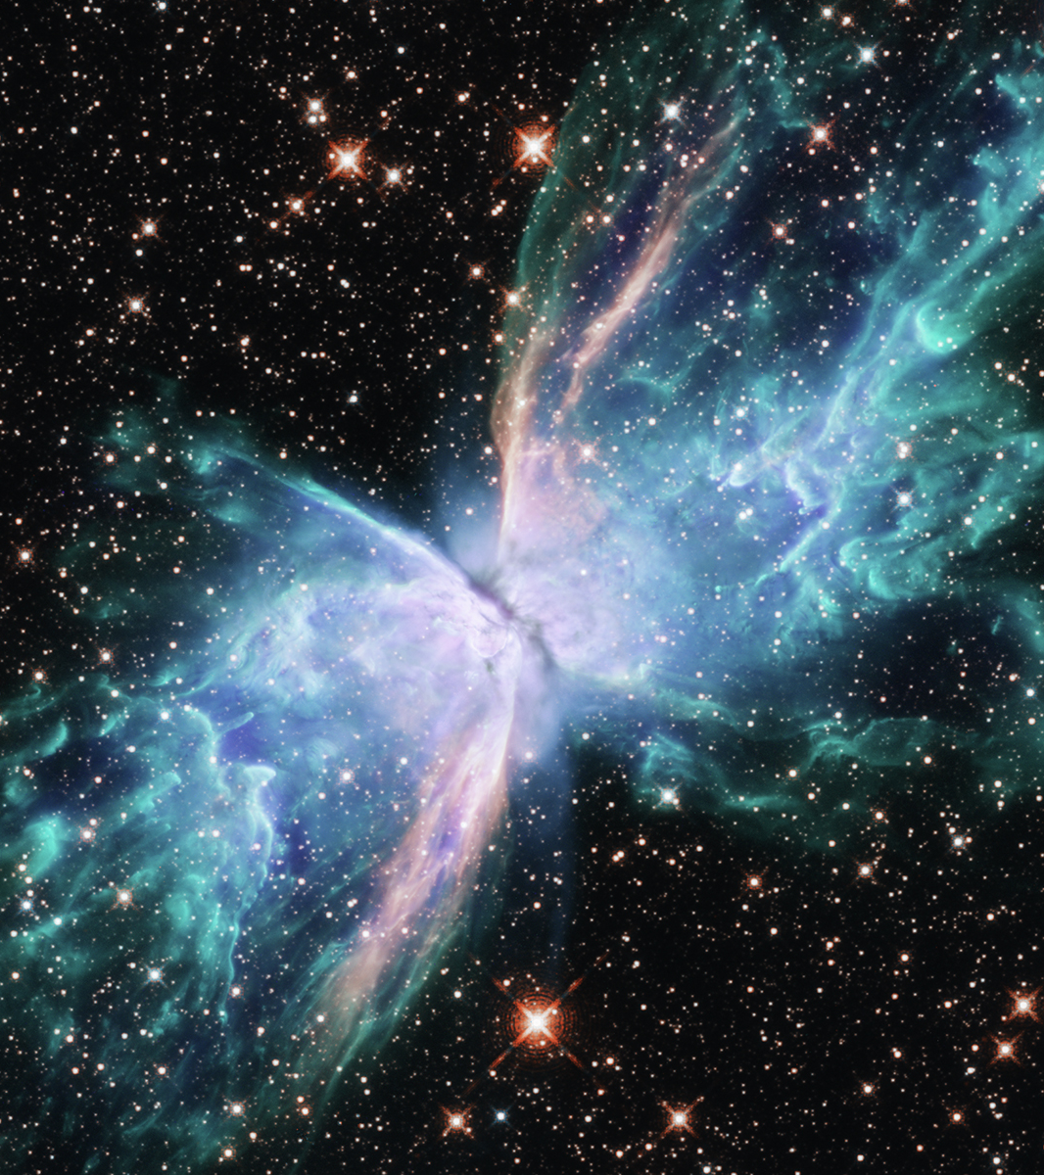
Transient modelling

Slide 20
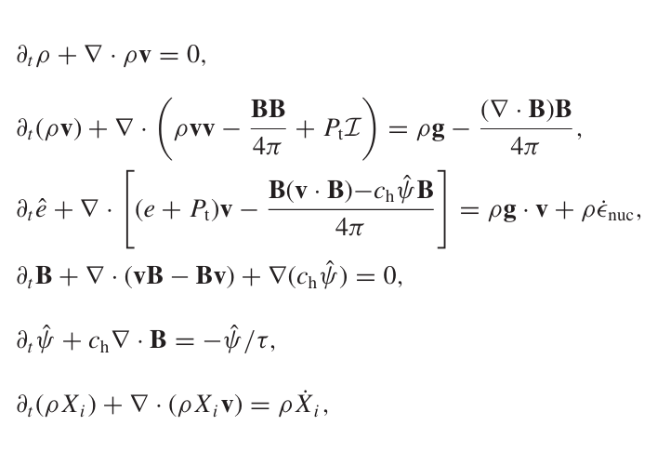
3D SUPERNOVA SIMULATION
Initial conditions are taken from 1D stellar evolution models
This is mapped into a 3D grid, which solves the full set of hydrodynamic (or magnetohydrodynamic) equations and neutrino radiation transport equations
Ideally, this would be general relativistic, or include a relativistic correction to Newtonian gravity
In-situ networks or a simple “flashing” scheme to resolve the energy output from the explosive burning of oxygen, neon, carbon, etc …
A choice of (usually tabulated) high density equation of state

Slide 21
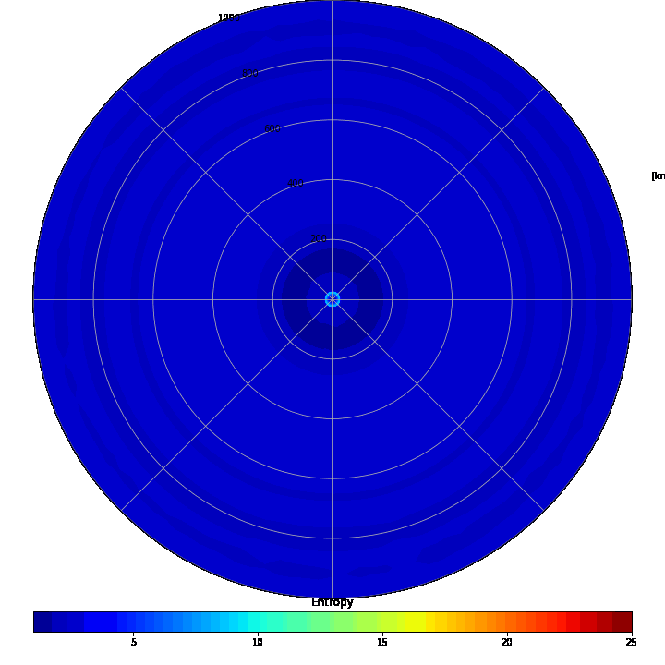
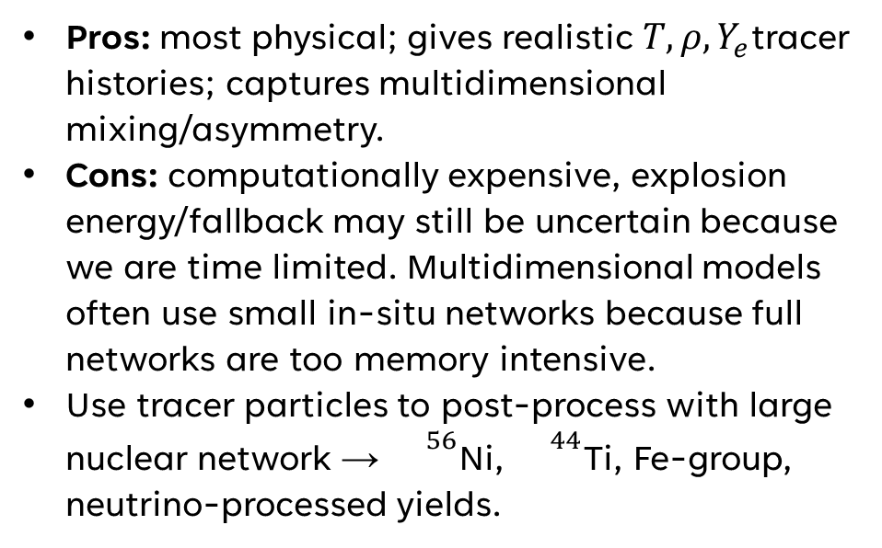
3D hydrodynamic model
Pros: most physical; gives realistic $T,ρ,Y_{e}$tracer histories; captures multidimensional mixing/asymmetry.
Cons: computationally expensive, explosion energy/fallback may still be uncertain because we are time limited. Multidimensional models often use small in-situ networks because full networks are too memory intensive.
Use tracer particles to post-process with large nuclear network → ${}^{56}$Ni, ${}^{44}$Ti, Fe-group, neutrino-processed yields.

Slide 22
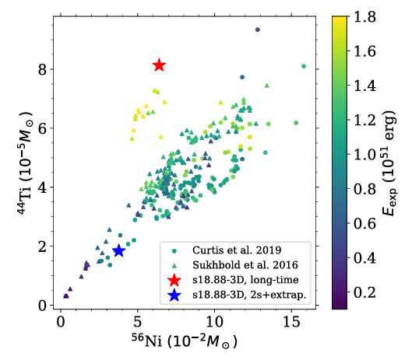
3D hydrodynamic model
3D neutrino hydrodynamics/MHD sets explosion energy, asymmetry and ejecta trajectories
High-temperature ejecta may be treated with NSE or approximate networks in situ
Shock passage explosively modifies O/Ne/C/Si-rich layers
Neutrinos can alter Yₑ and enable ν-process or νp-process channels
Plot comparing Ti44 and Ni56 of long-timescale 3D simulations compared to simplified simulations and short-timescale 3D simulations (Sieverding et al 2023)

Slide 23
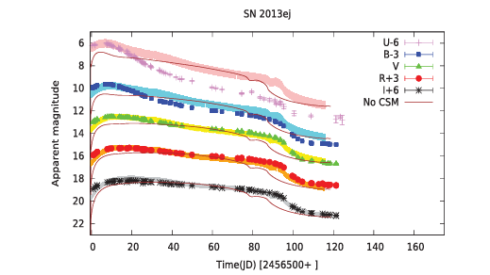
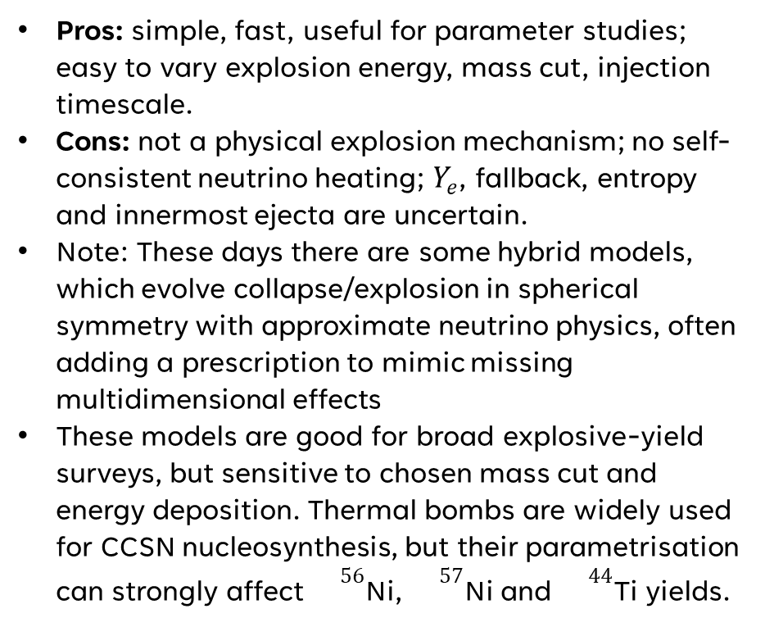
1D explosion models
Pros: simple, fast, useful for parameter studies; easy to vary explosion energy, mass cut, injection timescale.
Cons: not a physical explosion mechanism; no self-consistent neutrino heating; $Y_{e}$, fallback, entropy and innermost ejecta are uncertain.
Note: These days there are some hybrid models, which evolve collapse/explosion in spherical symmetry with approximate neutrino physics, often adding a prescription to mimic missing multidimensional effects
These models are good for broad explosive-yield surveys, but sensitive to chosen mass cut and energy deposition. Thermal bombs are widely used for CCSN nucleosynthesis, but their parametrisation can strongly affect ${}^{56}$Ni, ${}^{57}$Ni and ${}^{44}$Ti yields.
Comparison of best fit thermal bomb explosion model to real data (Das & Ray 2017)

Slide 24
CCSN POST-PROCESSING AND UNCERTAINTIES
3D CCSN
tracers
large network
ejected yields
Large networks compute detailed isotopic yields after the hydro run
Most sensitive regions are close to the mass cut and neutrino-heated ejecta
Major uncertainties: explosion energy, fallback, resolution, neutrino transport and Yₑ
Post-processing cannot recover material that the simulation incorrectly ejects or accretes
Since most simulations are limited in time, either the analysis is limited, or relies on extrapolation
21

Slide 25
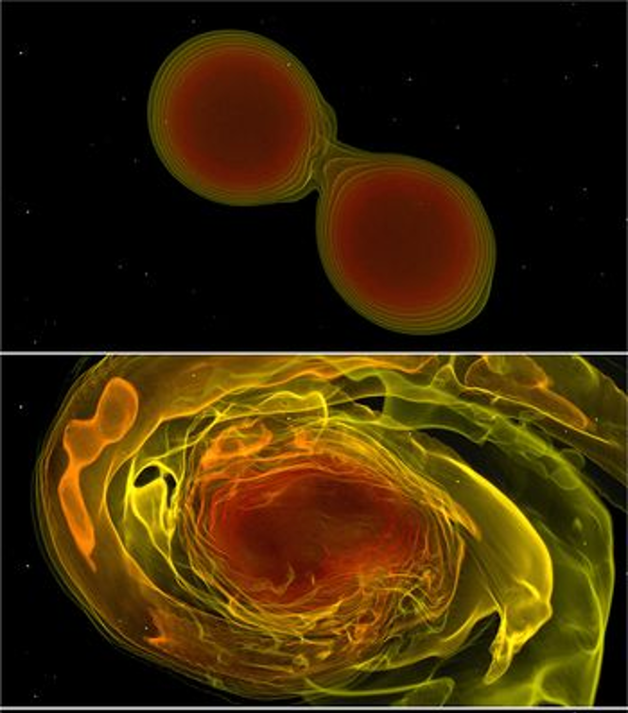
Binary transient systems

Slide 26
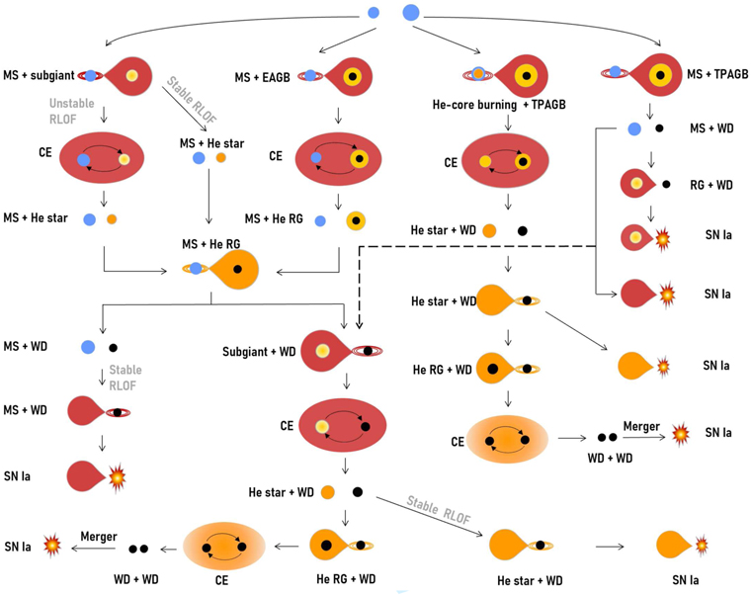
3D binary simulations
Similar to CCSNE simulations, since we solve the same hydrodynamic equations
Added parameters – choosing mass ratio, spin of each object, orbital separations
For kilonovae, we need GR
For type Ia supernovae, ignition scale is often much smaller than what can be resolved (m or cm scale)

Slide 27
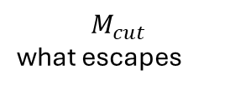
SIMPLIFIED MODELS OF EXPLOSIVE EVENTS
What is parameterized?
T(t), ρ(t)
thermodynamic path
Yₑ
neutron richness
One-zone burns at trajectories of T and ρ
Trajectories determined from analytic expanding trajectories, or more detailed 1D hydrodynamics, without capturing the full multidimensional complexities
Simple models can isolate how nuclear outcomes (or physical ones) respond to chosen controls
Eₑₓₚ
explosion strength
$$M_{cut}$$
what escapes
τₑₓₚ
expansion time
κ
opacity / colours
26

Slide 28
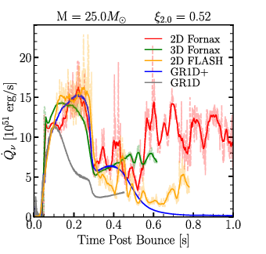
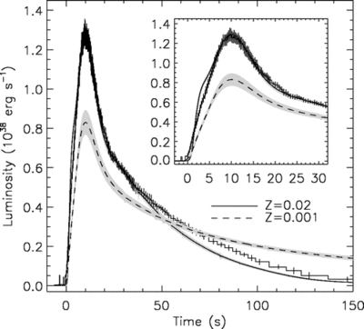
WHY SIMPLIFIED MODELS ARE USEFUL
Some detailed models are impossible: e.g. full stellar evolution
Allows us to do large parameter studies, covering a range of physical parameters. Useful for testing nuclear reaction sensitivities
Guides what models are important to explore in more detail
Some detailed models may not provide much additional information
Comparison of neutrino heating rates between 1D, 2D and 3D CCSNE simulations (Bociolli et al 2025)
27
Observed X-ray burst light-curve vs model (Heger et al 2007)

Slide 29
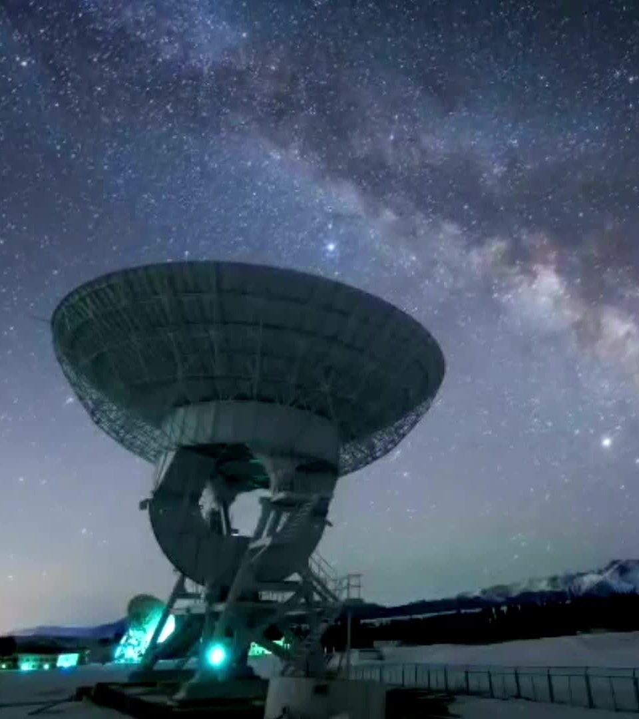
Tying models to observations

Slide 30
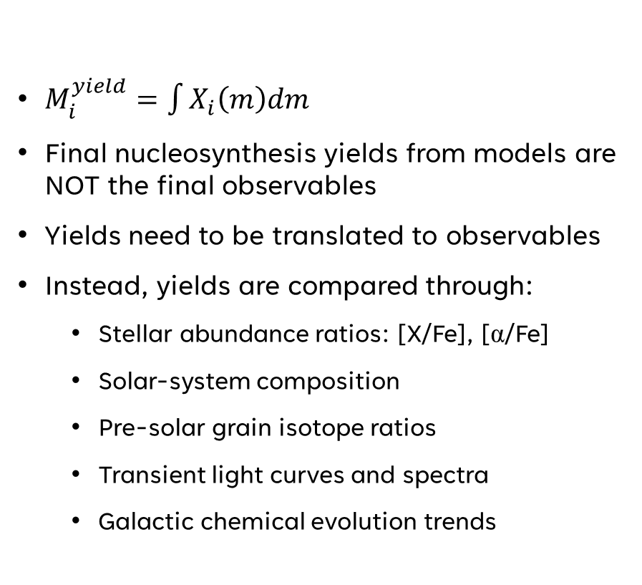
FROM YIELDS TO OBSERVABLES
What changes the observable?
$M_{i}^{yield}​=\int{X_{i}​\left(m\right)dm}$
Final nucleosynthesis yields from models are NOT the final observables
Yields need to be translated to observables
Instead, yields are compared through:
  Stellar abundance ratios: [X/Fe], [α/Fe]
  Solar-system composition
  Pre-solar grain isotope ratios
  Transient light curves and spectra
  Galactic chemical evolution trends
Radioactive decay — sets heating rate
Opacity — sets colours + diffusion
Geometry + mixing — sets viewing angle and line profiles
Atomic data — sets line strengths and IDs
Forward modelling links calculated abundances to what telescopes actually measure.

Slide 31
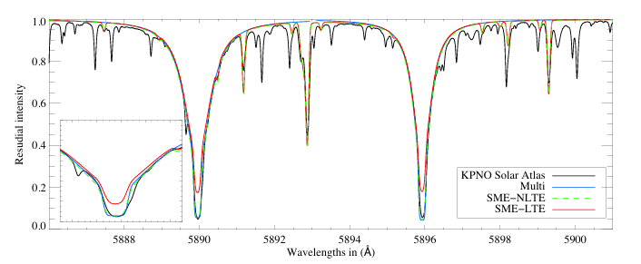
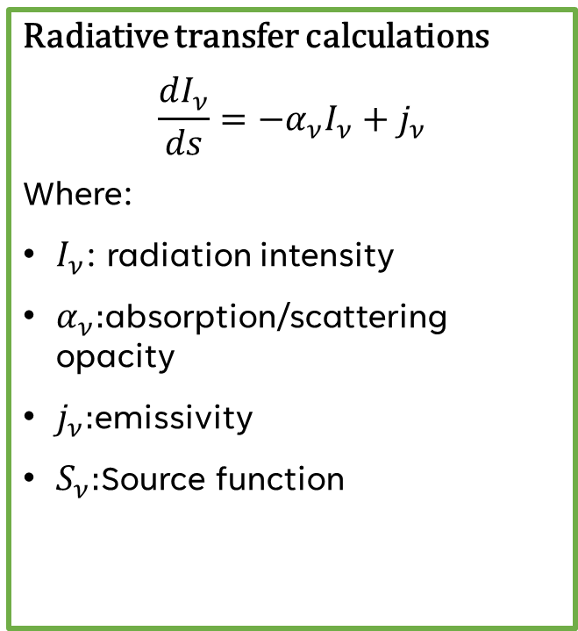
Input: density structure, velocity, composition, atomic/molecular line list
Radiative transfer calculations
$$\frac{dI_{ν}}{ds}=−α_{ν}I_{ν}+j_{ν}$$
Where:
$I_{ν}$: radiation intensity
$α_{ν}:$absorption/scattering opacity
$j_{ν}:$emissivity
$S_{ν}:$Source function
NLTE spectrum synthesis for the sun, comparison of several methods from Piskunov & Valenti 2017
Output: bolometric light curve, multiband photometry, spectra

Slide 32
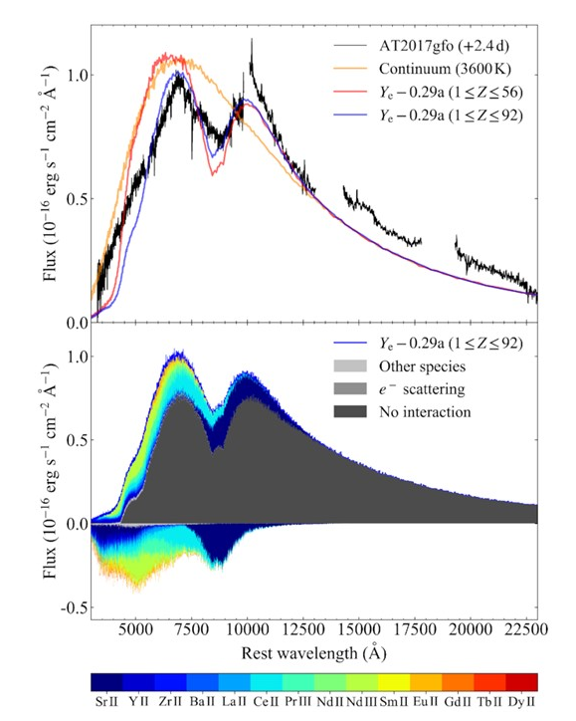
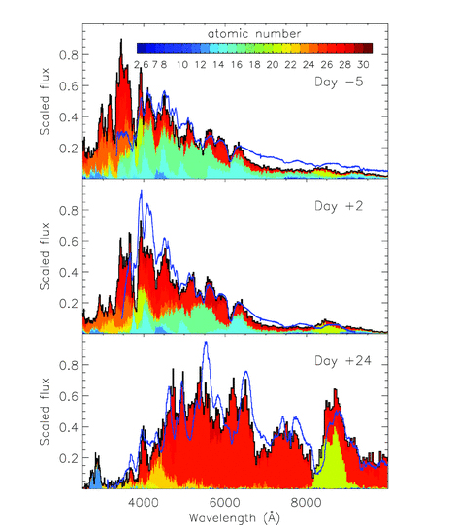
Expanding ejecta
Unlike in many stellar cases, supernovae/kilonovae are not static atmospheres
Fast expansion velocities can lead to doppler broadening blending thousands of lines (or more)
Ionization states evolve rapidly in time, as the radiation field is non-local and time-dependent
Radioactive heating is distributed through the ejecta
Instead of fitting lines, radiative transfer models for transients try to fit the whole evolving spectrum
Comparison of spectra from 3D explosion and radiative transfer model to SN 1994D (Kromer & Sim 2009)
Modelling of AT2017gfo spectrum at +2.4d post-explosion (Gillanders et al 2022)

Slide 33
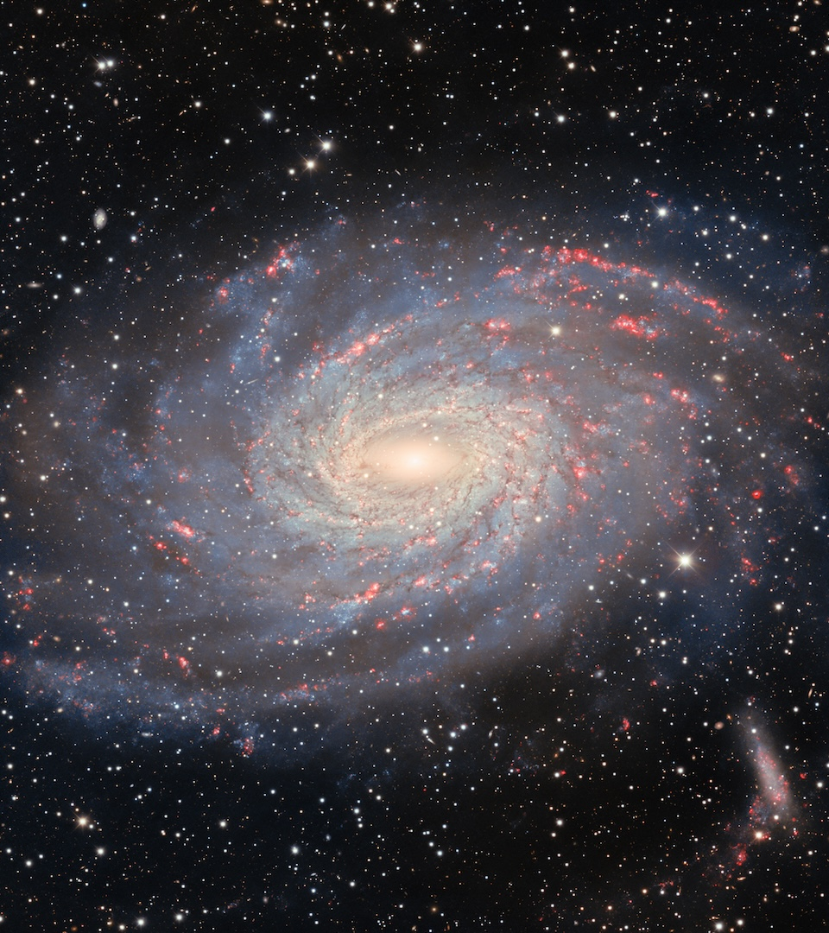
Galactic Chemical Evolution
Much of this section was heavily inspired by content from https://galaxiesbook.org/ Chapter 11, along with reviews by

Slide 34
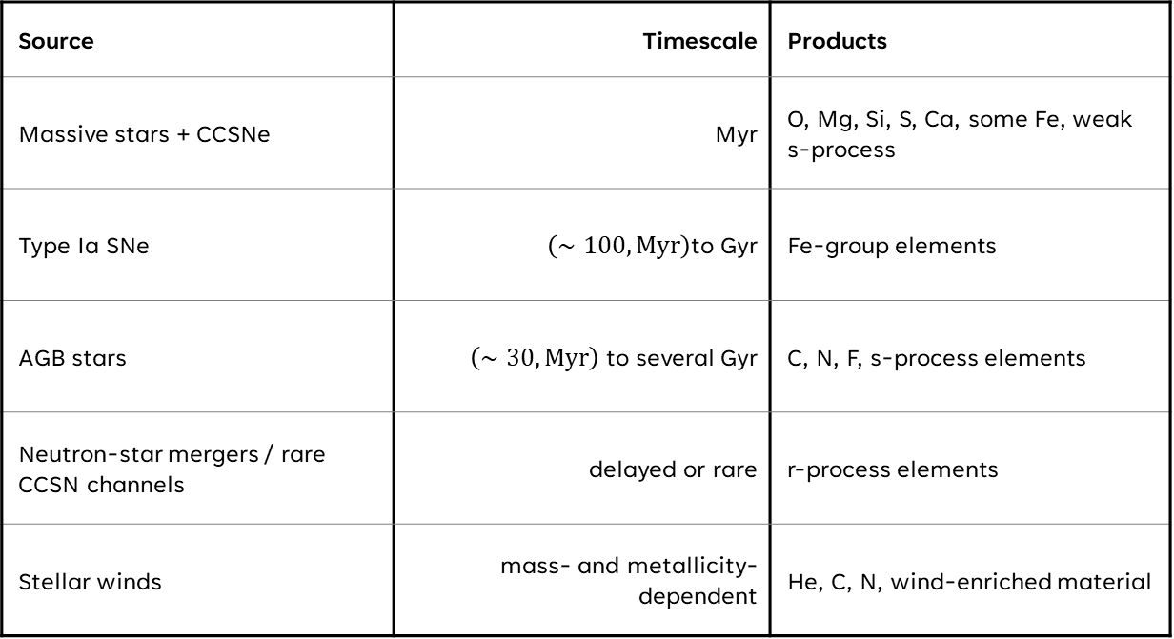
What is GCE trying to do?
Source | Timescale | Products
Massive stars + CCSNe | Myr | O, Mg, Si, S, Ca, some Fe, weak s-process
Type Ia SNe | $\left(∼100,\text{Myr}\right)$to Gyr | Fe-group elements
AGB stars | $\left(∼30,\text{Myr}\right)$ to several Gyr | C, N, F, s-process elements
Neutron-star mergers / rare CCSN channels | delayed or rare | r-process elements
Stellar winds | mass- and metallicity-dependent | He, C, N, wind-enriched material
GCE is a modelling framework that connects individual nucleosynthesis sites to the chemical composition of a galaxy
Bridges stellar models and their yields to galaxy-wide abundance trends
Due to the lifetimes of different stars, and the timescale to binary interactions, different processes enrich the medium at different timescales

Slide 35
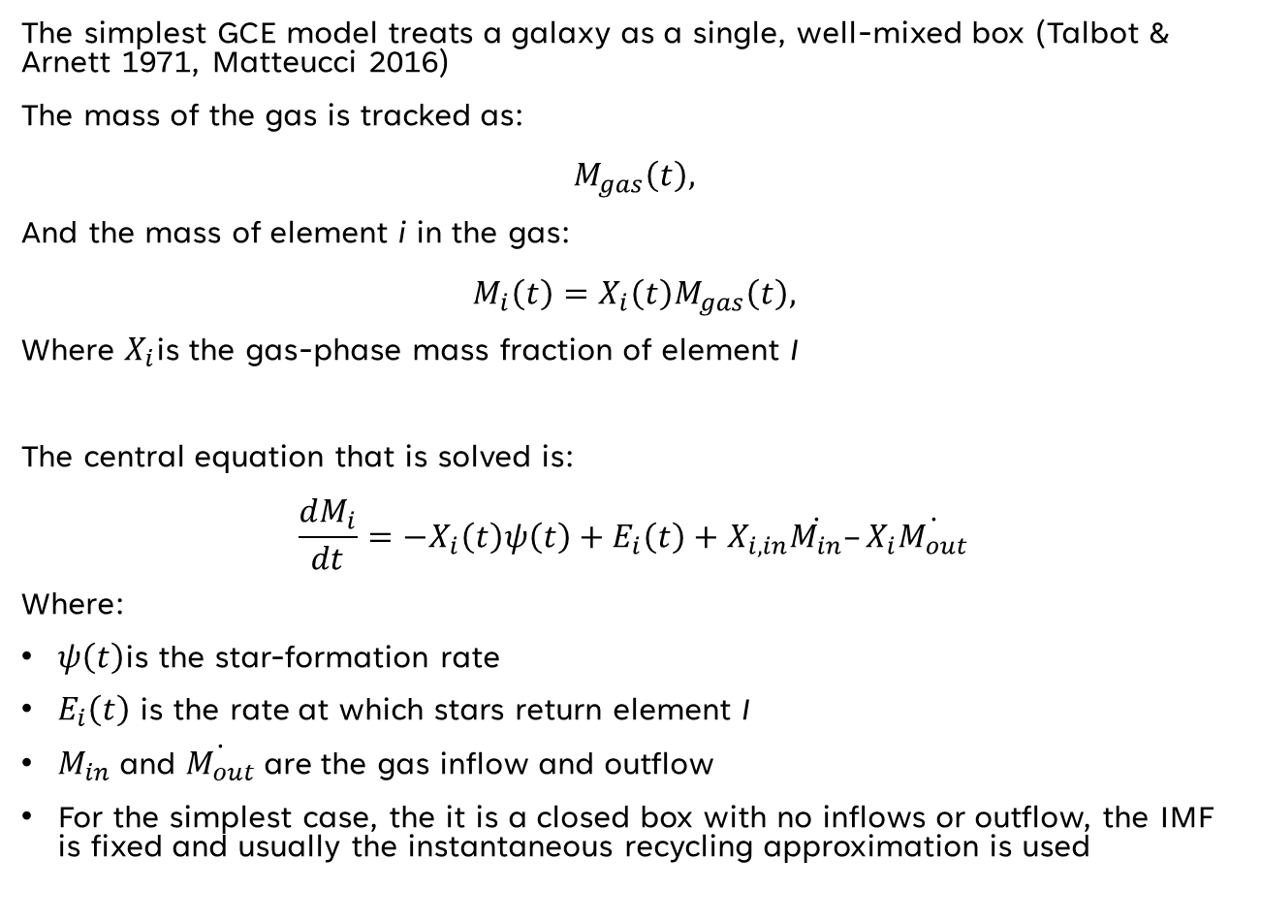
Simple one-zone model
The simplest GCE model treats a galaxy as a single, well-mixed box (Talbot & Arnett 1971, Matteucci 2016)
The mass of the gas is tracked as:
$$M_{gas}\left(t\right),$$
And the mass of element i in the gas:
$$M_{i}\left(t\right)=X_{i}\left(t\right)M_{gas}\left(t\right),$$
Where $X_{i}$is the gas-phase mass fraction of element I
The central equation that is solved is:
$$\frac{dM_{i}}{dt}=−X_{i}\left(t\right)ψ\left(t\right)+E_{i}\left(t\right)+X_{i,in}\dot{M_{in}}–X_{i}\dot{M_{out}}$$
Where:
$ψ\left(t\right)$is the star-formation rate
$E_{i}\left(t\right)$ is the rate at which stars return element I
$M_{in}$and $\dot{M_{out}}$are the gas inflow and outflow
For the simplest case, the it is a closed box with no inflows or outflow, the IMF is fixed and usually the instantaneous recycling approximation is used
Locked into new stars
Returned by dying stars

Slide 36
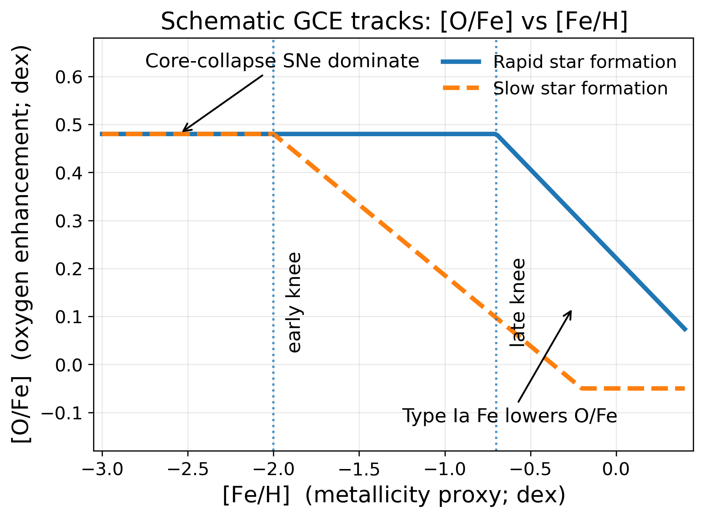
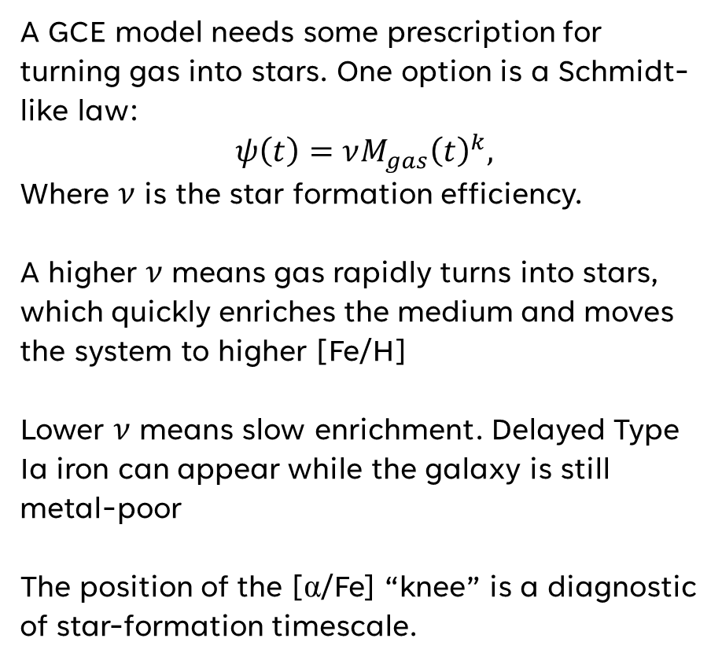
Star formation and gas consumption
A GCE model needs some prescription for turning gas into stars. One option is a Schmidt-like law:
$$ψ\left(t\right)=νM_{gas}{\left(t\right)}^{k},$$
Where $ν$ is the star formation efficiency.
A higher $ν$ means gas rapidly turns into stars, which quickly enriches the medium and moves the system to higher [Fe/H]
Lower $ν$ means slow enrichment. Delayed Type Ia iron can appear while the galaxy is still metal-poor
The position of the [α/Fe] “knee” is a diagnostic of star-formation timescale.

Slide 37
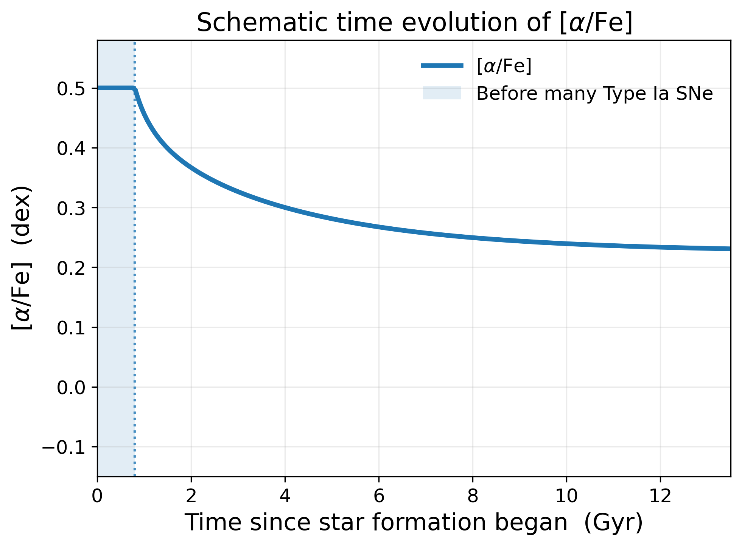
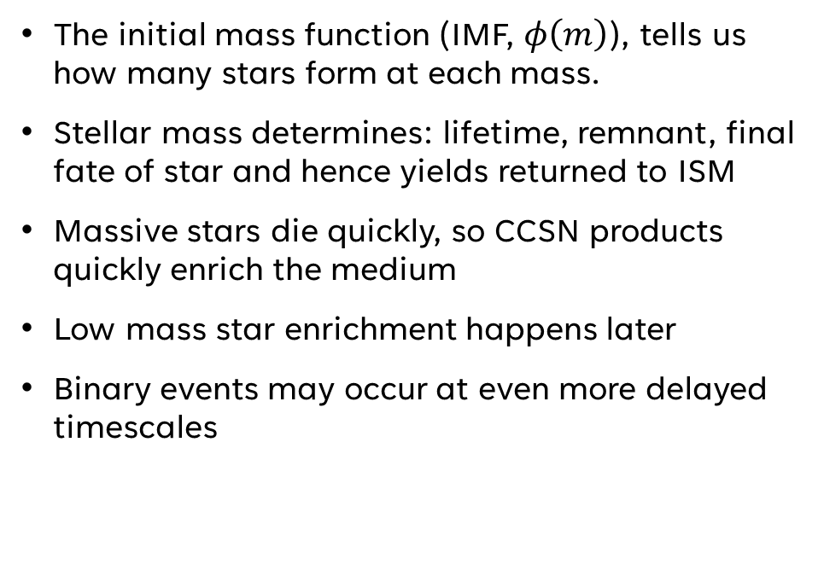
Stellar lifetimes and delayed enrichment
The initial mass function (IMF, $φ\left(m\right)$), tells us how many stars form at each mass.
Stellar mass determines: lifetime, remnant, final fate of star and hence yields returned to ISM
Massive stars die quickly, so CCSN products quickly enrich the medium
Low mass star enrichment happens later
Binary events may occur at even more delayed timescales

Slide 38
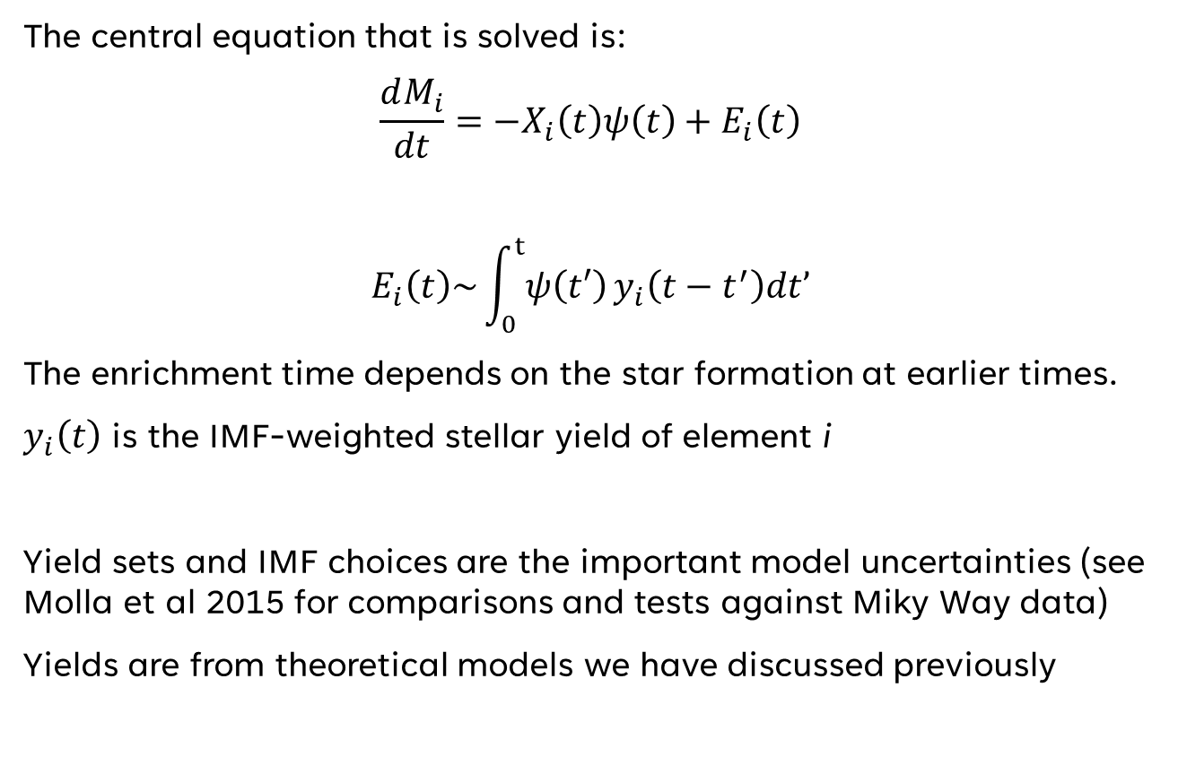
Stellar Yields
The central equation that is solved is:
$$\frac{dM_{i}}{dt}=−X_{i}\left(t\right)ψ\left(t\right)+E_{i}\left(t\right)$$
$$E_{i}\left(t\right)\sim \int_{0}^{t}{ψ\left(t′\right)}y_{i}\left(t−t^{′}\right)dt’$$
The enrichment time depends on the star formation at earlier times.
$y_{i}\left(t\right)$ is the IMF-weighted stellar yield of element i
Yield sets and IMF choices are the important model uncertainties (see Molla et al 2015 for comparisons and tests against Miky Way data)
Yields are from theoretical models we have discussed previously
stellar yields
IMF + SFR
gas flows
abundance trends

Slide 39
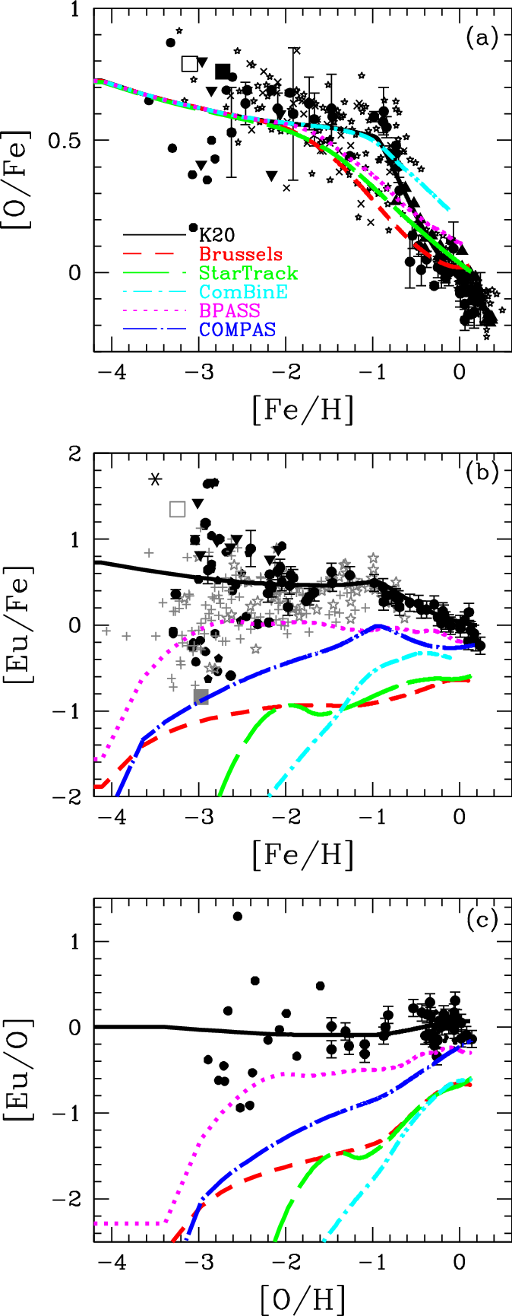
Solar system as a benchmark
Test if combined yields from AGB stars, CCSNE, Type Ia supernovae, kilonovae and rare events reproduce solar system abundances
Asplund et al. 2020 reassessed all 83 long-lived elements using solar modelling, spectroscopy, atomic data and meteoritic constraints.
The modern solar composition is still a key reference abundance scale, and acts as a good testing ground for astrophysical unknowns (e.g. IMF, binary rates)
Comparison of different inputs from a range of binary population synthesis models to model galactic/solar abundance (Kobayashi et al 2023)

Slide 40
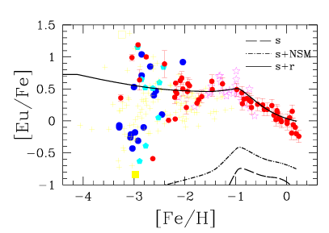
R-process nucleosynthesis test
Nucleosynthesis models of single events (e.g. neutron star mergers) can tell you if they produce r-process material
GCE models can try to test the merger rates, delay times, and if ejecta masses are compatible with observations
Kobayashi et al 2020 found NSM can produce r-process elements, but their delay times were too long to explain lowmetallicity observations
[Eu/Fe] vs [Fe/H] of s-process, s-process + neutron star merger yields and s + r-r-process yields, which includes magnetorotational supernova yields compared to glactic observations (Kobayashi et al 2020)

Slide 41
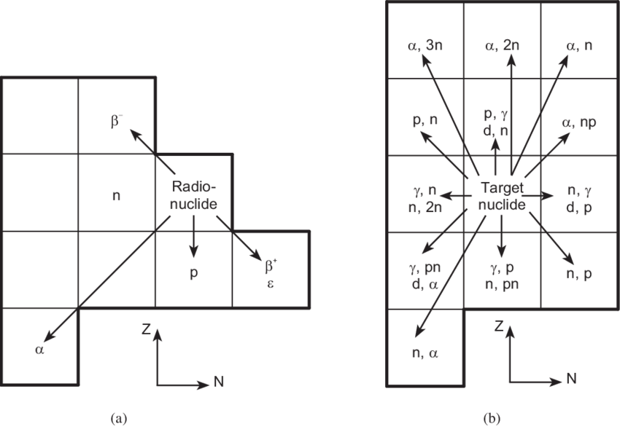
Summary
Although simple, one-zone modelling can be useful to understand the importance of different reaction rates
During computational modelling, in-situ nuclear networks are often limited by memory. Networks need to be crafted case-by-case
3D simulations usually perform nucleosynthesis by post-processing tracer particles
This is often temporally limited, so 1D modelling can also be extremely useful
The choice of models should be chosen carefully. More detailed isn’t often better for your purposes
GCE is able to craft galactic scale models, and answer questions beyond single events. Their uncertainties can be large due to the many input yields and assumptions

