Slide 1
How do we know what stellar thermonuclear reaction rates are?
Philip Adsley padsley@tamu.edu
Texas A&M University
Department of Physics & Astronomy
Cyclotron Institute

Slide 2
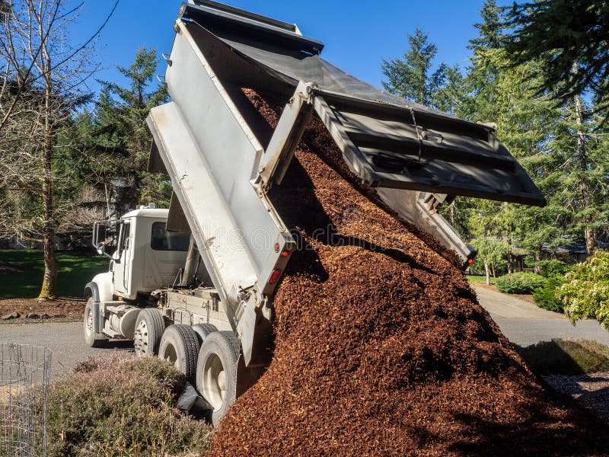


Outline
Moi
Information about how to do nuclear astro measurements
You lot

Slide 3
Outline
What do we need to know to understand stars? Nuclear data for nuclear astrophysics
Some nomenclature and definitions (I know, it’s dull)
Yesteday: Direct measurements with various beams, experimental techniques
Today: Indirect methods and reactions
Tomorrrow: Probing neutron star physics in the lab

Slide 4
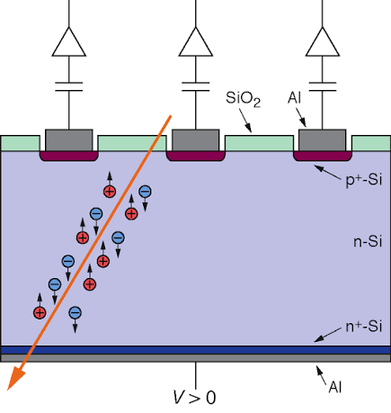
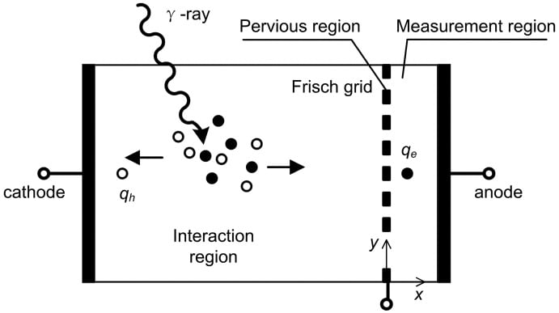
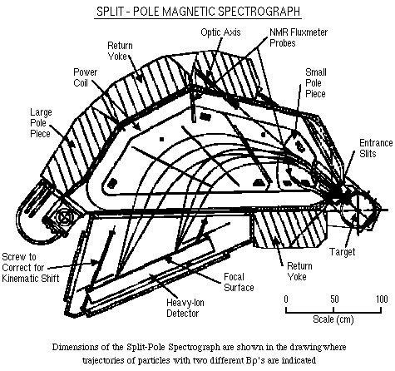
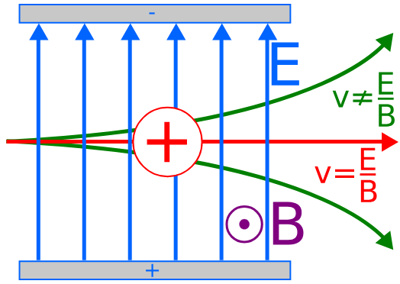
Charged-particle exit channels
All of our usual tricks, ionizing particles are easy to measure
Silicon detectors
Gas-filled detectors
Scintillators
Especially if we want to select channels: magnets and velocity filters

Slide 5
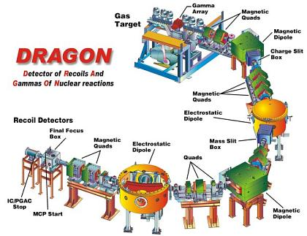
Experiments – direct studies with separators
Most of the time we measure light ions/neutrons (gross)/gamma rays from reactions
Can also measure the heavy thing with separators
Vital for radioactive beams since those are heavy beams on light targets
DRAGON @ TRIUMF
SECAR @ FRIB
Saint George @ Notre Dame
ERNA

Slide 6
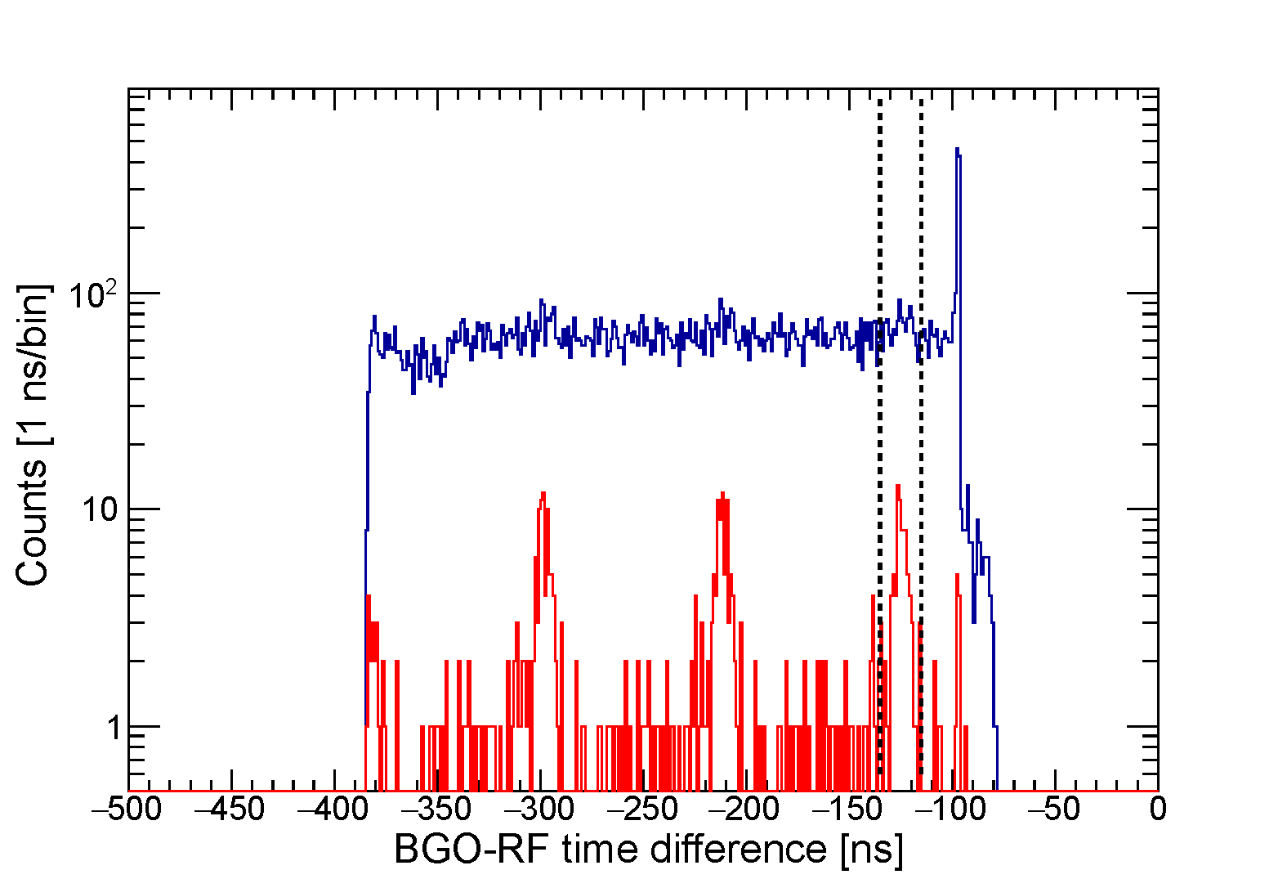
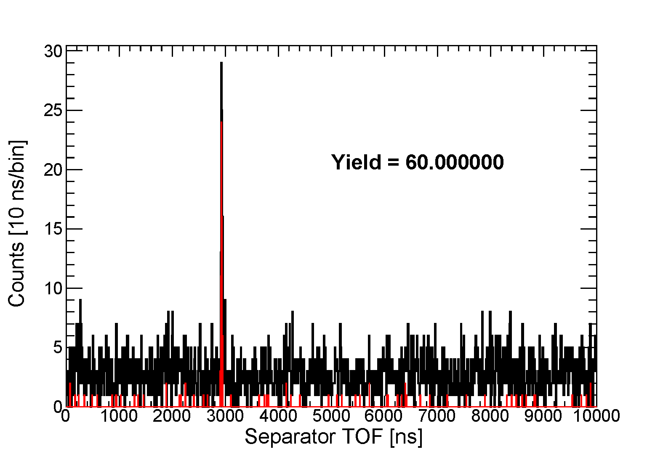
Experiments – direct studies with separators

Slide 7
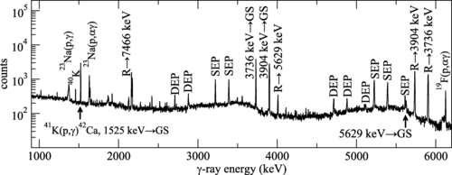
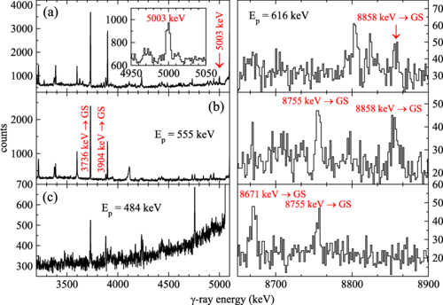
γ-ray exit channels - spectroscopy
Detection of γ rays using high-resolution detectors (HPGe)
Get REALLY GOOD energy information
Rarely collect all of the energy
Especially useful for impure targets since different reactions can be separated by energy
Really need to know γ-ray cascades – analysis depends on these being known
Scholz++ PRC 107 065806

Slide 8
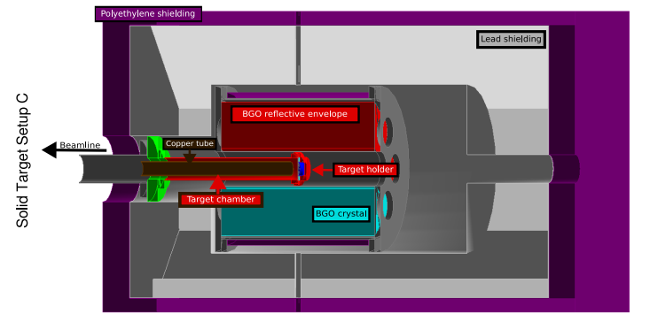
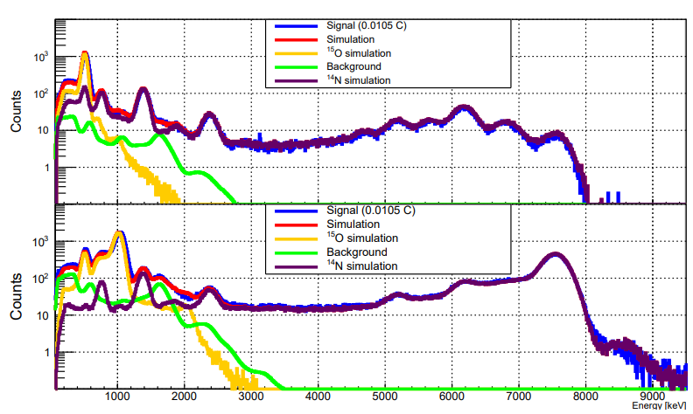
γ-ray exit channels – summing+TASs
HPGe suffers from lower efficiency
Incomplete capture – Compton, PP, escape peaks etc
What if we can just calorimeter things? Absorb all the energy?
Total Absorption Spectrometer (TAS)
Often more sensitive, contamination can be v big problem
Stronkowski++ arXiv 2510.05939

Slide 9
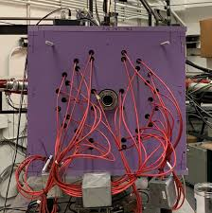
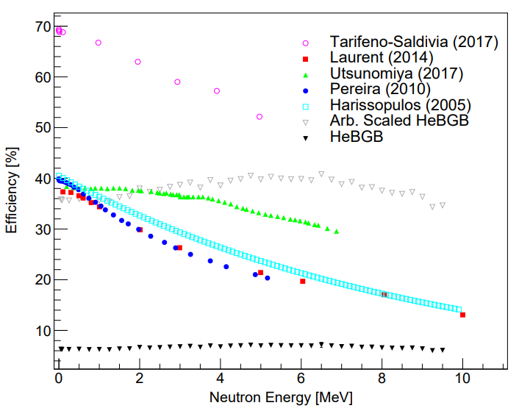
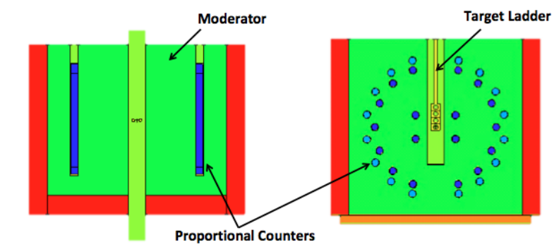
Neutron exit channels
Zach Meisel
I hate measuring neutrons
Neutral so need to convert to other things
Scintillators (light)
Proton recoils
Moderate, ³He, BF₃ tubes
Efficiency is very hard to determine, often not great

Slide 10
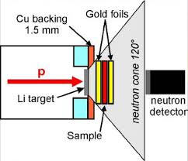
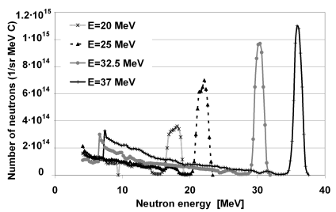
Neutron beams
Neutron-induced reactions are very important for s-process, some other processes
Neutron targets are not (yet, maybe ever – ask if you’re interested) possible
Can make neutron beams by:
Quasi-monoenergetic processes (7Li(p,n) and tuning the proton energy)
Spallation (nTOF, LANSCE) with time-of-flight of the neutrons
C. Lederer-Woods (I think)
O. Svoboda, J. Vrzalova, V. Wagner, A. Krasa, A. Kugler, M. Majerle
J. Korean Phys. Soc. 59(2(3)), 1709 - 1712 (2011)

Slide 11
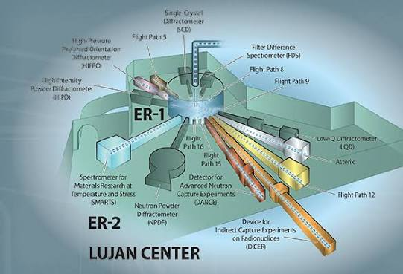
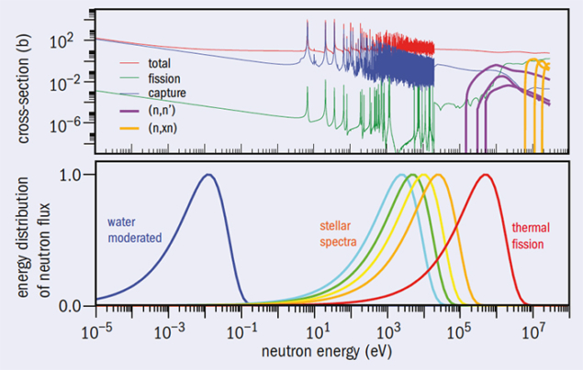
Neutron beams
Neutron-induced reactions are very important for s-process, some other processes
Neutron targets are not (yet, maybe ever – ask if you’re interested) possible
Can make neutron beams by:
Quasi-monoenergetic processes (7Li(p,n) and tuning the proton energy)
Spallation (nTOF, LANSCE) with time-of-flight of the neutrons
ntof collaboration

Slide 12
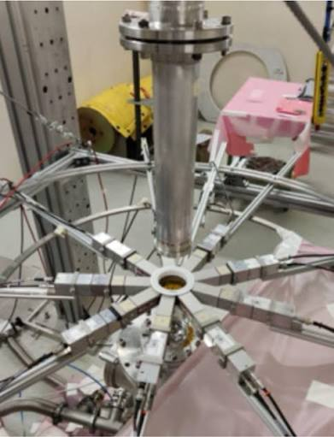
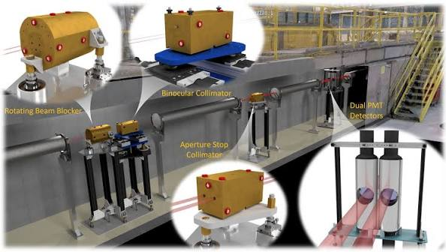
Neutron beams
For (n,γ) capture:
Usually use a scintillator that can discriminate scattered neutrons from gammas (CD2, LaBr…)
This works for stable targets, for unstable ones the background can be overwhelming
Resonance scattering can help
Neutron transmission spectroscopy with e.g. DICER @ LANSCE

Slide 13
γ-ray beams
γ ray-induced reactions can be important but (caveats)
Direct lab measurements often less helpful for astrophysics
Problem is that usually that when these reactions matter in stars it’s VERY hot
Reactions on excited states really matter
Which isn’t to say lab measurements aren’t helpful but they usually need to be coupled with measurements of the γ-ray strength function, about which more tomorrow

Slide 14
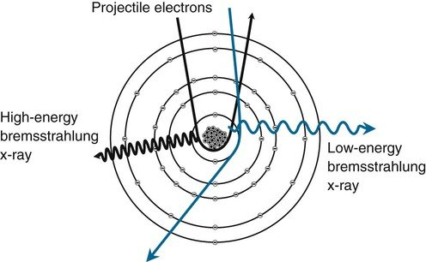
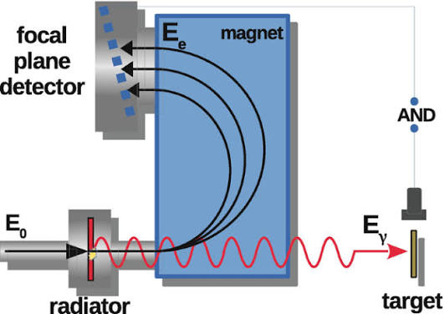
γ-ray beams
PhysicsOpenLab
Two main production pathways (now)
Bremsstrahlung (tagged or not)
Compton backscattering
Used to have in-flight positron annihilation at Saclay and Livermore but not longer active
Csige, L., Filipescu, D.M. (2023). Photofission Studies: Past and Future. In: Tanihata, I., Toki, H., Kajino, T. (eds) Handbook of Nuclear Physics . Springer, Singapore.

Slide 15
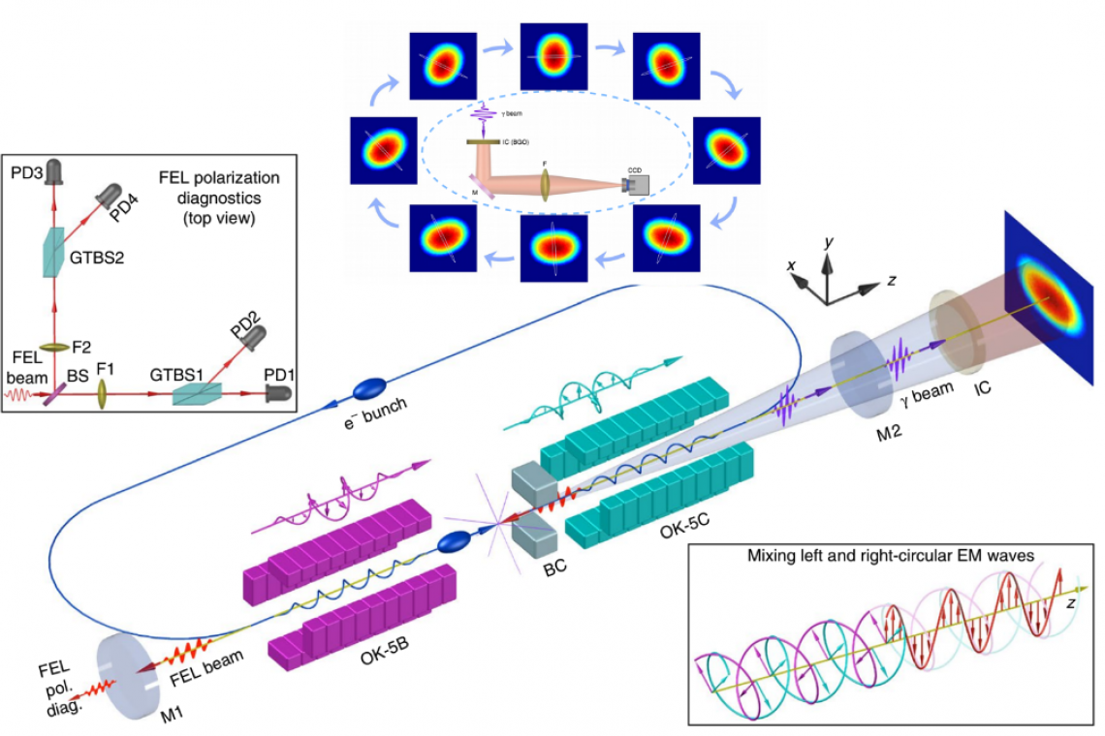
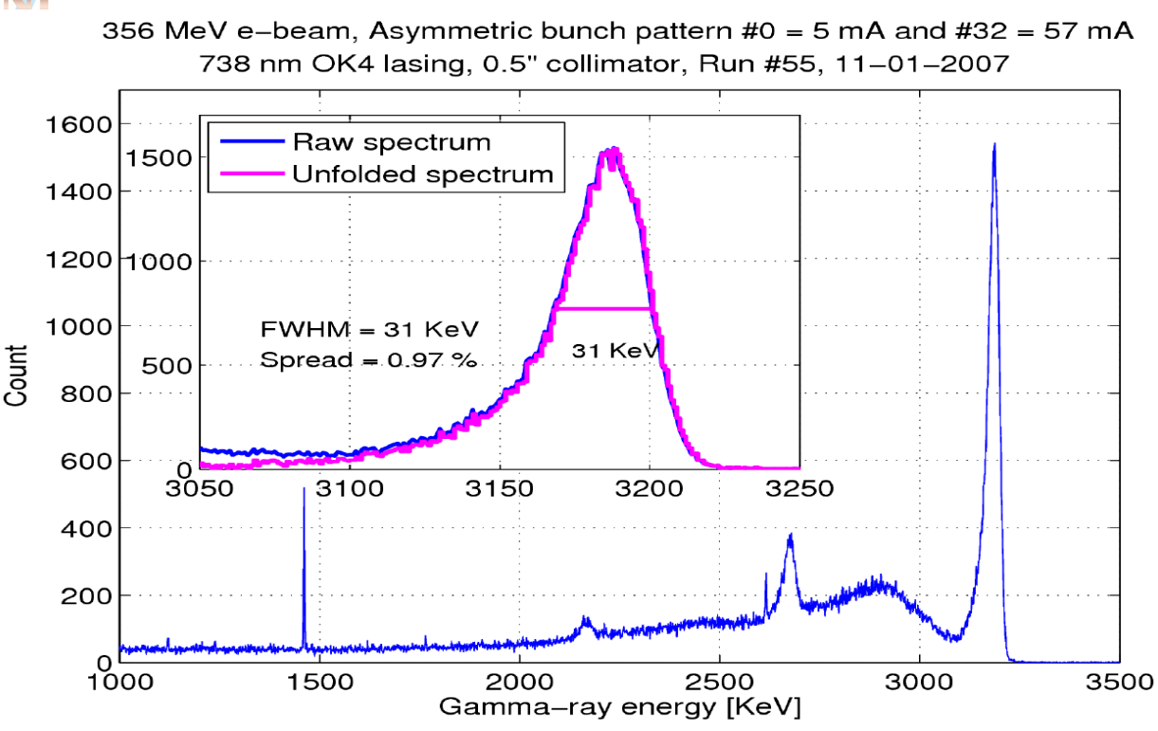
γ-ray beams
HIGS @ Duke
Two main production pathways (now)
Bremsstrahlung (tagged or not)
Compton backscattering
Used to have in-flight positron annihilation at Saclay and Livermore but not longer active
YK Wu

Slide 16
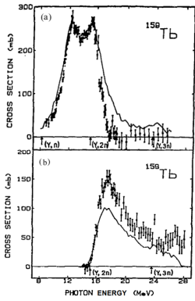
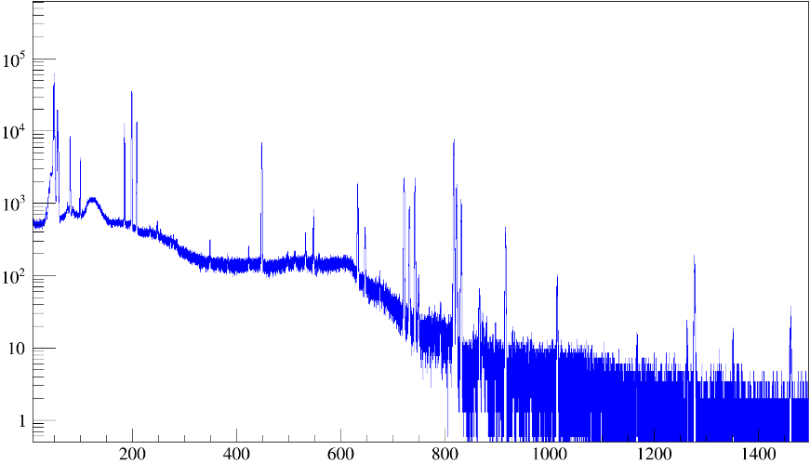
Activation
So far all of the cross sections have been “prompt”
Detect the radiation straight from the reaction
BUT
If we make something:
Radioactive
With a unique, detectable decay
Can look at it decaying!

Slide 17
Experiments – “thick” and “thin” targets
Ultimately we want cross sections so just measure them
BUT we don’t measure cross sections, we count hits
If we have a target which has a wide energy range compared to the resonance of interest, measure ~integrated cross section
Call this thing the resonance strength
Thick is a relative term but reactions only in one section of the target is a reasonable definition
BEAM
Target – beam is losing energy
Resonance at this energy
Beam energy
Depth into target
Number of reactions at each depth
Depth into target

Slide 18
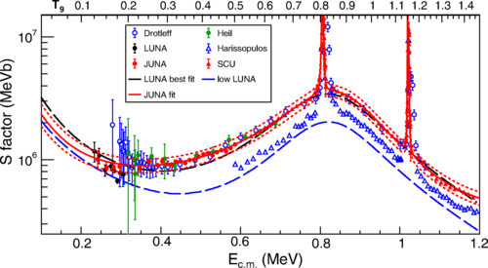
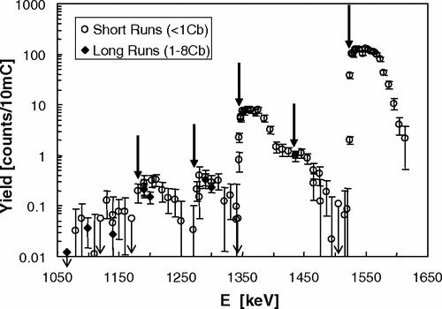
Experiments – “thick” and “thin” targets
Ultimately we want cross sections so just measure them
BUT we don’t measure cross sections, we count hits
If we have a target which has a wide energy range compared to the resonance of interest, measure ~integrated cross section
Call this thing the resonance strength
Thick is a relative term but reactions only in one section of the target is a reasonable definition

Slide 19
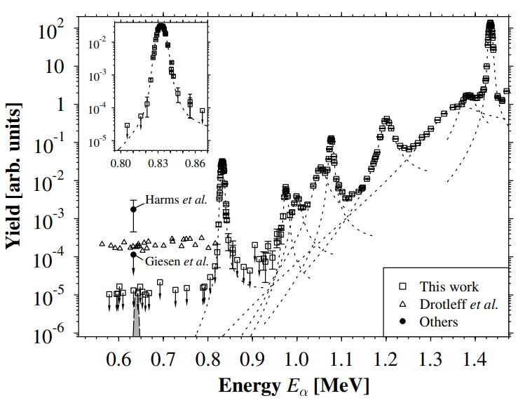
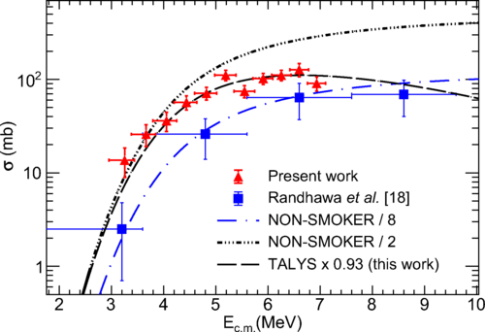
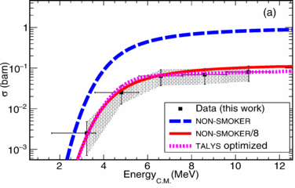

Clustering and astrophysical measurements
Jayatissa++ PRL 131 112701(2023)
Jaeger++ PRL 87 202501 (2001)
Left: measurements of α-induced reactions with small energy steps showing clear cluster resonance structures
Right: measurements of α-induced reactions with active targets, missing the cluster resonance structures
Randhawa++ PRL 125 202701 (2020)
Strandberg++ PRC 77 055801(2008)

Slide 20
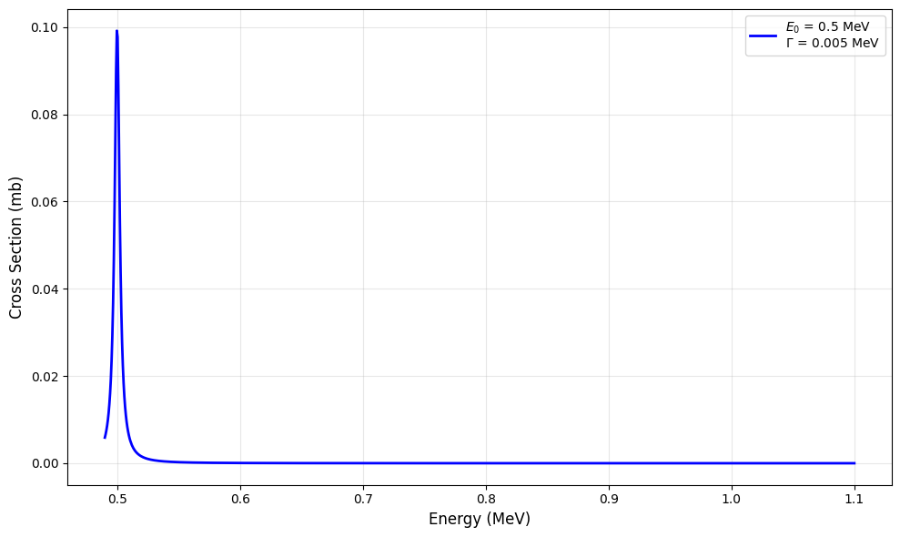
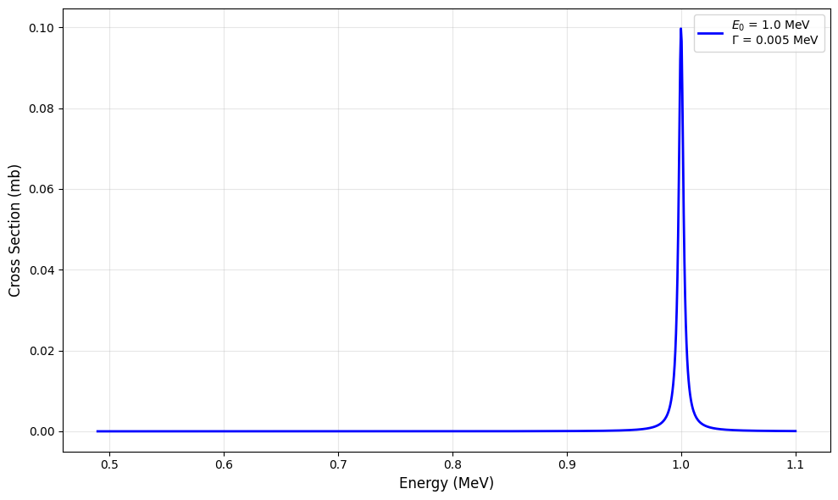
Let’s take the most extreme example!
Let’s do maths! ☺
We measure a resonance strength in the 500-1000 keV bin
The Boltzmann constant is 86.2 keV/GK in useful units
At 1 GK, the uncertainty in the rate is exp(500/86.2)~330
Get that down to 50 keV bins: ratio is 1.8
5 keV: factor 1.06
An oversimplification! Almost never the case that one resonance dominates (except for ¹⁵O(α,γ)¹⁹Ne and ²²Ne+ α and maybe other cases but we don’t have the spectroscopic information to be able to tell)
What is the uncertainty? I don’t know.
Where is the resonance? Don’t have information inside this energy range

Slide 21



The TESSERACT Project
Thick-target Energy StudieS Estimating Reaction-rate Ambiguity from Cross–section Techniques (stop booing)
Want to estimate the uncertainty on the cross section
How? We don’t know the cross sections properly!
Toy data:
Generate resonances
Compute correct reaction rate from resonances
Put resonance data through sausage machine to get thick-target cross section
Do analysis with thick-target cross section as it is actually done (using TALYS)
Compare the results – how good is the cross section we determine from thick-targets + TALYS?
Repeat this process many times and look at the distribution of the results
Generate resonance information
Mr. Aldus Verastegui
Dr. Chirag Rathi
Generate cross section from resonance information, put through experiment-like process
Calculate what the rate should be with this information
Compare the RATES (not the crosss sections)

Slide 22
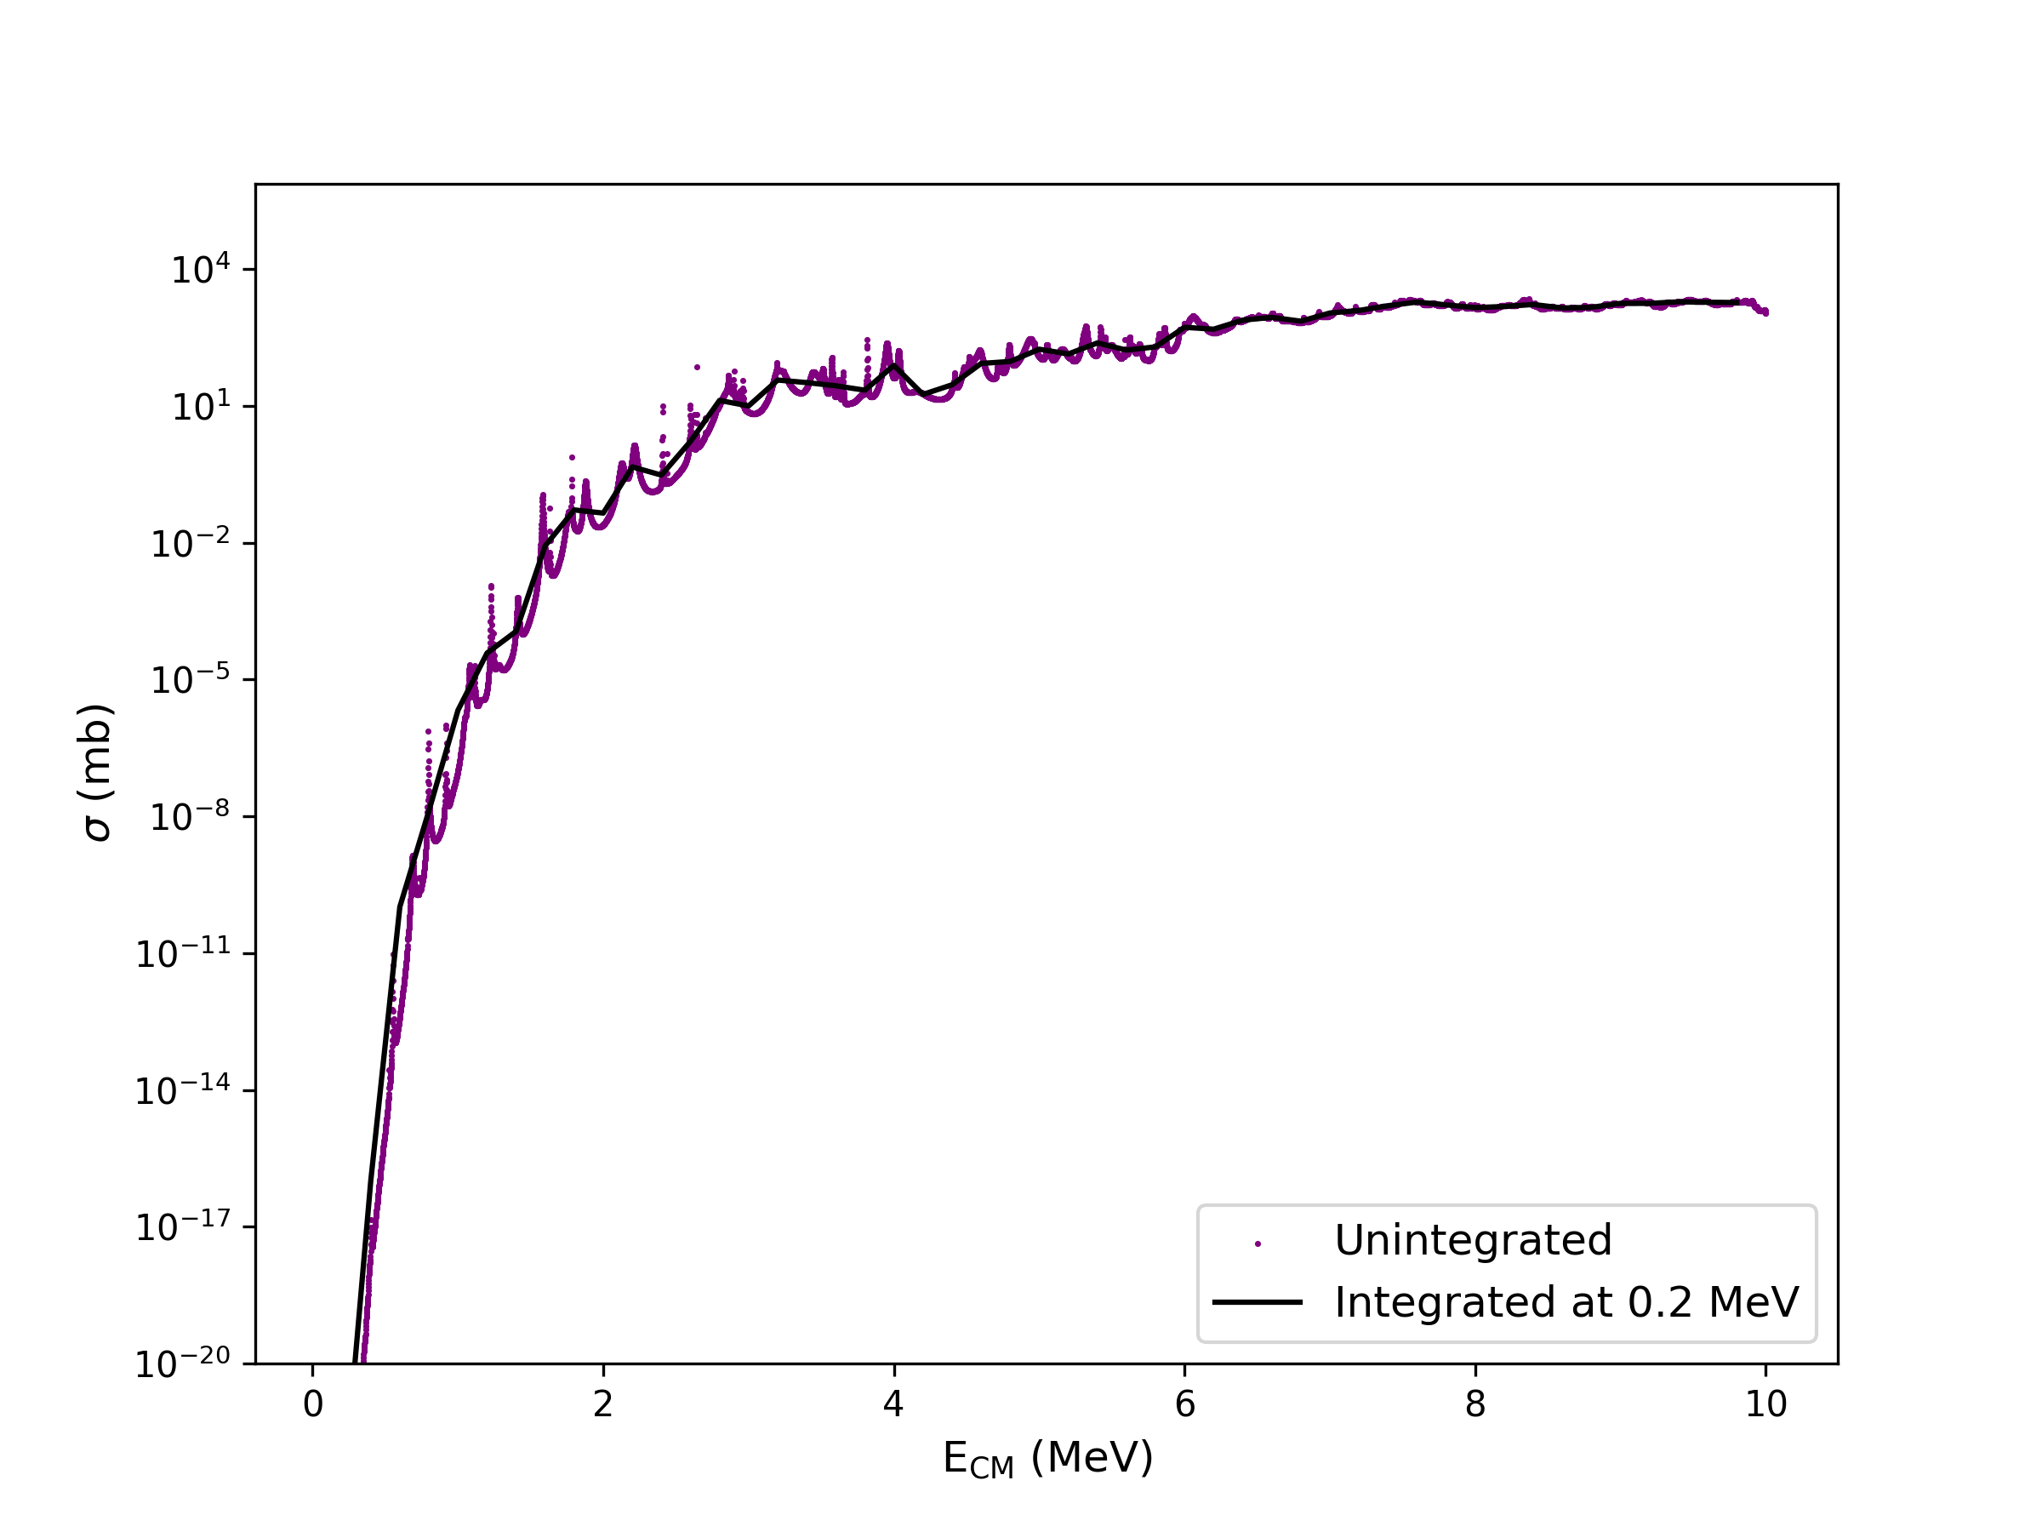
What does this process actually look like?
Example using 200-keV bins
We can change this easily but we picked it for our example case
Smoothing out the cross section by integrating across each bin

Slide 23
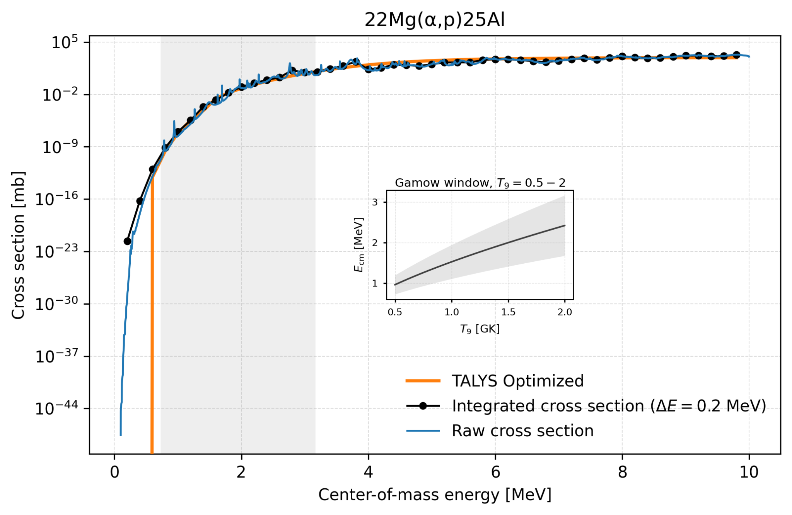
What does this process actually look like?
Example using 200-keV bins
We can change this easily but we picked it for our example case
Smoothing out the cross section by integrating across each bin
(This was an example, we have fixed the TALYS limit issue for the cross section)

Slide 24
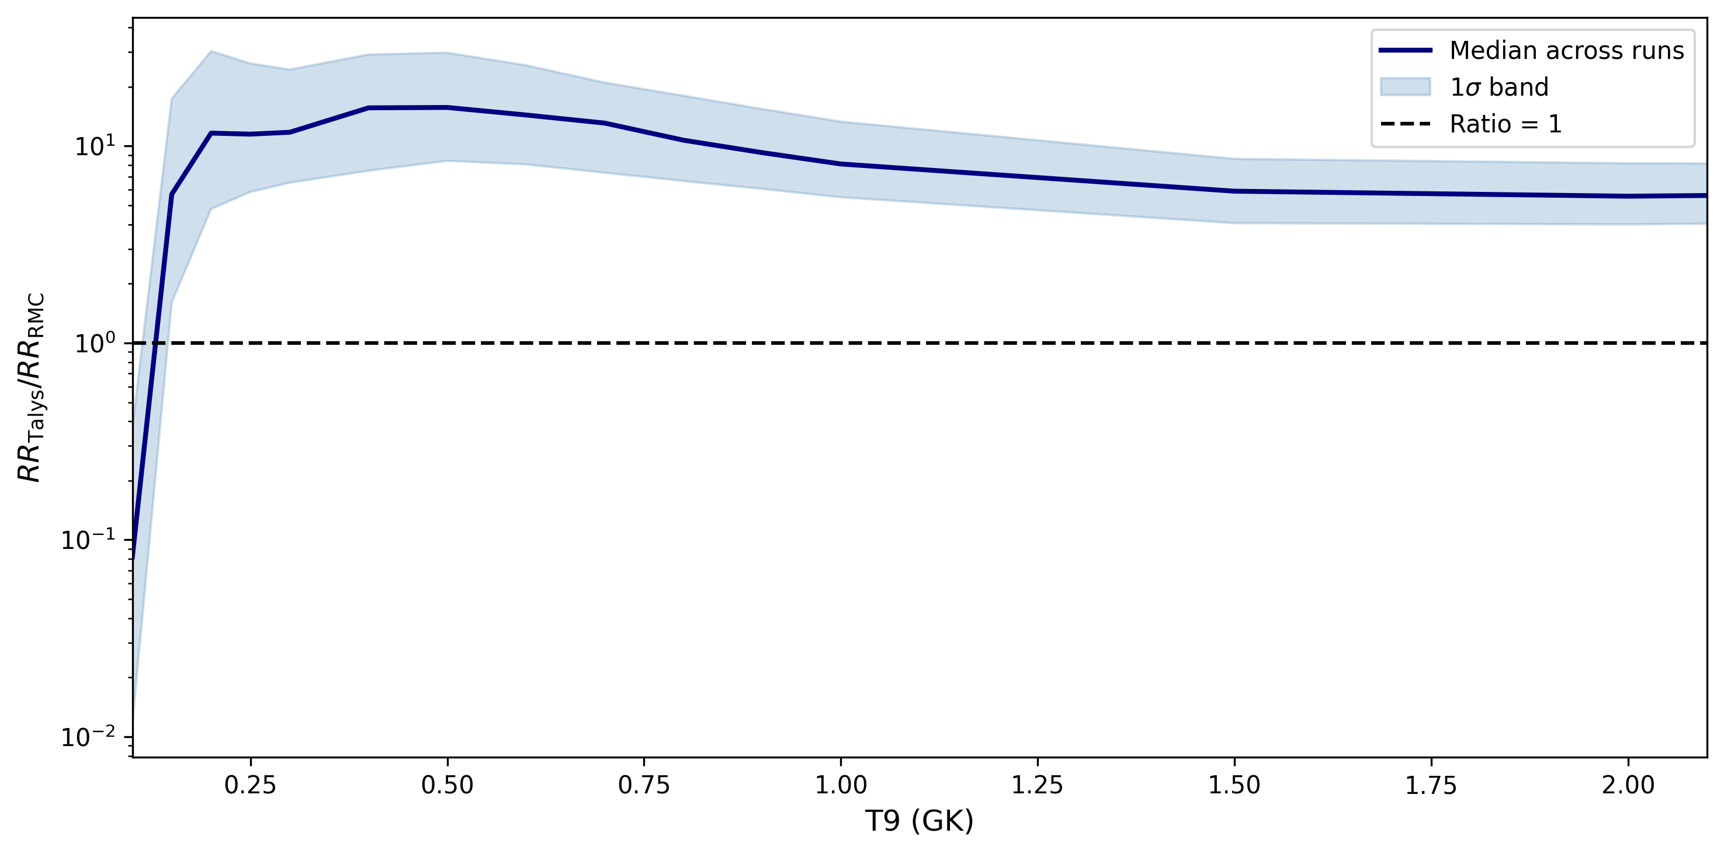
Comparing the results – very preliminary
Example using 200-keV bins
Show a strong deviation from unity BUT
We need to do some QA/QC to check somethings
Why does this happen?
Do our generated nuclear data follow the pattern we prescribed?
Conflict between our prescription for widths (using Coulomb penetrability) and OMPs?
²²Mg(α,p)

Slide 25
Why do we need indirect methods?
Count rates
Reactants
Physical data needs
To guide direct measurements

Slide 26
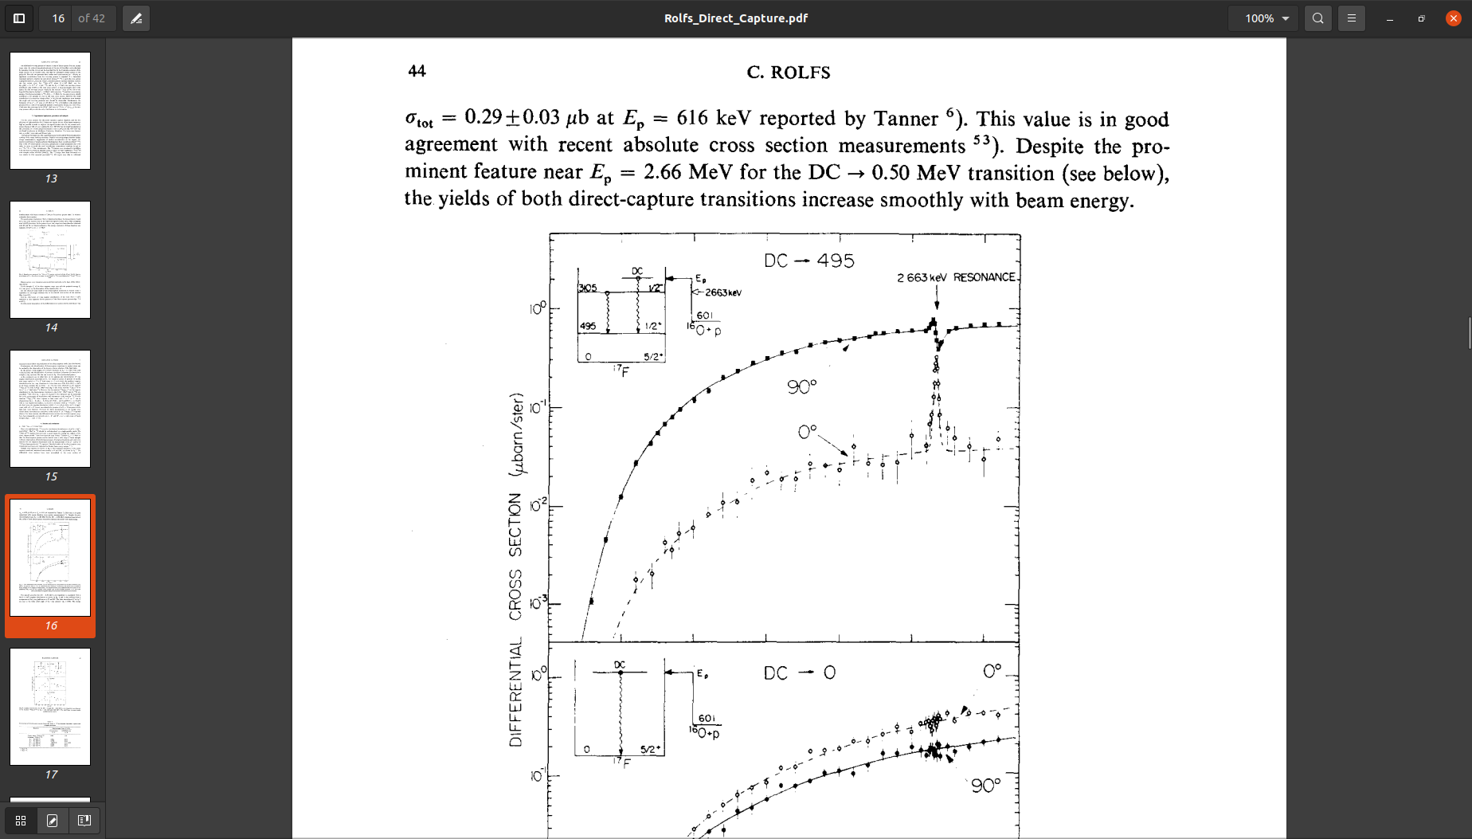
Count rates
Cross sections for nuclear astro are horribly small
10-3 ub/sr @ 500 keV, assume uniform over solid angle
Assume 1 uA beam
100 ug/cm2 target
I get 0.6 event/s but at 500 keV
But for CNO cycles actually care about 70-140 keV – about a factor 100 million lower at 70 keV than 500 keV ☹
500 keV
Rolfs Nuclear Physics A 217 29-70 (1973)

Slide 27
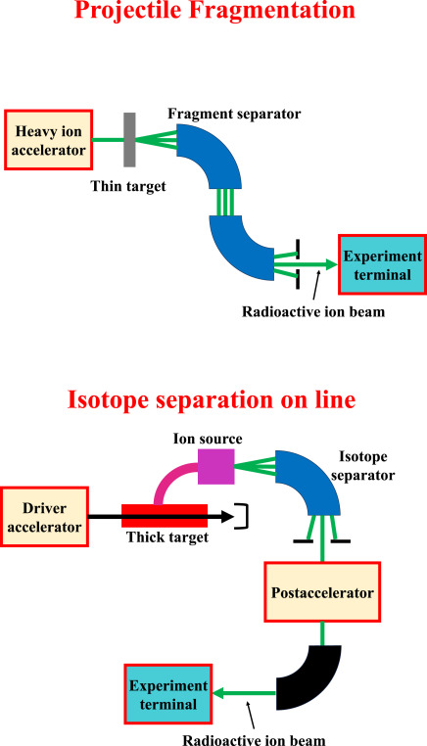
Reactants
Lots of reactions involved something radioactive
May not be able to make in large amounts
Neutron capture on short-lived radioactive things is ~ impossible
Knowing something about the nuclear properties can constrain the rates
Wei Nan++ Nuclear physics at BRIF,
PPNPhysics 145 2025 104188

Slide 28
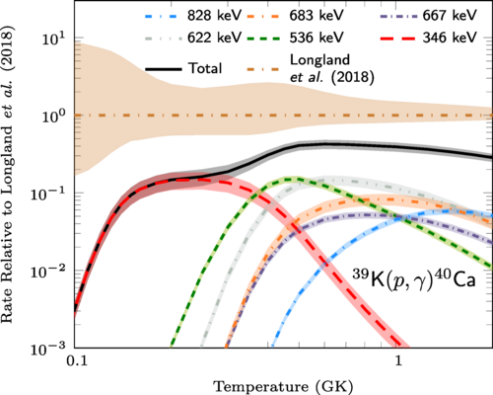
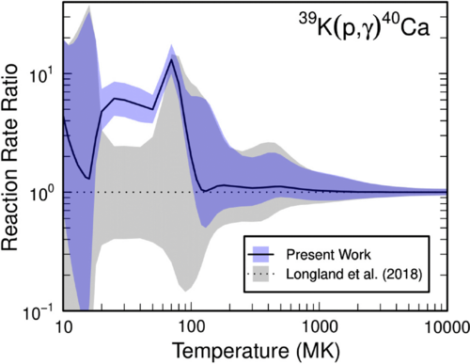
Physical data needs
Two main aspects here:
More direct access to the information which matters – example with ³⁹K(p,γ)⁴⁰Ca
Summary: if the proton width is the thing that matters, measure that ☺
Electron screening: lab vs stellar reactions

Slide 29
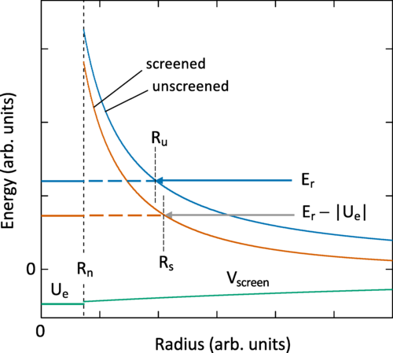
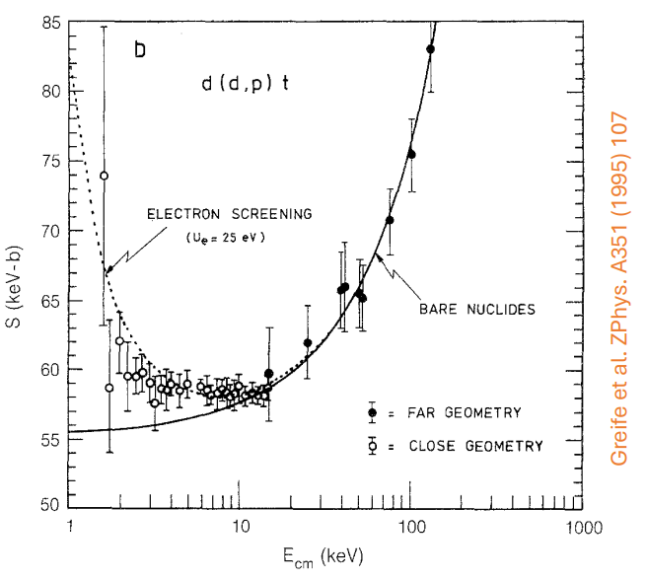
Electron screening
Iliadis, PRC 107 044610
Summary: no one knows, abandon all hope
In the lab, our targets have electrons
In stars, they are ionized
In the lab, see an increase in the cross section at low energies which isn’t true for stars
Our theories to describe the screening aren’t great TBQH

Slide 30

Planning direct measurements
Going back to the hierarchy of needs:
Need to ask some basic questions sometimes
How many resonances are there? Where are they? Which ones could matter? What energies/resonances do I need to measure in the lab?
𝛤/𝜔𝛾
Me
C²S, BRs
J^{𝜋}
E_{x}/E_{r}
How many states?
Masses? Q values?
Zach Meisel pointed out I was missing these…

Slide 31
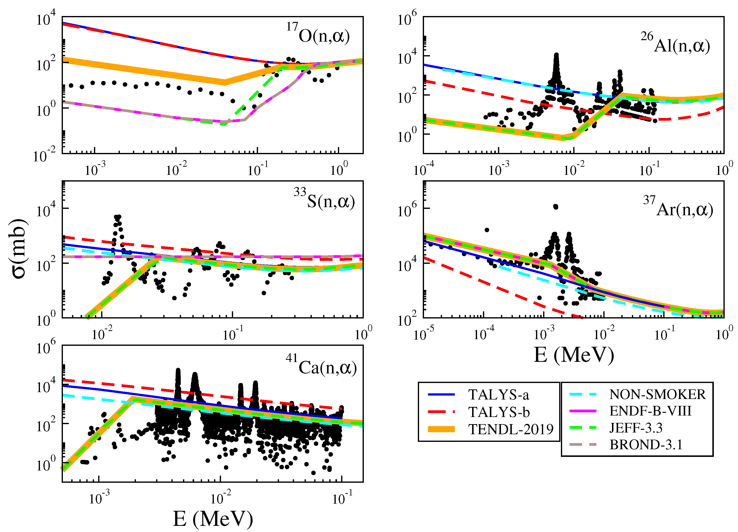
Statistical models
“Statistical” models
When we have a high enough* level density, can look at the average properties of resonances
If we know average properties then we can compute the rate from those
Level density, resonance widths (particle and gamma)
*10 levels / MeV / partial wave??
Küçüksucu, S., Yiğit, M., & Paar, N. (2022)
Universe, 8(1), 25

Slide 32
I should stop talking…

Slide 33
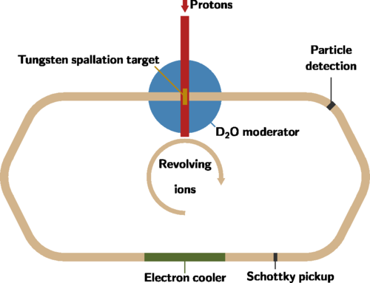
Neutron targets
The idea is to make a neutron cloud with a spallation proton beam
Then a storage ring with heavy ions
Look for the cases where a neutron gets picked up by the beam ions
Problems? Many!

Slide 34
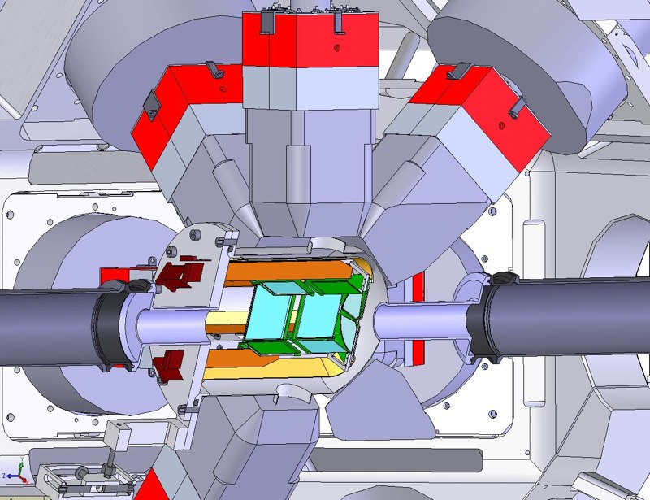
Experiments – indirect studies
Yield from direct measurements is often extremely small ~0
Can calculate the reaction rate if we have spectroscopic information
If we know information like if states exist, excitation energy, and spin and parity (therefore orbital angular momentum) we can work out which states might be important
Target direct measurements or plan indirect studies
Silicon+HPGe
SHARC/TIGRESS(+EMMA)
T-REX/Miniball
GODDESS (Argonne/FRIB)

Slide 35
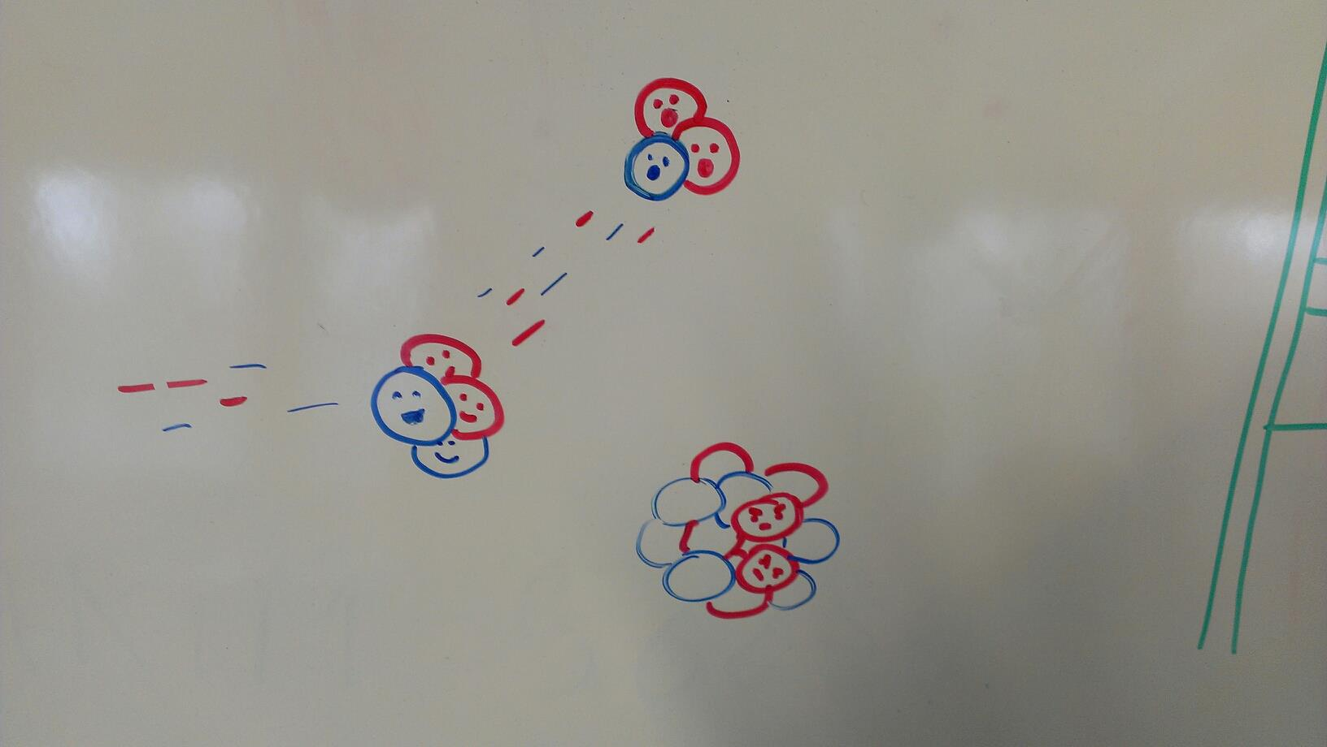
Experiments – transfer reactions and nuclear data
I want to use transfer reactions as my example (pay attention, FRESCO people)
We can do lots of things with them including
-finding states and getting their energies
-constraining spins and parities
-inferring partial widths from transfer reactions
Richard Longland

Slide 36
Theory of transfer reactions
Assume the following:
Entrance and exit channels dominated by elastic scattering
Transfer is weak - treat as first-order perturbation
Transfer proceeds directly between two channels
Direct transfer into the final state with no other rearrangement of the core
Consider a reaction like A(x,y)B where x = y+c and c is a cluster which gets transferred
Using potentials to describe interactions e.g. x = y+v is held together with a potential, A and x have some interaction between them
y
x = y+c
B = A + c

Slide 37
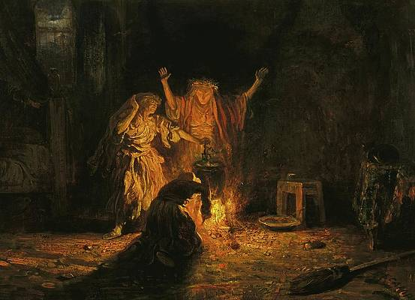
Theory of transfer reactions
Some necessary ingredients
Optical-model potential for outgoing distorted waves (from elastics)
Optical-model potential for incoming distorted waves (from elastics)
Overlap function - usually single-particle states in a Woods-Saxon potential with adjusted depth
Transfer operator - what potential describes the actual transferring part
Initial and final states (energies, spins, parities), masses, beam energy etc

Slide 38
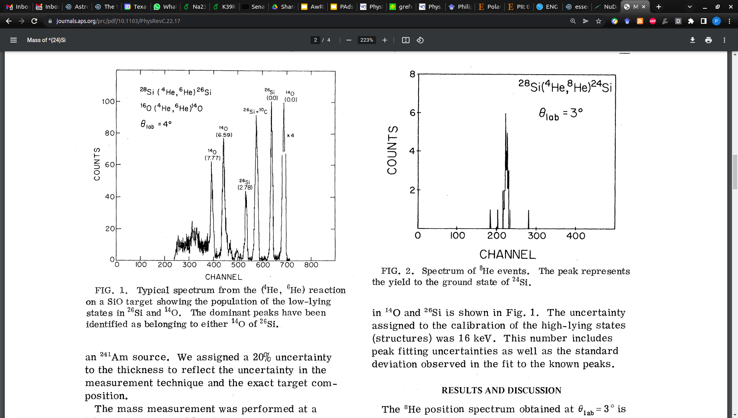
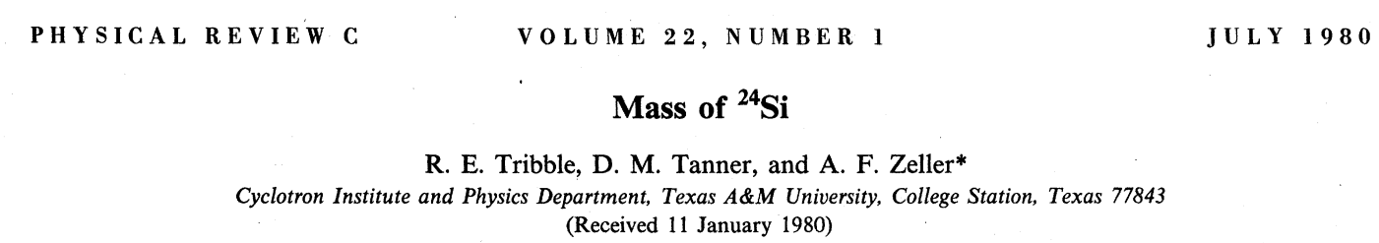
Transfer reactions for E_{r}
The first and most basic task is to work out if there are states in a nucleus!
Generally we can do this at the same time as working out some other things like spins and parities but not always
Back before RIB+Penning traps were a thing - mass measurements using transfer reactions
Can find excited states by the same process (which traps generally cannot)

Slide 39


Computing widths from transfer reactions
The spectroscopic factor and the single-particle partial width both depend on the binding potential used
Negatively correlated!
Their product is less uncertain than each of them are independently
Means that we end up with a smaller uncertainty on the width than each of the spectroscopic factor and single-particle width independently

Slide 40
Useful tools
FRESCO is great for transfer and it gives us wavefunctions for our calculations <3
DWUCK4 allows transfer to unbound states with computed widths as well (find my Github “padsley” if you want to try DWUCK4)
RatesMC (also on Github) is a great tool for calculating reaction rates with uncertainties (Richard Longland) + STARLIB database
People – ask for help! I’m happy to try to help if you have questions but I’m slow and don’t like reading my emails so be patient

