Slide 1
Nuclear DFT calculations - a practitioner's intro
Vladimir Manea
IJCLab, Orsay, France
vladimir.manea@ijclab.in2p3.fr

Slide 2
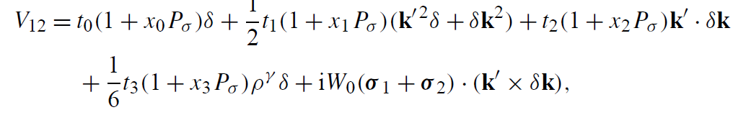



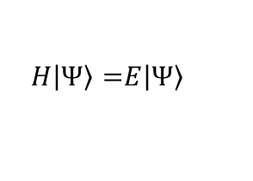



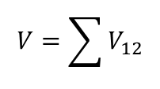

Brief description of formalism
Goal: Solve
$$H\left|\left.Ψ\right\rangle =\right.E\left|\left.Ψ\right\rangle \right.$$
starting from
$$H=T+V$$
$$V=\sum{V_{12}}$$
$$V_{12}$$
with
and
a nuclear two-body interaction, in practice either a Skyrme (below), or a Gogny
Central
Momentum-dependent terms simulating finite range
$$δ=δ(r_{1}−r_{2})$$
Density-dependent term simulating 3-body effects
Spin-orbit term
With t₀₋₃ and x₀₋₃, W₀ and γ parameters of the interaction and all the others
$$k=k_{1}−k_{2}$$
$$k_{1,2}=\frac{i}{2}∇_{1,2}$$
Momentum operator:
$$k′=k_{1}−k_{2}$$
$$P_{σ}$$
Spin exchange operator
D. Vautherin, D.M. Brink, Phys. Rev. C 5, 626 (1972)
K. Bennaceur, J. Dobaczewski, Comp. Phys. Commun. 168, 96 (2005)

Slide 3
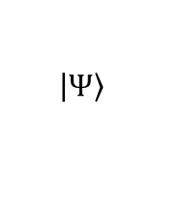
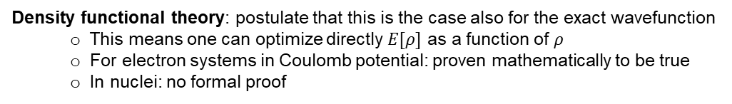



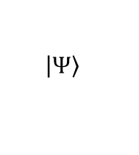
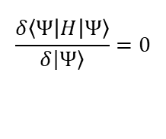

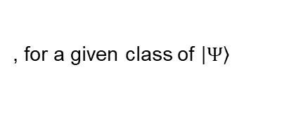
Brief description of formalism
Goal: Solve
$$H\left|\left.Ψ\right\rangle =\right.E\left|\left.Ψ\right\rangle \right.$$
starting from
$$H=T+V$$
Use variational principle: Minimize
$$\left\langle Ψ | H | Ψ\right\rangle$$
with a specific class of
$$\left|\left.Ψ\right\rangle \right.$$
Hartree-Fock:
$$\left|\left.Ψ\right\rangle \right.$$
is a Slater determinant of single-particle wavefunctions
In this case:
$$\left\langle Ψ | H | Ψ\right\rangle =ℰ[ρ]$$
(functional of the density)
Density functional theory: postulate that this is the case also for the exact wavefunction
  This means one can optimize directly $E[ρ]$ as a function of $ρ$
  For electron systems in Coulomb potential: proven mathematically to be true
  In nuclei: no formal proof
The basic difference:
Hartree-Fock-(Bogoliubov/BCS)
Density Functional Theory
$$\frac{δ\left\langle Ψ | H | Ψ\right\rangle }{δ\left|\left.Ψ\right\rangle \right.}=0$$
$$\frac{δℰ[ρ] }{δρ}=0$$
, for a given class of $\left|\left.Ψ\right\rangle \right.$
varying $ρ$
D. Vautherin, D.M. Brink, Phys. Rev. C 5, 626 (1972)
K. Bennaceur, J. Dobaczewski, Comp. Phys. Commun. 168, 96 (2005)

Slide 4
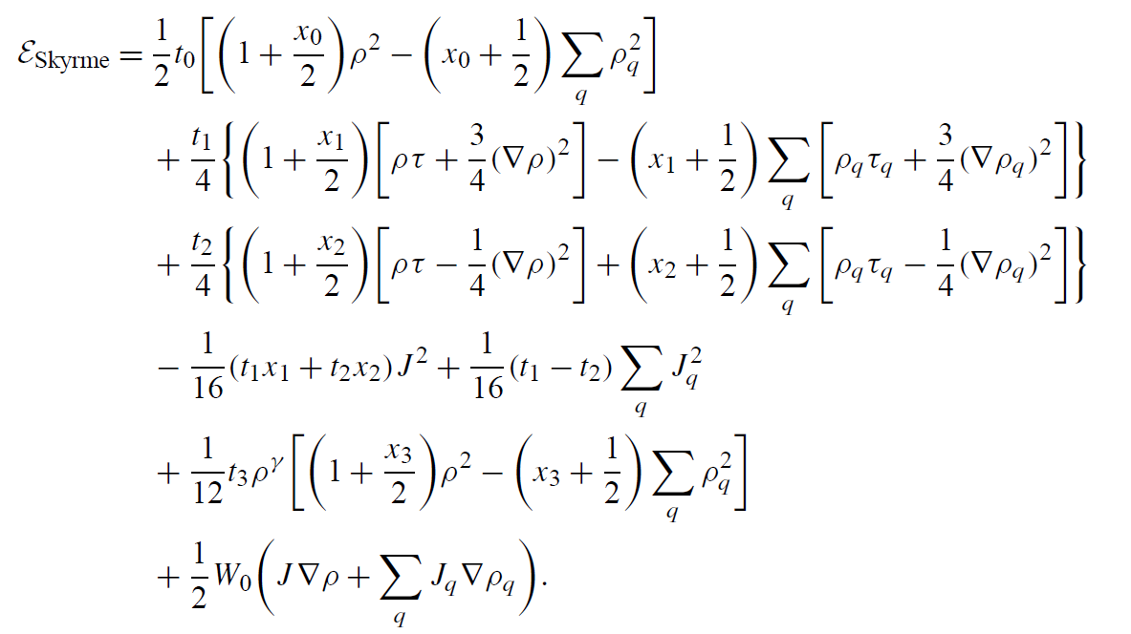
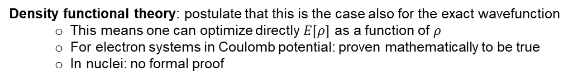
Brief description of formalism
Goal: Solve
$$H\left|\left.Ψ\right\rangle =\right.E\left|\left.Ψ\right\rangle \right.$$
starting from
$$H=T+V$$
Use variational principle: Minimize
$$\left\langle Ψ | H | Ψ\right\rangle$$
with a specific class of
$$\left|\left.Ψ\right\rangle \right.$$
Hartree-Fock:
$$\left|\left.Ψ\right\rangle \right.$$
is a Slater determinant of single-particle wavefunctions
In this case:
$$\left\langle Ψ | H | Ψ\right\rangle =ℰ[ρ]$$
(functional of the density)
Density functional theory: postulate that this is the case also for the exact wavefunction
  This means one can optimize directly $E[ρ]$ as a function of $ρ$
  For electron systems in Coulomb potential: proven mathematically to be true
  In nuclei: no formal proof
For a Skyrme
The basic difference:
Hartree-Fock-(Bogoliubov/BCS)
Density Functional Theory
$$\frac{δ\left\langle Ψ | H | Ψ\right\rangle }{δ\left|\left.Ψ\right\rangle \right.}=0$$
$$\frac{δℰ[ρ] }{δρ}=0$$
, for a given class of $\left|\left.Ψ\right\rangle \right.$
varying $ρ$
D. Vautherin, D.M. Brink, Phys. Rev. C 5, 626 (1972)
K. Bennaceur, J. Dobaczewski, Comp. Phys. Commun. 168, 96 (2005)

Slide 5



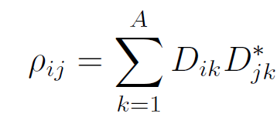
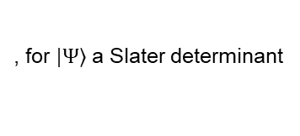


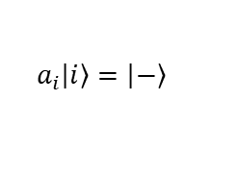

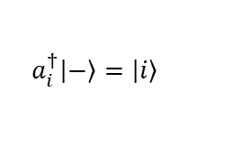
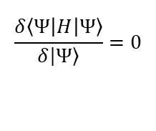
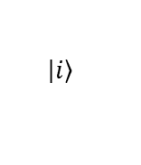
Brief description of formalism
Goal: Solve
$$H\left|\left.Ψ\right\rangle =\right.E\left|\left.Ψ\right\rangle \right.$$
starting from
$$H=T+V$$
Use variational principle: Minimize
$$\left\langle Ψ | H | Ψ\right\rangle$$
with a specific class of
$$\left|\left.Ψ\right\rangle \right.$$
Notations:
Hartree-Fock:
$$\left|\left.Ψ\right\rangle \right.$$
is a Slater determinant of single-particle wavefunctions
In this case:
(functional of the density)
$$\left.\left|i\right.\right\rangle$$
One-body wavefunction (e.g. harmonic oscillator)
$$\left\langle Ψ | H | Ψ\right\rangle =ℰ[ρ]$$
$$A_{ij}=\left\langle i | A | j\right\rangle$$
$$\frac{δ\left\langle Ψ | H | Ψ\right\rangle }{δ\left|\left.Ψ\right\rangle \right.}=0$$
, for $\left|\left.Ψ\right\rangle \right.$ a Slater determinant
$$A_{ijkl}=\left\langle ij | A | kl\right\rangle$$
If one actually performs this differentiation, one sees that it is equivalent to an eigenvalue problem for a one-body Hamiltonian h:
$${\overline{A}}_{ijkl}=\left\langle ij | A | kl\right\rangle −\left\langle ij | A | lk\right\rangle$$
The one-body density matrix
$$a_{i}^{†}\left.\left|−\right.\right\rangle =\left.\left|i\right.\right\rangle$$
Diagonal in the same basis as h_{ij} (canonical basis)
$$a_{i}\left.\left|i\right.\right\rangle =\left.\left|−\right.\right\rangle$$
D. Vautherin, D.M. Brink, Phys. Rev. C 5, 626 (1972)
K. Bennaceur, J. Dobaczewski, Comp. Phys. Commun. 168, 96 (2005)

Slide 6
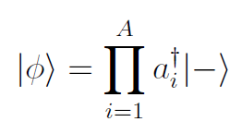



Brief description of formalism: quasiparticles
The BCS idea: instead of Slater determinant,
use this ansatz:
Notations:
$$\left.\left|i\right.\right\rangle$$
One-body wavefunction (e.g. harmonic oscillator)
$$A_{ij}=\left\langle i | A | j\right\rangle$$
Theorem: one can define
$$A_{ijkl}=\left\langle ij | A | kl\right\rangle$$
$${\overline{A}}_{ijkl}=\left\langle ij | A | kl\right\rangle −\left\langle ij | A | lk\right\rangle$$
then
$$a_{i}^{†}\left.\left|−\right.\right\rangle =\left.\left|i\right.\right\rangle$$
$$a_{i}\left.\left|i\right.\right\rangle =\left.\left|−\right.\right\rangle$$
D. Vautherin, D.M. Brink, Phys. Rev. C 5, 626 (1972)
K. Bennaceur, J. Dobaczewski, Comp. Phys. Commun. 168, 96 (2005)

Slide 7

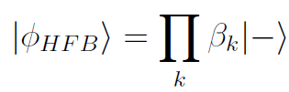
Brief description of formalism: quasiparticles
The BCS idea: instead of Slater determinant,
use this ansatz:
Notations:
$$\left.\left|i\right.\right\rangle$$
One-body wavefunction (e.g. harmonic oscillator)
$$A_{ij}=\left\langle i | A | j\right\rangle$$
Theorem: one can define
$$A_{ijkl}=\left\langle ij | A | kl\right\rangle$$
$${\overline{A}}_{ijkl}=\left\langle ij | A | kl\right\rangle −\left\langle ij | A | lk\right\rangle$$
then
$$a_{i}^{†}\left.\left|−\right.\right\rangle =\left.\left|i\right.\right\rangle$$
Bogoliubov: Let’s generalize the definition, not making directly pairs from basis states
$$a_{i}\left.\left|i\right.\right\rangle =\left.\left|−\right.\right\rangle$$
D. Vautherin, D.M. Brink, Phys. Rev. C 5, 626 (1972)
K. Bennaceur, J. Dobaczewski, Comp. Phys. Commun. 168, 96 (2005)

Slide 8
Brief description of formalism: quasiparticles
The BCS idea: instead of Slater determinant,
use this ansatz:
This form only in the basis that diagonalizes the one-body density matrix: mean field chooses what states will pair
Notations:
$$\left.\left|i\right.\right\rangle$$
One-body wavefunction (e.g. harmonic oscillator)
$$A_{ij}=\left\langle i | A | j\right\rangle$$
Theorem: one can define
$$A_{ijkl}=\left\langle ij | A | kl\right\rangle$$
$${\overline{A}}_{ijkl}=\left\langle ij | A | kl\right\rangle −\left\langle ij | A | lk\right\rangle$$
then
$$a_{i}^{†}\left.\left|−\right.\right\rangle =\left.\left|i\right.\right\rangle$$
Bogoliubov: Let’s generalize the definition, not making directly pairs from basis states
$$a_{i}\left.\left|i\right.\right\rangle =\left.\left|−\right.\right\rangle$$
D. Vautherin, D.M. Brink, Phys. Rev. C 5, 626 (1972)
K. Bennaceur, J. Dobaczewski, Comp. Phys. Commun. 168, 96 (2005)

Slide 9
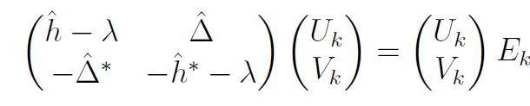




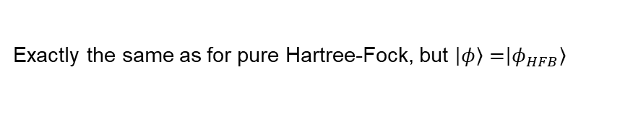

Hartree-Fock-Bogoliubov equations
Hartree-Fock field
Pairing field
Think of it as state mixing with a cross-diagonal term which is only non-zero if particles are paired
$$ρ_{ij}=\left\langle φ_{HFB} | a_{j}^{†}a_{i} | φ_{HFB}\right\rangle$$
Exactly the same as for pure Hartree-Fock, but $\left|\left.φ\right\rangle =\right.\left|\left.φ_{HFB}\right\rangle \right.$
Pairing tensor
$$ρ=V^{∗}V^{T}$$
$$κ=V^{∗}U^{T}$$

Slide 10
Hartree-Fock-Bogoliubov equations
Hartree-Fock field
Pairing field
Think of it as state mixing with a cross-diagonal term which is only non-zero if particles are paired
$$ρ_{ij}=\left\langle φ_{HFB} | a_{j}^{†}a_{i} | φ_{HFB}\right\rangle$$
Exactly the same as for pure Hartree-Fock, but $\left|\left.φ\right\rangle =\right.\left|\left.φ_{HFB}\right\rangle \right.$
Pairing tensor
$$ρ=V^{∗}V^{T}$$
$$κ=V^{∗}U^{T}$$
The numerical algorithm mostly proceeds like in the HF case

Slide 11
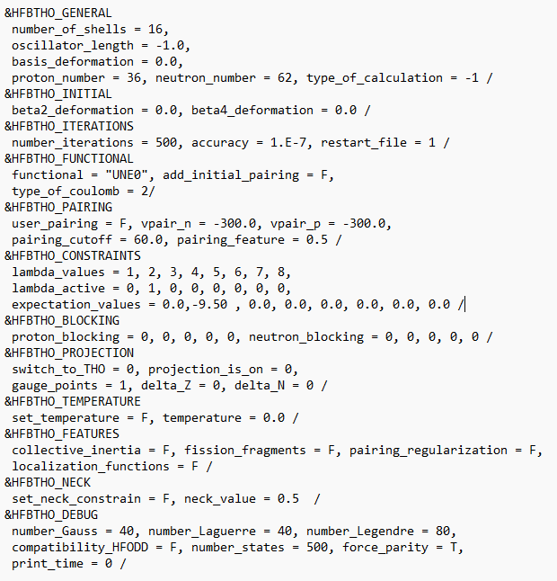
Input file

Slide 12
Input file
Wavefunctions expanded in a Harmonic Oscillator basis
Larger means more accurate representation, but longer computation time: use 10 for today’s exercise. Normally this parameter is gradually increased until convergence.
The length parameter of the oscillator (equivalently, the oscillator frequency) needs to scale with mass in order to avoid truncation errors: -1 means standard scaling hω as 1,2 x 41/A^{1/3}
The oscillator basis can be axially quadrupole deformed: this helps converge faster (with fewer shells) very deformed states. Keep it spherical for today.
Type of calculation (HFB or HFB with Lipkin-Nogami corrections for breaking particle number conservation). -1 means HFB-LN, which we will use.
Type of functional: 'SIII‘,'SKM*‘,'SKP‘,‘SLY4‘,'SLY5‘,'SLY6‘,'SLY7‘,'SKI3‘,'SKO‘,'SKX‘,'HFB9‘,'UNE0‘,'UNE1‘,'UNE2‘,'N0LO‘,'N1LO‘,'N2LO‘,'FITS‘,'D1‘,'D1p‘,'D1S‘,'D1N‘,'T0X0'
Type of calculation of Coulomb potential: use 2 (full approximate calculation)

Slide 13
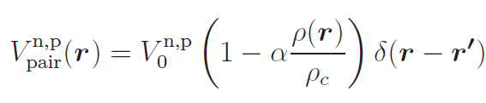
Input file
Generally, pairing interaction defined by 2 parameters:
A strength (V₀) which can be different for protons and neutrons
A coefficient defining how much « volume » or « surface » it is:
  α = 0 → pure volume force
  α = 1 → pure surface force
  α = 1/2 → mixed volume/surface
If user_pairing = F, the pairing force is set by default to what the functional prescribed (use this at the beginning)
If user_pairing = T, the pairing force is defined by the vpair_n and vpair_p (which fix V₀ for protons and neutrons), and pairing_feature (which fixes the value of α); you can use this (for example α = 0) to play with the pairing strength and see what this does to the results.

Slide 14
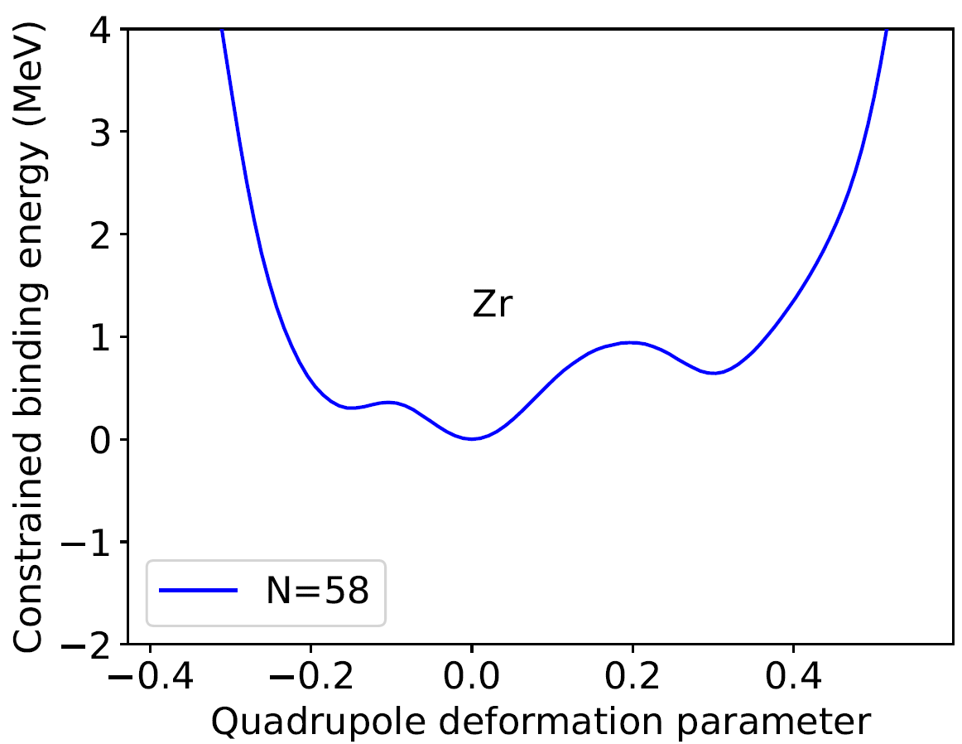
Input file
Allows applying a constraint to a multipole moment of the nucleus and determining how the energy varies with shape (allows producing a « deformation plot ») like shown below.
lambda_values simply lists what moments (dipole, quadrupole, octupole, hexadecapole, … 2^lamba_value-pole) can be constrained, lambda_active shows which ones are actually constrained (put 1 at the appropriate position) and expectation_values sets to which values they should be constrained (in the example, you can see what one should input for a constraint on the quadrupole moment to -9,5 barn).
To produce the plot below, 101 calculations were performed, each constraning the shape to a slightly different value of the quadrupole moment, scanning the range between -10 b and +15 b.

Slide 15
Input file
Allows computing an odd nucleus by the « blocking » prescription, which performs a 1-quasiparticle excitation starting from a fully paired HFB solution of the Z-1 or N-1 even neighbour. To block neutrons in Z = 50 and N = 71, set proton_number = 50, neutron_number = 70 and neutron_blocking = 1,0,0,0,0. This is an automatic choice which blocks one after the other quasiparticle states having maximum wavefunction overlap with the single-particle states within 2 MeV from the Fermi level. For each trial state, one full calculation and one full output is generated. At the end, the user should assign the ground state to the result with minimal energy.
In the .sum file, one will have a line of results for the reference calculation performed in the neighbouring even isotope (in my example Z = 50 and N = 70) and then a line of results for each blocked candidate state in the odd one (Z = 50, N = 71 in this case), of which the lowest in energy should be picked as the ground state.
If one can infer from experimental data the Nilsson quantum numbers of a state, then one can specify a single state to block. In this exercise, we will use the automatic search for the optimal state to block.

Slide 16
Running the code
To run a single calculation:
  Create an input file, ideally without any extension (to avoid double extension of the output files)
  In the terminal (being in the « source » folder), run ./hfbtho_main [input_file]
  The code will run and show the output in the terminal
  The output will be written in the file [input_file].out
  A summary of the output will be written in the file [input_file].sum
    The file contains the following values: [constrained value of Q₂₀],[binding energy], [charge radius], [quadrupole deformation parameter beta_20], [convergence]
  The hfbtho_solver.f90 can be modified and recompiled to write other outputs tot he summary file (search for string lsumm, which is the label of the output file, to find the line where the values are written to file)
A bash script create_inputs.sh can be used to automatically generate inputs with one parameter varies (like the Q₂₀ constraint), which can then be run in series using another bash script.

Slide 17
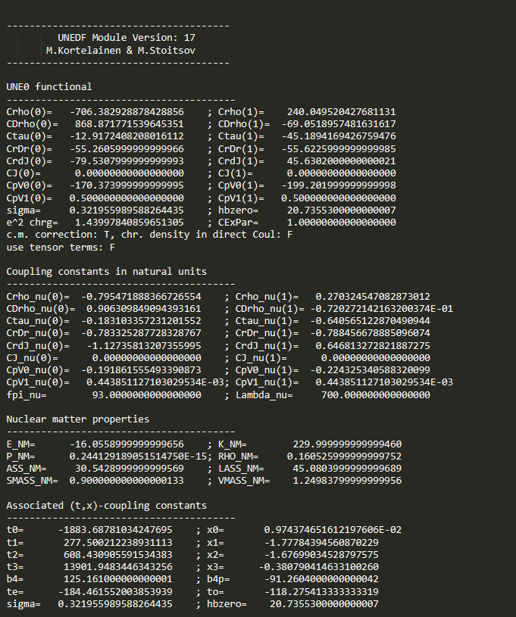
Key elements of output file
Coupling constants of the energy density functional
Equivalent coupling constants of the Skyrme interaction

Slide 18
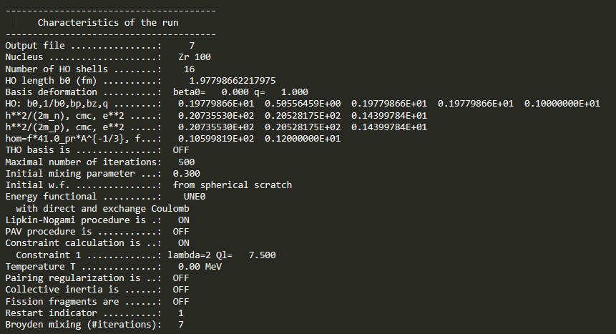
Key elements of output file
Summary of the calculation options in natural language

Slide 19
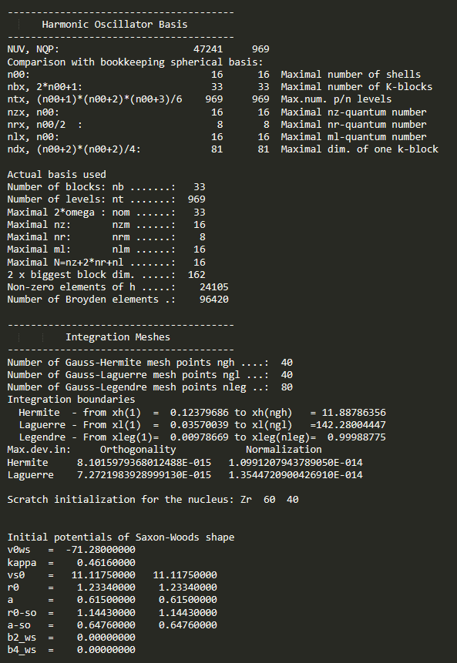
Key elements of output file
Parameters of the Harmonic Oscillator basis used for the computation
Numerical parameters for integrations
Parameters of the initial solutions used to start the calculations

Slide 20
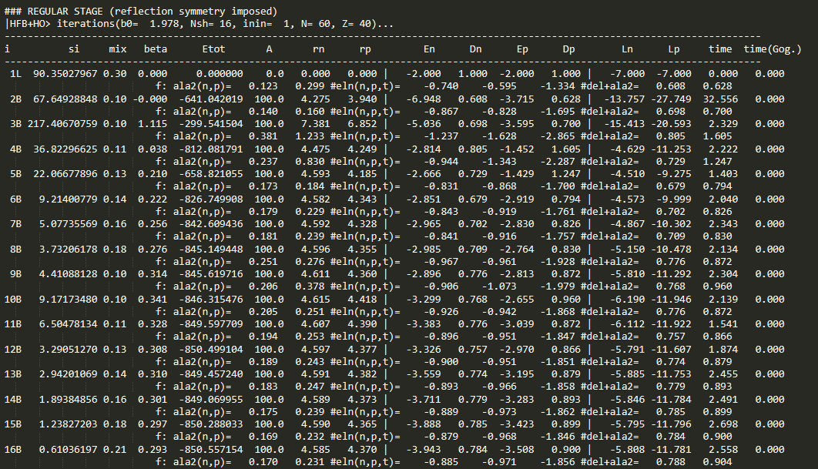
Key elements of output file
Print-out of the result of each HFB iteration (Etot being the binding energy), with some additional check parameters. The iterations stop when the energy difference between consecutive steps is below what was set in the input file as « accuracy »

Slide 21
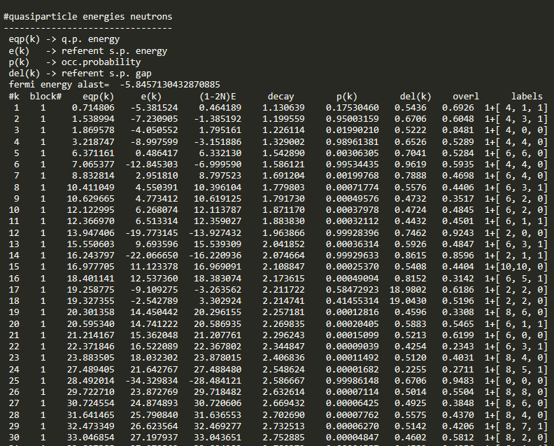
Key elements of output file
Energies of neutron quasiparticle states

Slide 22
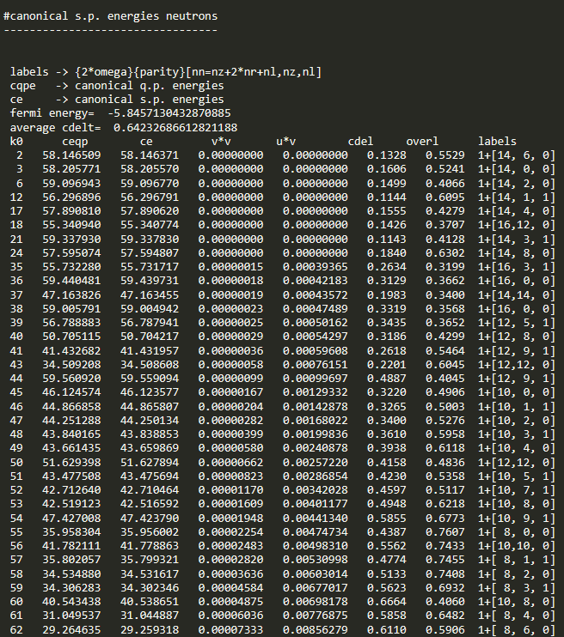
Key elements of output file
Energies of canonical single-particle basis states for neutrons

Slide 23
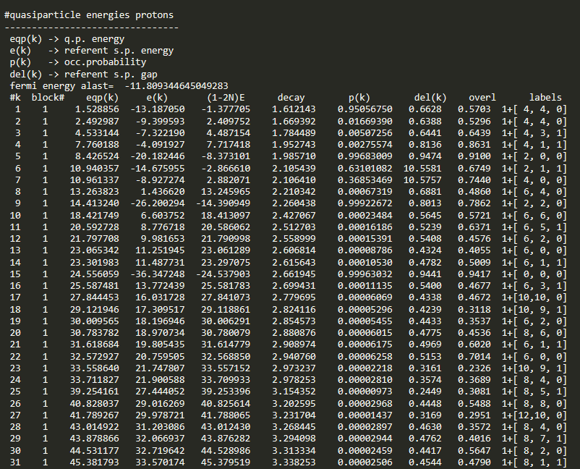
Key elements of output file
Energies of proton quasiparticle states

Slide 24
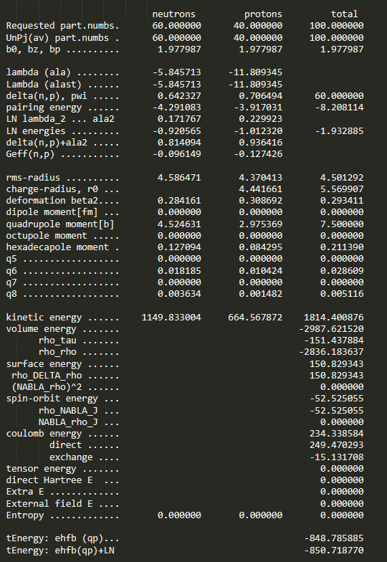
Key elements of output file
Main calculations results
Charge radius without Lipkin-Nogami corrections (larger than proton rms radius due to contribution from the radius of a single proton)
Quadrupole moment obtained in the calculation without LN corrections (usually equal exactly to the one which was constrained)
Hexadecapole moment obtained in the calculation without LN corrections
Binding energy in the calculation without LN corrections (if type_of_calculation = 1 meaning standard HFB, only this will appear)
Binding energy in the calculation with LN corrections (appears only if type_of_calculation = -1 meaning calculations with LN corrections).

Slide 25
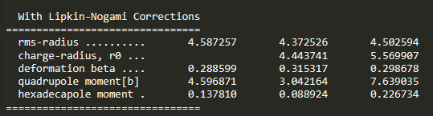
Key elements of output file
Main calculations results
If calculations are performed with LN corrections (type_of_calculation = -1), this additional set of results will appear, since the charge radii, quadrupole moment and deformation parameters will be also impacted. If LN corrections are active, these results should be chosen rather than the ones without corrections (together with the corresponding binding energy).
Calculations with LN corrections are considered to be more accurate (obtained binding energy is lower).
Note: HFBTHO manuals for full information arXiv:1210.1825v3 and arXiv:1704.03945v1

