Slide 1



From the Infrared Triangle to Finite Causal Diamonds
Temple He
Walter Burke Institute & Leinweber Forum, Caltech
Celestial Holography
Simons Satellite Meeting
Apr 14, 2026

Slide 2
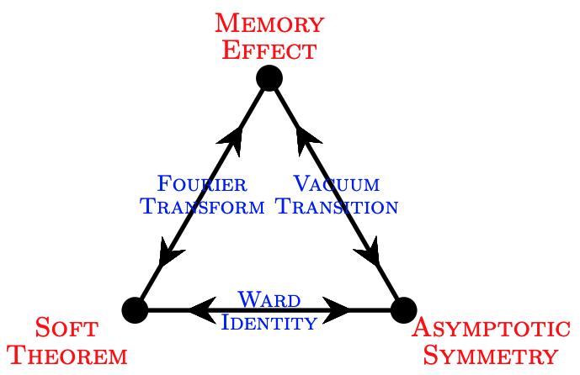
Infrared triangle
Over the last decade, Strominger and collaborators have discovered an equivalence in the infrared sector of gravity and gauge theories [the audience 14-present].
This helped initiate the field of celestial holography!
From Strominger 17
Notes:
”3” sides of the same coin

Slide 3
Multiple vacuum states
We now understand for gravitational (and gauge) theories, there are infinitely many vacua populated by clouds of zero-energy gravitons (or photons/gluons) [TH/Mitra/Lysov/Strominger 14, TH/Mitra/Strominger 15].
The memory effect corresponds to a permanent change in separation between objects due to gravitational radiation [Zel’dovich/Polnarev 74].
It can be interpreted as vacuum transitions between the different vacua [Strominger/Zhiboedov 14].
Notes:
The memory effect was first discovered by Zel’dovich and Polnarov in 1974 and understood as a purely GR effect.
More recently, we now appreciate this as a vacuum transition between spontaneously broken BMS vacua.

Slide 4
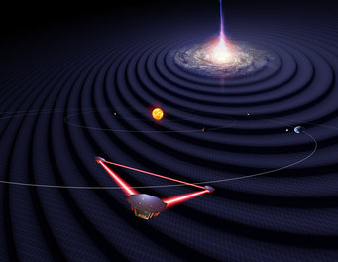
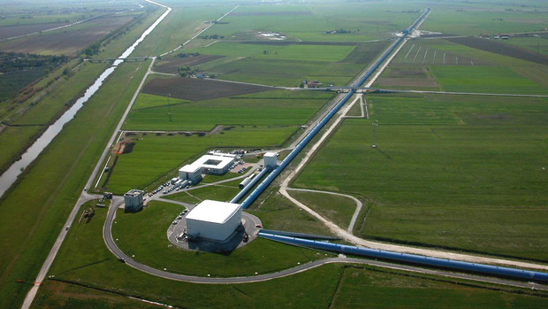
Experimental motivation
The gravitational memory effect might be observable in Advanced LIGO by accumulating multiple signals to increase the signal-to-noise ratio.
Furthermore, another potential experiment that can detect the memory effect is LISA.
This will be a direct experimental verification of the soft graviton theorem as well as the BMS group.
Notes:
The memory effect signal is 10-100 times weaker than the gravitational wave signal and has a lower frequency.
LISA does not need pendulums, so easier to detect memory effect.

Slide 5
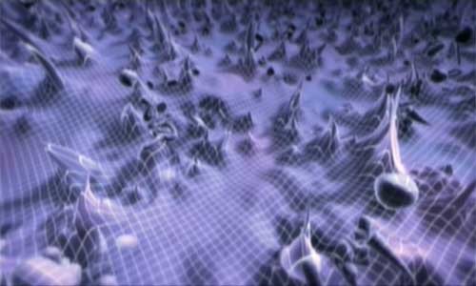
Potential quantum observable?
Quantum fluctuations can also potentially source the gravitational memory effect. This was the motivation for studying shockwaves [TH/Raclariu/Zurek 23, 24].
We would like to think of quantum sourced memory effect as spontaneous vacuum transitions between different vacua.
What is the size of such “quantum memory effect”?
Notes:
Shockwaves are delta function metric perturbations and also arise in the context of AdS/CFT to build wormhole geometries and study chaotic dynamics.
Shockwaves are used as a toy model for vacuum metric fluctuations.
These fluctuations may be viewed as noise on top of the gravitational memory effect arising from classical sources.

Slide 6
EFT estimate of fluctuation size
Standard EFT methods of computing the size of length fluctuations due to quantum effects yields is 10⁻³⁵ m [Carney/Karydas/Sivaramakrishnan 24, Freidel/Oberfrank 26]. This is 10²⁰ times smaller than the diameter of a proton.
This is too small for any experiments in our lifetimes to detect. But the calculation was also done assuming a single unique Lorentz-invariant vacuum.
Notes:
Not much guidance to QG from experiments.

Slide 7
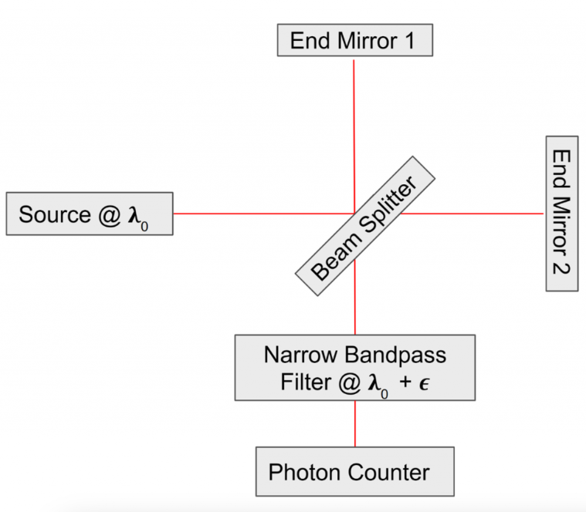
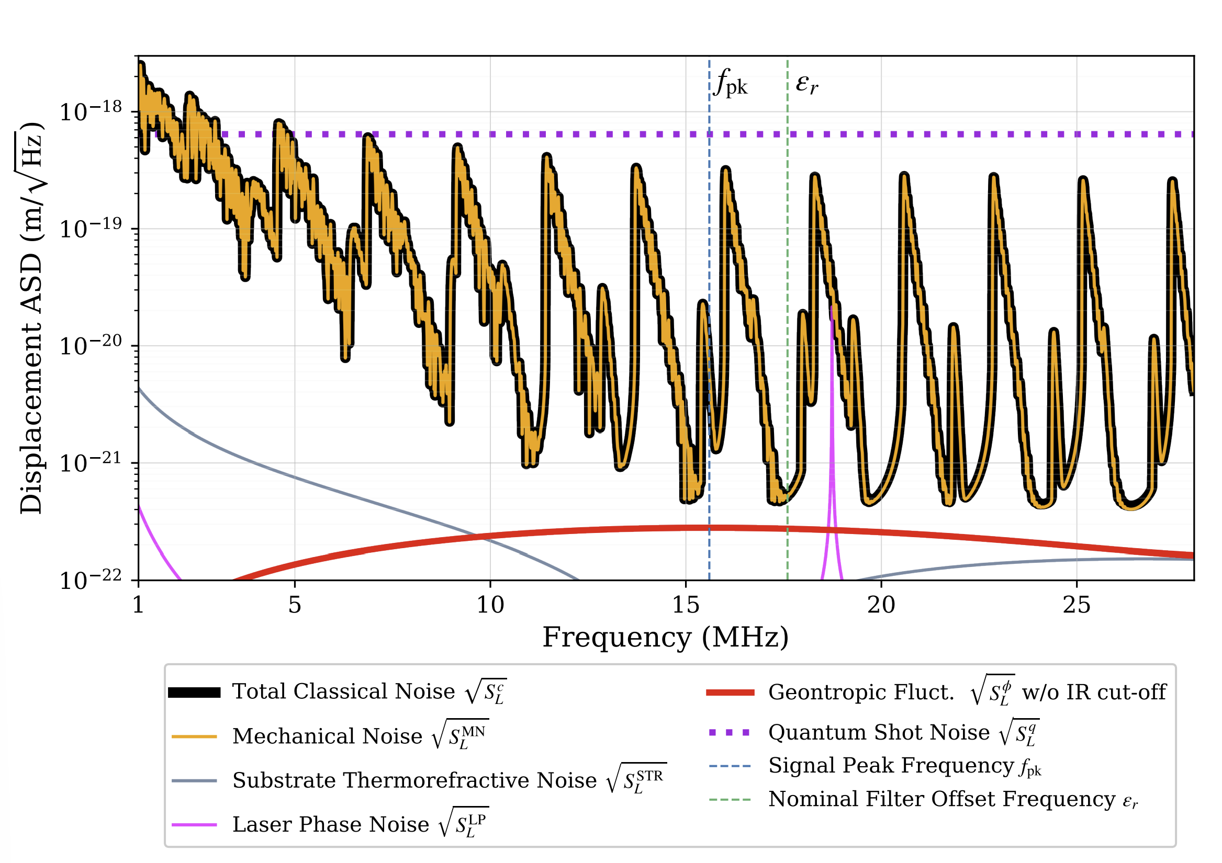
GQuEST
From Fermilab website
GQuEST is a 5-meter laser interferometer being built at Caltech, in collaboration with Fermilab, to look for possible fluctuations of the memory effect.
It can detect metric fluctuations on the order of 10⁻¹⁷ to 10⁻¹⁸ meters!
From Vermeulen et al 25
Notes:
GQuEST = Gravity from the Quantum Entanglement of SpaceTime
Planck length is 10^-34 m.
GQuEST peak signal frequency is 15 MHz
Goal is to give a first principles derivation of the size of vacuum fluctuations by computing correlation functions of soft operators.

Slide 8


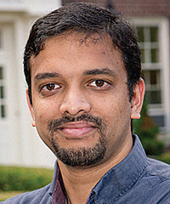


Relevant papers
We take a step towards understanding of quantum metric fluctuations from an observational standpoint by focusing on the study of finite causal diamonds.
We exploit our refined understanding of asymptotically flat gravity in our analysis.
The focus of today’s talk rests on
Causal diamond phase space [Bub/TH/Mitra/Zhang/Zurek 2408.11094]
Connect causal diamond to vacuum AFG [Ciambelli/TH/Zurek 2512.09018]
Construct the vacuum state of large causal diamond [TH/Mitra/Zurek 2509.13401]
See also: [Ciambelli/TH/Zurek 2504.12282, Fransen/TH/Zurek 2507.22977]
Notes:
CD are a toy model still (they are spherically symmetric).
Once we have the vacuum state, we can compute many information theoretic quantities, e.g. the modular Hamiltonian.

Slide 9
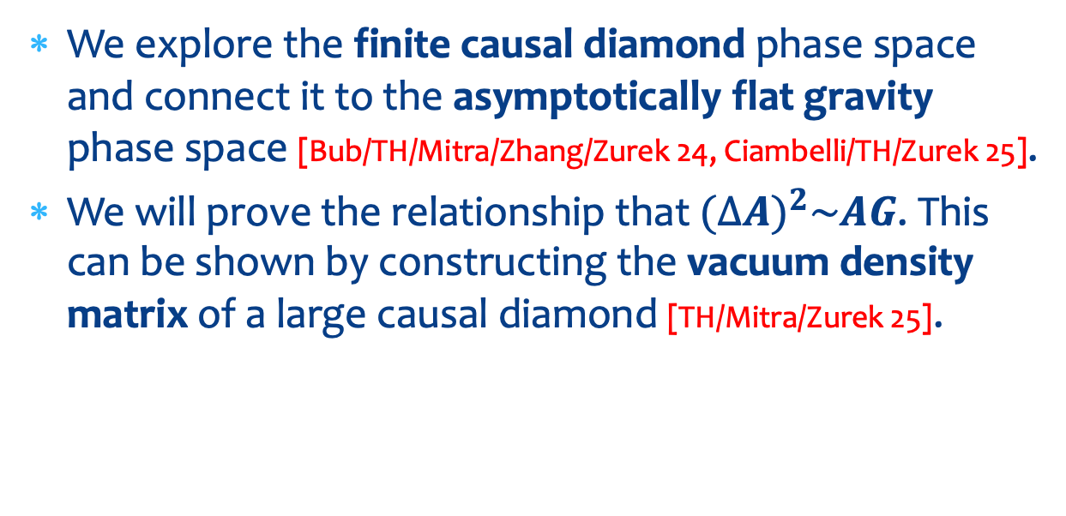
Goal of presentation
We explore the finite causal diamond phase space and connect it to the asymptotically flat gravity phase space [Bub/TH/Mitra/Zhang/Zurek 24, Ciambelli/TH/Zurek 25].
We will prove the relationship that ${(∆A)}^{2}\sim AG$. This can be shown by constructing the vacuum density matrix of a large causal diamond [TH/Mitra/Zurek 25].
Notes:
Note that vacuum modular Hamiltonian is nontrivial only if there is vacuum degeneracy. This shows how the IR scale enters into the size of area fluctuations.
This relates quantities from quantum information, particle physics, and general relativity! The existence of many connections to different subfields of physics suggests exciting new possibilities and directions to explore!

Slide 10
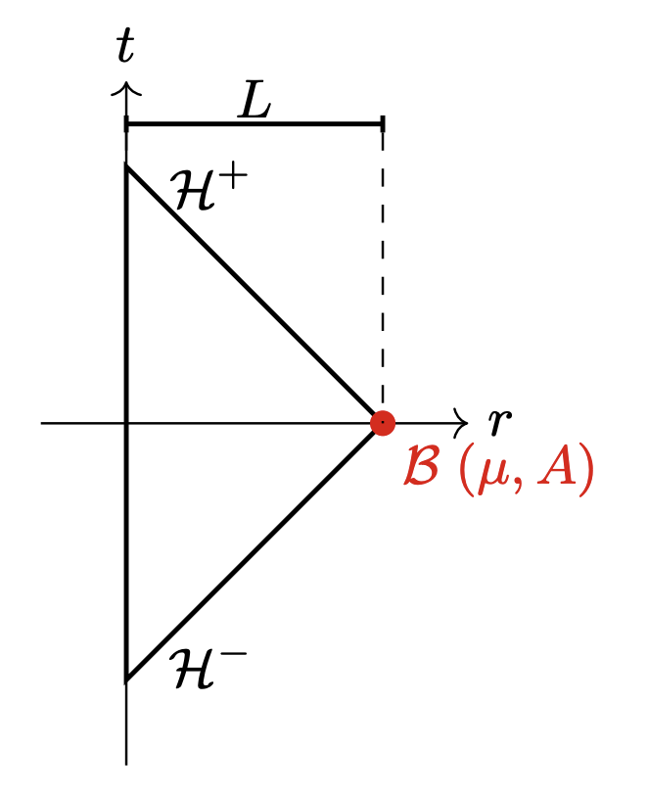
Finite causal diamond
Asymptotic analysis is oftentimes simpler since interactions decouple due to fall-off conditions.
However, we want to study large but finite causal diamonds for practical reasons.
We will focus on quantizing the degrees of freedom governing a spherically symmetric causal diamond in Minkowski spacetime.
Notes:
Finite CDs are relevant for experiments.
All computations are done in semiclassical gravity.

Slide 11
Gaussian null coordinates
Consider a spherically symmetric causal diamond in Minkowski spacetime:
It is convenient to work in Gaussian null coordinates:
Notes:
Gaussian null coordinates is obtained by performing diffeo of causal diamond in pure Minkowski spacetime.

Slide 12
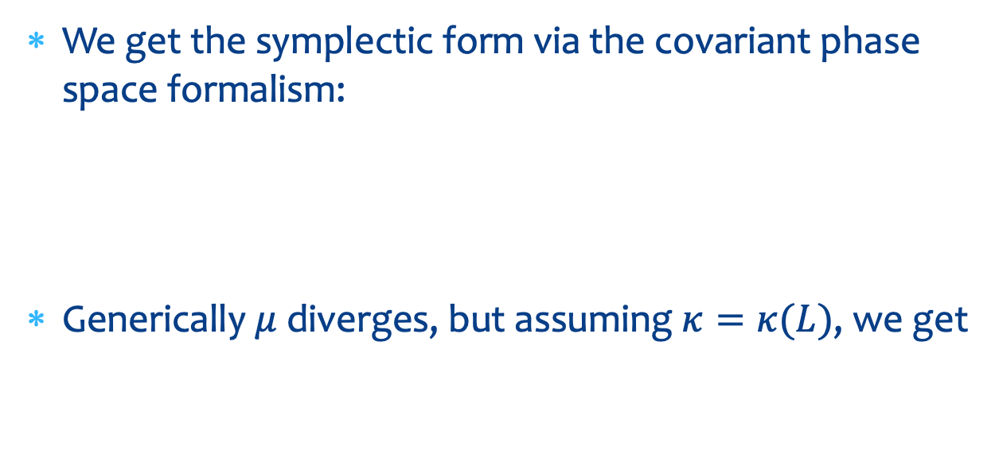
Causal diamond symplectic form
We get the symplectic form via the covariant phase space formalism:
Generically $μ$ diverges, but assuming $κ=κ(L)$, we get
Notes:
The symplectic form localizes to the corner.
The divergence cancels since the wedge product is antisymmetric.

Slide 13
Causal diamond corner algebra
Inverting the symplectic form, we get the Poisson bracket [Bub/TH/Mitra/Zhang/Zurek 24]
This is an algebra defined at the corner (edge modes), and is reminiscent of the leading soft graviton and supertranslation Goldstone mode defined on the celestial sphere [TH/Mitra/Sivaramakrishnan/Zurek 24].
Notes:
The mapping is true only for angle-averaged fields.

Slide 14
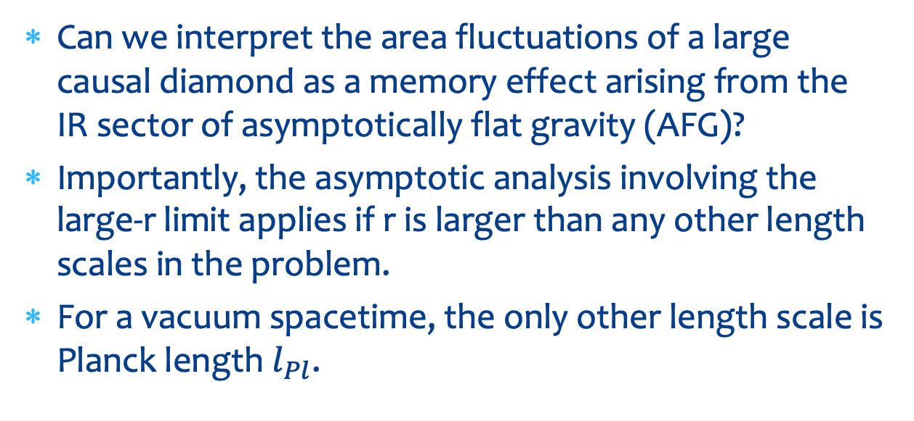
Connection to AFG
Can we interpret the area fluctuations of a large causal diamond as a memory effect arising from the IR sector of asymptotically flat gravity (AFG)?
Importantly, the asymptotic analysis involving the large-r limit applies if r is larger than any other length scales in the problem.
For a vacuum spacetime, the only other length scale is Planck length $l_{Pl}$.
Notes:
r is dimensionful and so we really mean r/eps_UV to be large.
If eps_UV is the length scale, then asymptotic analysis should apply to any macroscopic CD.

Slide 15
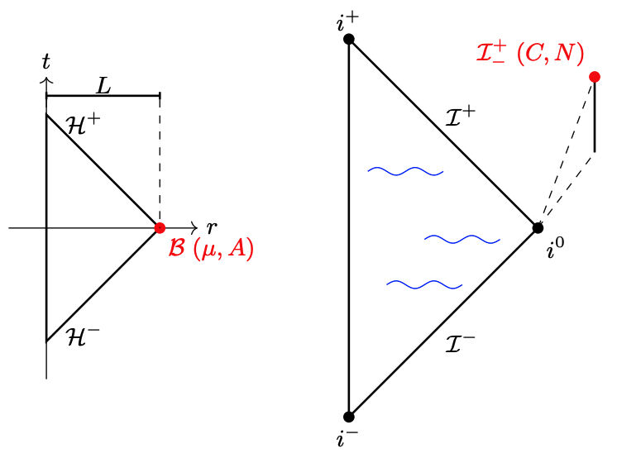
Connection to AFG
Thus far, we studied a Minkowski diamond whose area fluctuates radially.
We need to map this to the asymptotically flat spacetime where the C,N modes capture the leading fluctuations.
We will focus on 4D.
Notes:
This relates the transverse fluctuations of the AFG to radial fluctuations of the finite causal diamond.

Slide 16
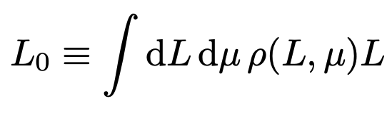

Length fluctuations
We want to parametrize the phase space in terms of length fluctuations instead. We thus define the mean length to be
We can then isolate the fluctuating radial mode to be
Notes:
rho is the probability distribution of CDs in phase space

Slide 17
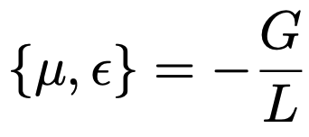
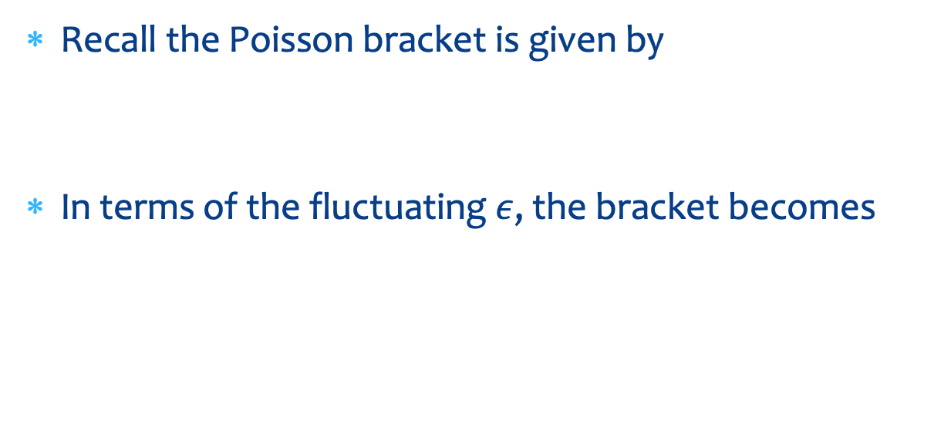
Length fluctuations
Recall the Poisson bracket is given by
In terms of the fluctuating $ε$, the bracket becomes
Notes:
The inverse L is an interesting feature and will contribute later to the mapping not being linear.

Slide 18
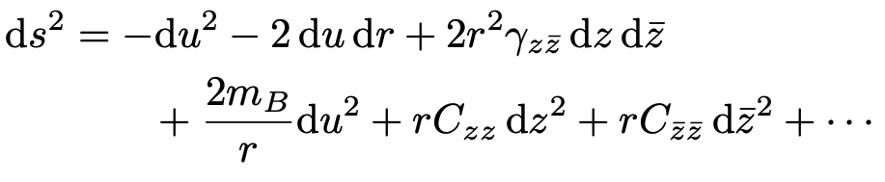
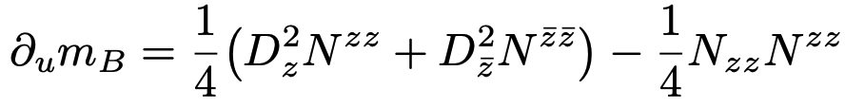
Asymptotically flat metric
The Bondi metric for asymptotically flat spacetimes is [Bondi/van der Burg/Metzner 62, Sachs 62]
In the absence of matter, we have the constraint equation
Notes:
mB corresponds to local energy fluctuations.
Czz corresponds to transverse fluctuations.
Nzz captures gravitational radiation.

Slide 19
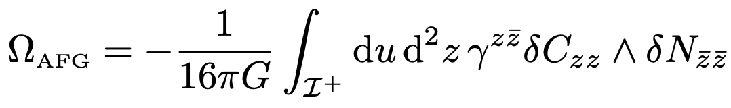
AFG symplectic form
Using the covariant phase space formalism, the symplectic form is [Ashtekar/Streubel 81]
The leading soft graviton and Goldstone modes are captured by the memory shear [Strominger/Zhiboedev 14, TH/Raclariu/Zurek 24]

Slide 20
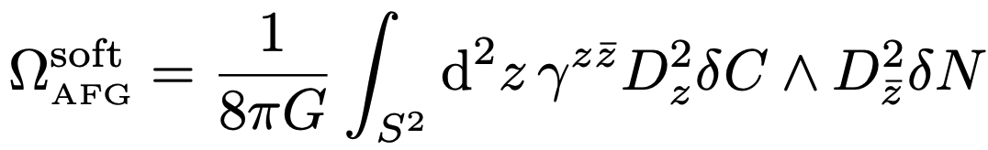

AFG soft symplectic form
Substituting into the symplectic form, we get
Inverting and performing an angle-averaging, we get the bracket
Notes:
Note this is a corner symplectic form.
Note we have extended our phase space to allow for zero modes of C and DDN.

Slide 21
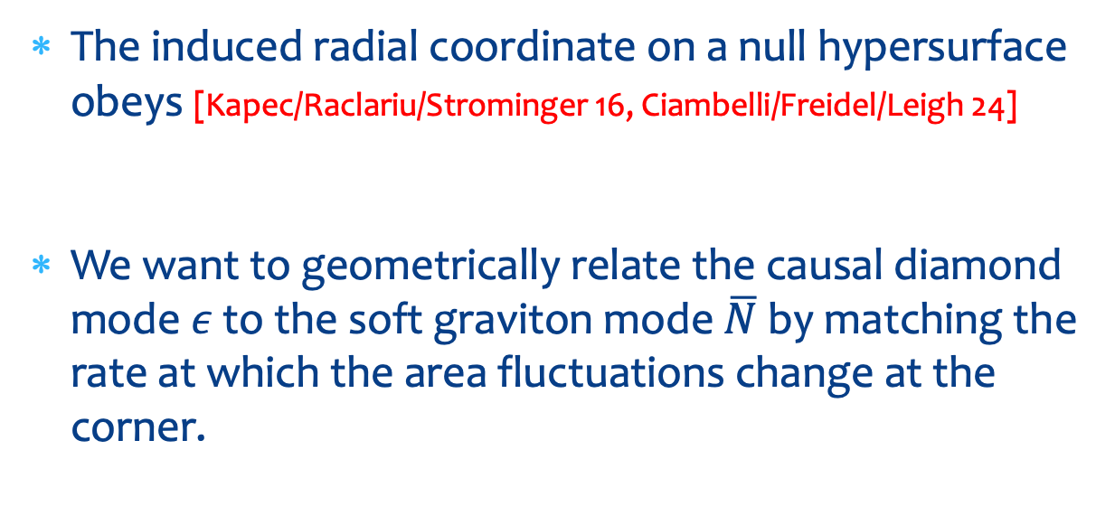
Area fluctuations on horizon
The induced radial coordinate on a null hypersurface obeys [Kapec/Raclariu/Strominger 16, Ciambelli/Freidel/Leigh 24]
We want to geometrically relate the causal diamond mode $ε$ to the soft graviton mode $\overline{N}$ by matching the rate at which the area fluctuations change at the corner.
Notes:
The corner is where the phase space lives for both CD and AFG.

Slide 22

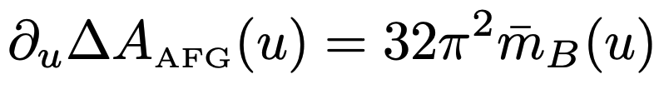

Area fluctuations on horizon
For a causal diamond in Minkowski spacetime, the rate at which area fluctuations changes is
For AFG, the rate is
Matching them at the corner, we get the identity
Notes:
For the CD, mB=0.

Slide 23
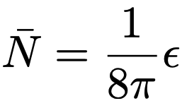

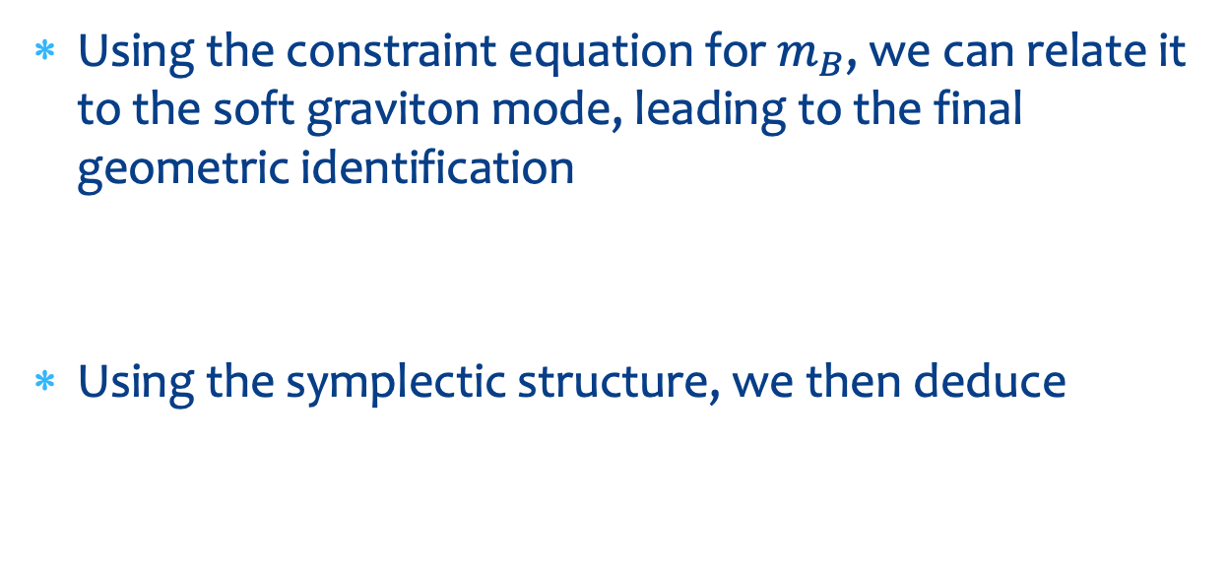
Phase space identification
Using the constraint equation for $m_{B}$, we can relate it to the soft graviton mode, leading to the final geometric identification
Using the symplectic structure, we then deduce
Notes:
Soft graviton mode can be thought of implementing vacuum fluctuations (memory effect), and on the CD this corresponds to radial (area) fluctuations.
C follows from choosing a particular function h(L) that eliminates the divergent part of mu

Slide 24
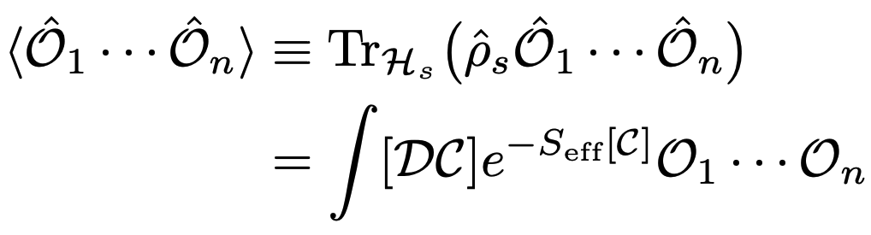
A causal diamond vacuum state
Having identified the isomorphism between the causal diamond and AFG phase spaces, we now use asymptotic analysis to construct a natural vacuum state for a large causal diamond.
We will utilize the soft effective action to construct a density matrix that reproduces the IR factorization and Weinberg’s soft graviton theorem:

Slide 25
Vacuum Hilbert space
After canonically quantizing the phase space, the soft and Goldstone modes obey the commutation relation
where
The C-eigenstates form a basis
Notes:
kappa^2 = 32pi*G

Slide 26
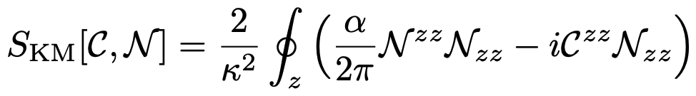
Soft effective action (SEA)
In 4D gravity, the soft effective action is [Kapec/Mitra 21]
where
The O(N²) term is an IR divergent term in 4D and follows from IR factorization. The O(CN) term follows from leading soft graviton theorem.
Notes:
Lambda is soft/hard separation scale, mu is IR cutoff.
IR factorization is <O1…On>_\mu = e^{-Gamma}<O1…On>_\Lambda, where Gamma is determined from Feynman diagrams.

Slide 27
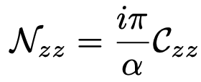
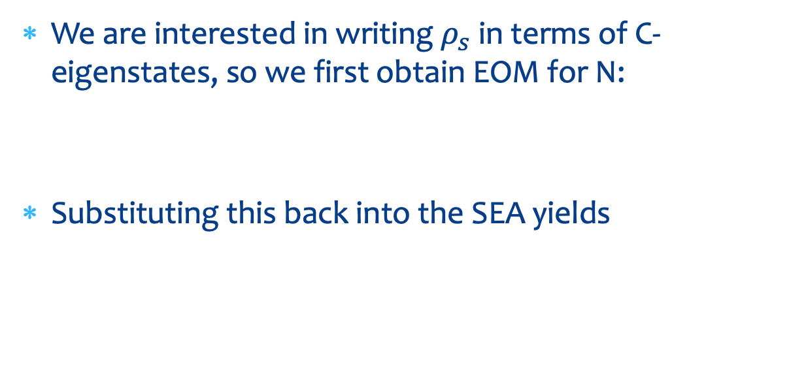
Soft effective action (SEA)
We are interested in writing $ρ_{s}$ in terms of C-eigenstates, so we first obtain EOM for N:
Substituting this back into the SEA yields

Slide 28
A soft density matrix
Consider the density matrix
This captures the IR dynamics governed by the SEA since
Notes:
The measure is normalized so that Tr(rho)=1.

Slide 29
Vacuum modular Hamiltonian
The vacuum modular Hamiltonian by definition is
To compute the mean and variance, we decompose C into spherical harmonics
Notes:
Kappa is included for dimensional reasons, and l_max regulates UV divergence

Slide 30
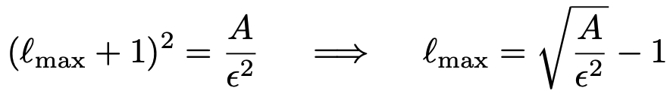

Discretizing the celestial sphere
We provide a geometric meaning to $ℓ_{max}$by assuming the asymptotic analysis is applicable to a large celestial sphere (compared to $l_{Pl}$) with area A.
Discretizing the sphere, we get the relationship
Notes:
(l_max+1) is total # of C_{lm}, and A/eps^2 is total # of plaquettes on sphere.

Slide 31
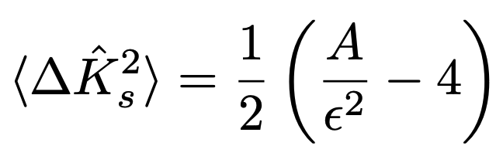
Mean and variance of K_{s}
We can now perform the Gaussian path integrals. The mean of K_{s} is
The variance of K_{s}, which is an observable, is divergence-free:
Notes:
The non-normalizability of C gives a divergence. This can be regularized away by introducing a small potential (same divergence of free particle in QM).
<K> is not an observable.

Slide 32
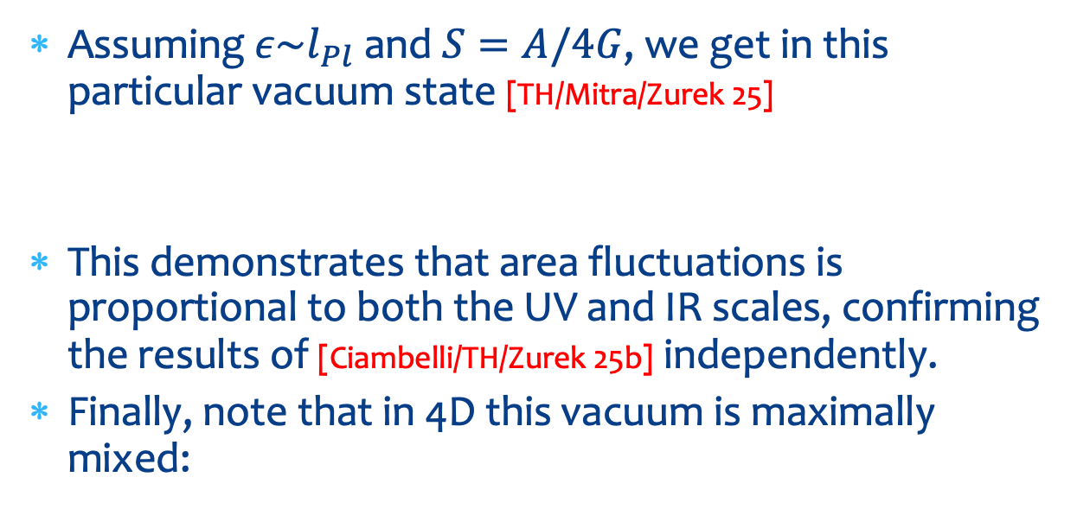
Area fluctuations
Assuming $ε\sim l_{Pl}$ and $S=A/4G$, we get in this particular vacuum state [TH/Mitra/Zurek 25]
This demonstrates that area fluctuations is proportional to both the UV and IR scales, confirming the results of [Ciambelli/TH/Zurek 25b] independently.
Finally, note that in 4D this vacuum is maximally mixed:
Notes:
It would be insightful to determine if such area fluctuations can be determined using graviton exchange Feynman diagrams.
This is similar to dS entropy being maximal, as argued by Jacobson, Silverstein,…

Slide 33
Summary
We constructed the vacuum phase space of a finite causal diamond in the spherically symmetric limit and then demonstrated its relation to angle-averaged soft and Goldstone modes.
Utilizing the connection between the asymptotic analysis and causal diamonds, we construct a vacuum density matrix for a large but finite celestial sphere and discretize it.
We find that area fluctuations depend on UV and IR scales.
Notes:
The enhancement can intuitively be thought of the fact the vacuum can fluctuate into many different vacua.

Slide 34
The road goes ever on and on…
We have learned a lot about the connections between soft modes, edge modes, and the vacuum density matrix through our analysis.
However, our results are at present still completely formal. We need to relate it to the GQuEST experiment and compute the power spectral density of the length fluctuations.
Ultimately, we want to make a novel prediction for our experimental colleagues inspired by the methods of celestial holography.

Slide 35

Thank you!

Slide 36
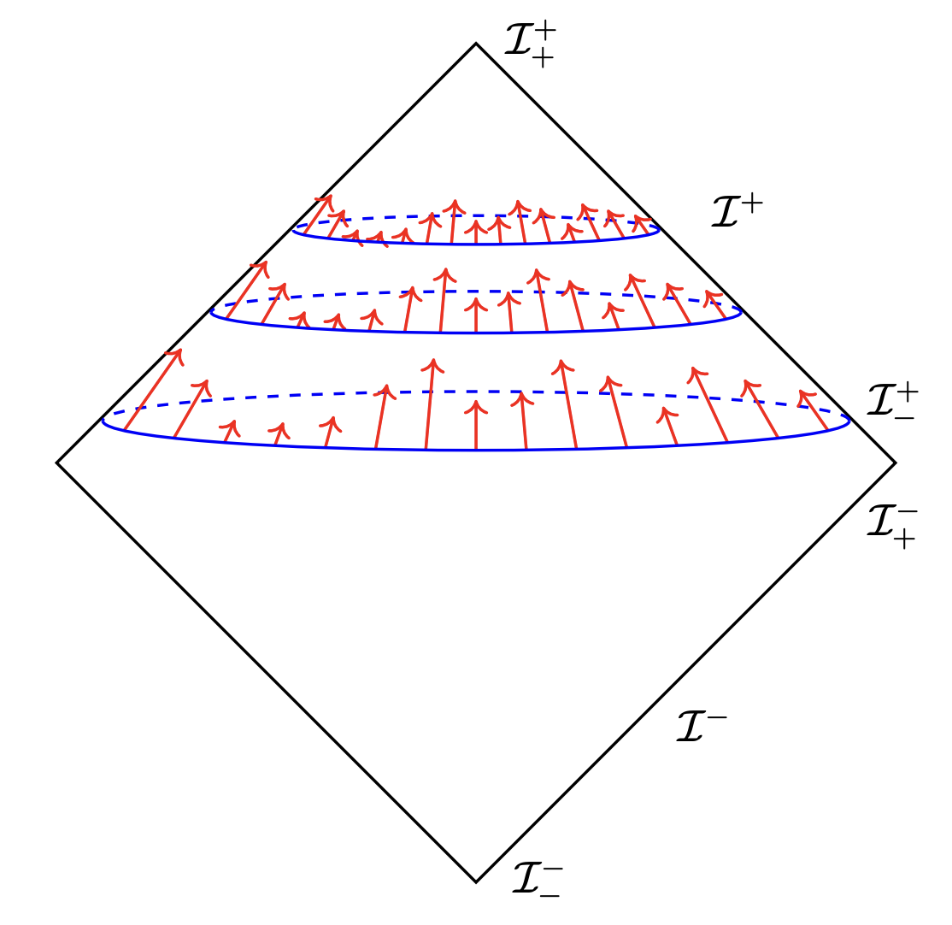
History – asymptotic symmetries
In 1962, Bondi, Metzner, van der Burg, and Sachs studied transformations that preserve boundary fall-off conditions.
Supertranslations are a class of such asymptotic symmetries, and is part of the BMS group.
From Strominger 17
Notes:
Explain Penrose diagram – Each circle is a celestial sphere (2-sphere in 4 bulk dim).
Any two points on the celestial sphere is causally disconnected as they’re infinitely far away; so we cannot synchronize their clocks and can shift them by different amounts.

Slide 37
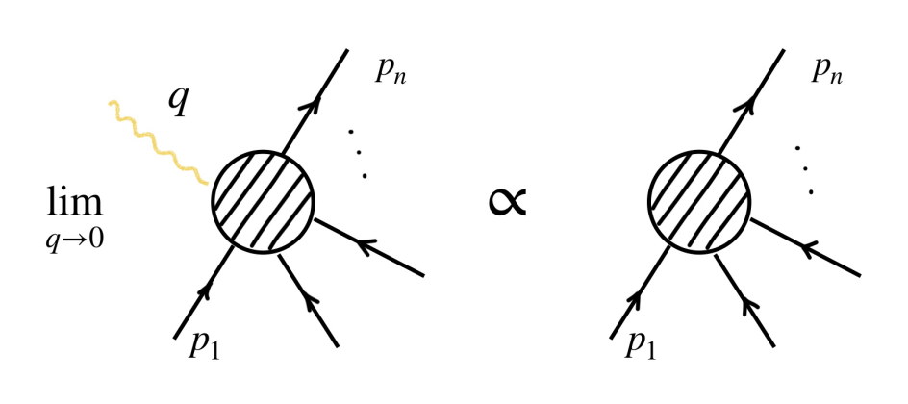
History – soft theorem
Weinberg discovered the leading soft graviton theorem in 1965.
Taking the momentum of the external graviton to be small causes the scattering amplitude to factorize.
From Raclariu 21

Slide 38
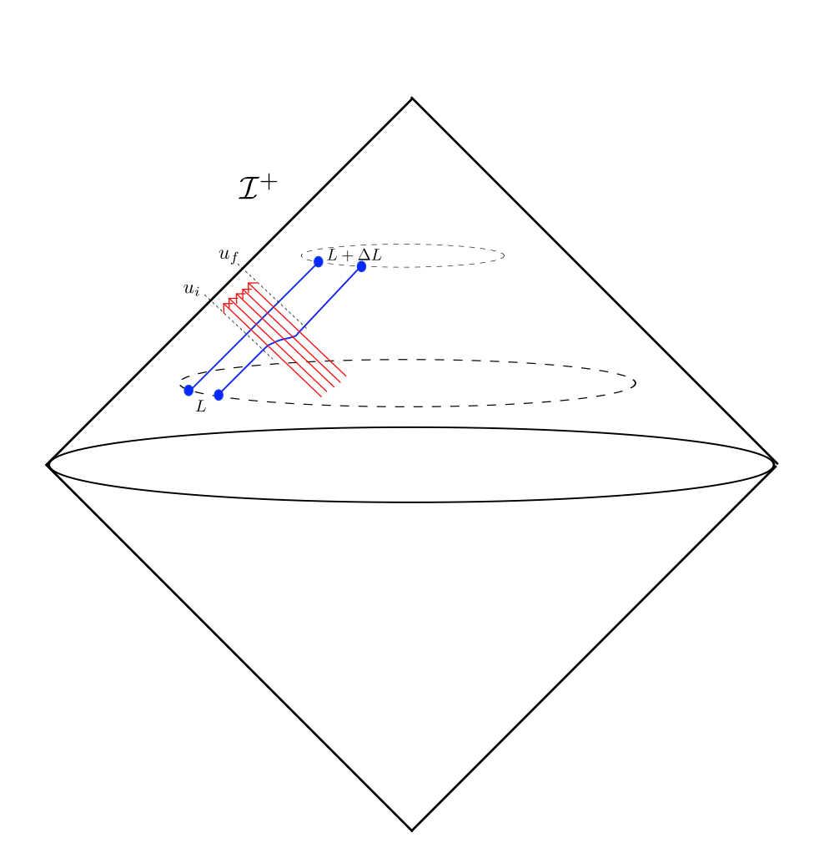
History – memory effect
Zel’dovich and Polnarev discovered the memory effect in 1974.
The permanent change in separation of two objects is potentially measureable!
From Strominger/Zhiboedov 14
Notes:
This is something that can be measured by LISA…harder to measure with LIGO since it uses pendulums, which swing back after a DC displacement.
Exciting to make contact with experiment!

Slide 39
Forming the IR triangle
Each corner of the triangle was separately studied for over half a century by general relativists, particle physicists, and astrophysicists.
With Strominger and collaborators, we proved the equivalence in 2014 [TH/Lysov/Mitra/Strominger 14, Strominger/Zhiboedov 14].
This helped initiate the study of celestial holography!
From Strominger 17

Slide 40
Verlinde/Zurek argument
It was argued in [Verlinde/Zurek 19a, 19b] that size of length fluctuations due to quantum effects may be larger than Planck length.
Roughly, the crux of the argument involves
We want to derive variance of length fluctuation using the gravitational memory effect.
Notes:
The argument utilizes thermodynamical intuition.
S=A/4G gives first relation.
For statistically indep N dof, extensive quantity E obey <E> = N, <delta E^2> = N.
Last relation assumes linear fluctuations in length do not contribute to observable and E~TS~L^2 (1st law of thermo).
It is important to understand if the vacuum degeneracy affects the EFT calculations in gravity (novel prediction of IR triangle).

Slide 41
CD symplectic potential
The symplectic potential for Einstein gravity is
Substituting in the Gaussian null metric, we get
Notes:
The symplectic potential is obtained from covariant phase space formalism.

Slide 42
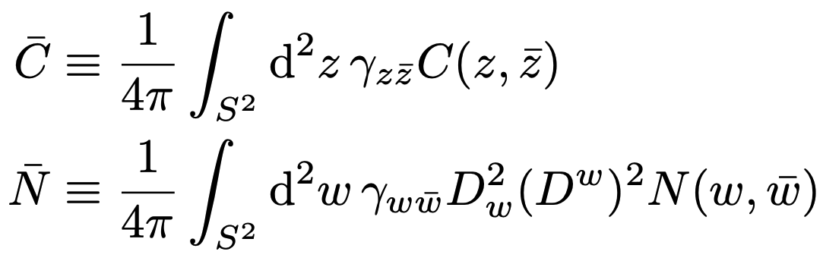
Angle-averaged phase space
To compare with the spherical CD phase space, we angle average to obtain
where
Notes:
WIP in how to generalize the identification w/o spherical symmetry.

Slide 43
Soft effective action
The soft effective action is defined by the action that appears in the path integral once we integrate out the energetic modes.
It was obtained by requiring the soft graviton theorem to hold [Kapec/Mitra 21].
Due to the universal nature of Weinberg’s soft theorem, the soft effective action is universal as well.
Notes:
We can still perform variational principle to obtain the EOM for soft modes.
IR physics does not care about the details of the energetic particles.

