Slide 1

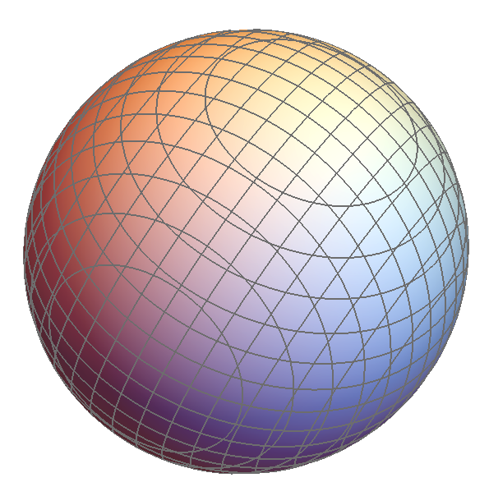
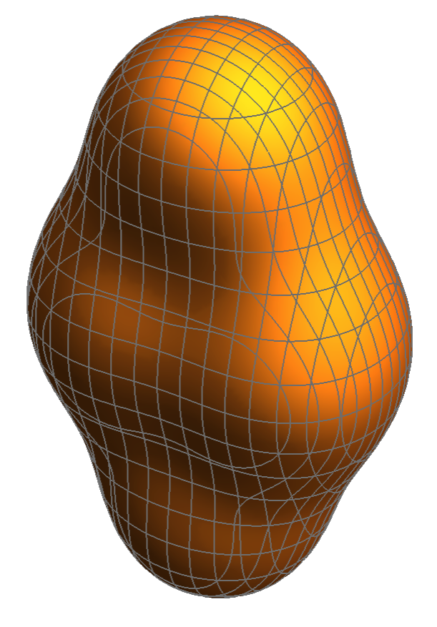
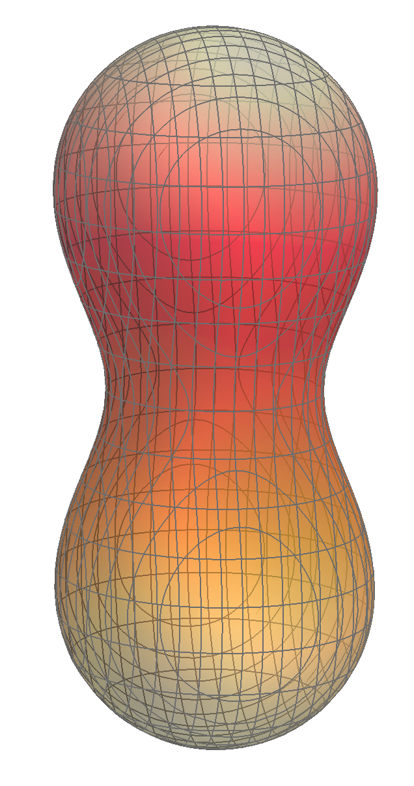
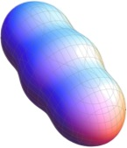
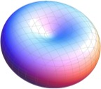









Ab Initio Calculations of
Alpha-Induced Astrophysical
Reactions
$$α$$
$$α$$
$$α$$
$$α$$
$$α$$
$$α$$
$$α$$
$$α$$
$$α$$
$$α$$
$$α$$
$$α$$
$$α$$
$$α$$
Kevin S. Becker
$$α$$
$$α$$

Slide 2
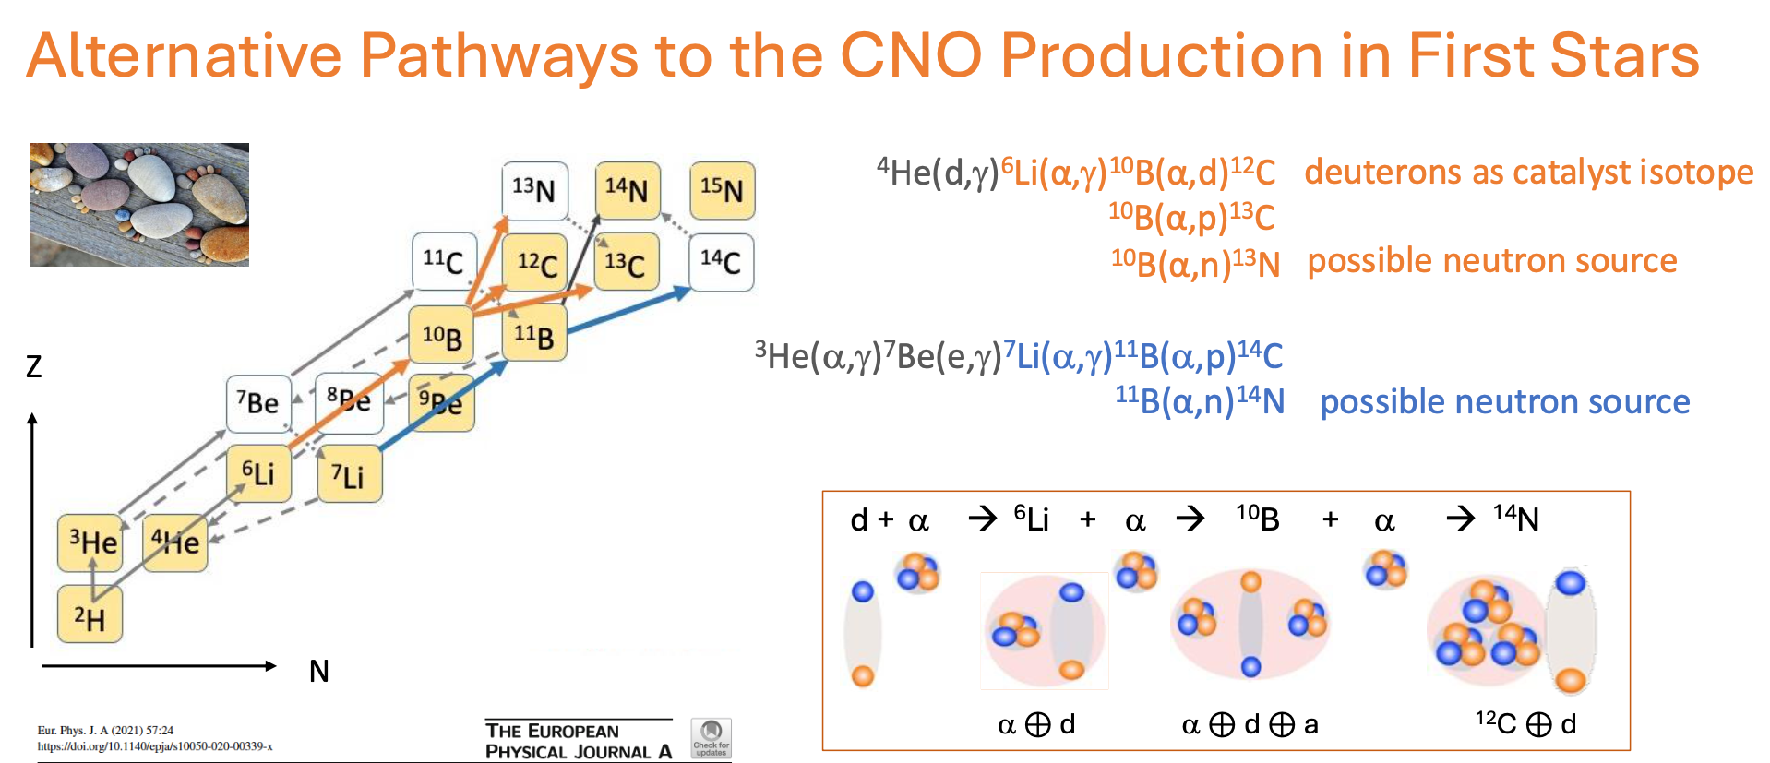
Motivation
M. Aliotta

Slide 3
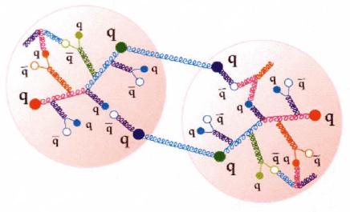
Ab Initio Nuclear Modelling
Nuclear forces tied to quarks and gluons
Don’t resolve, but don’t ignore either: Chiral EFT!
Fully microscopic many-body framework
Structure: No-Core Shell Model
Effective forces
nucleon
nucleon
nucleon
nucleon

Slide 4
Ab Initio Nuclear Modelling
Nuclear forces tied to quarks and gluons
Don’t resolve, but don’t ignore either: Chiral EFT!
Fully microscopic many-body framework
Structure: No-Core Shell Model

Slide 5
Ab Initio Nuclear Modelling
Nuclear forces tied to quarks and gluons
Don’t resolve, but don’t ignore either: Chiral EFT!
Fully microscopic many-body framework
Structure: No-Core Shell Model
Reactions: NCSMC

Slide 6




¹⁴N: Dense Spectrum, Many Thresholds
Besides multiple mass partitions…
Many open channels within a given partition!
Actually not too bad…
MAIN PROBLEM: ¹⁴N spectrum incredibly dense!
10B + $α$
$α$ + 10B
13N + $n$
13C + $p$
ENSDF
data

Slide 7
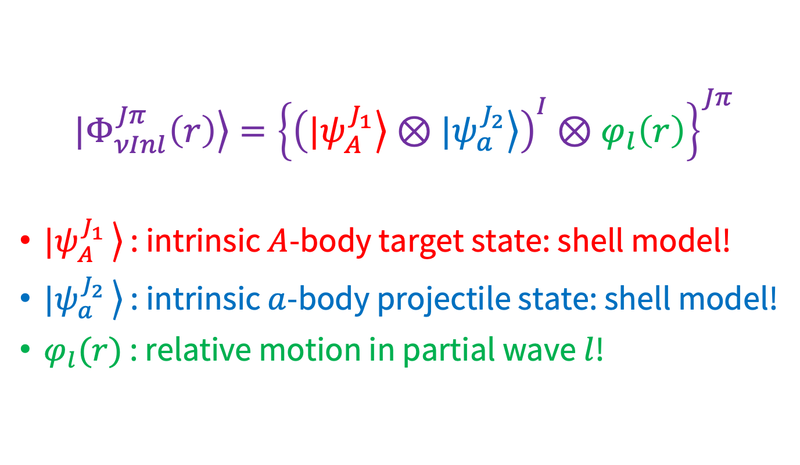



Mass Partitions: Microscopic Cluster Basis
$|\left.Φ_{νInl}^{Jπ}\left(r\right)\right\rangle ={\left\{{\left(|\left.ψ_{A}^{J_{1}}\right\rangle ⊗|\left.ψ_{a}^{J_{2}}\right\rangle \right)}^{I}⊗φ_{l}\left(r\right)\right\}}^{Jπ}$
$|\left.ψ_{A}^{J_{1} }\right\rangle$ : intrinsic $A$-body target state: shell model!
$|\left.ψ_{a}^{J_{2} }\right\rangle$ : intrinsic $a$-body projectile state: shell model!
$φ_{l}(r)$ : relative motion in partial wave $l$!
$$A$$
$$a$$
$$r$$

Slide 8
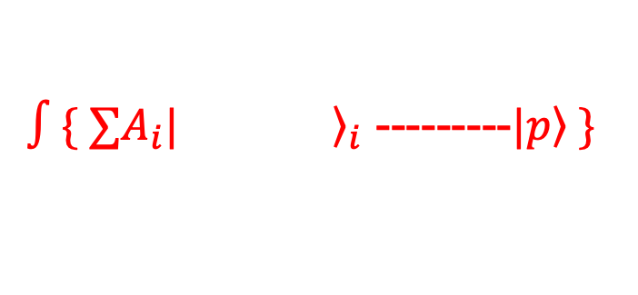

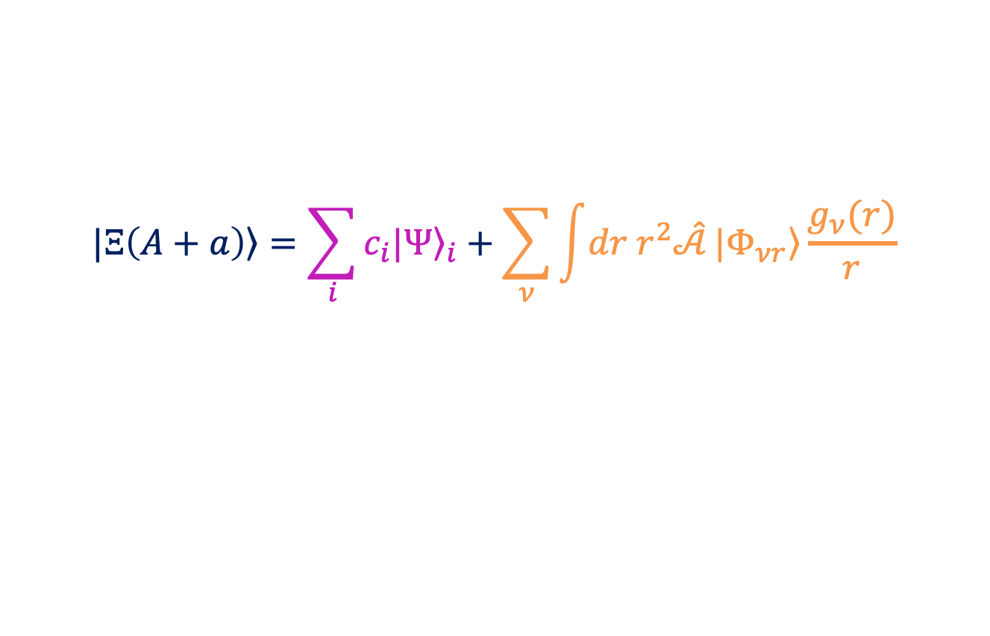

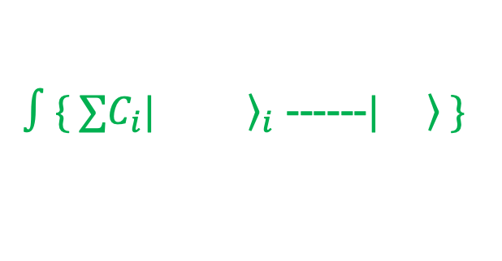



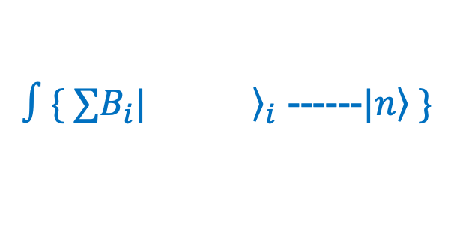



No-Core Shell Model with Continuum
$$|\left.Ξ\left(A+a\right)\right\rangle =\sum_{i}{c_{i}|{\left.Ψ\right\rangle }_{i}}+\sum_{ν}{\int{dr r^{2}\hat{𝒜}}|\left.Φ_{νr}\right\rangle \frac{g_{ν}(r)}{r}}$$
$∫\{ ∑A_{i}|{\left.aaaaaa\right\rangle }_{i}$ ---------$|\left.p\right\rangle \}$
¹⁴N
Ex1
¹³C
$$r,l$$
$$c_{0}$$
¹⁴N gs
$$+c_{1}$$
$$+…$$
+
$∫\{ ∑B_{i}|{\left.aaaaa\right\rangle }_{i}$ ------$|\left.n\right\rangle \}$
¹³N
$$r,l$$
Discrete bound states:
$$\hat{H}|{\left.Ψ\right\rangle }_{i}=E_{i}|{\left.Ψ\right\rangle }_{i}$$
$∫\{ ∑C_{i}|{\left.aaaa\right\rangle }_{i}$ ------$|\left.aa\right\rangle \}$
+
¹⁰B
$$α$$
$$r,l$$

Slide 9
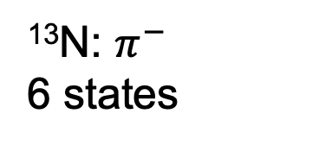
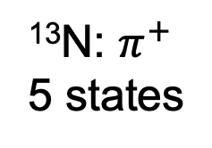
¹³N(n,n)¹³N Elastic Scattering: N_{max} = 2 (…)
¹³N: $π^{+}$
5 states
¹³N: $π^{−}$
6 states

Slide 10
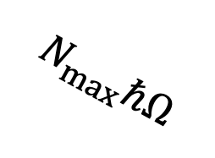

NCSMC: Powerful, but Painful!
Still quite challenging!
Target: some $N_{max}$
projectile
$$N_{max}ℏΩ$$
Target

Slide 11
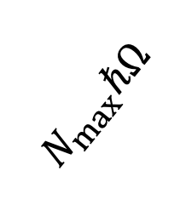

NCSMC: Powerful, but Painful!
$$N_{max}ℏΩ$$
Still quite challenging!
Target: some $N_{max}$
Projectile: same $N_{max}$…
projectile
Target

Slide 12
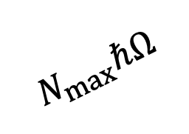
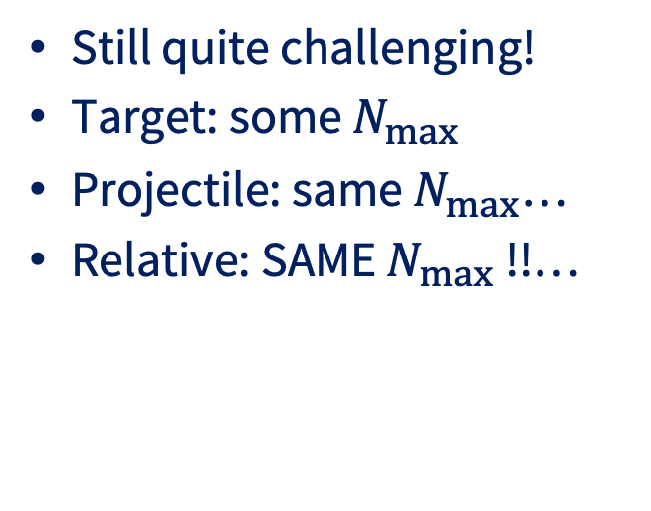
NCSMC: Powerful, but Painful!
Still quite challenging!
Target: some $N_{max}$
Projectile: same $N_{max}$…
Relative: SAME $N_{max}$ !!…
`
projectile
Target
$$N_{max}ℏΩ$$

Slide 13
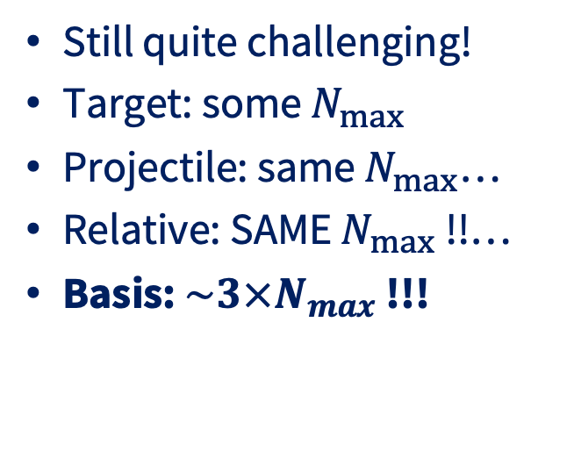
NCSMC: Powerful, but Painful!
Still quite challenging!
Target: some $N_{max}$
Projectile: same $N_{max}$…
Relative: SAME $N_{max}$ !!…
Basis: $\sim 3×N_{max}$ !!!
projectile
Target

Slide 14
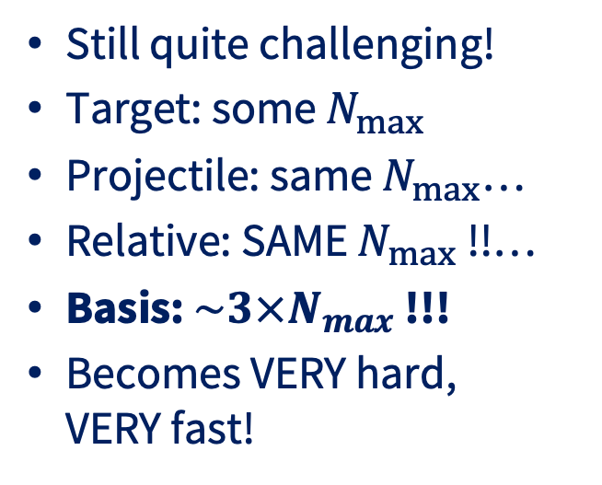
NCSMC: Powerful, but Painful!
Still quite challenging!
Target: some $N_{max}$
Projectile: same $N_{max}$…
Relative: SAME $N_{max}$ !!…
Basis: $\sim 3×N_{max}$ !!!
Becomes VERY hard,
VERY fast!

Slide 15
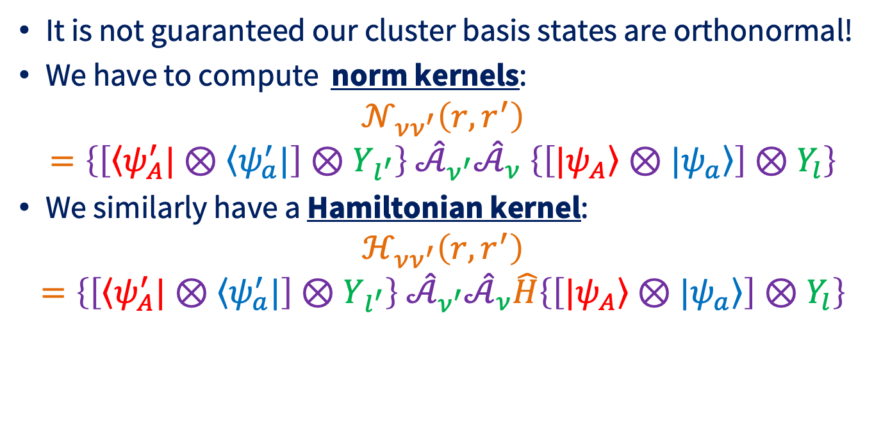
Not Quite… Coupled Channel Equations…
It is not guaranteed our cluster basis states are orthonormal!
We have to compute norm kernels:
$$𝒩_{νν^{′}}\left(r,r^{′}\right)=\left\{\left[\left\langle ψ_{A}^{′}|\right.⊗\left\langle ψ_{a}^{′}|\right.\right]⊗Y_{l^{′}}\right\} {\hat{𝒜}}_{ν^{′}}{\hat{𝒜}}_{ν} \left\{\left[|\left.ψ_{A}\right\rangle ⊗\left.|ψ_{a}\right\rangle \right]⊗Y_{l}\right\}$$
We similarly have a Hamiltonian kernel:
$$ℋ_{νν^{′}}\left(r,r^{′}\right)=\left\{\left[\left\langle ψ_{A}^{′}|\right.⊗\left\langle ψ_{a}^{′}|\right.\right]⊗Y_{l^{′}}\right\} {\hat{𝒜}}_{ν^{′}}{\hat{𝒜}}_{ν}\hat{H}\left\{\left[|\left.ψ_{A}\right\rangle ⊗\left.|ψ_{a}\right\rangle \right]⊗Y_{l}\right\}$$

Slide 16
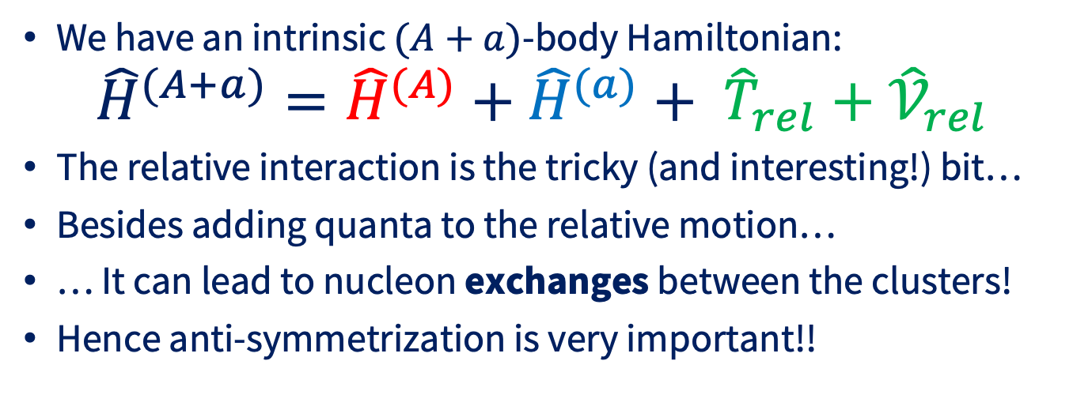
Hamiltonian Kernel
We have an intrinsic $(A+a)$-body Hamiltonian:
$${\hat{H}}^{(A+a)}={\hat{H}}^{(A)}+{\hat{H}}^{(a)}+ {\hat{T}}_{rel}+{\hat{𝒱}}_{rel }$$
The relative interaction is the tricky (and interesting!) bit…
Besides adding quanta to the relative motion…
… It can lead to nucleon exchanges between the clusters!
Hence anti-symmetrization is very important!!

Slide 17
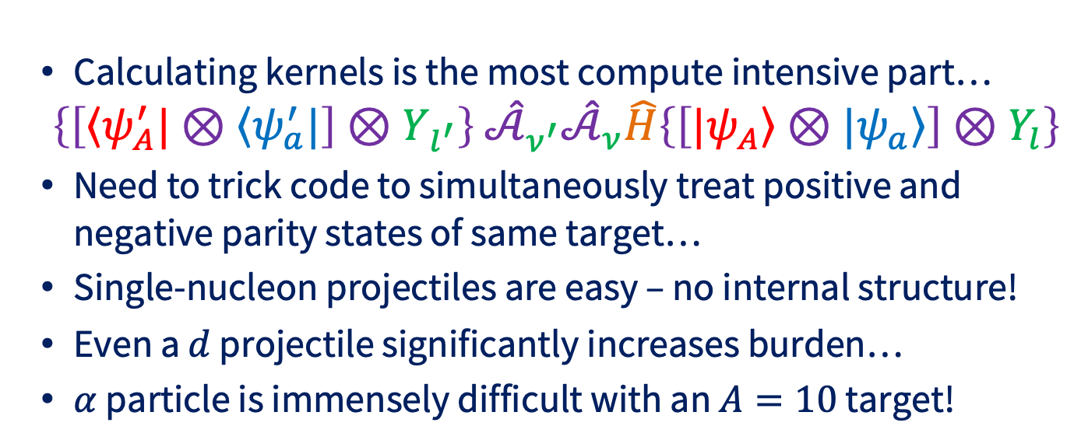
Hamiltonian Kernel
Calculating kernels is the most compute intensive part…
$$\left\{\left[\left\langle ψ_{A}^{′}|\right.⊗\left\langle ψ_{a}^{′}|\right.\right]⊗Y_{l^{′}}\right\} {\hat{𝒜}}_{ν^{′}}{\hat{𝒜}}_{ν}\hat{H}\left\{\left[|\left.ψ_{A}\right\rangle ⊗\left.|ψ_{a}\right\rangle \right]⊗Y_{l}\right\}$$
Need to trick code to simultaneously treat positive and negative parity states of same target…
Single-nucleon projectiles are easy – no internal structure!
Even a $d$ projectile significantly increases burden…
$α$ particle is immensely difficult with an $A=10$ target!

Slide 18
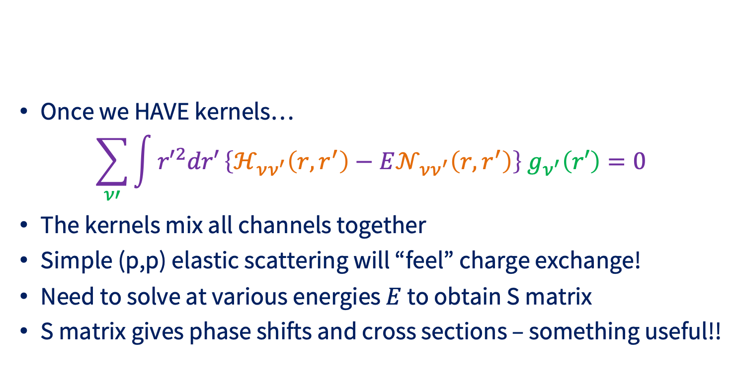
Reaction Calculation!
Once we HAVE kernels…
$$\sum_{ν′}{\int{{r′}^{2}dr′}\left\{ℋ_{νν^{′}}\left(r,r^{′}\right)−E𝒩_{νν^{′}}\left(r,r^{′}\right)\right\} g_{ν^{′}}\left(r′\right)}=0$$
The kernels mix all channels together
Simple (p,p) elastic scattering will “feel” charge exchange!
Need to solve at various energies $E$ to obtain S matrix
S matrix gives phase shifts and cross sections – something useful!!

