Slide 1



Framework overview
(non-technical and from an end-user perspective)
Nigel Hambly, and Brendan O’Brien, Malcolm Illingworth, Simon Harnqvist
SPACIOUS is a Horizon Europe HORIZON-CL4-2023-SPACE-01-71 project funded under grant agreement no. 101135205
https://spacious.ub.edu/

Slide 2
What this meeting is for …
This FDR is not only a formal milestone for the project, but also an opportunity to
              review where we have got to
              discuss and work on current issues
              plan for the final few months of the project
              ensure the long-term legacy of the developments

Slide 3

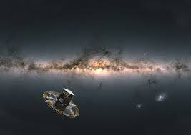

Staff & HW resources for UEDIN IfA space astronomy science platform dev-ops is provided by:
UKRI - STFC (1.8 FTE)
Gaia CU9 (science exploitation-enabling)
IRIS (private OpenStack Cloud compute resources)
Horizon Europe SPACIOUS (1.7 FTE)
Science PlAtform Cloud Infrastructure for Outsize Usage Scenarios
(+ BSC & Gcloud compute)

Slide 4

Medium-term view in the UK
We have been generously resourced (staff and computing) up to now, but this will change significantly in 2027:
anticipate UKRI–STFC grant renewal by the end of the year but with significant reduction in staff resource from April 2027
IRIS resource allocation by the end of the year, significant reduction in compute resources
SPACIOUS-NET might mitigate the former …

Slide 5
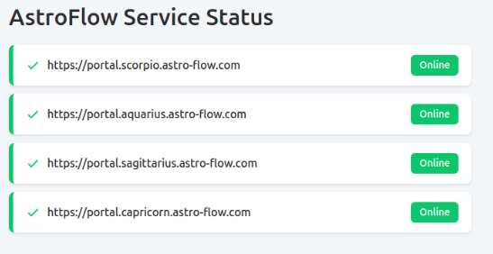

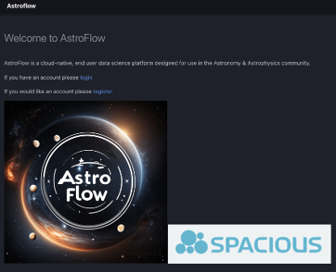


Existing deployments
AstroFlow is now deployed on
•‘Aquarius’
•Somerville OpenStack hosted by University of Edinburgh
•Primary data-intensive services for public Gaia data; also UAT
•‘Capricorn’
•Arcus OpenStack hosted by University of Cambridge
•high memory services (and also primary back-up)
•‘Scorpio’
•RALCloud hosted by UK STFC / RAL
•CPU intensive (Euclid) services
•‘Sagittarius’
•nCloud2 hosted by BSC
•hosting proprietary ESA Gaia DR4 data for performance verification
•GCloud demo
•Google Cloud
•Proof-of-concepts, cost / benefit and potential scale-out studies

Slide 6
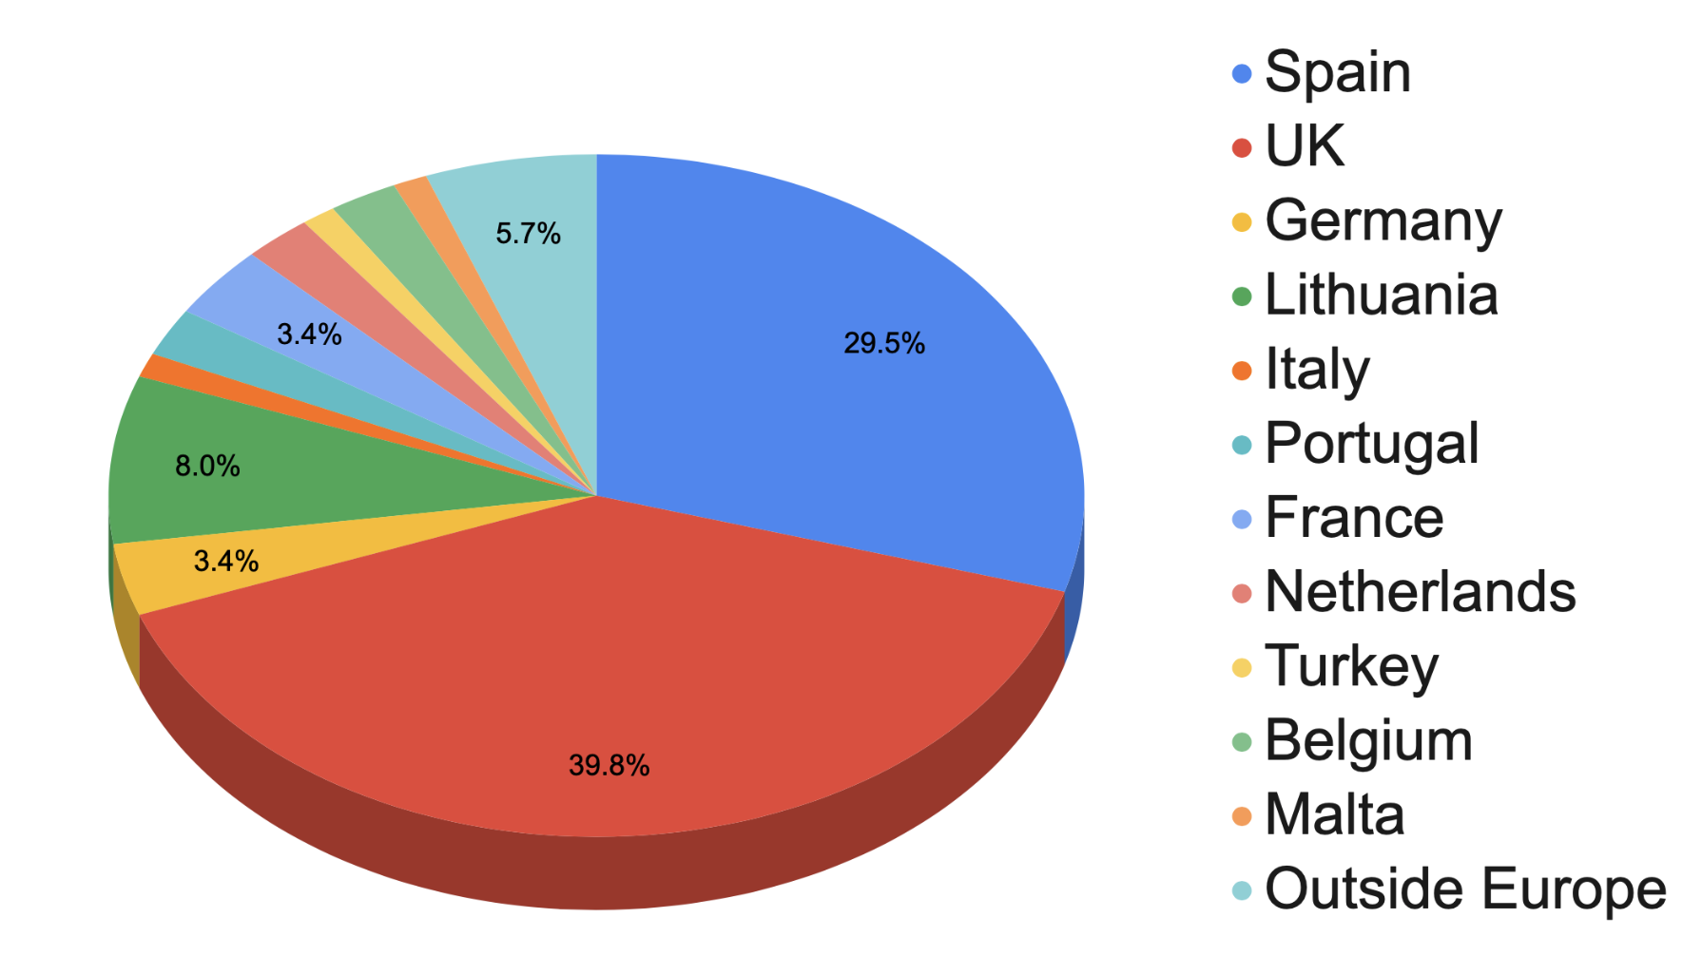
User base
We have nearly 100 users
registered for the SPACIOUS-
AstroFlow services, yet
only around 10% are active
tangible outputs are growing
(but few…)
What can / should we do to improve this?

Slide 7
Nurturing the user base: a few ideas
Better availability (currently no better than around 90%)
Better documentation
More proactive ‘courting’ of potential users
AstroFlow community
Gaia DR4 (December 2026)
Euclid DR1 (LE3 science produces mid-2027)
AstroFlow community
More integrated datasets
… and ultimately more functionality …

Slide 8
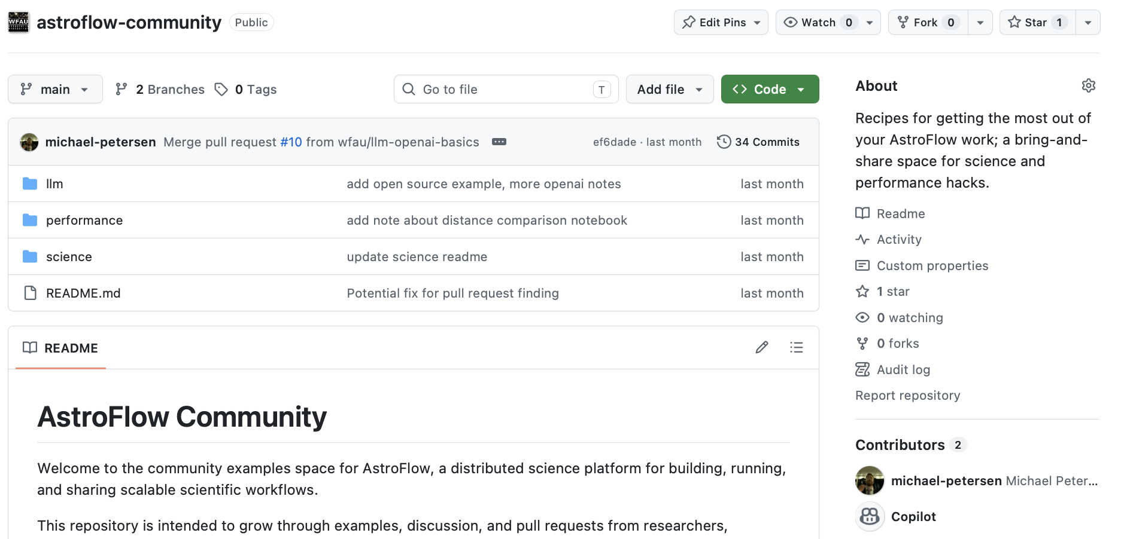
AstroFlow community on GitHub
        More science examples
        A bring-and-share collaboration space

Slide 9
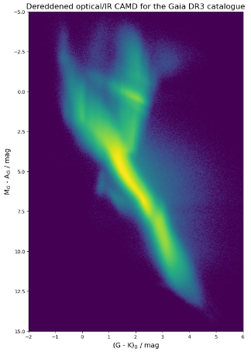
Support for more, large data volumes
• Parquet
• Highly compact, column-oriented access
• Production DR3 partitioning scheme
• Hash-mod partitioning on source identifier key (not partitioned on-sky)
• Gaia DR4 partitioning scheme
• Uses Apache Iceberg managed datasets in HATS-like file arrangement in sky regions
• Associated datasets via pre-computed XM
• local copies of ‘external’ catalogues: 2MASS, PanSTARRS PS1 and ALLWISE(+MEP; ZTF lightcurves via new XM for which we have used LSDB XM implementation)

Slide 10
Legacy aspects
technical documentation needs attention
operational documentation should be written
code repo(s) should be rationalised
      code repo(s) should be made public

Slide 11

Summary
The SPACIOUS-Astroflow framework is demonstrably
Deployed in several Cloud IaaS
Scalable to data intensive applications
Flexible for configuration to CPU intensive applications
Under active usage by (a few in) the community

