Slide 1



SPACIOUS Internal Science Challenge 3:
Euclid 3x2pt cosmological parameter inference
Update by NCH
(now on behalf of IfA Euclid Theory group)
SPACIOUS is a Horizon Europe HORIZON-CL4-2023-SPACE-01-71 project funded under grant agreement no. 101135205
https://spacious.ub.edu/

Slide 2
The Challenge
Confront state-of-the-art cosmological models against a ‘Stage IV’ imaging and spectroscopic survey
ESA Euclid ‘Level 3’ data, i.e. galaxy lens-lens, cluster-cluster auto-correlation and lens-cluster cross-correlation statistics
          This is a highly technical Bayesian problem involving advanced simulation and statistical methodologies
          It is a computationally (not data) intensive problem
          Internal becomes external: recruited IfA black-belt cosmological physicists and using STFC-Cloud at RAL: ‘scorpio’

Slide 3
Euclid data release schedule
At the time of SPACIOUS proposal writing we anticipated availability of Level 3 products well before the end of the project
As it turns out the Level 3 data products are to be published within the Euclid Consortium mid-2027 (!)
This was identified as a risk right from the start, with mitigation being use of Level 3 ‘mock’ data

Slide 4
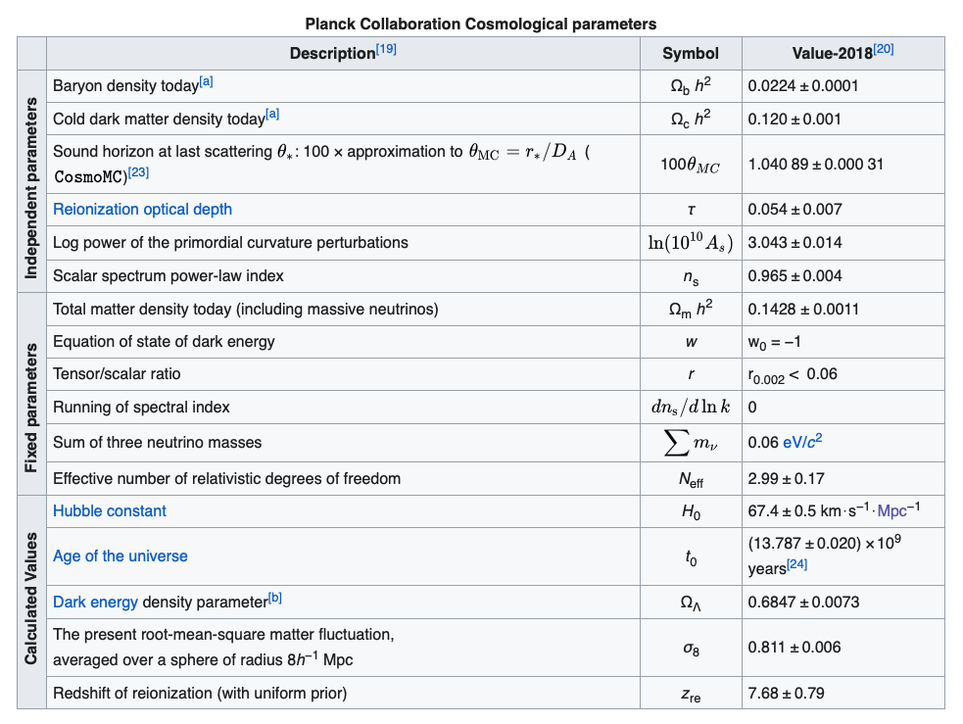
Note to self: Standard Lambda-CDM

Slide 5
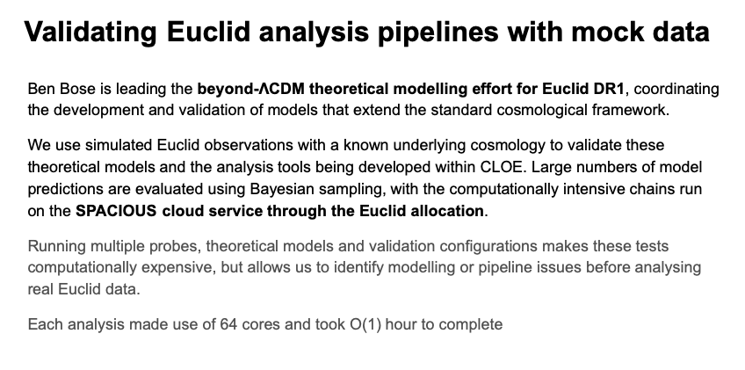
From the IfA group:

Slide 6
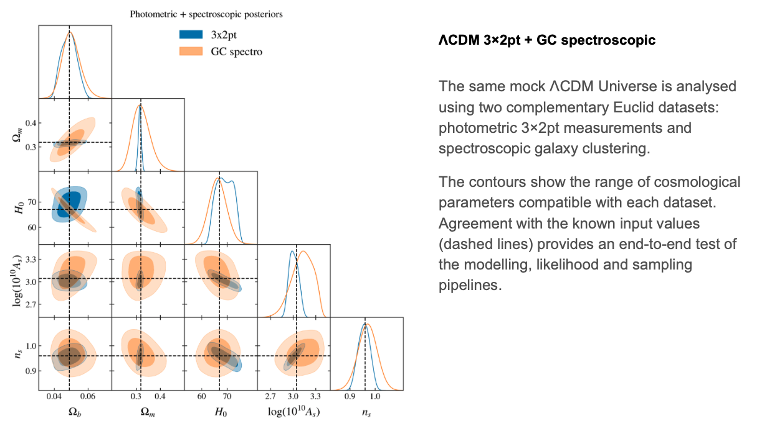
(… continued)

Slide 7
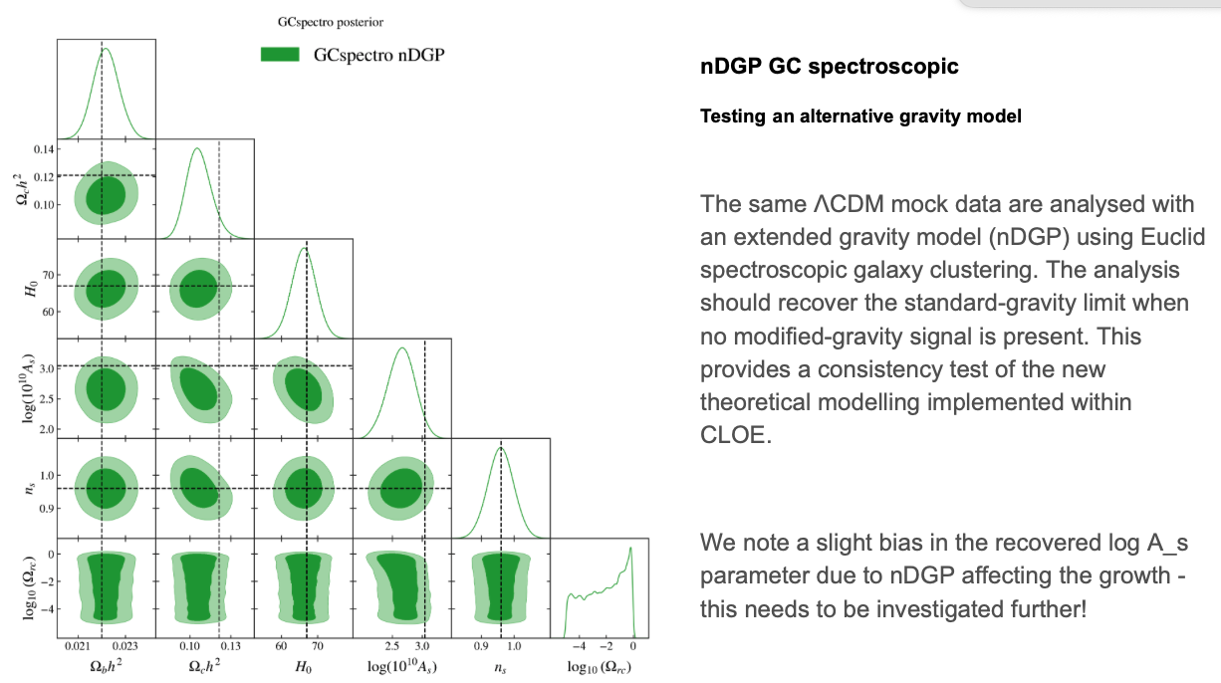
(… continued)

Slide 8
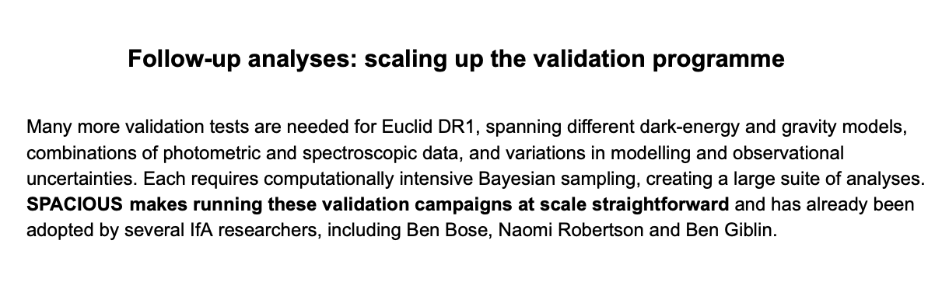
(… continued)

