Slide 1
Beyond The Lab Event
Oskar Dondelewski
University of Edinburgh

Slide 2
About me:
Heavy-research focus:
Technical Student Programme at CERN
Exchange Programme at National University of Singapore
Aeronautical research at Nagoya University in Japan
Visiting Researcher at Imperial College London (Electrochemical Science and Engineering Group)

Slide 3
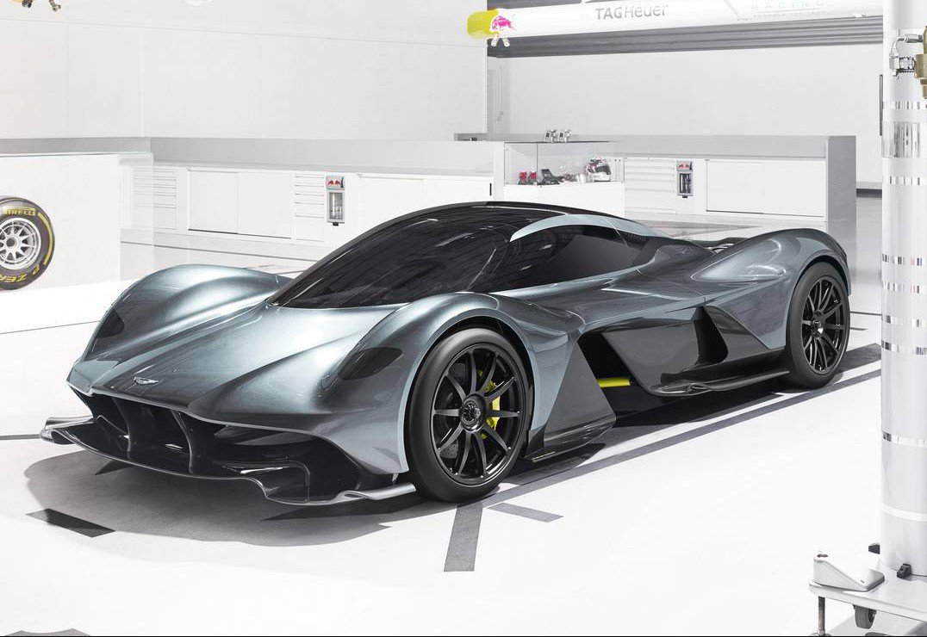
About me:
Industrial Experience:
Research Engineer at Aston Martin’s Q Advanced Operations
Currently project manager on Innovate UK project developing hypercar batteries, where Aston Martin partnered with Imperial College London and Dukosi

Slide 4
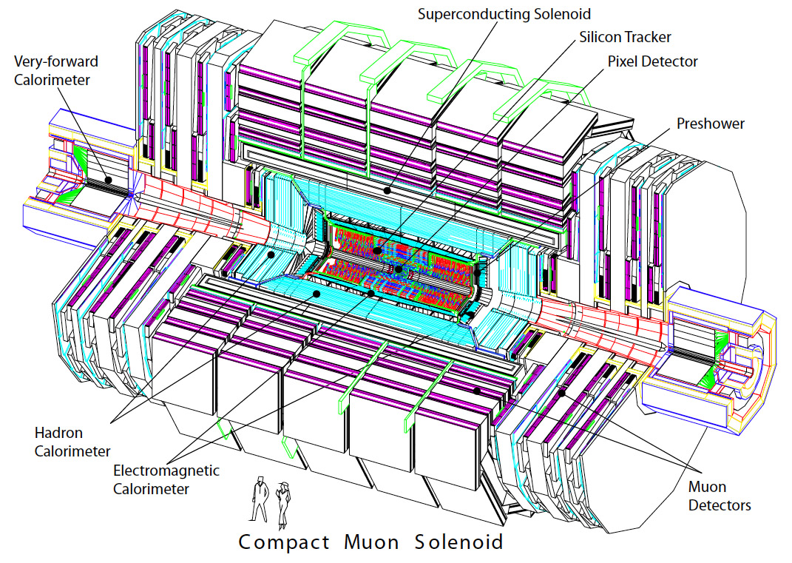
Compact Muon Solenoid:

Slide 5
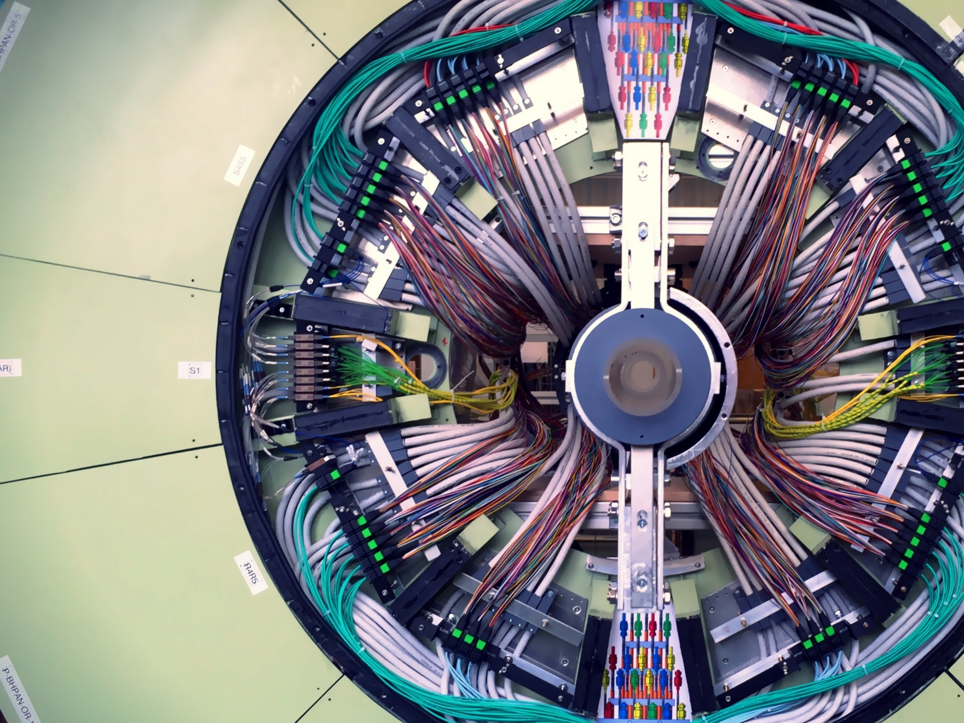
In-demand Skills:
Understanding new technologies: searching for and implementing them (technology scouting at AML)
Building prototypes and testing them (Pixel Detector Services)

Slide 6
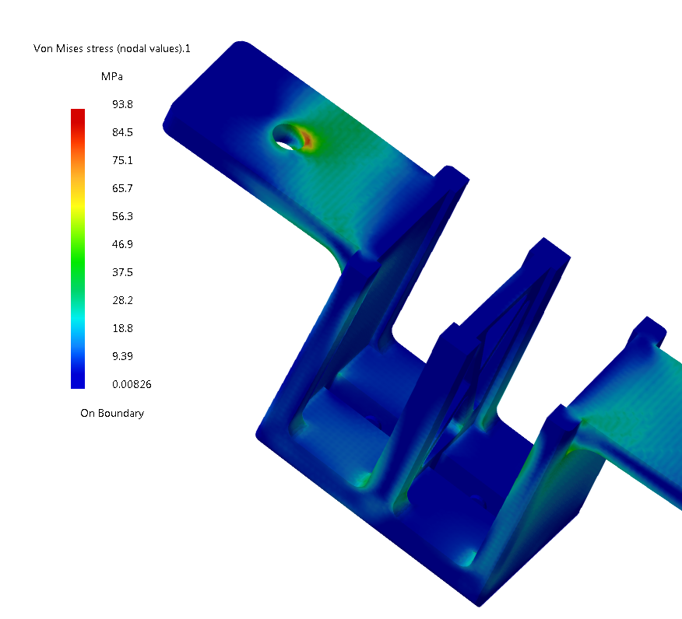
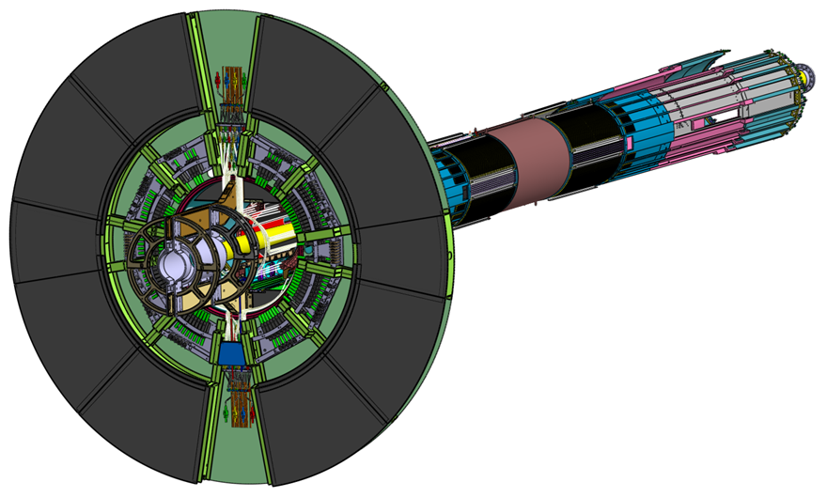
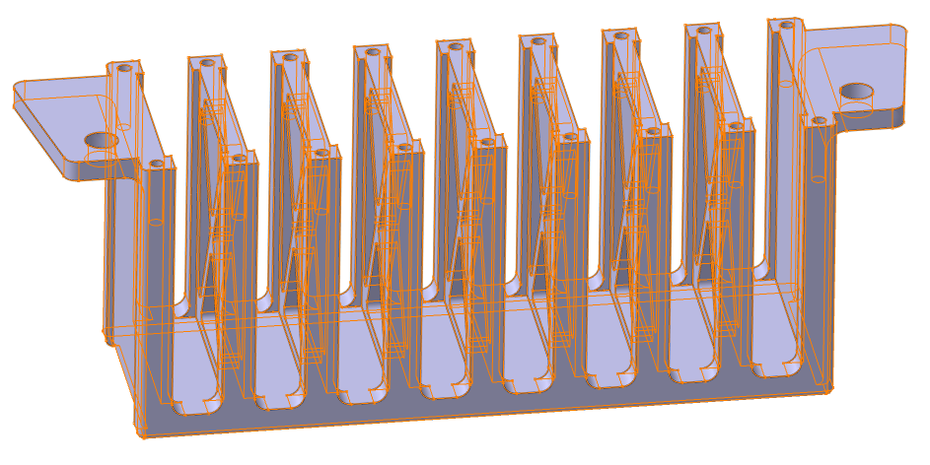
In-demand Skills:
Using Engineering Software i.e. CATIA/ANSYS/COMSOLE
Using complex mathematical models to conducting simulations (MATLAB & Simulink)

Slide 7
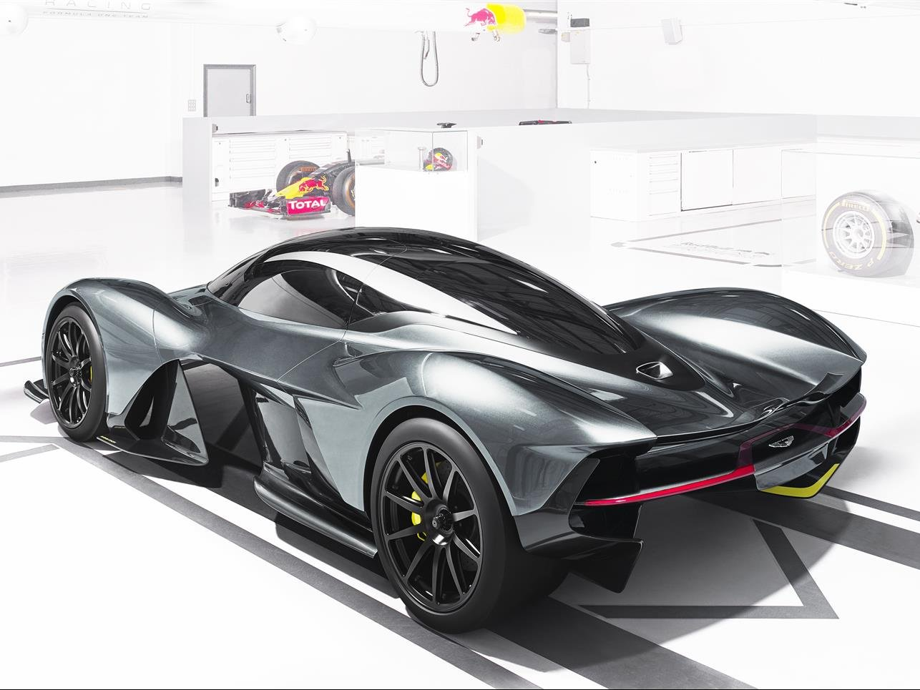
Mindset Differences:
Lack of thinking about products “Research for the sake of research, to prove that what is needed is more research”
Money is not an issue Financial constraints are inherent to industry, in academia notion of revenue is rather theoretical
Applicability One thing is to invent something, but to commercialise is another. After invention come safety regulations, certification, market viability

Slide 8
Strong Incentives for Collaboration:
To innovate
Innovations = science applied to a product. Industry and research collaboration is a perfect environment for innovations.
To solve technical problems
Reduce vehicle emissions (fuel tank & polymers example), understand why components fail (vibration absorber example) or cause problems (break noise example)
To conduct projects too-risky to run separately
Industry & research partnerships can be supported by public funding (Innovate UK, Horizon 2020 etc.)

