Slide 1
From Theoretical Physics to Transport Technology
Julian Gascoyne
Student and CPS at Continuum Industries

Slide 2
Well-Researched Scientific Principles
Highly Skilled Team
Digital Super Twin
Powerful Genetic Algorithms
Out-of-Core Computing
Engineers
Computer Scientists
Physicist
Systems of Systems Multi-model
Abstract everything from demand modelling to multiphysics simulation

Slide 3
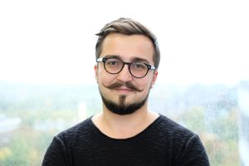
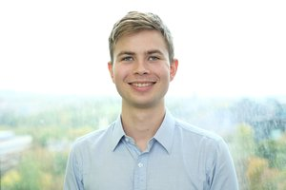
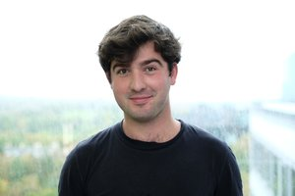
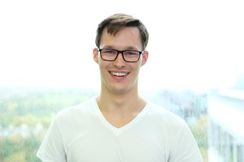
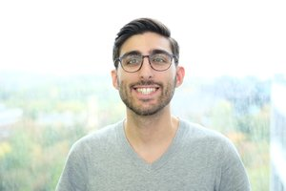
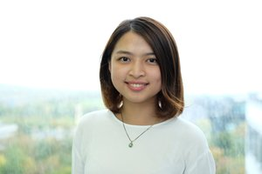
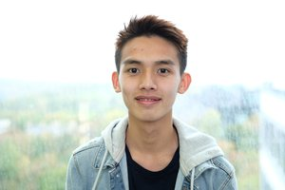
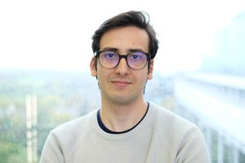
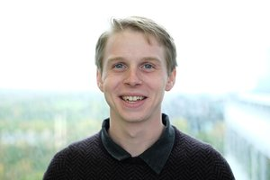
Adam Anyszewski
Co-Founder and System Architect
Current UoE PhD Candidate
Emil Hansen
Co-Founder and CTO
Current UoE BEng Student
Matt Blythe
Co-Founder and CCO
Former UoE MSc Student
Grzegorz Marecki
Co-Founder and CEO
Former Heriot-Watt MEng Student
Andy Malekos
Optimisation Engine Developer
Current UoE BSc Student
Isabella Chan
Software Engineer
Former UoE BSc Student
Ivan Chan
Optimisation Engine Developer
Current UoE BEng Student
Daniel Toth
Power and Control Systems Engineer
Current UoE MEng Student
Julian Gascoyne
Chief Problem Solver
Current UoE BSc Student

Slide 4
September 2017
June 2018
September 2018
HYPED
Hyperloop Beta
CONTINUUM INDUSTRIES
At HYPED, I worked on the ‘Halbach Wheel’ subteam which designed and built the pod’s propulsion module.
Over the summer, I worked on a feasibility study for the UK doing Aero, Propulsion, Power consumption, and more.
At Continuum, I’m the chief Problem Solver, tasked with working on everything from automating network design to coding.

Slide 5
01
De-Abstractify the results
Abstractify a problem
Physics in Continuum
03
02
Design a mathematical framework

Slide 6
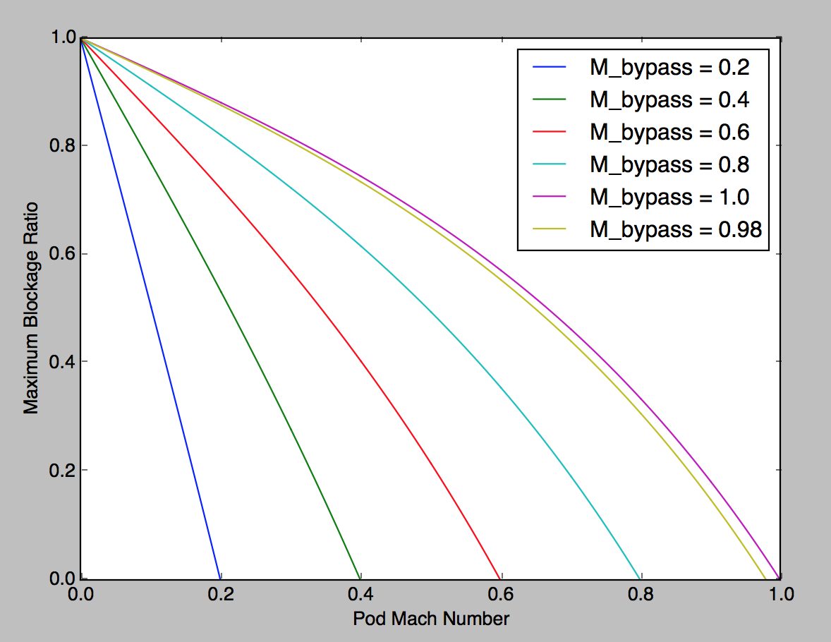
From:
Cargo Container size
Get:
How many pods fit inside track
Tube
Pod
Cargo Container

Slide 7
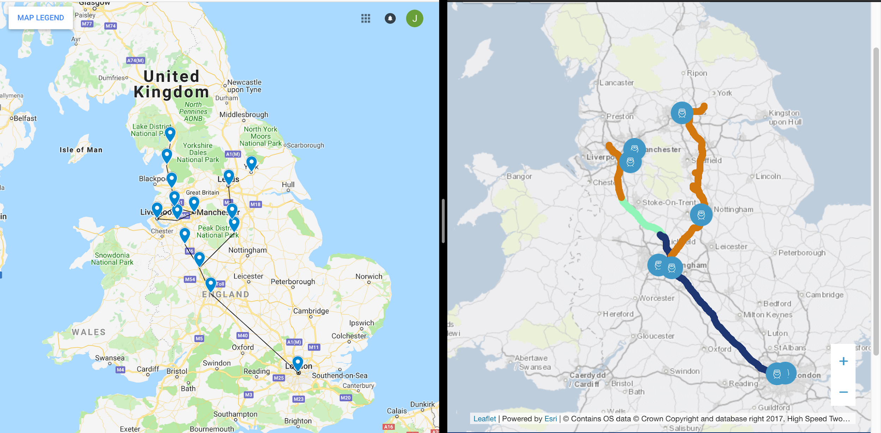
From:
List of Cities
Generate:
Network

Slide 8
Thinking of getting involved in a startup?
Get passionate
Surround yourself with others
Commercialise an idea
Thank you for Listening!

