Slide 1
Beyond the Lab
Luigi Del Debbio – Head of Particle & Nuclear Physics
Edinburgh – January 2019

Slide 2
building networks
great opportunities to build collaborations between industry and academia
bottom-up approach
need to know the relevant problems -- current and future
academia: knowledge, technology, students
our alumni, CERN alumni
build a network: be aware of opportunities on both sides
create a ‘technology roadmap’?

Slide 3
Opportunities
courtesy of G Porcellana CERN-KT

Slide 4
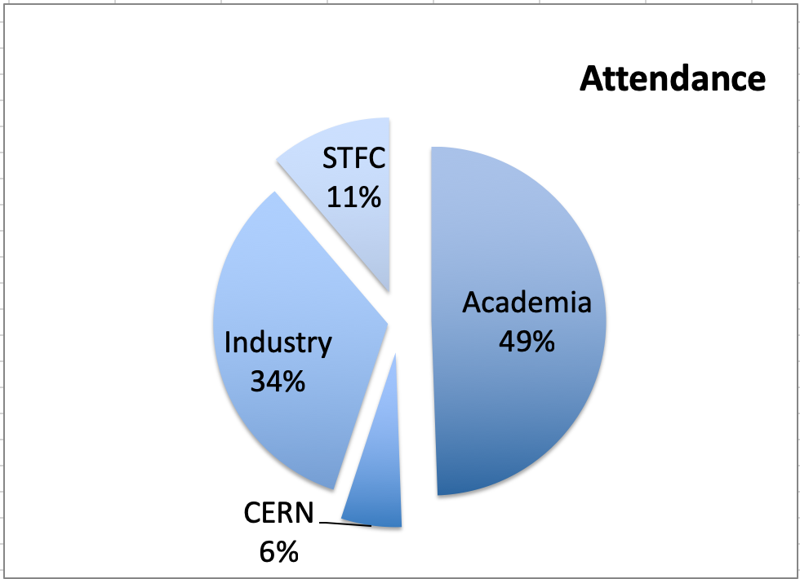
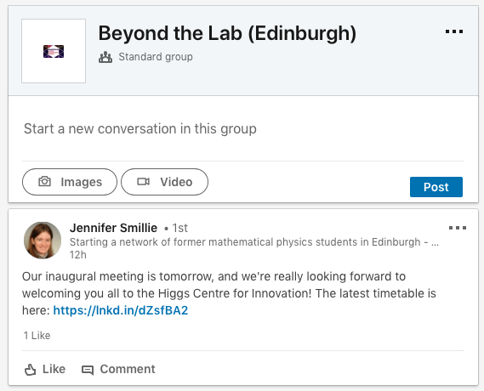
From one workshop to an initiative

Slide 5
Thank you

