Slide 1
Detector Innovation for High Energy Physics
Kirsty Hall
Senior Sales Engineer
Academic & Research
Thursday 29th October 2026

Slide 2
Index
Who are we?
  Introduction to Hamamatsu Photonics
What do we do?
  Detectors for high energy physics
Why talk to us?
  Our expertise and how we can help you

Slide 3
Who are we?

Slide 4
History of Hamamatsu Photonics
1953
Hamamatsu TV Co., Ltd is founded.
1959
Developed the first PMTs – the beginning of our journey into low light detectors.
1967
Started to participate in space development projects.
1969
Expanded into medical fields.
1972
Developed silicon photodiodes.
1978
Developed high-precision video cameras.
1983
Became Hamamatsu Photonics K.K. and developed our cameras for microscopes.
1994
Microfocus x-ray sources placed on the market.
2002
Nobel Prize in physics for Kamiokande research.
2013
Hamamatsu SSDs, APDs and PMTs contribute to the detection of the Higgs bosons.

Slide 5
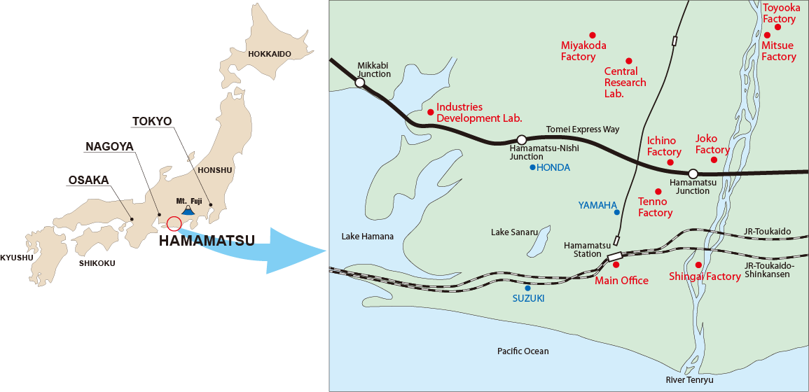
Where is Hamamatsu?

Slide 6
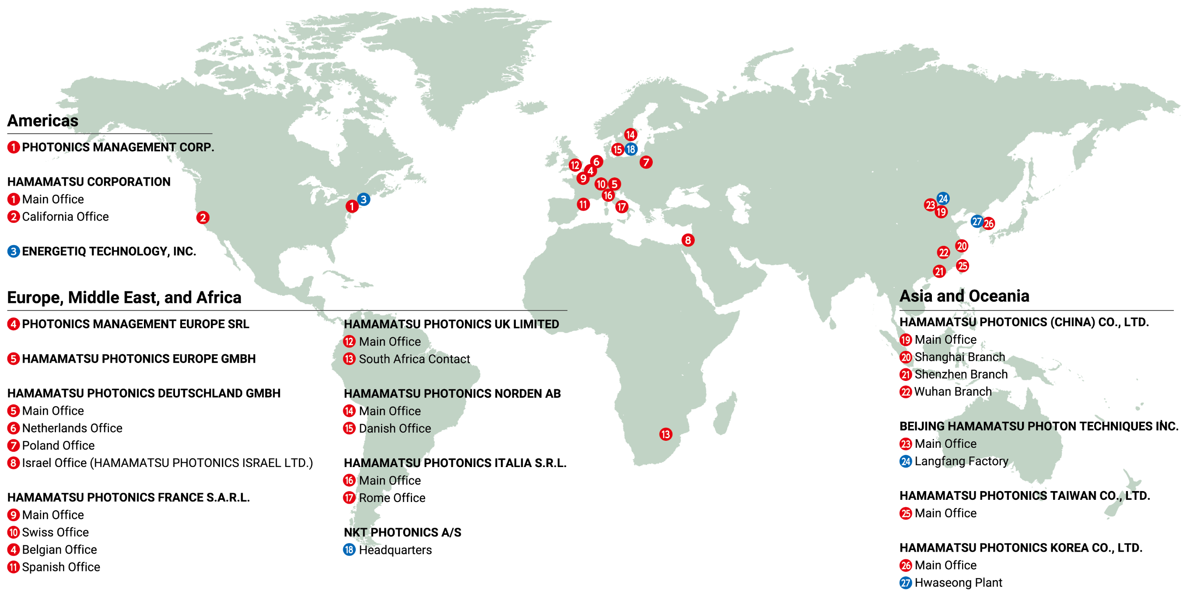
World-wide Sales Organization

Slide 7

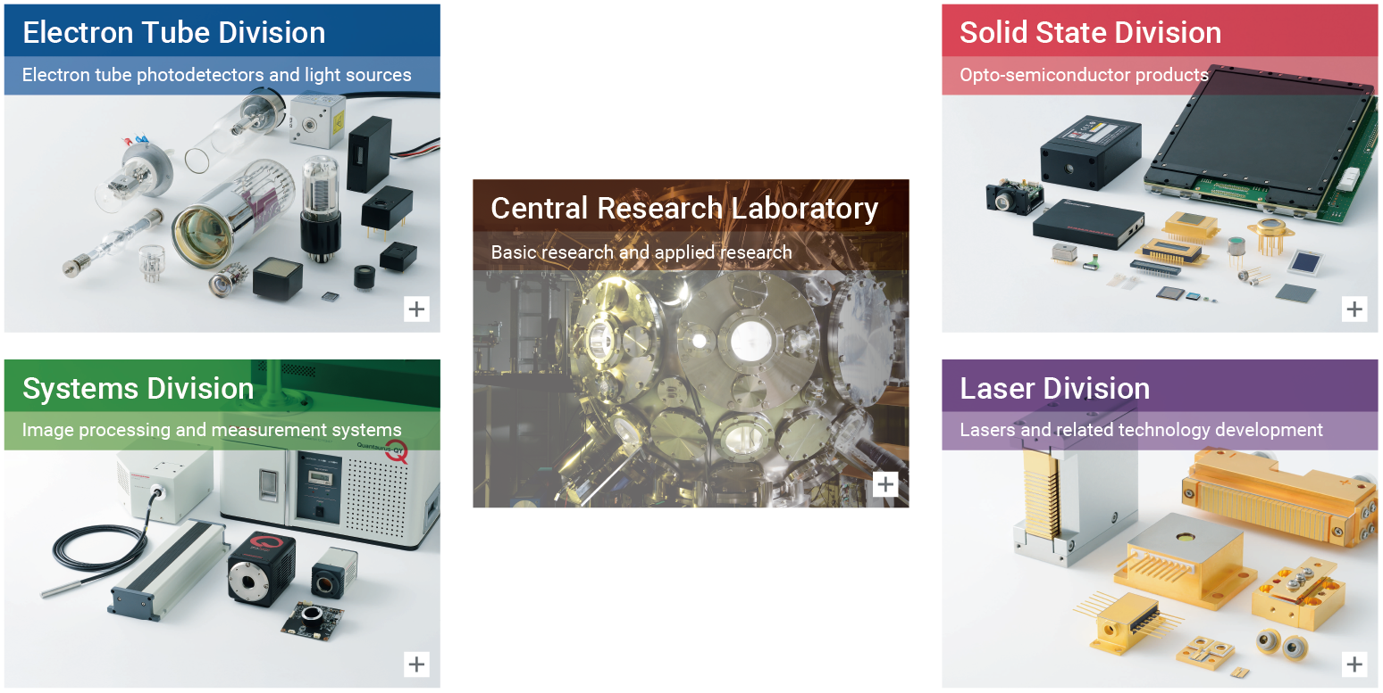

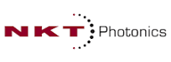

Hamamatsu Divisions

Slide 8
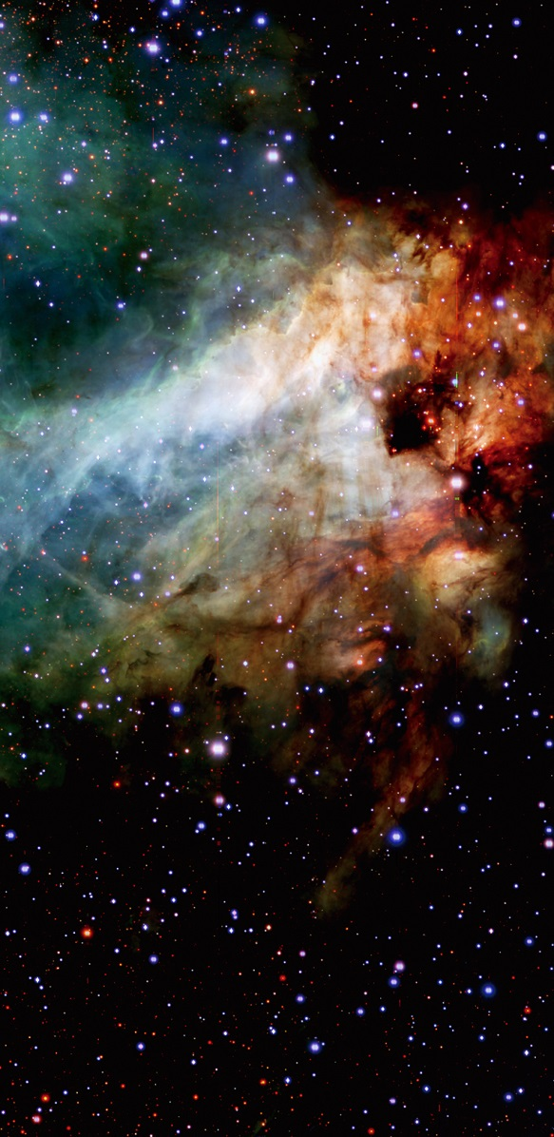
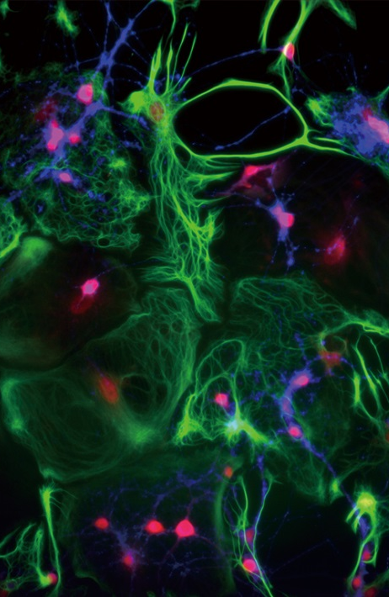
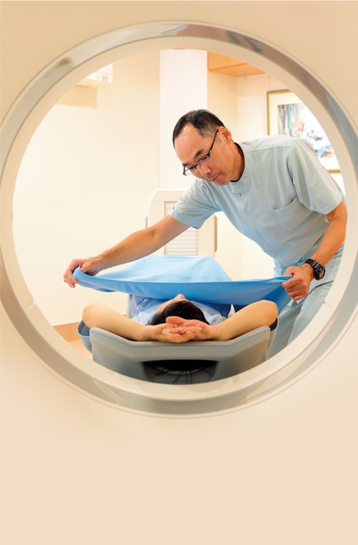
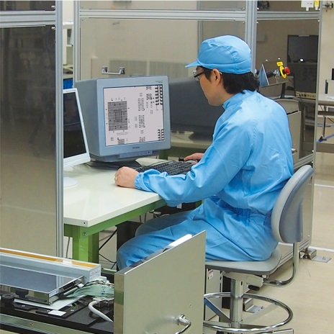



Markets
Manufacturing
Life Science
Medical Science
Environmental
Science
Fundamental Research
Automotive
Daily Life

Slide 9
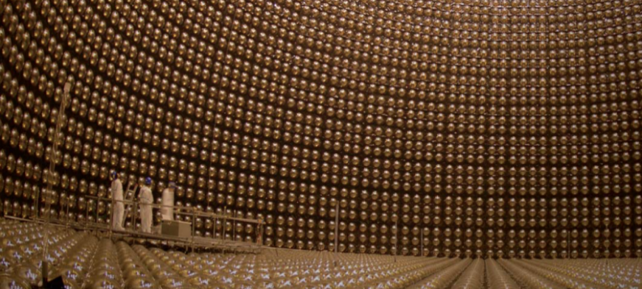
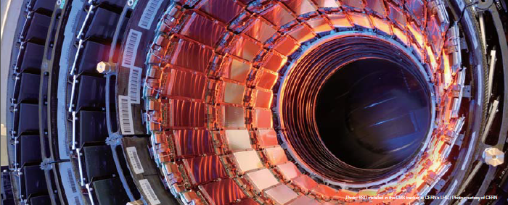
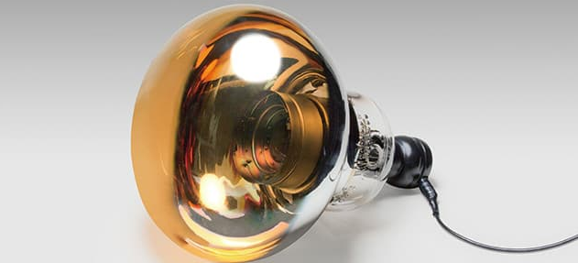
History in HEP
Kamiokande: in 2002 Prof. Masatoshi Koshiba was awarded the Nobel Prize in physics for history’s first observation of neutrinos that where released from a supernova explosion captured by the world’s largest 20-inch diameter PMT.
Large Hadron Collider: in 2013 Prof François Englert and Peter W. Higgs was awarded the Nobel Prize in physics for the discovery of the Higgs boson often called the God particle that gives mass to matter particles. Our Silicon Strip Detectors contributed to this great discovery.
Super Kamiokande: in 2015 Professor Takaaki Kajita, University of Tokyo, was awarded the Nobel Prize in Physics for the discovery of neutrino oscillations that indicate a neutrino has a mass. This breakthrough was the result of research at Super Kamiokande where our photomultiplier tubes were installed.

Slide 10
What do we do?

Slide 11

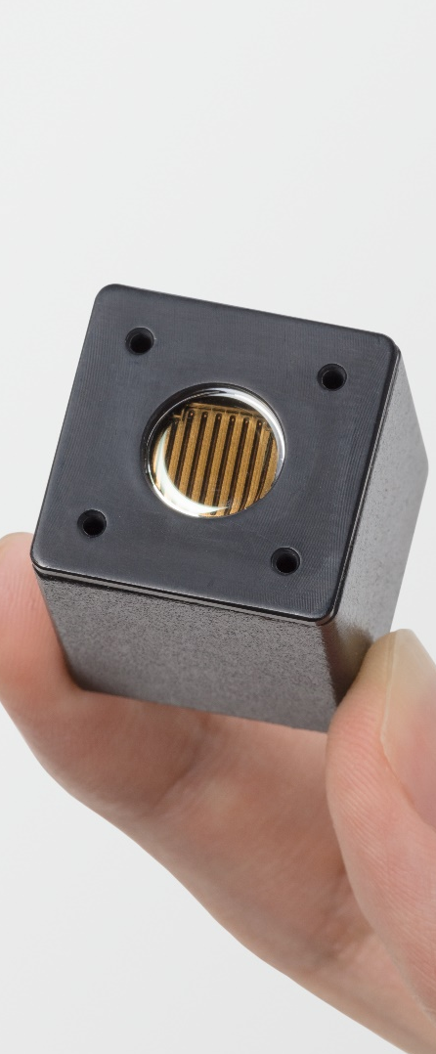
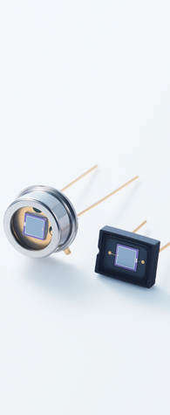
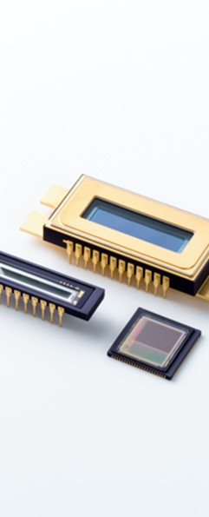
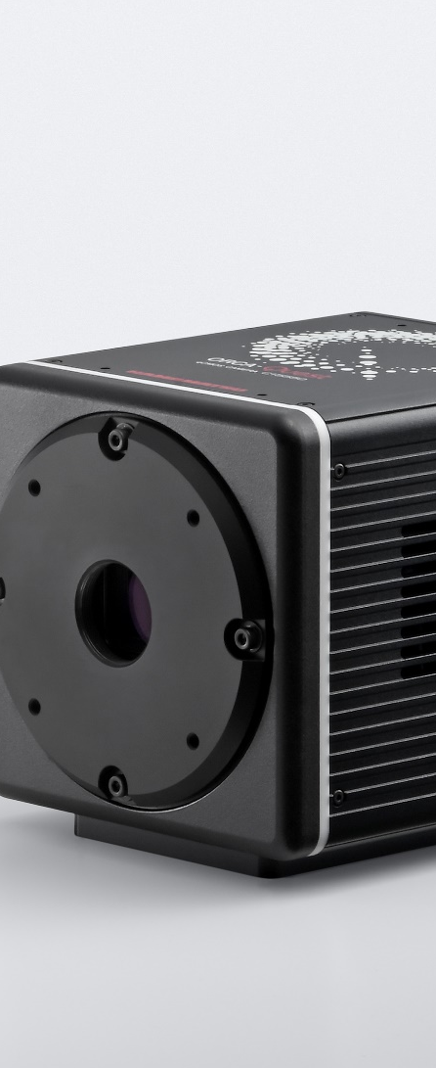

Detectors for High Energy Physics
Photomultiplier tubes (PMTs)
PMT modules
Si photodiodes, APDs, MPPC®
Image sensors
Cameras
X-ray related products

Slide 12
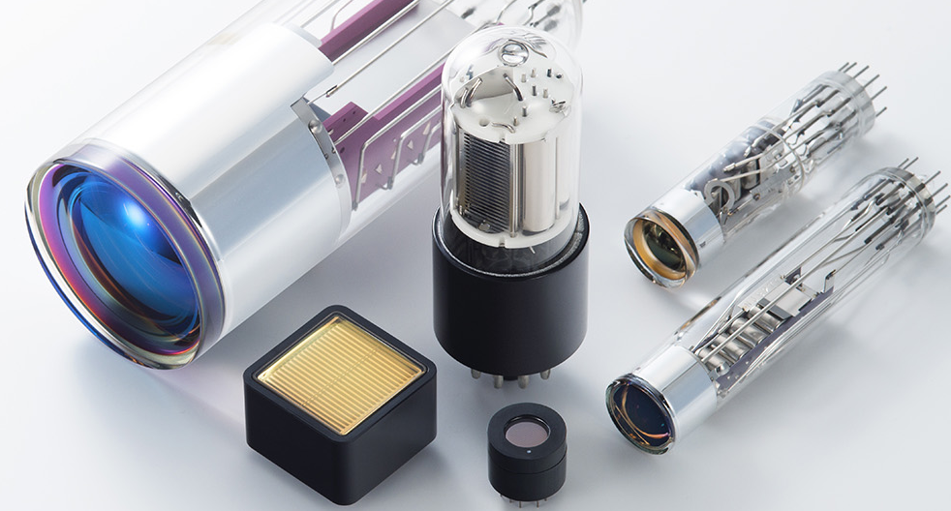
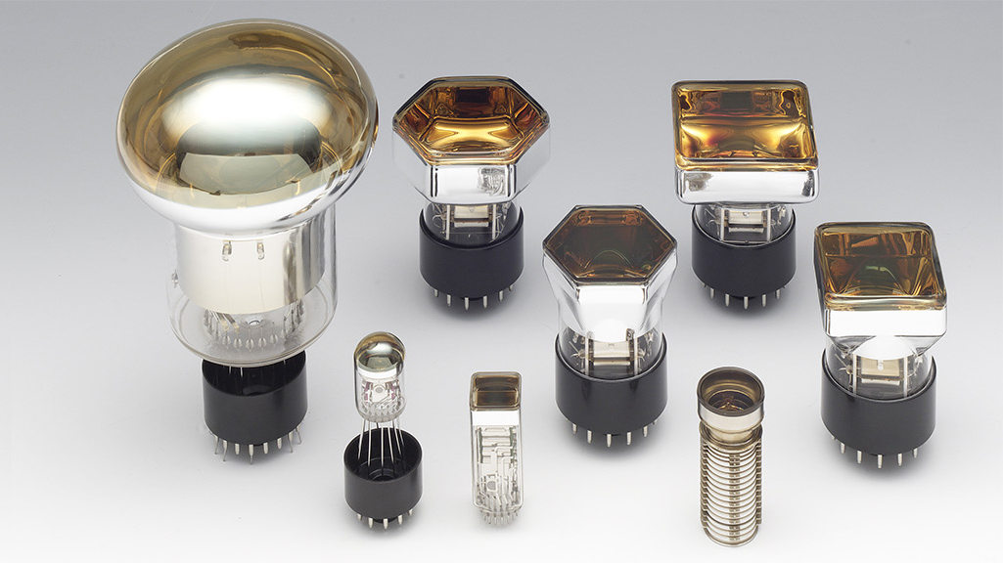
Photomultiplier Tubes (PMTs)
Wavelength range
Choice of window and photocathode material e.g. UV windows, high QE photocathodes, extended green options
Size and shape
Photocathode shapes and sizes e.g. square or circular, 8mm to 20” options
Multiplication method
Classic dynode structure, metal dynodes, multichannel plates (MCPs), hybrid detectors
Anode readout
Single channel and multianode array options
Accessories
Sockets, power supplies, amplifiers, coatings, shielding etc.

Slide 13
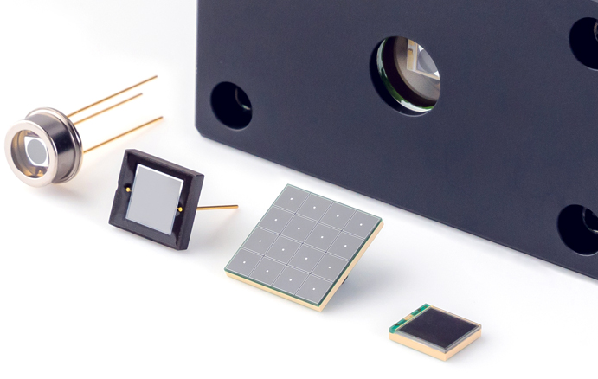
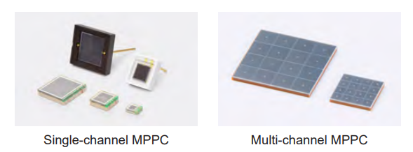
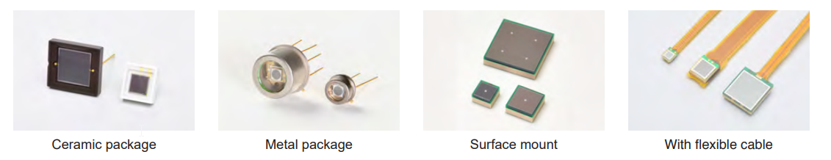
Silicon Photomultipliers (SiPMs)
Wavelength range
UV and NIR enhanced options
Photosensitive area
1.3mm to 6mm
Pixel size
10μm to 75μm pixel pitch
Single-channel or multi-channel
Single-element and array options
Cooling
Options for lowering dark noise
Ceramic, metal, and surface mount
Package type

Slide 14
SiPM Development
Significant development on a new series of SiPMs
  Advances in the S13360 & S14160 series
  Key specifications:
    Lower dark current
    Higher photon detection efficiency (PDE) – particularly in the UV-Blue
Engineer visits planned for mid-2027
  Opportunity for direct discussion with engineers from our Solid State Division
    SiPMs, Si photodiodes, InGaAs detectors etc.
  Discussions can include:
    Existing products and optimisation of use
    Customisation possibilities
    New products/roadmap

Slide 15
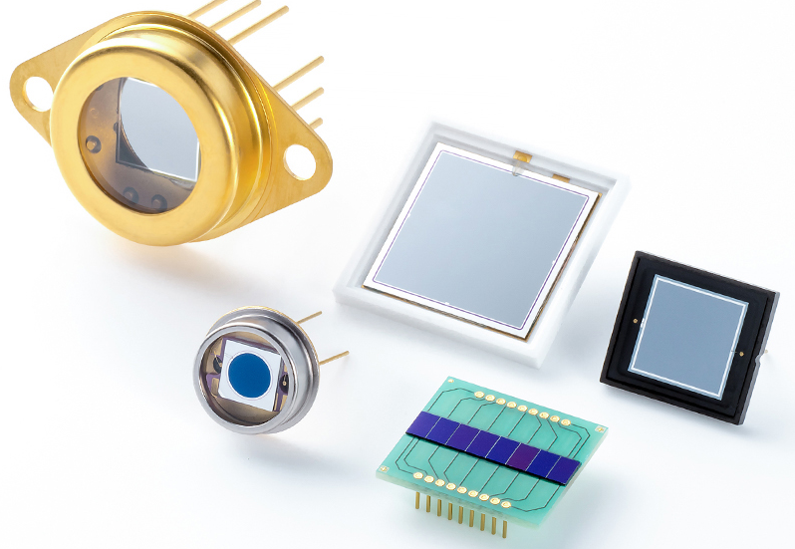
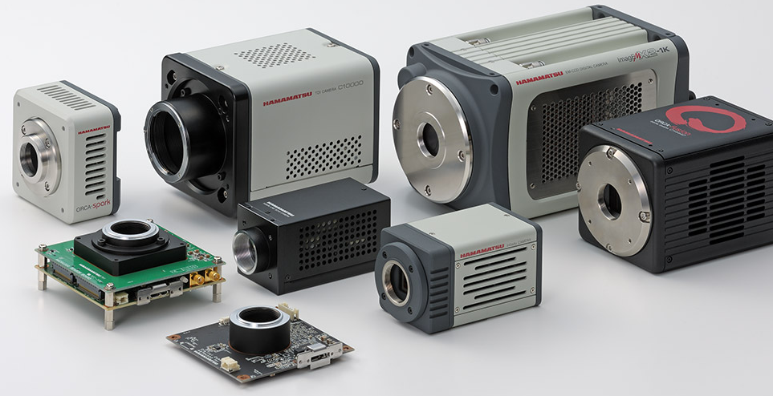
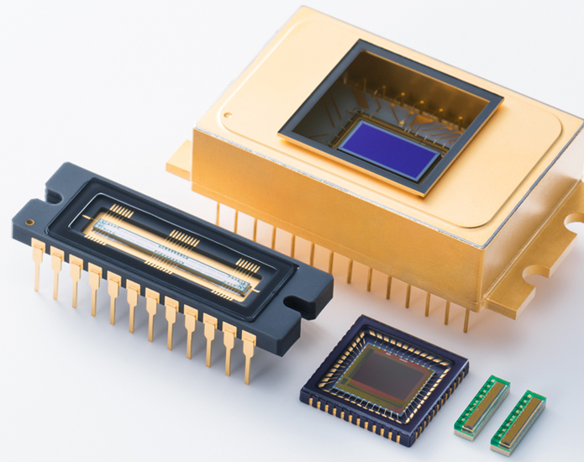
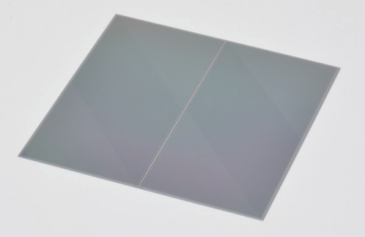
Anything else?
Photodiodes
Imaging solutions
Large area devices
Arrays
High speed options
Low noise camera
Quantitative CMOS
X-Ray TDI
Image sensors
Silicon array detectors
Linear devices
Area devices
Readout solutions
Low noise sCMOS from Fairchild Imaging
Photodiode arrays
Segmented photodiodes
Silicon strip detectors

Slide 16
Why talk to us?

Slide 17
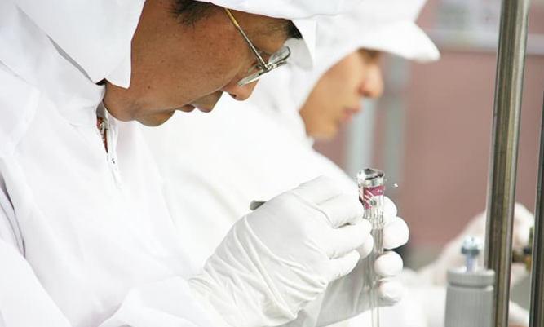

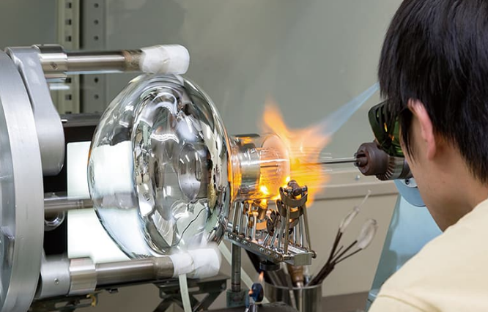
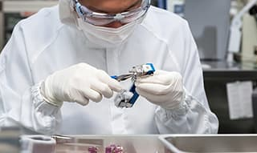
Why Hamamatsu?
Experience
Collaboration
Customization

Slide 18
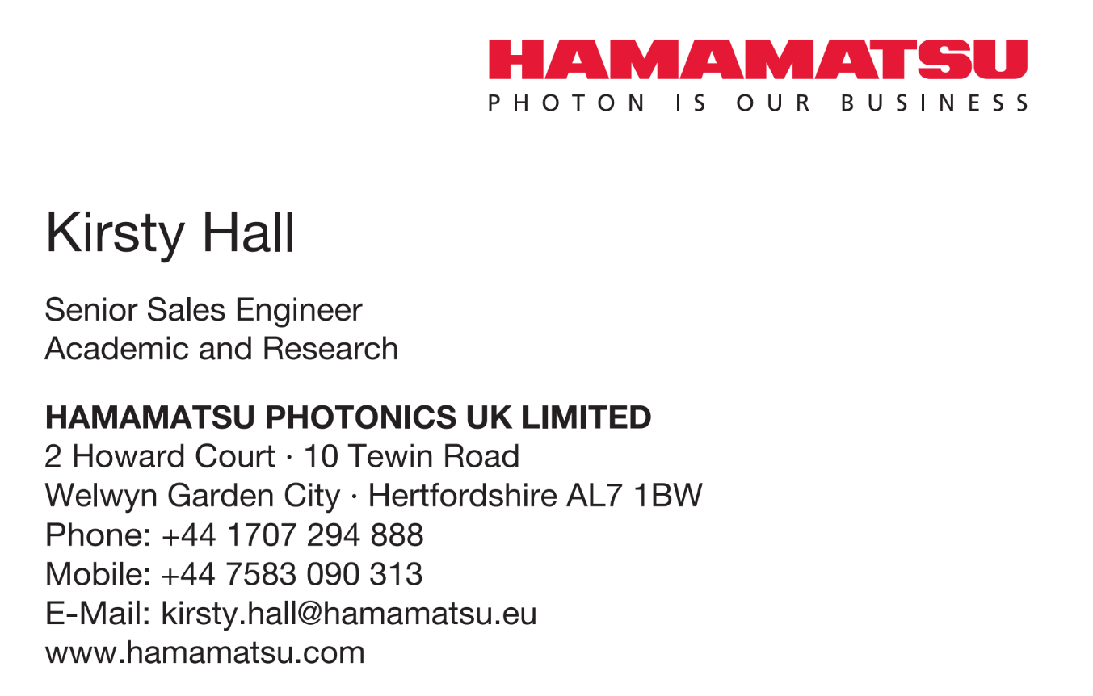
To summarise...
Who are we?
What do we do?
Why talk to us?
Based in Newcastle

