Slide 1
Measurement of top-quark differential cross-sections in ttH signal region
Michele Faucci Giannelli

Slide 2
Top differential cross-sections in ATLAS
ATLAS has performed many differential cross-sections measurement of top pair observables at 7, 8 and 13 TeV
15+ published papers and more ready to be submitted
Will focus on the most recent publications at 13 TeV using l+jets channel for tt+jets (JHEP 10 (2018) 159)
Where jets can be 0, 1 or ≥2
I will also use some results from other channels for comparison
di-lepton channel (Eur. Phys. J. C77 (2017) 299)
L+jet channel (boosted and resolved) (JHEP 11 (2017) 191)
di-boosted hadronic channel (Phys. Rev. D 98 (2018) )

Slide 3
tt+jets: analysis goals
We aim to exploit the large number of top pair produced in 2015 to measure differential cross-sections for top pairs produced in association with jets
study the effect of emission of QCD radiation on the kinematic variables of top quark
Probe a region of phase space that is crucial for many analyses
The variables considered are:
Top_{H} p_{T}: it is a well know that there is mis-modelling and we want to check how this depends on the number of additional jets
TTbar system p_{T}: this variable is sensitive to additional radiation and its shape depend on the number of additional jets
$\left|P_{out}^{tt}\right|$: studies of top modelling published in ATL-PHYS-PUB-2016-020 show that this is another variable sensitive to additional radiation

Slide 4
Summary of cross-sections
Reco to parton unfolding
Theory
Partons
Full Phase space
Experiment
Reconstruction
Parton to particle (i.e. apply shower)
Particle
Fiducial Phase space
RIVET
Reco to particle unfolding
Focus on measurement close to experimental acceptance
Reduce dependency on theory
Migration matrix is more diagonal
Expected reduced systematic uncertainties from modelling
Theorist can compare new models
The results will be relevant for years

Slide 5
Two types of differential cross-sections
Data and MC can have a significant difference in the normalisation
Absolute differential cross-sections takes into account the normalisation and give the actual cross-section
Normalised differential cross-sections provide shape information with higher precision
several uncertainties cancel when dividing for the total cross-section

Slide 6
Event selection and reconstruction
Single lepton with p_{T} > 25 GeV
lepton
At least 4 jets with p_{T} > 25 GeV
υ
W
b
Leptonic Top:
lepton
E_{T}^{Miss}
Closest b-jet to lepton
t
W reconstruction: two jets that best reconstruct W mass
t
Select two highest p_{T} b-jets (70% WP)
W
light quark
b
light quark
Hadronic Top:
two light jets
other b-jet
Top selection is identical at reconstruction and particle level

Slide 7
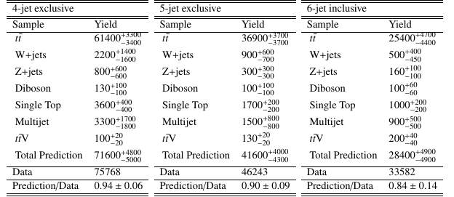
Configurations definition
Events are divided in three orthogonal configurations depending on the number of jets:
4-jet exclusive
5-jet exclusive
6-jet inclusive
30%
50%
20%

Slide 8
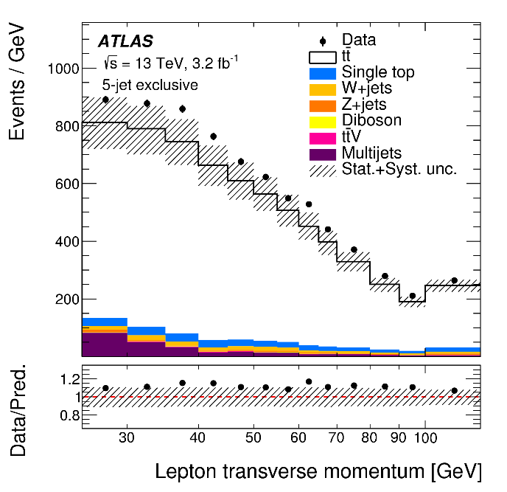
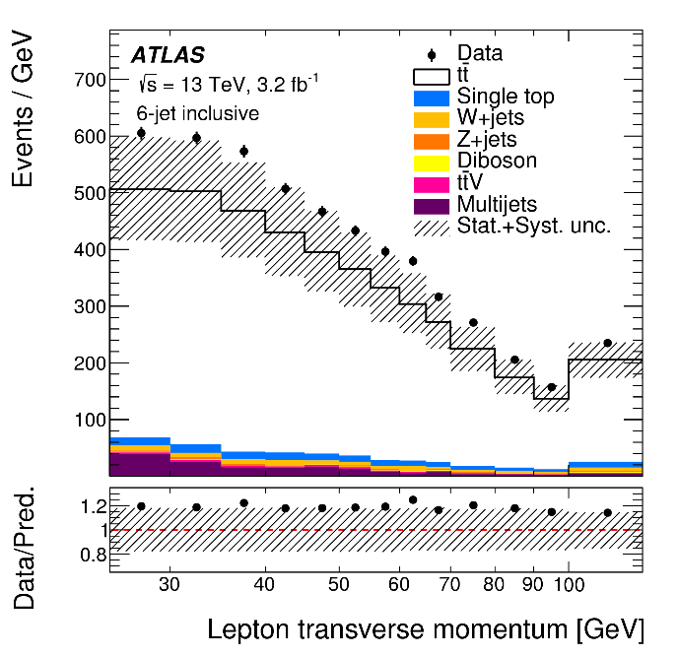
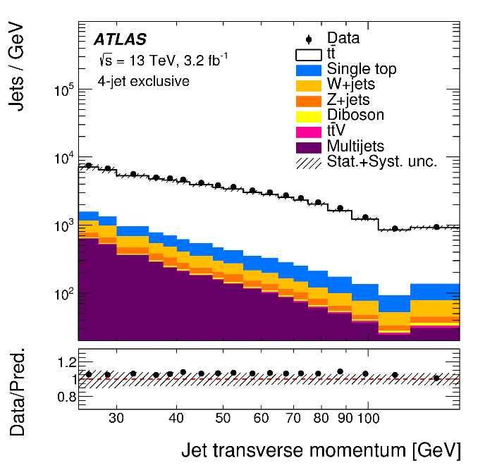
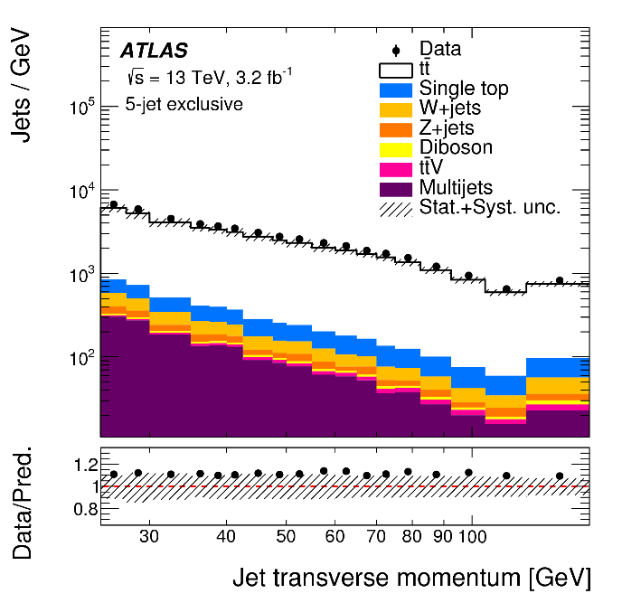
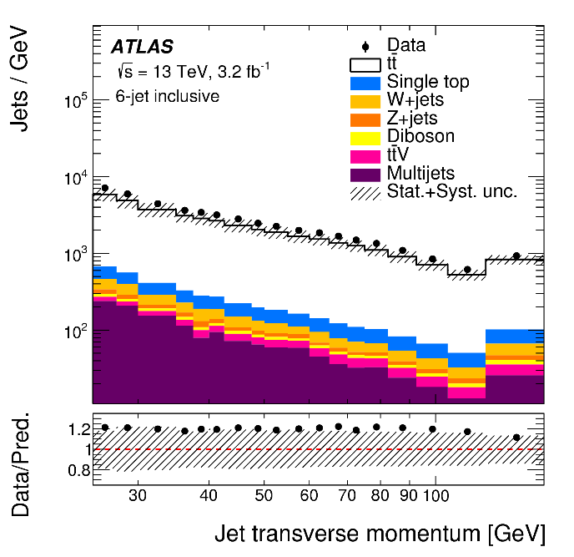
Data/MC

Slide 9
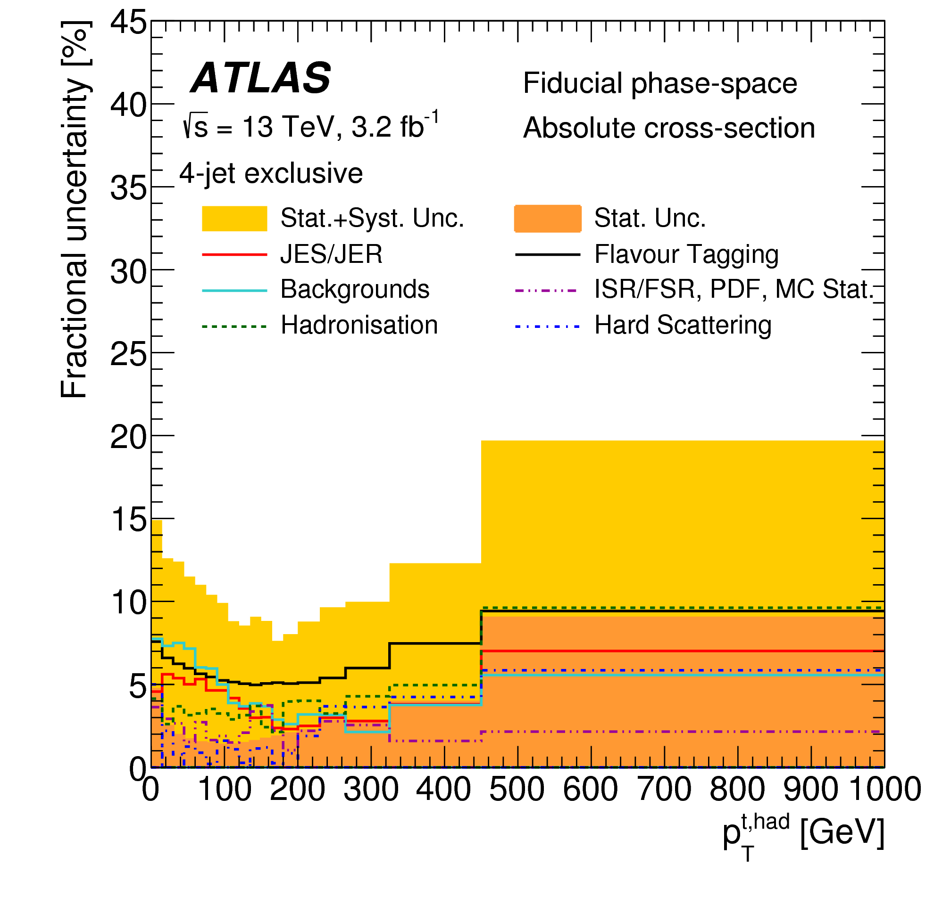
Uncertainties
Strong reduction of detector systematics for normalised results

Slide 10
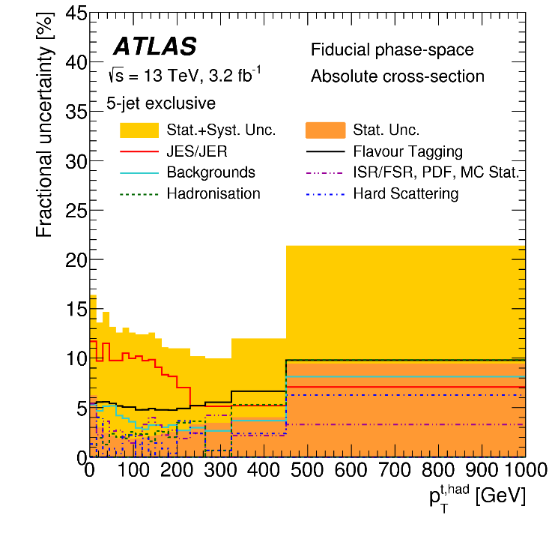
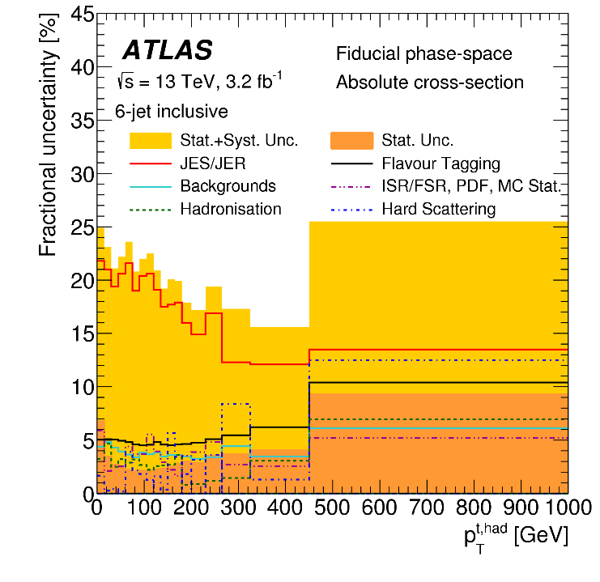
Fractional uncertainties by region
JES uncertainties increase with the number of jets
Background uncertainty higher at lower jet multiplicity
Top modelling systematics increase slightly with the number of jets

Slide 11
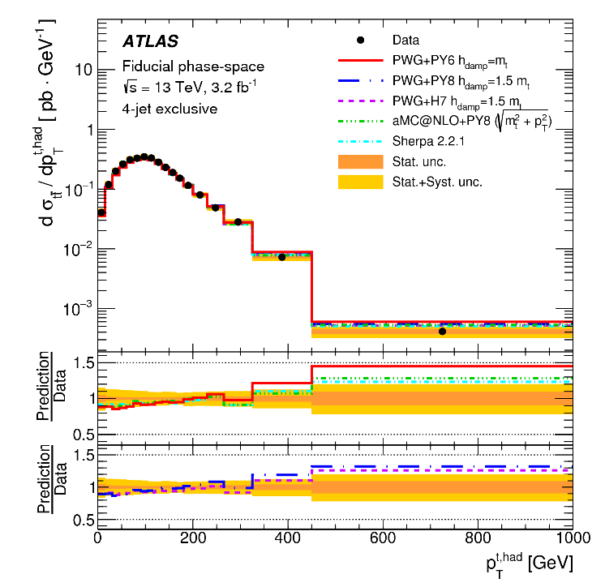
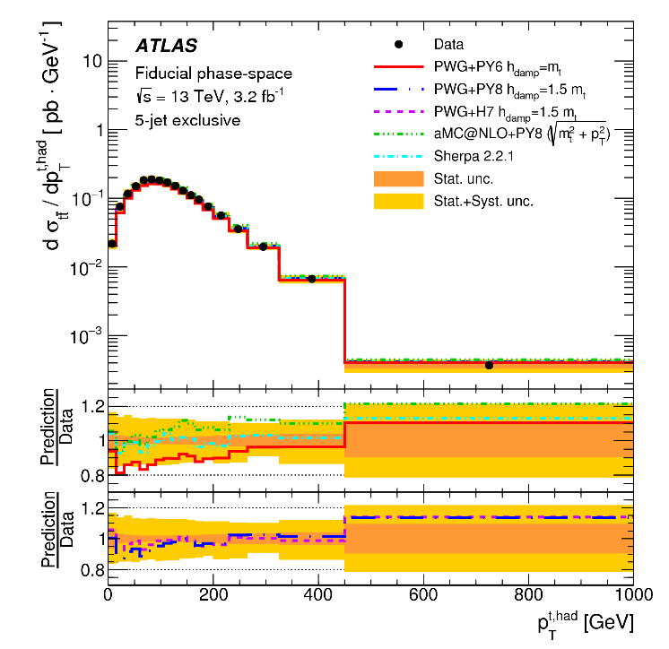
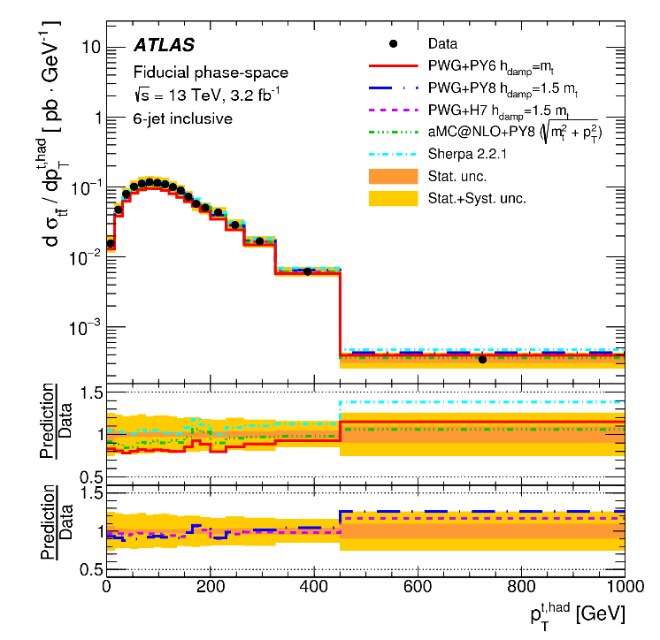
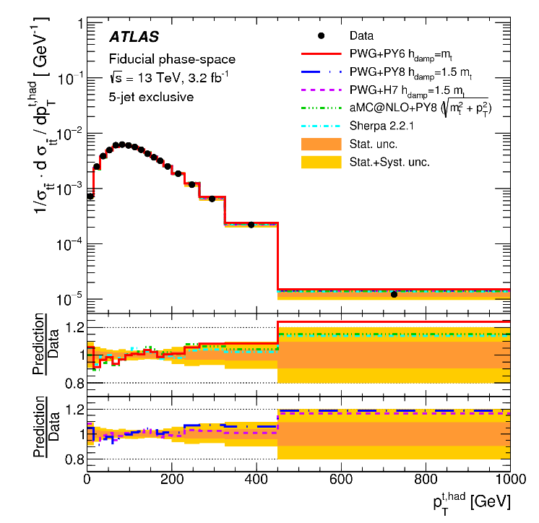
Results: top p_{T}

Slide 12
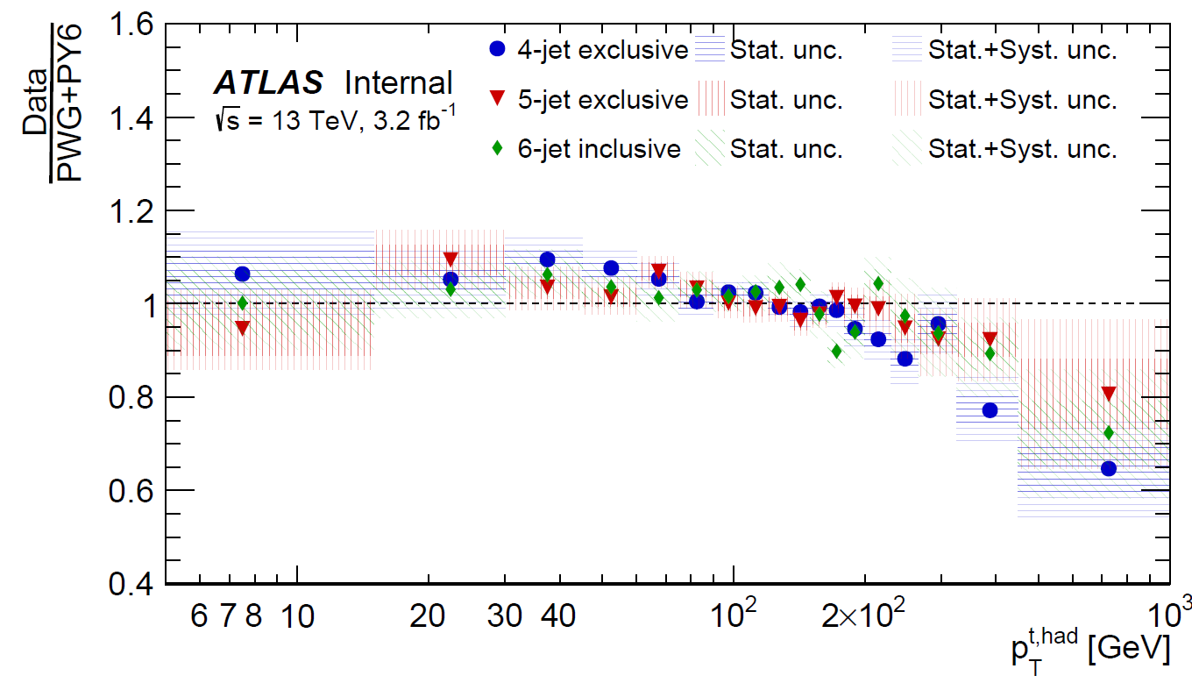
TopH p_{T}: agreement in different regions
The slope seen in the inclusive analysis is caused by events with 4 jets while events with higher jet multiplicity are better modelled
This could be an effect of tuning of Parton Shower

Slide 13
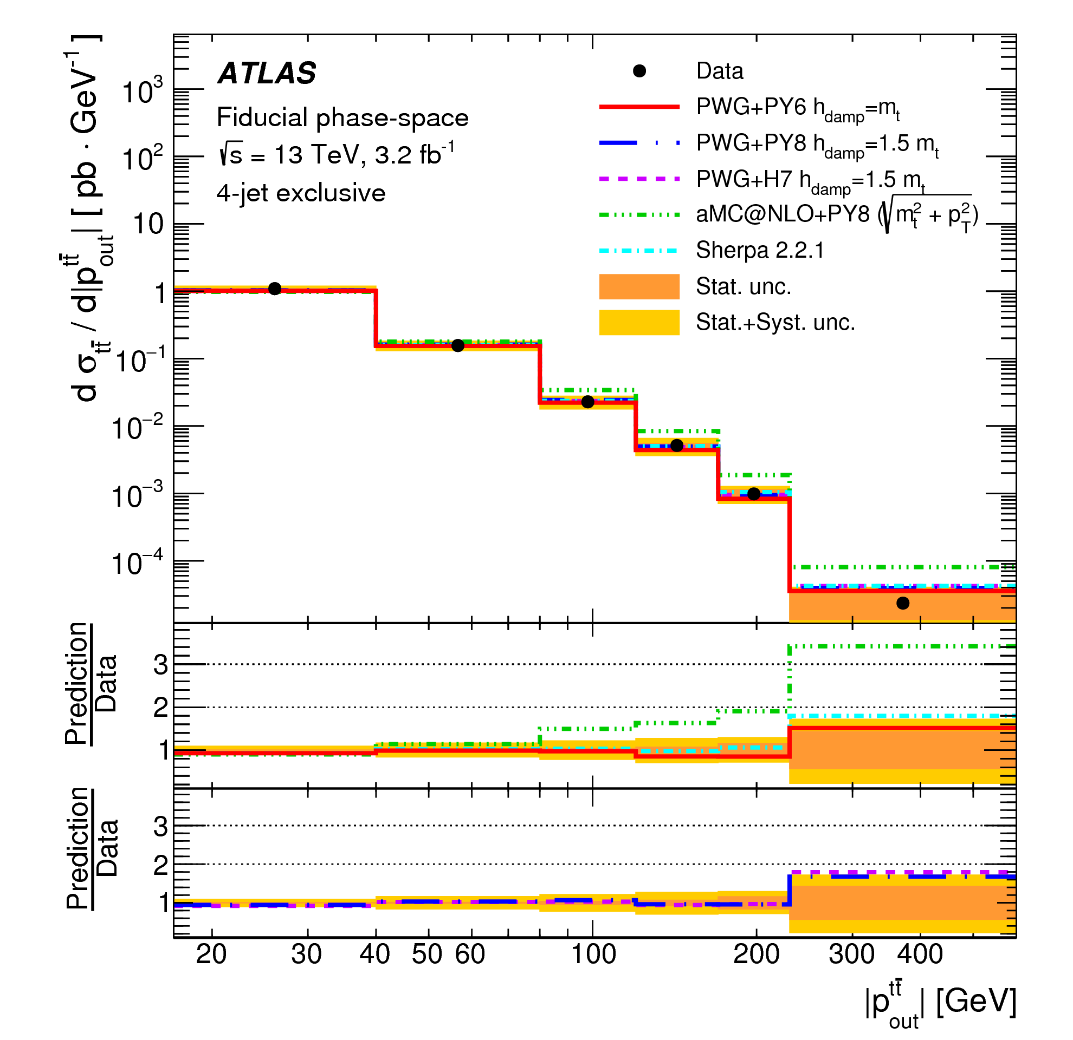
Results: P_{out}
aMC@NLO does not describe the data

Slide 14
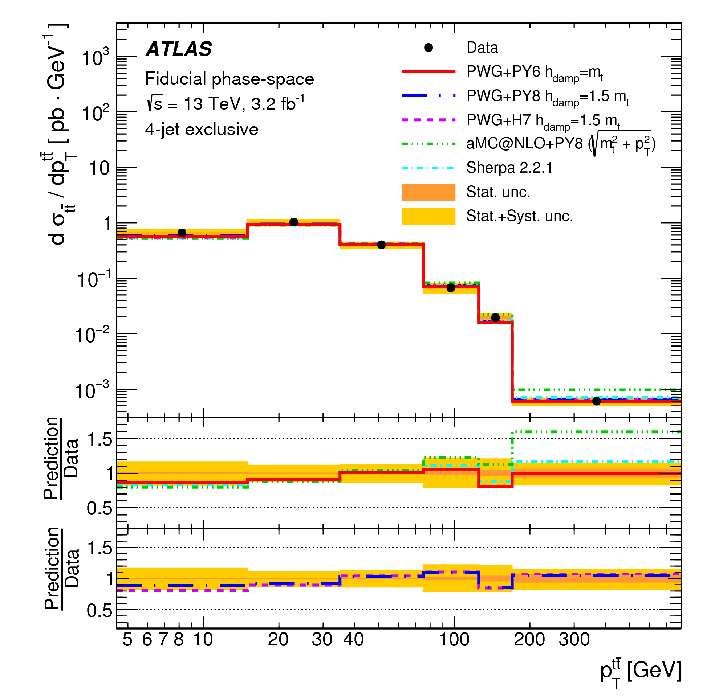
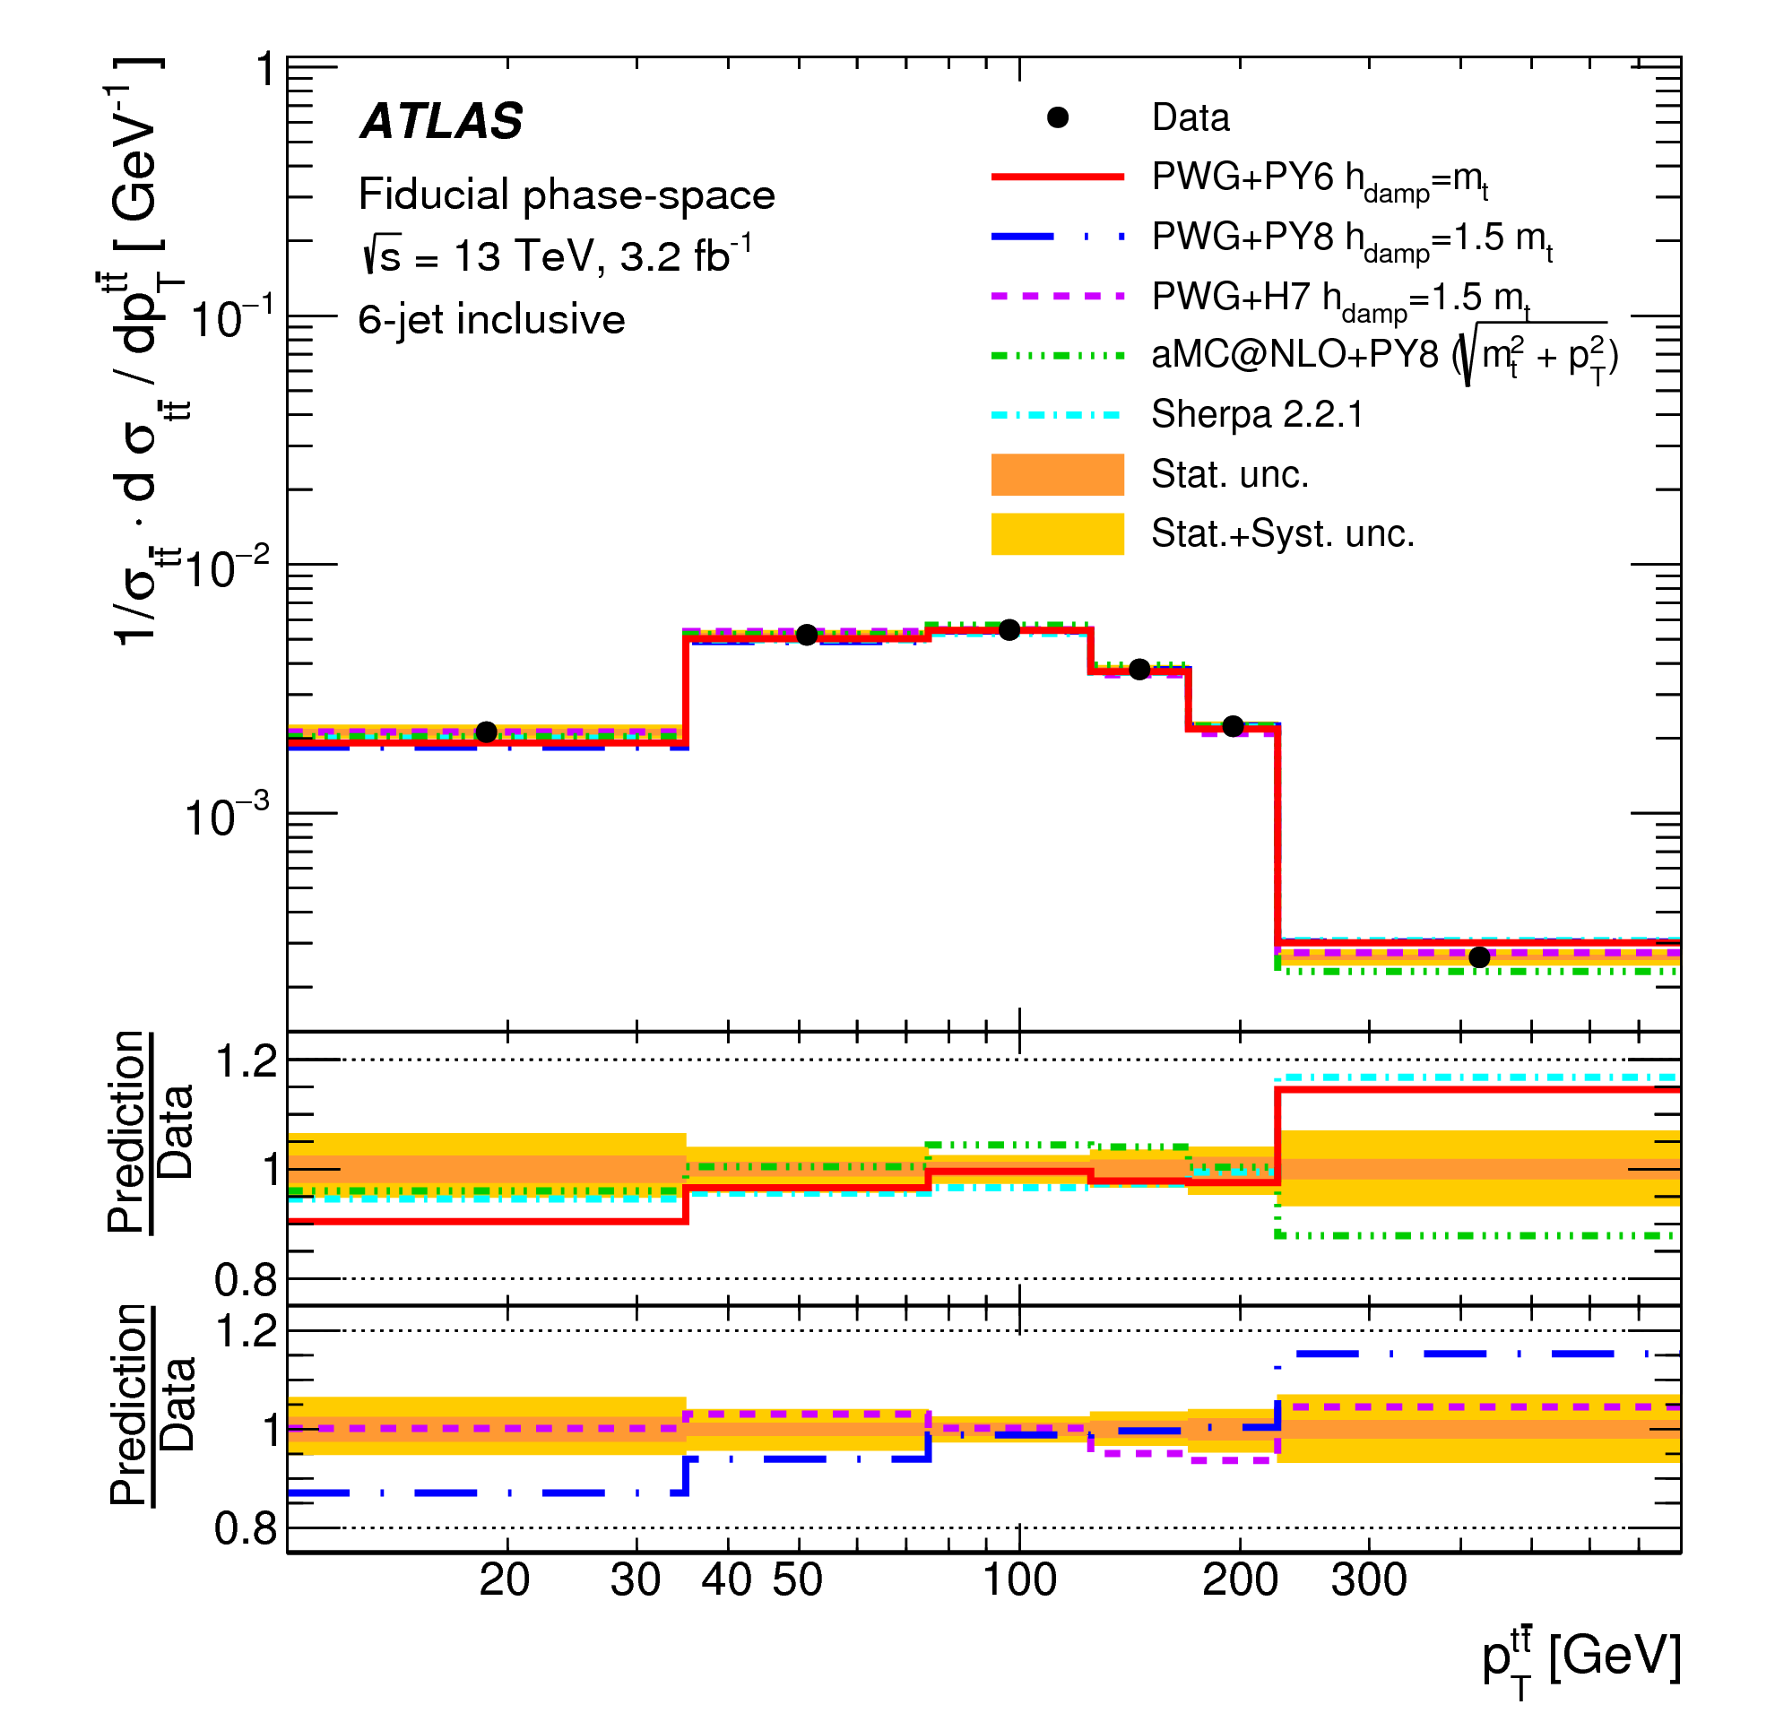
Results: $p_{\text{T}}^{tt}$
aMC@NLO has tension in 4-jet region
All MC have a slope in the 6-jet region

Slide 15
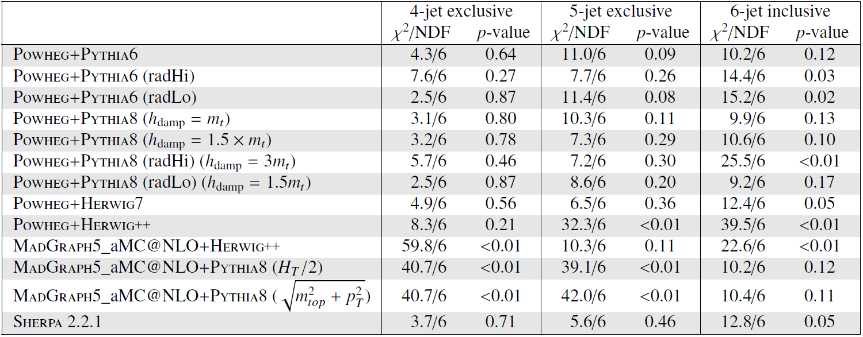
χ² tables: P_{out}
Absolute
aMC@NLO:
Compatible for Absolute XS
Not compatible with Normalised XS
For SHERPA and PH7 is the opposite is true
Normalised
Both ABS and Norm. provide discrimination

Slide 16
Comparison with other analyses

Slide 17
Topologies and reconstruction
di-lepton channel: neutrino weighting (top variables)
l+jets resolved channel: pseudo-top
l+jets boosted channel: only 1 large-R jet
Hadronic di-boosted channel: 2 large-R jets
u/d/s/c
lepton
υ
W
b
Leptonic top:
lepton
E_{T}^{Miss}
Closest b-jet to lepton
t
W reconstruction: select the two jets that best reconstruct the W mass
t
W
lepton
Select two highest p_{T} b-jets (70% WP)
u/d/s/c
b
u/d/s/c
u/d/s/c
Hadronic top:
two light jets
other b-jet
Top selection is identical at reconstruction and particle level

Slide 18
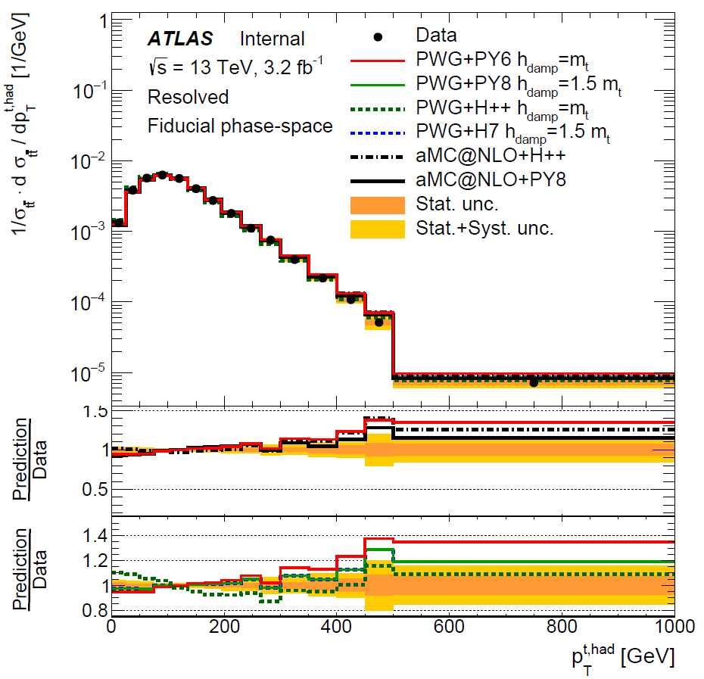
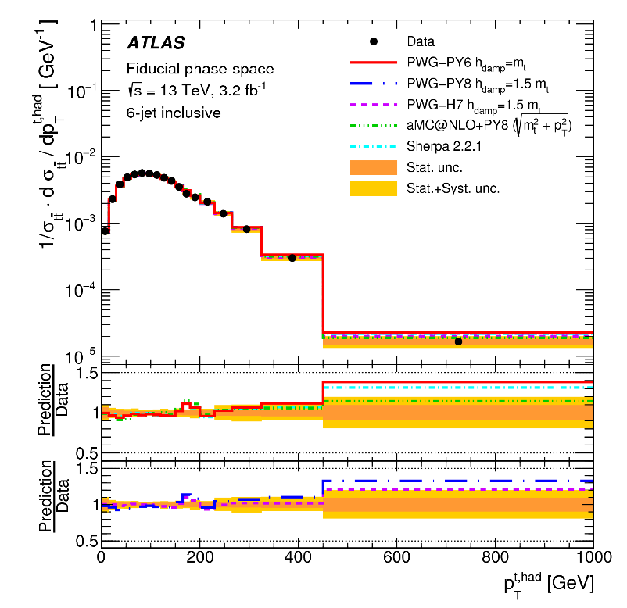
Impact on other analyses
ttH and other searchers suffer from the topH pT mis-modelling and always try to correct for it
Actually this is not as needed as the inclusive selection may suggest since in 6-jet inclusive the modelling is much better than in the 4-jet inclusive

Slide 19
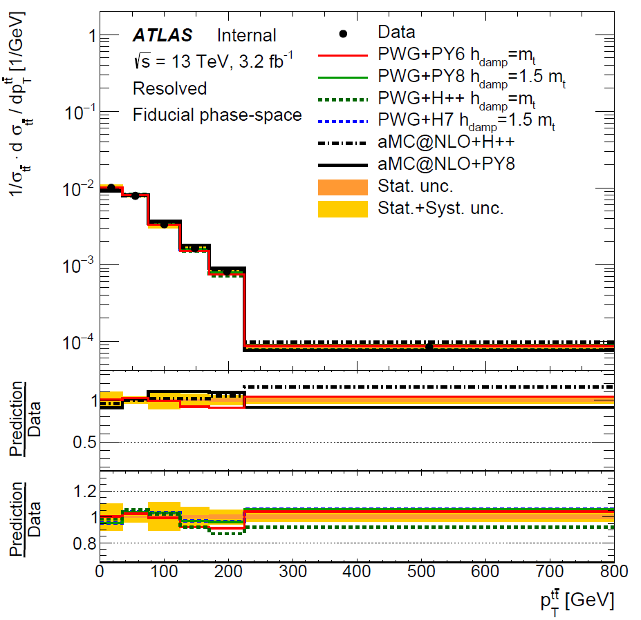
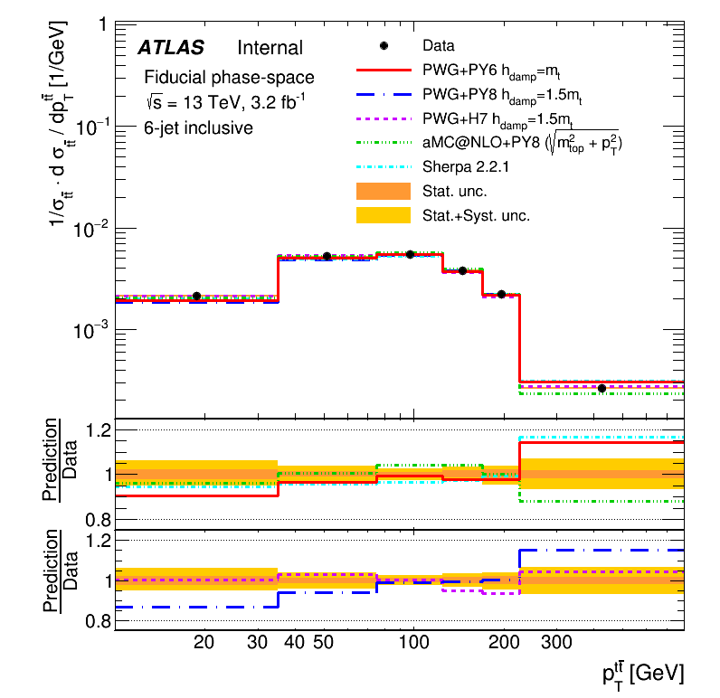
Impact on other analyses
The system p_{T} instead is normally considered well modelled after fixing h_{damp} but in 6-jet a slope is visible for the nominal sample
Actually it got worse in PP8 (blue) with respect to PP6 (red)
Both are compatible with data, but will trigger new discussion in ttH

Slide 20
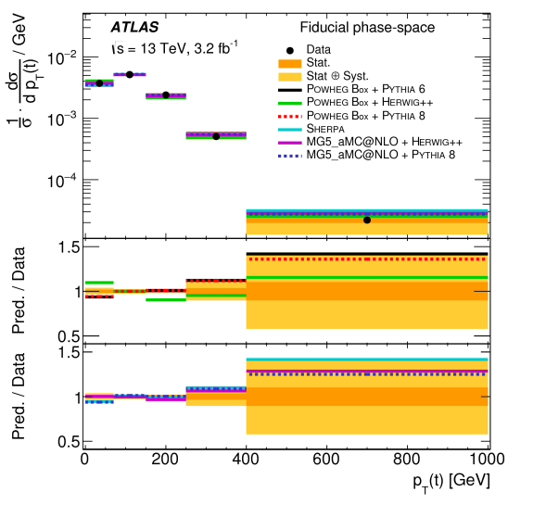
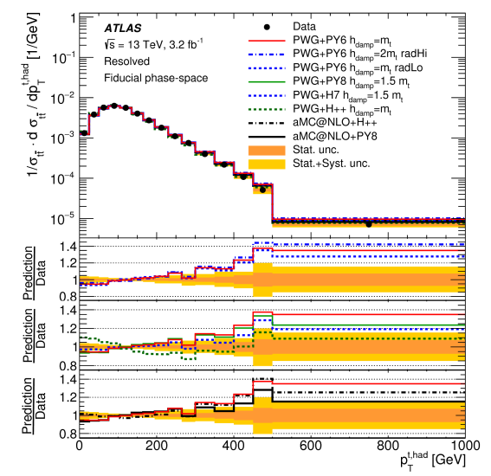
Result: top p_{T} resolved
di-lepton
l+jets
All MC predicts a higher cross-section at high p_{T} than what is observed in data
Similar results are obtained in the boosted channels

Slide 21
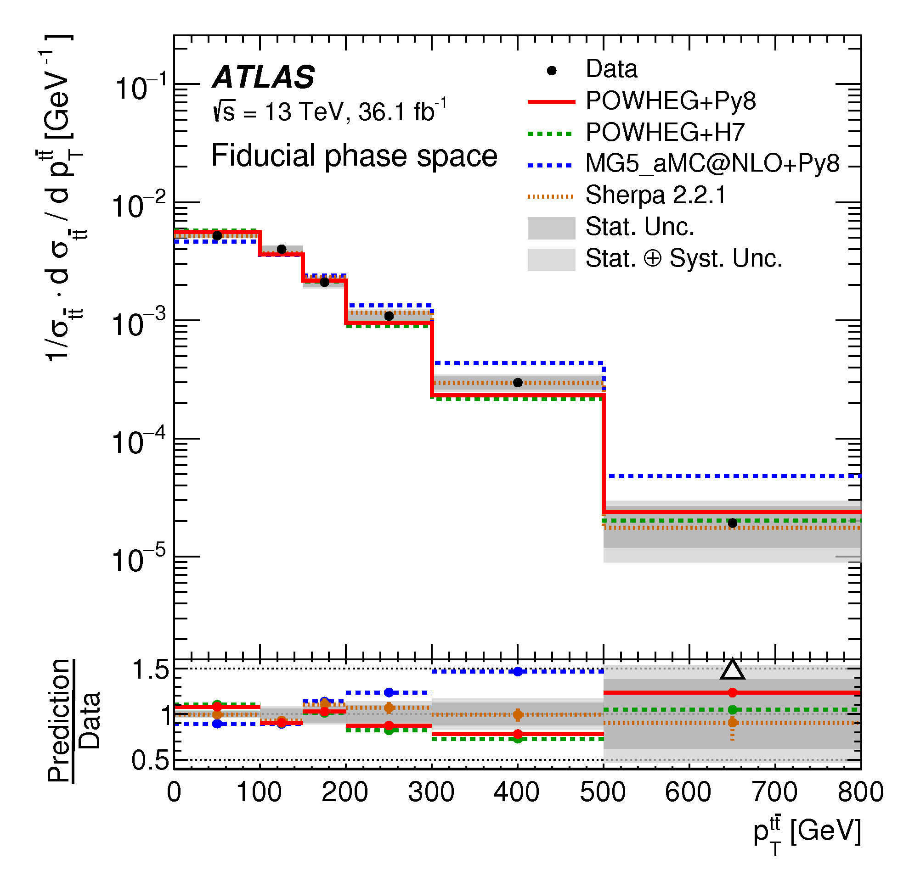
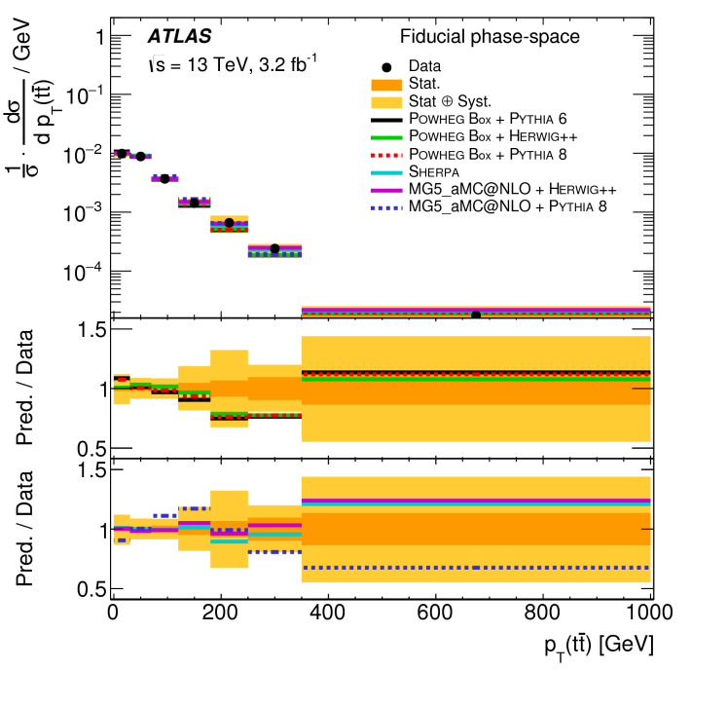
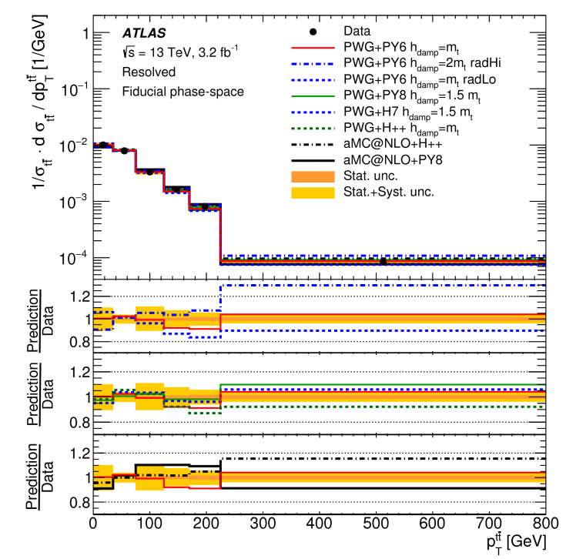
System p_{T}
di-boosted
di-lepton
l+jets
Similar (but reduced) effects as those observed in exclusive analysis

Slide 22
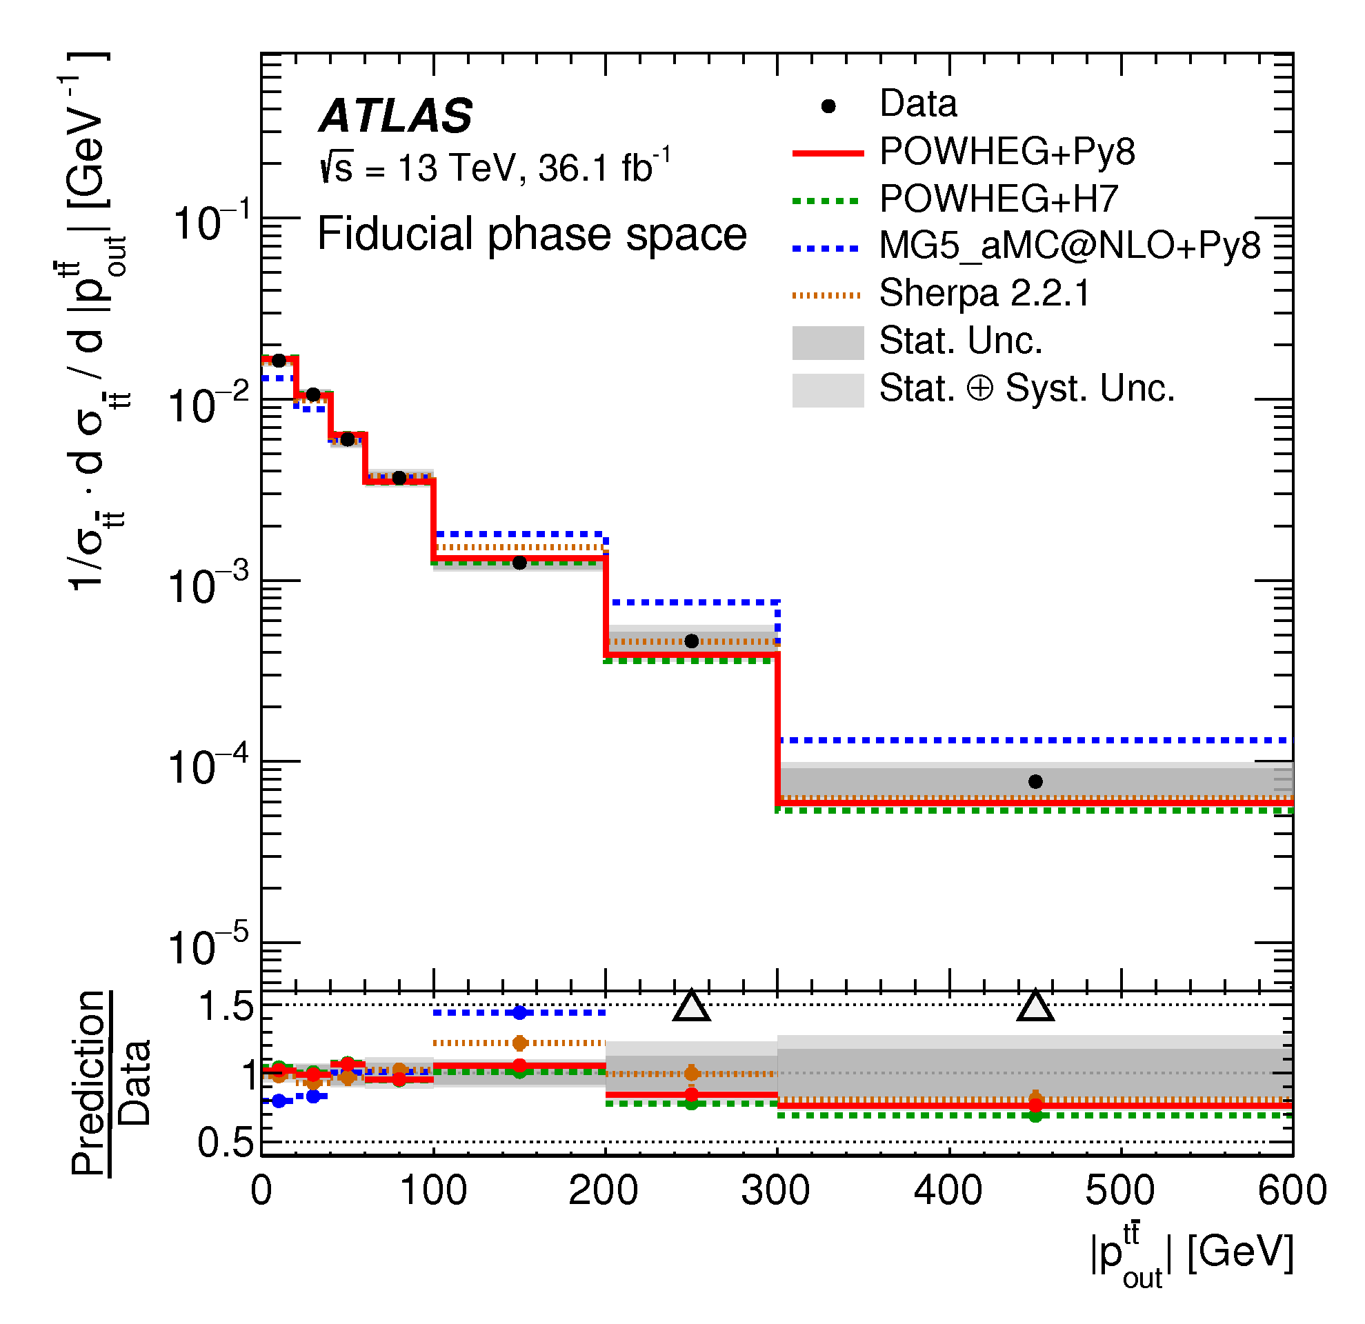
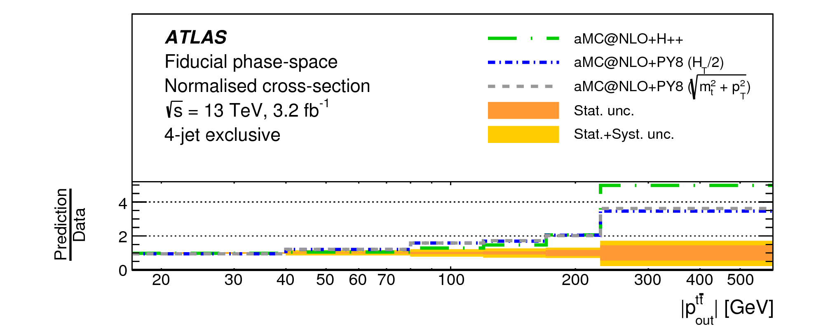
P_{out}
All analyses exclude aMC@NLO
We tested different scales and PS but neither fixed it

Slide 23
Conclusion
The tt+jets analysis provides more information than the existing results by looking in corner of the total phase space
It provides the inputs to improve the tuning of MC in ATLAS for a better agreement in signal regions of high profile analyses such as ttH, 4 tops, SUSY
More results are in the pipeline including 2D measurements in several channels
We are involved in both l+jet and all-hadronic resolved

Slide 24
Backup

Slide 25
Data and MC samples used
Data:
di-lepton and l+jets: 2015 data (3.2 fb⁻¹)
di-boosted: 2015+2016 data (36.1 fb⁻¹)
MC predictions:
PowHeg+Pythia6 (old nominal)
PowHeg+Herwig++
PowHeg+Pythia8 (new nominal)
PowHeg+Pythia6/8 IFSR variations
PowHeg+Herwig7
MG5_aMC@NLO+Herwig++
MG5_aMC@NLO+Pythia8
Sherpa (2.2.1)

Slide 26
Normalisation in 5 and 6 jets configurations
The slope in nJets has been observed in all measurements using PP6

Slide 27
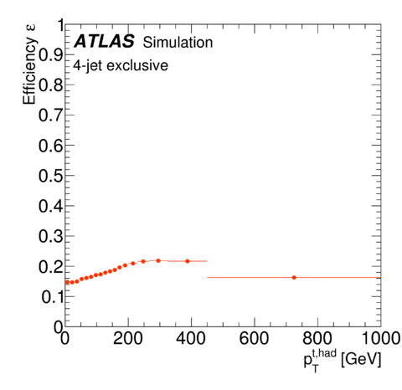
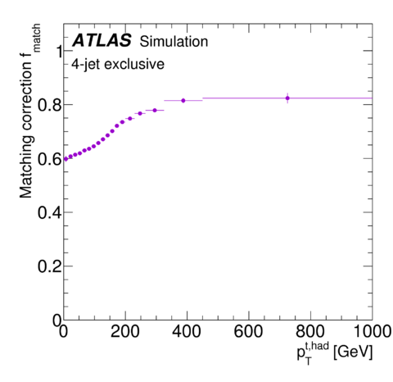
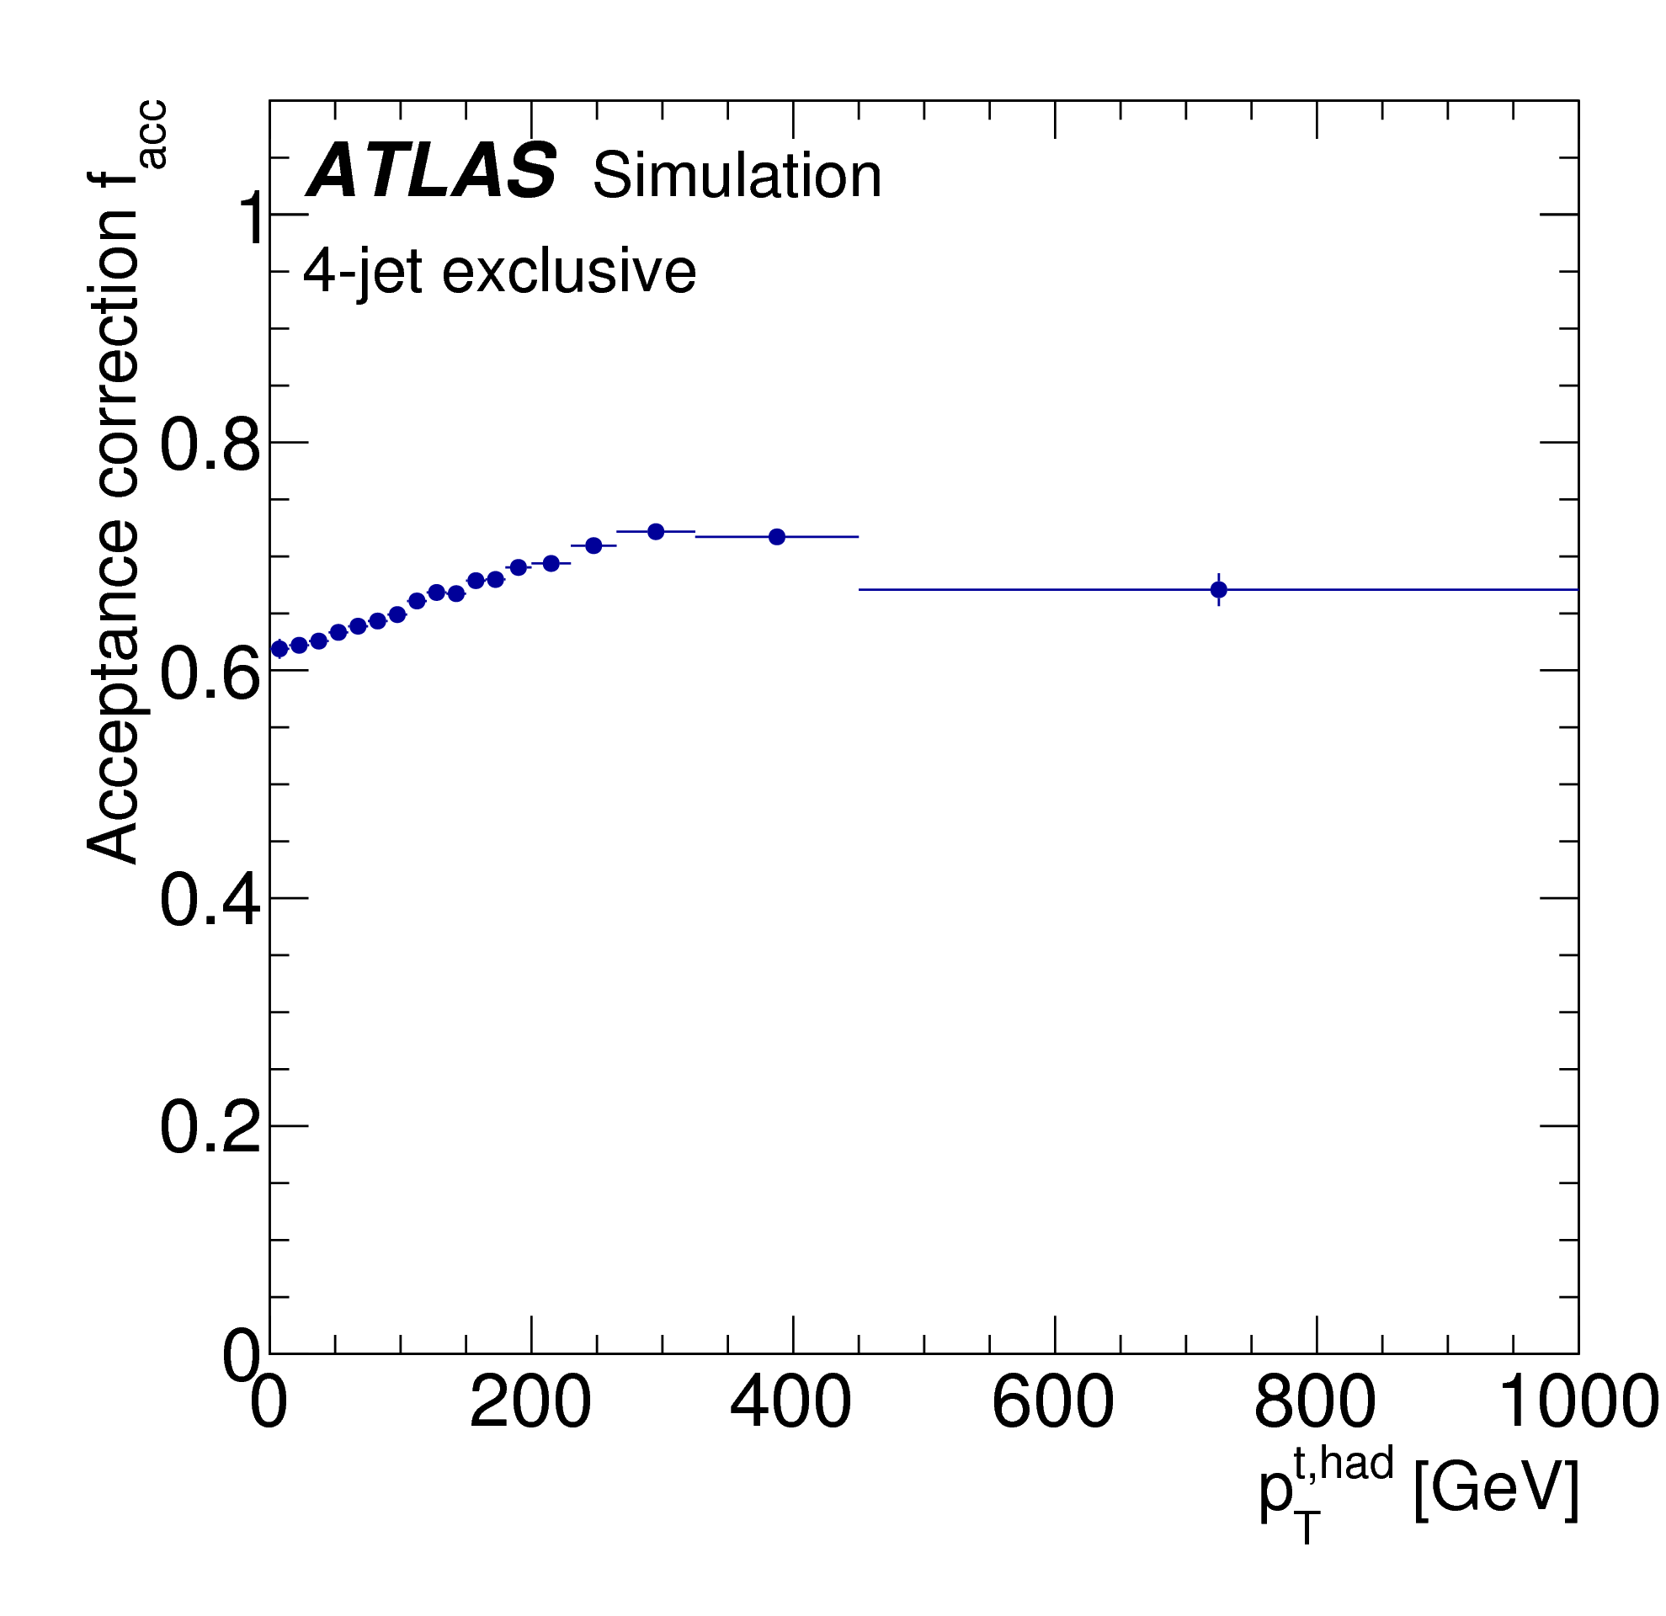
Unfolding example
Matching between detector and particle level objects is required to have a more diagonal migration matrix
This helps the unfolding procedure
$ε_{eff}=ε_{part!reco}=\frac{N_{part}}{N_{reco∧part∧match}}$
$ε_{match}=\frac{N_{reco∧part∧matched}}{N_{reco∧part}}$
$ε_{acc}=ε_{reco!part}=\frac{N_{part∧reco}}{N_{reco}}$

Slide 28
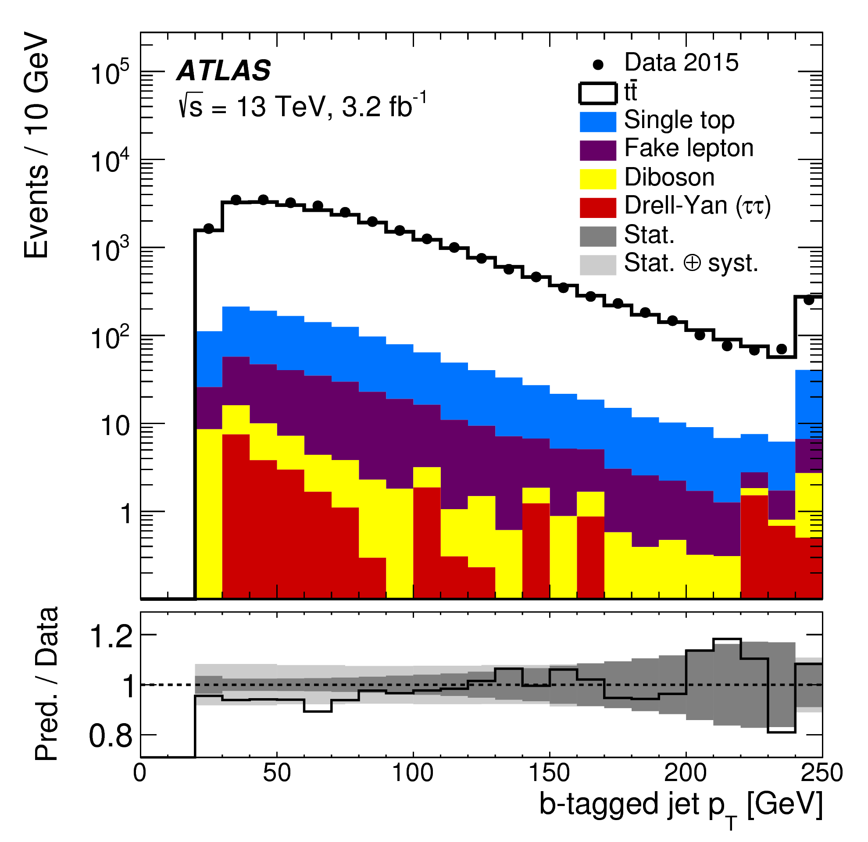
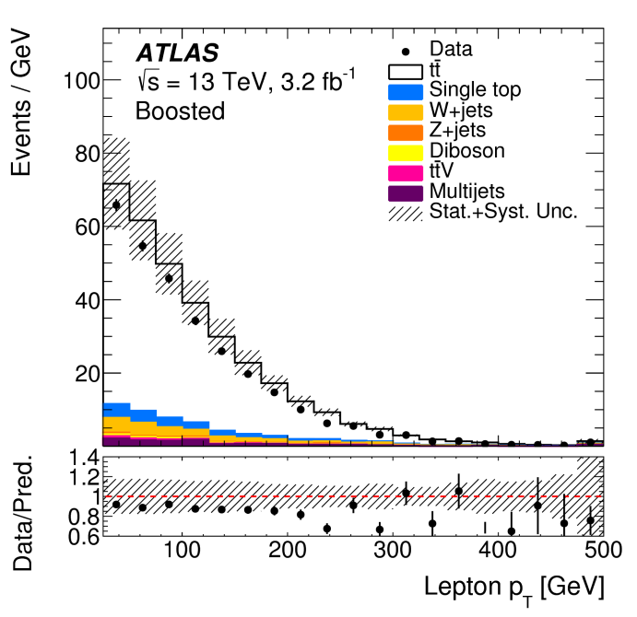
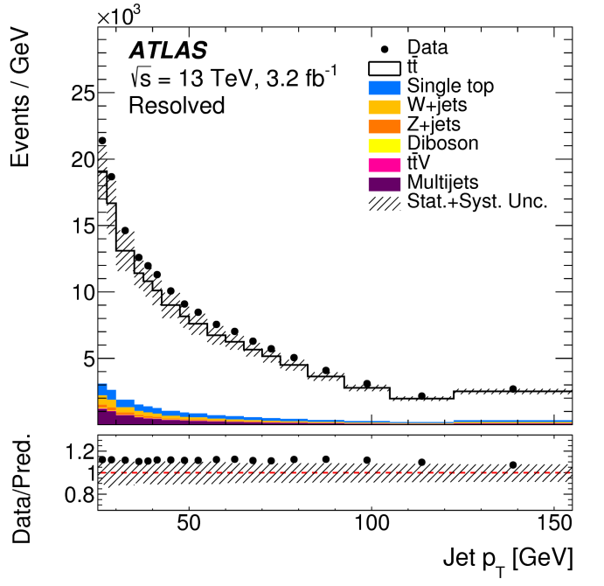
Data/MC agreement
di-lepton
di-boosted
l+jets
l+jets
The background is small in all channels

Slide 29
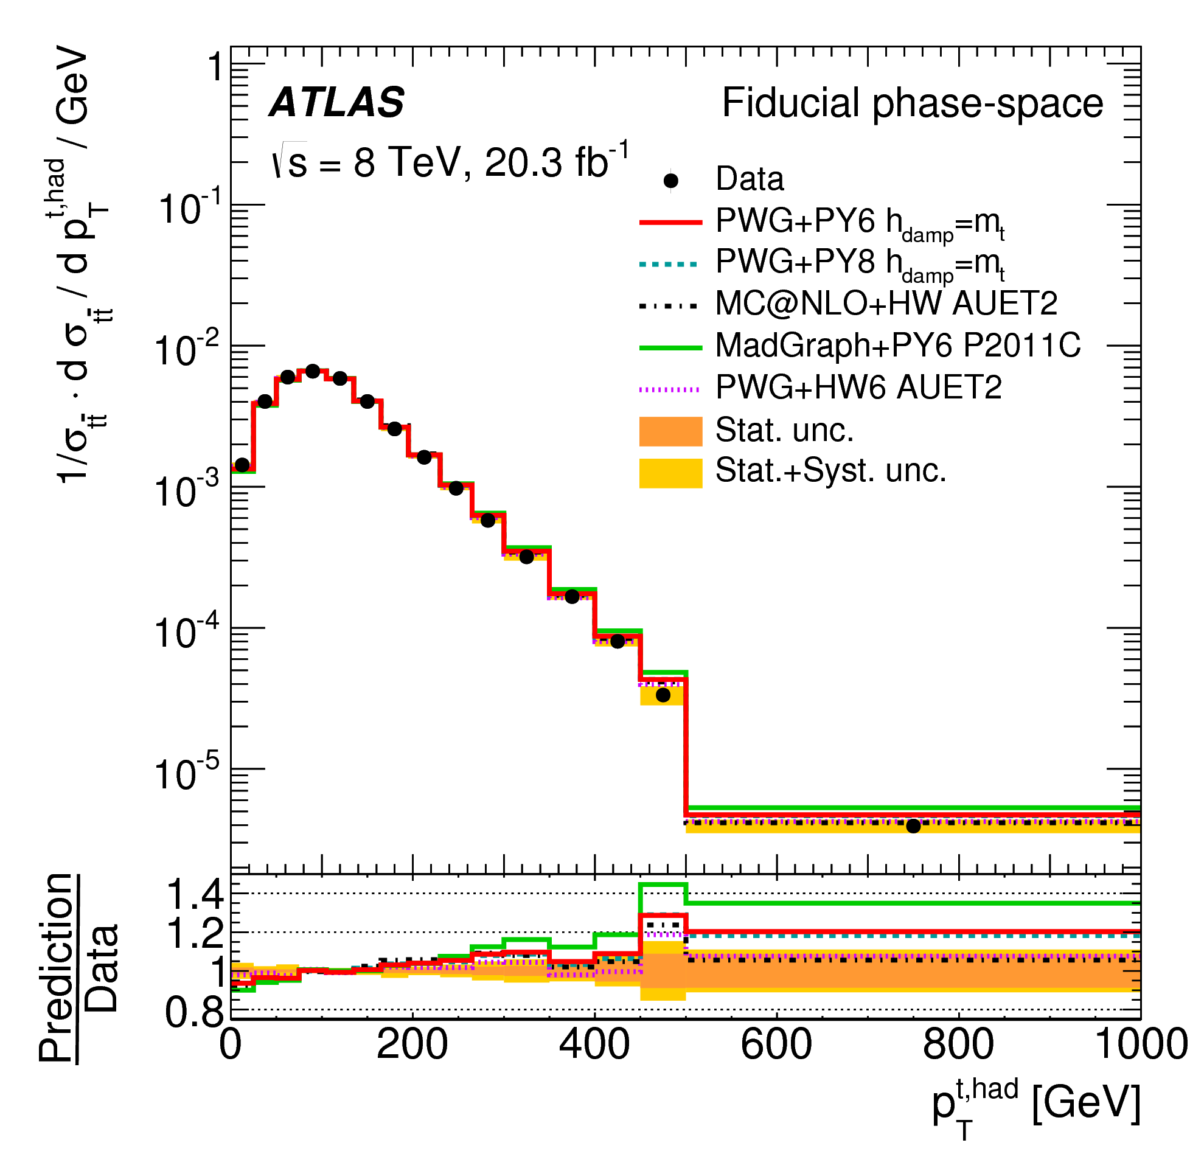
Top p_{T}: an history at particle

Slide 30
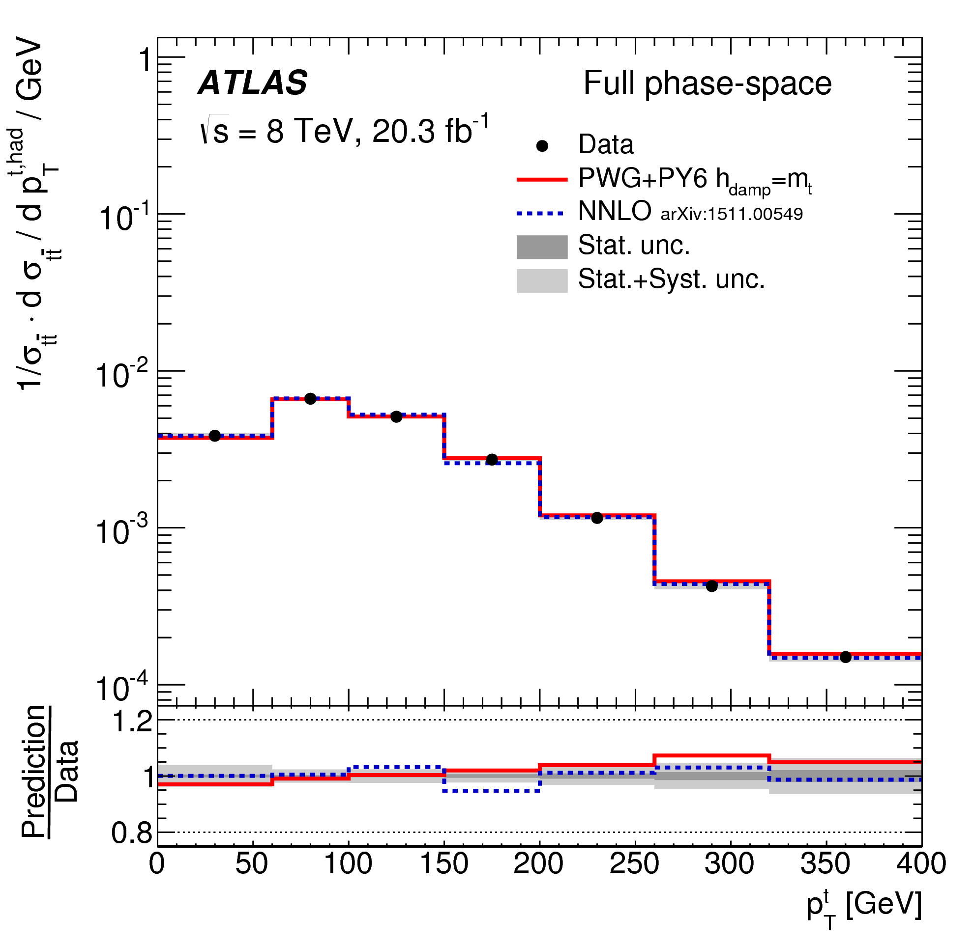
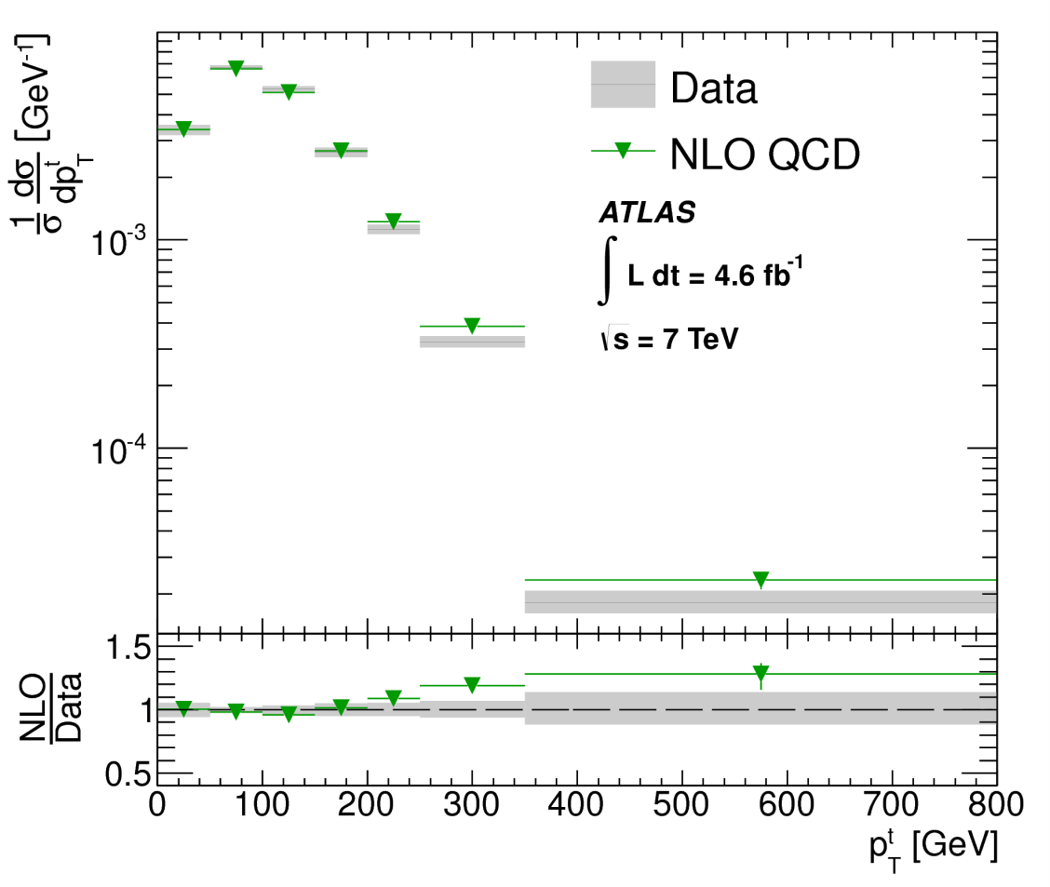
and parton level

Slide 31
Selections

Slide 32
Di-lepton analysis: topology and selection
1 electron and 1 muon with opposite sign
Both leptons with p_{T} > 25 GeV
lepton
At least 2 jets with p_{T} > 25 GeV
υ
At least one b-jets (77% WP)
W
b
t
t
lepton
The reconstruction uses the neutrino weighting method
W
b
υ

Slide 33
Resolved l+jet analysis: topology and selection
Single lepton with p_{T} > 25 GeV
lepton
At least 4 jets with p_{T} > 25 GeV
υ
W
b
Leptonic Top:
lepton
E_{T}^{Miss}
Closest b-jet to lepton
t
W reconstruction: two jets that best reconstruct W mass
t
Select two highest p_{T} b-jets (70% WP)
W
light quark
b
light quark
Hadronic Top:
two light jets
other b-jet
Top selection is identical at reconstruction and particle level

Slide 34
Boosted l+jets: topology and selection
Single lepton with p_{T} > 25 GeV
1 b-jet with p_{T} > 25 GeV (R=0.4)
lepton
E_{T}^{Miss} > 20 GeV
m_{T}(W) > 60 GeV
υ
W
ΔR(l, jet) < 1.5
t
ΔR(l, l-jet) < 1.5
b
t
W
ΔR(b-jet, l-jet) < 1.5
b
light quarks
Large jet R=1: p_{T}>300GeV, mass> 100 GeV

Slide 35
Di-boosted hadronic: topology and selection
2 Large-R jets:
J1 > 500 GeV
J2 > 300 GeV
light quarks
W
2 b-tag jets (>25 GeV, 70% WP)
They bust be inside the large-R jet cone
t
b
t
W
b
light quarks

Slide 36
Particle level objects
γ
Charged leptons not decaying from a hadrons are “dressed” with the energy from all photons within a R=0.1 cone around the lepton
l
ν
μ
π
K
Jets are clustered from stable MC particles using anti-k_{t} with R=0.4 (R=1 for boosted objects)
Neutrinos and muons from hadrons are included
E_{T}^{Miss} defined as sum of all other neutrinos
B tagging defined by matching a jet with a b quark with R<0.35
Overlap removal is not applied at particle level in 2015 only results

Slide 37
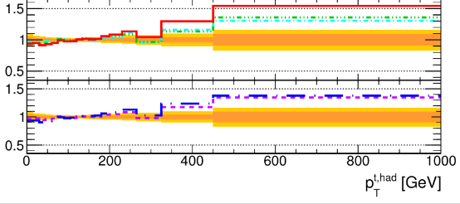
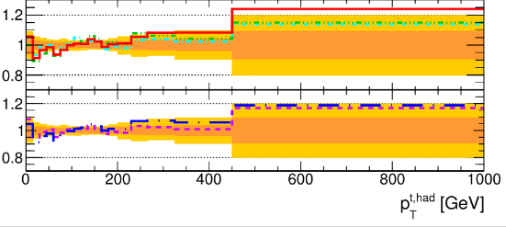
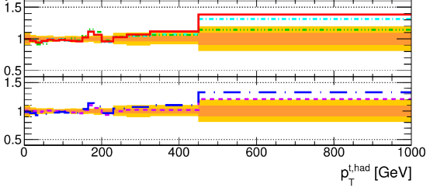
TopH p_{T}: slope
4ex
5ex
6in

Slide 38
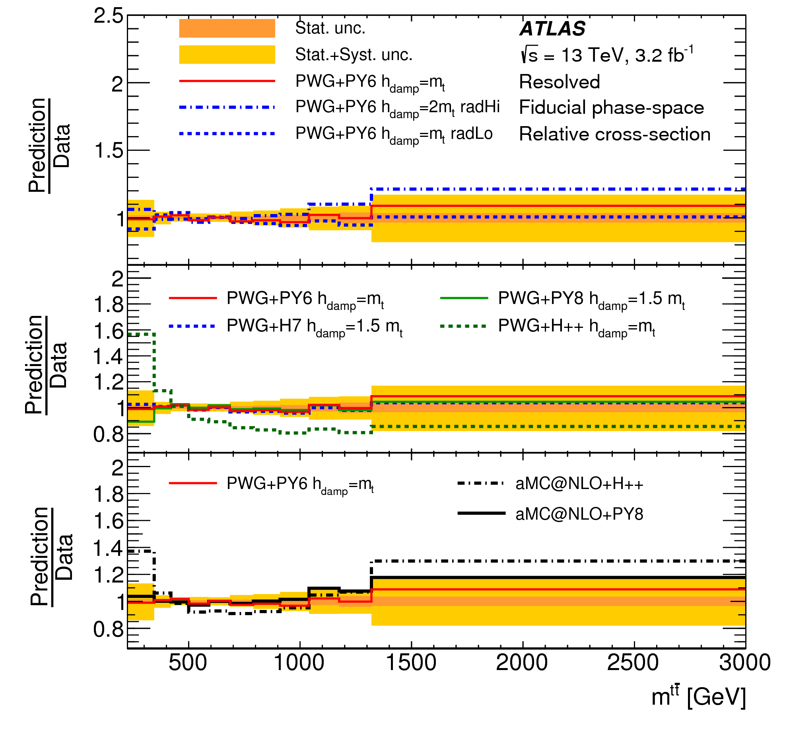
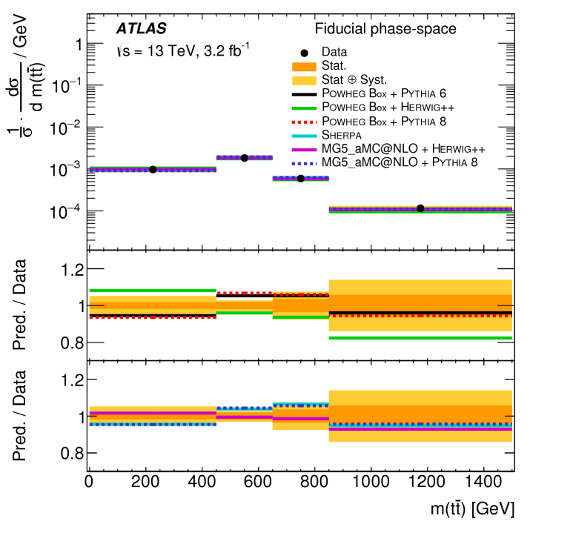
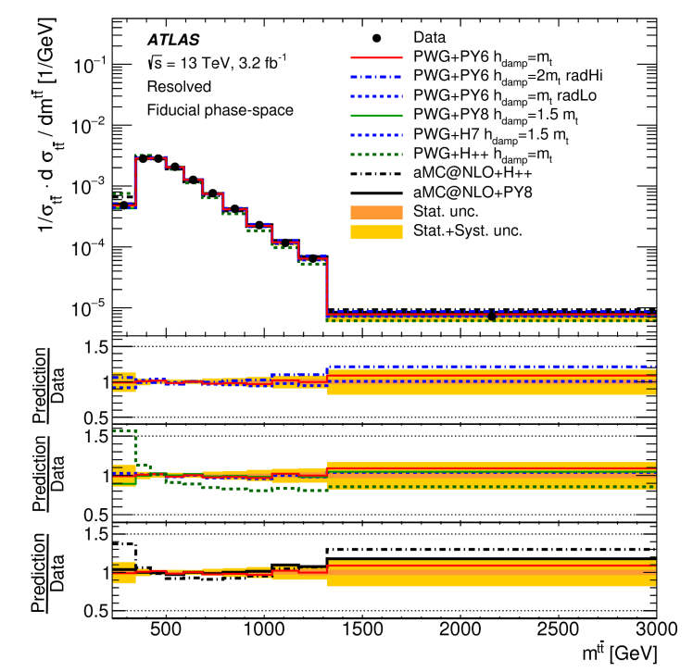
Mass
di-boosted
di-lepton
l+jets
Many predictions using Herwig++ are not compatible with data

Slide 39
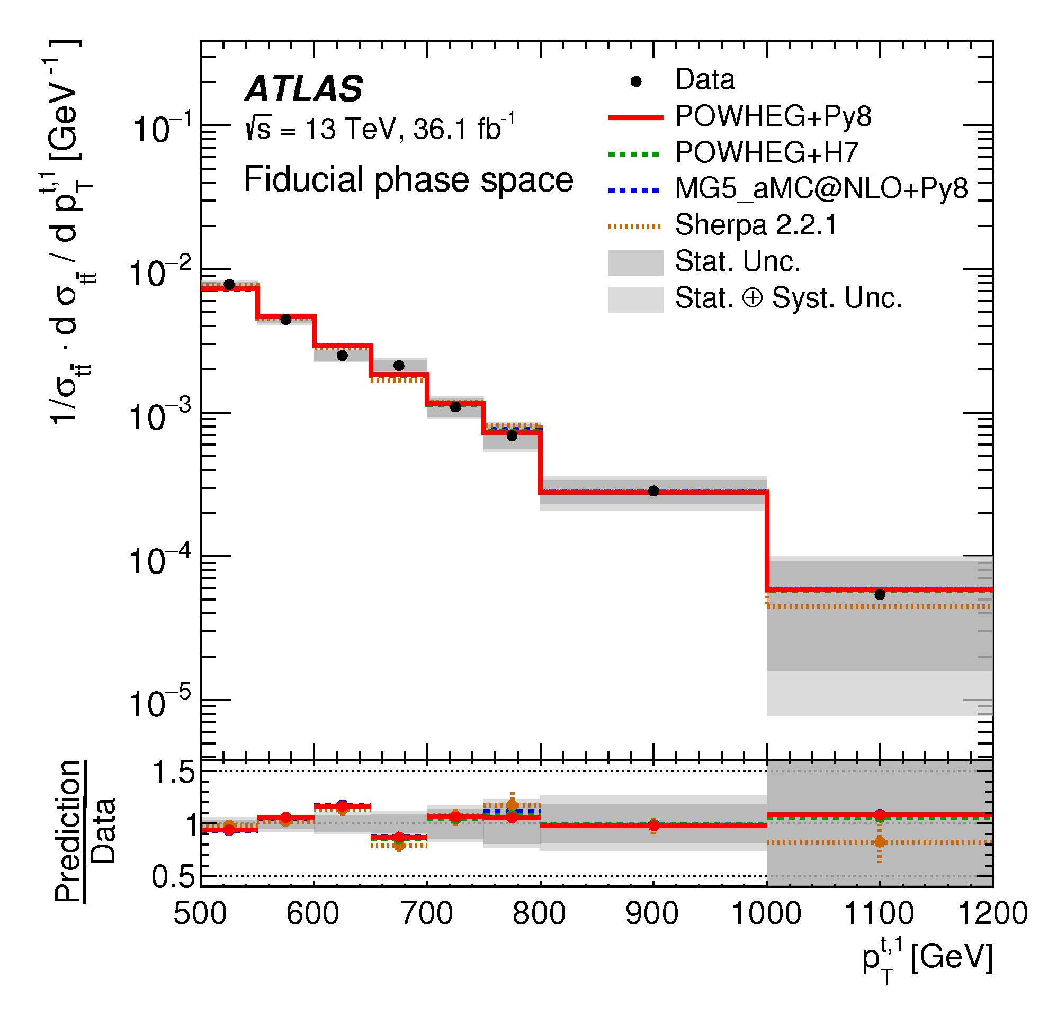
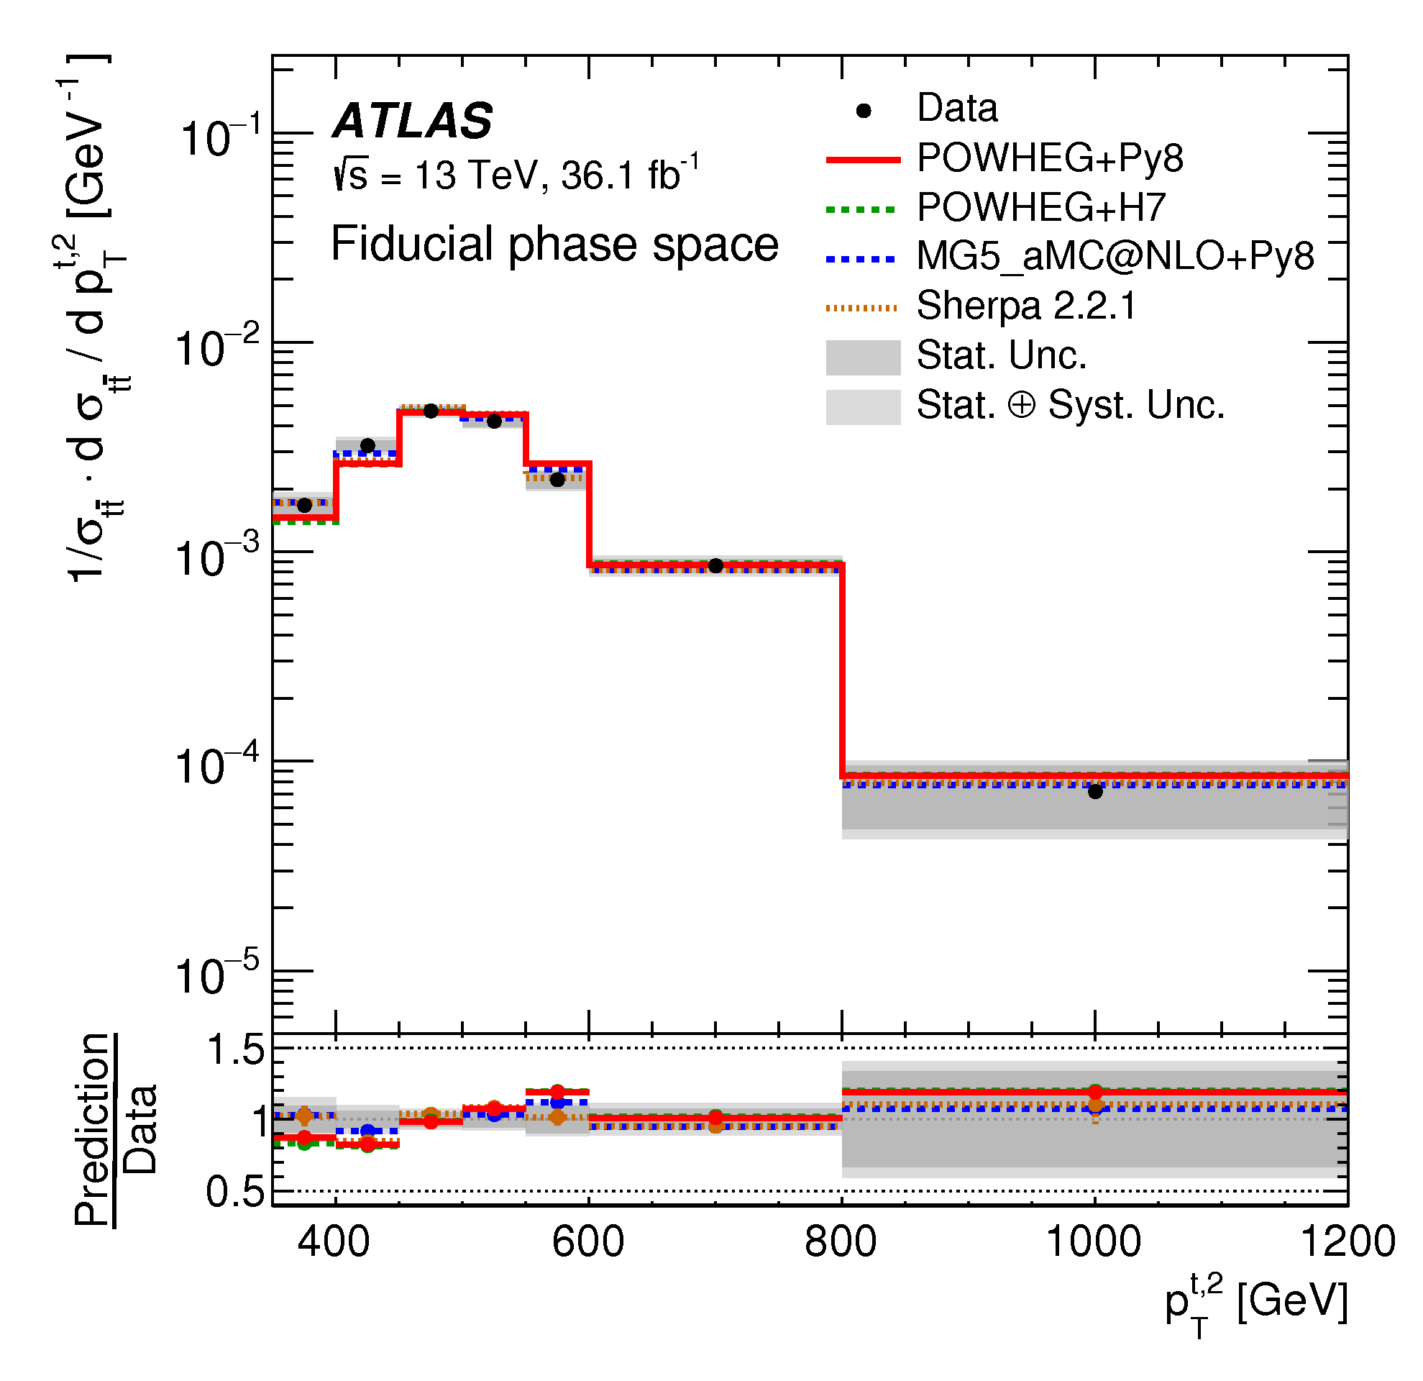
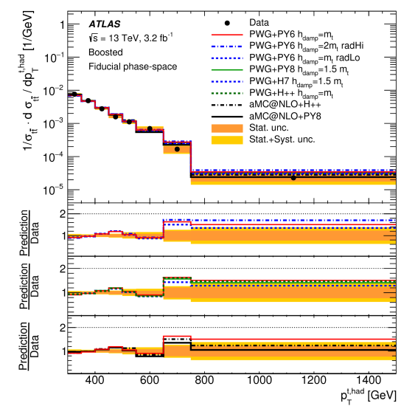
Result: top p_{T} boosted
Di-boosted
Leading top
Di-boosted
Sub-leading top
l+jets boosted
The agreement is different between leading and sub-leading tops
The sub-leading and in l+jets result are consistent with previous slide

Slide 40
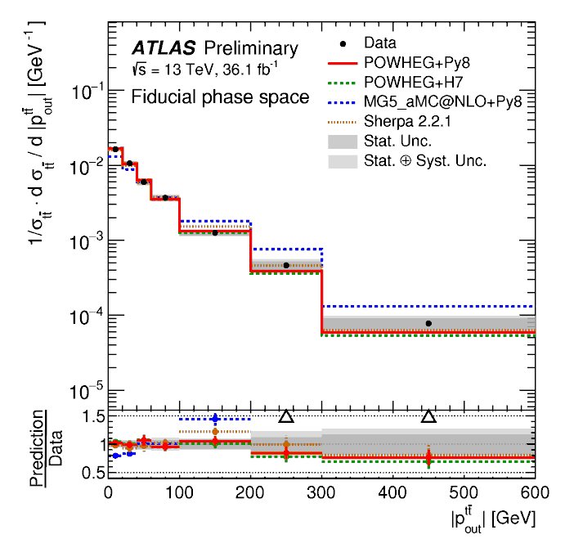
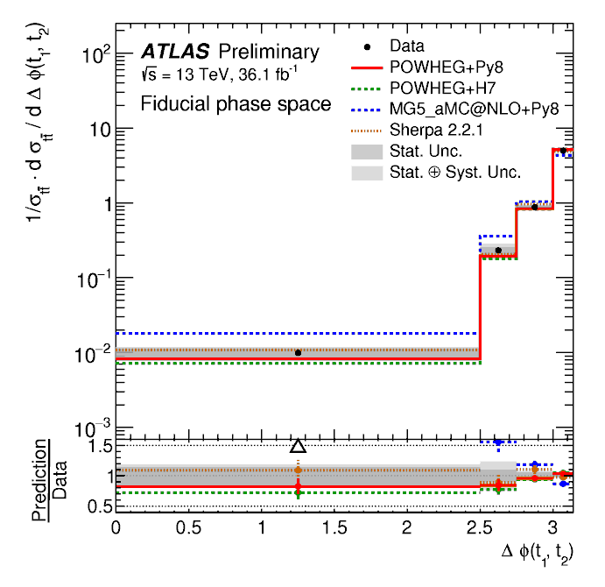
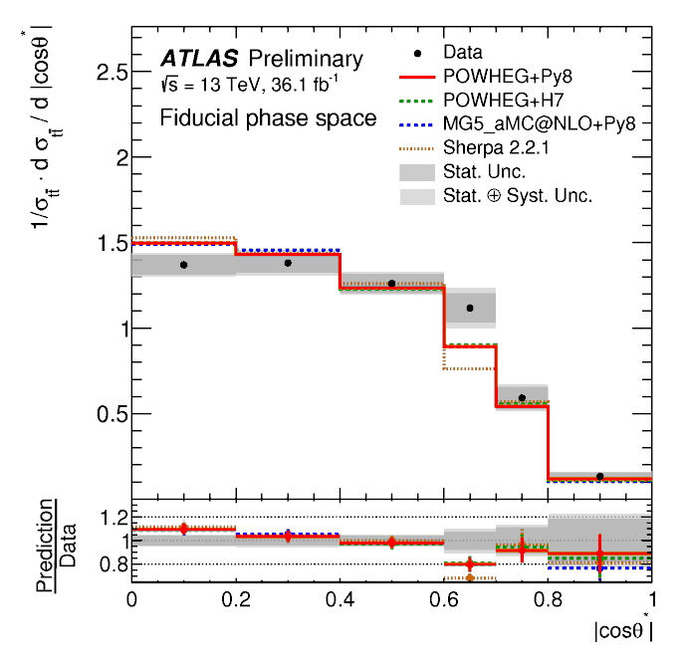
Other variables
di-boosted
Only MG5_aMC@NLO is not compatible with data
$${\vec{p}}_{out}^{t\overline{t}}={\vec{p}}_{t,had}∙\frac{{\vec{p}}_{t,lep}×\hat{z}}{\left|{\vec{p}}_{t,lep}×\hat{z}\right|}$$
$χ_{t\overline{t}}=exp\left[y_{t,had}−y_{t,lep}\right]$

