Slide 1
Symmetry breaking and electroweak unification — an Imperial College perspective
Tom Kibble
Imperial College London
8 Jan 2014

Slide 2
Outline
Story of spontaneous symmetry breaking in gauge theories
— from my viewpoint at Imperial College
• Physics around 1960
• Gauge theories — the idea of unification
• Obstacles to unification — Goldstone theorem
• The Higgs mechanism
• Electroweak unification
• Later developments
• Discovery of the Higgs boson
• Is the standard model now complete?

Slide 3
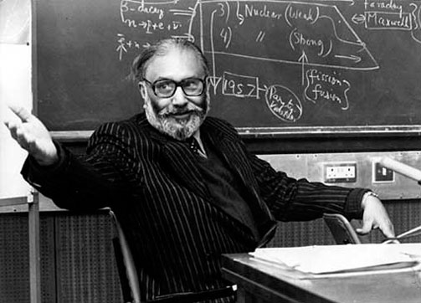
Imperial College in 1959
Imperial College theoretical physics group was founded in 1956 by Abdus Salam — in 1959 he became the youngest FRS at age 33
• I arrived in 1959
• 3 permanent faculty:
— Abdus Salam
— Paul Matthews
— John C Taylor
• I joined faculty in 1961
• Numerous visitors:
Murray Gell-Mann,
Stanley Mandelstam,
Steven Weinberg,
Kenneth Johnson, Art Rosenfeld, ...

Slide 4
Physics after WW2
• During the war, physicists had been working on atomic weapons, radar, operational research, etc.
• After 1945, they went back to fundamental physics, leading to very rapid developments, in particular Renormalization Theory of Quantum Electrodynamics (QED).
— Feynman, Schwinger, Tomonaga — Dyson, Salam
• Following that success, people started search for theories of other interactions — or better still, a unified theory of all of them.
• Initially most interest on strong interactions, but because perturbation theory could not be used, field theory went out of fashion — the new rage in the 50s was S-matrix theory
• But in a few places, the flag of field theory was kept flying
— Imperial College, Harvard, . . .

Slide 5
Gauge theories
• QED is a gauge theory — it has a special symmetry
— in quantum mechanics, we have invariance under
— this is a global U(1) symmetry: is space- and time-independent
• In QED: also invariance under the local symmetry
provided a matching transformation is made to
the electromagnetic potentials.
• This idea of replacing global by local symmetry – the gauge principle
— gives a rationale for the existence of the electromagnetic field, and
for the zero mass of the photon.
• So could this idea could be applied elsewhere?

Slide 6
Gauge theories
• Salam was convinced from an early stage that a unified theory of all interactions should be a gauge theory.
• First example of a gauge theory beyond QED was the Yang-Mills theory (1954), with gauged SU(2)
— intended as a theory of strong interactions, with SU(2) symmetry
representing isospin
— same theory also proposed by Salam’s student Ronald Shaw, but
unpublished except as a Cambridge University PhD thesis.
• There was a lot of interest in gauge theories at Imperial College
— my own first involvement in 1961 was to show how gravity could be
viewed as a gauge theory of the Poincaré group (but non-
renormalizable).

Slide 7
Broken symmetries
• Symmetries were a major concern – SU(2) isospin, SU(3) eightfold way
— Murray Gell-Mann, Yuval Ne’eman (Salam’s student), ...
These were approximate, therefore broken — spontaneously?
• Spontaneous breaking of gauge symmetry, giving mass to the plasmon, was known in super-conductivity. Nambu (1960) suggested a similar mechanism could give masses to elementary particles.
• Nambu and Jona-Lasinio (1961) proposed a specific (non-gauge) model
exact, but chiral symmetry
spontaneously broken by
• Model has a massless pseudoscalar, identified with pion
— N & J-L suggested chiral symmetry was not quite exact even before spontaneous symmetry breaking, hence pion has a small mass

Slide 8
Unification
• Because of the difficulty of calculating with a theory with large coupling constant, interest began to shift towards the weak interactions.
• A very important step was the discovery that the weak four-fermion interactions involved V and A rather than S, T or P.
• V–A theory proposed by Marshak & Sudarshan (1957) and by Feynman & Gell-Mann (1958)
• This meant that the weak interactions could be seen as due to the exchange of spin-1 W± bosons. This made them seem very similar to electromagnetic interactions mediated by photons.
— So the question arose:
could there be a unified theory of weak and electromagnetic
interactions?

Slide 9
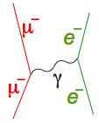
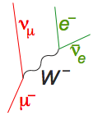
Similarity and Dissimilarity
Electromagnetic
interaction
Weak
interaction
exchange of
spin-1 .
exchange of
spin-1 W±
But
long range
short range
large
parity conserving
(mirror symmetric)
parity violating
(non-mirror symmetric)
So: Can there be a symmetry relating and W±?
If so it must be broken

Slide 10
Early Unified Models
• The first suggestion of a gauge theory of weak interactions mediated by W⁺ and W– was by Schwinger (1957), who suggested there might be an underlying unified theory, incorporating also the photon.
• Glashow (1961) proposed a model with symmetry group SU(2) x U(1) and a fourth gauge boson Z⁰, showing that the parity problem could be solved by a mixing between the two neutral gauge bosons.
• Salam and Ward (1964), unaware of Glashow’s work, proposed a similar model, also based on SU(2) x U(1).
• But in all these models symmetry breaking, giving the W bosons masses, had to be inserted by hand — and models with spin-1 bosons with explicit masses were known to be non-renormalizable.
• Big question: could this be a spontaneously broken symmetry?

Slide 11
Spontaneous Symmetry Breaking
• Particle physics exhibited many approximate symmetries
— it was natural to ask whether they could be spontaneously broken
• Spontaneous breaking of symmetry occurs when the ground state or vacuum state does not share the symmetry of the underlying theory. It is ubiquitous in condensed matter physics
• Often there is a high-temperature symmetric phase, and a critical temperature below which the symmetry is spontaneously broken
— crystallization of a liquid breaks rotational symmetry
— so does Curie-point transition in a ferromagnet
— gauge symmetry is broken in a superconductor
• But there was a big problem — the Goldstone theorem.

Slide 12
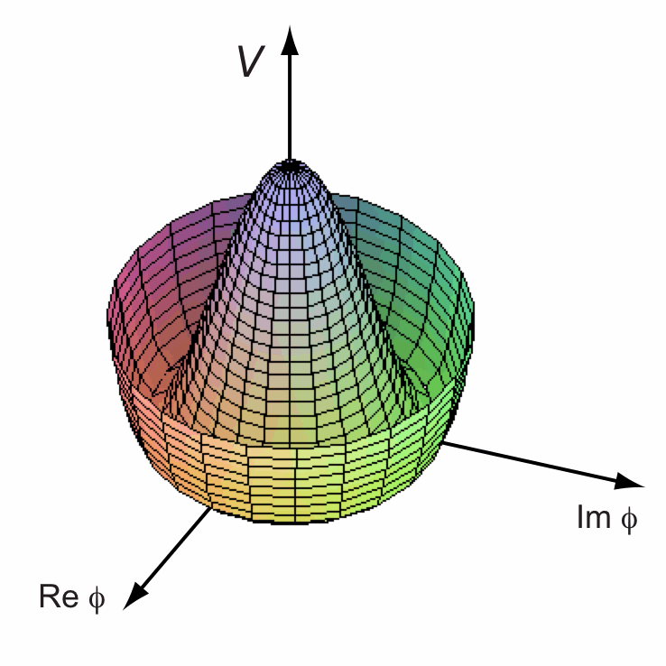
Nambu-Goldstone bosons
• Spontaneous breaking of a continuous symmetry existence of massless spin-0 Nambu-Goldstone bosons.
• e.g. Goldstone model
— vacuum breaks symmetry:
— choose
and set
cubic and quartic terms
So (Goldstone boson)
• This was believed inevitable in a
relativistic theory

Slide 13
Are massless bosons inevitable?
• No massless spin-0 bosons had been seen, though they should be easy to see
• If they are an inevitable consequence of spontaneous symmetry breaking, that rules it out
• So among would-be unifiers there was a lot of discussion about whether there was any way around the Goldstone theorem
• There were known counter-examples in condensed matter physics, in particular in superconductivity, but it was generally believed that massless bosons are inevitable in a relativistic theory
• When Steven Weinberg spent a sabbatical at Imperial in 1962, he and Salam developed a proof of the Goldstone theorem for relativistic theories

Slide 14
Goldstone Theorem
• Proof (Goldstone, Salam & Weinberg 1962): assume
1. symmetry corresponds to conserved current:
2. there is some field whose vev is not invariant: ,
thus breaking the symmetry
• Now would seem to imply
• The broken symmetry condition is then
• But if Q is time-independent, the only intermediate states that can contribute are zero-energy states which can only appear if there are massless particles (or other vacua? — see later).

Slide 15
Counter-examples
• No observed massless scalars no spontaneous breaking of a continuous symmetry !
• There were known (but not well understood) counter-examples in condensed matter, e.g. superconductivity (Philip Anderson 1963).
• Because of the Goldstone theorem, it was widely believed that this could not happen in a relativistic theory.

Slide 16
Impasse
• In a relativistic theory, there seemed to be no escape
— spontaneous symmetry breaking implied the existence of
zero-mass spinless bosons
— since no such bosons had been seen, spontaneous symmetry
breaking was ruled out
— other models with explicit symmetry breaking were clearly
divergent, giving infinite results
• Weinberg commented:
‘Nothing will come of nothing; speak again!’ (King Lear)
• I was very interested when in 1964 Gerald Guralnik (a student of Walter Gilbert, who had been a student of Salam) arrived at Imperial College as a postdoc to find that he had been studying this problem, and already published some ideas about it. We began collaborating, with another US visitor, Richard Hagen. We (and others) found the solution.

Slide 17
Higgs mechanism
• The argument fails in the case of a gauge theory
— Englert & Brout (1964), Higgs (1964), Guralnik, Hagen & TK (1964)
• Higgs model (gauged Goldstone model):
Again set
cubic terms ...
Thus the massless gauge and Goldstone bosons have apparently combined to give a massive gauge boson.
But: there is more to it.

Slide 18
Gauge conditions
• Field equations
are also satisfied for any so long as
(gauge invariance of original model)
• To tie down not only but also and , we need to impose a gauge condition:
• With the Coulomb gauge condition requires
(or constant)
• However the Lorentz gauge condition only requires that
satisfy
— in this manifestly covariant gauge, the Goldstone theorem does apply, but the Goldstone boson is a pure gauge mode.

Slide 19
How is the Goldstone theorem avoided?
• This is the particular question asked by Guralnik, Hagen & TK
• We assumed that implied
• But this is only true if we can drop a surface integral at infinity:
• This is permissible in a manifestly Lorentz-invariant theory (e.g.
Lorentz-gauge QED), because commutators vanish outside the light
cone
— but not in Coulomb-gauge QED
• In fact, when the symmetry is spontaneously broken, the integral
does not exist as a self-adjoint operator

Slide 20
Q does not exist
• When the symmetry is spontaneously broken, the integral
does not define a conserved charge operator.
• For example, in the simple Higgs model,
• So
which is clearly not time-independent, and in fact does not exist as a self-adjoint operator.

Slide 21
Unitary inequivalence
• The non-existence of Q is related to the fact that spontaneous symmetry breaking implies a degenerate vacuum. We chose a state
in which
• But we could equally well have chosen any other phase: a state
for which
• If Q existed, would be unitary, and we would expect
• But in fact and indeed for
• and belong to orthogonal Hilbert spaces, carrying unitarily inequivalent representations of the canonical commutation relations
• This is a defining property of spontaneous symmetry breaking

Slide 22
Electroweak unification
• The three papers on the Higgs mechanism attracted very little attention at the time.
• By 1964 both the mechanism and Glashow’s (and Salam and Ward’s) SU(2) x U(1) model were in place, but it still took three more years to put the two together.
• Further work on the detailed application of the mechanism to non-abelian theories (TK, 1967). This work helped, I believe, to renew Salam’s interest.
• Unified model of weak and electromagnetic interactions of leptons proposed by Weinberg (1967)
— essentially the same model was presented independently by Salam in lectures at IC in autumn of 1967 and published in a Nobel symposium in 1968 — he called it the electroweak theory.

Slide 23
Later developments
• Salam and Weinberg speculated that their theory was renormalizable. This was proved by Gerard ’t Hooft in 1971 — a tour de force using methods of his supervisor, Tini Veltman, especially Schoonship.
• In 1973 the key prediction of the theory, the existence of neutral current interactions — those mediated by Z⁰ — was confirmed at CERN.
• This led to the Nobel Prize for Glashow, Salam & Weinberg in 1979
— but Ward was left out (because of the ‘rule of three’?)
— ’t Hooft and Veltman gained their Nobel Prizes in 1999.
• In 1983 the W and Z particles were discovered at CERN.
• In the 1970s and 1980s the gauge theory of strong interactions, quantum chromodynamics (QCD) was developed, a gauged SU(3)
— so we now have the SU(3) x SU(2) x U(1) standard model.

Slide 24
The Higgs boson
• In 1964, the Higgs boson had been a very minor and uninteresting feature of the mechanism
— the key point was the mechanism for giving the gauge bosons
masses and escaping the Goldstone theorem.
• But after 1983 it started to assume a key importance as the only missing piece of the standard-model jigsaw. The standard model worked so well that the boson (or something else doing the same job) more or less had to be present.
• Finding the Higgs was one of the main objectives of the LHC
— this succeeded triumphantly in 2012
— led in 2013 to Nobel Prizes for Englert and Higgs
• This ‘completes’ the standard model — but ...

Slide 25
Is the standard model ‘complete’?
• The standard model is wonderfully successful, but it is a mess
— it has something like 20 arbitrary parameters whose values we
cannot predict, e.g. ratios of particle masses
— it is not a unified model, being based on the symmetry group
SU(3) x SU(2) x U(1), with three independent coupling strengths
• There are suggestions that all three interactions become truly unified at an energy scale of about 10¹⁵ GeV
— one of the reasons for favouring supersymmetry is that this grand
unification idea works much better in a supersymmetric extension
of the standard model
— but the evidence seems to be against it
• The standard model does not include gravity
— for that perhaps we need string theory or M-theory or •••.

Slide 26
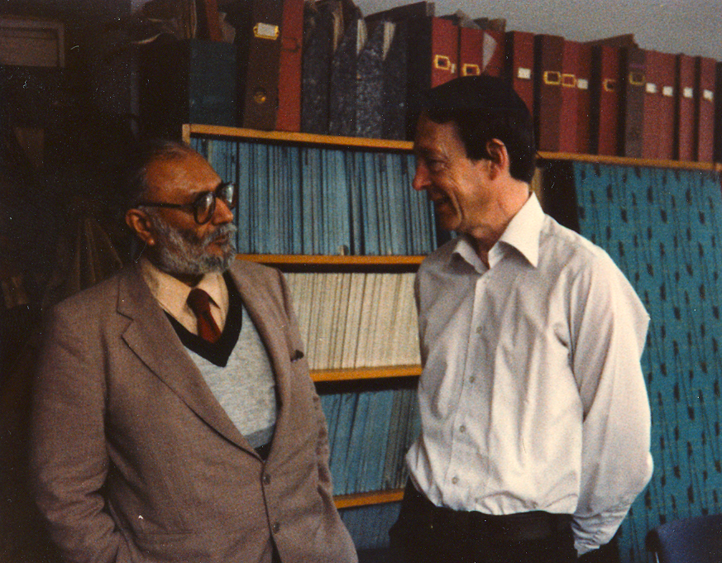
The End
• I wish to conclude by acknowledging my huge debt to my mentor and inspiration, Abdus
Salam
• He was a brilliant physicist, an inspiring leader, a skilled diplomat, and a warm and generous man.
• It was a very sad loss when he died prematurely in 1996.

Slide 28
