Slide 1
The ATLAS experiment at cern is shut down

Slide 2
We can rebuild it. We have the technology.
Well… Not yet actually. But were getting there!

Slide 3
The Really Expensive Particle Detector
AKA:
ATLAS ITk Upgrade Activities here at Edinburgh

Slide 4
ITk upgrade
For High Luminosity LHC
To operate for >10years, accumulating 4000fb-1
Split into Pixels and Strip detectors
Institutions world wide
Pushing the limit of technology
Extensive design and production qualification required to ensure it works. (until a weasel chews through a cable again…)

Slide 5
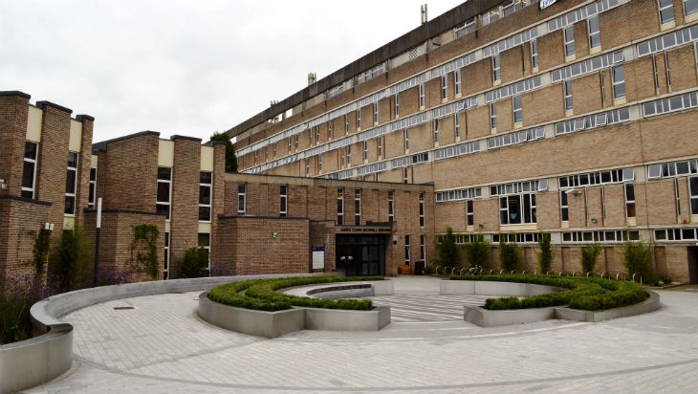
Edinburgh’s contributors
Stephan Eisenhardt
Yanyan Gao
Bojan Masic
Chloe Stanton – Me!
Owen Shea
John Webster
Sinead Farrington
Michele Giannelli

Slide 6
Breakdown
Two areas of particular focus for us here in Edinburgh are Pixel Modules and Outer Endcap services (cables, PCBs, routing)
Design work for both of these sub-projects is mature – Qualification work is underway
Planning our Quality Control procedures for when we get to full production is the big issue. Especially as prototypes are rare at this moment, and essentially priceless, so no blowing things up!

Slide 7
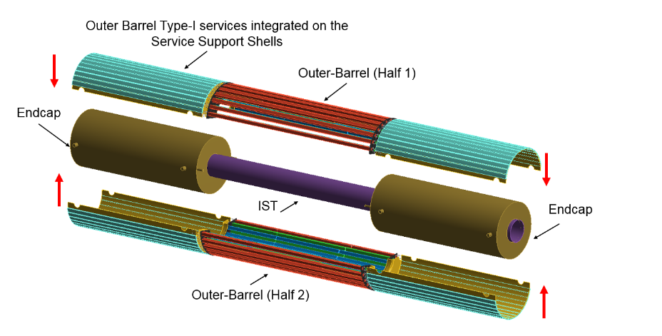
ATL-TDR-030 · LHCC-2017-021 Page 337

Slide 8
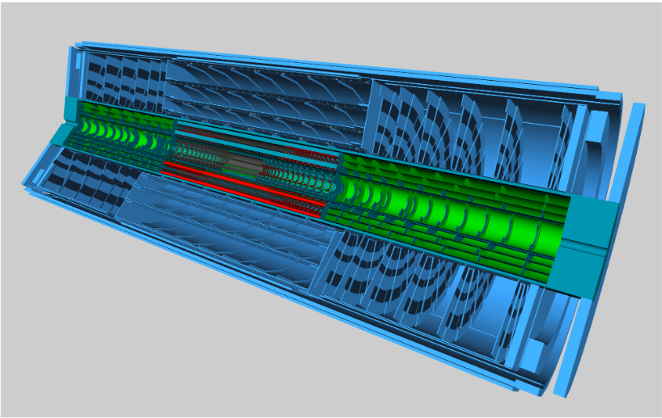
ATL-TDR-030 · LHCC-2017-021 Page 19

Slide 9
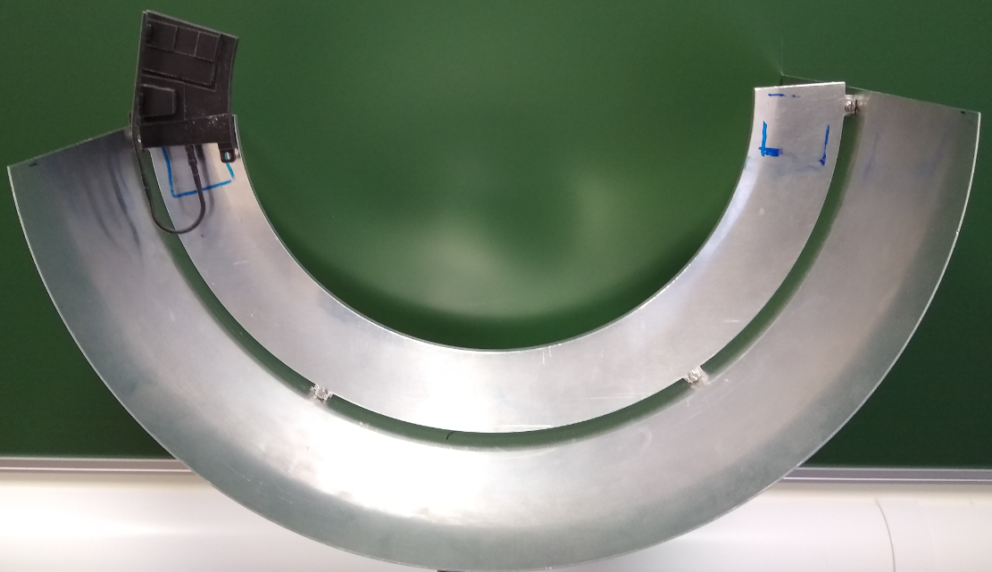
Endcap Services
The modules need Power and data connections to the outside world.
It’s a heck of a lot of cables….
Cables and connectors have got to be radiation hard – cant just go to B&Q
Were fighting (figuratively) to free up any spare millimetres…
Integration is a big issue.
No substitute for having a tangible mock-up.

Slide 10
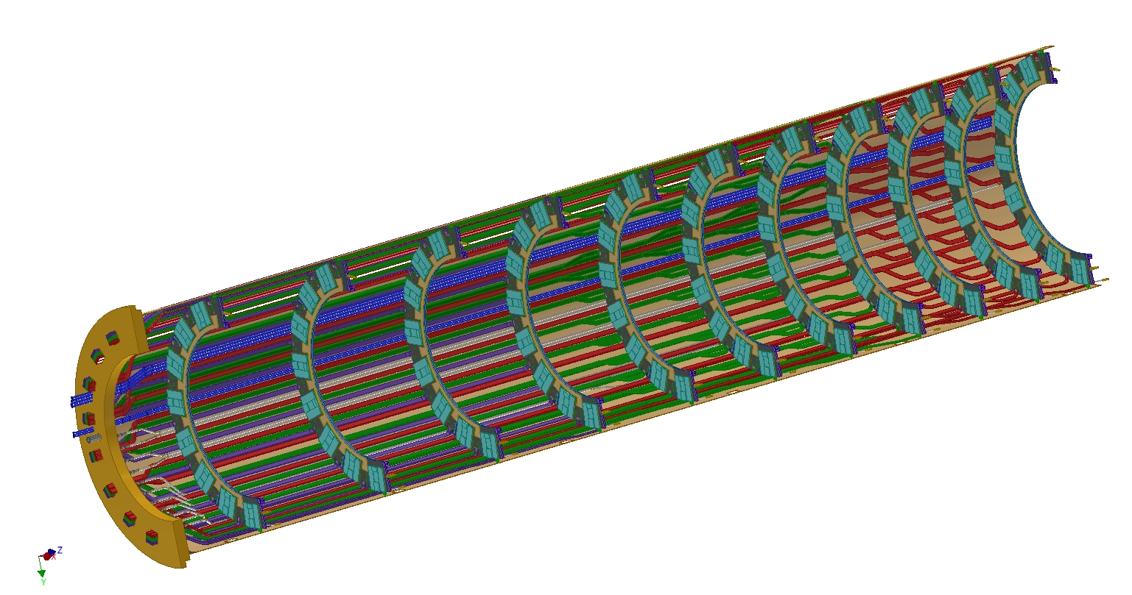
Preliminary layout: demonstrating the concepts
to z=0
gravity
direction
y direction
R1
R0
R2
R3
R4
R5
R6
to PP1
R7
R8
R9
R10
Credit: Fred Gannaway

Slide 11
EndCap services

Slide 12
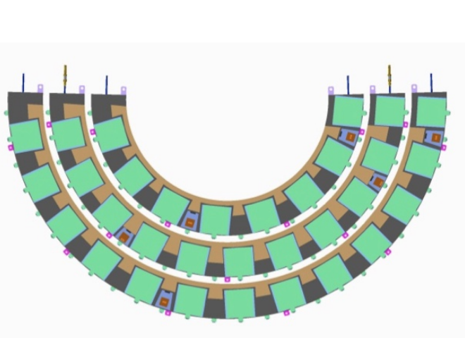
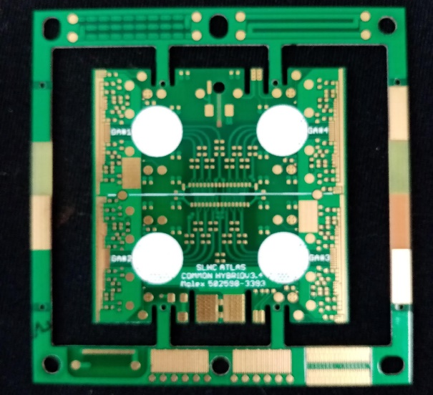
Pixel Modules
Iterative process – Now on “RD53A”
Design reasonably mature – A lot of effort in learning from it and ironing out issues ahead of the real thing
Edinburgh producing a Quality Control plan.
Intended to be a Hospital site during production – wastage is costly, but production sites don’t have time to stop and diagnose failures.

Slide 13
Questions?

